Slide 1


Evaluating the Opportunity to Repurpose Gas Transmission Assets for Hydrogen Transportation
Antony Green, Lloyd Mitchell & Ashley Adams
International Conference on Hydrogen Safety
22nd September 2021

Slide 2



The Team
Antony Green
Project Director – Hydrogen (FutureGrid Project Sponsor)
Lloyd Mitchell
Hydrogen Engineer
Ashley Adams
Codes Change Lead

Slide 3




Role of Gas in the UK
Gas Demand in the UK today:
7,600km
high-pressure pipe
22m
gas customers
across the UK
39%
94 bar
maximum pressure on the network
24
compressor stations
504
above-ground installations
85%
households are using gas for heat
38%
8
connected distribution
networks
Power
Generation
Domestic
Use
Industrial & Commercial
881TWh
of energy is delivered by the NTS
23%

Slide 4

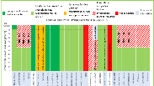
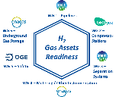



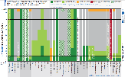


Increasing our asset knowledge
To increase our ability to repurpose assets for hydrogen use, we first need to understand their compatibility. The past 3 years has begun a journey to increase our understanding
Hydrogen on the network
Asset Knowledge & Evidence Base
Targeted vendor RFI’s
Can we put H₂ in the network?
H2GAR
Internal customer surveys
External research
Need further collaboration and strategic testing development
Internal research
c.2025
Notes:
Tony

Slide 5
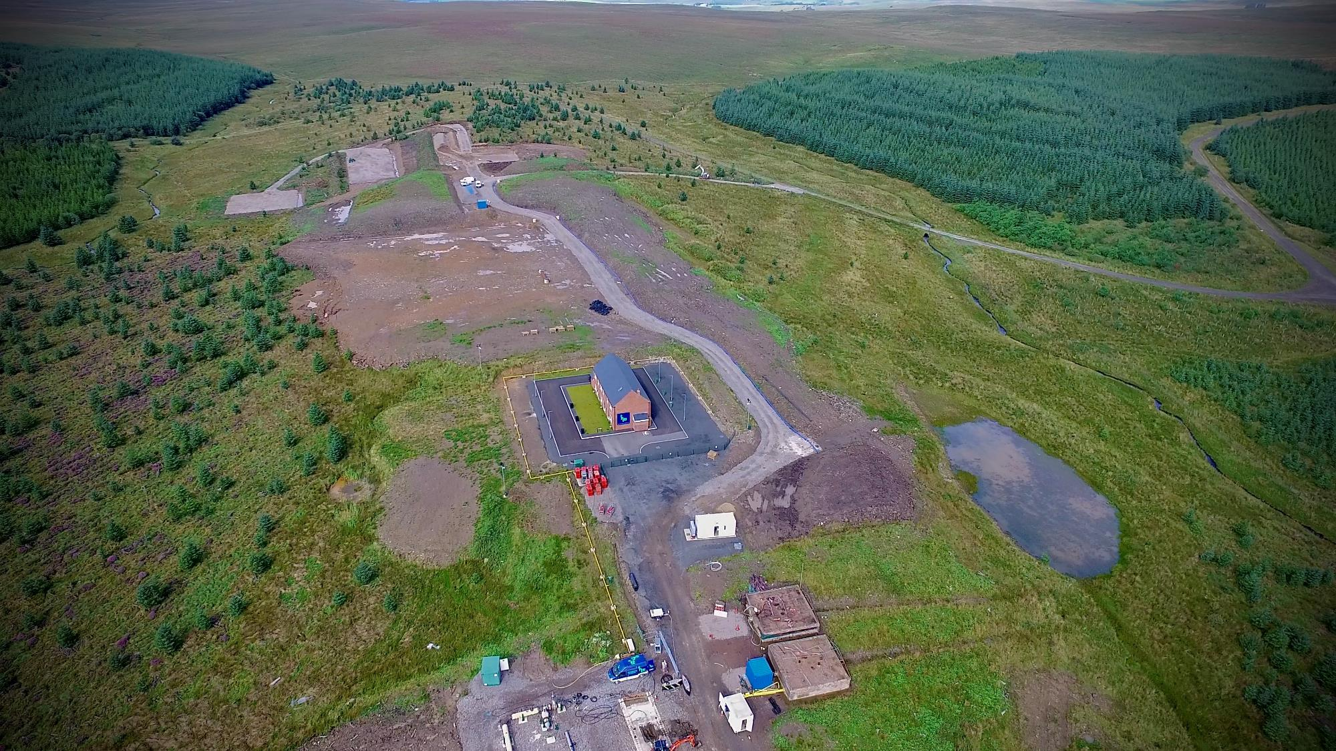


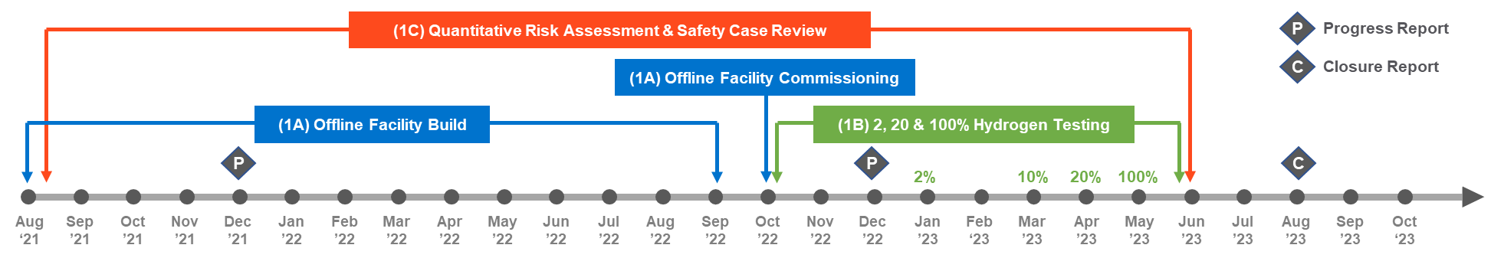
DNV Engineering Research & Development Centre – Spadeadam, Cumbria
An ambitious programme to build a hydrogen test facility from decommissioned assets at DNV’s facility in Cumbria to demonstrate the National Transmission System (NTS) can transport hydrogen.

Slide 6

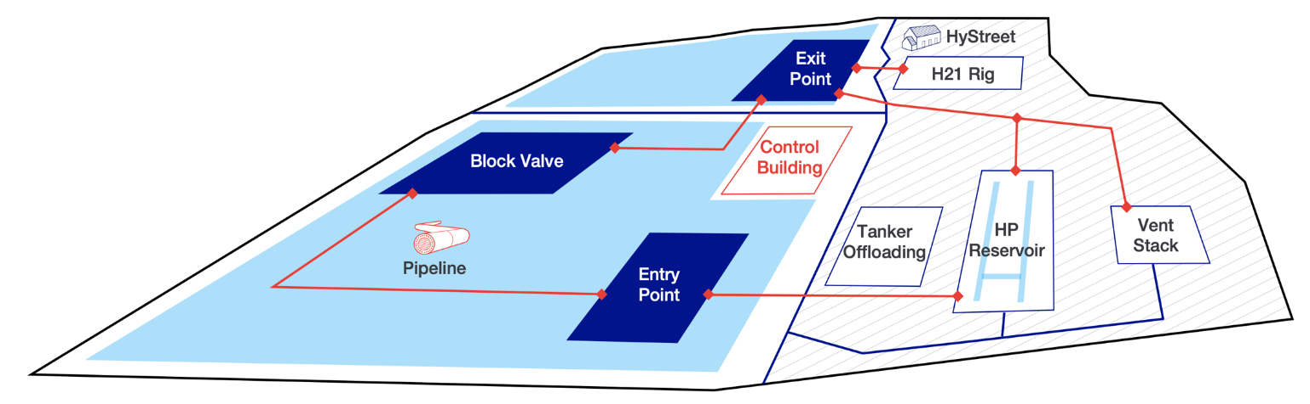







Collaborative Hydrogen Test Facility
Total Project Cost
£12.7m
Project Start
April ‘21
Project Duration
2 years
DNV are our main delivery partner, responsible for building the test facility and developing the comprehensive master test plan across the range of decommissioned assets.
HSE Science Division are supporting the development of the test facility and subsequent master test plan, providing technical assurance and validation across the project.
Northern Gas Networks are collaborating on the project to drive closer links with the H21 project which is building a distribution test facility at DNV GL’s Spadeadam Facility.
Fluxys are the equivalent Gas Transmission Operator in Belgium and are contributing a substantial level of hydrogen research, to ensure an internationally collaborative approach.
Durham University will be sponsoring a secondment student to study the NTS asset gaps, focusing on the development skills and training courses along with Phase 2 & 3 of FutureGrid.
Supporting the trials and developing technical papers and research from the project to enable dissemination, linking the H100 activities and FutureGrid/H21 activity to prevent duplication.

Slide 7
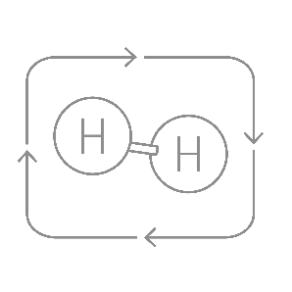


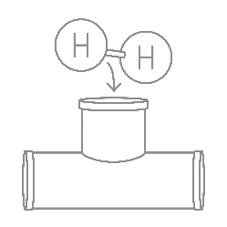

Hydrogen Testing Plan
Three concentrations of hydrogen will be tested:
Operate the offline test facility for 7 months across the 3 H₂ concentrations with the standalone test modules running throughout the 2 year period.
Offline Hydrogen Test Facility
2%
hydrogen in natural gas
A representative range of decommissioned NTS assets of different types, sizes, and material grades will be tested with 2, 20 & 100% hydrogen
Review and evaluate the test results utilising the Fluxys Fast Screening Methodology allowing for the extrapolation of results across the NTS.
20%
hydrogen in natural gas
Standalone Hydrogen Test Modules
Validate flow parameters such as gas velocities, pressures, energy delivery to understand how we need to operate the NTS with a hydrogen blend (or 100%).
100%
hydrogen
Standalone hydrogen test modules will operate alongside the main test facility, to provide key data required to feed into the main facility
Test Modules

Slide 8
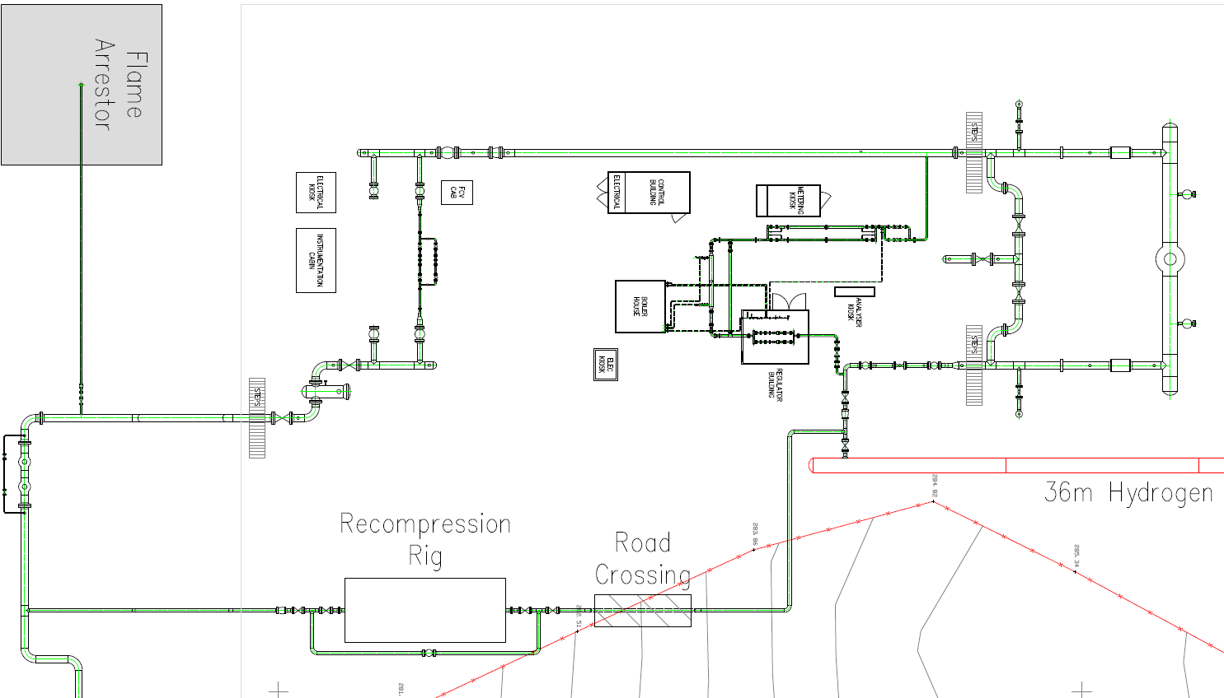
Work Package
Build & Commission
Work Package
Work Package
Work Package
1A
1B
1C
1D
General Arrangement – Phase 1
3
5
6
4
2
7
Low pressure hydrogen store
8
1
To high pressure hydrogen store
Notes:
1,2,4: Terminal Model
5: Offtake Model
6: Block Valve Model
1: High Pressure Inlet connected to 48" hydrogen storage vessel (H21 + Hystreet are connected to other end of HP Inlet)
2: Double Block and Bleed Ball Valve Arrangement, including one acting as a "Slamshut" Electrically Actuated ball valve: prevent overpressure gas flowing back to compressor/HP storage.
3: Vent Stack Arrangement to enable FutureGrid facility to be vented using a controlled venting procedure, and to assess the noise and venting procedure for hydrogen
4: Filters to capture any oils/grease from compressor, and assess DP across when in hydrogen; Twin Stream Ultrasonic Meters with flow computers to calculate flow rates for facility which are logged
5: Offtake arrangement: where GDN's/Power Stations receive gas from. Includes: Filters, Orifice Plate Meters, Gas Quality Sampling point + chromatograph (to confirm specification of gas), Heat Exchanger + Modular Boilerhouse, Slamshut and Regulator skid (Slamshut: acts as safety device to prevent overpressured gas going into downstream; Regulators: to control pressure to a fixed setting entering downstream)
6: Block Valve arrangement: 36" ball valve with 18” bypass line, to demonstrate capability of critical valves which are used to isolate NTS pipelines in event of an emergency. Outlet of site also includes an 8" Flow Control Valve. This means that the FutureGrid facility can be run as either Pressure Control (via 5) or Flow/Volumetric Control (via 6).
7: Low Pressure hydrogen store for outlet of Offtake (5)
8: Recompression Rig: Fully contained recompression rig to generate flows required to mimic demand on the NTS and allow for operational data to be gathered on FutureGrid facility.

Slide 9



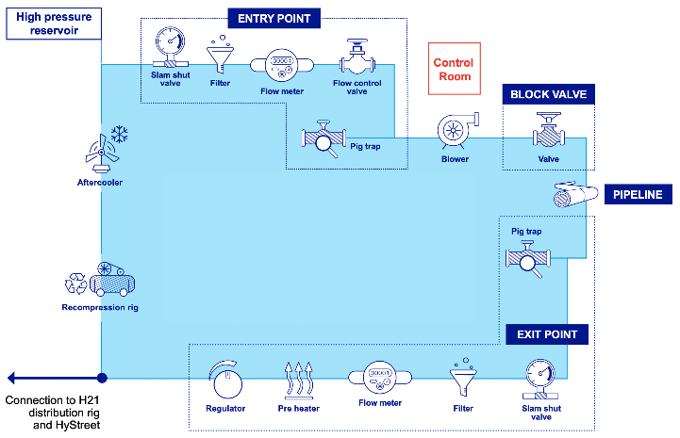
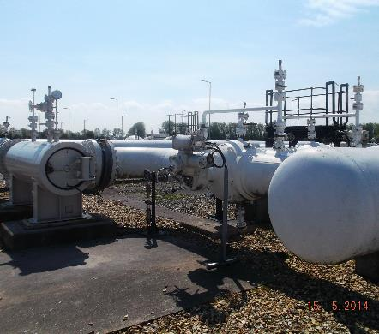
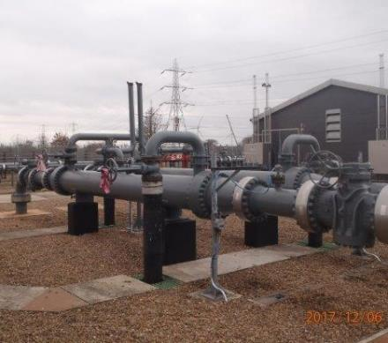
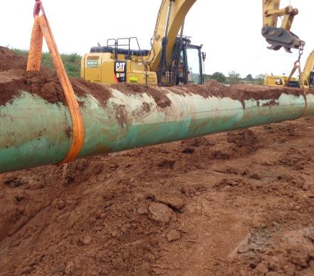
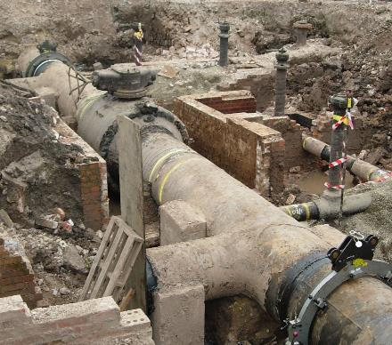
Offline Facility Build
Constructing the test facility from decommissioned assets to provide a representative NTS in the most efficient and effective way
Connection to H21 distribution test facility and HyStreet
Notes:
Order of the animation:
Entry point
Block valve
Pipeline
Exit point
Don’t call out the specific asset types.
Highlight that a representative range of assets due to be decommissioned in early RIIO-2 will be repurposed from various places on the NTS, to build the test facility.
The map on the right shows where we expect these assets to come from, for each element of the facility.
The exit point will allow gas to either be recirculated around the test network, or redirected to the H21 distribution facility.

Slide 10







Offline Hydrogen Test Facility – Key Mechanical Assets
Flow Control Valve
8” Flow Control Valve (FCV) sourced from Sellafield
Steel Pipeline
18” X65 outlet pipework from the high pressure gas storage array to the first isolation valve
Three lengths of 36” X60, 19.1mm WT pipe for the low pressure (LP) gas storage array from the Pipeline Maintenance Centre (PMC)
18” X52 pipe to join HP Gas storage array to Enron and Enron to Lanark assets.
Seven lengths of 48” pipe grade X65 for high pressure (HP) gas storage array (previously welded and constructed as part of the H21 Phase 2a project)
Filters & Meter Streams
One 18” Filter and associated valves, two 10” meter streams (one of the meter stream to be replaced by a meter from Eakring with modifications to the pipework and the second left blanked)
18” header and outlet manifold sections, 18” Flow control valve (FCV) and 18” Non return valve (NRV) sourced from Enron Billingham.
Recompression Unit
New item to allow operation of test facility
Re-compressor unit housed in a steel container
Valves
36” ball valve and 18” bypass pipework with associated 18” valves sourced from Lanark
Two 18” valves sourced from Billingham
Two new 4” NB manual isolation valves and a non-return valve
Pre-Heater and Regulators
3” and 4” above ground installation (AGI) c/w twin filter streams, twin meter streams, pre-heater (incl boiler package) and twin regulator streams from Hays Chemicals

Slide 11


Offline Hydrogen Test Facility – Key Instrumentation
Metering
Pressure
Temperature
Metering skid from Eakring, which consists of two ultrasonic metering streams, pressure transmitters and flow computers
10 premium accuracy Druck UNIK5000 100 transducer
Stainless steel sheathed mineral insulated Type ‘T’ thermocouple
Noise
Hydrogen Flux
Direct Vibration Managements
Casella Cel CEL-240/K1 Sound Level Meters
Hydrosteel flux analysis system
Fluke 805 vibration meter
Fluke
805

Slide 12





Standalone Hydrogen Test Modules
Material Permeation Testing
Pipe Coating and CP Testing
Fatigue Testing
This test will determine the rate at which hydrogen permeates through the pipe wall in a pressurised hydrogen environment. This will inform the soak time required for full saturation on other tests.
These tests will assess the impact of hydrogen on external pipe coatings as well as the cathodic protection system to identify any issues.
To demonstrate the NTS can endure tens of thousands of pressure cycles in hydrogen service.
Flange Testing
Asset Leak Testing
Rupture Testing
To assess the effect of hydrogen on RF and RTJ flanged joints.
Hydrogen is significantly more prone to leaking than natural gas. We need to understand the extent of this to determine if additional mitigations are required.
Investigate overpressures caused by delayed ignition of ruptures on a buried line containing 100% hydrogen. 36” NB gas storage array to provide the necessary gas flow.

Slide 13
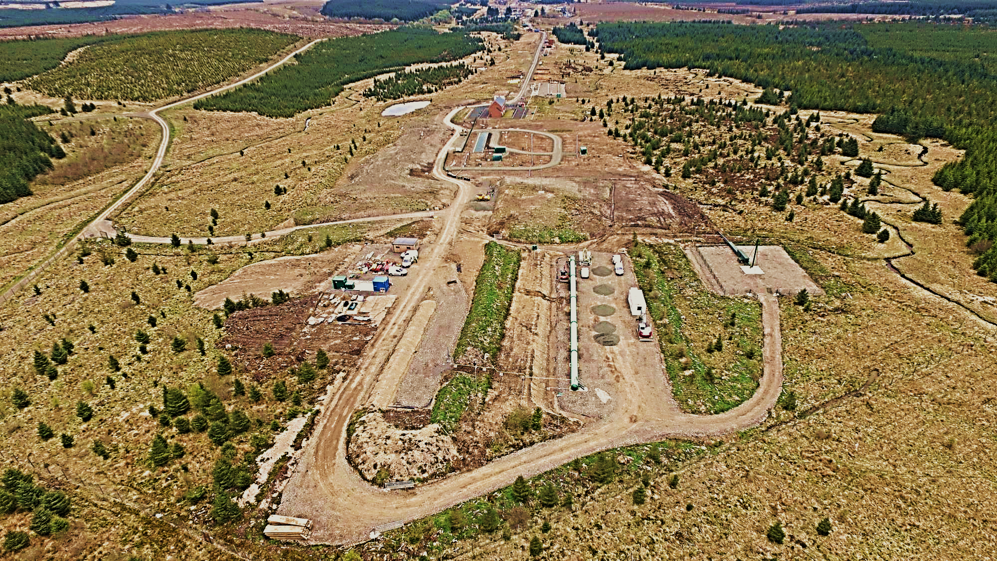
Entrance to Test Site West from main RAF road
HyStreet
Potential Phase 2 Expansion
NGN Distribution Micro-Grid
Phase 2
NGN Control Room
FutureGrid Control Room Site
High Pressure Reservoir
HP Reservoir Tanker Loading
Road crossing from HP Reservoir to FG Site
Entrance to FutureGrid Phase 1 Site
Phase 1

Slide 14
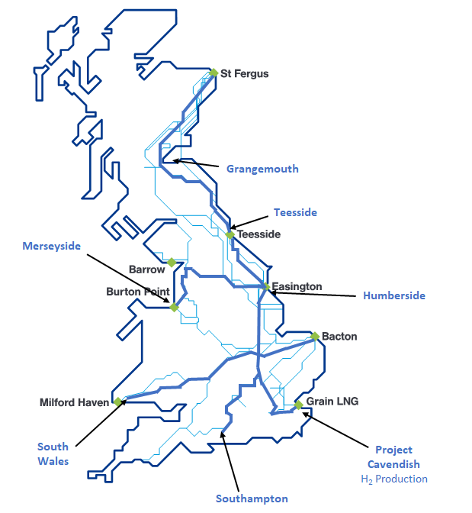

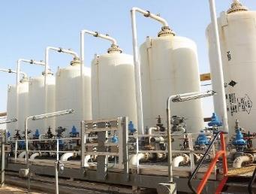
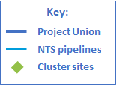
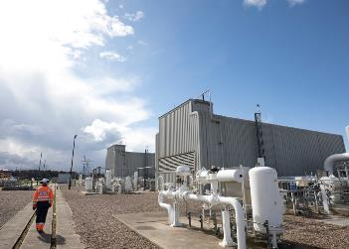
What’s next?
Phase 2a
Review and develop cost effective technologies for deblending using capabilities seen today in industry at a smaller scale.
Phase 2b
Use of hydrogen to fuel the gas turbines and the ability of compressors to compress hydrogen / natural gas mixes

Slide 15





You can find out more across our website and social media or email us at: @nationalgrid.com
© National Grid Gas 2020

