Slide 1
Fracture properties of welded 304L in hydrogen environments
Joe Ronevich, Chris San Marchi, Michael Maguire, Dorian K. Balch
Sandia National Laboratories
2021 International Conference on Hydrogen Safety (ICHS)
September 21-24, 2021
SAND2021-11145C

Slide 2
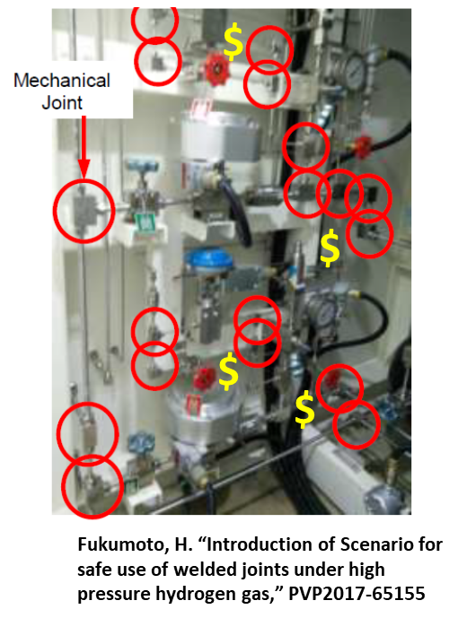
Motivation – Welds offer benefits compared to mechanical joints → Fracture behavior in hydrogen is not well defined
Austenitic stainless steels are more resistant to H₂ embrittlement
    → Desirable for H₂ containment components
Commonly assumed that welds are more susceptible than base metal
→ Weld usage has been limited due to lack of data
Significant benefits for using welding compared to mechanical joints
  Lower cost
  Less maintenance
  Reduced leaks (safety and product loss)
In some applications (e.g. large pressure vessels), necessary to use welds
Fracture properties of stainless steel welds in H₂ environments are limited

Slide 3
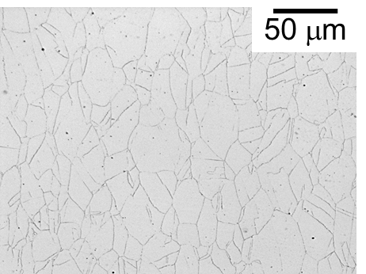
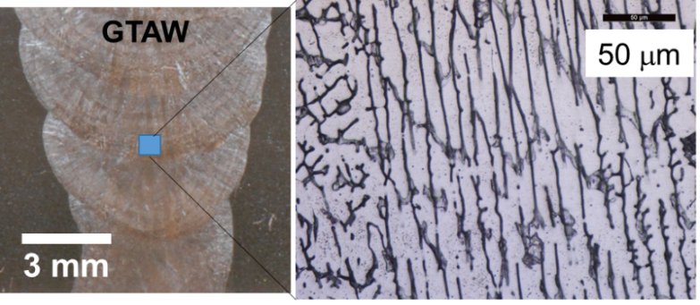
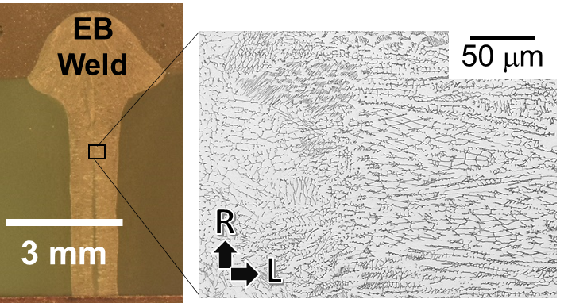
Electron beam (EB) welds have advantages over conventional welds like GTA welds
Electron beam welds
Reduced heat input
Smaller heat-affected zone (HAZ)
Maintain higher strength
No filler wire
Gas Tungsten Arc (GTA) Weld
Requires filler metal
Prep can be easier in field
Forged 304L

Slide 4
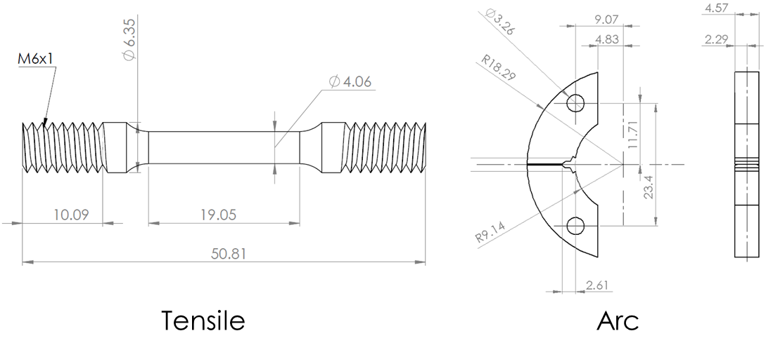
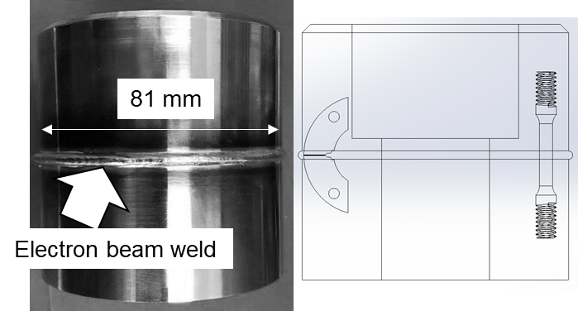
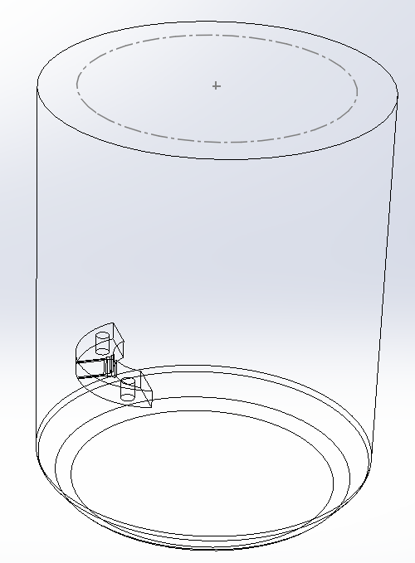
Extracted test coupons from EB weld rings for fracture testing
Arc coupons from forgings were tested for comparison
304L Forging
YS = 447 MPa
UTS = 666 MPa

Slide 5
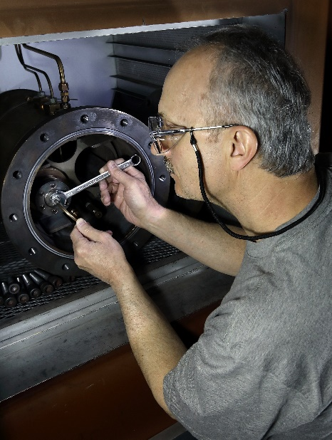
Thermally precharged samples to represent long-term exposure to hydrogen
Diffusion rates at room temperature in austenitic stainless steel are very slow (10⁻¹⁶ m²/s)
  ~ 1 mm in 16 years
Use thermal precharging to accelerate diffusion and permit saturation of material with hydrogen
  573 K at 138 MPa for ~ 10 days = 140 wppm H
  573 K at 41 MPa for ~ 10 days = 66 wppm H
    Hydrogen contents were measured from an outside laboratory on coupons extracted from samples
  Samples were then stored at 220 K until testing in air
Two different internal hydrogen contents were evaluated which represent different long term hydrogen exposures

Slide 6
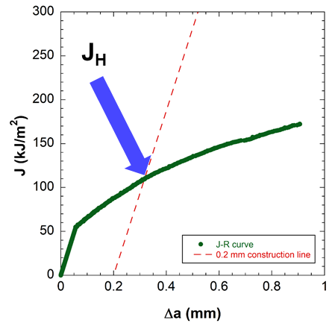
Mechanical testing performed in air on H-precharged samples at 223 K (-50°C) and 293 K (20°C)
Low temperatures (223 K) are known to degrade fracture properties of stainless steels and gas is often prechilled to these temperatures at hydrogen refueling stations
Tensile Testing
  Displacement rate = 5 x 10⁻⁴ s⁻¹
  Measurements of yield strength, tensile strength and reduction of area (RA)
Fracture testing
  Elastic-plastic fracture testing according to ASTM E1820 using constant rising displacement
  Displacement rate = 1.5 mm/hr
  J_{H} value determined by intersection of J vs crack extension (Δa) (e.g. J-R) curve with 0.2 mm construction line

Slide 7
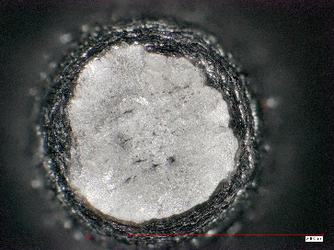
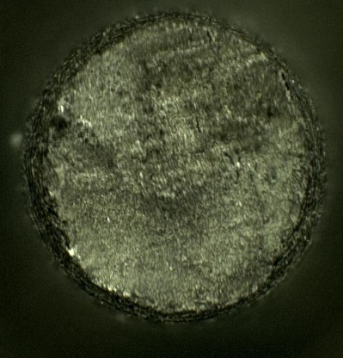
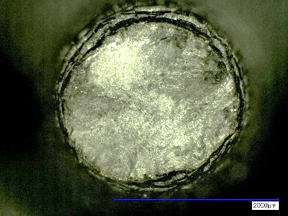
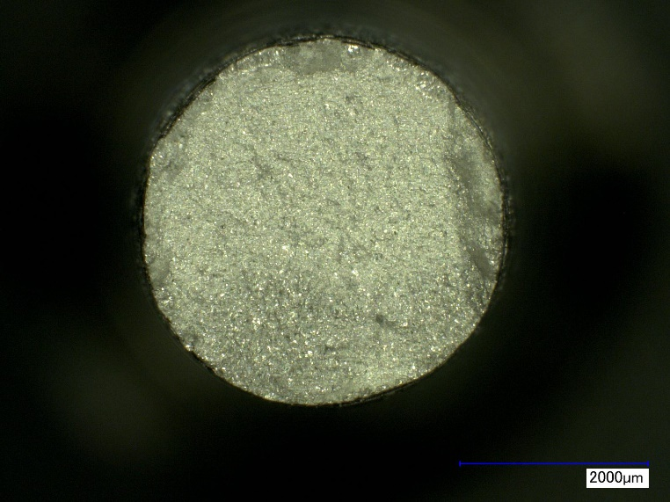
Ductility loss of H-precharged forgings and EB welds
Fracture surfaces of tensile samples
0 wt ppm
293 K
RA ~ 0.85
Decreasing ductility
66 wt ppm
293 K
RA ~ 0.53
140 wt ppm
223 K
RA ~ 0.22
Reduction of area decreased with increasing hydrogen content

Slide 8
Fracture resistance (J_{H}) decreased with increasing internal hydrogen content
Forged 304L and EB welds, similarly, exhibited decreasing fracture resistance as internal hydrogen content increased
Low temperature further degraded fracture performance in both weld and forging
For reference:
Many pressure vessels
(Cr-Mo) steels
have J_{H} ~ 10 to 20 kJ/m²
in 100 MPa H₂ gas at 293K
EB weld fracture behavior was similar to forged 304L

Slide 9
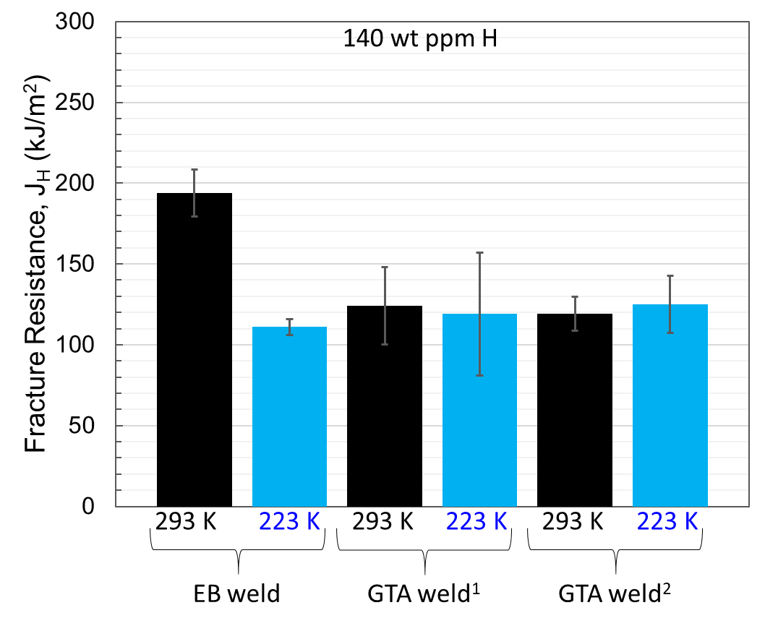
Fracture resistance of EB weld compared to conventional Gas Tungsten Arc (GTA) welds
EB weld has superior fracture resistance to GTA welds (304L/308L) from literature^{1,2} at room temperature (293 K)
At low temperature (223 K), the fracture resistance is comparable between EB and GTA welds
Small fractions of ferrite are present in all welds, which is likely cause for reduced performance at 223 K
Low temperature appears to result in similar fracture behavior among welds
¹Ronevich, J. (PVP2019-93823)
²Jackson, H. (Corr Science, 2013)

Slide 10
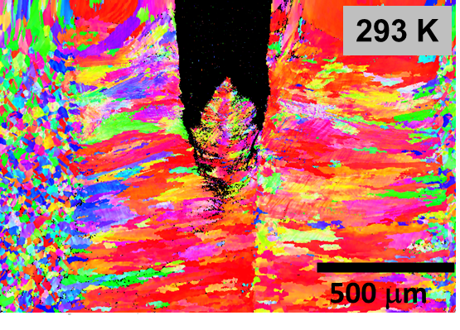
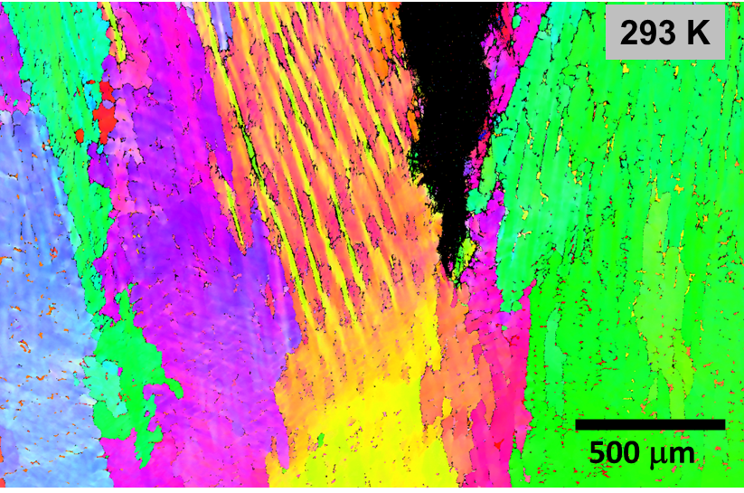
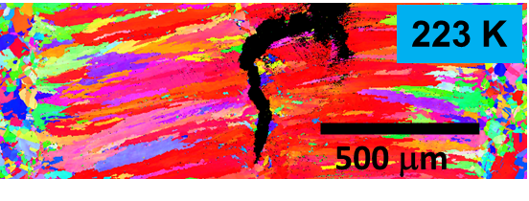
Crack deflection improves fracture resistance in EB weld
140 wppm H
EB weld
GTA weld
Crack growth direction
Cracks growth along elongated features
Orientation and finer features result in crack deflection and improved fracture resistance in EB
Crack branching is observed

Slide 11
Summary
Tensile and fracture coupons were extracted from forged 304L and Electron beam (EB) welded 304L, thermally precharged with hydrogen (66 or 140 wppm H), and tested at 293 K or 223 K
Reduction of Area (RA) measurements were consistent between forged 304L and EB weld
  Both decreased with increasing internal H-content
  Both decreased with decreasing temperature
Fracture resistance degraded with increasing H-content for both forged 304L and EB weld
  Low temperature reduced fracture resistance (J_{H})
EB welds outperformed conventional gas tungsten arc (GTA) welds at 293 K but had similar J_{H} values at 223 K
  Improved performance of EB weld at 293 K is attributed to crack deflection brought about by finer microstructure and microstructure orientation
Overall, EB weld performance with hydrogen was comparable to forged 304L suggesting it could be a viable, cost-effective replacement to mechanical joints

Slide 12
Acknowledgements / Questions
Special thanks to Jeff Campbell for thermal hydrogen precharging and James McNair for sample preparation at Sandia and the whole Hydrogen Effects of Materials Laboratory (HEML) Team.
Sandia National Laboratories is a multimission laboratory managed and operated by National Technology and Engineering Solutions of Sandia, LLC., a wholly owned subsidiary of Honeywell International, Inc., for the U.S. Department of Energy’s National Nuclear Security Administration under contract DE-NA-0003525. This paper describes objective technical results and analysis. Any subjective views or opinions that might be expressed in the paper do not necessarily represent the views of the U.S. Department of Energy or the United States Government.
Joe Ronevich
jaronev@sandia.gov

