Slide 1
7th ICHS 2017, Hamburg
Vented Lean Hydrogen–Air Deflagrations in an ISO container
Vendra C. Madhav Rao & Jennifer X. Wen
Warwick FIRE, School of Engineering
University of Warwick, UK

Slide 2
Outline
HyFOAM solver description
Numerical results
CFD and FE
Concluding remarks

Slide 3
Numerical method
Large Eddy Simulations (LES) /RANS method in OpenFOAM.
The Favre-filtered unsteady compressible Navier-Stokes equations are solved in a segregated manner, wherein each dependent variable equation is solved sequentially.
The pressure-velocity coupling is handled using Pressure-Implicit Split Operator (PISO) solution method.
Sub-grid turbulence kinetic energy is solved using the one equation eddy viscosity model.*
* MENON S., YEUNG P. K., and KIM W. W., Effect of Subgrid Models on the Computed Interscale Energy Transfer in Isotropic Turbulence,” Computer and Fluids (1996), Vol. 25, No. 2, pp. 165-180

Slide 4
Combustion model
The flame wrinkling combustion model of Weller et al. (1998).
Considering a single step chemistry, unity Lewis number and flamelet regime, the thermo chemistry of the reacting flow is described by the unburnt zone volume fraction denoted as regress variable (b), taking values 1 and 0 in unburnt and fully burnt region. The transport equation for the regress variable:
where, is sub grid flame wrinkling, is laminar flame speed
Mixture fraction equation is also solved.
WELLER, H. G., TABOR, G., GOSMAN, A. D. & FUREBY, C. (1988) Application of a flame-wrinkling les combustion model to a turbulent mixing layer. Symp. (Int.) on Combustion, 27, 899-907.

Slide 5
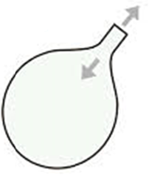
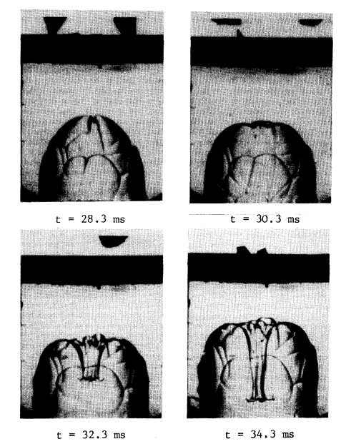
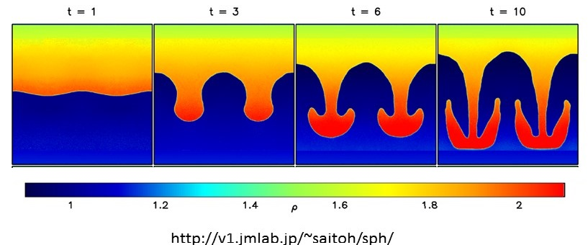
Experimental observation of vented gas explosions
Physical phenomena (McCann et al. 1985):
Helmholtz oscillations.
Cellular spherical flames.
RT instabilities.
Acoustical modes of the enclosure.
Turbulence
External explosion
McCANN, P. J., THOMAS, G. O., and EDWARDS, D. H. (1985) Geodynamics of Vented explosions Part I: Experimental studies, Combustion and Flame, 59 : 233-250.

Slide 6
Flame wrinkling factor
The closure for the sub-grid wrinkling is provided considering the flame instabilities into three components, (Bauwens, C. R (2011)a),
---------- (2)
where, corresponds to the surface wrinkling factor due to turbulence,
is surface wrinkling factor due to the Darrieus-Landau flame instability,
is the surface wrinkling factor due to the Rayleigh-Taylor instability.
BAUWENS, C. R., CHAFFEE, J. & DOROFEEV, S. B. (2011a) Vented explosion overpressures from combustion of hydrogen and hydrocarbon mixtures. International Journal of Hydrogen Energy, 36, 2329-2336.

Slide 7
Flame wrinkling due to turbulence
The surface wrinkling factor due to turbulence is modelled as transport equation*
---(3)
The modelling for the respective terms in above equation are given as,
and resolved strain rates,
and are subgrid turbulence
generation and removal rates with ,
* WELLER, H. G., TABOR, G., GOSMAN, A. D. & FUREBY, C. (1988) Application of a flame-wrinkling les combustion model to a turbulent mixing layer. Symp. (Int.) on Combustion, 27, 899-907.

Slide 8
Darrieus-Landau flame instability
The surface wrinkling factor due to the Darrieus-Landau flame instability is modelled as (Bauwens, C. R (2011)),
---------- (4)
where, is cutoff wavelength of unstable scale, is a coefficient to account for the uncertainty in .
* BAUWENS, C. R., CHAO, J. & DOROFEEV, S. B. (2011) Evaluation of a multi peak explosion vent sizing methodology .

Slide 9
RT instability - Transport Eq.
The surface wrinkling factor due to turbulence is modelled as transport equation *.
- generation rate of flame wrinkling due to RT instability
- removal rate of flame wrinkling due to RT instability
* BAUWENS, C. R., CHAFFEE, J. & DOROFEEV, S. B. (2011) Vented explosion overpressures from combustion of hydrogen and hydrocarbon mixtures. International Journal of Hydrogen Energy, 36, 2329-2336.

Slide 10
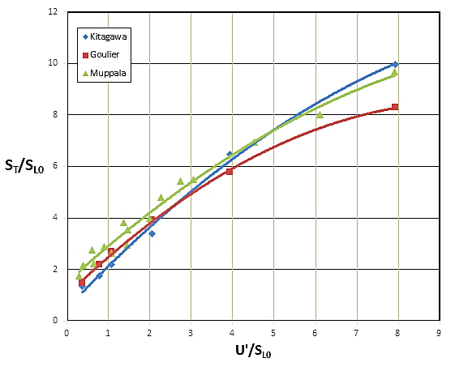
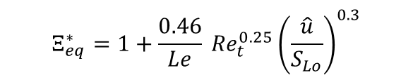
Turbulent flame speed correlation
$$Ξ_{eq}^{∗}=1+\frac{0.46}{Le} {Re}_{t}^{0.25}{\left(\frac{\hat{u}}{S_{Lo}}\right)}^{0.3}$$
Muppala Reddy, S. P., Aluri Naresh K., Dinkelacker, F., Development of an algebraic reaction rate closure for the numerical calculation of turbulent premixed methane, ethylene, and propane/air flames for pressure up to 1.0 MPa (2005), Combust. And Flame, 140
Kitagawa, T., Nakahara, T., Maruyama, K, Kado, K., Hayakawa, A., Kobayashi, S., Turbulent burning velocity of hydrogen-air premixed propagating flames at elevated pressure (2008), Int. Jol. of hyd. Energy, 20:33.
Goulier, J. Comandini, A., Halter, F., Chayumeix, N., experimental study on turbulent expanding flames of lean hydrogen/air mixtures (2016), Proc. Combust. Inst.

Slide 11
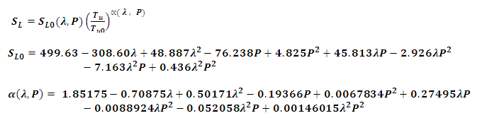
Laminar flame speed for lean-hydrogen-air mixtures
Power law function of elevated temperature and pressure*
S_{L} in cm/s , P is pressure in bar and unburnt gas temperature in K.
Correlation is valid for the equivalence ratios between 0.33 and 0.47 (lean mixtures), pressures range of 1bar to 8.5 bar and temperature range of 300 K to 800 K.
* Verhelst, S, Sierens , R., A laminar burning velocity correlation for hydrogen-air mixture valid at the spark ignition engine conditioned, ASME spring engine technology conference, 2003, Austria :555.
Notes:
Most of the correlation the laminar flame speed correlation available is valid between

Slide 12
Geometry
A typical standard 20 ft. ISO container used in the experiments at GEXCON

Slide 13
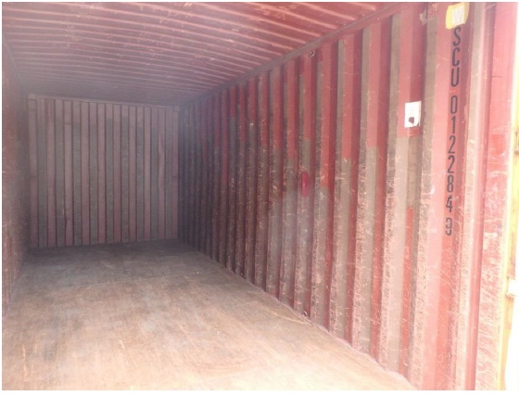
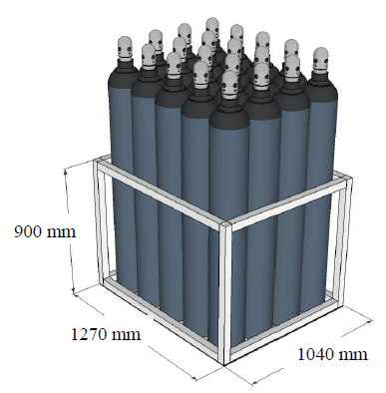
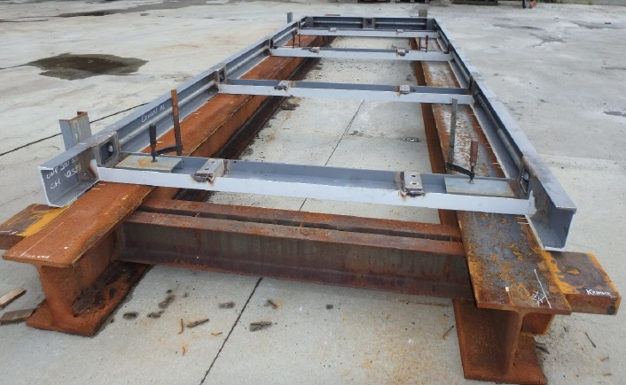
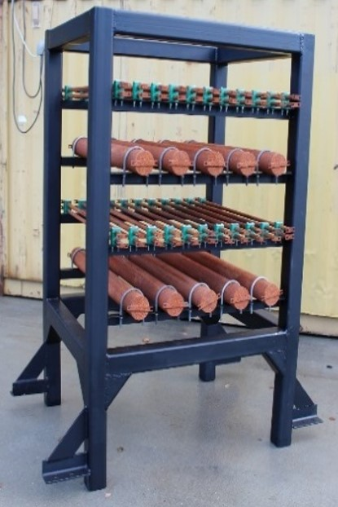
Congestion
(c) Bottle stack
(a) Container corrugation
(d) Pipe rack
(b) Obstacle holding frame

Slide 14
Computational domain
The vented chamber is enclosed by 30.0 x 10.0 x 30 m mesh volume to capture the venting of burned gas, the external explosions and to reduce the effect of boundary conditions on the numerical results
Total domain discretized into 5 x 10⁶ hybrid cells ( hex, tet, prisms)
Computation domain and the mesh distribution in the vertical and horizontal plan.

Slide 15
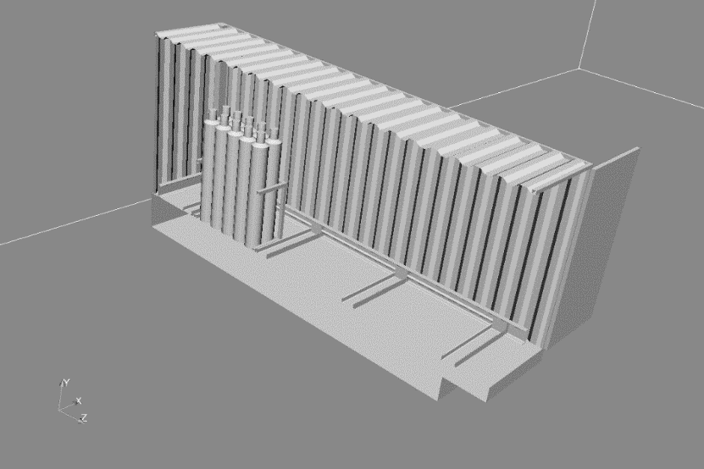
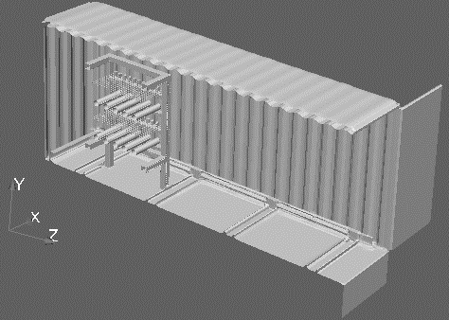
Computational domain (2)
With bottle basket obstacle (b) With pipe rack obstacle
The standard 20-ft ISO container with model obstacles

Slide 16
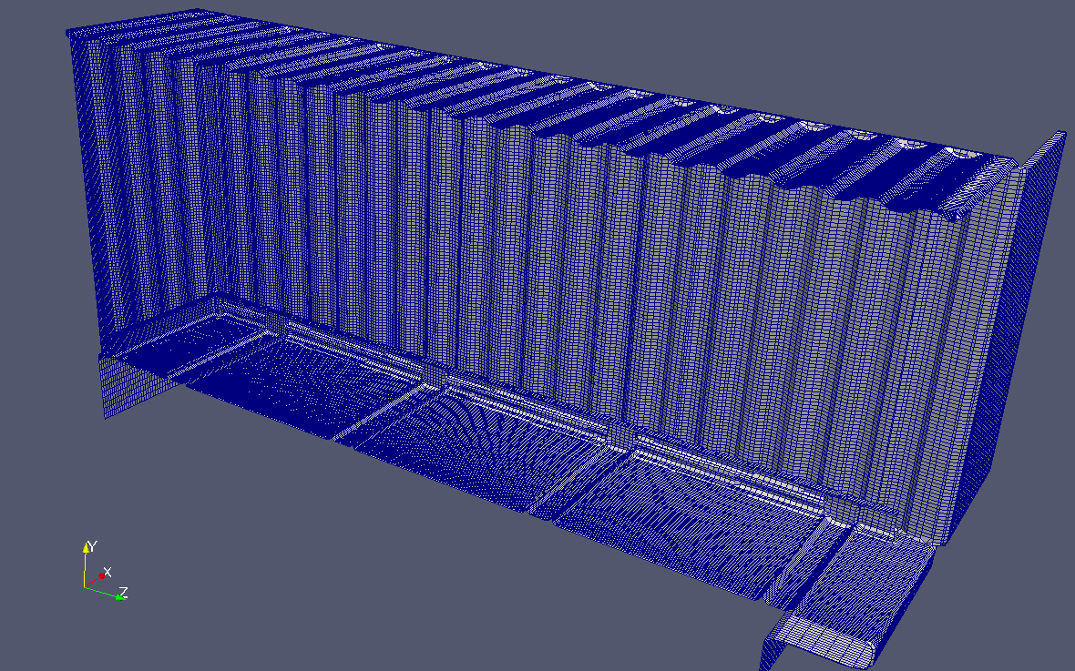
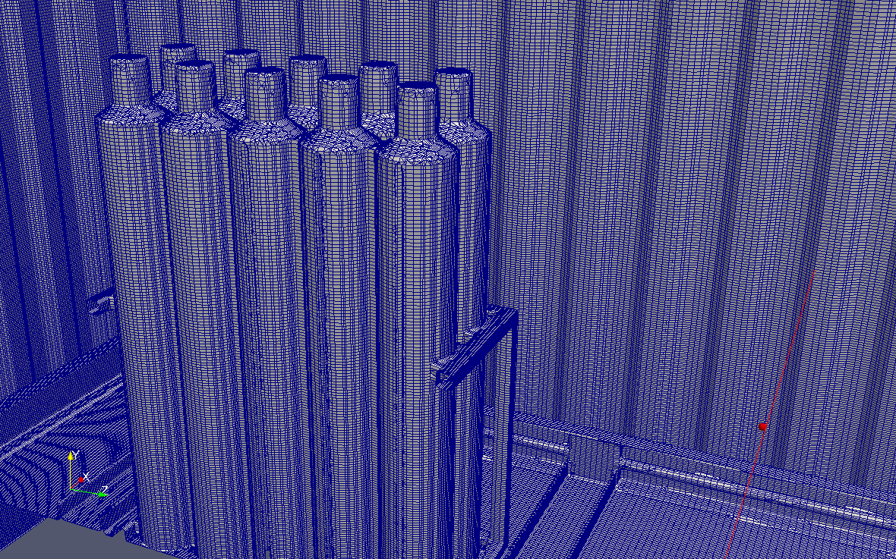
Mesh resolution
The mesh distribution on the obstacles (sample)

Slide 17
Numerical Setup
Boundary conditions
The flow field is initialized with zero mean and u’ = 0.1 m/s rms velocity.
The mixture faction value of 0.0122 was initialized inside the venting chamber volume for 15 % hydrogen volume concentration.
Variable | boundary | condition
velocity | Opening | totalpressure
 | Wall | No-Slip
Pressure | Opening | Pressurevelocityinletoutlet
 | Wall | Zero Gradient
Temperature | Opening | inletOutlet
 | Wall | FixedValue

Slide 18
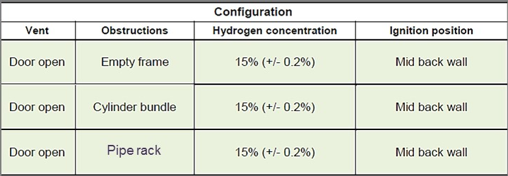
20 feet ISO container Base test case scenarios

Slide 19
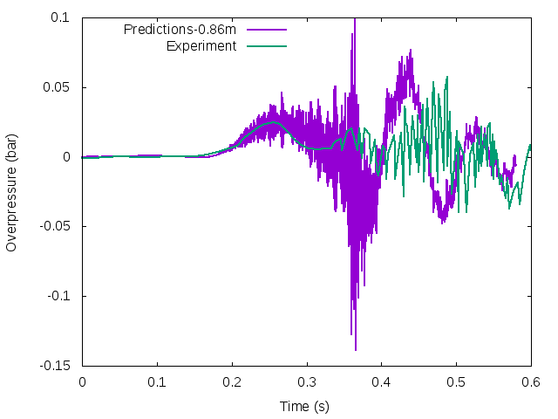
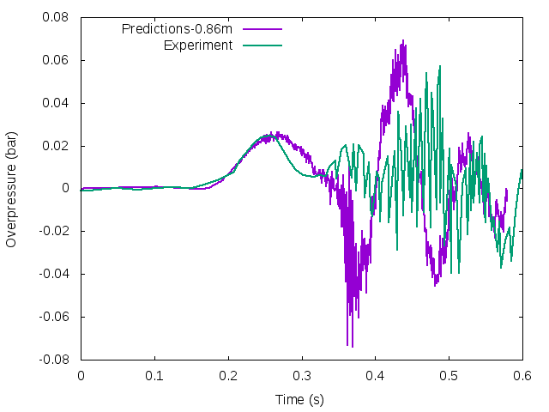
15 % Hydrogen concentrations (empty)
Instantaneous pressure profile (b) Time averaged profile for 5 ms
Pressure trace curve for P1 pressure probe location along with experiment measurements

Slide 20
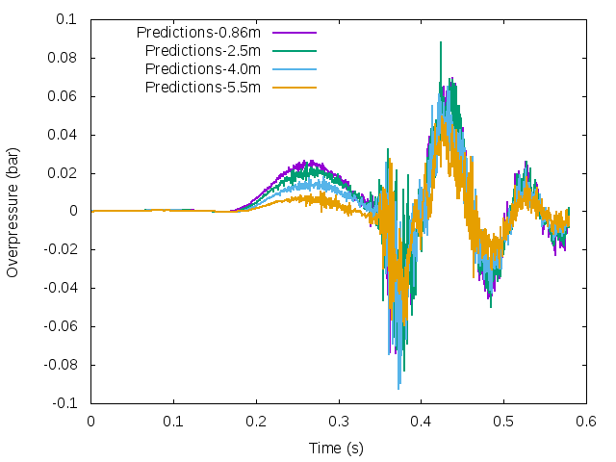
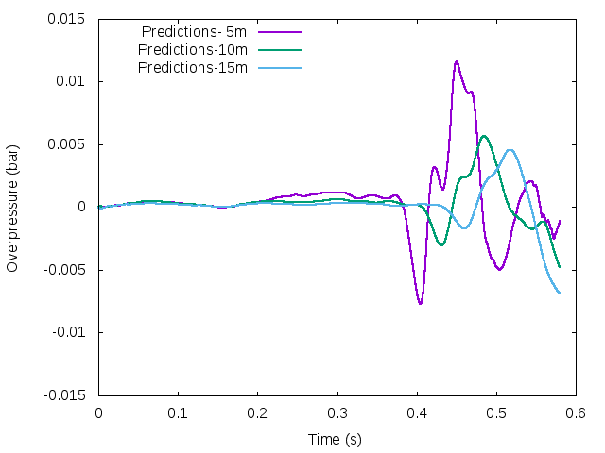
15 % Hydrogen concentrations (Empty)
(a) (b)
Numerical predicted of pressure trace curve for pressure probes ( time averaged 5 ms),
(a) inside the container, (b) outside and in front of the open container door

Slide 21
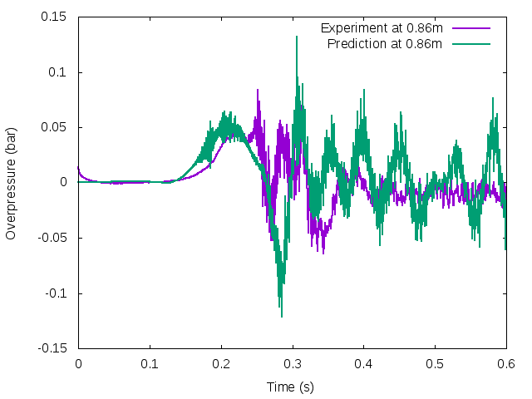
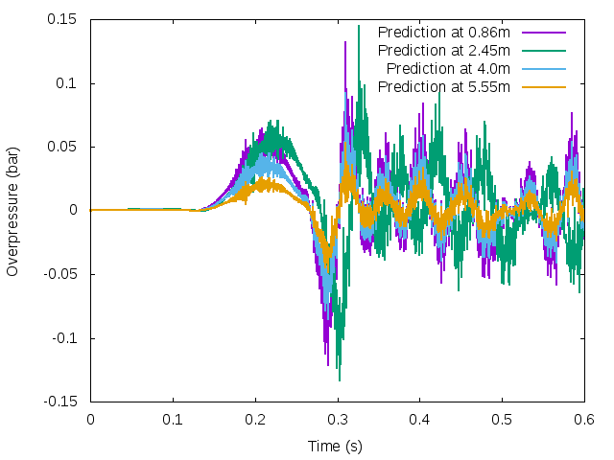
15 % hydrogen concentration with cylinders
(a) (b)
Numerical predicted of pressure trace curve for pressure probes inside container
(a) time averaged 5 ms
(c ) time averaged curves for probes inside the container

Slide 22
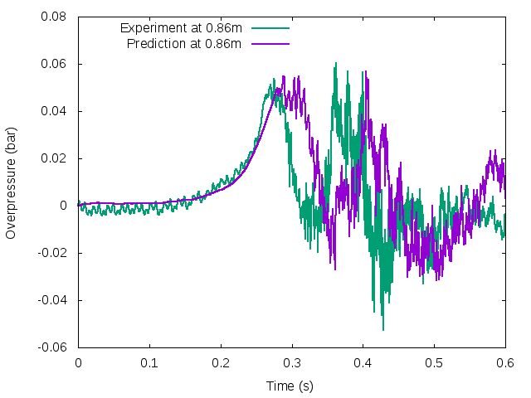
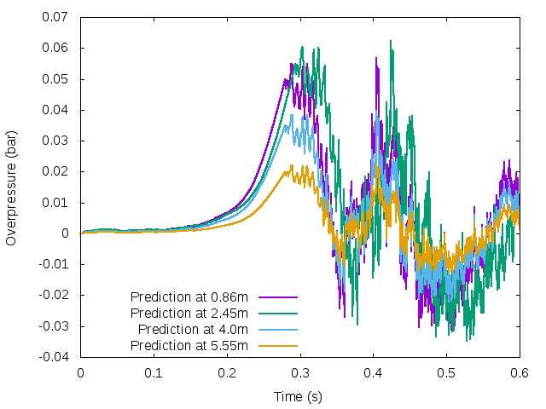
15% Hydrogen Concentration with pipe rig
Pressure trace curve for P1 pressure probe location along with experiment measurements with pipe rack as obstacle

Slide 23
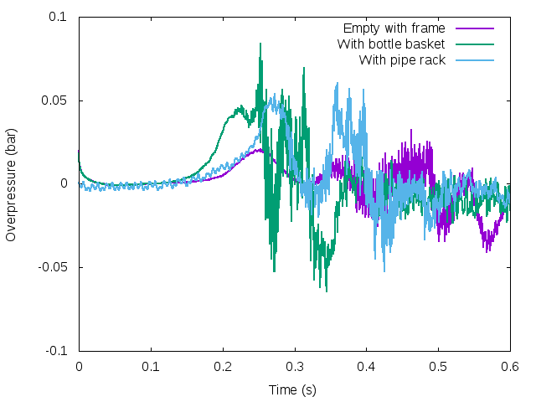
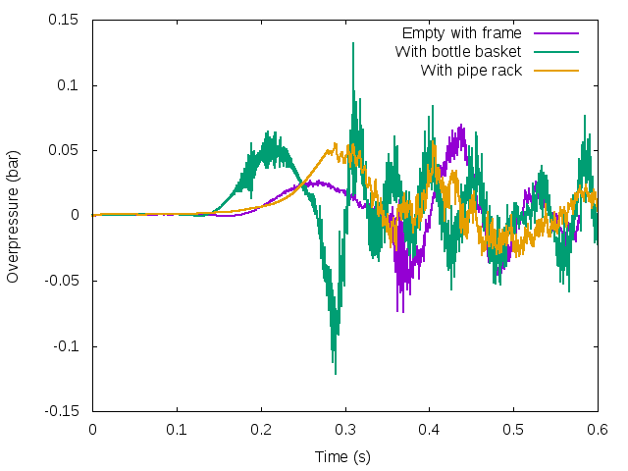
Overall Overpressures trends
Experiments results (b) Numerical predictions
Pressure trace curve for P1 pressure probe location for three scenarios

Slide 24
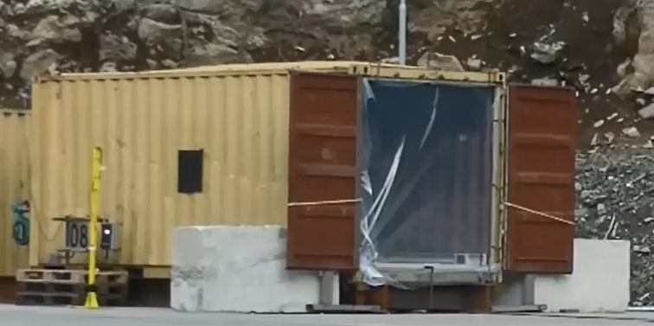
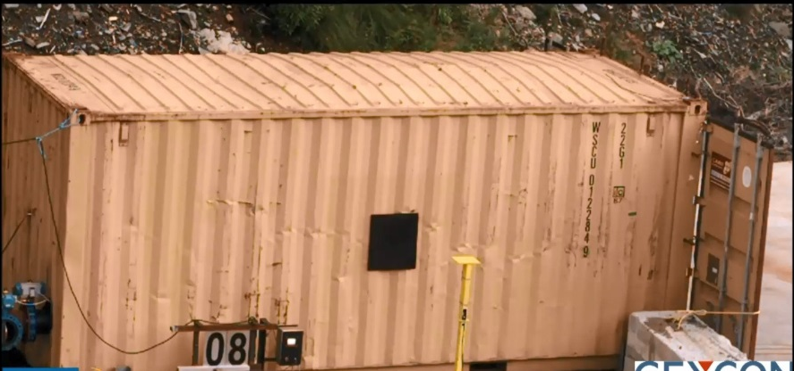
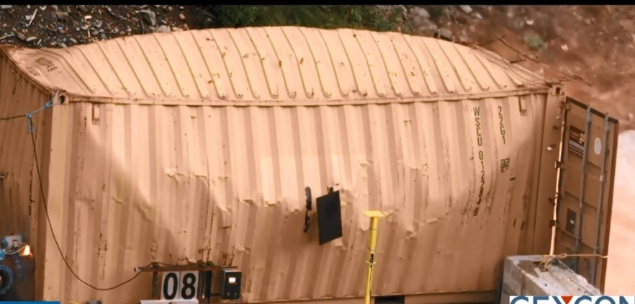
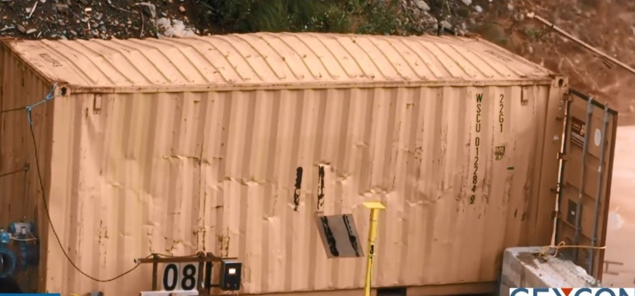
Vented explosion Experiment
(empty) at Gexcon

Slide 25
Container wall displacement

Slide 26
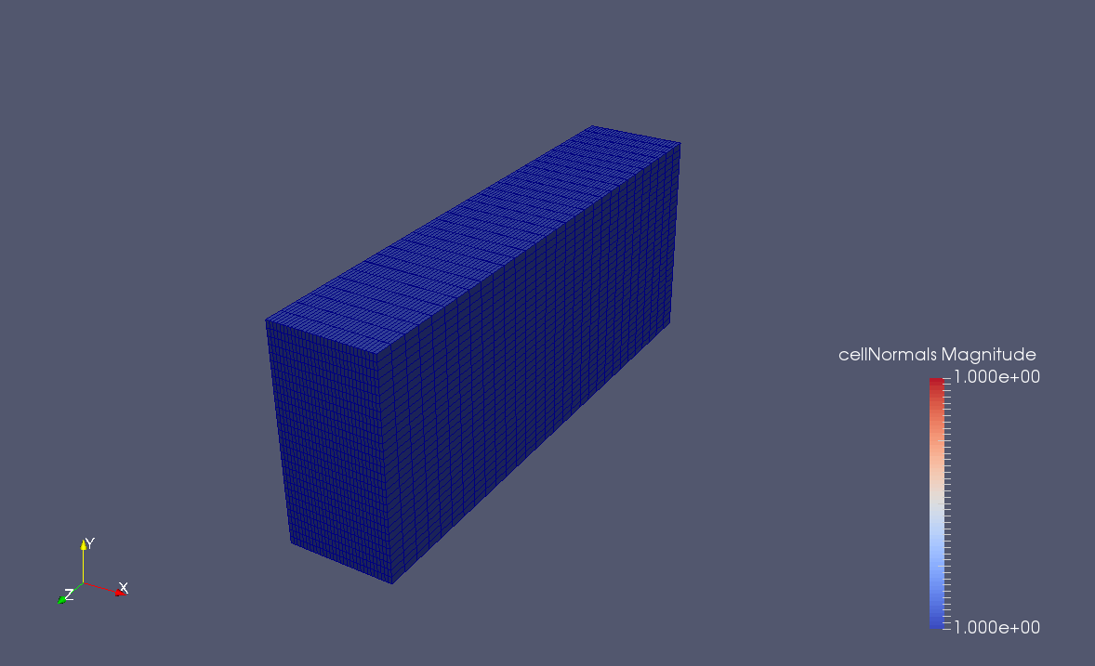
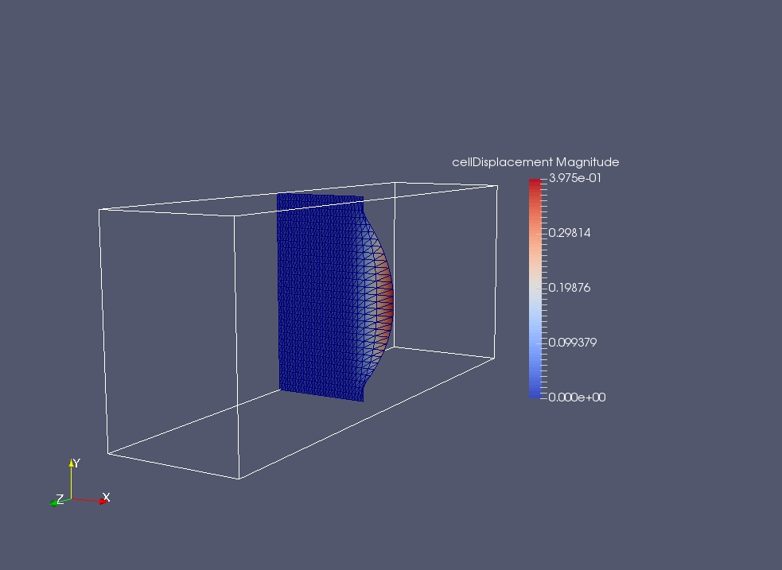
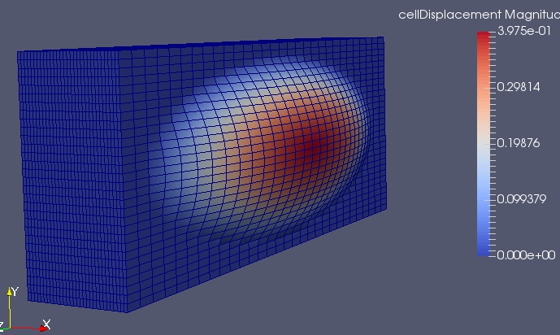
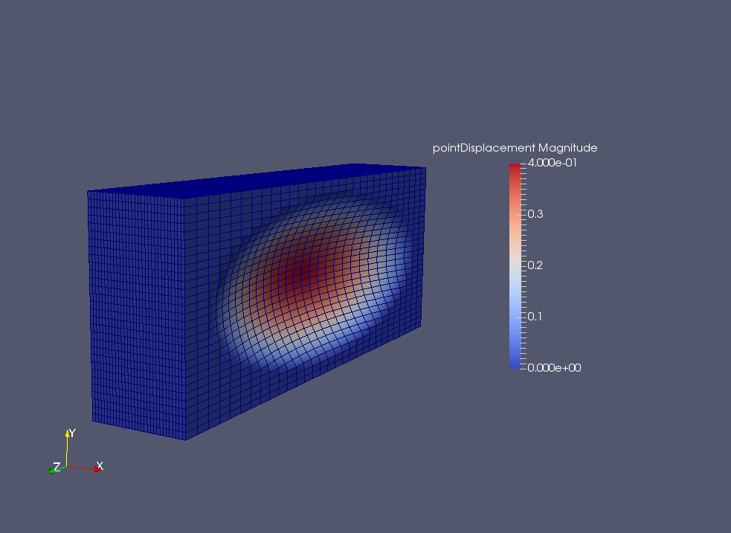
Wall Patch displacement

Slide 27
Conclusions remarks
Vented explosion modelling in RANS/LES method using HyFOAM solver.
Dominant Combustion instabilities in vented explosion process are modelled.
The modelled equations are validated for the container experiments available results.
Experiments geometry details are included in modelling.
CFD and FE integration are considered in one-way coupling , at the moment. ( Although pseudo two-way couple or full two-way coupling can be done in OpenFOAM ).

Slide 28
Acknowledgements
The HySEA project (www.hysea.eu) receives funding from the Fuel Cells and Hydrogen Joint Undertaking under grant agreement No 671461. This Joint Undertaking receives support from the European Union’s Horizon 2020 research and innovation programme and United Kingdom, Italy, Belgium and Norway.

Slide 29
Thank you

