Slide 1
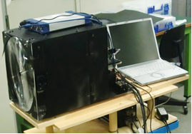
Observation of the hydrogen dispersion by using Raman Scattering measurement and increase of measurable distance
Y.Segawa, M.Inoue, A.Nakamoto, S.Umehara
Department of Natural Resource Engineering
Kyushu University
Sep 12,2017

Slide 2
≪Agenda≫
Background and purpose of the research
Principle of measurement
Raman sensor equipment
Experiments
Development of sensor
Conclusions

Slide 3
≪Agenda≫
✅
Background and purpose of the research
Principle of measurement
Raman sensor equipment
Experiments
Development of sensor
Conclusions

Slide 4
≪Background and purpose of the research≫
The problem of conventional Hydrogen sensors
They must be in contact
Installed placement is important
Some delay will occur
Calibration is necessary to know
the actual H₂ arrival time
A new Raman sensor was developed
It can measure hydrogen from remote distance based on the optical principle(can be measured over glass)
Almost no delay to detect hydrogen

Slide 5
≪Agenda≫
✅
Background and purpose of the research
✅
Principle of measurement
Raman sensor equipment
Experiments
Development of sensor
Conclusions

Slide 6
≪principle of measurement≫
scattering
Gas
Laser
Types of scattering
scattering
Rayleigh scattering
Mie scattering
Raman scattering
Same wavelength
Raman scattering・・・
The scattering has shifted wavelength from original light
①The amount of wavelength shift depend on the type of gas
②The strength of scattering is proportion to the gas concentration

Slide 7
≪Agenda≫
✅
Background and purpose of the research
✅
Principle of measurement
✅
Raman sensor equipment
Experiments
Development of sensor
Conclusions

Slide 8
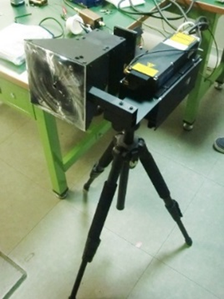
≪Measuring equipment≫
Mirror
Laser
PMT
Target Gas
Lens
(Photomultiplier Tube)
Light receiving device

Slide 9
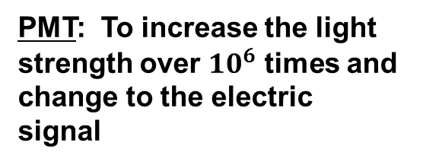
Light receiving device
Pinhole : To cut the sun light
Collimator lens: To make the light parallel
PMT: To increase the light strength over ${10}^{6}$ times and change to the electric signal
Edge filter: To cut the light under the laser wavelength
Gas filter: To penetrate the light only
the Raman wavelength

Slide 10
$$Gas Concentration=\frac{RS\left(gas\right)−RS\left(gas=0\right)}{RS\left(N_{2}=78\right)−RS\left(N_{2}=0\right)}×\frac{0.78}{σ/{σN_{2}}}×100 \left(\%\right)$$
Using 355nm laser
RS(gas): Raman scattering signal strength of the target gas
RS(gas=0): Target gas’s Raman scattering signal strength (in case of 0%)
RS(N2=78): Raman scattering signal strength of nitrogen
RS(N2=0): N₂‘s Raman scattering signal strength (in case of 0%)
σ⁄σN2: Raman scattering cross section of the target gas for N₂
Gas | Raman wave length(nm) | σ/σN₂(Signal strength ratio)
CO₂(2v2) | 371.7 | 1.1
CO₂(v1) | 373.1 | 1.5
O₂ | 375.4 | 1.6
CO | 383.9 | 1.3
N₂ | 386.7 | 1
H₂S | 390.9 | 6.8
CH₄ | 395.6 | 11.5
CH₄(v3) | 397.3 | 5
NH₃ | 402.3 | 3.9
H₂O | 407.5 | 2.8
H₂ | 416.1 | 3.1

Slide 11
≪Agenda≫
✅
Background and purpose of the research
✅
Principle of measurement
✅
Raman sensor equipment
✅
Experiments
Development of sensor
Conclusions

Slide 12
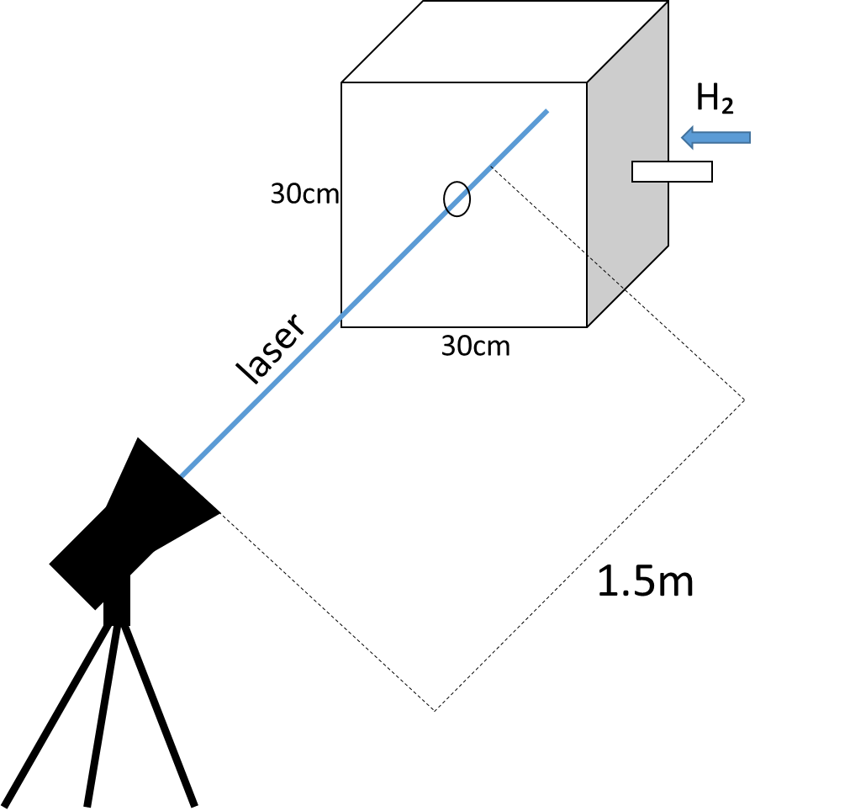
≪Experiments≫
The purpose
To understand hydrogen behavior in narrow space
To confirm the difference by changing the supply flow rate
Details
Hydrogen is supplied to the box of
30 cm × 30 cm × 30 cm (27L)
for 2 seconds at 40 L/min (total 1.3L )
As supply nozzle, 1＆6 mm diameter nozzles were used
Raman sensor

Slide 13
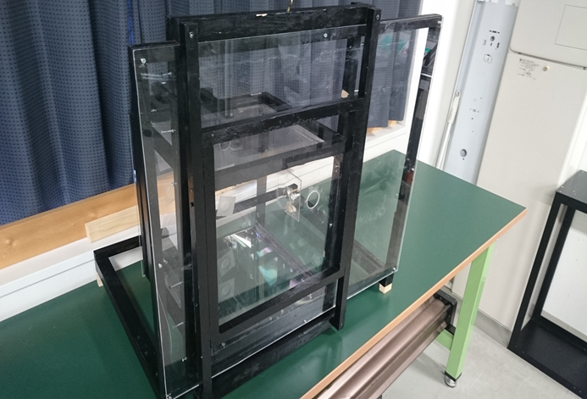
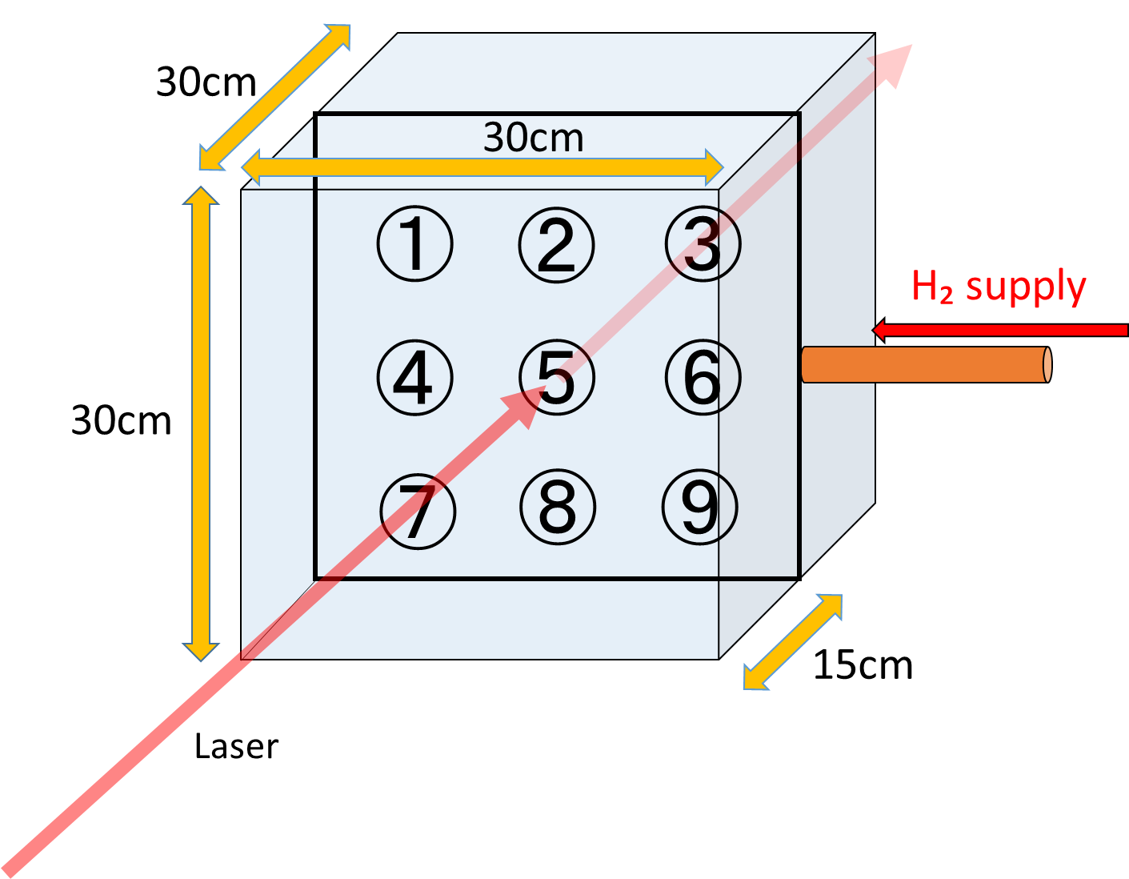
≪H₂ measurement≫
Acrylic plate:
To pass Raman scattering from gas
Quartz glass：
To suppress the reflection of the laser
Front
The container for experiment
seal
hole
back
40L/min 2sec
Nozzle size | Initial velocity
6mm | 23.5m/sec
1mm | 849m/sec
Φ=6mm
&
1mm
※Calculated value

Slide 14
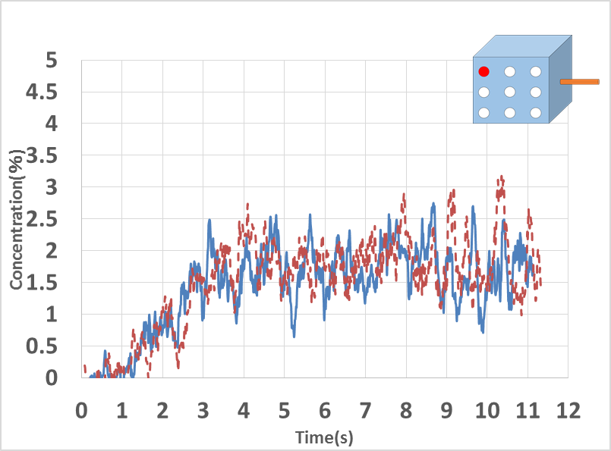
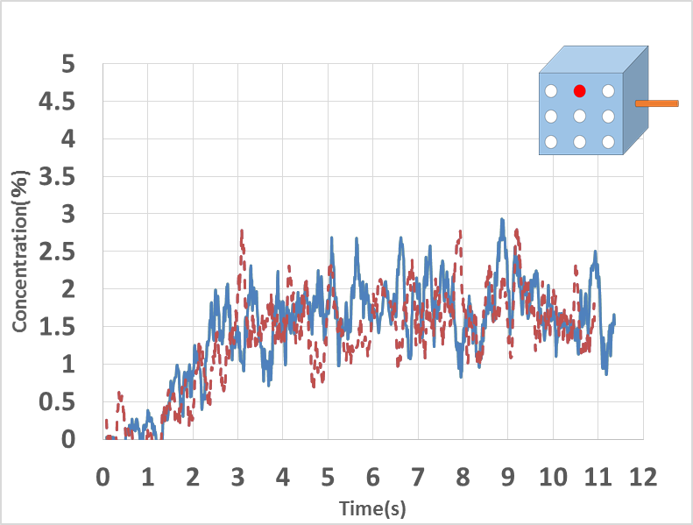
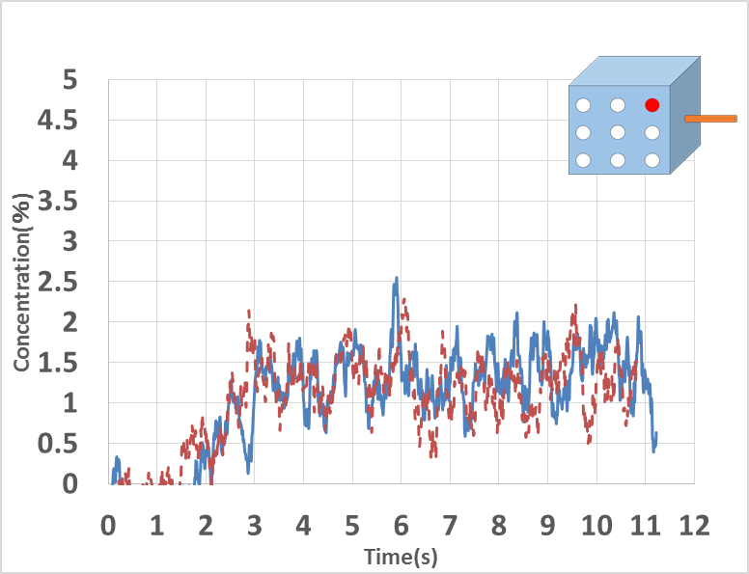
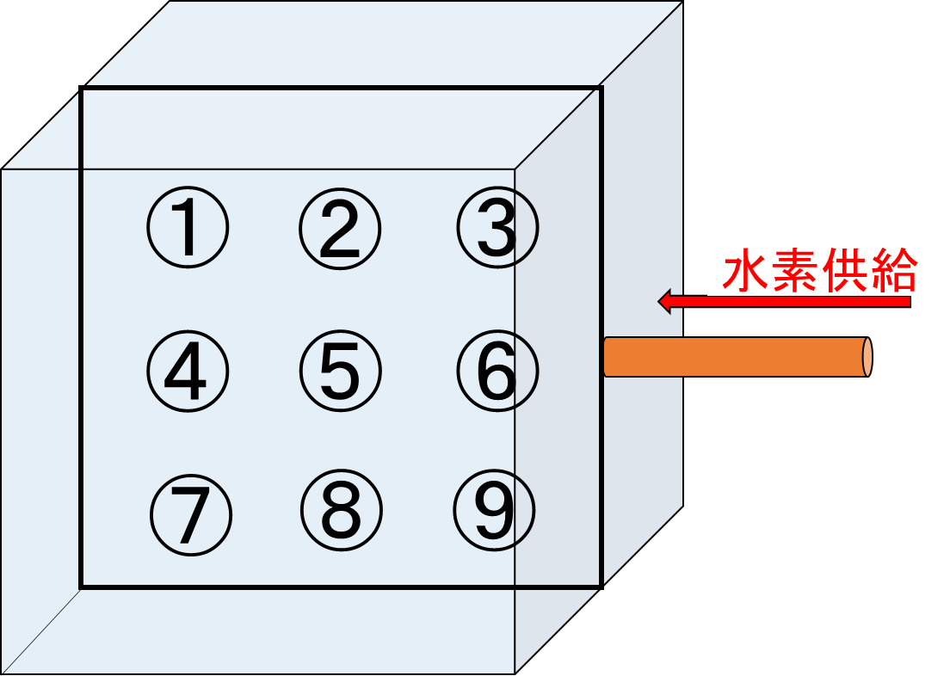
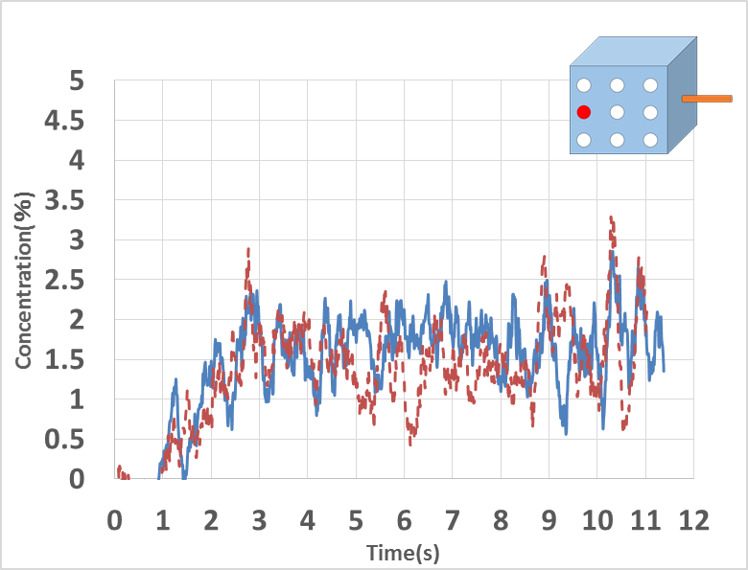
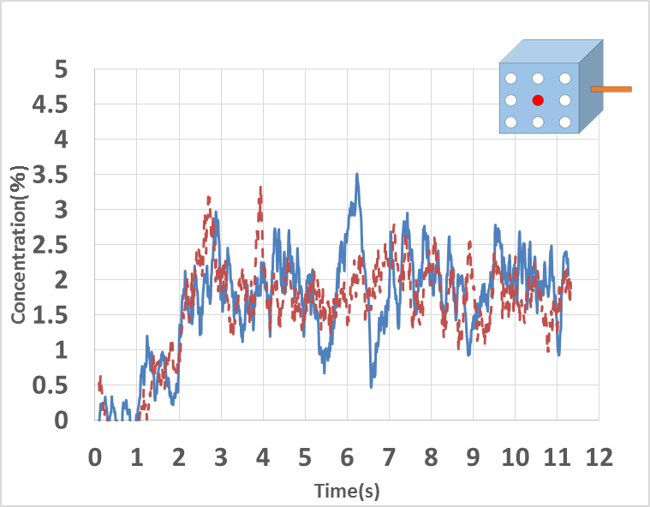
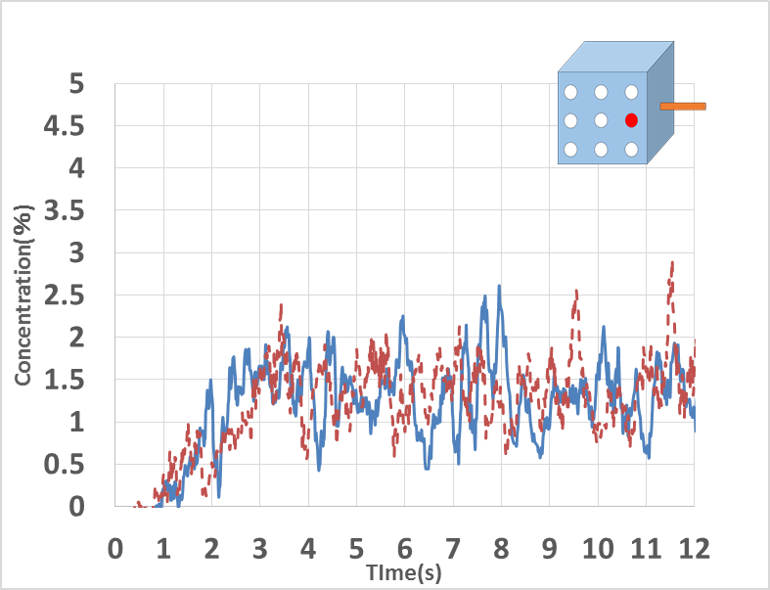
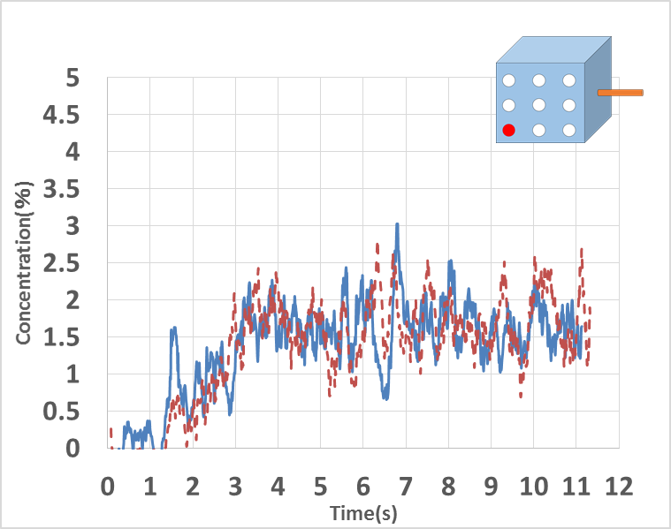
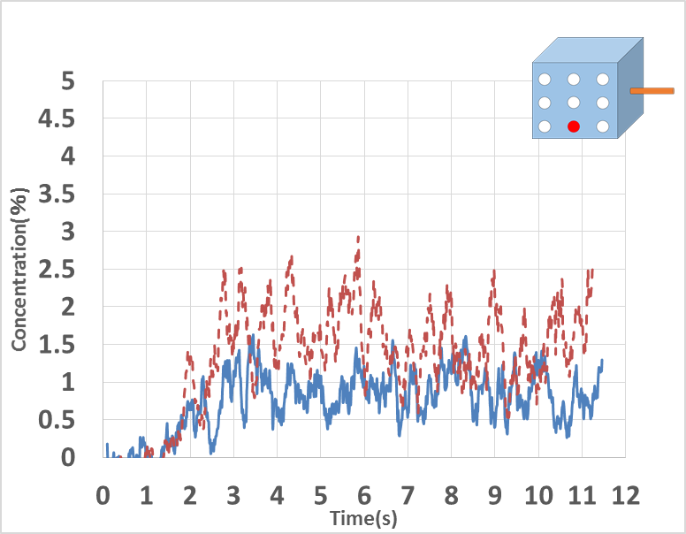
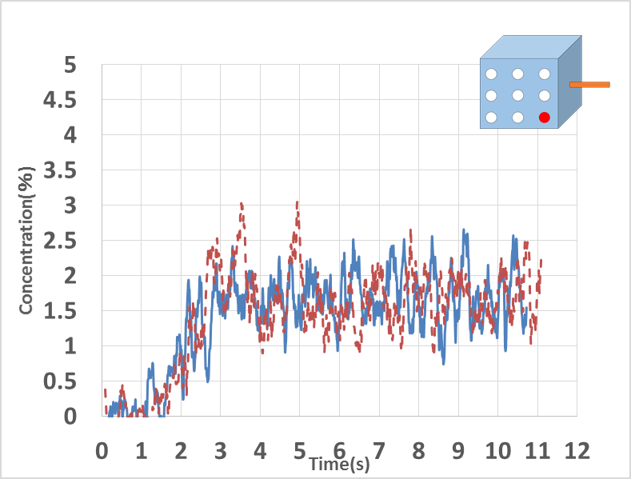
≪Using 1mm nozzle≫
①
②
③
1st experiment
2nd experiment
④
⑤
⑥
H₂40L/min
2 sec
supply
⑦
⑧
⑨
：H₂supply start
(1sec)
Concentration(％)
：H₂supply stop
(3sec)
Time(s)
Fig.1 H₂ dispersion by 1mm nozzle

Slide 15
Hydrogen behavior estimation when using 1 mm nozzle
H₂ supply nozzle

Slide 16
≪Using 1mm nozzle≫
①
②
③
1st experiment
2nd experiment
④
⑤
⑥
H₂40L/min
2 sec
supply
⑦
⑧
⑨
：H₂supply start
(1sec)
Concentration(％)
：H₂supply stop
(3sec)
Time(s)
Fig.1 H₂ dispersion by 1mm nozzle

Slide 17
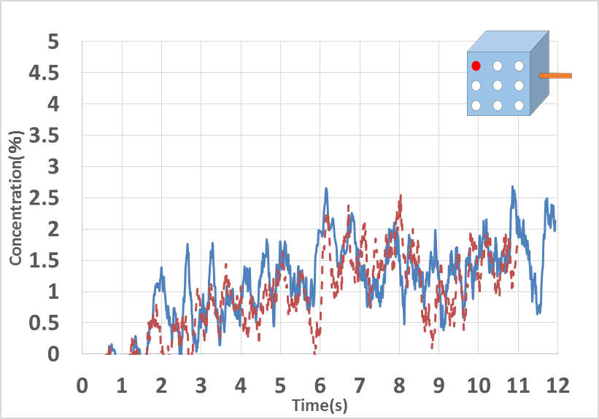
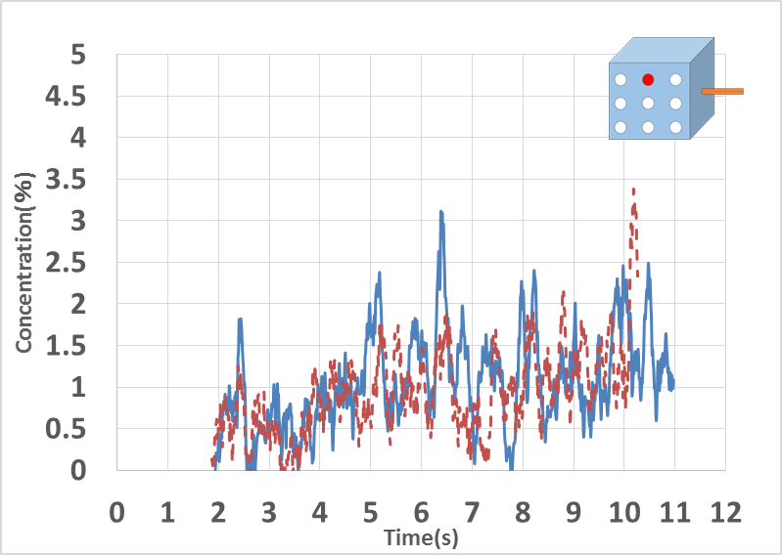
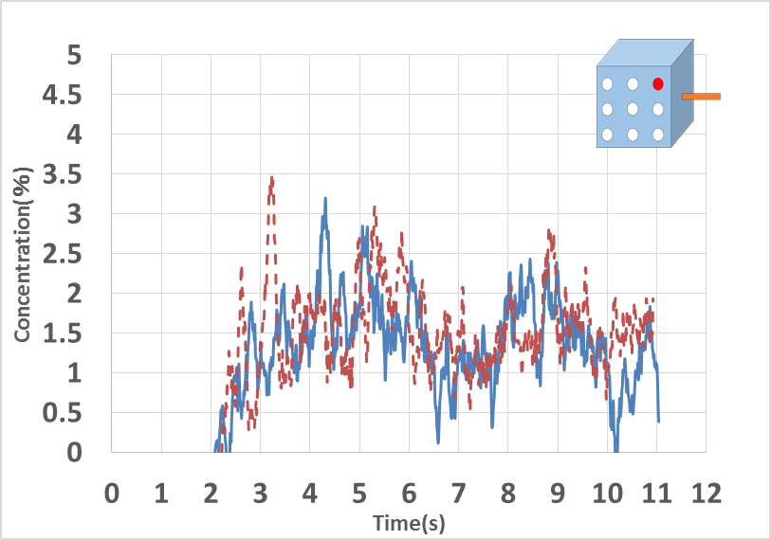
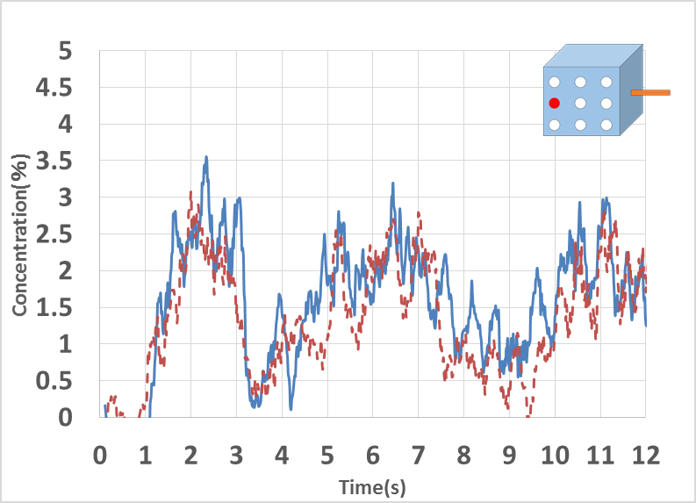
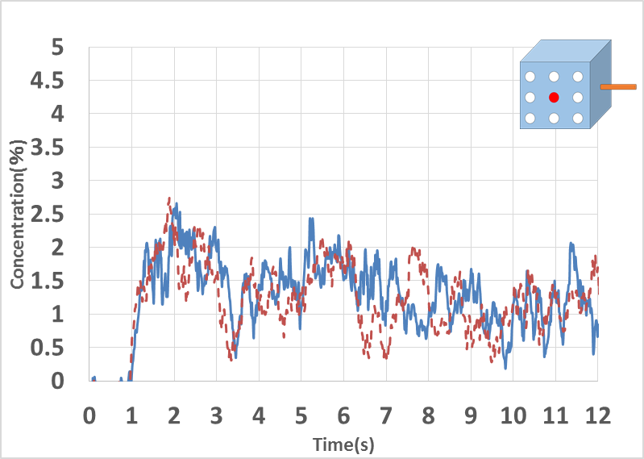
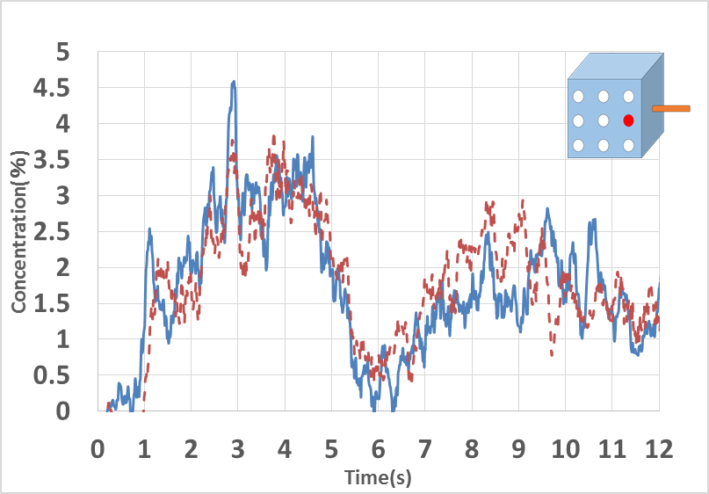
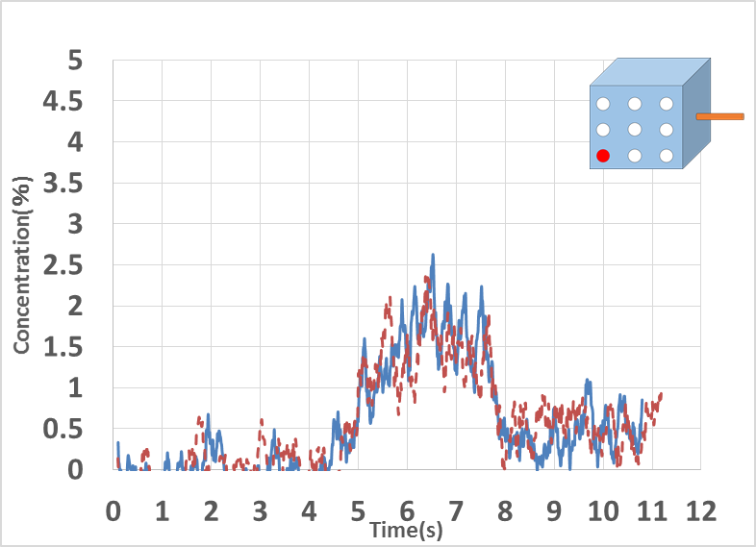
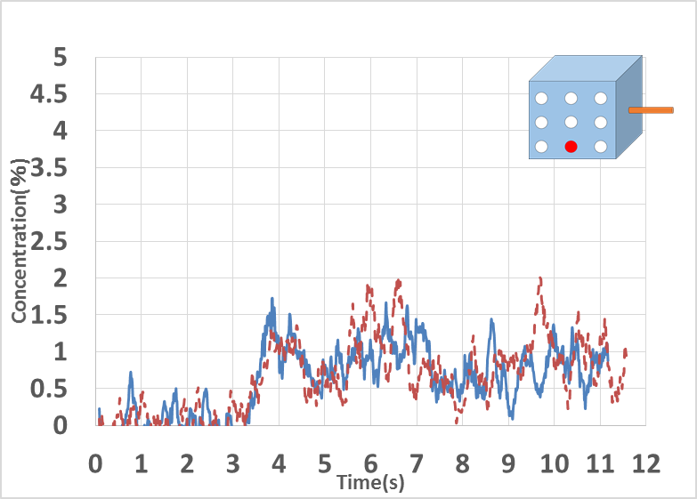
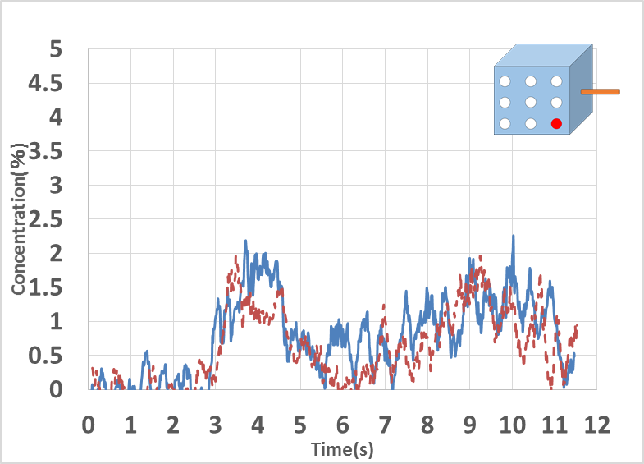
≪Using 6mm nozzle≫
①
②
③
1st experiment
2nd experiment
④
⑤
⑥
H₂40L/min
2 sec
supply
⑦
⑧
⑨
：H₂supply start
(1sec)
Concentration(％)
：H₂supply stop
(3sec)
Time(s)
Fig.2 H₂ dispersion by 6mm nozzle

Slide 18

Hydrogen behavior estimation when using 6 mm nozzle
H₂ supply nozzle
①

Slide 19
≪Using 6mm nozzle≫
①
②
③
1st experiment
2nd experiment
④
⑤
⑥
H₂40L/min
2 sec
supply
⑦
⑧
⑨
：H₂supply start
(1sec)
Concentration(％)
：H₂supply stop
(3sec)
Time(s)
Fig.2 H₂ dispersion by 6mm nozzle

Slide 20
Hydrogen behavior estimation when using 6 mm nozzle
③
②
H₂ supply nozzle
①

Slide 21
≪Using 6mm nozzle≫
①
②
③
1st experiment
2nd experiment
④
⑤
⑥
H₂40L/min
2 sec
supply
⑦
⑧
⑨
：H₂supply start
(1sec)
Concentration(％)
：H₂supply stop
(3sec)
Time(s)
Fig.2 H₂ dispersion by 6mm nozzle

Slide 22
Hydrogen behavior estimation when using 6 mm nozzle
③
②
④
H₂ supply nozzle
①
⑤

Slide 23
≪Using 6mm nozzle≫
①
②
③
1st experiment
2nd experiment
④
⑤
⑥
H₂40L/min
2 sec
supply
⑦
⑧
⑨
：H₂supply start
(1sec)
Concentration(％)
：H₂supply stop
(3sec)
Time(s)
Fig.2 H₂ dispersion by 6mm nozzle

Slide 24
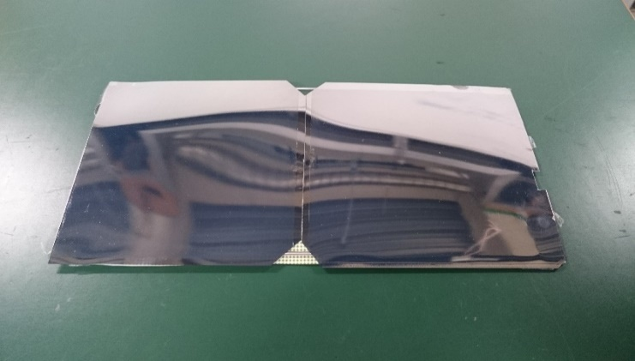
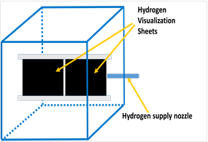
Verification of Initial Hydrogen Diffusion
by Hydrogen Visualization Sheet
It becomes transparent when hydrogen is detected
Target gas | Only hydrogen
Response time | Less than 3sec(100％H2 50ml/min 0.1MPa)
durability | 10 times
size | 140mm×130mm
Hydrogen Visualization Sheet
(by Atumitec Co.)
These sheets set as Fig.3 for the nozzle
Since there was no difference transparent area size due to the hydrogen supply time, hydrogen supply for 4 seconds are shown next slide
Fig.3 H₂ visualization sheets installment

Slide 25
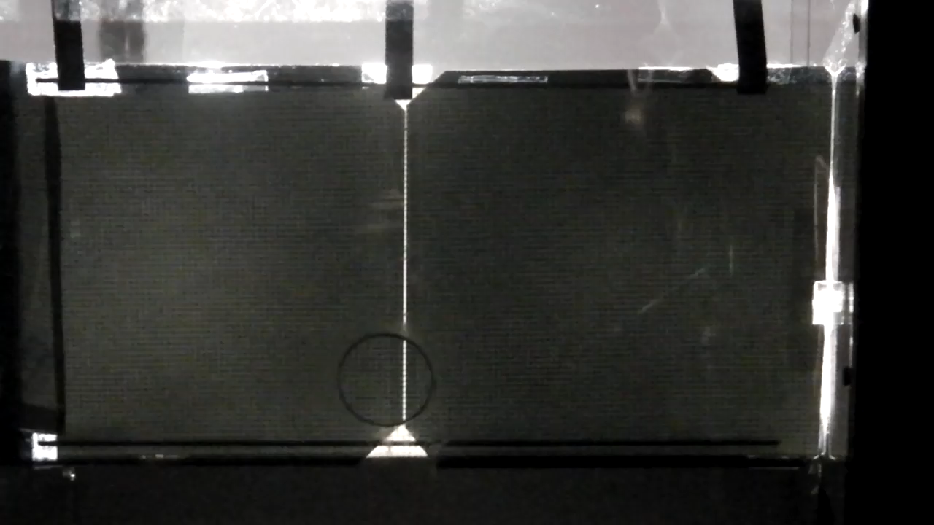
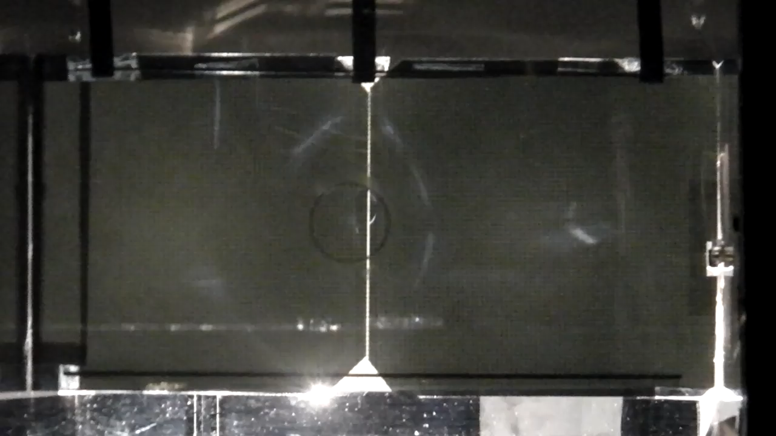
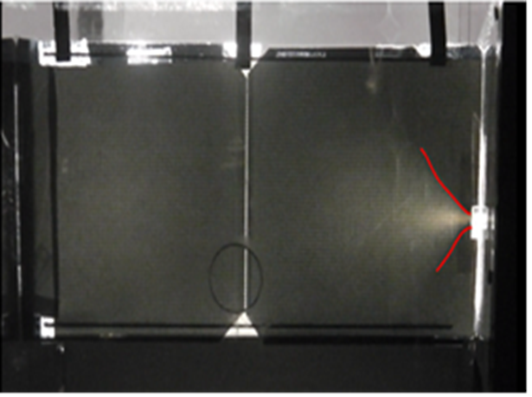
≪Using 1mm nozzle≫
≪Using 6mm nozzle≫

Slide 26
≪Agenda≫
✅
Background and purpose of the research
✅
Principle of measurement
✅
Raman sensor equipment
✅
Experiments
✅
Development of sensor
Conclusions

Slide 27
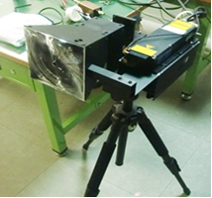
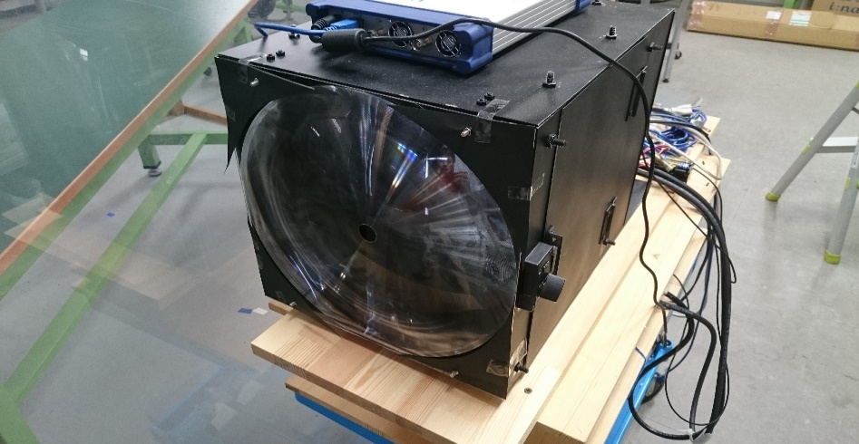
≪Development of sensor≫
The previous sensor’s measurable distance is 3 to 4 m
The new sensor was developed by improving a lens size 15cm to 30 cm diameter that can detect hydrogen from a long distance
Fig.4 previous sensor
Fig.5 New sensor

Slide 28
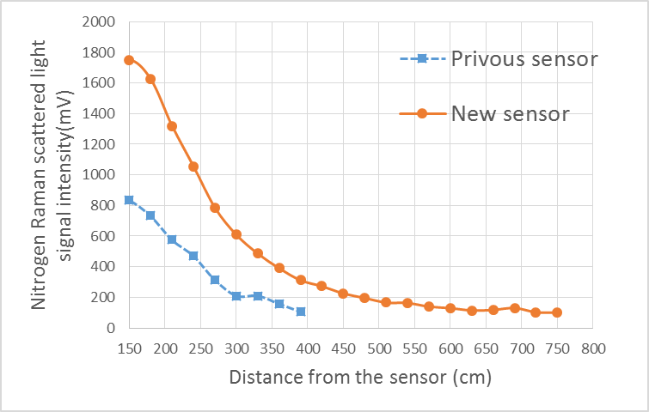
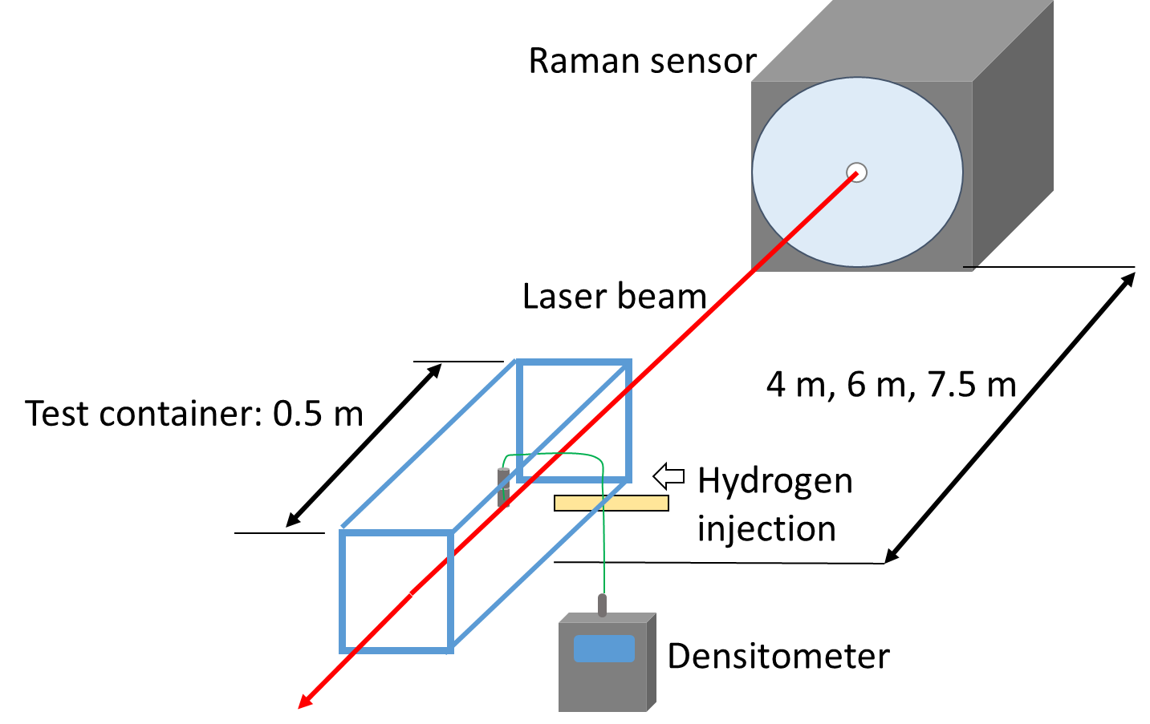
As the distance increases, the obtained signal becomes smaller
N₂ signal can be detected even at the 7.5 m point with the new sensor
Fig.6 The N₂ signal strength when the measurement distance changes
In order to check the ability of new device, the environment like Fig.7 was made, and compared with the value of conventional hydrogen sensor
H₂ supply 0,2,3L/min, and changed the measurement distance 4,6,7.5m
Fig.7 experimental environment

Slide 29
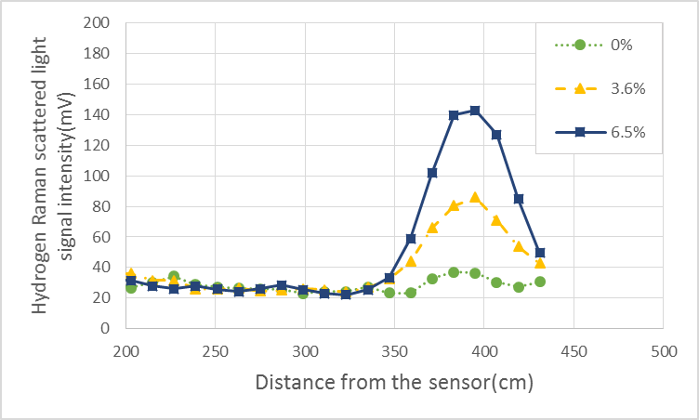
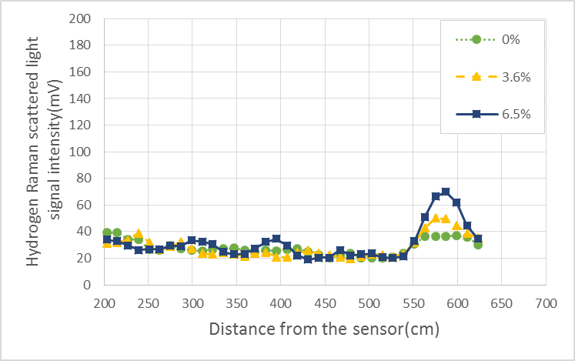
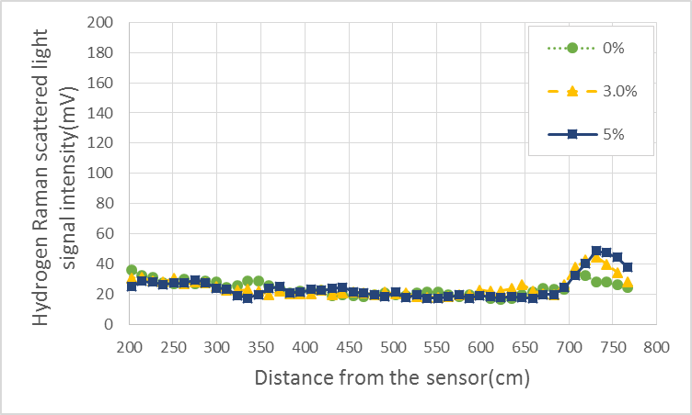
Fig.8 Supply installation at 4 m
Fig.9 Supply installation at 6 m
The measurement maximum value by the conventional sensor and the hydrogen signal intensity change by the Raman sensor are shown
H₂ signal can be detected at 7.5 m point, but since the signal becomes smaller as the distance becomes longer, H₂ can be qualitatively detected but quantitative measurement becomes difficult
Fig.10 Supply installation at 7.5 m

Slide 30
≪Agenda≫
✅
Background and purpose of the research
✅
Principle of measurement
✅
Raman sensor equipment
✅
Experiments
✅
Development of sensor
✅
Conclusions

Slide 31
≪Conclusion≫
We were able to ensure the behavior of the hydrogen gas in the small space by Raman sensor
Improvement of the lens size improved the measurable distance
In the future…
It becomes possible to simultaneously measure not only H₂ but various kinds of gases including O₂ by Raman scattered light measurement
It will be possible to know hydrogen concentration promptly from long distance by using this technology

Slide 32
THANK YOU

Slide 33

≪PMT(Photomultiplier Tube)≫
It can convert light into electric energy from over ${10}^{6}$ times by using photoelectric effect
Dynode
Photoelectron
Raman
Scattering
PMT

Slide 34
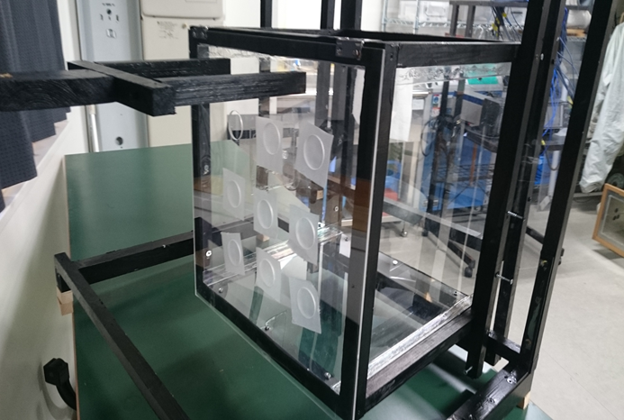

Slide 35
The laser specification
波長 |  | 355nm
運転モード |  | パルスレーザー
繰り返し周波数 |  | 1-100Hz
パルスエネルギー |  | ＞70μJ
出力 |  | ＞70kW
パルス幅 |  | ≒1ns
空間モード |  | TEM₀₀
偏光比 |  | ＞100:1,垂直
出力安定性 |  | ＜±3%
レーザークラス |  | 3B/Ⅲb
消費電力 |  | ＜70W
使用周囲温度 |  | 18℃～38℃
寸法、質量 | レーザーヘッド | 89(W)×44.7(H)×274(D)、1.5kg
 | 本体 | 130(W)×105(H)×166(D)、1.5kg

