Slide 1
Proceedings of the 2017 International Conference on Hydrogen Safety
ICHS2017
September, 11-13 2017 - Hamburg ,Germany
ICHS-131
LES SIMULATION OF BUOYANCY JET FROM UNINTENDED HYDROGEN RELEASE WITH GASFLOW-MPI
Li Yabing Zhang Hai, Jianjun Xiao
Institute for Nuclear and Energy Technologies
Karlsruhe Institute of Technology, Germany
Notes:
Good morning everyone. I’m Li yabing from Karlsruhe institute of technology. It’s my honor to have this presentation today.

Slide 2
Outlines
Introduction
Modeling
Result and Discussion
Conclusions
Notes:
This is the outline of my presentation.

Slide 3
Outlines
Introduction
Modeling
Result and Discussion
Conclusions
Notes:
This is the outline of my presentation.

Slide 4
Introduction
A small unintended hydrogen release has been identified as an important phenomenon for codes and standards development in hydrogen energy industry.
it may lead to combustion hazard.
it is often too small to detect for hydrogen measurement.
For this phenomenon, the two important factors are: initial momentum and buoyancy
Fr<10
Buoyancy
dominated
pushing away heavy surrounding air
Buoyancy
jet
Initial momentum
Turbulent mixing
$$Fr=$$
$$\frac{u_{inlet}}{{\left({gd\left(ρ_{∞}−ρ_{inlet}\right)}/{ρ_{∞}}\right)}^{1/2}}$$
10<Fr<1000
Both
dominated
air
entrainment
Buoyancy
Fr>1000
Momentum
dominated
Pure hydrogen injection
Notes:
A small unintended hydrogen release has been identified as an important phenomenon for codes and standards development in hydrogen energy industry. it may lead to combustion hazard. it is often too difficult to detect for hydrogen measurement.
Pure hydrogen releases into still air, firstly, hydrogen with low density needs to push away the heavy air to going up. In the meantime, the surrounding air will be entained with the up-going gas. As the result, both velocity and hydrogen fraction will decay while the hydrogen jet develops. The two important factors are: initial momentum and buoyancy creating by density difference. This can be described with Froude number.
Previews research shows that, If Fr < 10, the injected flow is more plume like, dominated by buoyancy generated from density difference between hydrogen and surrounding air; if Fr>1000, the injected flow is more jet like, dominated by initial momentum and if 10<Fr<1000, the injected flow is dominated by both buoyancy and initial momentum in this intermediate range [1].

Slide 5
Introduction
Integral model: taking account of assumptions for entrainment velocity, density or velocity distributions.
Boussinesq plume & non-Boussinesq plume, MTT theory.
a new theory (van den Bremer & Hunt, 2011) provides universal solution for both Boussinesq and non-Boussinesq plumes, through solving for the variation with height of Γ, a local Richardson number.
CFD approach
Small scale, low Re, “numerical experiment”
DNS and LES
GASFLOW-MPI
a parallel computational fluid dynamics (CFD) Code;
a best-estimate tool for predicting transport, mixing, and combustion of hydrogen.
In this paper, GASFLOW-MPI is validated with small-scale hydrogen release experiment
buoyancy jet and turbulence mixing of different species.
Three turbulence model: k-ε, LES, and DES model
Notes:
Previous research tended to solve this problem with integral model taking account of assumptions for entrainment velocity, density or velocity distributions. One of the important assumptions is Boussinesq assumption. Hence the models can be divided into two types: Boussinesq plume & non-Boussinesq plume. While a new theory provides universal solution for both Boussinesq and non-Boussinesq plumes, through solving for Γ, a local Richardson number.
Recently, the CFD approach are increasingly applied for plume analysis. CFD can captured detailed behaviors that cannot be captured by classical plume theory such as pressure field.
In this paper, we validate GASFLOW-MPI small-scale hydrogen release experiment, three different turbulent models are discussed i.e. k-ε, LES, and DES model, in order to discuss the code performance of GASFLOW-MPI for both buoyancy jet and turbulence mixing of different species.

Slide 6
Outlines
Introduction
Modeling
Result and Discussion
Conclusions

Slide 7
Turbulence model
，
，
LES model has been adopted to simulate buoyancy plume in many research since most of the turbulent fluctuation could be resolved directly and only the turbulence eddy at sub-grid scale is modelled by sub-grid scale model.
The Smagorinsky model is employed in GASFLOW-MPI to calculate the SGS turbulent viscosity due to its simplicity and practicality.
Detached Eddy Simulation (DES) model is a kind of hybrid turbulence model. The main feature of DES model is that it could switch between RANS and LES adaptively according to the local turbulent information.
LES
k - ε
k & ε:
Solved by two equations
DES:
k & ε Solved by two equations

Slide 8
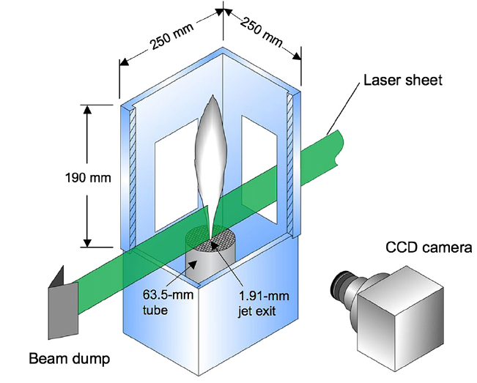
Modeling of experiment
Conducted in Sandia National Laboratories;
Provide data for the validation of CFD models to predict unintended hydrogen release scenario;
Pure hydrogen is released in to still surrounding air at constant velocity.
Dinlet:1.91mm
Vinlet=133.9m/s
Re: 2384; Fr 268.
Tinlet =Tambient = 21℃；
Pambient: 1 bar
Experiment of small-scale unintended releases of hydrogen
Notes:
The experiment of small unintended hydrogen release is conducted in Sandia National Laboratories. In order to provide data for the validation of CFD models to predict unintended hydrogen release scenario.
In this experiment, Pure hydrogen is released in to still surrounding air at constant velocity.

Slide 9
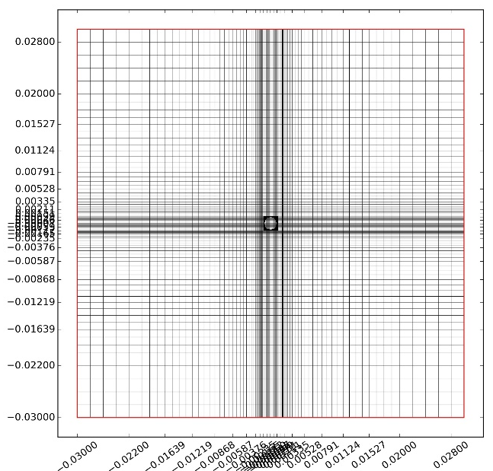
Modeling of experiment
Cartesian coordinate system
the computational domain size of 30*30*115mm.
This domain is divided into 90*90*150 grids, with a total cell number 1,215,000,
Diagram of mesh
(b)X-Z view
(a) X-Y view
Notes:
The computational domain is with side length of 30 mm, 115 mm height. This domain is divided into and This is the diagram of mesh. There is refinement near the injection. Minimum grid is 0.1 millimeter.

Slide 10
Outlines
Introduction
Modeling
Result and Discussion
Conclusions
Notes:
This is the outline of my presentation.

Slide 11
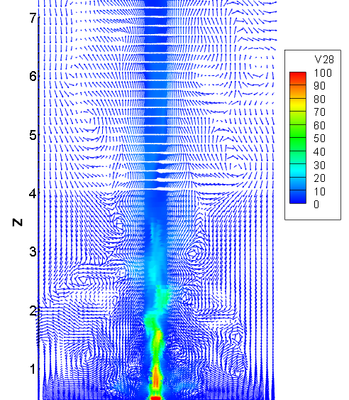
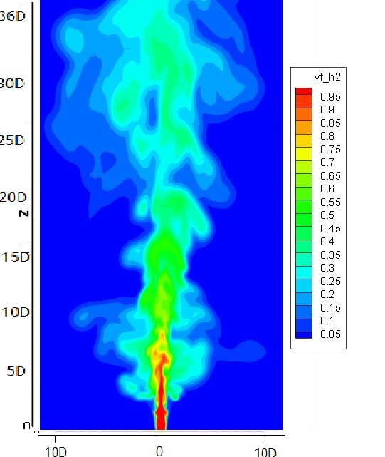
Result-LES
with Fr number of 268 in this case, hydrogen is mainly dominated by momentum at beginning.
At the beginning, the flow near the inlet is a steady axisymmetric laminar flow, then the development of the instability generated at the shear layer, leads to interaction between injected hydrogen and the surrounding air.
Instantaneous Vector colored in Vmag in Z/D 0-40.
Instantaneous
Time-averaged
mole fraction of hydrogen in Z/D 0-40.
Notes:
The left figure gives the instantaneous vector colored in velocity magnitude. We can see small vortexes at the edge of the hydrogen jet creating by this interaction. The right figure gives both instantaneous and time averaged mole fraction of hydrogen. The averaged fraction shows an inversely conical shape, consisting with the experiment.

Slide 12
Result-LES
z-direction velocity and hydrogen mole fraction along centreline consist with experiment data.
LES calculation confirms the conclusion from previous research: In momentum dominated region, for both velocity and fraction, the decay rate follows a 1/z dependence.
z-direction velocity along centerline -time averaged
1/vf_{h2} along centreline- time averaged
Notes:
We compare the z-direction velocity and hydrogen fraction along centreline. , the velocity remains constant near the inlet where the turbulence is not fully developed. after that u_{cl} decays linearly along the reciprocal of height. The similar tendency is also found in mole fraction . Both velocity and hydrogen fraction consist with experiment data. And the LES calculation confirms the conclusion that In momentum dominated region, for both velocity and fraction, the decay rate follows a 1/z dependence.

Slide 13
Result-LES
Previous research shows that radial profiles of the fraction collapse on to the same curve when plotted against the appropriate similarity variables.
Where vf_{h2}(r) is local mole fraction of hydrogen; vf_{h2cl} is centreline mole fraction of hydrogen; L_{1/2} - half radius of hydrogen jet; r – radius.
${{vf}_{h2}\left(r\right)}/{{vf}_{h2cl}}=exp⁡[−0.693{\left(r/{L_{1/2}}\right)}^{2}]$
radius profile of hydrogen -time averaged
Notes:
Previous research shows that radial profiles of the fraction at different height collapse on to the same curve when plotted against the appropriate similarity variables.
This equation is fitted from experiment data. In this equation, vf_{h2}(r) is normalized with centerline vf_{h2}, and the radius r is normalized with mole fraction half radius of different height.
The results show that the simulated vf_{h2} profiles at different downstream locations reach the self-similar state and agree quite well with the equation from experiment.
Based on calculation above, the LES model is validated with small unintended hydrogen release experiment. The result shows that numerical simulation has a good agreement with experiment. Therefore, LES model of GASFLOW-MPI can provide a reasonable prediction for a plume driven by momentum and buoyancy, also turbulence mixing of different species.

Slide 14
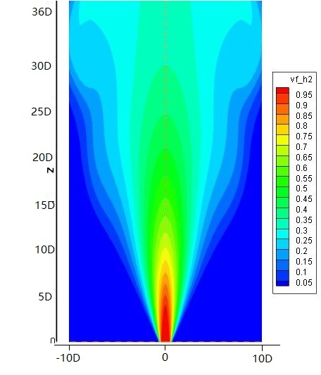
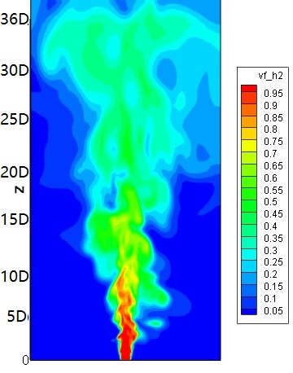
Result- k-ε and DES
z-direction velocity along centerline -time averaged
k-ε Model
DES Model
instantaneous mole fraction of hydrogen
1/vf_{h2} along centreline- time averaged
Notes:
As a RANS-based turbulent model, all turbulence information is modelled in k-ε Model. Therefore, in k-ε simulation, the turbulent vortexes are averaged, and the mole fraction of hydrogen is symmetrical in theta-direction for an instantaneous result.
As for DES simulation, the results show the characters of both LES model and k-ε Model. near the inlet, the hydrogen distribution is similar to the LES simulation, while at the far field, the instantaneous result reveals the symmetric distribution similar to k-ε simulation. While for both of these two model, the calculation result have good agreement with the experiment data.

Slide 15
Outlines
Introduction
Modeling of Spent fuel compartment
Accident sequence analysis
Conclusions
Notes:
This is the outline of my presentation.

Slide 16
Conclusion
We validate the CFD code GASFLOW-MPI with the small-scale hydrogen release experiment to evaluate the code performance for buoyancy jet and turbulence mixing.
Three different turbulent models are discussed, i.e. LES model, DES model and k-ε Model.
Several quantities of interest are obtained to compare with experimental data.
The good agreement between the numerical results and the experimental data indicates that GASFLOW-MPI can successfully simulate hydrogen turbulent dispersion driven by both momentum and buoyant force.
k-ε and DES model are sufficient for industrial applications, while, LES model can be adopted to study detail behaviour for a jet/plume such as entrainment.

Slide 17
Thank you for your attention !
Any question ?
yabing.li@partner.kit.edu

