Slide 1

MODELING OF HYDROGEN PRESSURIZATION AND EXTRACTION IN CRYOGENIC PRESSURE VESSELS DUE TO VACUUM INSULATION FAILURE.
Julio Moreno-Blanco, Francisco Elizalde-Blancas,
Armando Gallegos-Muñoz, Salvador Aceves
7th International Conference on Hydrogen Safety (ICHS 2017)
September, 11-13 2017 - Hamburg (Germany)

Slide 2
Overview
1.- Background
2.- Objective
4.- Modeling
5.- Results and Discussion
6.- Summary

Slide 3
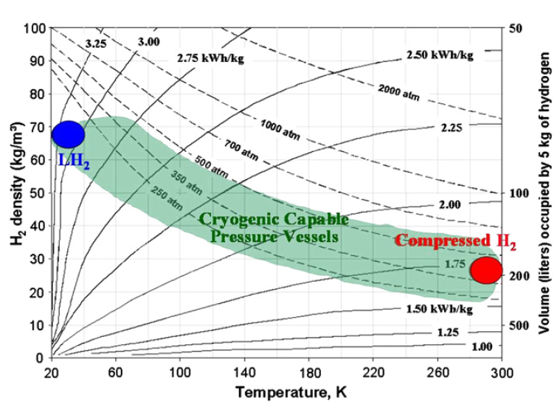
In comparison to hydrocarbons,
H₂ storage and delivery are challenging
Heat transfer is reduced until 1-3 W/m²
Commercial automotive hydrogen storage technologies are shown in a phase diagram².
Generation 2 cryogenic pressure vessel¹
The storage method will be determined by the final application, and must be cost competitive.
Cryogenic pressure vessels enable substantial reduction or elimination of H₂ losses.
¹S. M. Aceves, F. Espinosa-Loza, E. Ledesma-Orozco, T. O. Ross, A. H. Weisberg, T. C. Brunner, O Kircher, High-density automotive hydrogen storage with cryogenic capable pressure vessels, , International Journal of Hydrogen Energy 35 (2010) 1219–1226

Slide 4
We analyze safety implications of loss of cryogenic vessel vacuum insulation leading to ~100X increased heat transfer rate
In this paper we consider a previously unexplored safety aspect of cryogenic pressure vessels: the failure or leakage of the outer metallic jacket with the consequent loss of vacuum and sudden increase (~100X) in heat transfer from the environment.
Under these conditions, it is possible that a fraction of hydrogen may need to be released to the environment in order to avoid exceeding the MAWP.
Release of hydrogen could result in a dangerous situation if it occurs when the vehicle is parked in an enclosed space (e.g., a garage or tunnel)
It could be possible to consume the hydrogen in the vehicle fuel cell and dissipate the electricity generated by operating the vehicle accessories (mainly the air conditioning)

Slide 5
We model heat transfer and pressurization in cryogenic vessel subsequent to vacuum loss
Table 1. Specifications of the high-pressure inner vessel (from commercially available vessel ALT 890, Worthington).
ALT 890 Worthington
External diameter | 333 mm
Length | 1778 mm
Internal volume | 113.1 Lt
Mass | 181.18 Lb (82.184 kg)
Maximum operation pressure (MOP) | 350 bar
Maximum allowable working pressure (MAWP) | 437 bar
Weigth fraction of aluminum and composite | 50 % Al y 50% comp.
Vacuum insulation thickness | 2 cm
Schematic of cryogenic pressurized hydrogen storage system.

Slide 6
Loss of vacuum will demand rapid H₂ extraction to avoid exceeding vessel MAWP
We calculate the hydrogen extraction rate according to two different strategies:
Initiate hydrogen extraction immediately upon vacuum vessel failure.
This strategy minimizes hydrogen extraction rate,
vacuum sensors or continuous monitoring of pressurization rate to determine vacuum failure are necessary.
Wait until the vessel reaches MAWP before starting hydrogen extraction.
Requires faster hydrogen extraction,
it does not require sensors or calculations

Slide 7
Thermodynamic modeling of cryogenic vessel heating uses REFPROP property data programmed into Matlab
Thermodynamic model
Energy equation
Closed system:
Open system:
Vessel internal energy:
Mass conservation:
Heat transfer to the inner vessel:

Slide 8
H₂ extraction and consumption rate in fuel cell depends on fuel cell efficiency and accessory electricty consumption
PEM Fuel Cell Modeling
Efficiency:
Electric power output:
Heating power of inlet fuel:
Hydrogen mass flow rate:
36% fuel cell efficiency based on H2 HHV

Slide 9
At maximum refuel density (70 g/L), the vessel reaches MAWP in ~2 hours
Pressurization without hydrogen release
The maximum hydrogen density that will not exceed the MAWP is 27.4 kg/m³
Hydrogen pressure as a function of density when the vessel reaches thermal equilibrium with the environment at 300 K.
At 300 bar and 70 kg/m³, it would be necessary to release 4.81 kg of hydrogen to complete the process and ensure that the MAWP will not be exceeded

Slide 10
If H₂ extraction initiates upon vacuum loss (Strategy 1),
454 g/h need to be extracted to avoid exceeding MAWP
Strategy 1. Heating with immediate hydrogen extraction
2.7 hours after hydrogen extraction has started
The minimum output power to avoid exceeding the MAWP is 6.5 kW
(hydrogen extraction rate = 0.454 kg/h )
Vessel initially filled to 300 bar and 70 g/L, considering that H₂ extraction begins at the moment of vacuum insulation failure (Strategy 1).

Slide 11
If H₂ extraction initiates upon reaching MAWP (Strategy 2),
756 g/h need to be extracted to avoid exceeding MAWP
Strategy 2. Heating with extraction at maximum allowable working pressure
40 minutes since vacuum insulation failure
10.8 kW of fuel cell output power is the minimum necessary to avoid exceeding the MAWP.
(0.756 kg/h extraction rate)
Vessel initially filled to 300 bar and 70 g/L, considering that H₂ extraction begins at the moment of reaching MAWP (Strategy 2).
This output power is 40% higher than one in the Strategy 1.

Slide 12
Immediate H₂ extraction maintains vessel below MAWP at reduced fuel cell power (6.5 kW) but demands vacuum failure sensor
Comparison between the two strategies
Strategy 1 vs Strategy 2
6.5 kW 10.8 kW
*Air conditioning can consume 1-4 kW
Convergence 2 hours and 40 minutes after vacuum failure
Strategy 1
Surplus electricity could then be used for charging the battery
Strategy 2
Electrical resistances to consume all the electricity
Immediate H₂ extraction (Strategy 1, solid lines), and H₂ extraction at MAWP (Strategy 2, dotted lines)
The final decision will depend on the economical balance between both strategies.

Slide 13
H₂ extraction rate (and fuel cell power) is a strong function of initial fill density (6.5 kW @ 70 g/L vs. 0.5 kW @ 35 g/L)
Effect of fill density on H2 extraction rate and fuel cell output power
Strategy 1
Strategy 2
6.5 kW at 70 g/L → 0.5 kW at 35 g/L
10.8 kW at 70 g/L → 1 kW at 35 g/L

Slide 14
We have modeled the safety consequences of vacuum insulation failure in cryogenic pressure vessels
We have analyzed a critical subject for the safety of future vehicles powered by H₂ stored in cryogenic vessels: the possible consequences of vacuum insulation failure when the vehicle is in a closed space (e.g. in a garage or a tunnel).
Using a lumped thermodynamic model and taking into account non-ideal properties of hydrogen, we have calculated H₂ extraction rates from the cryogenic vessel, considering the most critical case in which the vessel is initially full at its maximum capacity (300 bar and 70 g/L).
Instead of releasing H₂ to the environment, which could potentially lead to ignition, we consider the possibility of consuming the extracted H₂ in the fuel cell and using the generated electricity to operate the vehicle accessories (mainly the air conditioning).

Slide 15
Safe operation is demonstrated: Even at maximum fill density, fuel cell can consume H₂ at the necessary rate to avoid exceeding MAWP
Two strategies were analyzed: in the first, H₂ extraction begins at the moment of vacuum system failure. In the second, H₂ extraction begins when the vessel reaches the maximum allowable working pressure (MAWP).
The first strategy results in slower extraction rate, but requires sensors or computational strategies that can detect the failure of the vacuum system.
The results indicate that the thermodynamic advantage of cryogenic pressure vessels capable of containing H₂ and releasing it at a relatively high temperature results in low hydrogen extraction rates that can be consumed by a fuel cell (6.5 and 10.8 kW of electric power) without the need to release hydrogen to environment.
Both strategies are thus feasible and the final decision depends on the economical balance between incorporating a system to detect the failure of the vacuum system, and additional electric resistances to dissipate electricity.

Slide 16
Thanks for your attention!!

