Slide 1
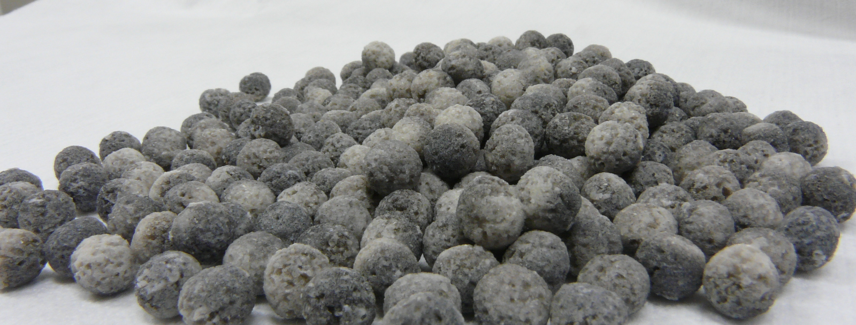
Humidity Tolerant H₂-O₂ Recombination Catalysts for H₂ Safety Applications
ICHS-2017, Hamburg, Germany L. Gardner (lee.gardner@cnl.ca),
2017-09-13 A. Vega, R. Tremblay, S. Suppiah,
D. Ryland
Notes:
For best results, please send the large top image to the back layer. Choose “Arrange” then select “Send to Back”.

Slide 2
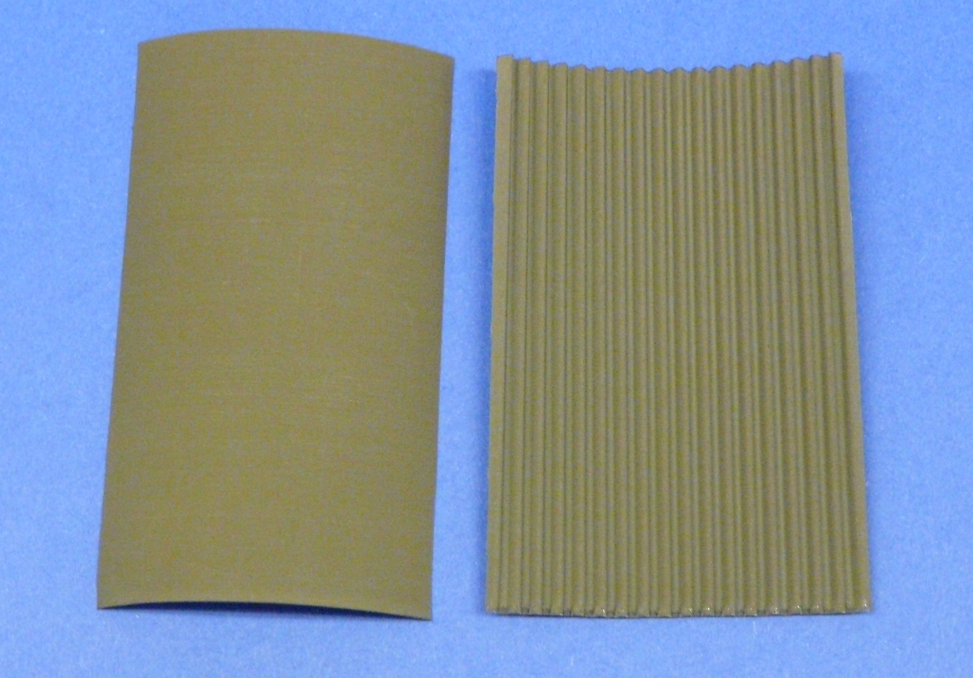
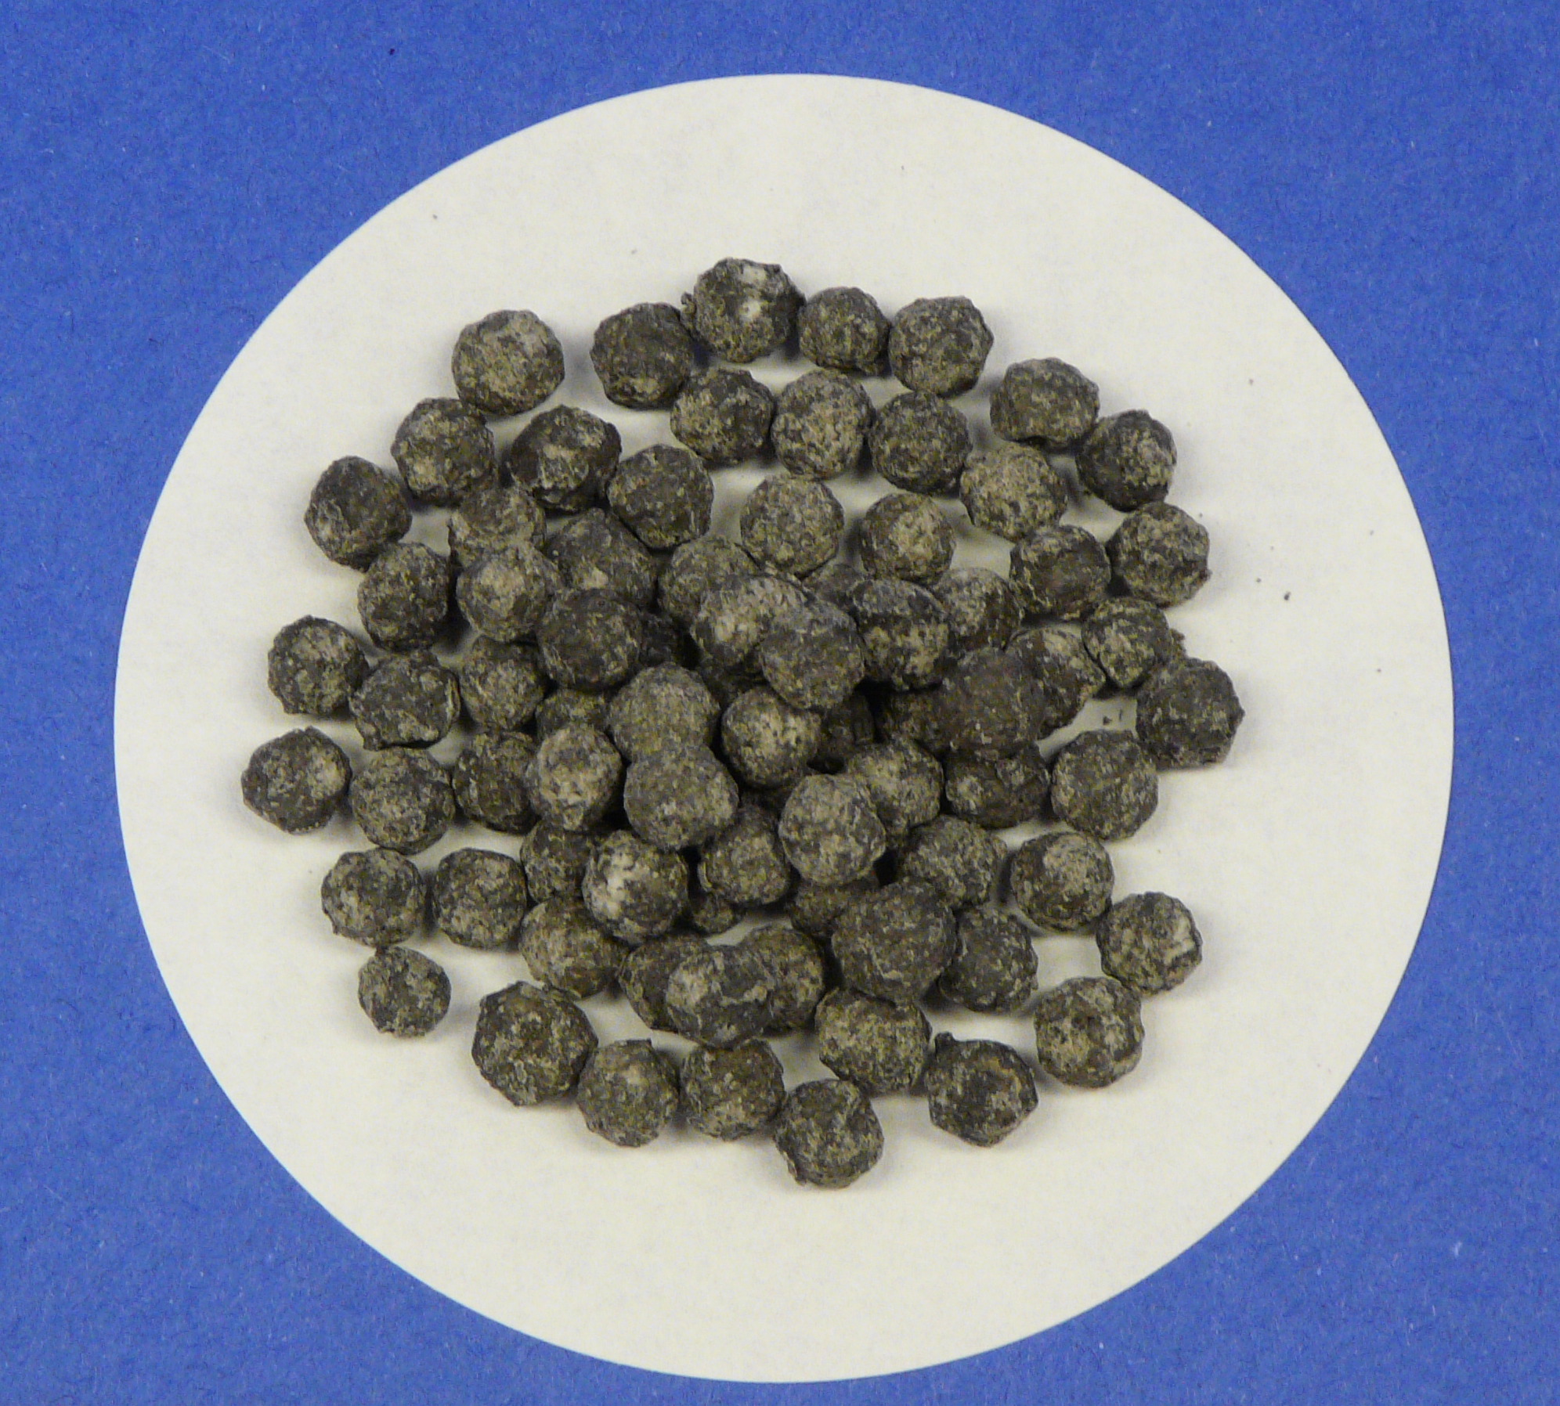
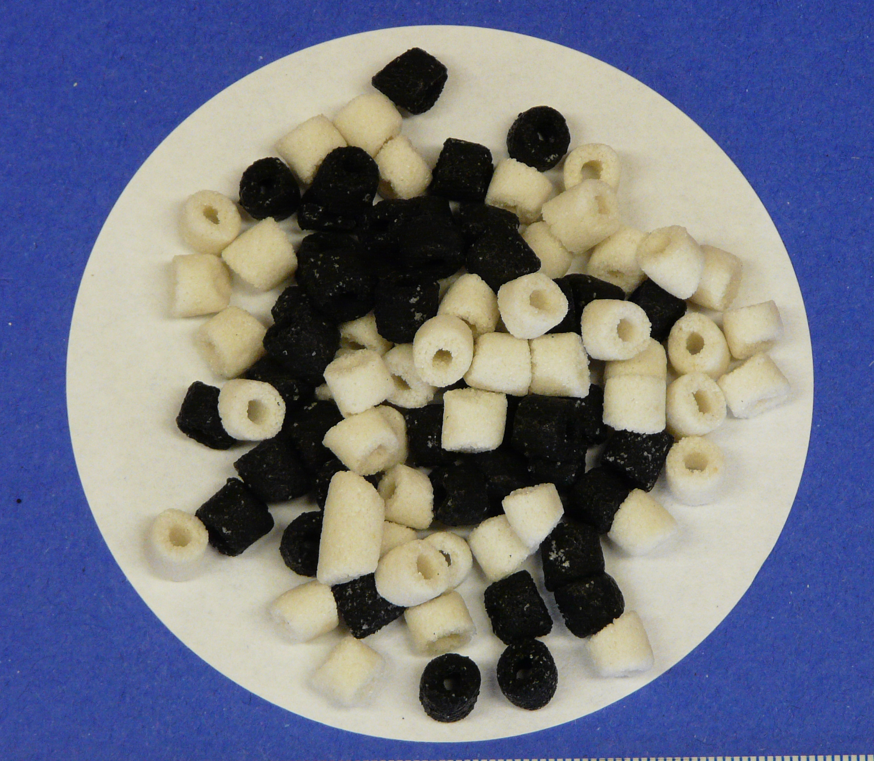
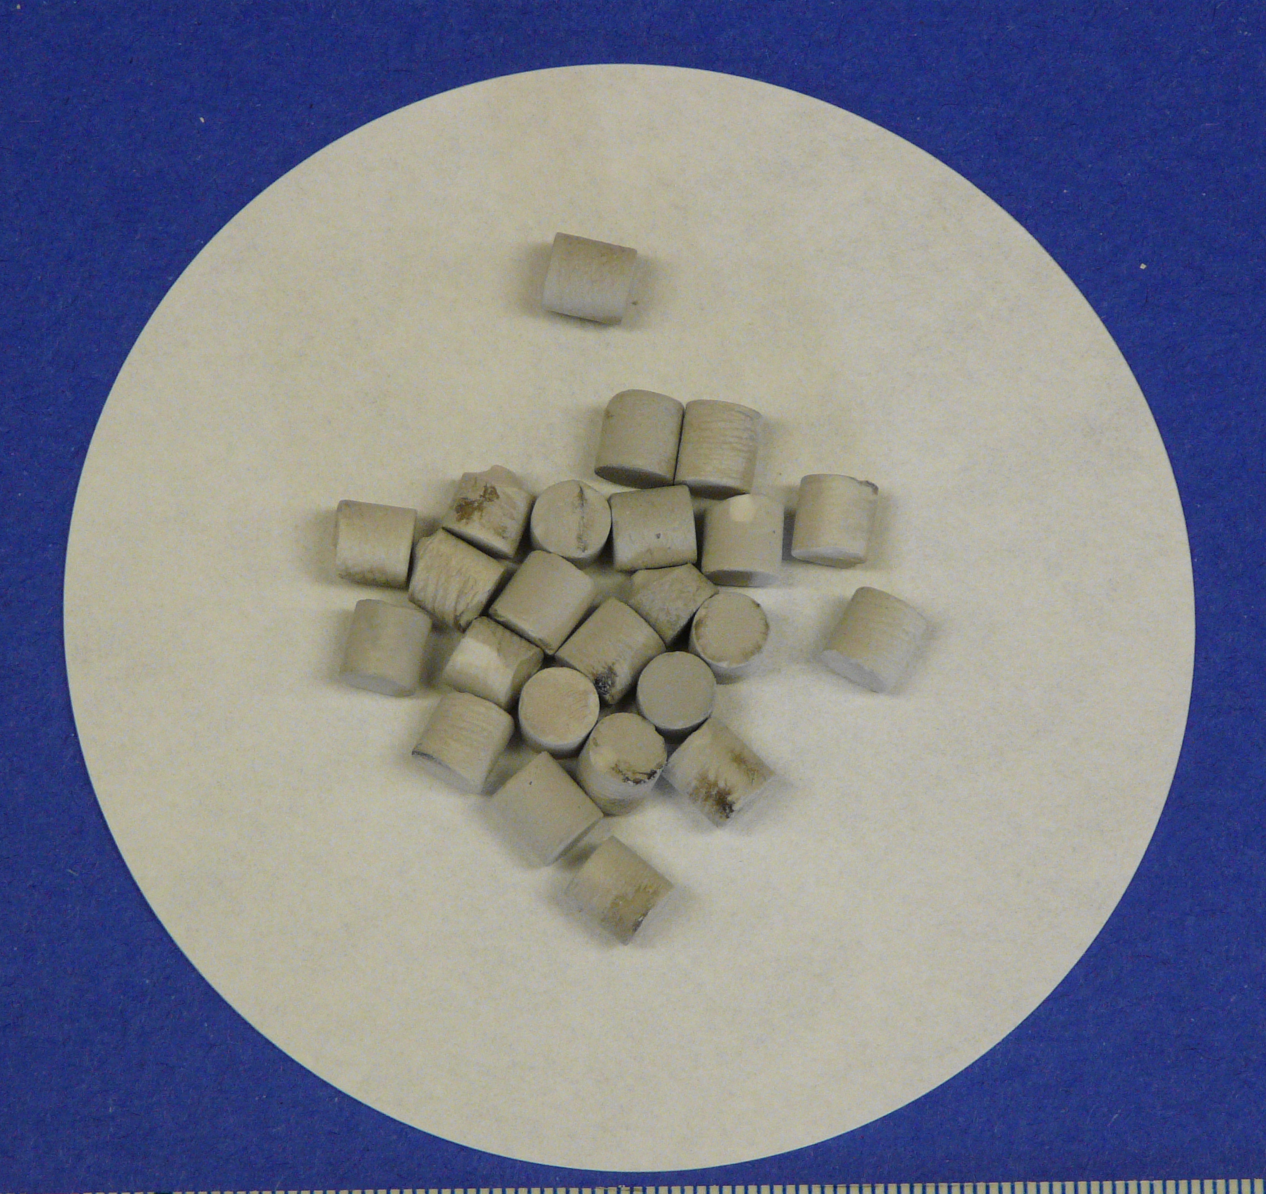
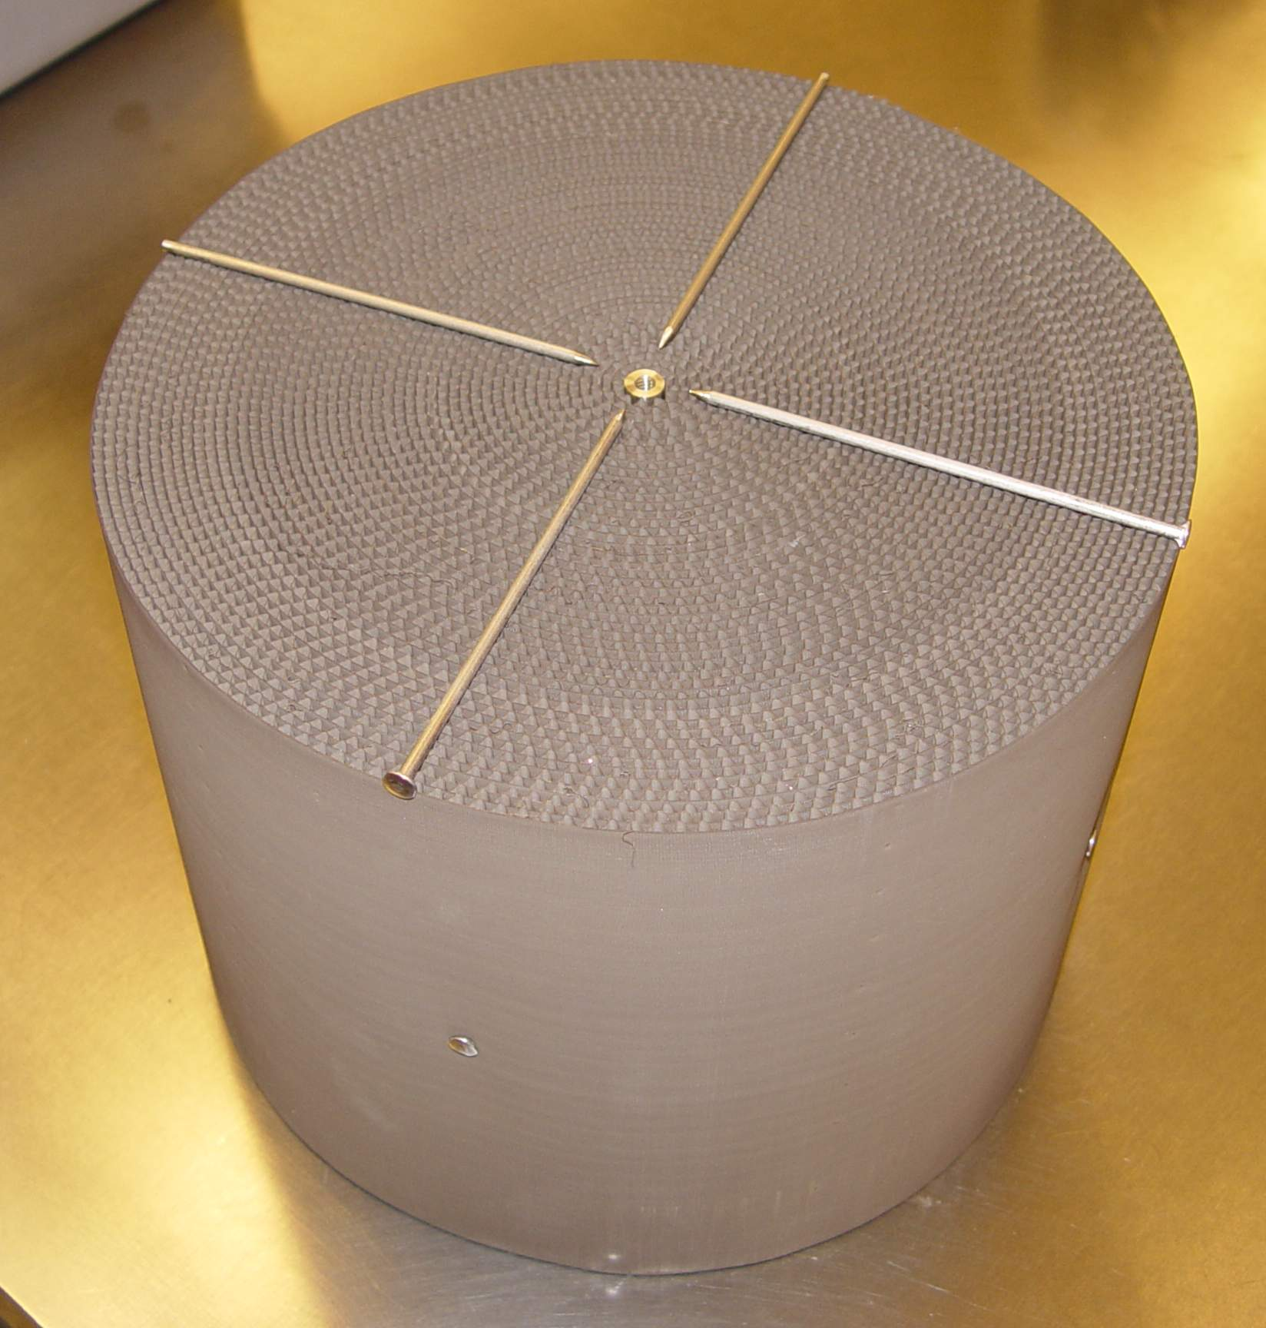
Overview
Introduction & Background
Applicability of CNL’s Recombiner Catalyst
Preliminary Catalyst Testing
Application Specific Catalyst Testing
Future Work

Slide 3
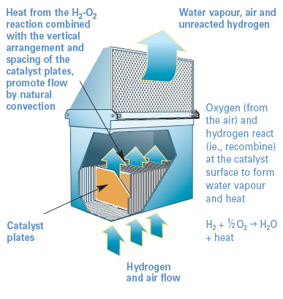
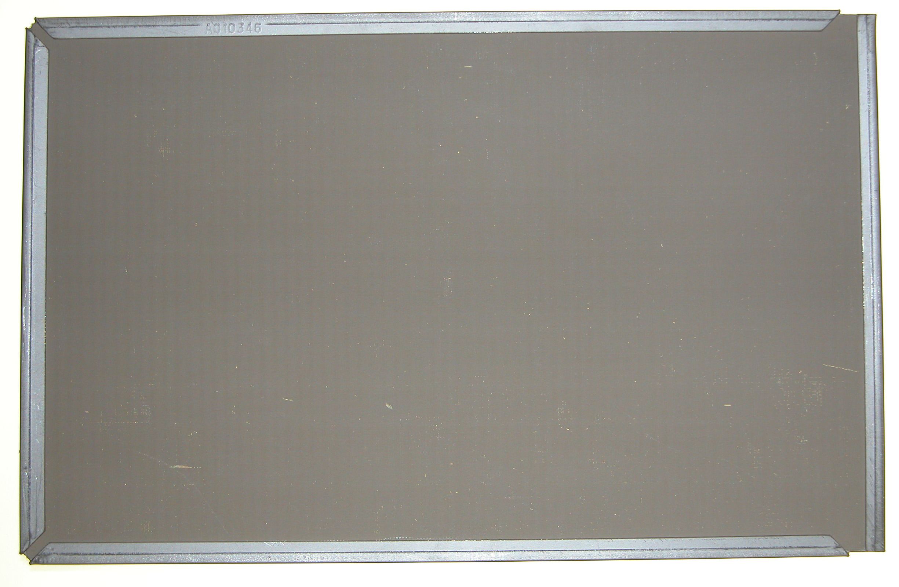
Introduction & Background
CNL investigated potential applications for H₂ recombiners
Radioactive waste storage was targeted due to applicability of the catalyst
H₂ is produced through water radiolysis and corrosion reactions
Typical storage tanks are vented to atmosphere
Active ventilation = significant engineering costs
Passive Autocatalytic Recombiner (PAR)

Slide 4
Applicability of CNL’s H₂ Recombiner Catalysts
Comparison between Catalyst Capabilities and Waste Storage Conditions
Condition | Radioactive Waste Storage | CNL’s H₂ Recombiner Catalysts
Temperature | 16 - 61⁰C | ≥ 10⁰C
Humidity | Close to atmospheric | 100% relative humidity
Liquid water | Potential splashes | Some catalysts can survive
Radiation | Some radiation fields depending on the tank | Most catalysts have been qualified
Contaminants | Nitrous Oxide Ammonia Carbon Monoxide VOCs | Small amount of test data on CO and VOCs available for some catalysts
Proposed: Position catalyst in tank head space to allow free contact with gas. Provide sufficient catalyst to maintain the H₂ concentration below the LFL.

Slide 5
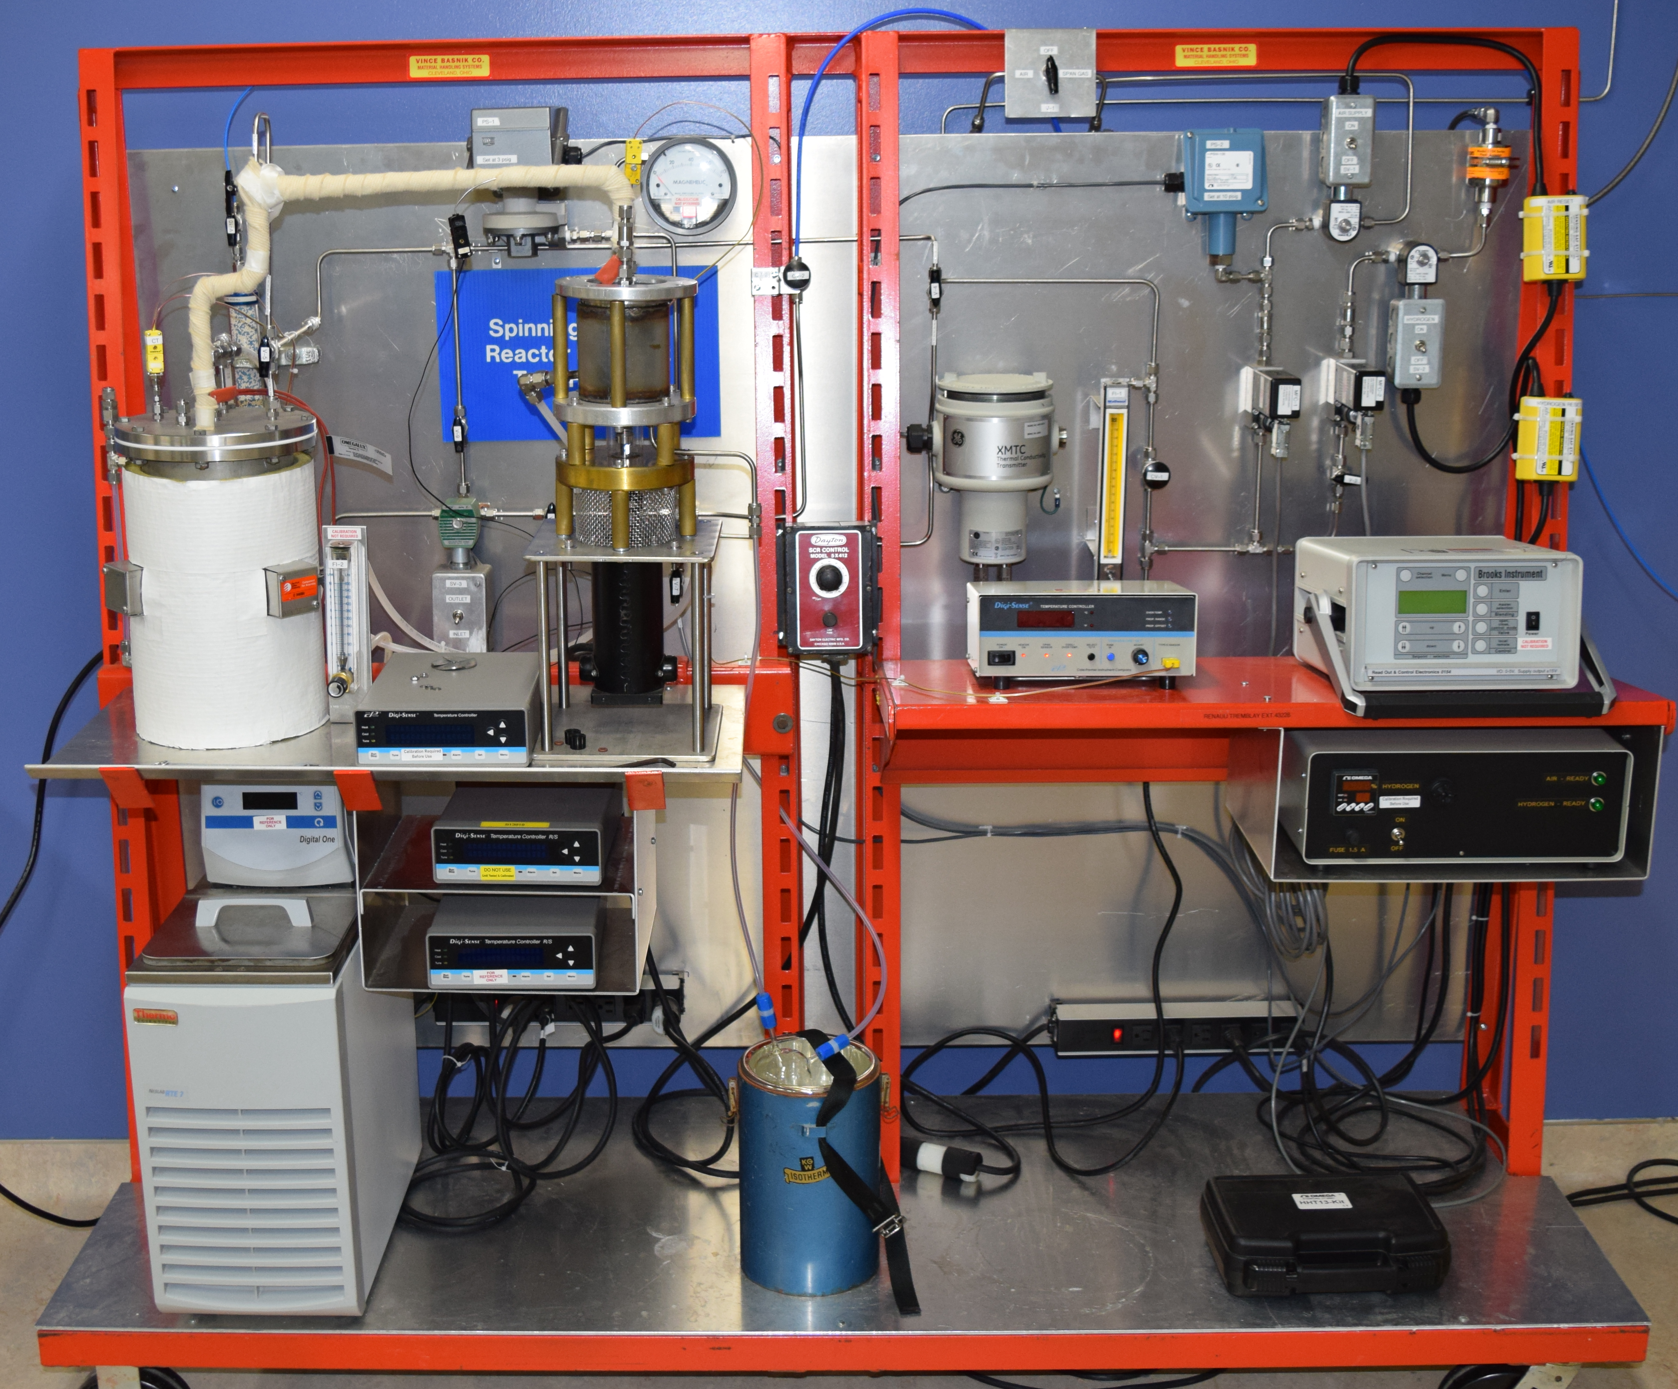
Preliminary Catalyst Testing – SBR
SBR is typically used by CNL to benchmark recombiner catalyst formulations
Continuous Stirred Tank Reactor (CSTR) with small amount of catalyst and H₂ to study reaction kinetics
SBR test is short (~ 2 h)
Performed two tests on each catalyst:
  Dry condition
  Wet condition (soaked in DI water for 1 h prior to testing)

Slide 6
Preliminary Catalyst Testing - Selection
After numerous tests, five catalyst formulations were selected
Catalyst Formulation | Structure | Catalyst Support | Active Metal | Active Metal Concentration* | Wetproofing Agent Concentration*
CatA (baseline catalyst) | 6 mm spheres | SiO₂ | Pt | 1.0 | 1.0
CatB | 6 mm spheres | TiO₂ | Pt | 0.8 | 0.5
CatC | 6 mm spheres | TiO₂ | Pt | 0.7 | 1.1
CatD | 6 mm rings | TiO₂ | Pt | 0.8 | 0.5
CatE | 6 mm rings | Carbon | Pt | 1.6 | 0.3
* Concentration values have been normalized to baseline catalyst values

Slide 7
Preliminary Catalyst Testing - Results
* Recombination rate values have been normalized to baseline catalyst values

Slide 8
Application Specific Catalyst Testing
A thorough investigation is needed under anticipated radioactive waste storage conditions to confirm the catalyst will maintain its performance
Trickle Bed Recombiner (TBR): investigate the catalyst hydrophobicity
Gas Phase Recombiner (GPR): investigate catalyst performance under forced flow and low O₂ conditions
Catalyst Activity Bench Scale (CABS) system: investigate the effects of contaminants on the catalyst
Oxygen
Cooling Water
Hydrogen
Excess
Water
‘Random’
Recombiner
Catalyst
Vent/Analysis
Water
Heat Exchanger
Trickle Bed Recombiner (TBR)

Slide 9
Trickle Bed Recombiner Tests
Only CatA (baseline), CatB (TiO₂ w/low wetproofing), CatC (TiO₂) were tested due to their geometry
Test conditions:
  Slightly above stoichiometric H₂/air
  Catalyst temperature maintained at 60°C
  Total flow = ~3 L/min
Notes:
Only CatA (baseline), CatB (TiO₂ w/low wetproofing), CatC (TiO₂) were tested due to their geometry
CatC had better performance than CatB likely due to higher wetproofing
CatA outperformed the TiO₂ catalysts likely because of the support’s
TBR tests contradict the SBR tests

Slide 10
Gas Phase Recombiner Tests
Tests performed in a 2 inch column at 25°C, 15 psig and dry conditions
High H₂ – Low Air (H₂ Purifier)
  Tests conditions: 15–60 L/min, 500–10,000 ppm O₂
  Conversion results: CatE > CatD > CatA
  When normalized to Pt content, CatD (Pt/TiO₂) has highest recombination rate in most conditions
Low H₂ – High Air
  Tests conditions: 5-40 L/min, 500-20,000 ppm H₂
  CatD (Pt/TiO₂) performs better in all conditions for H₂ recombination
Analysis/
Vent
Recombiner
Catalyst
Hydrogen
Oxygen/Air
Mixing
Vessel
Mixed Gas
Gas Phase Recombiner (GPR)

Slide 11
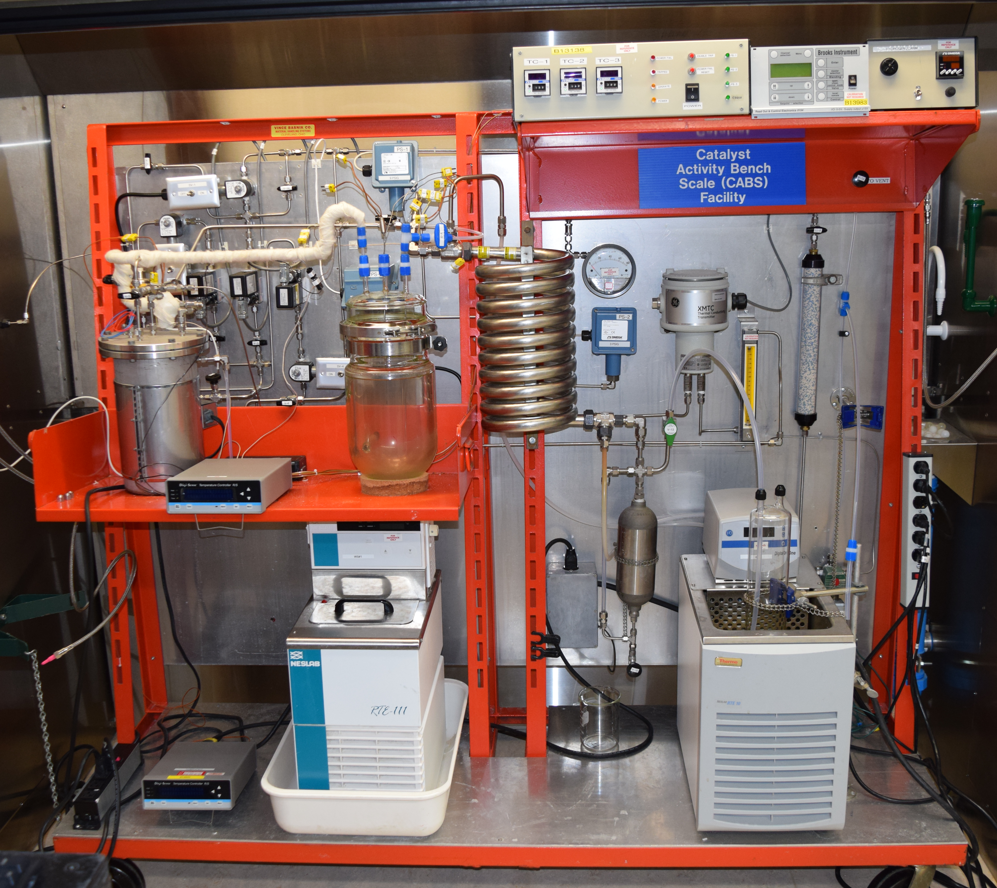
Future Work
Hydrogen
Perform tests in the CABS system with identified contaminants
  Nitrous Oxide
  Ammonia
  Carbon Monoxide
  VOCs
  CatA, CatD and CatE will be tested
  Tests conditions: 3 L/min, 25°C, 2 – 3 vol% H₂, dry and humidified conditions
Air
Analysis/Vent
Contaminant
Mixed Gas
Recombiner
Catalyst

Slide 12
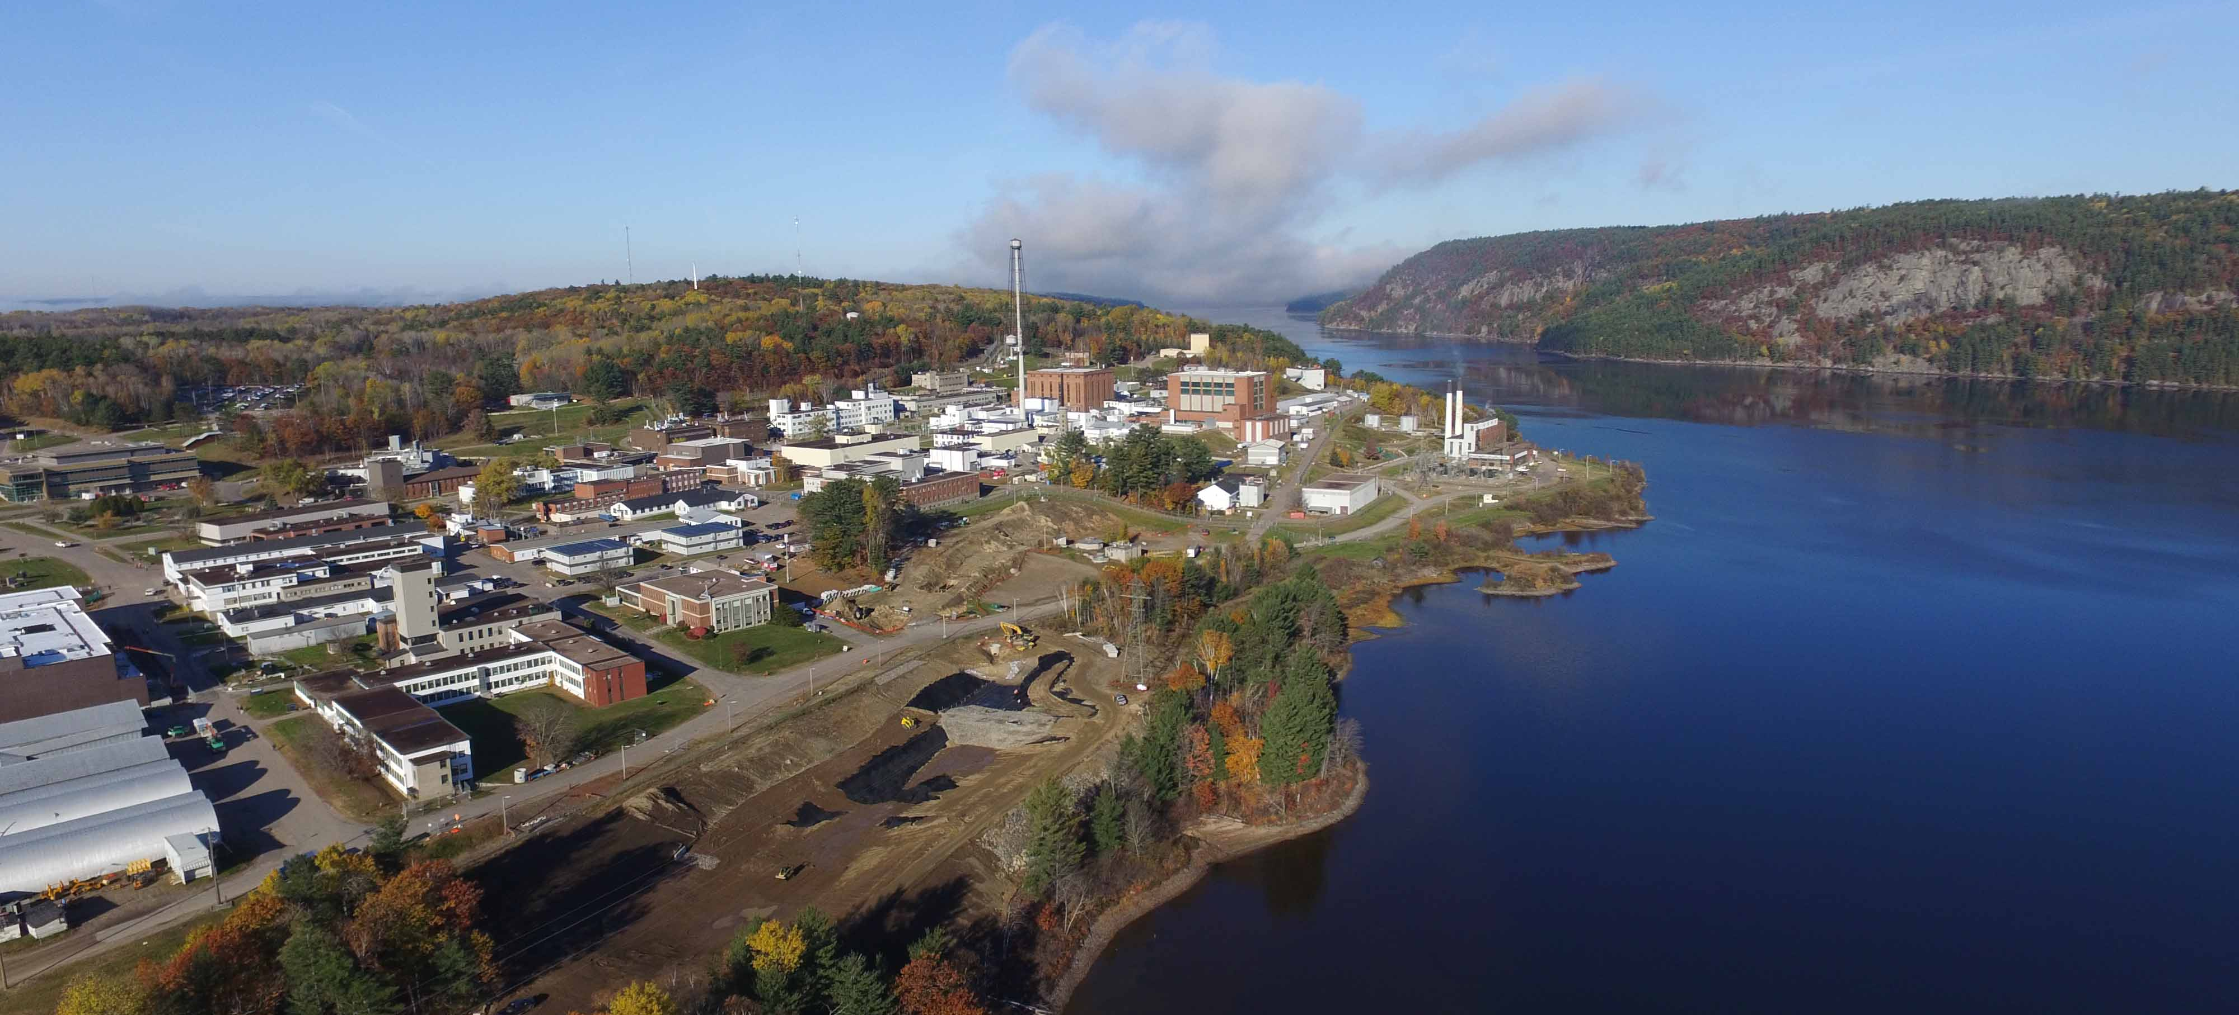

Thank you. Danke.
Questions?
Notes:
For best results, please send the large top image to the back layer. Choose “Arrange” then select “Send to Back”.
This slide is not available in the Master. To add slides to you deck, simply duplicate the slide itself.

