Slide 1
Best practice in numerical simulation and CFD benchmarking. Results from the SUSANA project
Tolias, I.C.¹, Giannissi, S.G.¹, Venetsanos, A.G.¹, Keenan, J.², Shentsov, V. ², Makarov, D. ², Coldrick, S.³, Kotchourko, A.⁴, Ren, K.⁴, Jedicke, O.⁴, Melideo, D.⁵, Baraldi, D.⁵, Slater, S.⁶, Duclos, A.⁷, Verbecke, F.⁷ and Molkov, V. ²
¹ Environmental Research Laboratory, National Centre for Scientific Research Demokritos, Agia Paraskevi, Athens, 15310, Greece, tolias@ipta.demokritos.gr
² HySAFER Centre, Ulster University, Newtownabbey, BT37 0QB, UK, dv.makarov@ulster.ac.uk
³ Health and Safety Executive, Harpur Hill, Buxton, SK17 9JN, UK, Simon.Coldrick@hsl.gsi.gov.uk
⁴ Karlsruhe Institute for Technology (KIT), Kaiserstrasse 12, Karlsruhe, Germany, olaf.jedicke@kit.edu
⁵ European Commission, Joint Research Centre (JRC), IET, Westerduinweg 3, 1755 LE, Petten, Netherlands, daniele.baraldi@ec.europa.eu
⁶ Element Energy Limited, Station Road 20, Cambridge, United Kingdom, shane.slater@element-energy.co.uk
⁷ Areva Stockage d'Energie SAS, Batiment Jules Verne, Domaine du Petit Arbois, Aix-en-Provence, France, audrey.duclos@areva.com

Slide 2
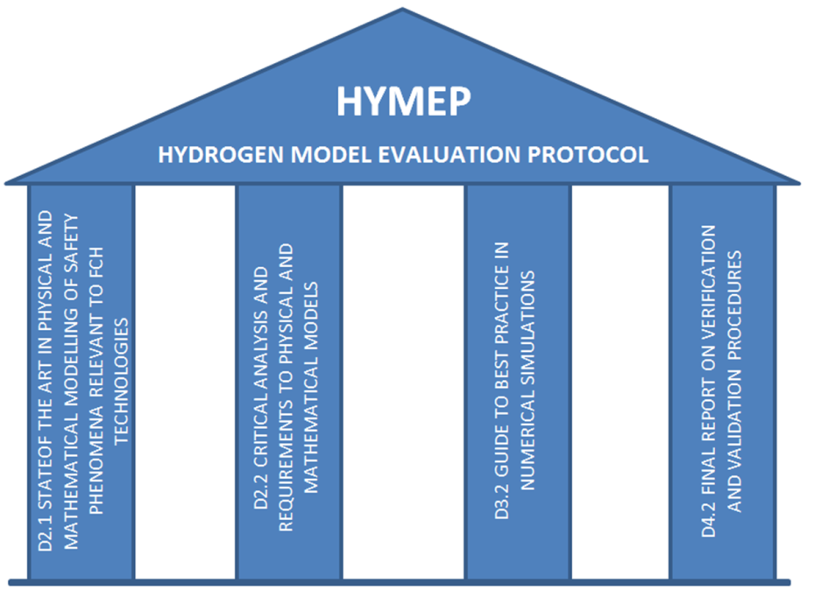
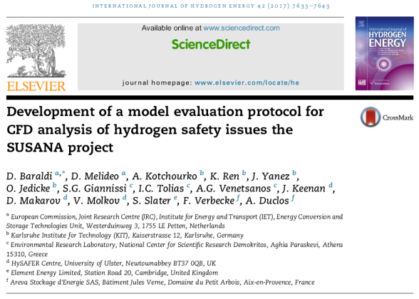
Introduction
SUSANA: SUpport to SAfety ANalysis of Hydrogen and Fuel Cell Technologies (www.support-cfd.eu) Aim: Support stakeholders who use Computational Fluid Dynamics (CFD) for safety engineering design and assessment of FCH systems and infrastructure
State-of-the-art in physical and mathematical modelling
Guide to Best Practice in use of CFD for safety analysis
Verification and validation procedures
Benchmarking
HYMEP (Baraldi et al. 2017)

Slide 3
Benchmarking
Improve the numerical modelling of realistic accident scenarios in hydrogen industry
Comparison of the different methodologies against experiments
Analysis of the suitability of the models for each specific physical process
Inter comparisons of the different methodologies
All phenomena are covered
Release and dispersion
Ignition
Jet fires
Deflagrations
Detonations
Notes:
The aim of the benchmarking is..

Slide 4
Best Practice Guidelines
To apply CFD properly and to provide accurate results, CFD users should follow the correct modelling strategy
A number of Best Practice Guidelines (BPG) for CFD applications have been developed for this purpose in the past
General BPG for industrial CFD simulations (ERCOFTAC, 2000)
CFD in urban environment (COST, 2007)
CFD in nuclear reactor safety applications (OECD, 2007)
Ventilation and gas dispersion in gas turbine enclosures (Ivings et al., 2003)
No BPG for hydrogen

Slide 5
Best Practice Guidelines
Produce a comprehensive publicly available Best Practice Guide on the application of the CFD methodology for safety analysis of Fuel Cells and Hydrogen (FCH) installations/ technology
Provide support on the correct application of the CFD methodology to
CFD users (industry/research) and stakeholders (industry/regulating officials)
Other on-going hydrogen safety related projects
The reader is introduced to the appropriate modelling approach and by following this, improve the accuracy and fidelity of their modelling

Slide 6
Best Practice Guidelines
Chapters of BPG (all related phenomena are covered)
Chapter 0: Introduction
Chapter 1: Hydrogen release and dispersion
Chapter 2: Ignition and jet fires
Chapter 3: Deflagrations
Chapter 4: Detonations
Chapter 5: CFD User Education and Training
Chapter 6: Appendix (Sample Cases)
Structure of each Chapter (all aspects of CFD simulations are covered)
Selection of physical models
Problem setup (geometry, mesh, initial and boundary conditions)
Numerical options (solver type, spatial and temporal discretization schemes, convergence criteria)
Analysis of the simulation results (validation, sensitivity and interpretation of the results)
Total number of pages: 235
Notes:
Covers all related phenomena: release, dispersion, ignition, fire, deflagration, detonation
All general aspects of CFD simulations

Slide 7
Best Practice Guidelines
General BPG
High quality mesh (expansion factor, cell aspect ratio, cell skewness)
Enhance accuracy and assist numerical convergence
Grid independency study
At least three different grid sizes should be tested
Ideally, each finer grid should have double the number of cells
Computational domain
Domain boundaries should be located far enough in order to minimize the impact of the boundary conditions on the results, e.g. away from vents
A domain size sensitivity study should be performed
Time step
Sensitivity study (a factor of two smaller time is recommended)
LES: small time step sizes corresponding to CFL<1 are suggested
Notes:
A grid independence study is very important because results with coarse grids can be misleading

Slide 8
Best Practice Guidelines
General BPG
Numerical scheme
High-order accuracy numerical schemes are recommended in order to decrease numerical diffusion - necessary for complex flows such as impinging jets and deflagrations
LES: central differences schemes because upwind-biased schemes suppress turbulence
Scalar conservation equation: Total Variation Diminishing (TVD) scheme should be used in order to ensure a bounded solution
Notes:
A grid independence study is very important because results with coarse grids can be misleading

Slide 9
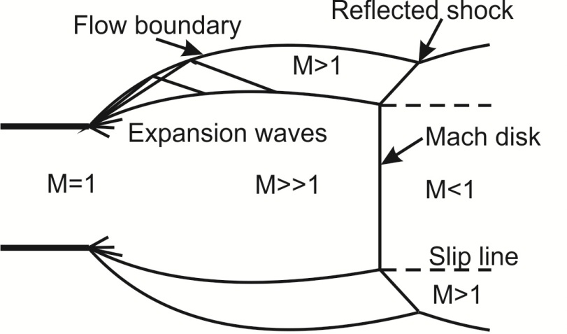
Release and dispersion: Best Practice Guidelines
High-pressure jet releases
For practical applications involving high pressure releases (above 1.9 times P_{atm}) notional nozzle approaches, are recommended:
Reasonable results avoiding the high computational cost of resolving directly the complex flow structure near the nozzle
For low storage pressures the approach of Birch et al. (1987) can be applied
For high storage pressures (above 10-20 MPa) where the ideal gas assumption becomes less valid, the Schefer et al. (2007) or Molkov et al. (2009) are recommended
Modelling the transient blowdown from a storage vessel requires a transient implementation of the notional nozzle approach

Slide 10
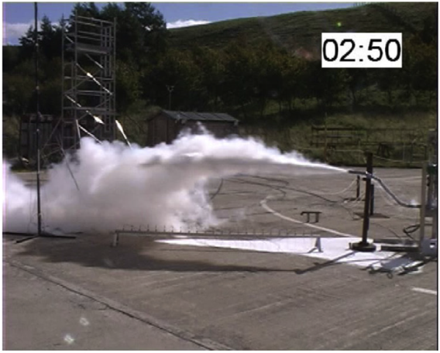
Release and dispersion: Best Practice Guidelines
Liquid hydrogen (LH2)
Isenthalpic or isentropic expansion can be assumed to estimate the flashed vapor fraction at the inlet
Various modelling approaches:
Mixture approach
Thermal equilibrium between phases => phase distribution using Raoult’s law
Conservation equations for the mixture and total hydrogen mass (vapour + liquid) with or without slip velocities
Multi-fluid approach
Separate conservation equations for each phase
Heat transfer modelling from the ground is important for LH2 releases near ground (film boiling phenomena)
Ambient air humidity condensation and nitrogen, oxygen liquefaction due to cryogenic temperatures may affect hydrogen dispersion

Slide 11
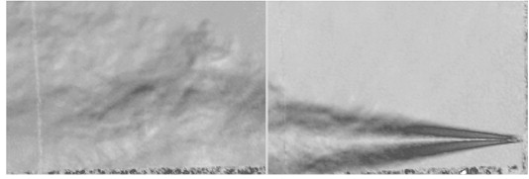
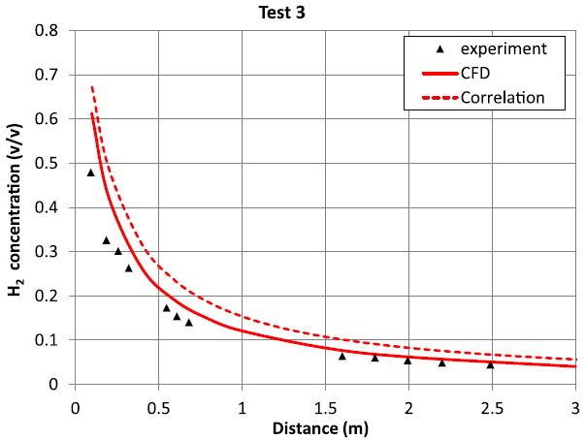
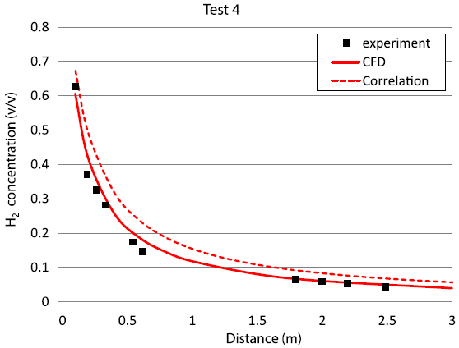
Release and dispersion: Benchmark
Benchmark experiment: KIT (Veser et al. 2011)
Cryo-compressed hydrogen
Horizontal jet releases in closed facility
Simulation (Venetsanos & Giannissi 2017):
Sensitivity studies: Domain size, CFL number, number of cells
3rd order numerical scheme (QUICK)
Birch (1987) notional nozzle approach
Good agreement with the experiment
Veser, A., Kuznetsov, M., Fast, G. et al., The structure and flame propagation regimes in turbulent hydrogen jets, Int. J. Hydrogen Energy, 36 (3), 2011, 2351-59
Venetsanos, A.G., Giannissi, S.G., Release and dispersion modeling of cryogenic under-expanded hydrogen jets, Int. J. Hydrogen Energy, 42 (11), 2017, 7672-82

Slide 12
Ignition and jet fire: Best Practice Guidelines
Sudden release of hydrogen gas from a high pressure reservoir Auto-ignition Jet fire
Auto-ignition modelling: Simulation of shocks, small scale turbulent mixing and shock wave/vortex interactions
Very dense mesh
Highly accurate numerical methods
Various strategies of modelling
2D DNS or LES models: Limited to simplified axi-symmetrical geometry.
3D LES models:
More realistic geometries
Accurate combustion models, such as EDC with detailed chemistry

Slide 13
Ignition and jet fire: Best Practice Guidelines
Jet fire modelling
Under-expanded jets for compressed hydrogen
Notional nozzle approach
Combustion modelling
Simplified EBU/EDM models
limited to well-ventilated fires
Flamelet model
EDC with detailed chemistry
more accurate
larger computational requirements

Slide 14
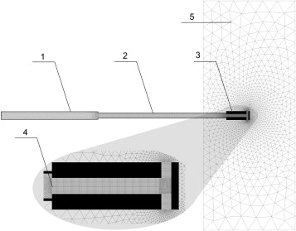
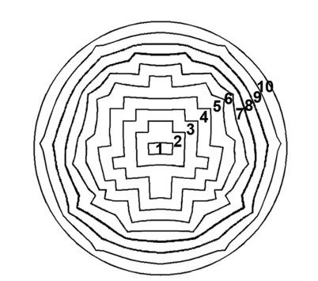
Ignition and jet fire: Benchmark
Spontaneous ignition in Pressure Relief Device (PRD), (Bragin et al. 2013)
LES modelling
EDC with detailed chemistry
Step-like approximation of the membrane burst process
External domain
High pressure tubes
PRD
Burst disk
Bragin, M.V., Makarov, D.V. and Molkov, V.V., Pressure limit of hydrogen spontaneous ignition in a T-shaped channel, Int. J. Hydrogen Energy, 38, No. 19, 2013, pp. 8039–8052

Slide 15
Ignition and jet fire: Benchmark

Slide 16
Deflagration: Best Practice Guidelines
Unfortunately, there is no modelling approach which is clearly superior to all others and applicable to all circumstances
complex interactions between the turbulent flow field and combustion chemistry
Instabilities (Darrieus-Landau, Rayleigh-Taylor e.t.c.)
very wide-range of applications (open deflagrations, vented deflagration, congestion)
BPG
The self-similar flame acceleration should be addressed in the model
Vented deflagration: accurate prediction of the intensity of the external explosion
Obstacles which influence the flame but are too small (PDR - Porosity Distributed Resistance models)
Non-uniform concentration
Equivalent uniform stoichiometric volume method

Slide 17
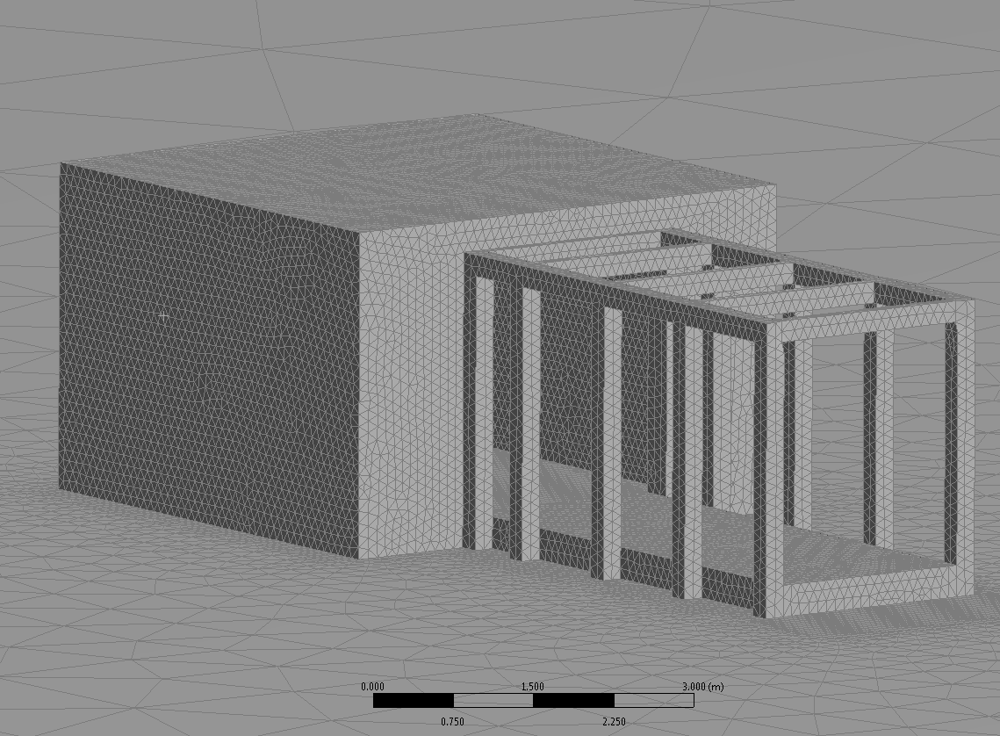
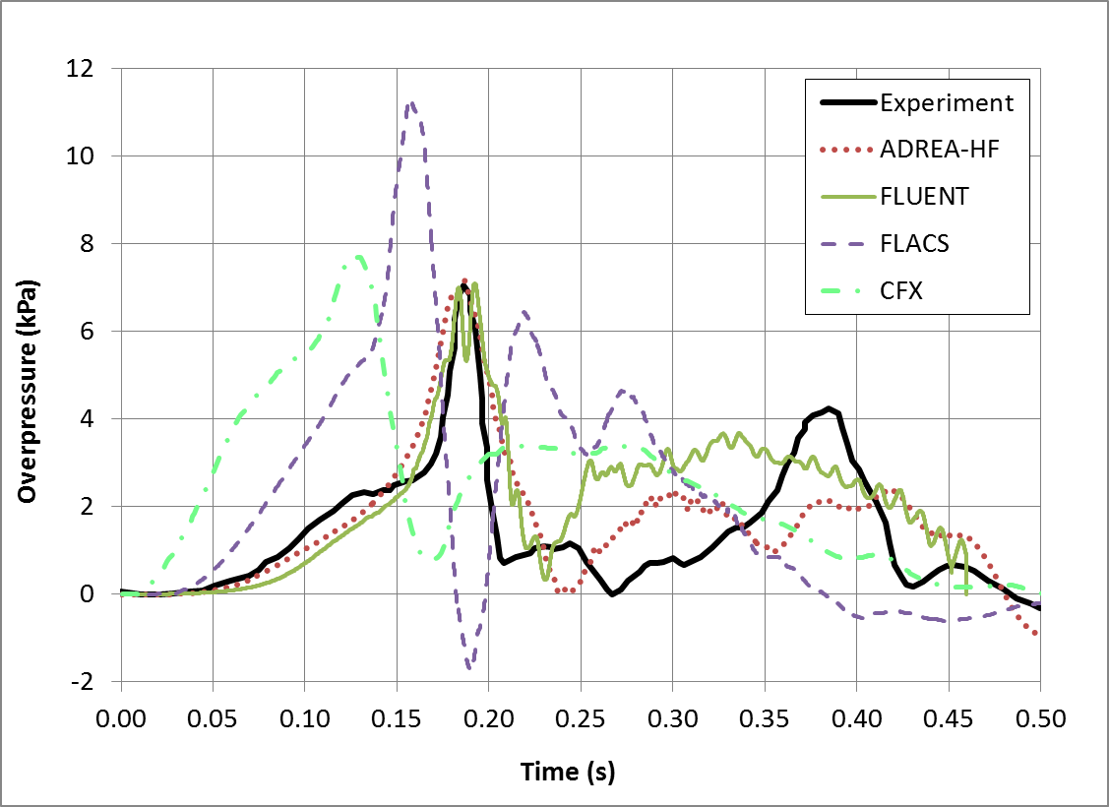
Deflagration: Benchmark
FM-Global experiment
Dimensions 4.6×4.6×3.0 m
Central ignition, 5.4 m² vent
Simulation using four codes
ADREA-HF
FLUENT
FLACS
CFX

Slide 18
Detonation: Best Practice Guidelines
Detonation modelling
Arrhenius law: The reaction zone must be resolved. Large number of cells must be placed inside it.
Heaviside detonation model: A specific model designed for under-resolved simulations, in which space resolution requirements cannot be satisfied, as it happens in most engineering and safety simulations
It assumes an infinitively fast chemical reaction
LES model based on progress variable equation
Does not require detailed chemistry
Detonation velocity can be pre-calculated
Computational cell size depends on the choice of chemical model:
Detailed chemistry model: 1 to 10 µm
One step Arrhenius model: 1 mm
Heaviside model: 0.1 m

Slide 19
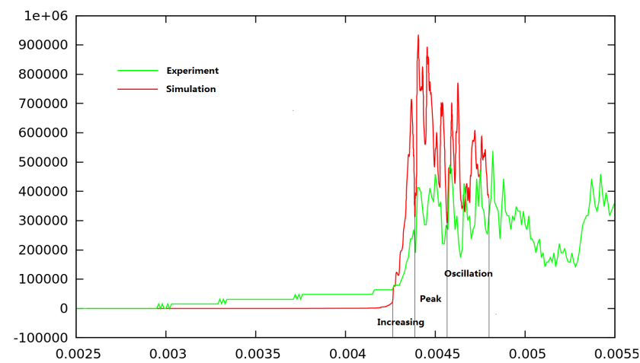
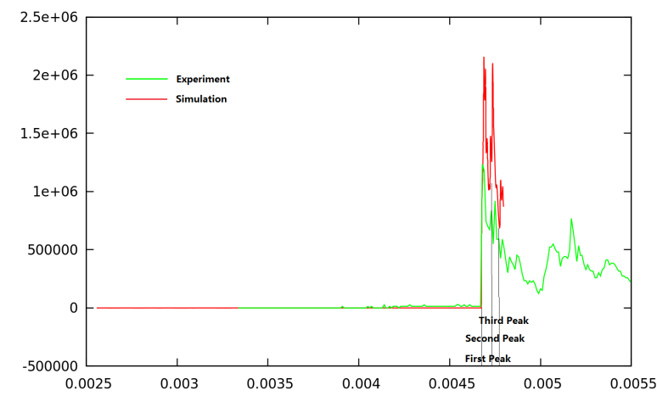
Detonation: Benchmark
Detonation’s cellular structures
Deflagration to Detonation Transition (DDT)
MINI RUT experiment

Slide 20
Conclusions
BPGs in numerical simulations for Fuel Cells and Hydrogen applications were briefly presented
Focus on the practical needs of engineers in consultancies and industry undertaking CFD simulations in support of hazard/risk assessments of hydrogen facilities, and the needs of regulatory authorities
BPG application through a series of CFD example cases were also presented for each phenomenon (dispersion, ignition, deflagration, detonation), in order to provide a demonstration of their application

Slide 21
Ευχαριστώ! (Thank you)
The authors would like to thank the SUSANA project, which has received funding from the European Union's Seventh Framework Programme (FP7/2007-2013) for the Fuel Cells and Hydrogen Joint Technology Initiative under grant agreement n°FCH-JU-325386.
www.support-cfd.eu

