Slide 1

Determination of Distribution Function
used in Monte Carlo Simulation on
Safety Analysis of H₂ Pressure Vessel
24th Sept. 2019
Bin Wang, Georg W. Mair, Stephan Gesell
8th Internat. Conference on Hydrogen Safety
ICHS 2019, Adelaide

Slide 2
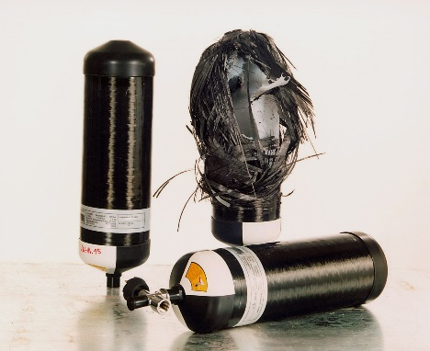

Sample Test and population properties
The development of fuel cell car strongly relies on the demonstration of safety of composite pressure vessels (CPV).
The wall thickness of CPVs has to be reduced to save costs without compromise of safety.
The safety of entire CPVs is often based on the limited numbers of test results.
Statistics are often used to derive the properties of whole CPV populations based on sample results.

Slide 3
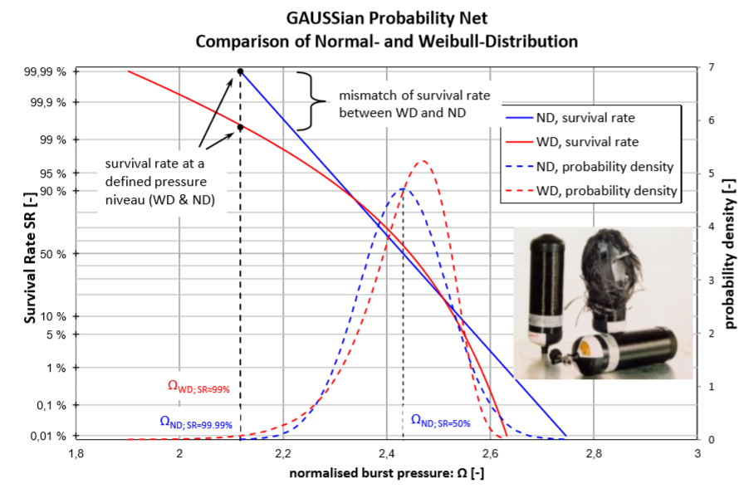
Survival rate and distribution function
Different survival rates are resulted from normal and Weibull distribution within the Gaussian probability net, [1].

Slide 4
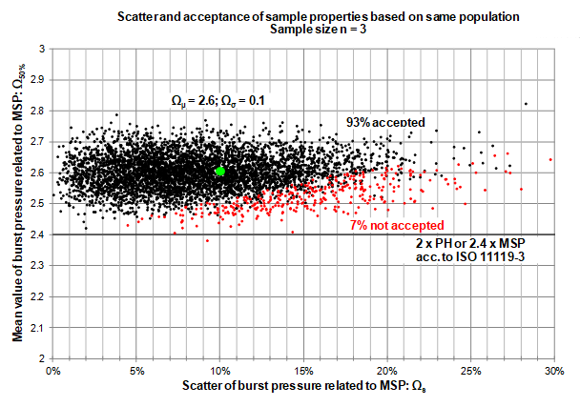
Monte Carlo simulation and distribution function
Monte Carlo simulation (MCS) is often employed to generate numerical test data, such as burst strength and life cycle strength.
Distribution function is required for MCS.
The acceptance rate of CPVs according to standards (e.g. ISO11119-3) can be determined.
Ref. [1]

Slide 5
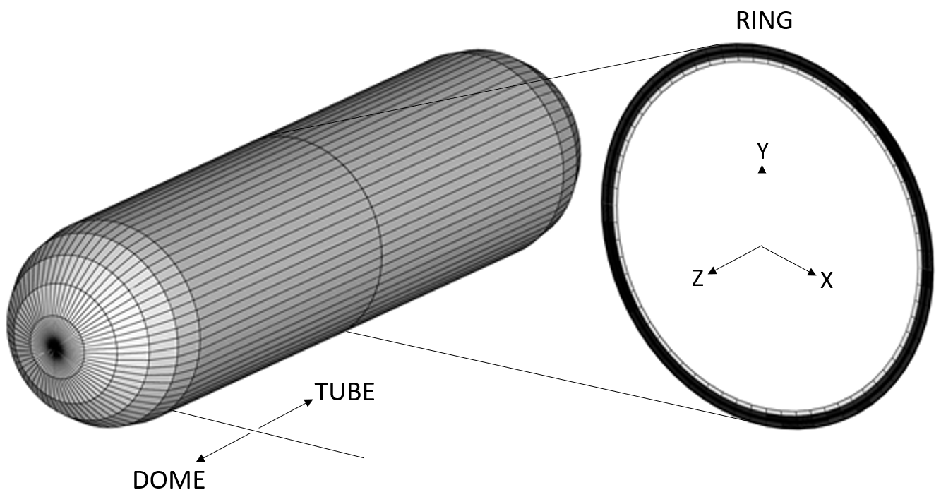
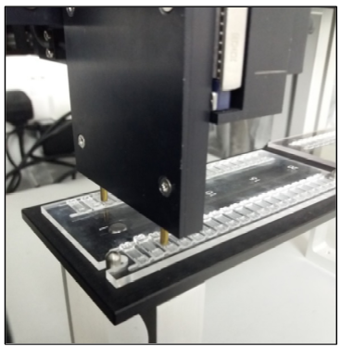
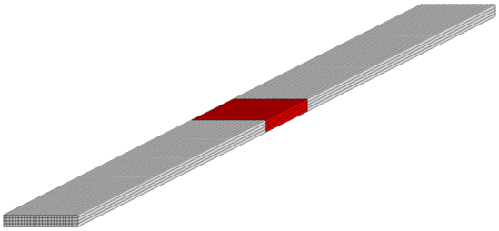
Monte Carlo simulation and Fibre Break Model
Update Material
Properties
Macroscopic
Microscopic
Random assignment of fibre strength at each Gauss Points is based on MCS; Weibull distribution parameters are calculated based on limited number of fibre strength test.
Fibre break test

Slide 6


Weibull distribution
Weibull distribution has the ability to describe different types of distribution.
$f\left(x\right)=\frac{b}{T}{\left(\frac{x}{T}\right)}^{b−1}e^{−{\left(\frac{x}{T}\right)}^{b}}; x,T,b≥0$
Density function:
$$P\left(x\right)=1−e^{−{\left(\frac{x}{T}\right)}^{b}}; x,T,b≥0$$
Distribution function:
where T – scale factor, b – shape factor.
Assumption: CPVs are failure free in the initial stage of the testing (T₀ = 0).

Slide 7
Methods to determine the Weibull distribution parameters (b, T)
The parameters of Weibull distribution can be determined by various methods:
Norm Log based method (L-N)
Least squares regression (LR)
Weighted least squares regression (WLR)
A linear approach based on good linear unbiased estimators (GLUE)
Maximum likelihood estimation (MLE)
The method of moments estimation (MME)
LR and WLR work in conjunction with ranking functions (probability estimators).
It is unclear which method is the best to fit the test data, how they impact the safety prediction of CPVs.

Slide 8





Ranking function
Probability can be determined using ranking function:
$$R_{j}=\frac{i−C_{j}}{n+1−2C_{j}}$$
i is the index in ascending order and n is the sample size.
$$C_{1}=0, then R_{1}=\frac{i}{n+1}$$
Mean rank:
(_R₁)
$$C_{2}=0.5, then R_{2}=\frac{i−0.5}{n}$$
Hazen’s:
(_R₂)
Median rank:
$$C_{3}=0.3, then R_{3}=\frac{i−0.3}{n+0.4}$$
(_R₃)
$$C_{4}=0.375, then R_{4}=\frac{i−0.375}{n+0.25}$$
Small sample:
(_R₄)

Slide 9
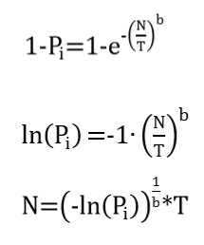

Monte Carlo simulation and Weibull parameters b, T
In Monte-Carlo simulation (MCS), the random numbers are generated corresponding to the probability, Pi.
Shape factor b and scale factor T are required.
N: fatigue life cycle of CPVs.

Slide 10
Goodness of Fit (GoF) test
Gaussian probability net & Weibull distribution net
Anderson-Darling (AD) [2,3], Kolmogorov-Smirnov (KS) tests, Kuiper's tests and Shapiro–Wilk test
Anderson darling test is performed to check the Goodness-of-Fit of data from real test or Monte-Carlo simulation.
The OSL (observed significance level) probability is used for quantifying the parameters of Weibull distribution [4]. If OSL < 0.05 then the Weibull assumption is rejected.
The higher value of observed significance level (OSL) indicates a better fit of the assumed distribution function to the test data.

Slide 11
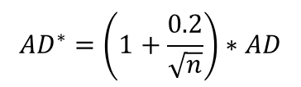
Anderson-Darling test and Observed Significance Level (OSL)
$$AD=\sum_{i=1}^{n}{\frac{1−2i}{n}\left\{\ln\left(1−exp\left[{−Z}_{\left(i\right)}\right]\right)+Z_{\left(n+1−i\right)}\right\}−n}$$
$${AD}^{∗}=\left(1+\frac{0.2}{\sqrt{n}}\right)∗AD$$
Where $Z_{(i)}={\left[x_{(i)}/T\right]}^{b}$, T and b are the scale factor and shape factor, respectively [4].
If OSL < 0.05 then the Weibull assumption is rejected, and the error committed is less than 5%. The OSL formula is given by [4]:
$OSL=1/\left\{1+exp⁡[−0.1+1.24∗\ln\left({AD}^{∗}\right)+4.48({AD}^{∗})]\right\}$

Slide 12
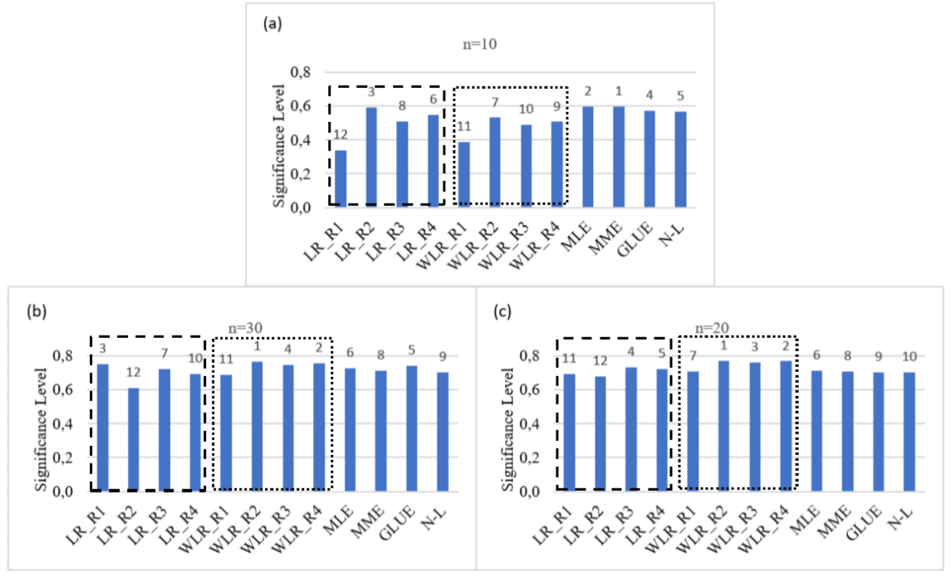
Performance index of data from MCS
As an example, T = 48186 and b = 4.281 are applied to MCS to generate fatigue life cycle data.
n=10
n=30
n=20

Slide 13
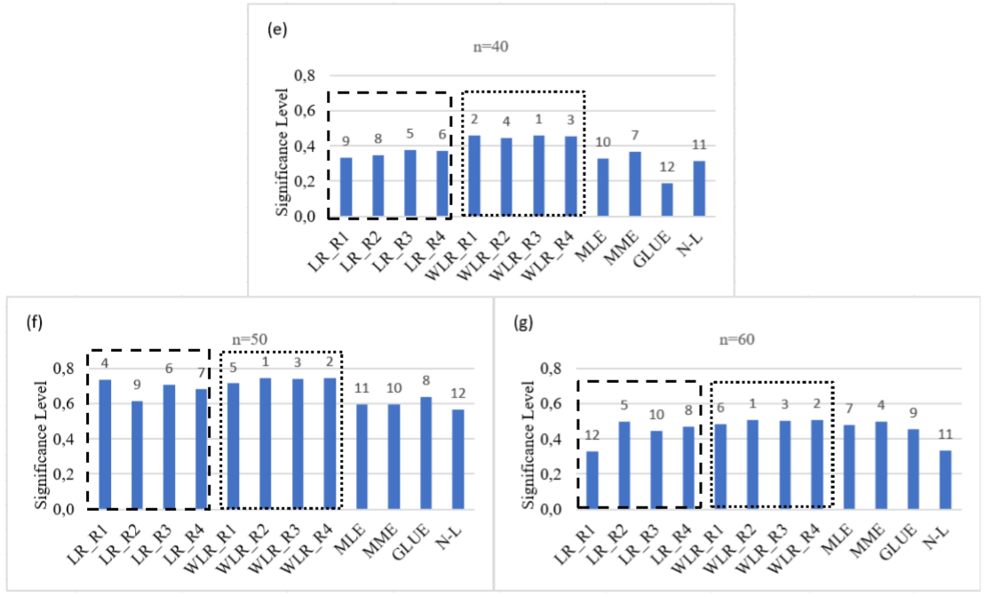
Performance index of data from MCS
n=40
n=50
n=60
WLR provides the best results in general in conjunction with Harz’s ranking function, (dotted square frame), exempt for sample size 10. The ranks from best to worst are WLR_R₂, WLR_R₄, WLR_R₃ and WLR_R₁.

Slide 14
Test data of CPVs
The following test data of CPVs are used to investigated
the performance of different estimation methods:
a) n = 10; type 4, GFRP cylinder, life cycle test.
b) n = 12; GFRP-type II cylinder for medical O₂.
c) n = 24; test results of burst pressure of type 4 CFRP cylinder, composite cylinder design types, named design D (type IV, CFRP, for breathing air, PH =45MPa).
d) n = 37; breathing air cylinders of type III made from CFRP with aluminum liner for 300 bar nominal working pressure after 15 years of service at the Berlin Fire Department.

Slide 15
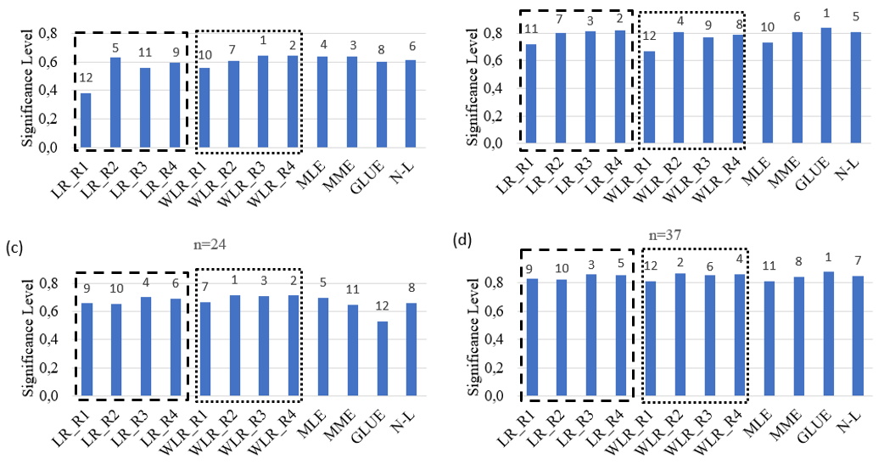
Performance index of real test data
The sample sizes are 10, 12, 24 and 37. WLR_R2, WLR_R3 and WLR_R4 are better.
n=12
n=10
n=37
n=24

Slide 16
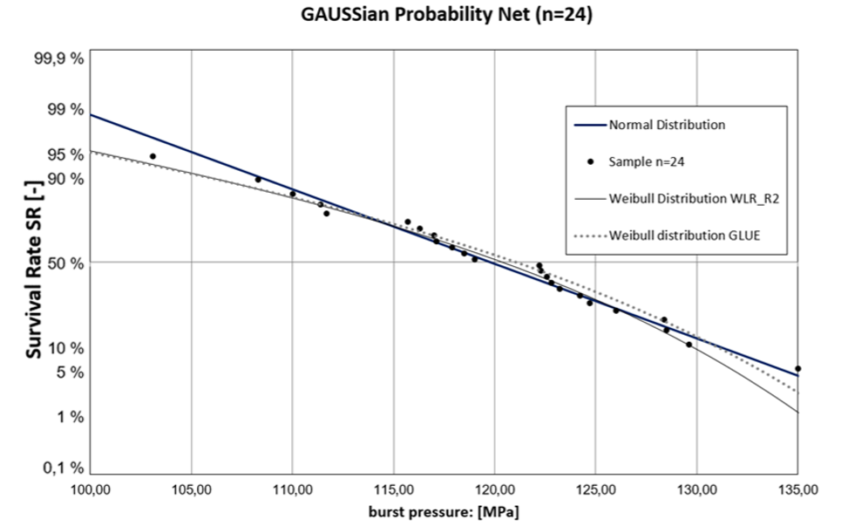
Survival rate for test data
Comparison of survival rate for burst test data (n=24), the best (WLR_R₂) and the worst (GLUE).

Slide 17
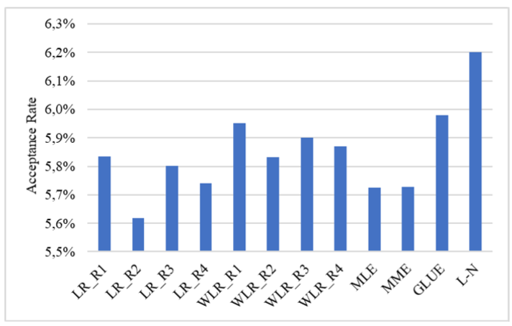
Acceptance rates of life cycle
Different acceptance rates of life cycle according to GTR No. 13 test procedure 11000 life cycles requirement.

Slide 18
Randomness of MCS
Different Weibull distribution parameters are obtained from varied sample size, even the identical scale factor and shape factor are applied to MCS. Either large numbers of sample size or high numbers of repeated small sample size are needed to obtain similar distribution function of the data.
Number of data | Weighted Least Square (Harz’s ranking)
 | Scale factor T | Shape factor b
n10 | 50095 | 4.029
n20 | 46967 | 4.682
n30 | 49170 | 4.501
n40 | 46753 | 4.317
n50 | 48821 | 3.592
n60 | 50474 | 4.618
Weibull parameters determined from WLR (Harz's ranking) for different sample size.

Slide 19
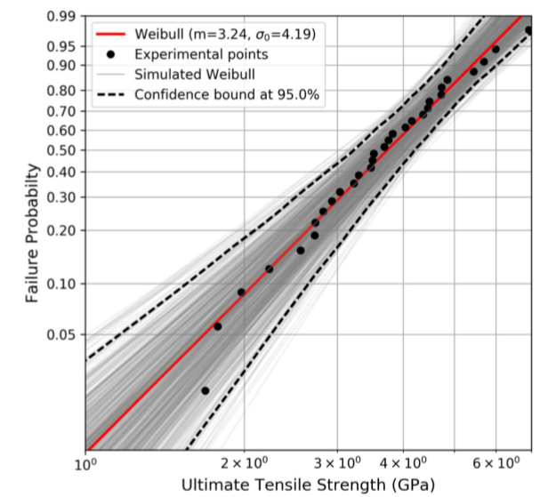
Randomness of MCS
Simulated Weibull distributions (based on sample size) together with experimental results, (FibreMod Project).

Slide 20
Summary and Conclusions
The weighted least square method shows the better goodness of fit except for small sample size 10.
The ranking function “Harz” shows the best performance combined with WLR method.
The impacts of using different estimation methods to the survival rate and the acceptance rate of CPVs according to GTR 13 life cycle requirement are insignificant for the data concerned here.
The result of MCS has randomness, care should be taken if the conclusion is drawn from single simulation. The mean, standard deviation and confidence bound should be taken into account for using MCS results.

Slide 21
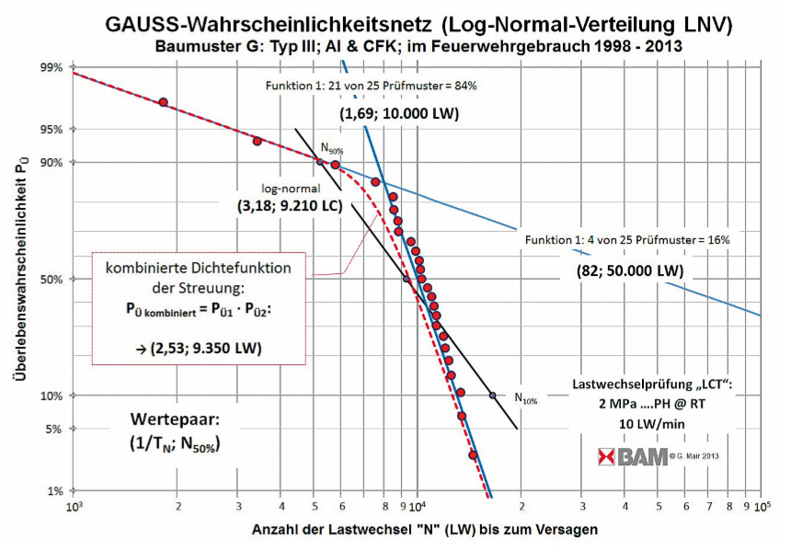
Future Works
Develop a tool to find out
the best Weibull
parameters
Three parameters
Weibull distribution.
Complicated distributions.
Machine learning.

Slide 22
References
G.W. Mair, B. Becker, F. Scherer, “Burst Strength of Composite Cylinders – Assessment of the Type of Statistical Distribution”, © Carl Hanser Verlag München, Materials Testing 56 (2014) 9.
A practical guide to statistical analysis of material property data, Romeu, J.L. and C. Grethlein, AMPTIAC, 2000.
MIL-HDBK-17 (1E), Composite Material Handbook.
Anderson Darling: A Goodness of Fit test for small samples assumption, START, vol. 10, No. 5.

Slide 23
Thanks for your attention!
Thanks for TAHYA Project!
This work is suported by EU Hydrogen car storage research project TAHYA

