Slide 1
Numerical modelling of unconfined and confined hydrogen explosions
8th International Conference of Hydrogen Safety, Adelaide, 24th September 2019 – ID 163
Pratap Sathiah and Arun K Ampi
SHELL INDIA MARKETS PRIVATE LIMITED, BANGALORE, INDIA

Slide 2
Definitions & cautionary note
Reserves: Our use of the term “reserves” in this presentation means SEC proved oil and gas reserves.
Resources: Our use of the term “resources” in this presentation includes quantities of oil and gas not yet classified as SEC proved oil and gas reserves. Resources are consistent with the Society of Petroleum Engineers 2P and 2C definitions.
Organic: Our use of the term Organic includes SEC proved oil and gas reserves excluding changes resulting from acquisitions, divestments and year-average pricing impact.
Resources plays: Our use of the term ‘resources plays’ refers to tight, shale and coal bed methane oil and gas acreage.
The companies in which Royal Dutch Shell plc directly and indirectly owns investments are separate entities. In this presentation “Shell”, “Shell group” and “Royal Dutch Shell” are sometimes used for convenience where references are made to Royal Dutch Shell plc and its subsidiaries in general. Likewise, the words “we”, “us” and “our” are also used to refer to subsidiaries in general or to those who work for them. These expressions are also used where no useful purpose is served by identifying the particular company or companies. ‘‘Subsidiaries’’, “Shell subsidiaries” and “Shell companies” as used in this presentation refer to companies in which Royal Dutch Shell either directly or indirectly has control. Companies over which Shell has joint control are generally referred to as “joint ventures” and companies over which Shell has significant influence but neither control nor joint control are referred to as “associates”. The term “Shell interest” is used for convenience to indicate the direct and/or indirect ownership interest held by Shell in a venture, partnership or company, after exclusion of all third-party interest.
This presentation contains forward-looking statements concerning the financial condition, results of operations and businesses of Royal Dutch Shell. All statements other than statements of historical fact are, or may be deemed to be, forward-looking statements. Forward-looking statements are statements of future expectations that are based on management’s current expectations and assumptions and involve known and unknown risks and uncertainties that could cause actual results, performance or events to differ materially from those expressed or implied in these statements. Forward-looking statements include, among other things, statements concerning the potential exposure of Royal Dutch Shell to market risks and statements expressing management’s expectations, beliefs, estimates, forecasts, projections and assumptions. These forward-looking statements are identified by their use of terms and phrases such as ‘‘anticipate’’, ‘‘believe’’, ‘‘could’’, ‘‘estimate’’, ‘‘expect’’, ‘‘intend’’, ‘‘may’’, ‘‘plan’’, ‘‘objectives’’, ‘‘outlook’’, ‘‘probably’’, ‘‘project’’, ‘‘will’’, ‘‘seek’’, ‘‘target’’, ‘‘risks’’, ‘‘goals’’, ‘‘should’’ and similar terms and phrases. There are a number of factors that could affect the future operations of Royal Dutch Shell and could cause those results to differ materially from those expressed in the forward-looking statements included in this presentation, including (without limitation): (a) price fluctuations in crude oil and natural gas; (b) changes in demand for Shell’s products; (c) currency fluctuations; (d) drilling and production results; (e) reserves estimates; (f) loss of market share and industry competition; (g) environmental and physical risks; (h) risks associated with the identification of suitable potential acquisition properties and targets, and successful negotiation and completion of such transactions; (i) the risk of doing business in developing countries and countries subject to international sanctions; (j) legislative, fiscal and regulatory developments including potential litigation and regulatory measures as a result of climate changes; (k) economic and financial market conditions in various countries and regions; (l) political risks, including the risks of expropriation and renegotiation of the terms of contracts with governmental entities, delays or advancements in the approval of projects and delays in the reimbursement for shared costs; and (m) changes in trading conditions. All forward-looking statements contained in this presentation are expressly qualified in their entirety by the cautionary statements contained or referred to in this section. Readers should not place undue reliance on forward-looking statements. Additional factors that may affect future results are contained in Royal Dutch Shell’s 20-F for the year ended 31 December, 2014 (available at www.shell.com/investor and www.sec.gov ). These factors also should be considered by the reader. Each forward-looking statement speaks only as of the date of this presentation, 14 April, 2015. Neither Royal Dutch Shell nor any of its subsidiaries undertake any obligation to publicly update or revise any forward-looking statement as a result of new information, future events or other information. In light of these risks, results could differ materially from those stated, implied or inferred from the forward-looking statements contained in this presentation. There can be no assurance that dividend payments will match or exceed those set out in this presentation in the future, or that they will be made at all.
We use certain terms in this presentation, such as discovery potential, that the United States Securities and Exchange Commission (SEC) guidelines strictly prohibit us from including in filings with the SEC. U.S. Investors are urged to consider closely the disclosure in our Form 20-F, File No 1-32575, available on the SEC website www.sec.gov. You can also obtain this form from the SEC by calling 1-800-SEC-0330.

Slide 3
Agenda
Introduction
Unconfined vapour cloud explosion modelling and its validation
Confined vapour cloud explosion modelling and its validation
Conclusions

Slide 4
Hazards of hydrogen storage
Managing hazards associated with hydrogen in large-scale production and storage facility requires an understanding of the behaviour of potential accidental releases of hydrogen.
In case of accidental release into a confined or congested area, a vapour cloud explosion may occur if the cloud is ignited.
Depending on the type and degree of confinement or congestion, the explosion may result in an overpressure that has potential to cause multiple fatalities and building damage.
In this work, we present validation of vapour cloud explosion modelling of hydrogen and comparison against experiments available in open literature.
Modelling is performed using Fire Explosion Release Dispersion (FRED) software.
It has two modules for explosion modelling i.e., Congestion Assessment Methodology (CAM) and Shell Code for Overpressure Prediction in Gas Explosions (SCOPE).

Slide 5
Modelling of unconfined vapour cloud explosions using CAM
It is based on empirical correlation for prediction of source overpressure obtained from vast explosion experiments.
$P=a_{o}({U_{o }(E−1))}^{2.71}l^{0.55}n^{a1}exp (a_{2}b$)…………………………..(1)
P= Source overpressure
a₀,a₁ and a₂ are the constants (determined from experiments)
U_{o}=laminar burning velocity
E=expansion ratio
n=number of obstacles in each direction
l length of the domain
b= blockage ratio
The methodology is well validated for propane, methane and ethylene explosion experiments. It can be applied to different scales of domain, varying equivalence ratio and account for effects of different shapes of obstacles.

Slide 6
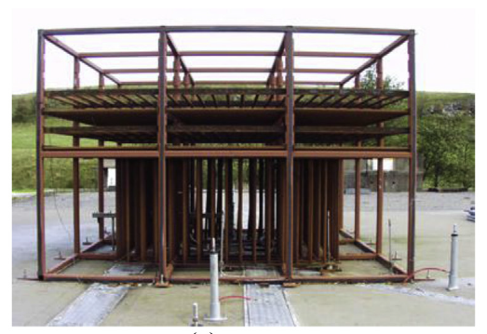
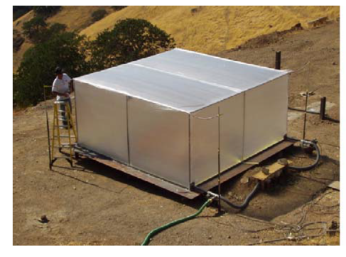
Experiments used for validation
Shirvill et al. performed several experiments investigating the effects of repeated pipe congestion on explosion. This involved ignition of hydrogen–air mixtures (with varying stoichiometric ratios) in a congestion rig consisting of horizontal and vertical pipe arrays.
Sato et al. experimentally measured explosion overpressure for hydrogen-air mixture with equivalence ratio of 0.6 and 1. The size of the gas cloud was varied from 5.2 to 37 m³.

Slide 7
Unconfined-congested vapour cloud explosion – source overpressure

Slide 8
Unconfined-uncongested vapour cloud explosion - source overpressure

Slide 9
Unconfined-congested vapour cloud explosion – pressure decay as a function of distance
The overpressure obtained using CAM well predict the experimental overpressure for unconfined explosions. Furthermore, CAM predicts the decay of overpressure well.

Slide 10
Modelling of confined vapour cloud explosions using SCOPE
It is a phenomenological model and is based on an understanding of the physical processes involved in the development of the explosion.
Essentially SCOPE solves rate of change in mass of unburned gas in the box, mass of gas emitted from the main vent and change in mass of burned gas as a function of time.
The flame propagation within the confinement is divided into quasi-laminar flame propagation, turbulent flame propagation and external explosion phases. It uses Bradley’s turbulent flame speed correlation to account for effects of increase in turbulence on the turbulent flame speed.
Turbulence is generated by obstacles or congestion which is specified by using number of obstacles, blockage ratio and obstacle diameter.

Slide 11
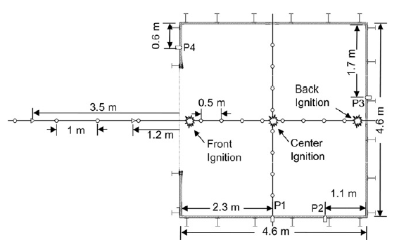
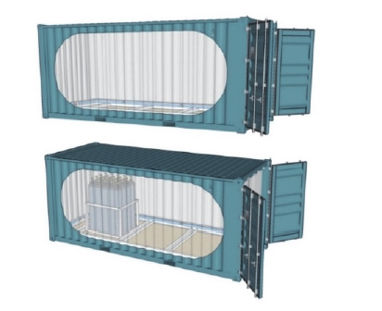
Experiments used for validation
Bauwen et al. investigated vented (two different vent area was investigated 2.7 and 5.4 m²) explosion experiments for lean hydrogen-air (concentration of 17.9 and 18.1 %) with cloud of size 63.7 m³.
Skjold et al performed hydrogen-air confined explosion experiments with 20-foot ISO container with open doors, with or without a bottle basket with twenty 50-litre high-pressure cylinders. Concentration of hydrogen-air mixture investigated was 15 %.

Slide 12
Confined vented vapour cloud explosion – maximum overpressure
SCOPE slightly overpredicts the maximum overpressure for Rocourt et al, this could be attributed to the small scale of the domain.

Slide 13
Confined vented vapour cloud explosion – Effects of increase in number of obstacles

Slide 14
Confined vented vapour cloud explosion – Effects of increase in blockage ratio
As the obstacle blockage ratio increases turbulence generation increases leading to increase in overpressure. SCOPE clearly predicts the trends of increase in overpressure with increase in blockage ratio and increase in number of obstacles well.

Slide 15
Conclusions
CAM is validated against vapour cloud unconfined explosion experiments. Experiments were performed using different sizes of gas cloud ranging from 5.2 m³ to 600 m³ with varying equivalence ratio increasing from lean mixture to rich mixture i.e. 0.6 to 3.2.
Although, there is some slight under prediction in certain cases. But overall, CAM modelling well predicts maximum explosion overpressure.
SCOPE is validated against congested confined vented explosion experiments. The experiments were performed using different size of the domain ranging from 1 m³ to 63.7 m³. The hydrogen concentration in the experiments were increased from 10 % to 27 %. The vent size was increased from 0.15 m² to 5.4 m².
SCOPE well predicts the explosion overpressure within the modelling uncertainty of ± 50 %.
Moreover, it well predicts the increase in overpressure with increase in number of obstacles, and blockage ratio.
Notes:
To conclude:

Slide 16
Acknowledgement
The authors thank Shell for permission to publish this paper.

Slide 17
Thanks for Listening – Questions ?

