Slide 1
Dispersion of cryogenic hydrogen through high-aspect ratio nozzles
Bikram Roy Chowdhury and Ethan S. Hecht
Sandia National Laboratories, Livermore, CA 94550, USA
International Conference on Hydrogen Safety, September 24-26, 2019,
Adelaide Australia
ID132
SAND2019-10522 C
Sandia National Laboratories is a multi-mission laboratory managed and operated by National Technology and Engineering Solutions of Sandia, LLC., a wholly owned subsidiary of Honeywell International, Inc., for the U.S. Department of Energy’s National Nuclear Security Administration under contract DE-NA0003525.

Slide 2
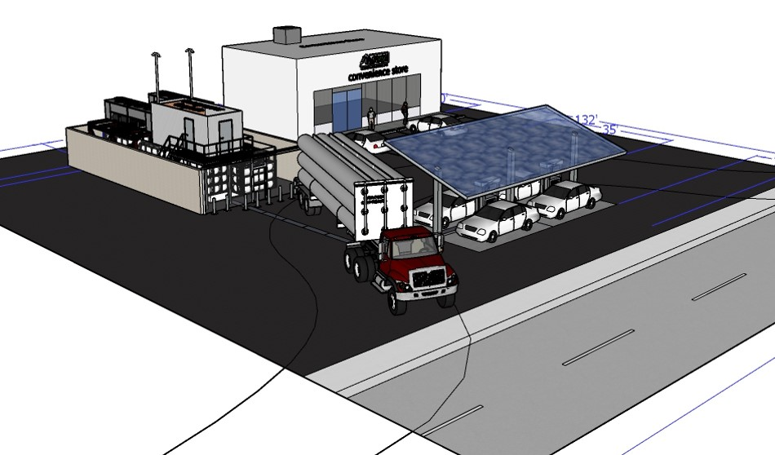
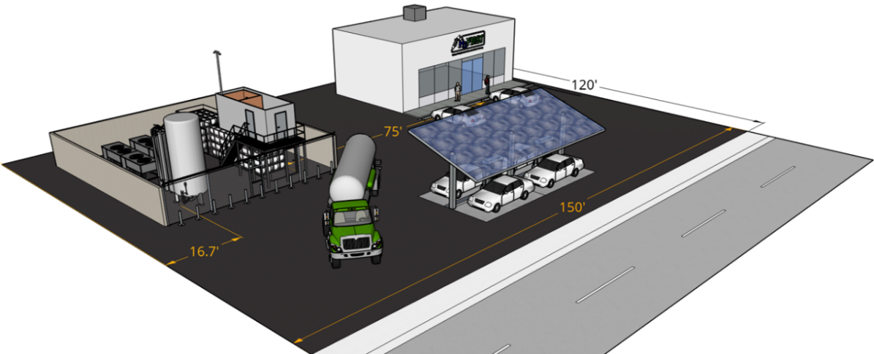
Current separation distances for liquid hydrogen systems in the U.S. are based on consensus rather than a comprehensive scientific basis
Compressed H₂ storage
Liquid H₂ storage
Previous work by Sandia led to science-based gaseous H₂ separation distances
Even with credits for insulation and fire-rated barrier wall, 75 ft. offset to building intakes and parking make footprint large
DOE goal: By September 30, 2022, identify ways to reduce the siting burdens that prohibit expansion of hydrogen fueling stations, through hydrogen research and development that enables a 40% reduction in station footprint, compared to the 2016 baseline of 18,000 square feet

Slide 3
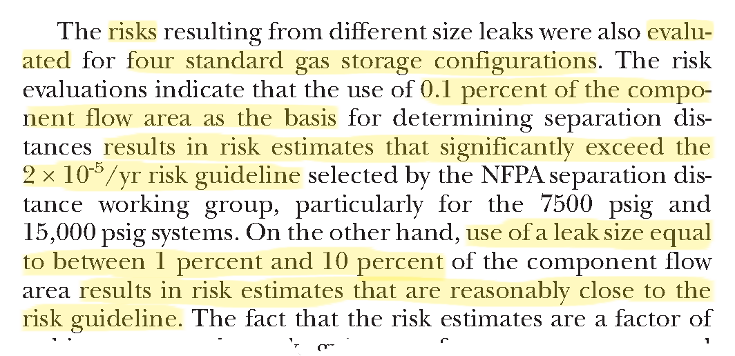
The fire code in the U.S. (NFPA 2) bases gaseous separation distances on the distance to a certain concentration level for a typical leak
Selected text from annex (I - NFPA 2, H – NFPA 55)
Gaseous distance reduction method:
QRA performed on typical system
Overall risk compared to deterministic hazard distances (jet flame radiation, unignited flammable concentration)
3% leak area reduced to 1% in 2020 NFPA 2 update – gaseous hydrogen setback distances further reduced

Slide 4
Previous work showed that non-circular orifices enhance mixing
Mi, Deo, Nathan. Phys. Fluids 2005. 068102
Ruggles, Ekoto. Int. J. Hydrogen Energ.
2014. 20331-20338
Lower concentration at a given normalized distance than round hydrogen jet
Round jet initial velocity penetrates further downstream than higher aspect ratios
Lower centerline velocity for equivalent normalized downstream distance

Slide 5
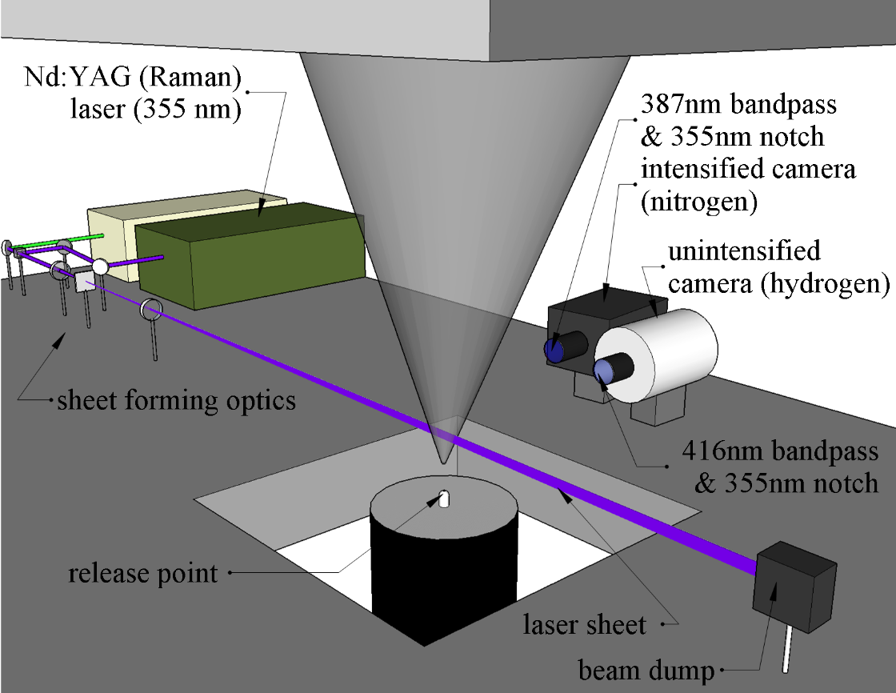
H₂-N₂ Raman imaging was used to measure concentration and temperature of cryogenic H₂
4 separate experiments:
Temperature: 50-64 K
Pressure:
3 bar_{abs}
5 bar_{abs}
Aspect ratios:
16 (0.22 mm x 3.55 mm)
32 (0.16 mm x 5.01 mm)
Approximate mass flows:
0.30 g/s (3 bar_{abs})
0.48 g/s (5 bar_{abs})

Slide 6
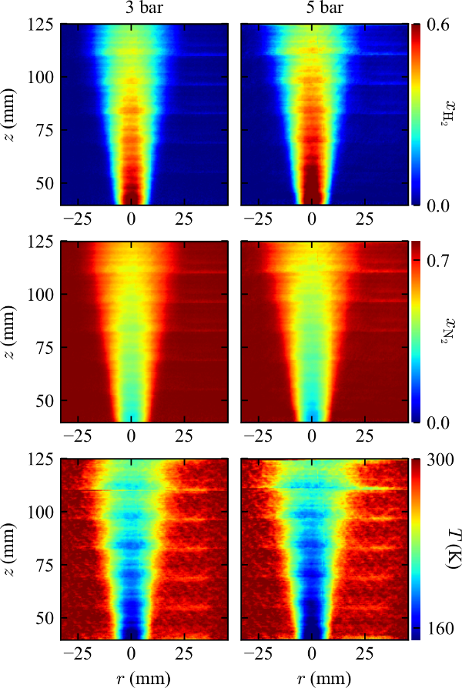
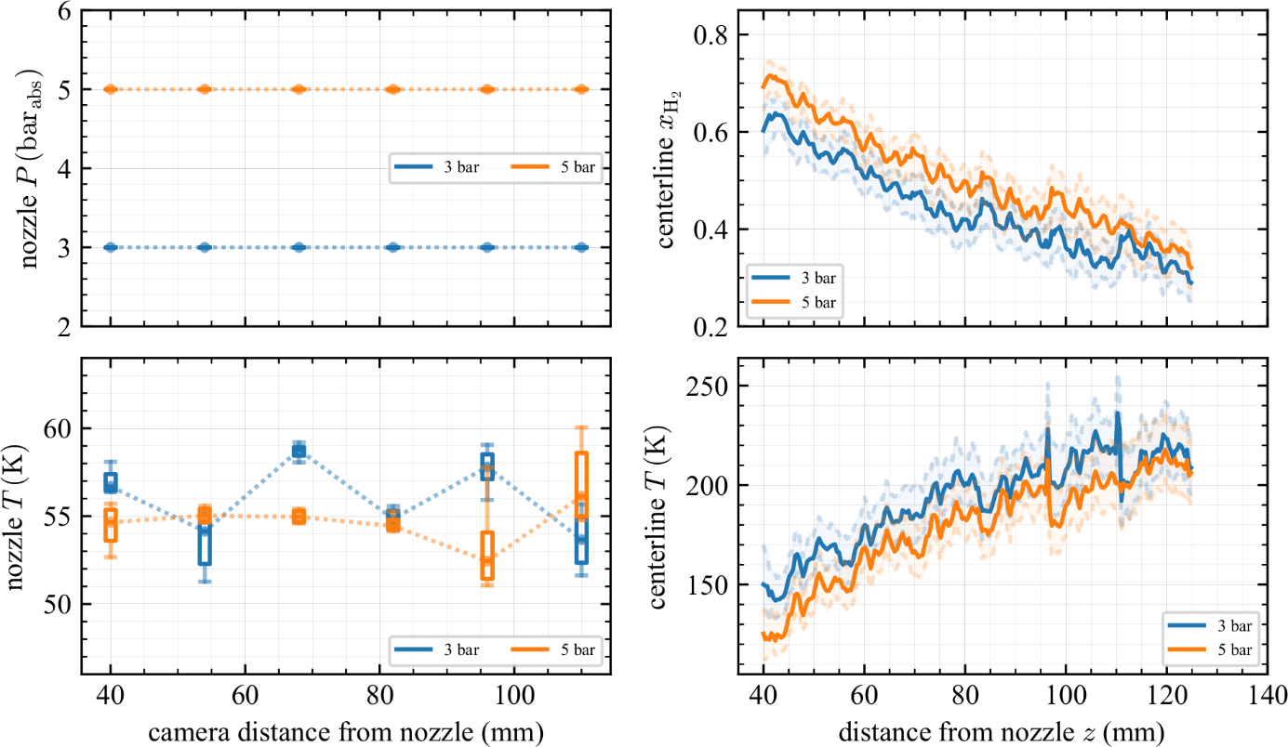
The centerline concentration is higher and temperature lower for a higher backpressure
AR16 nozzle
imaging along minor axis
Some discontinuities where images are stitched

Slide 7
Proper normalization leads to collapse of centerline concentration decay rate
Aspect ratio of 16 and 32 have nearly equivalent decay rates
Decay rate of 0.280 nearly equivalent to round jet decay rate of 0.277 (Hecht & Panda, Int. J. Hydrogen Energy (2019) 8960-8970)

Slide 8
At ≥ 40 diameters downstream, concentration profiles are Gaussian, self-similar, and the same along the major and minor axes
Aspect ratio 16
Aspect ratio 32
No significant difference between high aspect-ratio nozzles and round nozzle profile

Slide 9
The jet half width data collapses
No two-dimensional flow region
Axis-switching phenomena not observed
Spread rate of 0.06 slightly slower than round nozzles of 0.07 (Hecht & Panda, Int. J. Hydrogen Energy (2019) 8960-8970)

Slide 10
Proper normalization leads to collapse of centerline temperature increase and half-width spread rate
Inverse centerline temperature decay slope smaller than for round jet (0.026 vs 0.028 – Hecht, Panda, IJHE 2019)
Temperature half-width increases slightly faster than concentration half-width (0.07 mm vs 0.06 mm) and round nozzle (also 0.06 mm – Hecht, Panda IJHE 2019)

Slide 11
At ≥ 40 diameters downstream, temperature profiles are Gaussian, self-similar, and the same along the major and minor axes
Aspect ratio 16
Aspect ratio 32
Temperatures slightly wider than round nozzle temperature profiles (solid black line)

Slide 12
Summary
Concentrations decay hyperbolically, decay rate collapses when normalized by the effective diameter
Centerline concentration and temperature decay rate for AR 16 and 32 nozzles is the same as for round nozzles under these conditions (1 mm equivalent diameter, ≈55 K, 3 and 5 bar_{abs})
Concentration and temperature profiles are Gaussian, self-similar, and nearly equivalent along the major and minor axes (starting 40 diameters downstream)
Contrary to faster mixing observed in the literature for warmer (and often higher pressure) releases
Simulations using a round nozzle should be accurate, even for high aspect-ratio release geometries

Slide 13
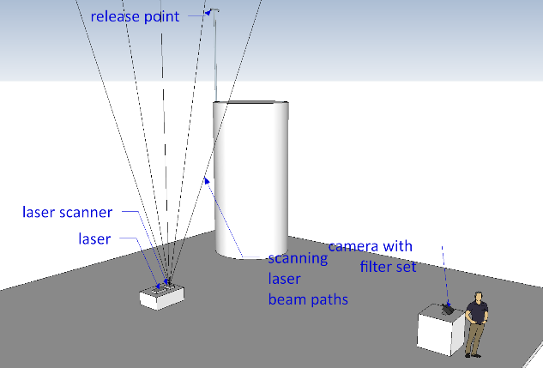
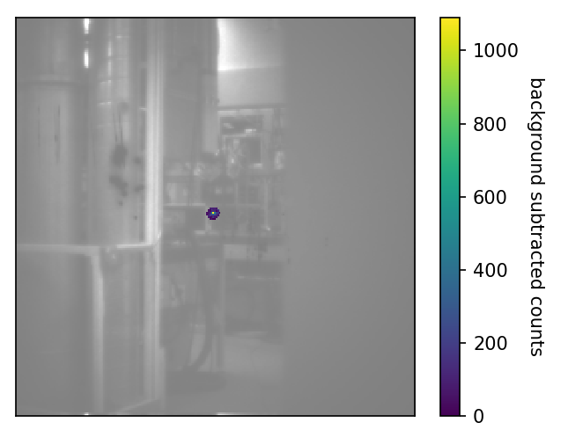
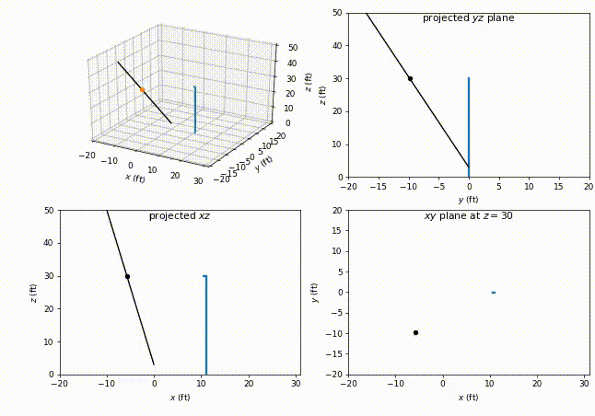
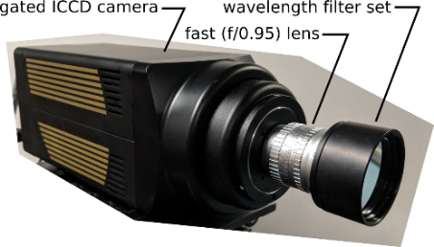
Future work: our lab-scale Raman diagnostic has been scaled up to study LH₂ vents and large-scale experiments
Enables application of diagnostic to releases with more flow (larger orifices or higher-pressures)
Focused experiments to explore additional LH₂ physics:
Pooling
Evaporation from LH₂ pools
Details of plume interactions with ambient air
Impact of barrier walls as a mitigation
Raman signal overlaid on laboratory scene

Slide 14
Acknowledgements
Thanks for funding support from:
United States Department of Energy, Energy Efficiency &Renewable Energy, Fuel Cell Technologies Office, Safety, Codes, and Standards subprogram managed by Laura Hill
Industry support including the OEM Group at the California Fuel Cell Partnership, Linde, and Shell
Air Liquide and partners
And thanks to the hydrogen research team at Sandia including:
Jon Zimmerman (H₂ program manager), Chris LaFleur (Risk, Codes & Standards) , Alice Muna (Risk), Brian Ehrhart (H₂FIRST), Gaby Bran-Anleu (H₂FIRST), Scott Bisson (optics), Tony McDaniel (experiments), Rad Bozinoski (modeling), Myra Blaylock (CFD), Chris San Marchi (materials/metal interactions with H₂), Joe Ronevich(materials/metal interactions with H₂), John Reynolds (HyRAM), Nalini Menon (polymer interactions with H₂)
Previous researchers: Pratikash Panda, Joe Pratt, Katrina Groth, Isaac Ekoto, Adam Ruggles, Bob Schefer, Bill Houf, Greg Evans, Bill Winters

Slide 15
The laser scanning system is ready for use when LH2 is available

