Slide 1
Experimental study of light gas dispersion in a channel
ICHS 2019 - ID216
Osama K. Ibrahim, Knut Vaagsaether and Dag Bjerketvedt Department of Process, Energy and Environmental Technology
Faculty of Technology, Natural Science and Maritime Science University of South-Eastern Norway (USN)
Porsgrunn, Norway

Slide 2
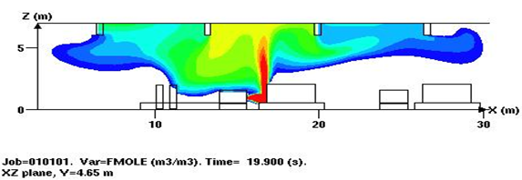
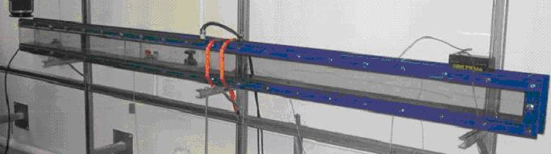
Background
The consequences of a gas explosion following a leak of hydrogen depends strongly on the dispersion process
Hydrogen is a light gas and disperse rapidly in open area, however confinement will hindered the dispersion and gravity currents may occurs
Previously we used a continuous ignition source to monitor propagation of gravity currents
In this work we are using concentration sensors
Objectives; Test concentration diagnostics, and
providing data for analyses (Fr-scaling) and validation of CFD codes (Open-FOAM)
spark

Slide 3
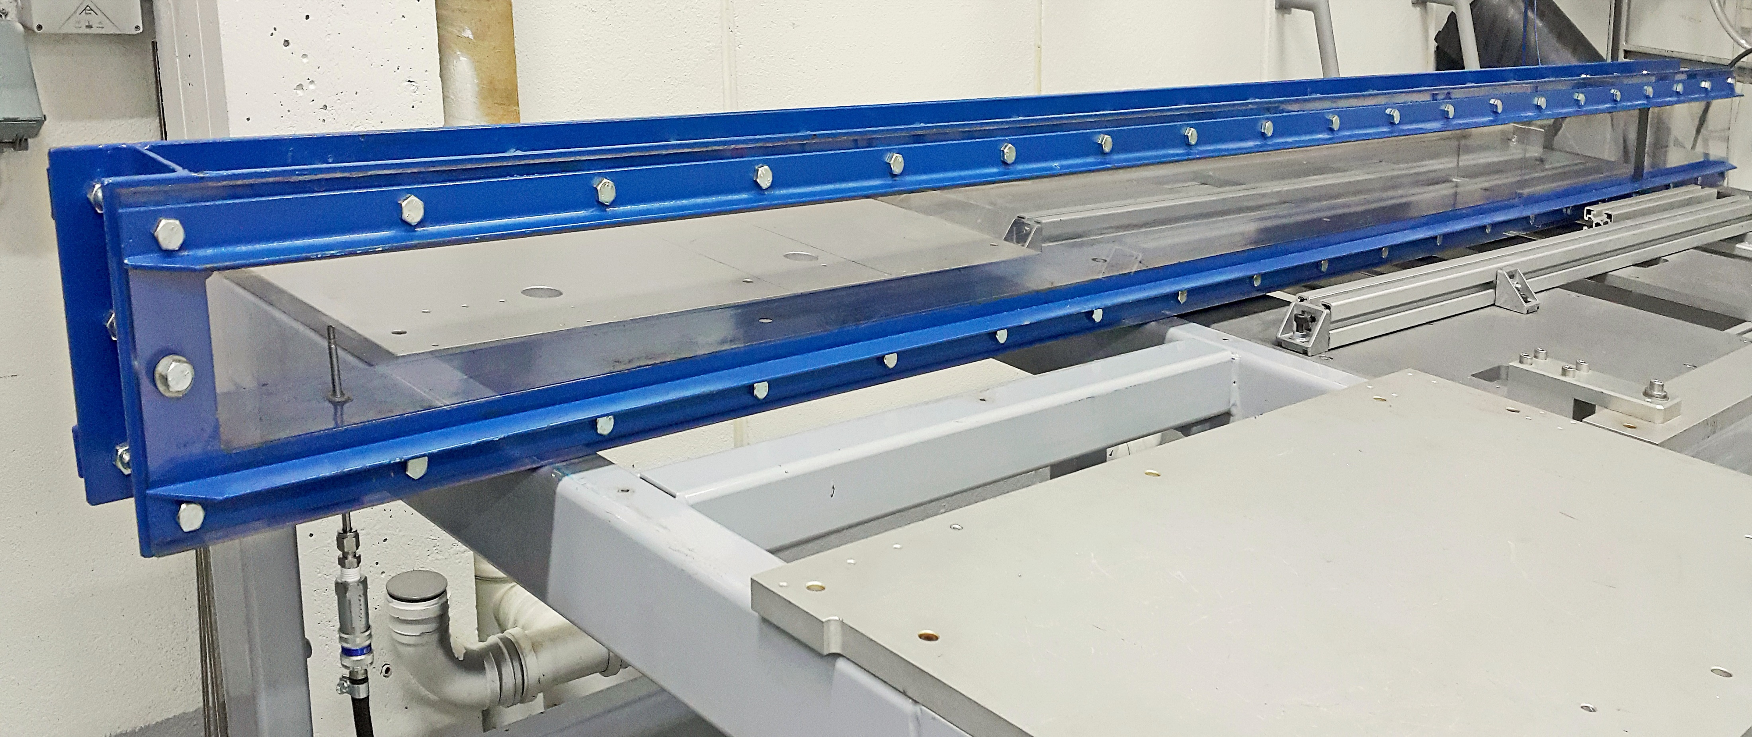
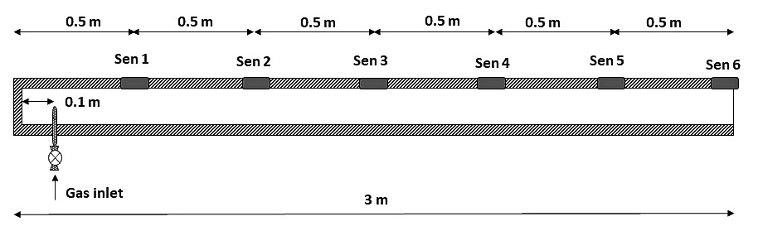
Experimental Set-Up
Channel 3 m length, 0.1 m width, and height
Injected gas : Helium or hydrogen
Geometry : Circular nozzle, pipe
Diameter 4, 2.5, 1, 0.5 mm
Releasing flow rate : 5 to 90 Ndm³/min(Liter/min)

Slide 4
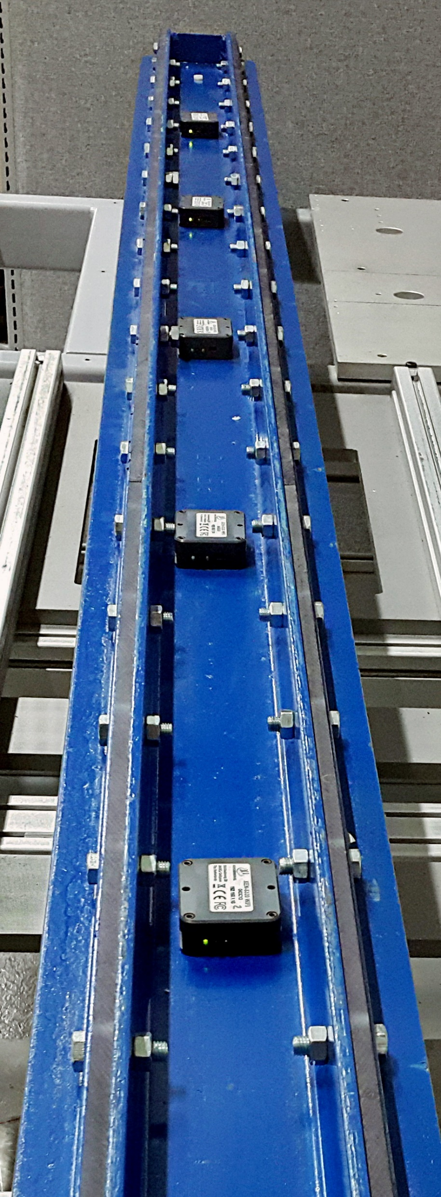
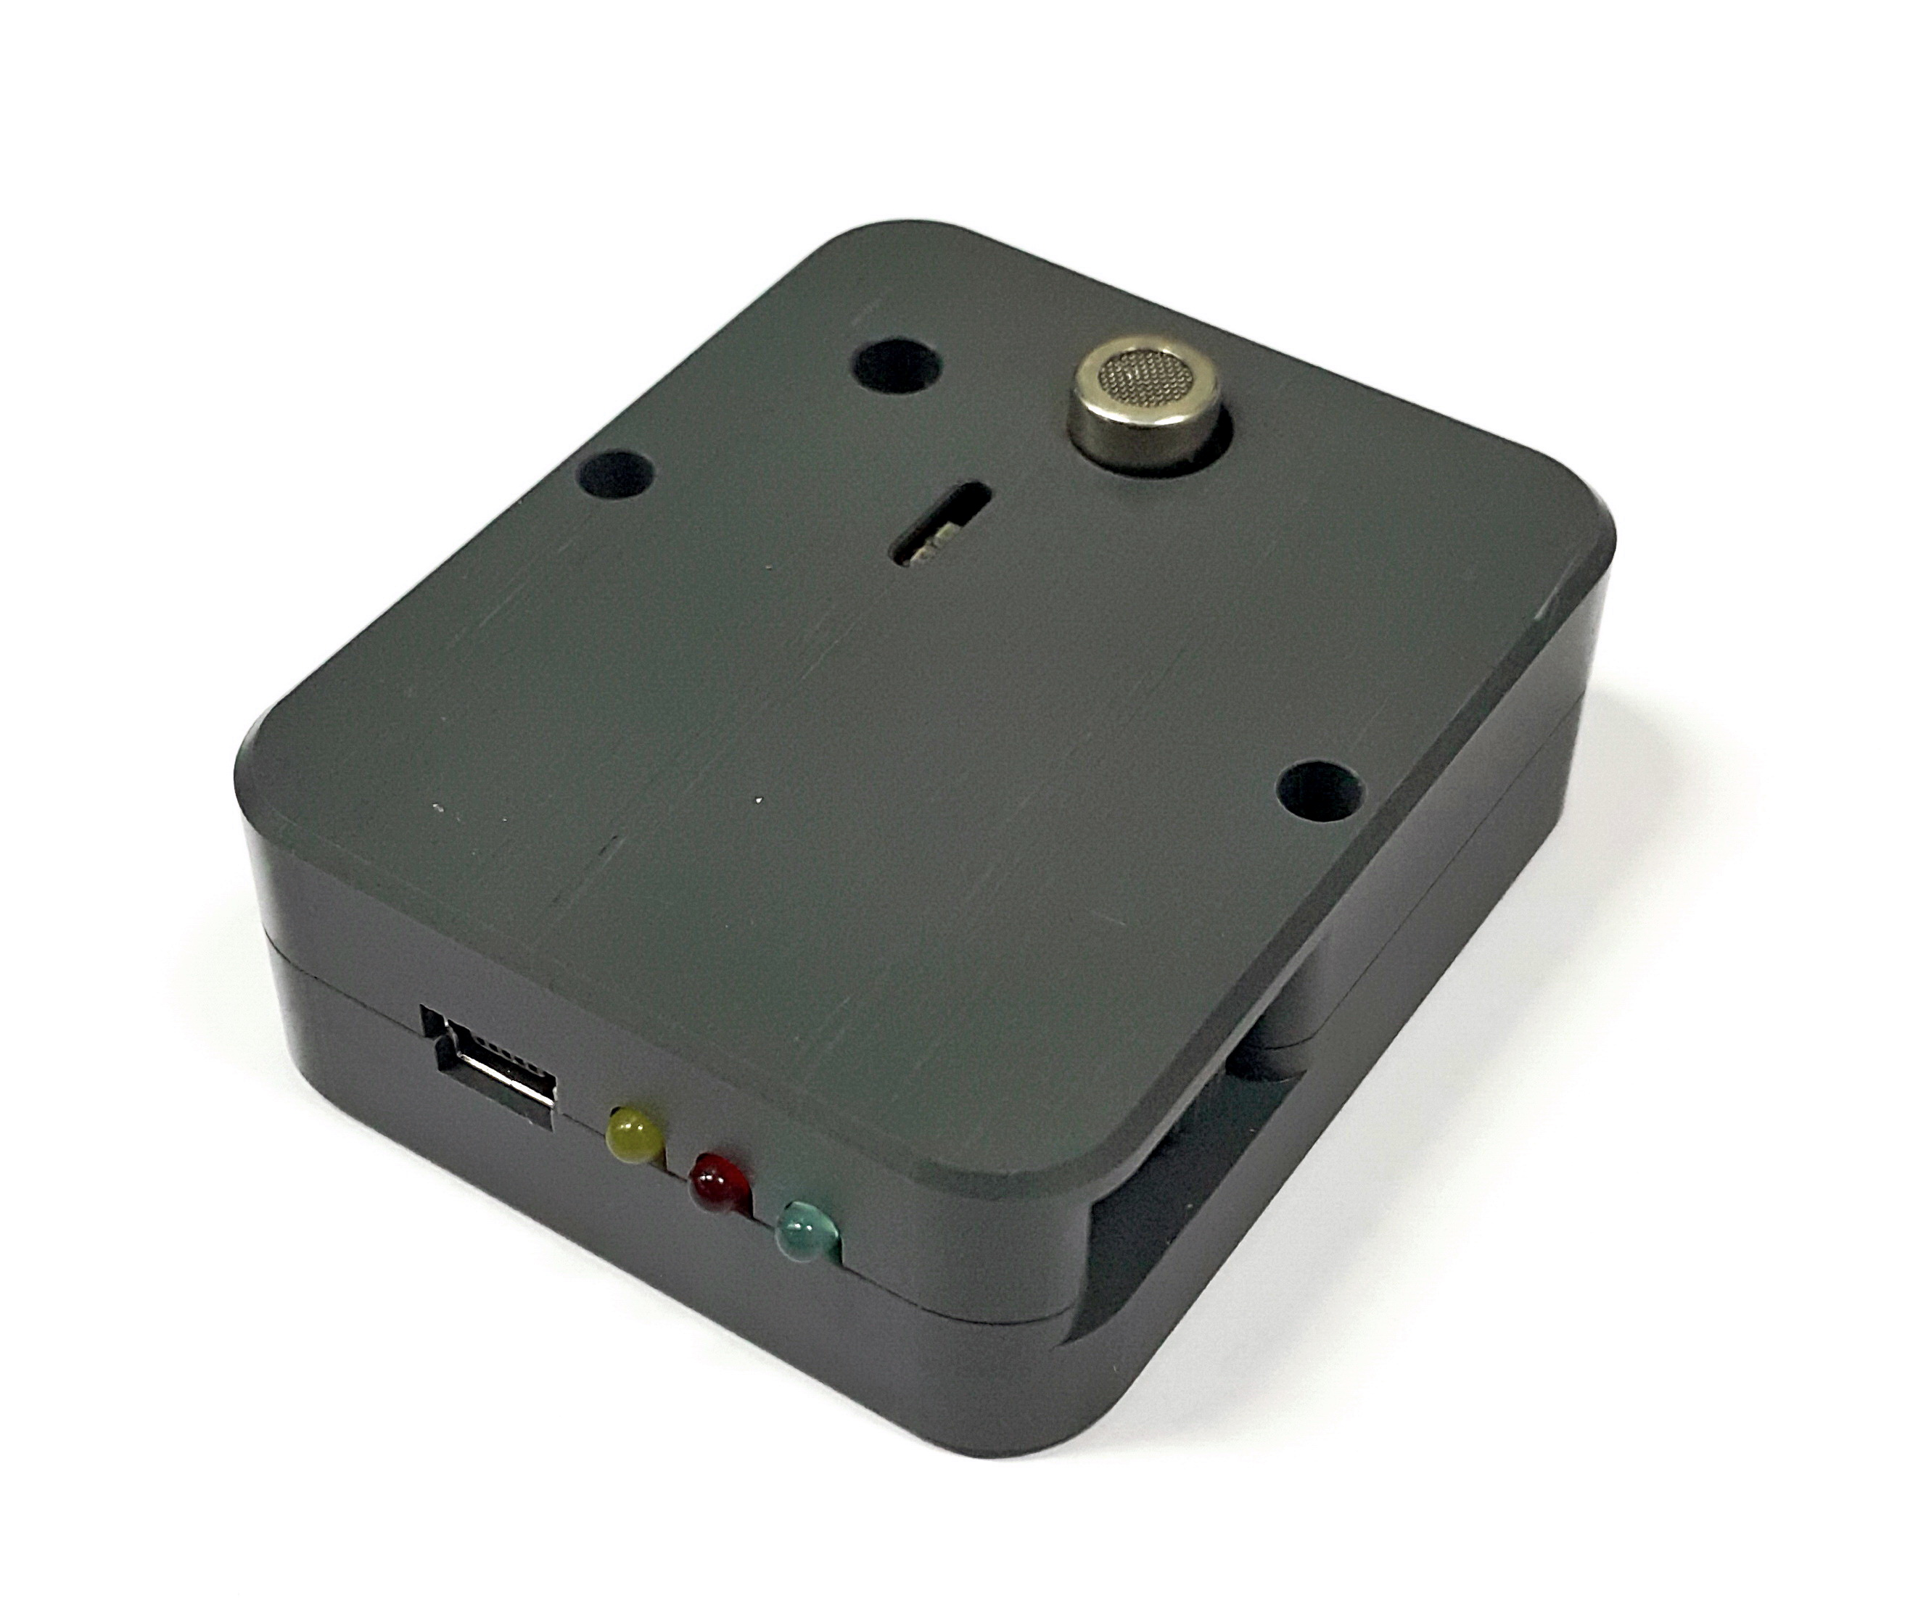
Concentration Sensors
Concentration sensors XEN-5320 from Xensor Integration.
WI-FI read out
Signal output:
- Hydrogen 0-100%
- Helium 0-100%
Measurement speed:
Standard: All data 3 Hz

Slide 5
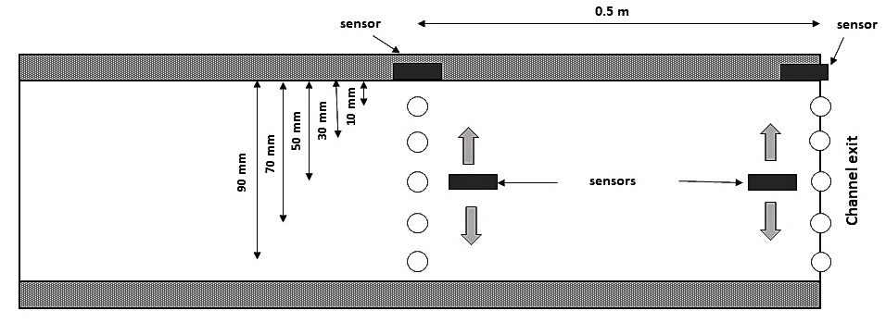
Concentration Sensors
Concentration sensors XEN-5320 from Xensor Integration.
WI-FI read out
Signal output:
- Hydrogen 0-100%
- Helium 0-100%
Measurement speed:

Slide 6
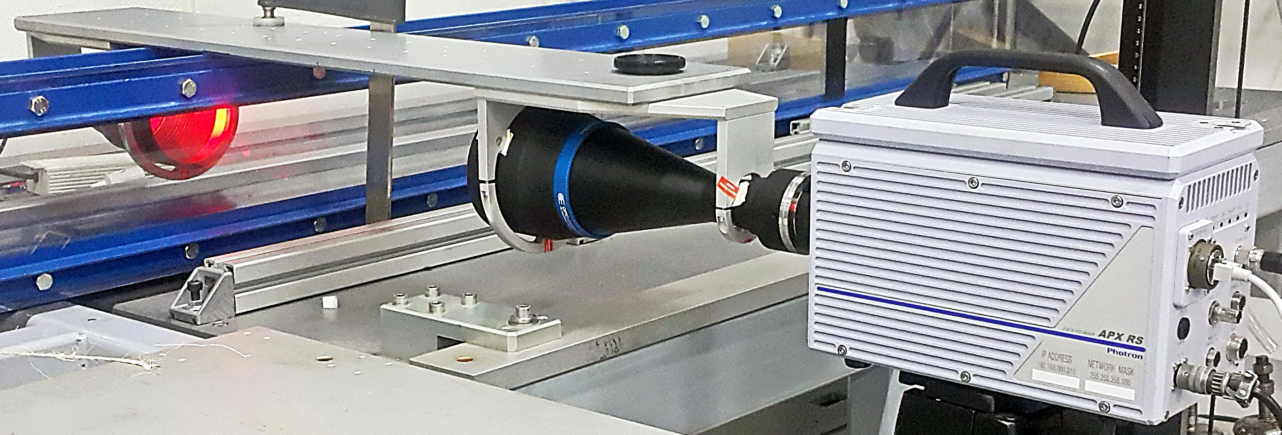
Shadowgraph Lens System (SLS)

Slide 7
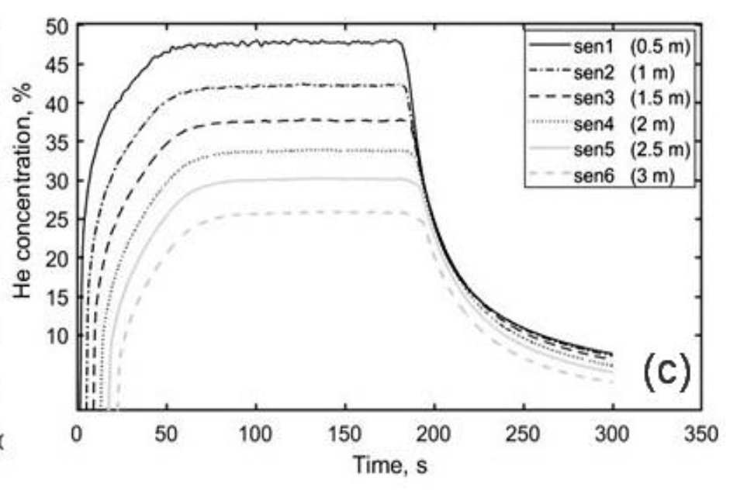
Results

Slide 8
Flow rate effect
Helium output concentration over time for upward release through 4 mm diameter pipe and at flow rates: (a) 5, (b) 15 and (c) 40 Ndm³/min

Slide 9
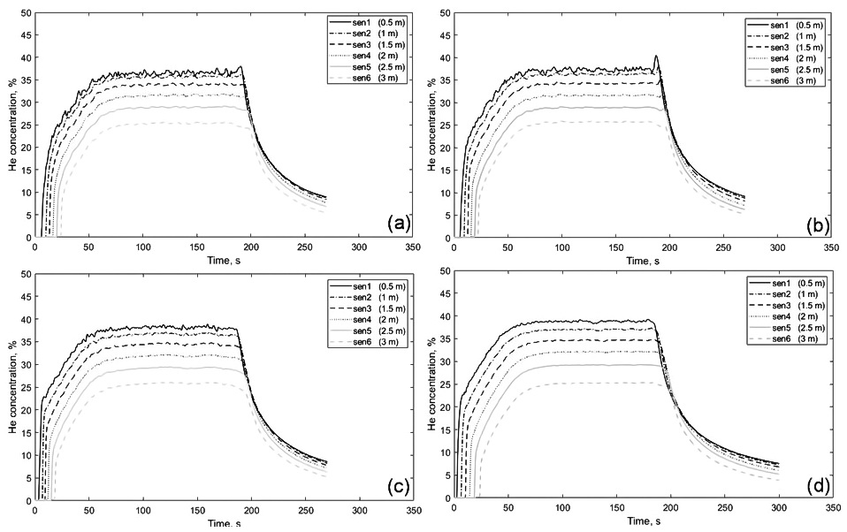
Nozzle size effects - Helium
Helium downward release at 40 Ndm3/min and through nozzle sizes: (a) 0.5, and (d) pipe diameter 4 mm.
D = 0.5 mm
D = 4.0 mm

Slide 10
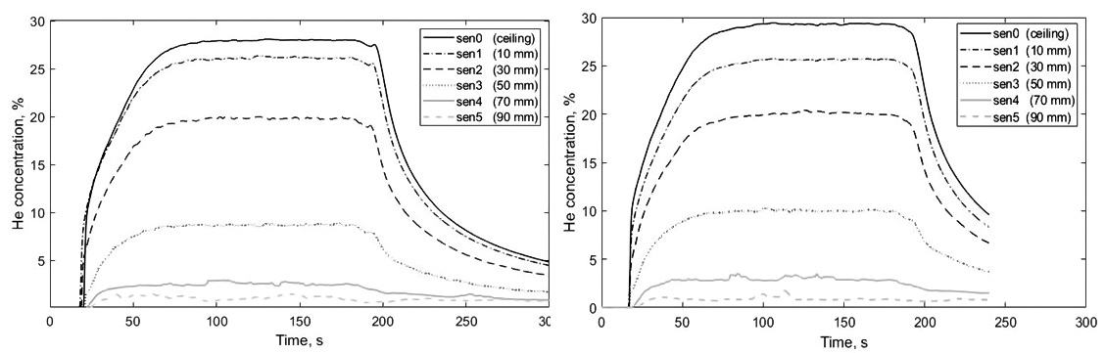
Nozzle size effects – Vertical distribution
Vertical concentration distribution over time of helium downward release at 40 Ndm³/min and through nozzle sizes, 2.5 mm (left) and pipe diameter 4 mm (right).
D = 2.5 mm
D = 4.0 mm

Slide 11
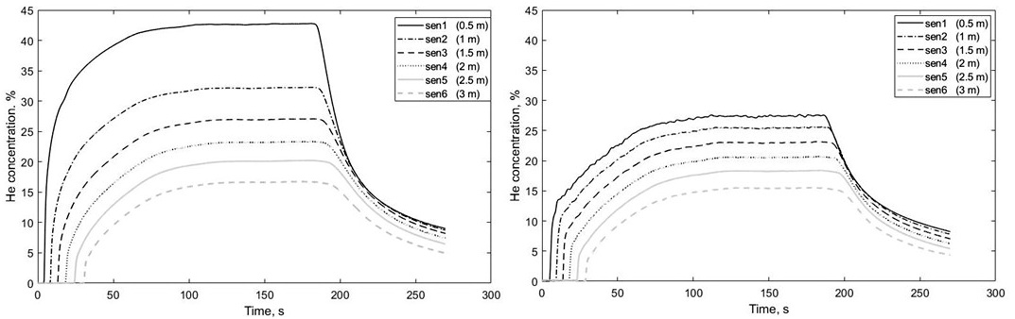
The influence of release direction – Horizontal distribution
Output helium concentration versus time for upward release, left and downward, right at flow rate 15 Ndm³/min and 2.5 mm nozzle size

Slide 12
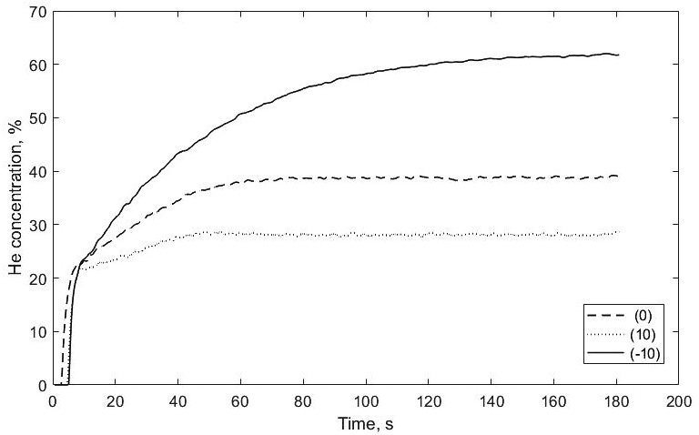
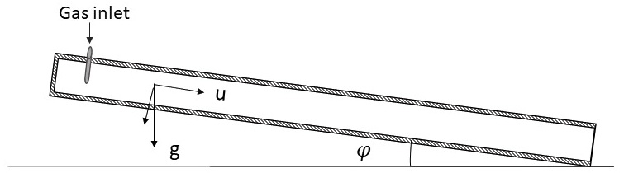
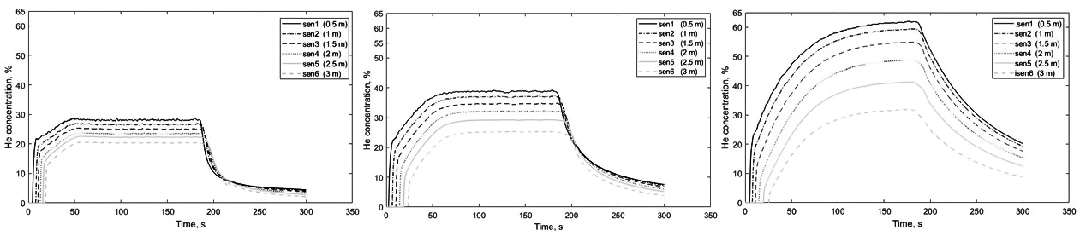
The influence of inclination
Helium concentration over time for downward release through 4 mm pipe at 40 Ndm³/min and in the channel with an inclination of -10°, left, horizontal, middle and inclination of 10°, right

Slide 13
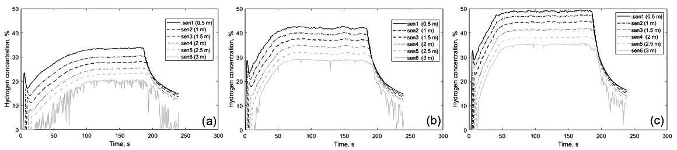
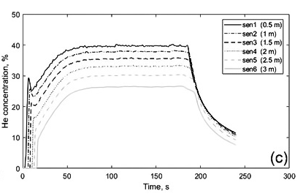
Comparison of hydrogen and helium results
H₂
He

Slide 14
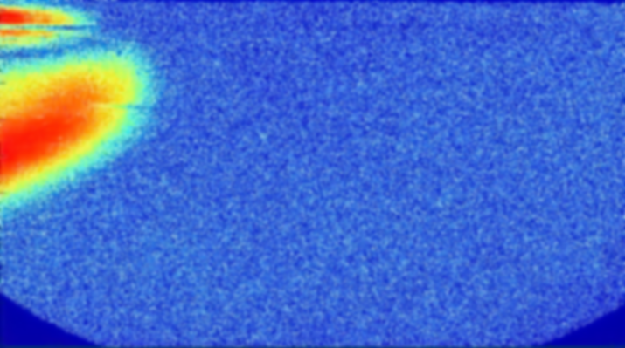
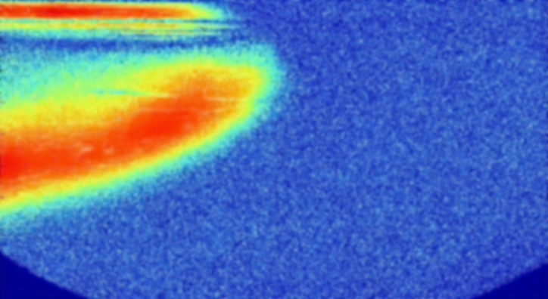
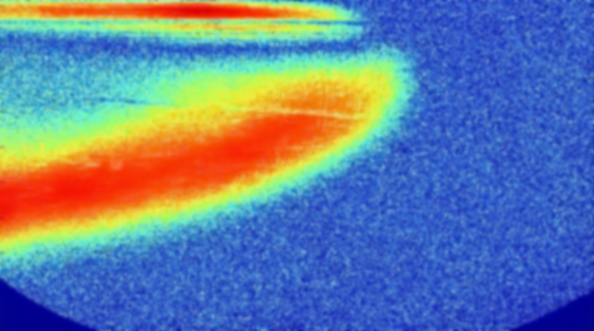
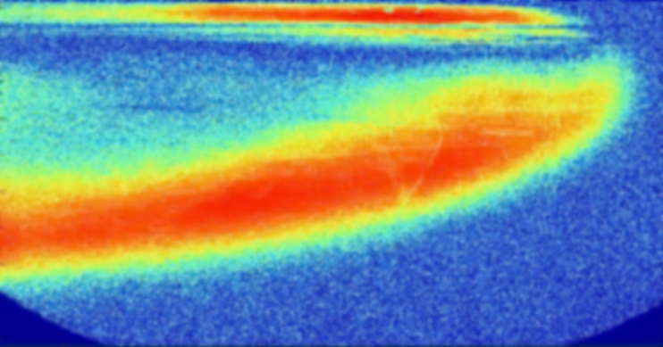
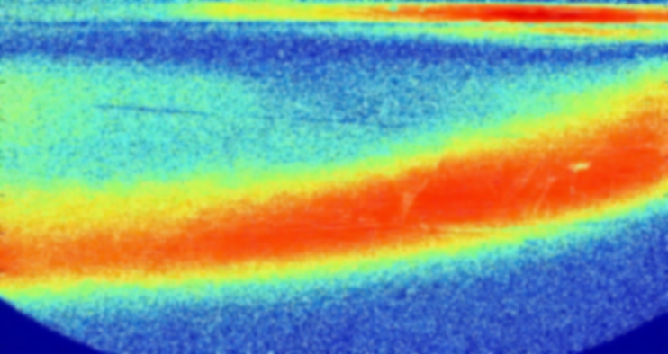
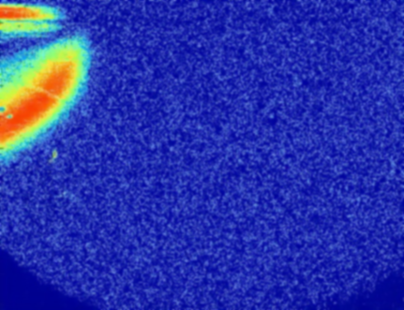
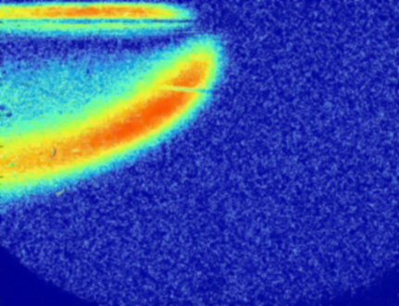
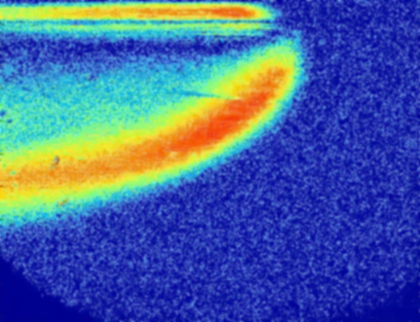
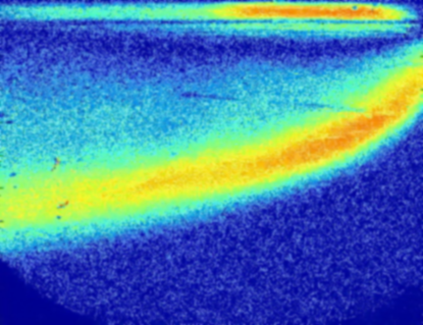
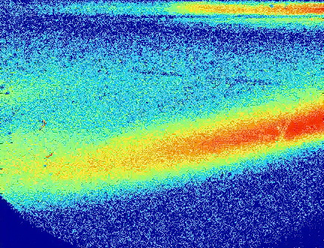
Concentration gradients of helium, upper series, and hydrogen, lower series, visualized by shadowgraph while the cloud propagating through the channel for at 1.5 m from the channel closed end for downward releases through 4 mm pipe and flow rate 40 Ndm³/min.
Helium
Hydrogen

Slide 15
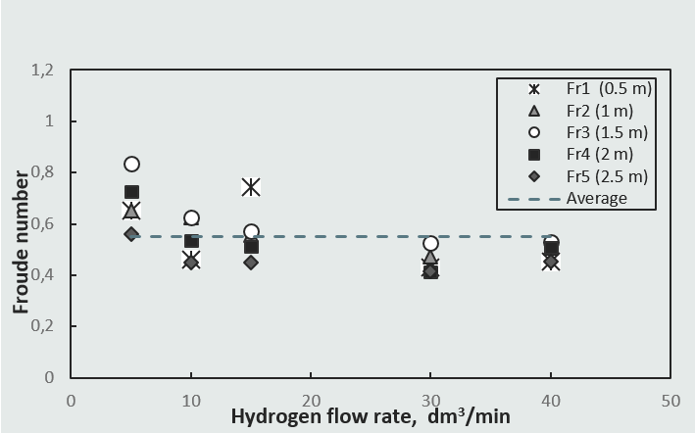
Froude Scaling

Slide 16
Conclusion
We have investigate dispersion of helium and hydrogen in partly confined 3 m long steel using concentration sensors with WI-FI read out
Concentrations were measured at various horizontal and vertical positions for releases at different flow rates, through different nozzle sizes and different injection directions.
The experiments confirmed that jet momentum- induced mixing happen close to release point and wave buoyancy-induced, away from it. Dispersion of helium in the channel characterized by the formation of inhomogeneous and stratified cloud.
The average Froude number obtained from concentration measurements is not in complete accord with the results from previous studies
This study contributes to the existing knowledge of hydrogen dispersion in confined spaces by providing practical data for further analyses and validation of CFD codes.

Slide 17
Acknowledgement
This work was performed within MoZEES, a Norwegian Centre for Environment-friendly Energy Research (FME), co-sponsored by the Research Council of Norway (project number 257653) and 40 partners from research, industry, and public sector.
The project has received funding from the Fuel Cells and Hydrogen 2 Joint Undertaking (JU) under grant agreement No 826193. The JU receives support from the European Union’s Horizon 2020 research and innovation programme.
The authors will like to thank the NREL sensor lab and William Buttner for contributing to this work and discussions regarding the sensors. The contribution is greatly appreciated.

