Slide 1
Evaluation of an improved vented deflagration CFD model against nine experimental cases
Tolias, I.C.¹, Venetsanos, A.G.¹, Kuznetsov, M.²
¹Environmental Research Laboratory, National Centre for Scientific Research Demokritos, Agia Paraskevi, Athens, 15341, Greece
²Institute of Nuclear and Energy Technologies, Karlsruhe Institute of Technology, Hermann-von-Helmholtz-Platz 1, 76344, Eggenstein-Leopoldshafen
tolias@ipta.demokritos.gr

Slide 2
Introduction
Hydrogen
Significant reductions in greenhouse gas emissions
Significant improvements in energy efficiency
Accidental release in closed space catastrophic consequences in the case of an explosion
Much higher over-pressure compared open space
A way of mitigation: Vents
Computational Fluid Dynamics (CFD)
Attractive methodology for risk assessment: Accurate modelling of the geometry and the flow
Turbulent combustion difficulties: Very large range of scales
Models are needed

Slide 3
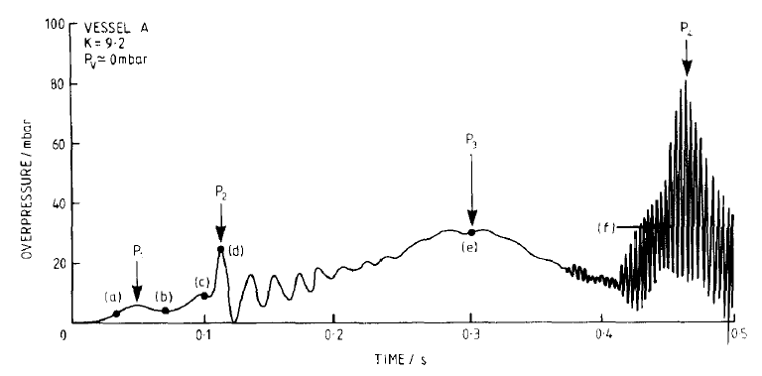
Introduction
The aim of the work is the improvement of a CFD model and the evaluation against vented deflagration experiments.
Vented deflagrations
Many overpressures peaks may appear
opening of the vent
external explosion
instabilities due to flame-acoustic interaction

Slide 4
CFD model
Deflagration model: LES with Multi-phenomena turbulent burning velocity model (Molkov 2012)¹
Gradient method:
Turbulent flame speed:
Ξ_{k} : Turbulence generated by the flame front itself
Ξ_{lp} : Leading point concept – preferential diffusion
Ξ_{f} : Increase of flame surface due to its fractal geometry
Promising model which, however, fails to reproduce external explosion in vented deflagrations
¹Molkov, V., Fundamentals of Hydrogen Safety Engineering II, BookBoon, 2012

Slide 5
CFD model
Changes made in the original model¹:
Account for subgrid scale phenomena (instabilities)
No modification of the laminar burning velocity
Wrinkling factors Ξ multiply the turbulent flame velocity
Turbulent flame speed: Schmid’s equation² instead of Yakhot’s equation³
More recent relation which account for Damköhler number
Turbulence approach: k-ε model (Kato, Launder 1993)⁴ instead of LES
Less strict requirements of k-ε model in terms of grid and numerical schemes
Initial model
New model
⁴Kato M, Launder BE. The modeling of turbulent flow around stationary and vibrating square cylinders. In: Ninth Symp. Turbul. Shear Flows, Kyoto, Japan, 16-18 August, 1993
³Yakhot V., 1988, Propagation Velocity of Premixed Turbulent Flames. Combust Sci Technol, 60, 191–214
²Schmid H-P, Habisreuther P, Leuckel W. A, 1998, Model for Calculating Heat Release in Premixed Turbulent Flames. Combust Flame, 113, 79–91
¹Tolias I.C., Venetsanos A.G., 2018, An improved CFD model for vented deflagration simulations – Analysis of a medium-scale hydrogen experiment, IJHE, 43 (52), 23568-84
Notes:
We performed the following changes in the model in order to improve its accuracy:
The first change is about how we account for the subgrid scale phenomena.
We do not modify the laminar burning velocity in the turbulent burning velocity relation. As a result the impact of turbulence on the flame remains unchanged.
In order to account for the instabilities, the Ξ factors multiples the turbulent flame velocity and not the laminar one like in the initial model.

Slide 6
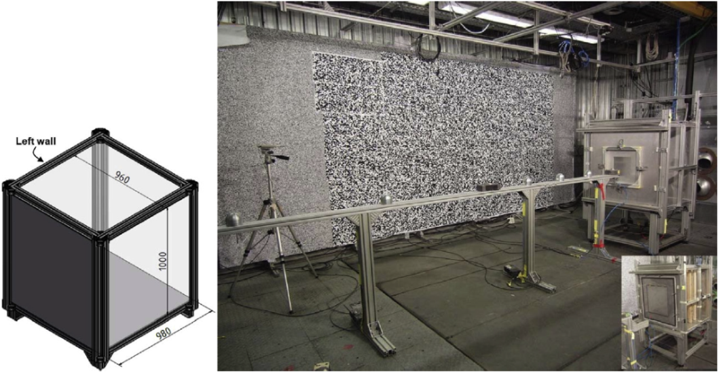
Experiments
KIT medium scale vented experiment (Kuznetsov et al. 2015)^{1,2}
0.94 m³ enclosure (0.98 x 0.96 x 1.0 m)
Vent 0.5 x 0.5 m²
18.0 % v/v hydrogen-air homogeneous mixture
Back-wall ignition
Pressure measurement inside & outside the enclosure
¹Kuznetsov, M., et al. (2015), Medium-scale experiments on vented hydrogen deflagration, Journal of Loss Prevention in the Process Industries, 36, 416-428
²HyIndoor project, Pre-normative research on safe indoor use of fuel cells and hydrogen Systems, www.hyindoor.eu

Slide 7
Experiments
Experimental overpressure

Slide 8
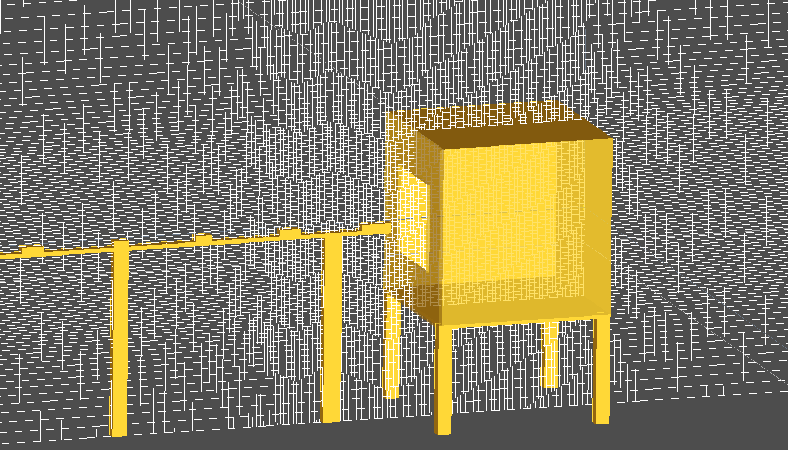
Simulation set-up
ADREA-HF CFD code
Navier-Stokes equations + Continuity equation
Energy equation (conservation equation of total enthalpy)
Conservation equations of mass fractions
k-ε turbulence model (Kato & Launder modification)
Numerical details
Bounded second order upwind method
CFL=0.2, fully implicit first order scheme
Stagnant initial flow field, very low values of k and ε (1.0e-06)
Three computational grids:
714,000 cells (dx=0.03 m)
1,539,000 cells (dx=0.02 m)
2,726,000 cells (dx=0.015 m)

Slide 9
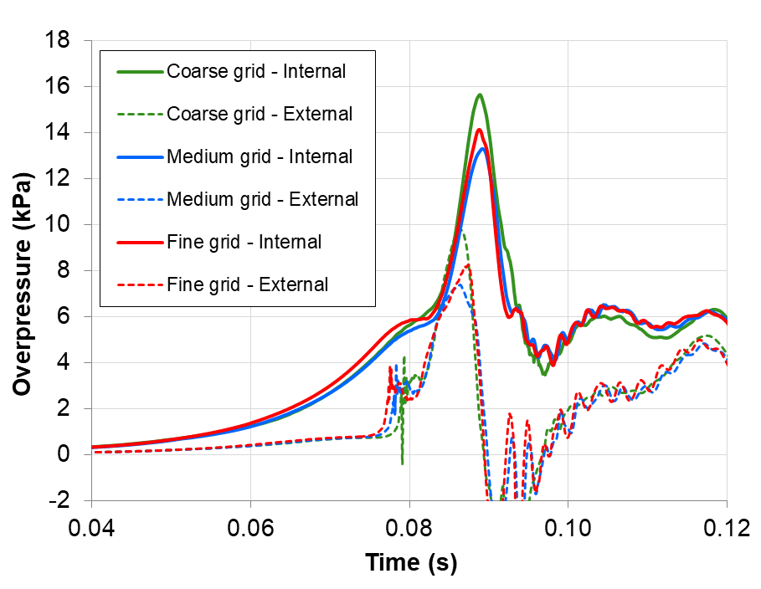
Simulation results
Grid independency study

Slide 10
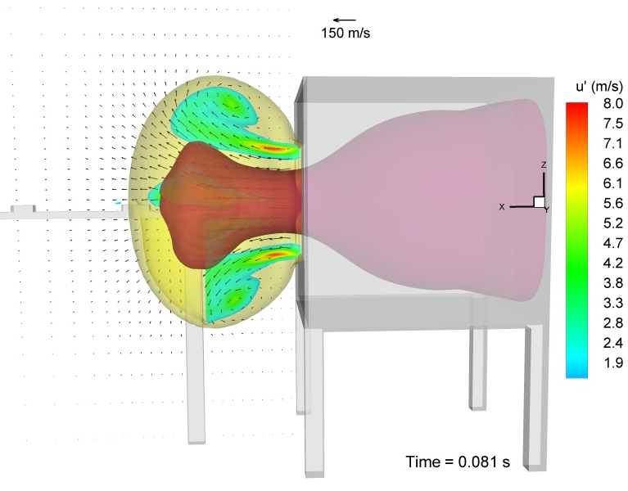
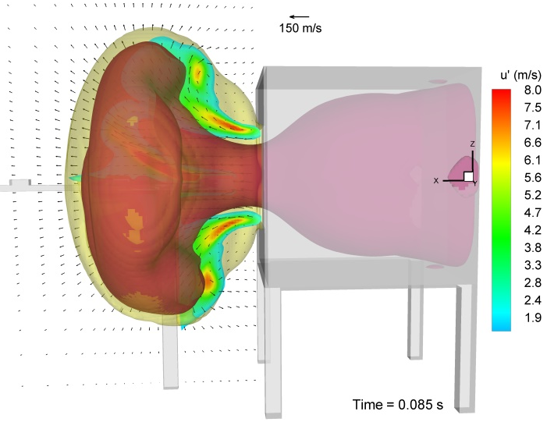
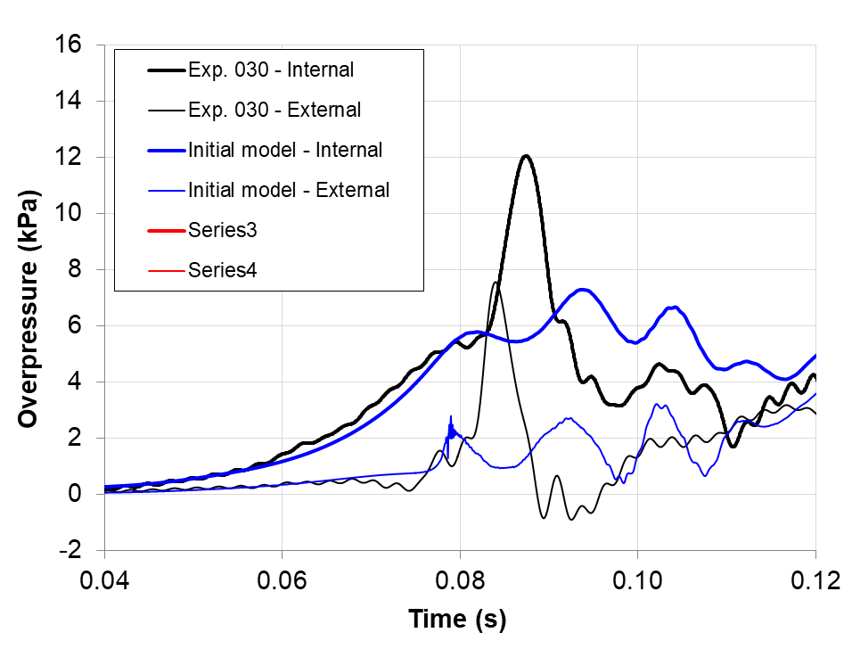
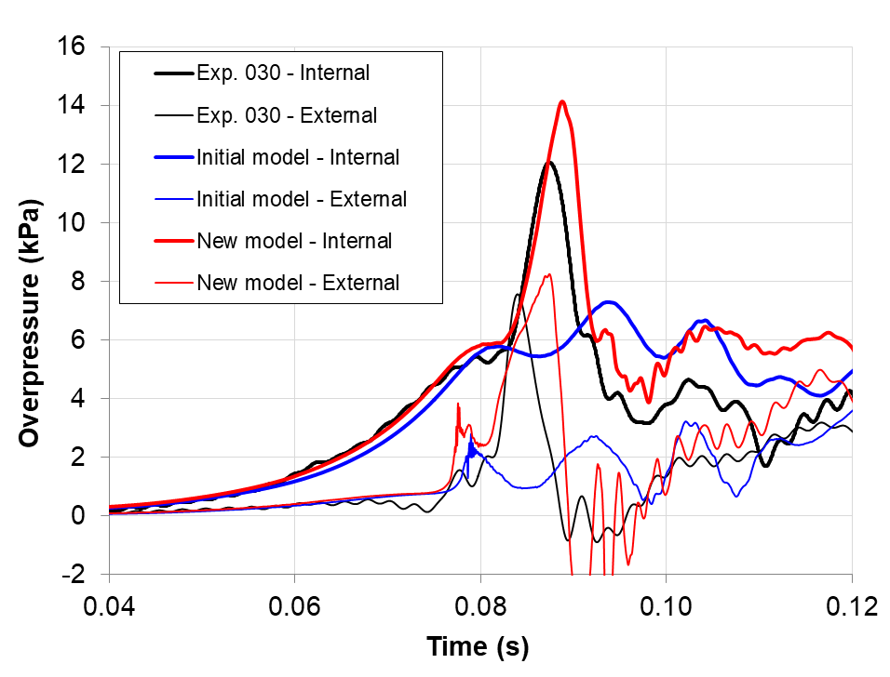
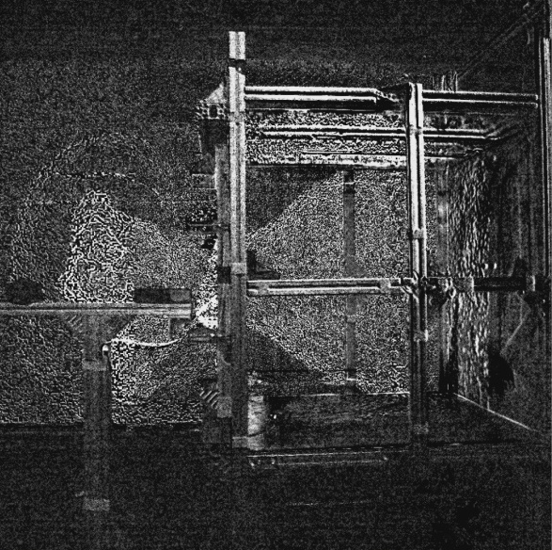
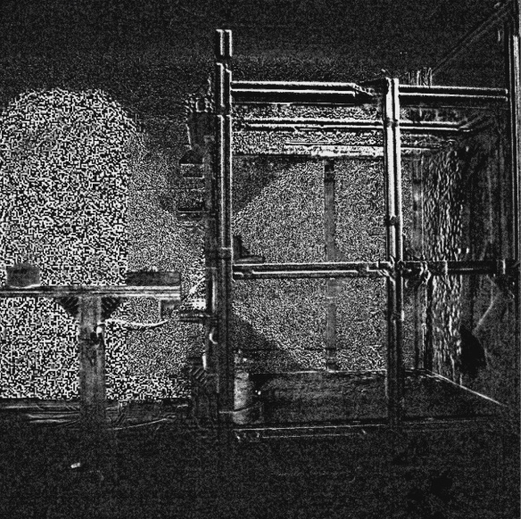
Simulation results
Comparison with experiment

Slide 11
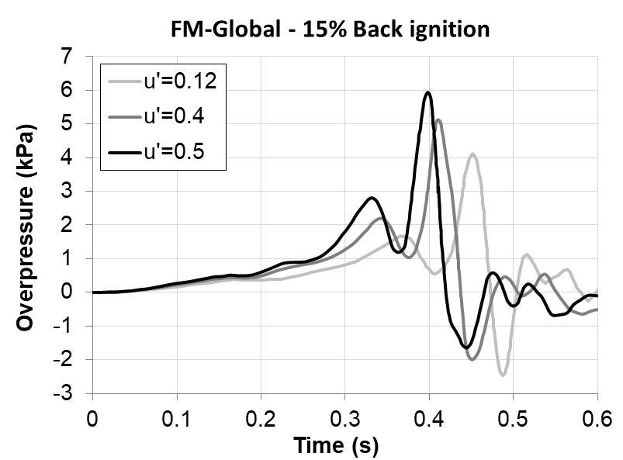
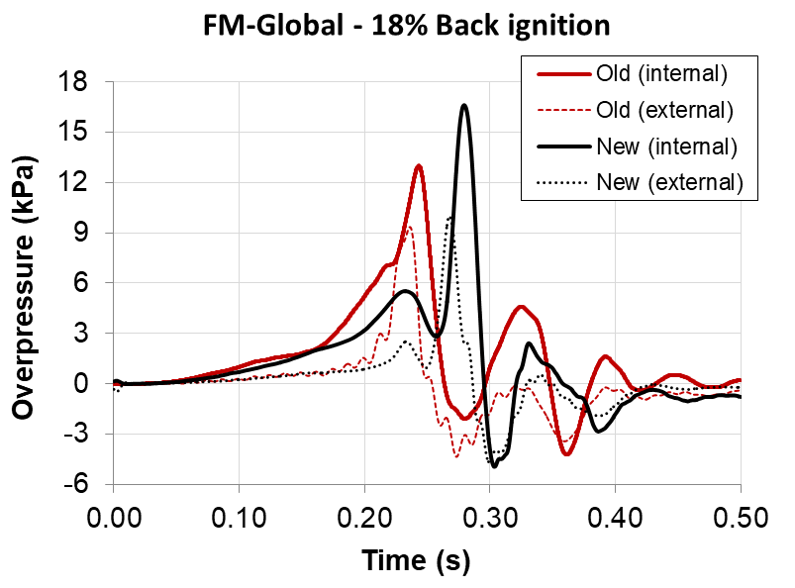
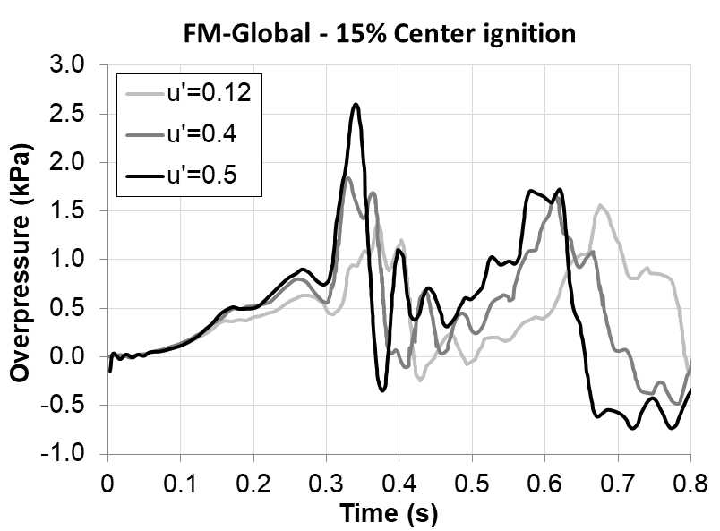
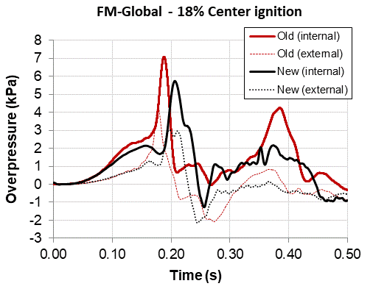
Experiments
FM-Global experiments in a real scale room (Bauwens et al.)^{1,2,3}
63.48 m³ enclosure (4.6 x 4.6 x 3.0 m)
Vent 5.4 x 5.4 m²
Back-wall or central ignition
Two groups of experiments
18.0 % v/v hydrogen-air homogeneous mixture (2 cases)
Back ignition
Central ignition
15.0 % v/v hydrogen-air homogeneous mixture with initial turbulence (6 cases)
Back ignition: 3 cases of initial turbulence
Central ignition: 3 cases of initial turbulence
¹Bauwens CR, Chaffee J, Dorofeev SB., 2011, Vented explosion overpressures from combustion of hydrogen and hydrocarbon mixtures. Int J Hydrogen Energy, 36, 2329–36.
²Bauwens CR, Dorofeev SB. Hydrogen Vented Deflagrations at FM Global: Tests and Modeling. Presentation in “Advanced Research Workshop: Progress in safe indoor use of fuel cells and hydrogen systems”, September 12th, 2013.
³Bauwens CR, Dorofeev SB., 2014, Effect of initial turbulence on vented explosion overpressures from lean hydrogen–air deflagrations. Int J Hydrogen Energy, 39,20509–15.

Slide 12
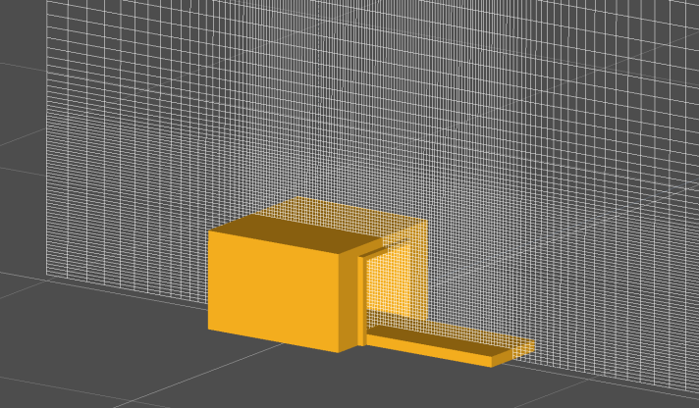
Simulation set-up
ADREA-HF CFD code
Same equations and numerical parameters like previous simulation
Symmetry was assumed
Two computational grids:
395,560 cells (dx=0.150 m)
893,412 cells (dx=0.100 m)

Slide 13
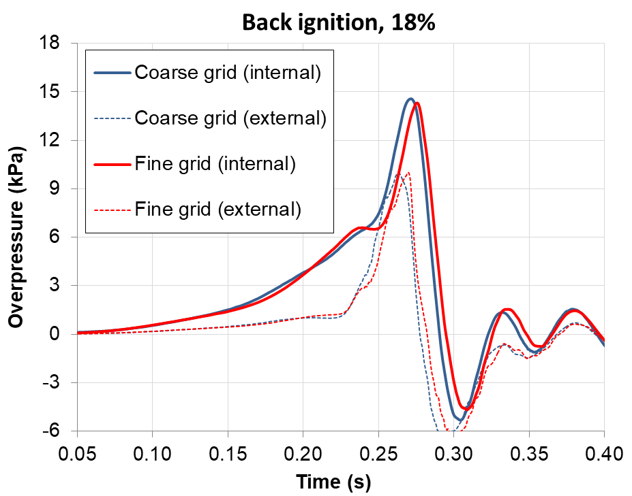
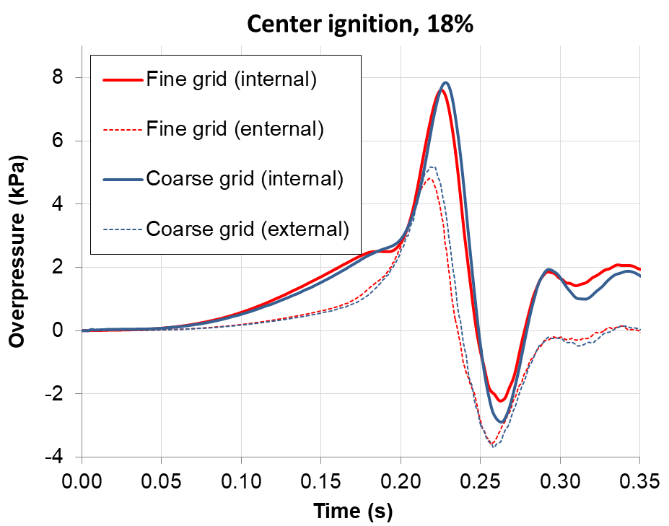
Simulation results – 18% FM-Global cases
Grid independency study

Slide 14
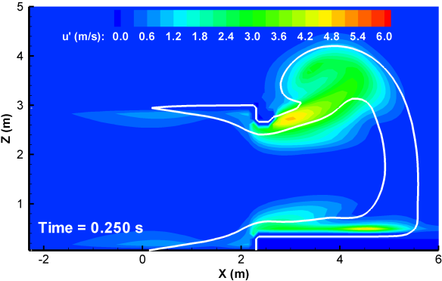
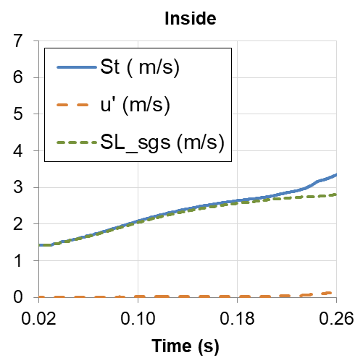
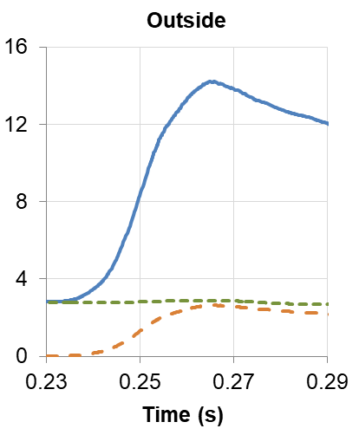
Simulation results – 18% FM-Global cases
Back ignition: 14% underprediction

Slide 15
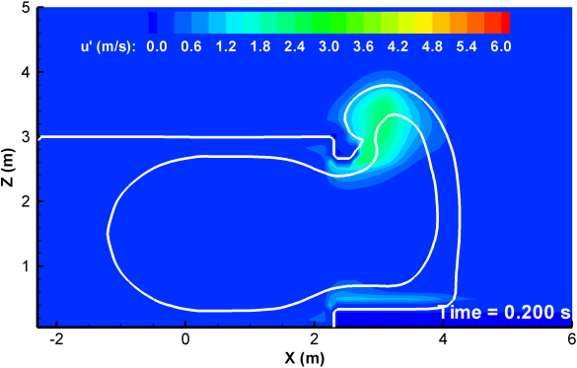
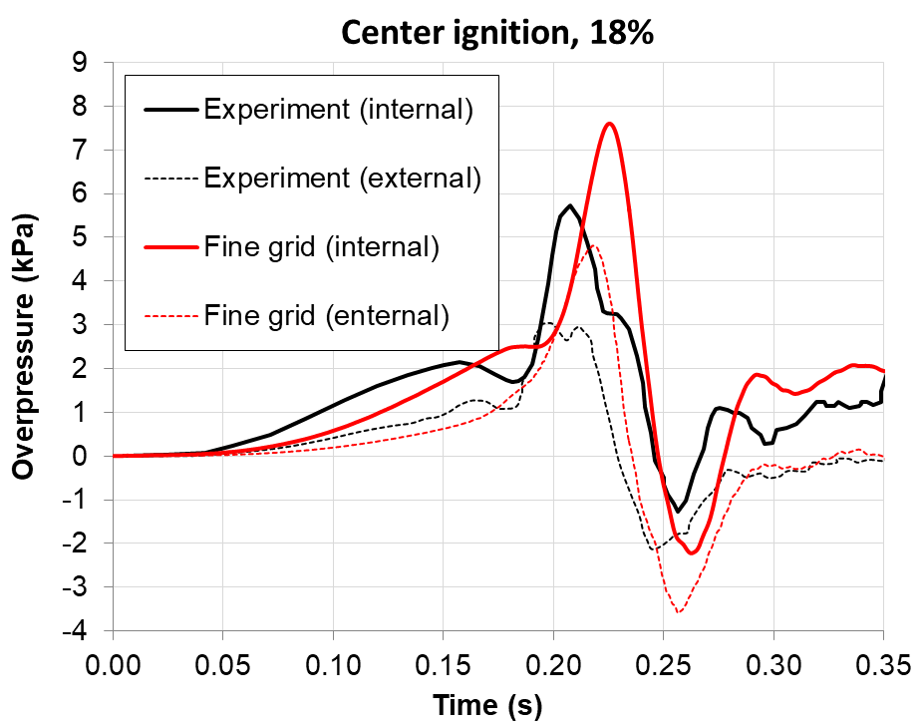
Simulation results – 18% FM-Global cases
Center ignition: 32% overprediction

Slide 16
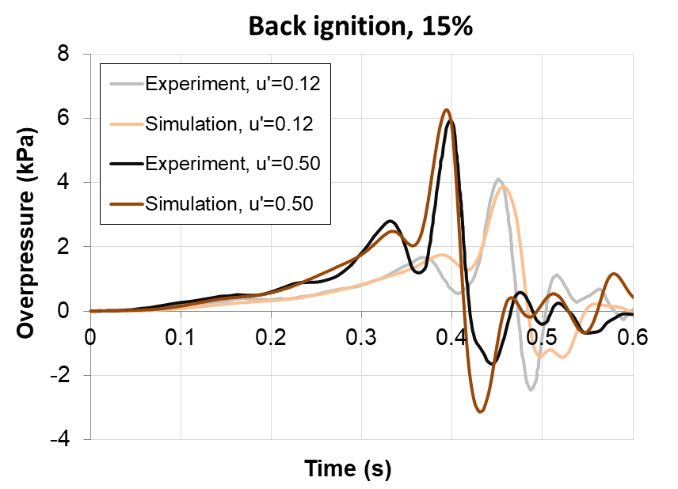
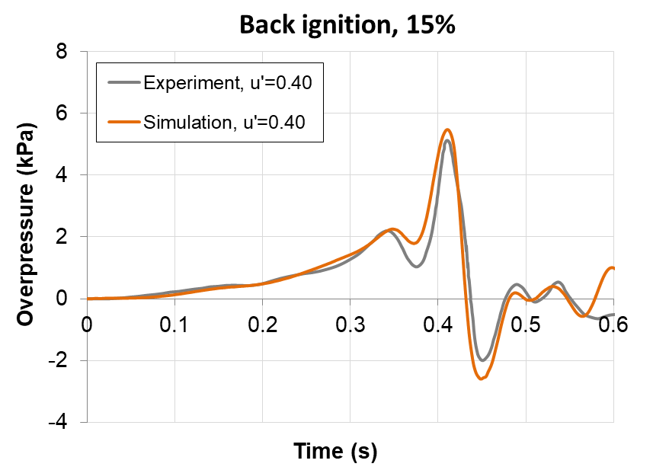
Simulation results – 15% FM-Global cases
Modelling of initial turbulence: A single constant factor was added¹, Ξ_{T0}
u’ (m/s) | Ξ_{T0}
0.12 | 1.00
0.40 | 1.12
0.50 | 1.17
¹Bauwens CR, Dorofeev SB., 2014, Effect of initial turbulence on vented explosion overpressures from lean hydrogen–air deflagrations. Int J Hydrogen Energy, 39,20509–15.

Slide 17
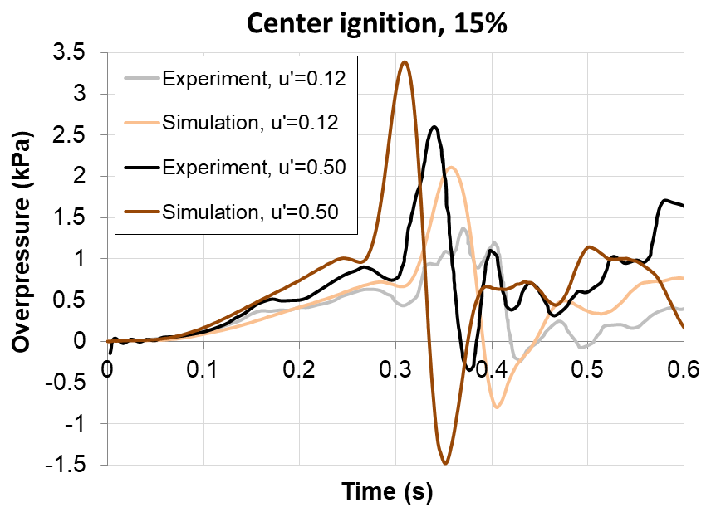
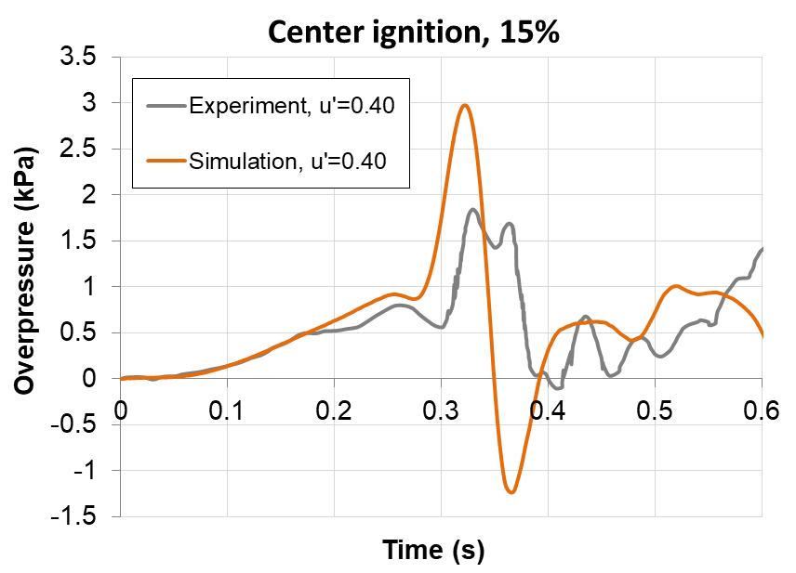
Simulation results – 15% FM-Global cases
Center ignition cases
Overprediction 30-61 %
The deviations from the experiments in the central ignition cases are likely to be partially caused by the omission of a vent cover opening model
¹Bauwens CR, Dorofeev SB., 2014, Effect of initial turbulence on vented explosion overpressures from lean hydrogen–air deflagrations. Int J Hydrogen Energy, 39,20509–15.

Slide 18
Conclusions
A newly developed CFD model for vented deflagration simulations was presented.
Very good qualitative performance in most cases.
New model predicts the violence of the external explosion very accurately
Very good performance for the back ignition cases: Maximum deviation of max. overpressure equal to 17%.
In central ignition cases, the model overpredicted the maximum overpressure up to 61%.
Vent opening may have a more considerable impact on these cases.
Initial turbulence: it was reproduced successfully by applying only a constant factor in the burning velocity.
Physics of the phenomenon:
Inside the enclosure: flame instabilities
Outside the enclosure: turbulence

Slide 19
Ευχαριστώ! (Thank you)
Questions
Acknowledgements: This Publication is supported by the program of Industrial Scholarships of Stavros Niarchos Foundation, Greece. The authors would like to gratefully thank Dr. Regis Bauwens for providing experimental data for the FM-Global experiments.

Slide 20
Simulation set-up
Combustion parameters
Hydrodynamic instability:

