Slide 1


ID154： Near-term location of hydrogen refueling stations in Yokohama city from the perspective of safety
International Conference on Hydrogen Safety
September, 24-26 2019, Adelaide (Australia)
Fuse, M.¹, Kawanishi, N.¹,Noguchi, H.¹, and Seya, H²
¹Graduate School of Engineering, Hiroshima University
²Graduate School of Engineering, Kobe University
This study was funded by the Japan Science and Technology Agency (JST), and the Cross-ministerial Strategic Innovation Promotion Program (SIP).

Slide 2
Hydrogen Refueling Stations in Japan
Introduction
Toward a hydrogen economy in Japan
Fuel cell vehicles (FCVs)
Hydrogen refueling stations (HRSs)
National level road map by METI
200,000 FCVs by 2025 (3,000 FCVs in 2019)
320 HRSs by 2025 (100 HRSs in 2019)
Safety of hydrogen refueling station
Hydrogen refueling station in Kofu, Japan
© Iwatani Corporation
Social acceptance; the neighbor’s objection
Needs for near-term location plan of safe hydrogen refueling station at city level
Notes:
As well know で水素は危険性をもつ

Slide 3
Previous Studies and Aim
Introduction
HRS Location study
Demand-based approach
P-median model
Flow interception model
Travel time
Supply-based approach
Life cycle cost for supply
Supply-Demand approach
This study: safety perspectives
The aim is to plan the HRS locations over the years 2020–2030 in Yokohama City.
Notes:
As well know で水素は危険性をもつ

Slide 4
Yokohama City in Japan
Method
A city at the forefront of Japan's push toward a hydrogen economy
3.7 million people, big industrial zone and port, and 4 stationary and 2 mobile HRSs
Notes:
As well know で水素は危険性をもつ

Slide 5
Approach in planning hydrogen station locations
Method
Safety
Notes:
As well know で水素は危険性をもつ

Slide 6



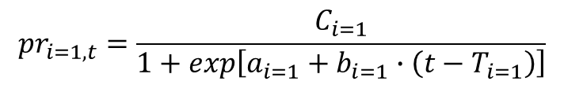


Demand Model
Method
FCV demand at neighborhood level
$${FCV}_{ijt}=\frac{{HV}_{jt}}{\sum_{j}{{HV}_{jt}}}∙{FCV}_{it}$$
FCV demand at city level
$${FCV}_{it}={pr}_{it}∙{PC}_{t}$$
Passenger vehicle demand
$${PC}_{t}=\left(a_{0}+b_{0}∙t\right)∙P_{t}$$
P: Population
Replacement rate
to FCV from FCV
Optimistic scenario
$${pr}_{i=1,t}=\frac{C_{i=1}}{1+exp\left[a_{i=1}+b_{i=1}∙\left(t−T_{i=1}\right)\right]}$$
Pessimistic scenario
$${pr}_{i=3,t}=a_{i=3}+b_{i=3}∙{\left(t−T_{i=3}\right)}^{2}+C_{i=3}∙\left(t−T_{i=3}\right)$$
Intermediate scenario
$${pr}_{i=2,t}=\frac{{pr}_{i=1,t}+{pr}_{i=3,t}}{2}$$
Allocation from city level to neighborhood level
$${HV}_{jt}={HV}_{j,t=2016}+\frac{{HV}_{j,t=2016}−{HV}_{j,t=2009}}{8}∙\left(t−2016\right)$$
HV: Hybrid Vehicles
Notes:
As well know で水素は危険性をもつ

Slide 7
Demand Model Parameters
Method
Model Assumptions
Optimistic scenario: FCVs has the similar demand trend of hybrid vehicles.
Pessimistic scenario: FCVs has the similar demand trend of electric vehicle.
Neighborhood level trend of FCVs has the same as that of hybrid vehicles.
Estimation Results of Model Parameters
 | Passenger vehicle ownership model | Hybrid vehicle replacement rate model (Optimistic scenario) | Electric vehicle replacement rate mode (Pessimistic scenario)
a | 6.4 | 790 | 170
b | -0.0031 | -0.39 | 0.000043
c |  | 0.25 | -0.17
R² | 0.96 | 0.98 | 0.99
n | 14, 2004-2017 | 20, 1998-2017 | 20, 1998-2017
Notes:
As well know で水素は危険性をもつ

Slide 8
Supply Model
Method
Model Assumptions
HRS type:
  Off-site-type stationary
  300 Nm³
  70MPa
  900 FCVs
Area: 700 m² by the safety regulations in Japan
Candidate place: surplus areas of gas stations
HRS candidates
Model Results
327 gas stations in Yokohama
95 HRS candidates with over 700 m² surplus areas
Surplus areas of gas stations in Yokohama City
Notes:
As well know で水素は危険性をもつ

Slide 9
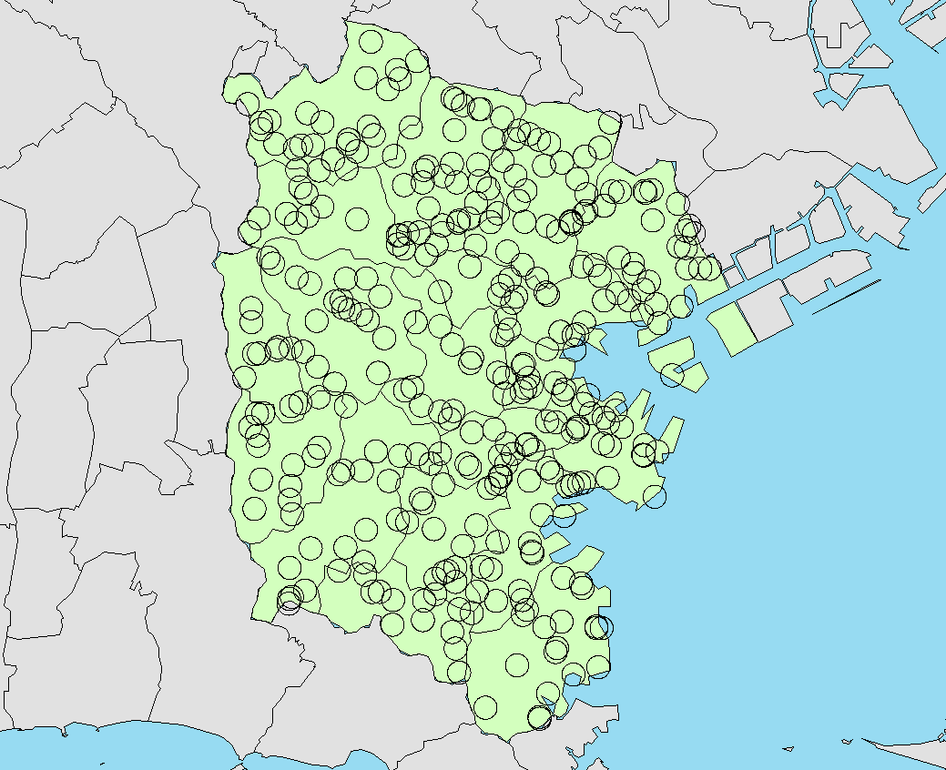
Supply-Demand Matching
Method
GIS superimposing analysis
Estimation data on FCV demand at Neighborhood level
Location data on HRS candidate
Calculate FCV demand of circles with radius 500 m around HRSs
Matching rule
Select HRSs in descending order of FCV demand (highest first) until reaching the maximum HRS
To avoid the overlapping, the selection is conducted by each ward (18 wards in Yokohama City).
Spatial distribution of circles around gas stations
In the case of radius 500 m
Notes:
As well know で水素は危険性をもつ

Slide 10
Number of Fuel Cell Vehicles owned in Yokohama
Results
Notes:
As well know で水素は危険性をもつ

Slide 11
Hydrogen Refueling Stations in Yokohama, Optimistic Scenario
Results
Notes:
As well know で水素は危険性をもつ

Slide 12
Hydrogen Refueling Stations in Yokohama, Intermediate Scenario
Results
Notes:
As well know で水素は危険性をもつ

Slide 13
Hydrogen Refueling Stations in Yokohama, Pessimistic Scenario
Results
Notes:
As well know で水素は危険性をもつ

Slide 14
Optimistic Scenario Location in Yokohama, 2030
Results
FCV demand at neighborhood level
Location of HRSs
Notes:
As well know で水素は危険性をもつ

Slide 15
Intermediate Scenario Location in Yokohama, 2030
Results
FCV demand at neighborhood level
Location of HRSs
Notes:
As well know で水素は危険性をもつ

Slide 16
Pessimistic Scenario Location in Yokohama, 2030
Results
FCV demand at neighborhood level
Location of HRSs
Notes:
As well know で水素は危険性をもつ

Slide 17
Conclusion
Summary
This study planned the location of hydrogen refueling stations (HRSs) in Yokohama City from 2020 to 2030, from the safety perspectives.
In this near-term plan, the existing HRSs could supply the FCVs up to 2024, and after that, the new HRS installations depend on the future scenarios.
Findings
In the long-term plan, the limitations in supplying the HRS supply will occur due to the luck of gas stations with a large surplus area.
Revisiting regulations on safety buffer zones and designing more compact HRS are options to mitigate the limitations in the planning.
Future works
The suggestions for revisiting safety regulations and designing compact HRS based on acceptable risk are future works.
Notes:
As well know で水素は危険性をもつ

Slide 18
Thank you very much for your attention !
masa-fuse@hiroshima-u.ac.jp

Slide 19
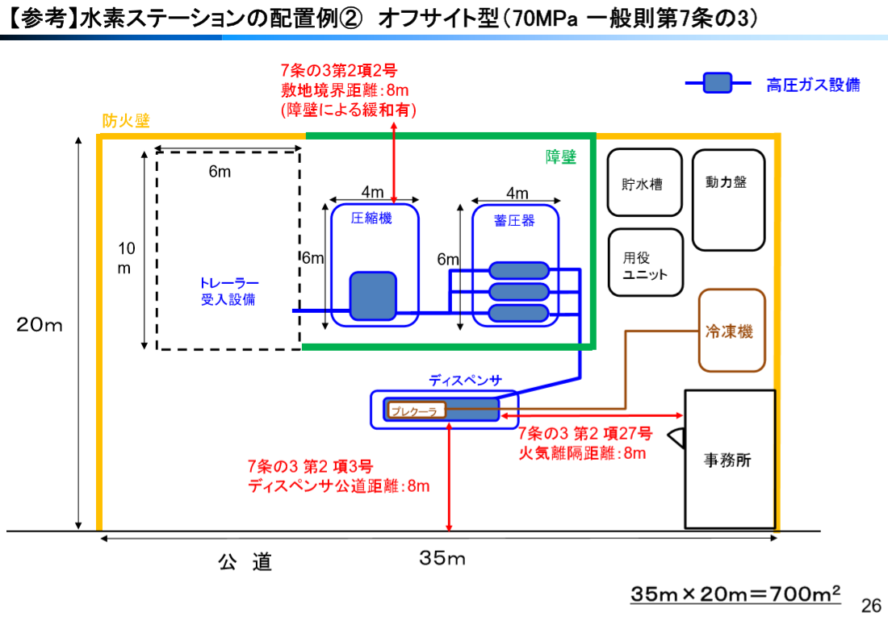
Japan Hydrogen & Fuel Cell Demonstration Project, The report of JHFC Phase 2: FY2006-2010,
Notes:
As well know で水素は危険性をもつ

