Slide 1
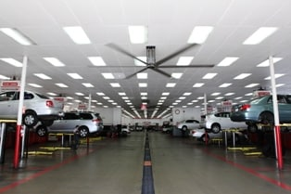
Risk Assessment and Ventilation Modeling for Hydrogen Vehicle Repair Garages
Brian Ehrhart, Shaun Harris, Myra Blaylock, Alice Muna, Spencer Quong (QAI), Dany Oliva (TMNA)
Sandia National Laboratories
International Conference on Hydrogen Safety
September 24, 2019
Paper # 236
SAND2019-10691 C
This presentation does not contain any proprietary, confidential, or otherwise restricted information
Sandia National Laboratories is a multimission laboratory managed and operated by National Technology & Engineering Solutions of Sandia, LLC, a wholly owned subsidiary of Honeywell International, Inc., for the U.S. Department of Energy’s National Nuclear Security Administration under contract DE-NA0003525.

Slide 2
H₂ Vehicle Repair Garage Infrastructure
Demand for additional maintenance facilities grows with increased hydrogen fuel cell electric vehicle (FCEV) use
Purpose-built, new infrastructure is expensive
Ventilation and other upgrades required for existing facilities
Cost can be very high for large, multi-bay repair facilities
Objective: Perform application-specific risk analyses to identify credible hazard scenarios resulting in unintentional indoor releases of hydrogen during vehicle maintenance operations, characterize key hydrogen release scenarios through detailed modeling, and improve code requirements.

Slide 3
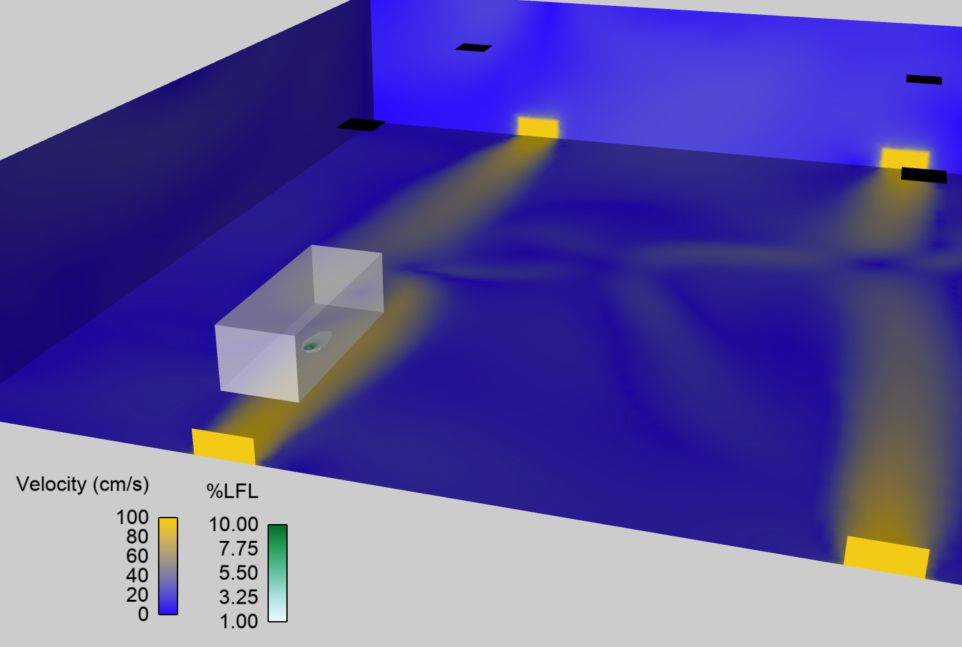
Approach: Risk Analysis and Modeling to Inform Code Requirements
Risk Analysis
Repair garage application-specific risk assessment and credible scenario identification
Modeling
Computational fluid dynamics (CFD) modeling for indoor hydrogen releases
Based on key scenarios from risk assessment
Code Recommendations
Results of risk analyses and modeling will be incorporated into proposals to improve requirements for repair garages while maintaining same level of safety
Select part
Identify relevant maintenance activities
Identify potential issues
Apply risk value

Slide 4
HAZOP Risk Analysis
Hazard and Operability Study (HAZOP)
Develop framework with input from QAI and industry for H₂ FCV scenarios
Scenarios ranked by severity of consequence and frequency of occurrence
490 unique scenarios identified
18 of these had potential hydrogen release
Others eliminated due to equivalent or lesser concern
Severity Value | Description
3 | Major: Release of full inventory of hydrogen
2 | Moderate: 1 tank of hydrogen (half of full inventory)
1 | Minor: Small release of hydrogen
Frequency Value | Description | Frequency
5 | Intentional
4 | Anticipated | f > 10⁻²/year
3 | Unlikely | 10⁻⁴/yr < f < 10⁻²/yr
2 | Extremely unlikely | 10⁻⁶/yr < f < 10⁻⁴/yr
1 | Beyond extremely unlikely | f < 10⁻⁶/yr

Slide 5
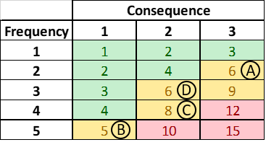
HAZOP Scenarios: 4 Medium-Risk, No High-Risk
Scenario | Event Description | Consequence (Release) | Comments
A | External fire causes TPRD release of H₂ cylinders | 2 tanks, high pressure, jet fire (worst consequence) | Only occurs when external fire heats H₂ storage
B | Small release in low-pressure system | <1 tank, low pressure (most likely) | Mitigated by detection; the event below bounds this scenario
C | Premature disconnect of venting tool | 1 or 2 tanks, low pressure | Focus of modeling due to higher risk score (combination of likelihood and consequence)
D | Premature disconnect of high pressure defueling tool | 1 tank, high pressure | Low probability of occurring

Slide 6
CFD Modeling Domain
Event: Vent hose severed while vehicle defueling to an external exhaust outlet
Typical 12-bay garage
Each bay 14’ x 27’ x 16’
Center aisle 6’ x 84’ x 16’
Leak:
2.5 kg of H₂ released
Most hydrogen vehicles have 2 tanks which store approximately 2.5 kg of hydrogen each
Release from mid-pressure port: 1.5 MPa (217.6 psi)
Downward release from vehicle underside

Slide 7
Modeling Scenarios Analyzed
Facility ventilation varied between cases
No ventilation
Regular ventilation (1 cfm/ft²) near the vehicle
Regular ventilation (1 cfm/ft²) away from the vehicle
Higher ventilation (300 cm/s) directed at the vehicle
Computer modeling simulates the leak and shows:
Direction of ventilation and released gas
Any areas of flammable mixture (Lower Flammability Limit (LFL) = 4 mol%)
Total flammable mass is critical safety metric considered

Slide 8
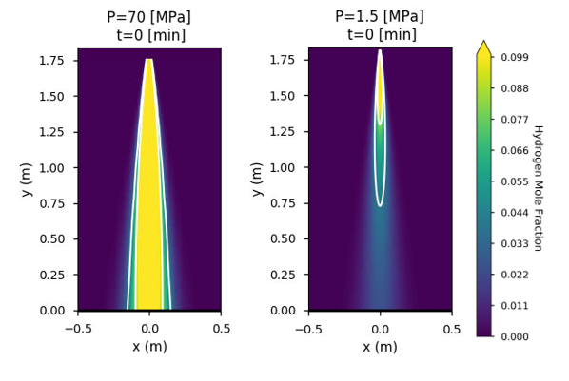
Hydrogen Leak Velocity
CFD simulations rely on low-velocity gas flow
Flammable concentration does not reach floor for low-pressure release
May need to model differently for high-pressure releases in the future

Slide 9
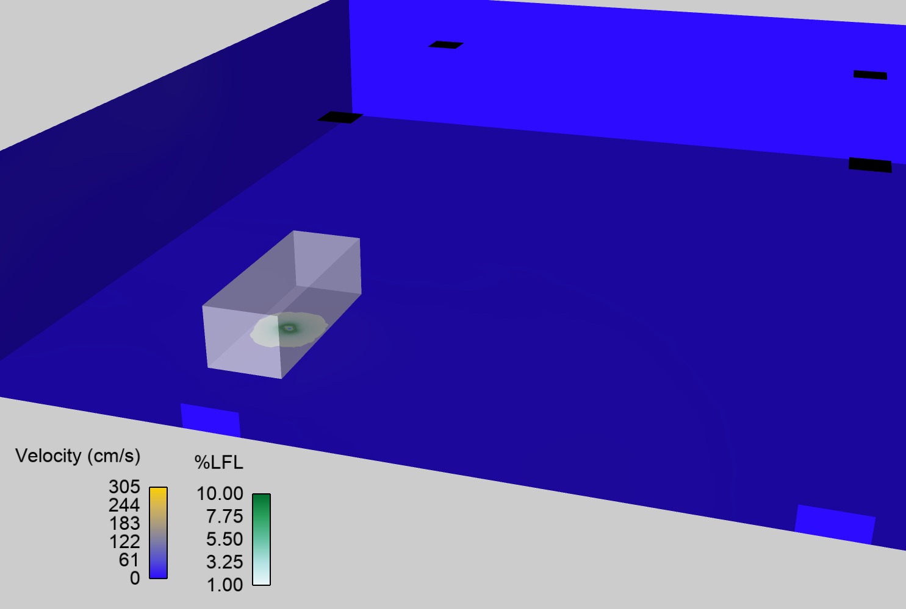
No Ventilation
Leak comes from center of bottom of vehicle
Vehicle
Flammable Area
(2 g total flammable H₂)
Fraction of LFL
Blue walls and floor are 0 cm/s velocity
Showing no air movement for no-ventilation scenario
Flammable area has color-scale based on concentration
Maximum flammable mass scenario

Slide 10
Ventilation Near Leak
Vent Outlets
Vent Air Inlet
(4 inlets, 1 cfm/ft²)
Vehicle
Flammable Area
(0.4 g total flammable H₂)
Smaller than no-ventilation scenario
Fraction of LFL
Flammable area has color-scale based on concentration
Yellow on walls and floor means ≥100 cm/s velocity
Showing air movement from ventilation
Ventilation directed at leak area leads to a decrease in maximum flammable mass

Slide 11
Ventilation Near Leak (Again) – Showing Dissipation
Side view of leak scenario
Hydrogen mixes with air (diluting) and going towards ceiling vent outlets
Vent Air Inlet
(4 inlets, 1 cfm/ft²)
Vehicle
Green is flammable area near leak point
Fraction of LFL
Purple is hydrogen concentration below LFL

Slide 12
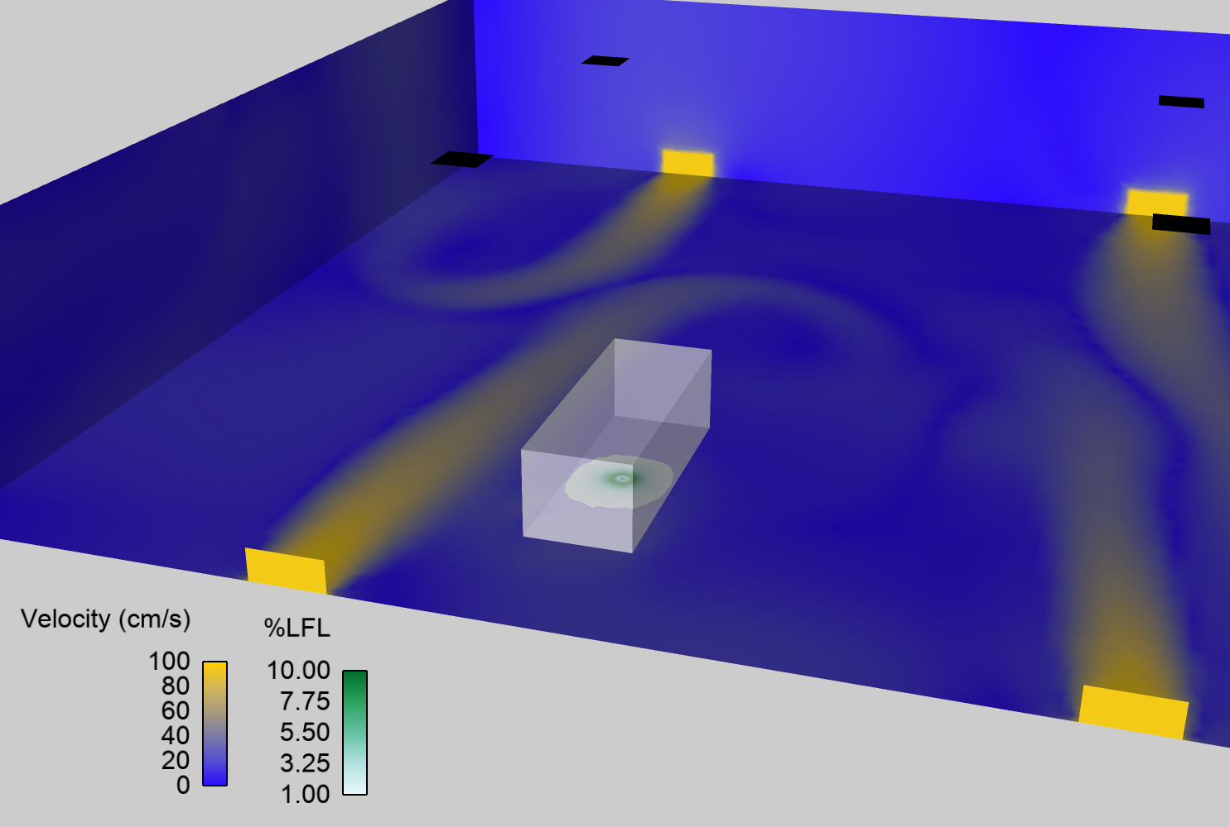
Ventilation Away From Vehicle
Vent Outlets
Vent Air Inlet
(4 inlets, 1 cfm/ft²)
Vehicle
Flammable Area
(2 g total flammable H₂)
Similar to no-ventilation case
Fraction of LFL
Yellow on walls and floor mean ≥100 cm/s velocity
Showing air movement from ventilation
Ventilation away from the vehicle has little affect on maximum flammable mass

Slide 13
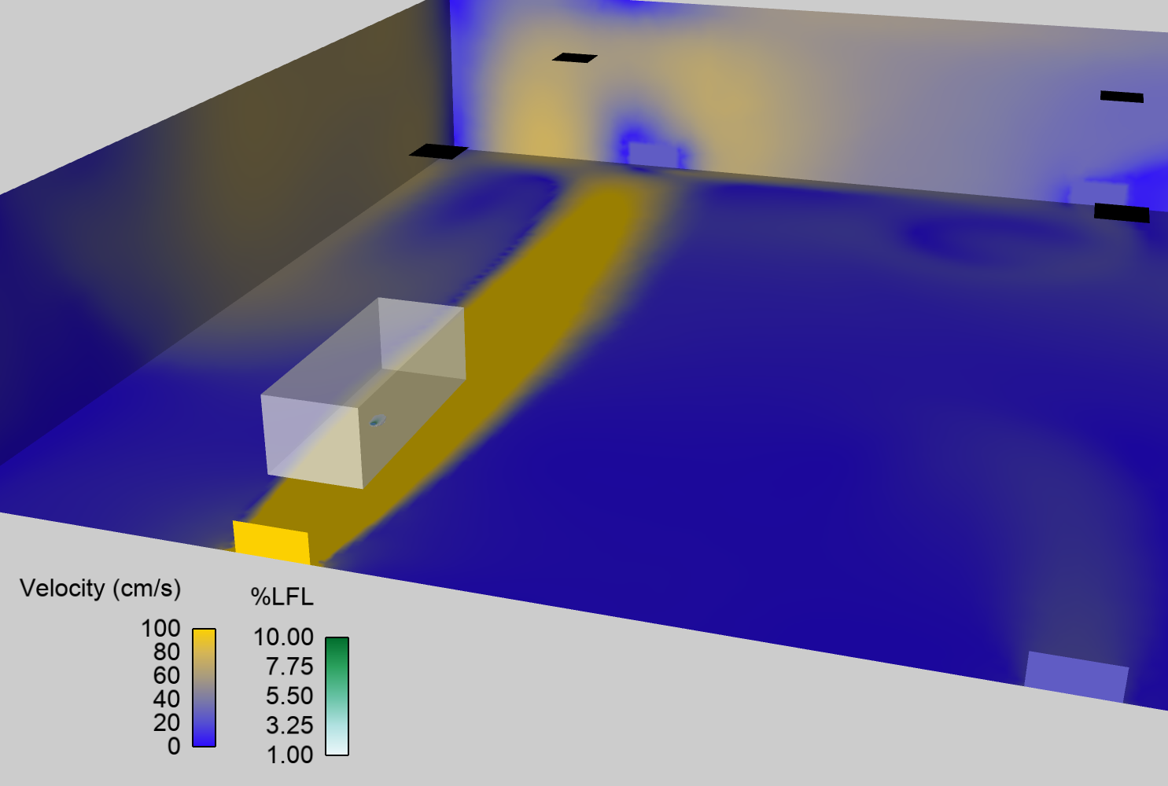
Higher Ventilation Directed at Vehicle
Vent Outlets
Vent Air Inlet
(1 inlet higher velocity
Total: 1 cfm/ft²)
Vehicle
Flammable Area
(0.06 g total flammable H₂)
Smaller than ventilation-near-leak and no-ventilation scenarios
Fraction of LFL
Dark yellow shows 300 cm/s velocity.
Showing air movement from ventilation
Higher ventilation directed at the leak area leads to the largest decrease of flammable mass

Slide 14
Hazard Quantification
Flammable mass
Total flammable mass of hydrogen in garage based on wherever the local hydrogen concentration is >LFL (>4 mol%)
No-ventilation case has low amount of flammable mass relative to mass released (<0.1% of 2.5 kg)
Dispersion of hydrogen in large area
Slow (low pressure) release
Ventilation directed at leak area leads to a 80% to 97% decrease in maximum flammable mass
Ventilation not directed at leak has little effect on maximum flammable mass
Ventilation | Maximum Flammable Mass (g)
No Ventilation | 2
Standard ventilation near leak | 0.4
Standard ventilation away from leak | 2
Higher velocity ventilation near leak | 0.06
1,000 g of hydrogen ≈ 1 gallon of gasoline

Slide 15
Conclusions
Code-compliant ventilation might not reduce flammable mass compared to no-ventilation case
Flammable mass small relative to amount released for low-pressure leak
Ventilation directed at leak reduced flammable mass by an order-of-magnitude
Higher velocity, directed ventilation further reduces flammable mass
Might provide a way to increase safety without changes to entire facility

Slide 16
Remaining Challenges
Risk analysis and modeling performed for large repair garage
Other structures (parking, small garages) could have different hazards and geometries
Effect of spreading or obstructions
Current CFD modeling jet unaffected by wall, floor, equipment, etc.
Further incorporation of results into safety codes and standards
Results and recommendations need to be translated into improved code requirements that maintain same level of safety

Slide 17
Questions?
Thank you!

