Slide 1

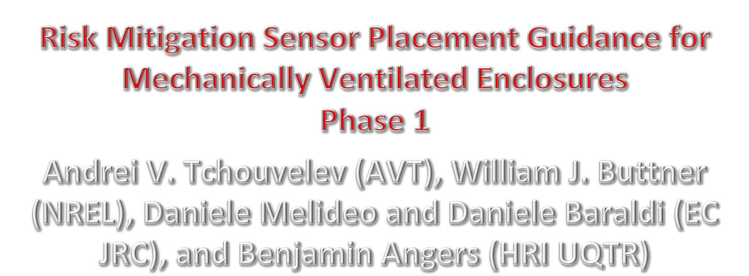
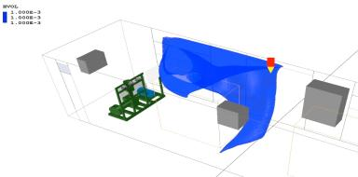
Funding support provided by US DOE FCTO and EC JRC
Notes:
We are here to help, update of our progress and provide a different perspective.

Slide 2
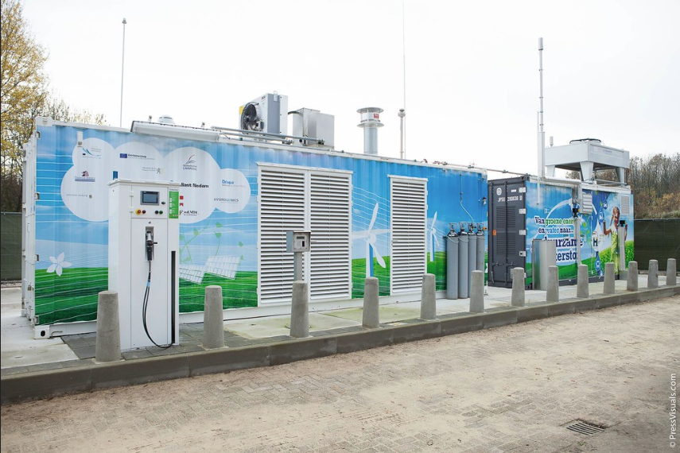
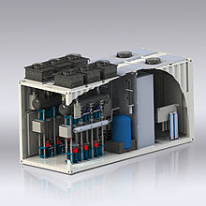
Motivation, Market Needs and Objective
Guidance on Sensor Placement – top research priority for hydrogen sensors at the 2018 HySafe RPW.
This work was initiated as an international collaborative effort to respond to emerging market needs.
The ultimate objective of this effort is to develop guidance for an optimal sensor placement allowing earlier H₂ leak detection leading to significant hazard reduction.
Examples of H₂ equipment enclosures

Slide 3
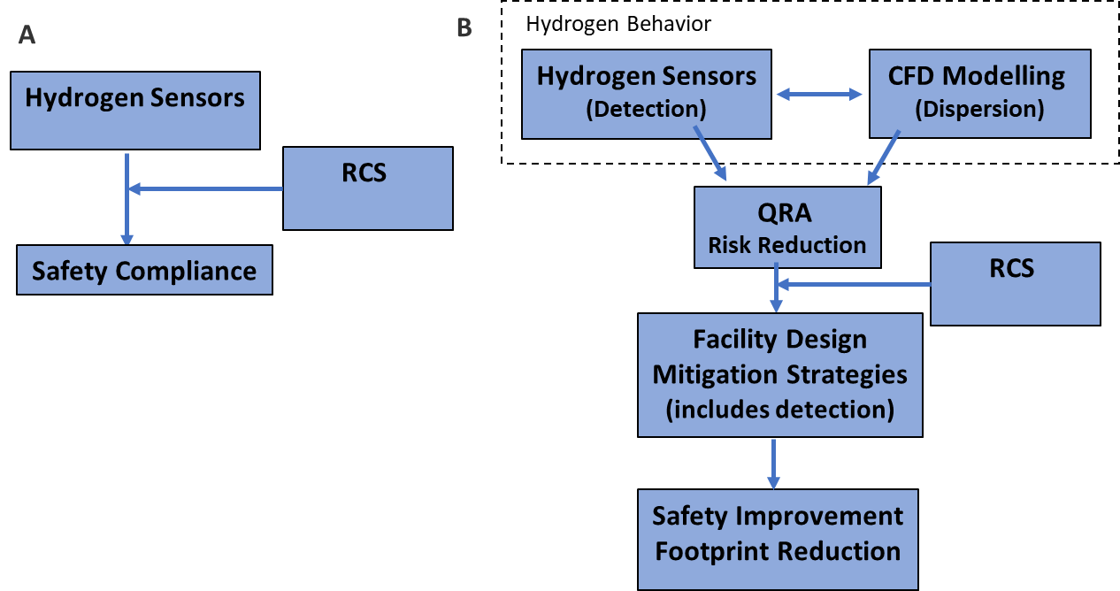
Evolution of Role of Hydrogen Sensors
A: conventional approach to ensure prescribed safety RCS compliance
B: expanded role to enable performance-based risk mitigation / reduction

Slide 4
Ventilation and Detection Design Philosophies
Detection-actuated forced ventilation:
  No forced ventilation during normal operation
  Forced ventilation and alarm actuation at 10-20% LFL (4,000 – 8,000 ppm)
  Equipment shut down at 25-50% LFL (10,000 – 20,000 ppm)
Multi-step forced ventilation interlocked with detection:
  33/40% full forced ventilation during normal operation
  Full (100%) forced ventilation and alarm actuation at 10-20% LFL (4,000 – 8,000 ppm)
    Note: an intermediate 2nd step at 67/75% full ventilation is sometimes used
  Equipment shut down at 25-50% LFL (10,000 – 20,000 ppm)
Optimum continuous forced ventilation with early detection – Recommended approach:
  Constant speed forced ventilation optimized for a max credible leak during normal operation
  Early detection at 2.5 to 10% LFL (1,000 – 4,000 ppm)
  Continuous detection, alarm and shutdown setpoints as above
Important notes:
  Options 1 & 2 “hide” the leak allowing it to potentially expand
  Option 3 allows for safe leak investigation and mitigation

Slide 5
Key Technical Challenge
Determine an optimal location for the placement of a hydrogen sensor (or sensors) so that the probability of detection is the highest and independent on the leak orientation / direction.
This requires an ability to predict air circulation inside the enclosure depending on location of air intake and exhaust, equipment placement inside the enclosure and air flow generated by the exhaust fan.
The key in this regard is to find / predict locations of low ventilation flow within the facility, which assures higher predictability of detection of low hydrogen concentrations, which are undetectable by other means (e.g., pressure sensors mounted on pneumatic lines).
From this perspective, spots with hydrogen concentrations between 1,000 to 4,000 ppm are the primary targets. This is a radically different approach from the current practice targeting hydrogen detection within a range between 8,000 and 16,000 ppm.

Slide 6
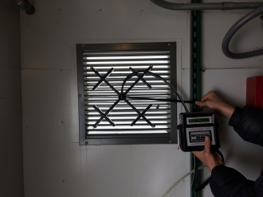
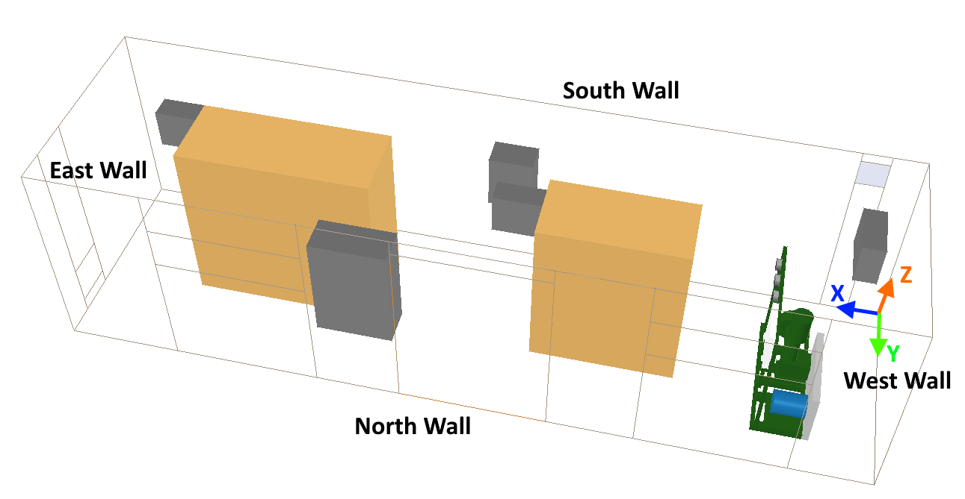
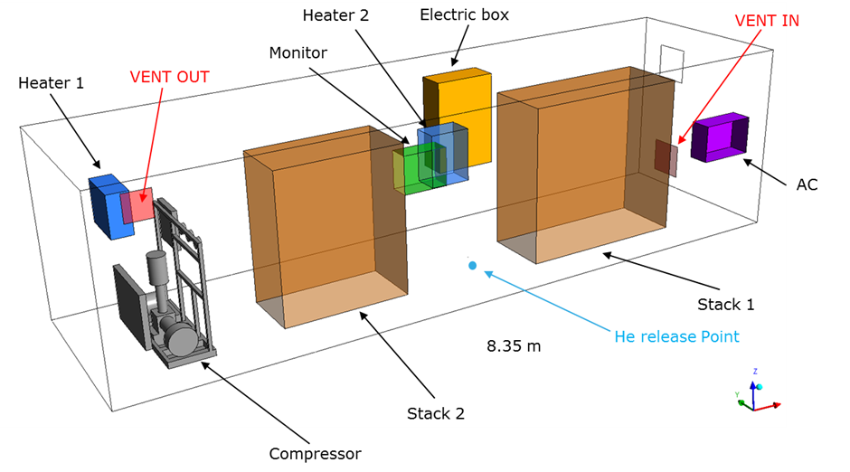
Real Enclosure Study
Air flow verification
NREL enclosure layout
AVT-UQTR CFD domain
EC JRC CFD domain

Slide 7
H₂ Leak Location and Parameters for CFD
Actual fitting at the wall of the enclosure selected as the leak point.
Leak orifice – per recommendations of IEC 60079-10-1:2015.

Slide 8
CFD Pre-Modeling Results
Concentrations between 2.5% and 5% LFL assure timely detection.

Slide 9
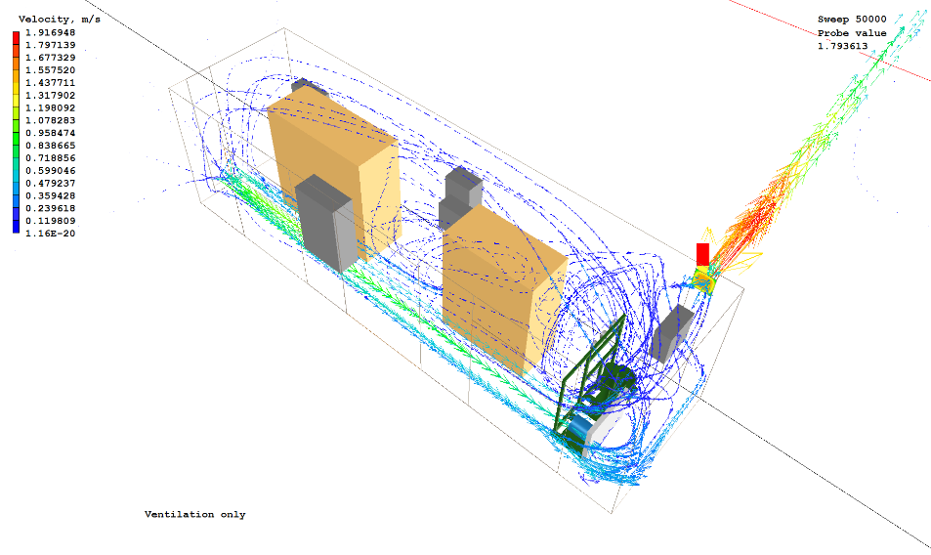
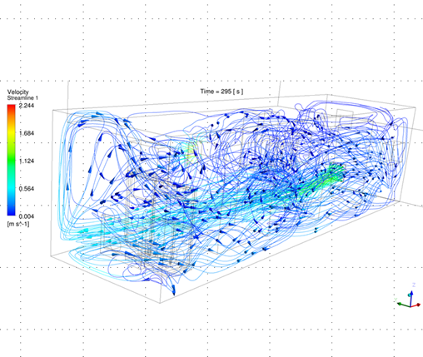
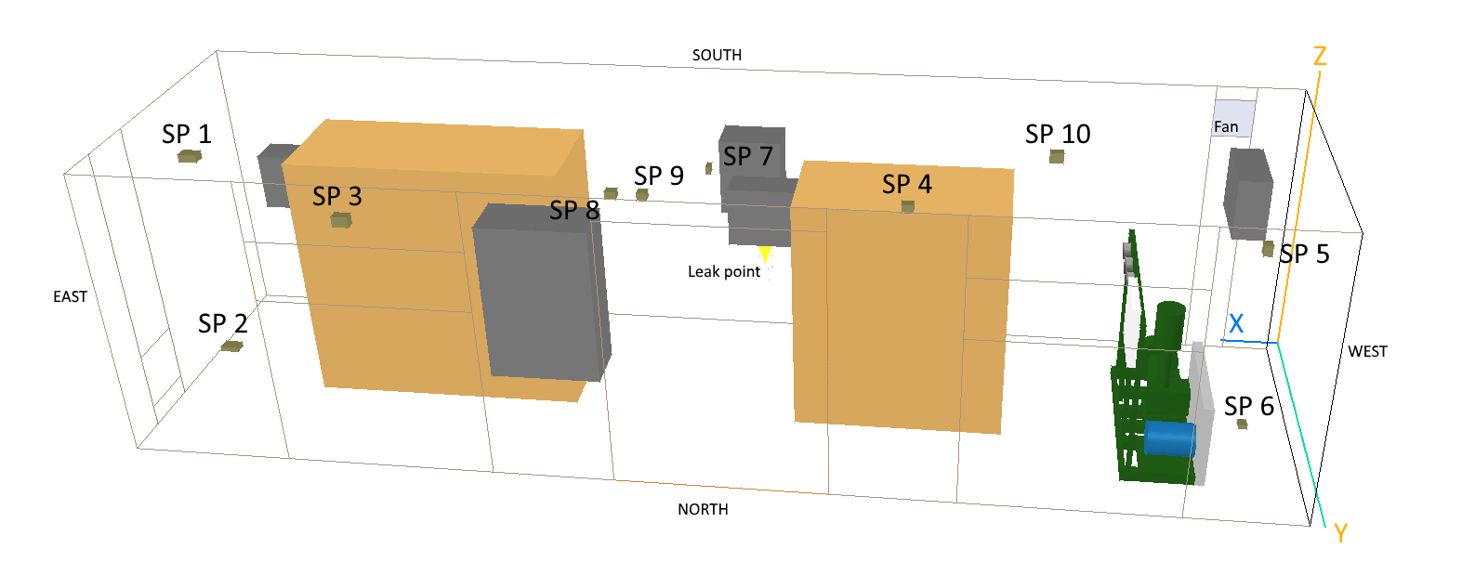
Setting Up for He Release Tests
Steady state air circulation profile at 300 cfm before He release
Locations of He sensors inside the enclosure during the release tests displayed in CFD domain. Details on sensors’ set up on pp 8-9 of paper ID117.

Slide 10
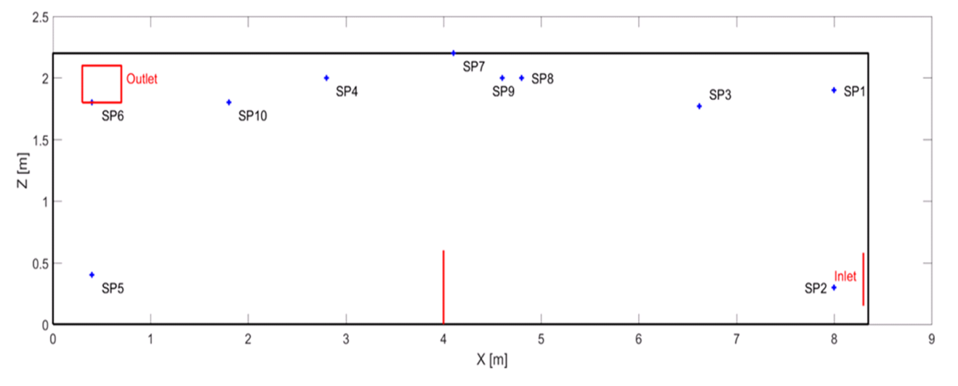
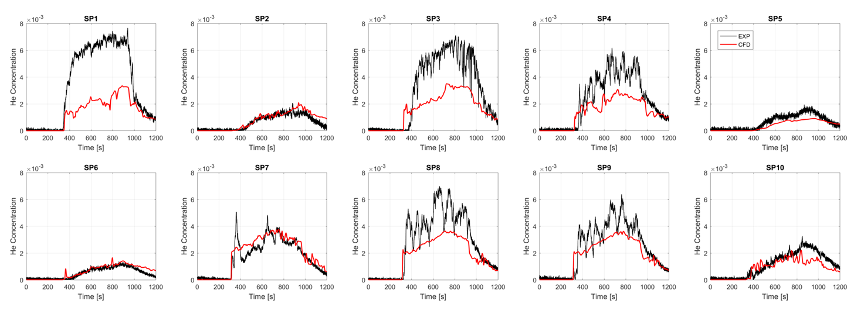
He Release Tests Results
He sensor locations during Sept 2017 tests modeled by EC JRC.
Comparison between experimental data (black) and simulation results (red) for the helium concentration (EC JRC data).

Slide 11
Preliminary Recommendations from Phase 1
Criteria for suitable locations:
Not on a direct path of the airflow from the air inlet to the exhaust fan to ensure low sensitivity to airflow fluctuations.
Minimum expected concentration is above the minimum practical level of 1000 ppm, while the maximum expected concentration is well below 10000 ppm (mostly around 4,000 ppm).
Below the enclosure ceiling thus not obstructed by the ceiling piping and lighting fixtures or other objects to ensure low turbulence around sensor head.
Preliminary recommendations for sensor placement strategy. Top shows Sept 2017 sensor setting, bottom – Dec 2017 setting.

Slide 12
Phase 2 Scope
Parameter sensitivity study within the enclosure, i.e. gas temperature, ventilation rate, ceiling piping and directions of leak
Expansion of indoor releases to larger facilities at least 5 times larger such as, for example, vehicle maintenance facilities and underground parking structures, and
Incorporation / plug-in into QRA tools, such as HyRAM.
It is anticipated that results of this work will be used to inform national and international standards such as NFPA 2 Hydrogen Technologies Code, Canadian Hydrogen Installation Code (CHIC) and relevant ISO/TC 197 and CEN documents.

Slide 13
Andrei V. Tchouvelev, PhD
Chair, ISO/TC 197 Hydrogen Technologies
President & CEO, A.V.Tchouvelev & Associates Inc.
6591 Spinnaker Circle, Mississauga, Ontario
L5W 1R2 Canada
Tel / Fax (905) 696-7007
Mobile (416) 464-5888 atchouvelev@tchouvelev.org
Contact Information:
13

