Slide 1
HYDROGEN VENTILATION TEST FACILITY FOR UNDERGROUND MINING AND TUNNELING
Gerhard Human (Gerhard.human@nwu.ac.za),
Faan Oelofse,
Dmitri Bessarabov and
Neels Le Roux
Hydrogen South Africa Infrastructure Centre of Competence
Faculty of Engineering
North-West University
Potchefstroom
South Africa

Slide 2
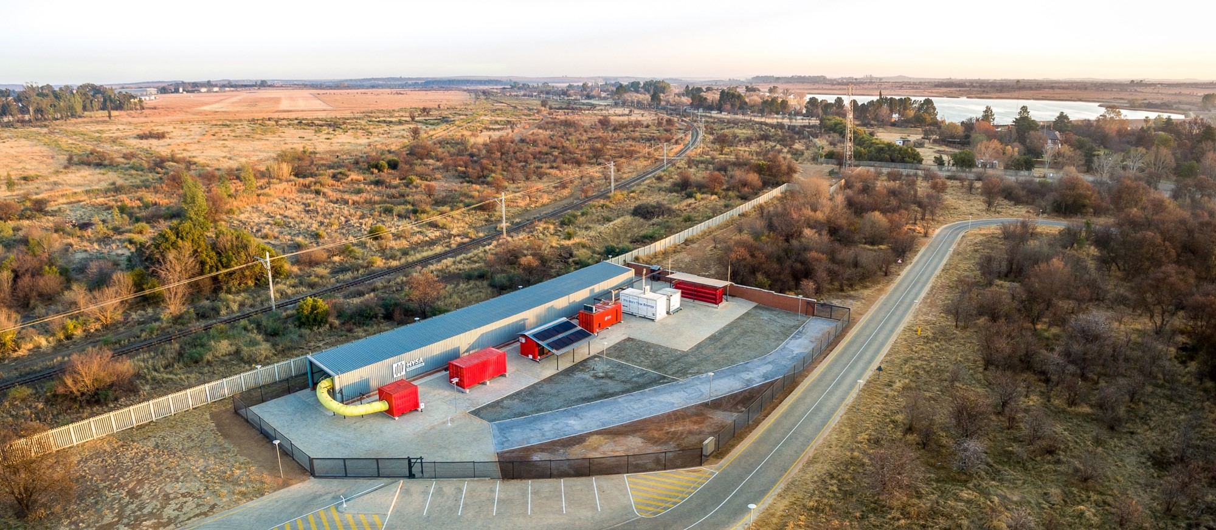
Table of contents
Introduction
Background
Ventilation test facility
Safety design
Results
Conclusions
Future work

Slide 3
Introduction
Mining companies are facing significant challenges in their efforts to de-carbonize
Half of worldwide industrial GHG traceable to 50 companies [1]
  Two mining companies in the top 5
  20 in the top 100
Diesel and batteries are not simultaneously clean, safe, and productive
Tethered vehicles are power-dense and have no direct emissions
  Introduces additional safety concerns
  Interferes with mobility and productivity
  Introduces weaknesses and high strain at the tether interfaces [2].
Diesel ICE
  Power-dense
  More mobile and productive than tethered
  Generate harmful emissions and unwanted heat [2].

Slide 4
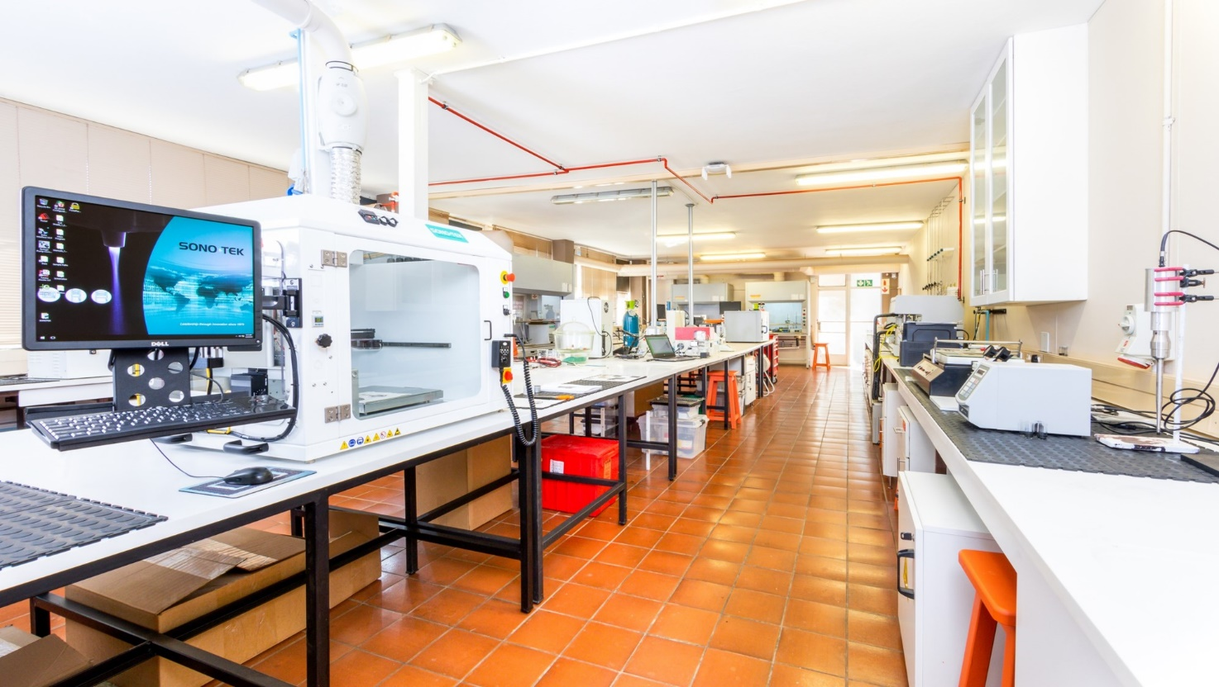
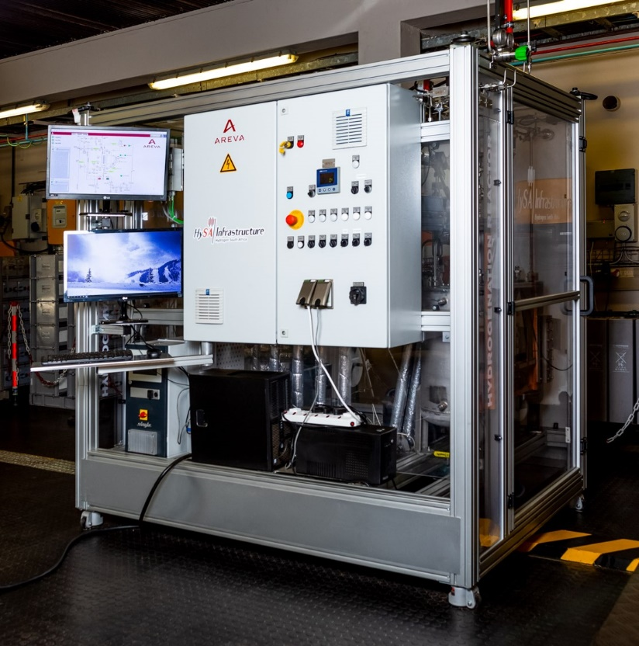
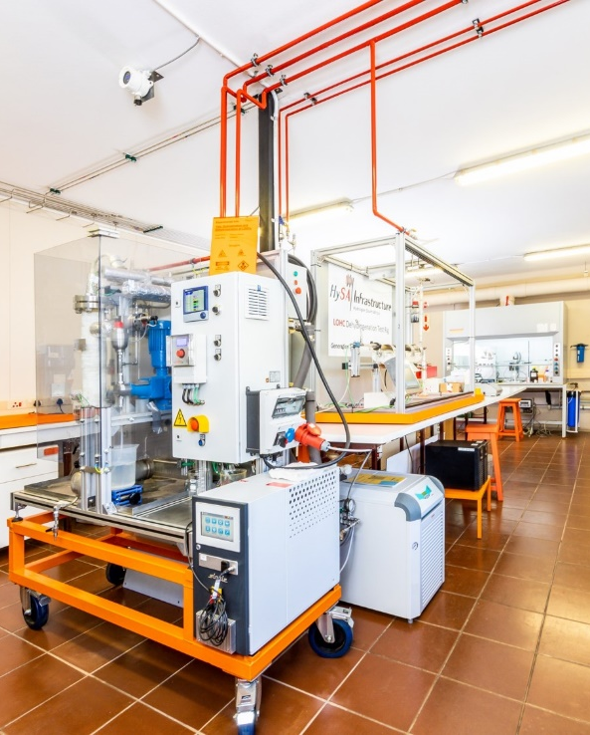
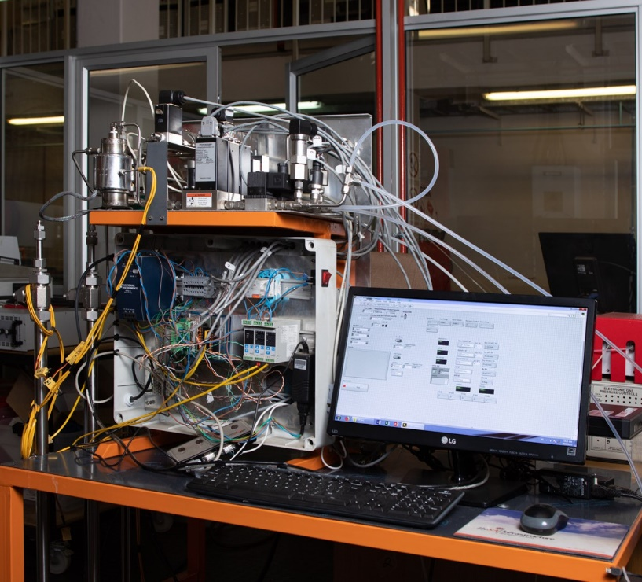
Introduction
Benefits of changing to electrical drive trains
  Battery equipment - 5% more expensive and tethered - 2.5% less expensive than diesel equivalent
  Tethered and battery equipment - 29.5% lower maintenance cost than diesel
  Battery equipment added 6% battery replacement cost but 5.5% more annual tonnage than diesel
  Tethered resulted in a sizeable 27% less tonnage
  Cost differences are more sensitive to electricity prices than to diesel fuel fluctuations [3].
  According to cost trends from the EIA, diesel prices will increase significantly while intermittent RE (solar and wind) will decrease [3]

Slide 5
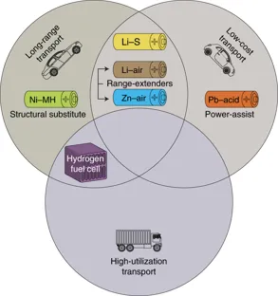
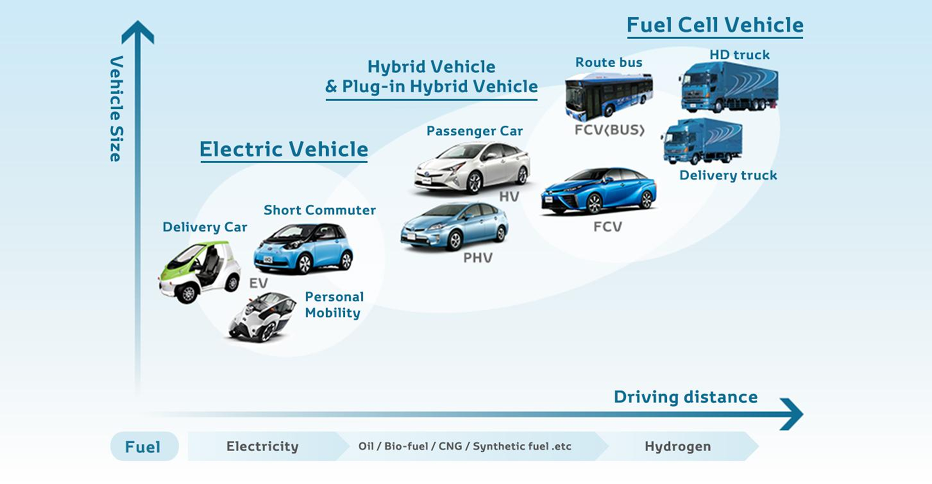
Introduction
Decarbonisation of heavy industry
  Maritime
  Trucks
  Trains/rail
  Mining
Source: Toyota. Available on: https://seekingalpha.com/article/4018696-toyota-produce-battery-electric-vehicles-fuel-cell-hydrogen-cars-still-alive
Zachary P. Cano, Dustin Banham, Siyu Ye, Andreas Hintennach, Jun Lu, Michael Fowler & Zhongwei Chen, Batteries and fuel cells for emerging electric vehicle markets, Nature Energy, vol 3, pages 279 –289, 2018

Slide 6
Introduction
Hydrogen fuel cells
  MW scalability
  capacity to store large amounts of energy for long times
  Fuel for transportation
  Continuous power operation (High utilisation transport)
Underground trucks, loaders and other machines have power ratings up to 750 kW
Above ground open pit > 2MW
FC in mines
  Lower emissions
  Improved health, comfort and safety
  Reduced operating costs

Slide 7
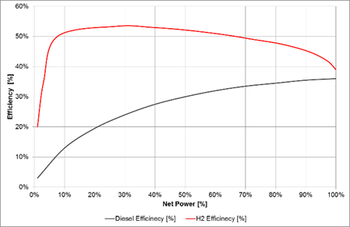
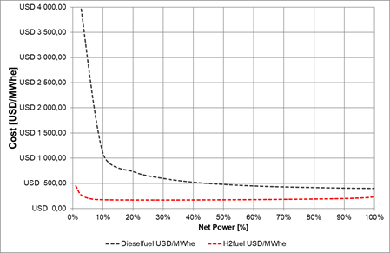
Introduction
FC vs. diesel cost-benefit analysis for Canadian mines [4]
  At the time of these studies FC-powered machines, based on expensive metal-hydride technology, showed a cost reduction in both operation and maintenance of equipment as well as overall mine ventilation and cooling requirements
  Cost of electricity is again the dominant cost factor for load-factors above 50% [5]
  24 to 53 % reduction in primary ventilation system electrical operating cost
  11 to 22 % reduction in auxiliary ventilation system operating costs
  27 to 38% reductions in greenhouse gas emissions for the same sites [6].
Notes:
Cost of hydrogen and diesel used in the analysis were estimated at $3.85/kg (~$0.12/kWh) and $0.5/liter (~0.05/kWh) respectively. Efficiency curves of typical PEM FC and diesel ICE given in Fig. 1a, show the FC to be more efficient that the diesel ICE through the entire power range. Fig. 1b provides the usable energy cost comparison between diesel fuel at a 5 year projected price of $1.43/liter and hydrogen fuel at $3.00/kg possible with large-scale RE hydrogen production.

Slide 8
Background
October 2002 - locomotive performed flawlessly with zero failures or downtime
  100% power availability for 8½ hours operation, whereas the
  battery-powered version revealed a steady performance decrease for around 7 hours of operation.
Working loader was developed and successfully tested aboveground
Hydrogen Mine Introduction Initiative (HMII)
  Examining the direct application to underground vehicles [7, 8].
  Main objective - develop norms and standards to support mining regulations for technological application in underground vehicles
Anglo American Platinum Ltd. (AAPL)
  second locomotive
  FC-powered mining dozer [9]
  AAPL continued the same dozer demonstrations
  Recently demonstrated using liquid organic hydrogen carrier (LOHC) technology

Slide 9
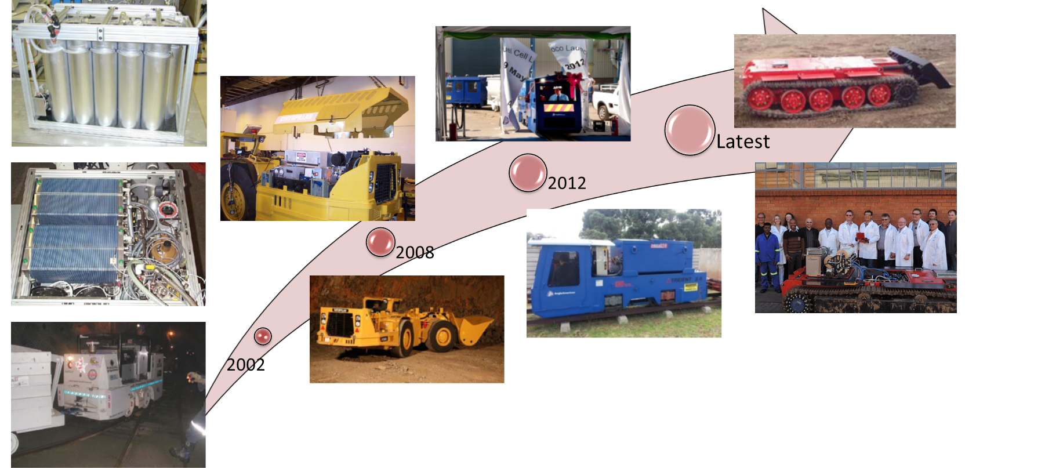
Background

Slide 10
Background
HMII deliverables
  field-test hydrogen leak behaviour in ventilated and confined areas [7, 8]
  Performed leak tests inside a 20” container
  Included several hydrogen release and ventilation flow configurations and conditions
  Hydrogen leaks considered were typical that would be expected from a metal-hydride bed at low pressure (max 20 bar)
  A similar project was initiated by the Hydrogen South Africa Infrastructure Centre of competence (HySA) at the North-West University in South Africa
  The limitations as well as numerous benefits mentioned, have motivated the need to develop a research infrastructure platform dedicated to hydrogen safety device testing and investigation of underground risks using hydrogen based fuels in both ventilated and unventilated confined underground mining spaces
  Due to the nature of the problem, tunnelling activities are also of interest.
  The objective was to perform similar tests starting at low pressure and then move to pressures as high as 350 bar

Slide 11
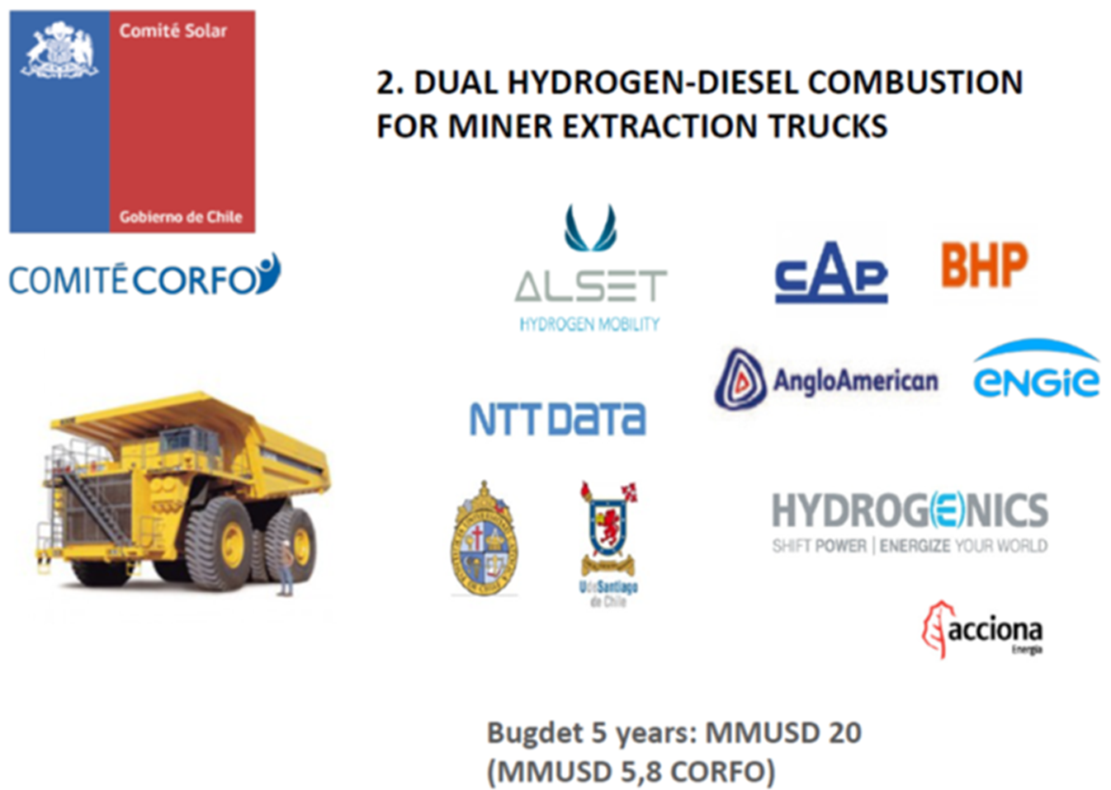
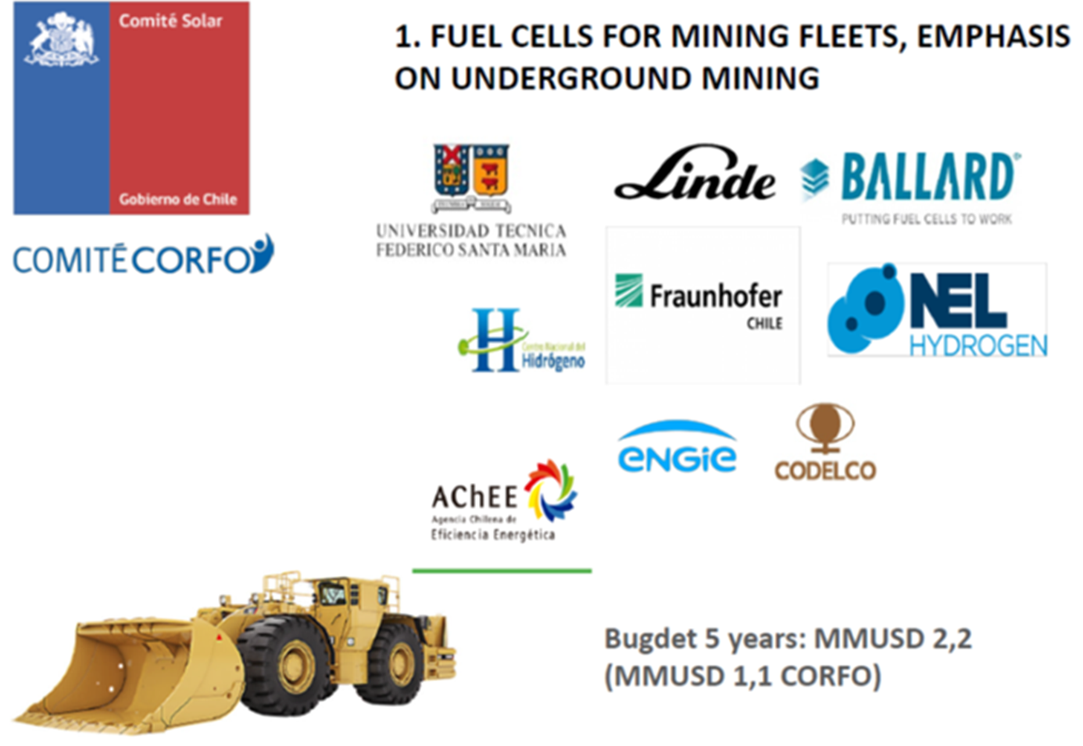
Background

Slide 12
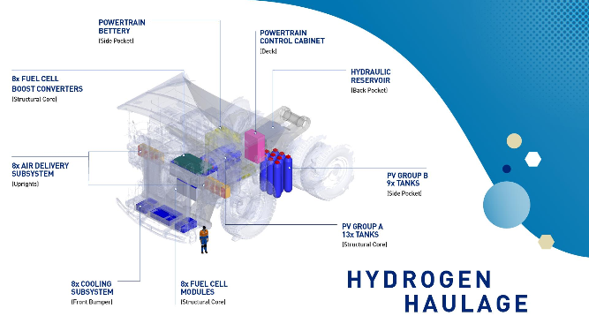
Background

Slide 13
Background
Hydrogen FC powered equipment provide
  health, comfort and economic benefits
  Increased uptime, Quick refuelling by operators themselves, small footprint, no performance degradation during shift
Hydrogen safety in underground confined spaces is a concern
Several issues regarding hydrogen in underground mining [6]
  No codes and standards for hydrogen FC powered equipment underground
  Little information on the behaviour of hydrogen (release, turbulence) in enclosed spaces (none for mining) with and without ventilation and behaviour versus lower flammability levels.
  Design, performance, reliability of available on-board hydrogen storage: safety assessment, hazard analysis
  Existing Mine Regulations, Hydrogen Codes and Standards
  All hazards should be demonstrated to be “as safe, or safer than”.
  Lack of dedicated refuelling infrastructure.
  Lack of performance and durability data (vehicles, hydrogen infrastructure).

Slide 14
Background
The risks and technologies associated with delivering, storing and using hydrogen underground first need to be investigated and understood
This work presents the design, construction and initial operation of a mining ventilation test facility (VTF) at the North-West University in South Africa that aims to investigate risk of hydrogen in confined ventilated environments.

Slide 15
Ventilation test facility
Bulk H₂ storage:
165 kg @ 20-00 bar
LOHC hydrogenation:
5Nm³/hr
H₂ generator & Dispenser:
4 Nm³/hr, 350 bar
Site office/
control room
Future
Ventilation fan:
50 m³/hr
Off-site 50 kW PV system

Slide 16
Ventilation test facility

Slide 17
Ventilation test facility
Safety considerations
  Equipment selection, safe distances and removing the risk
  Eliminating sources of ignition
  maintaining safe distances
  Placement of equipment
  (Operational measures (Procedures, risk assessments, access control, etc.)
Hazardous classification
  Hazardous area classification for equipment selection
  Majority of the site hydrogen installation is open to atmosphere
  Portion of the ventilation tunnel is indicated as a primary source of release, open to atmosphere - Zone 1
  Other Zones are the hydrogen vents and emergency ventilation fan exhausts
  No equipment located inside the tunnel except for the hydrogen detectors

Slide 18
Safety design

Slide 19
Safety design
Emergency shutdown devices (site wide)
  Stops the flow off hydrogen at source and storage
  Disconnects electrical input to production
  Activates site visual and audible alarms & notifies emergency personnel
Hydrogen leak detection
  Six hydrogen leak detectors located strategically around site
  Concentrations > 0.4 % (10 % of LEL) - stops tests and shut-down hydrogen production
  Concentrations > 0.8 % (20 % of LEL) - same sequence of events as ESD
Smoke detection
  Five smoke detectors located strategically around site
  Same sequence of events as the ESD
Organizational measures
  Training, written instructions and work permits, safety induction, access control (Limited access), CCTV monitoring, housekeeping rules, maintenance

Slide 20
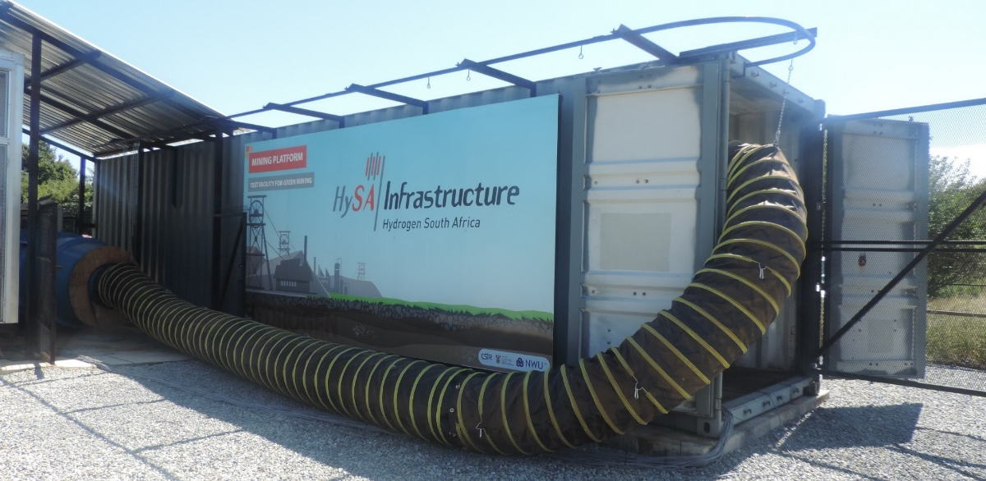
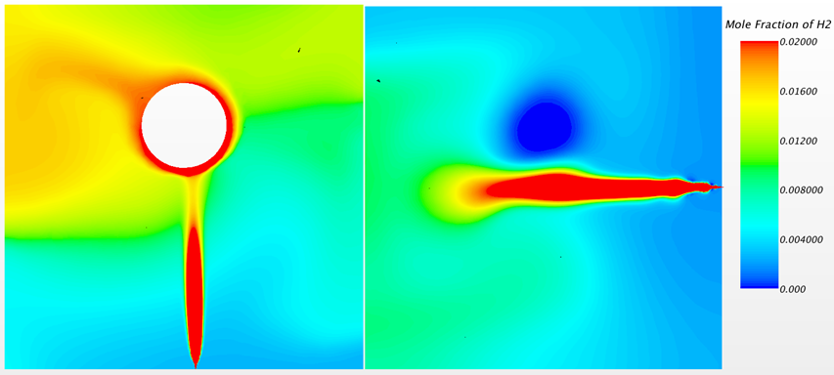
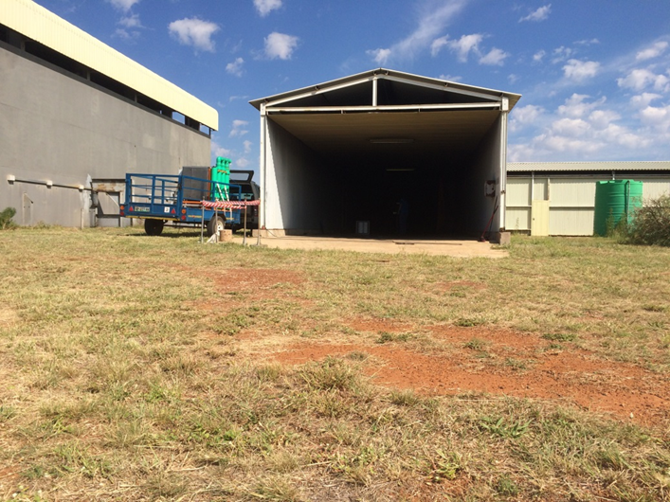
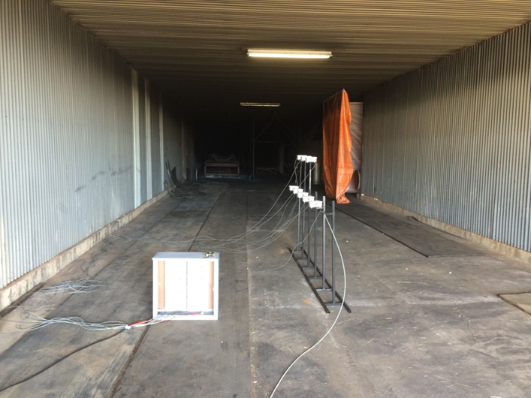
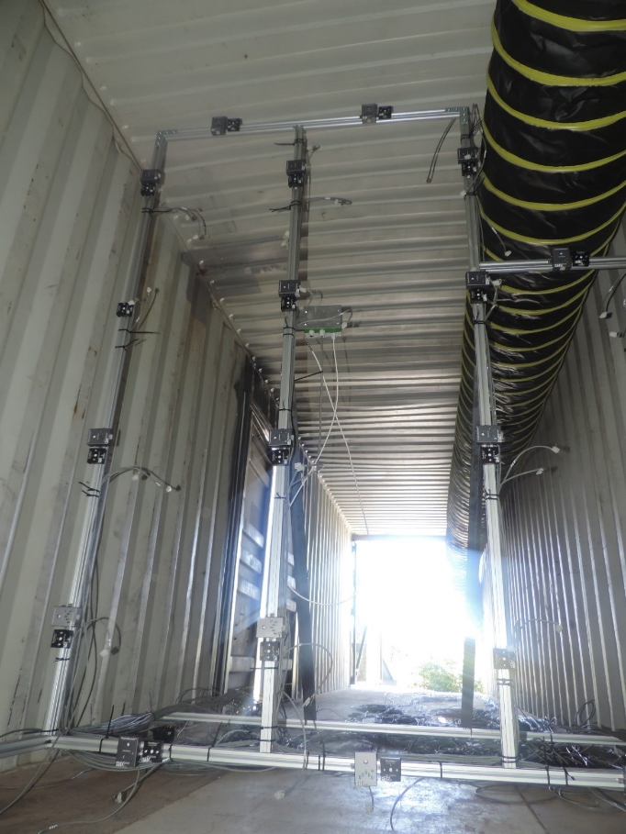
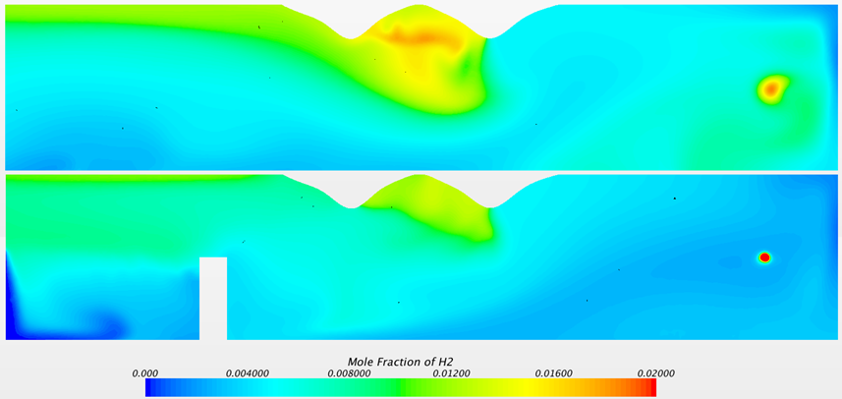
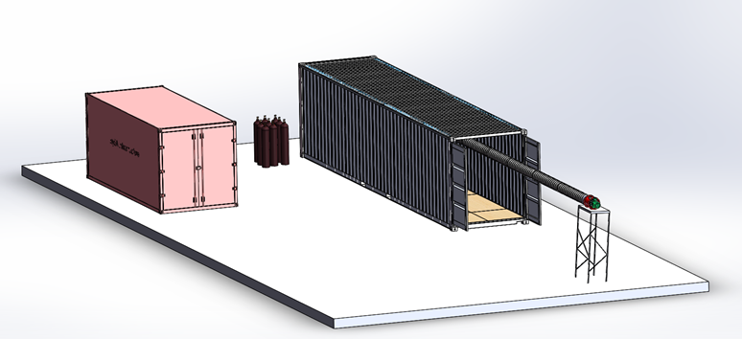
Results
Hydrogen is released until steady state
  worst-case scenario in terms of concentration levels
Kolppersbos and temporary ventilation test facility
  Limited equipment/automation, low air flow
Ventilation flow in the temporary tunnel difficult to determine
  VSD set to the same volume flow for all experiments (comparative results).

Slide 21
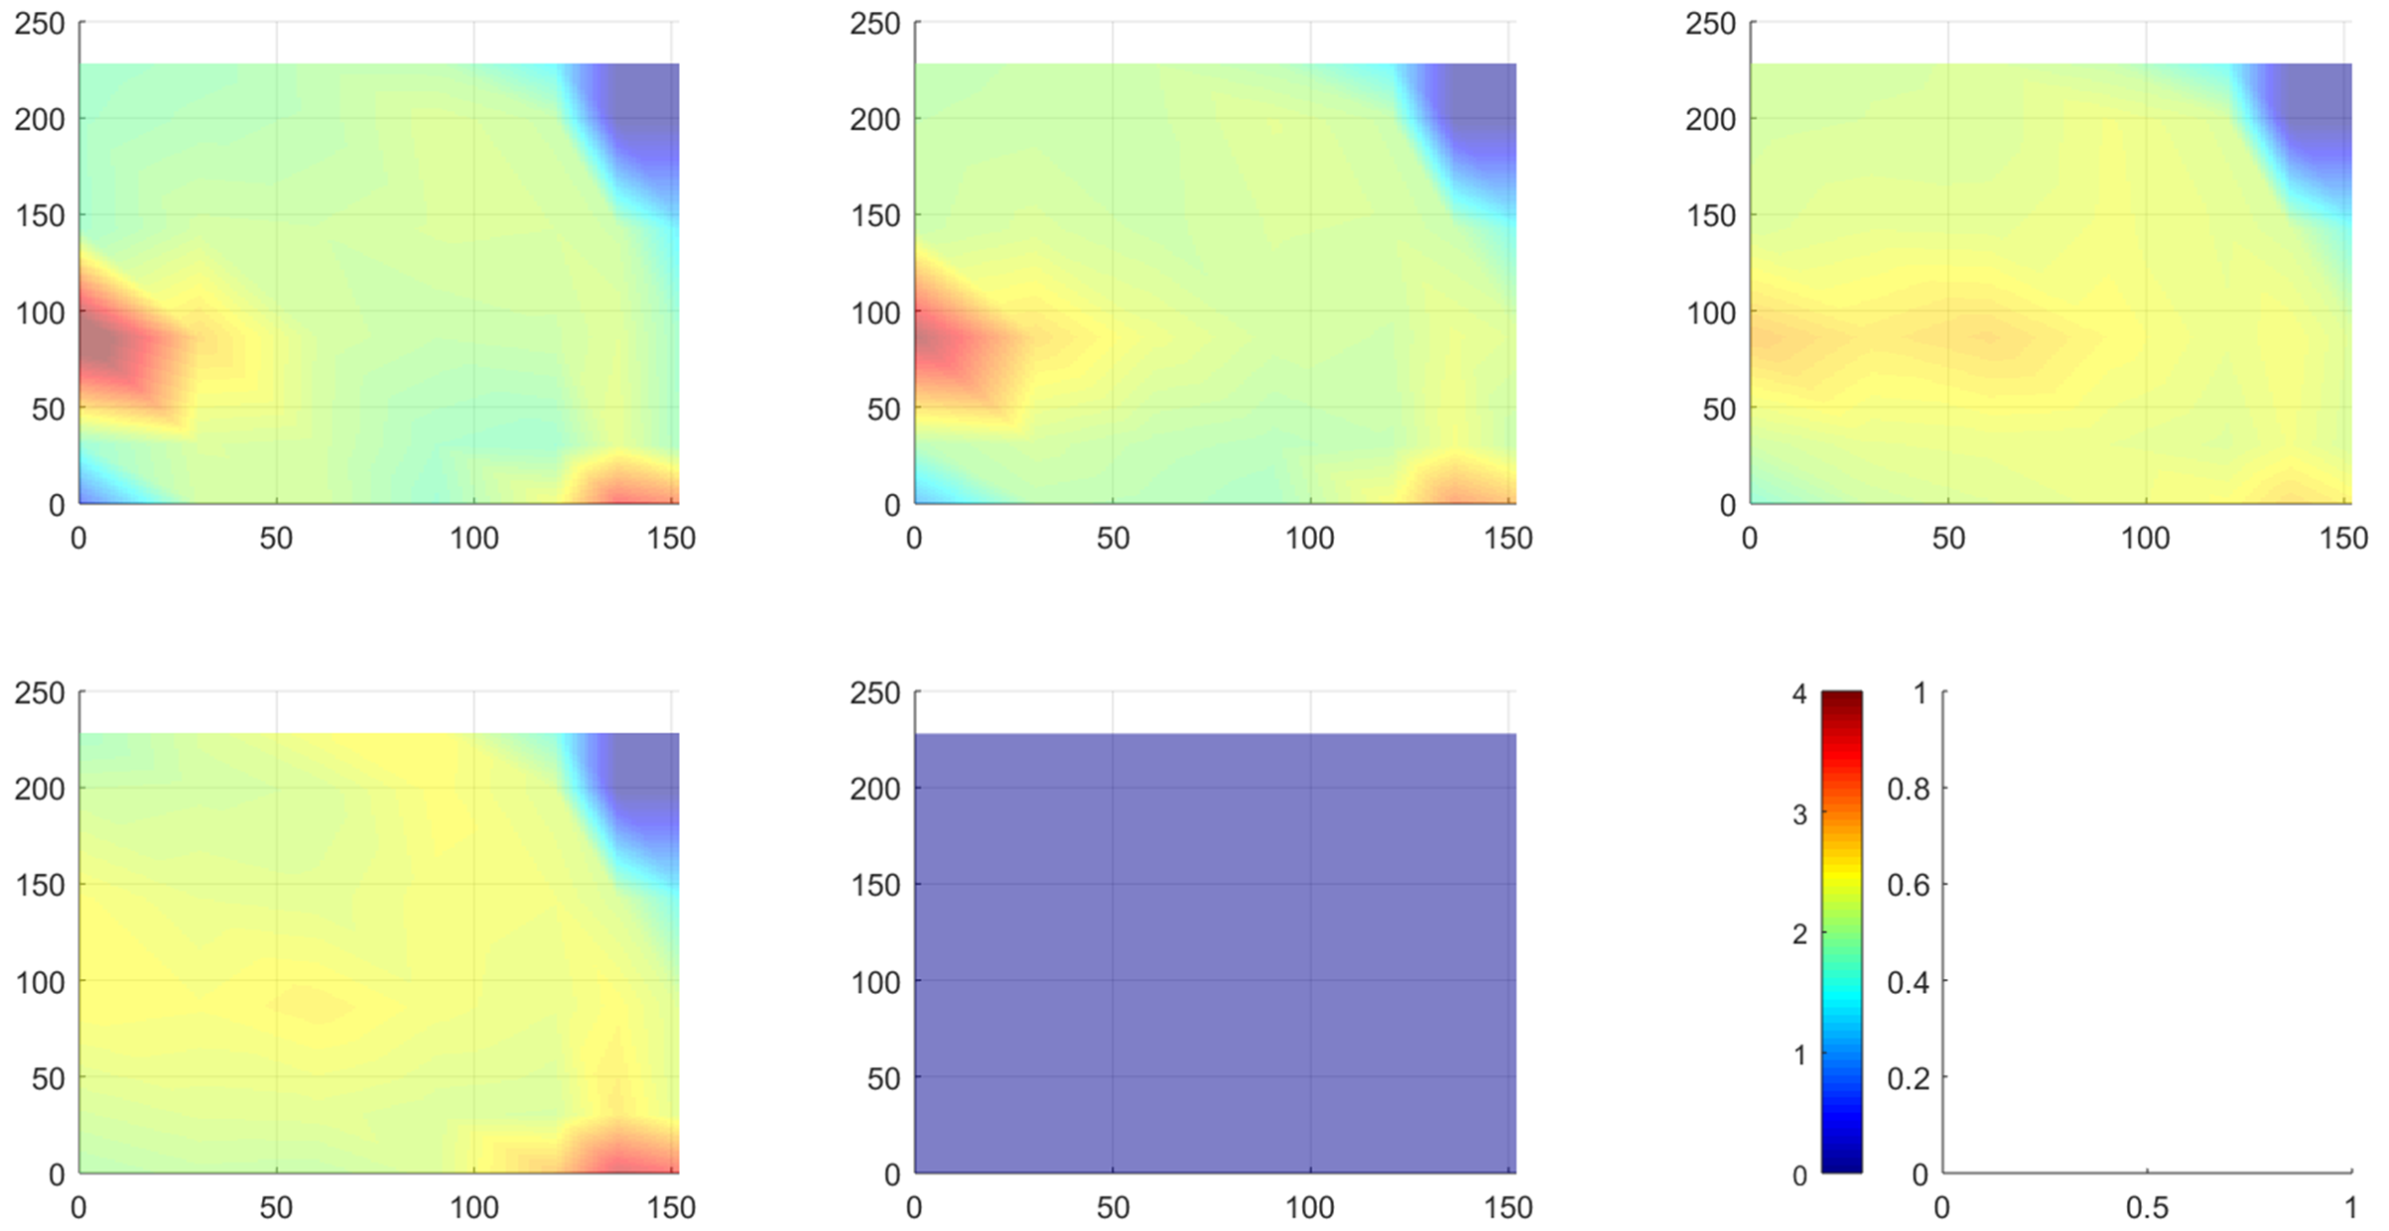
Results
20bar, 1.5mm, 500rpm

Slide 22
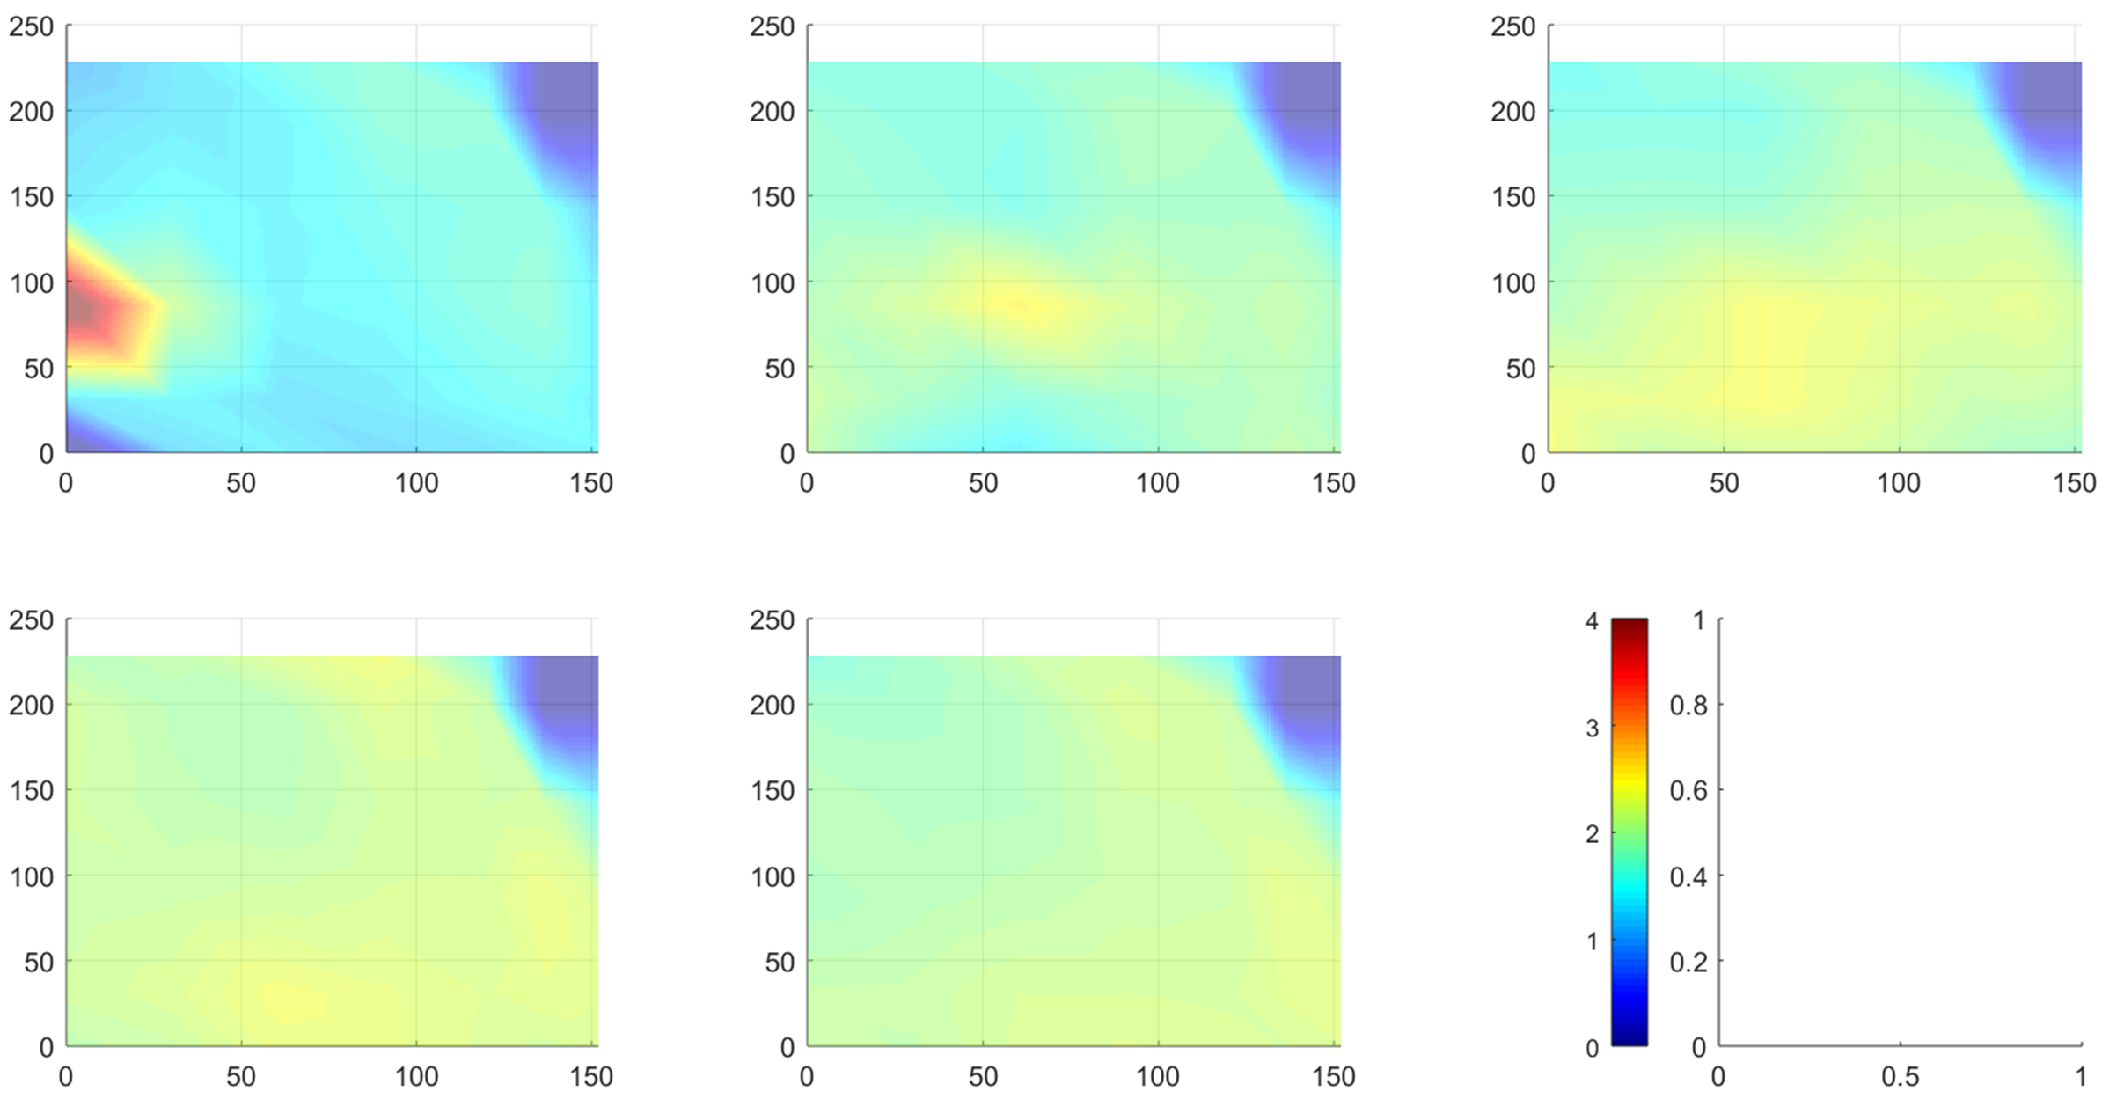
Results
50bar, 0.8mm, 500rpm

Slide 23
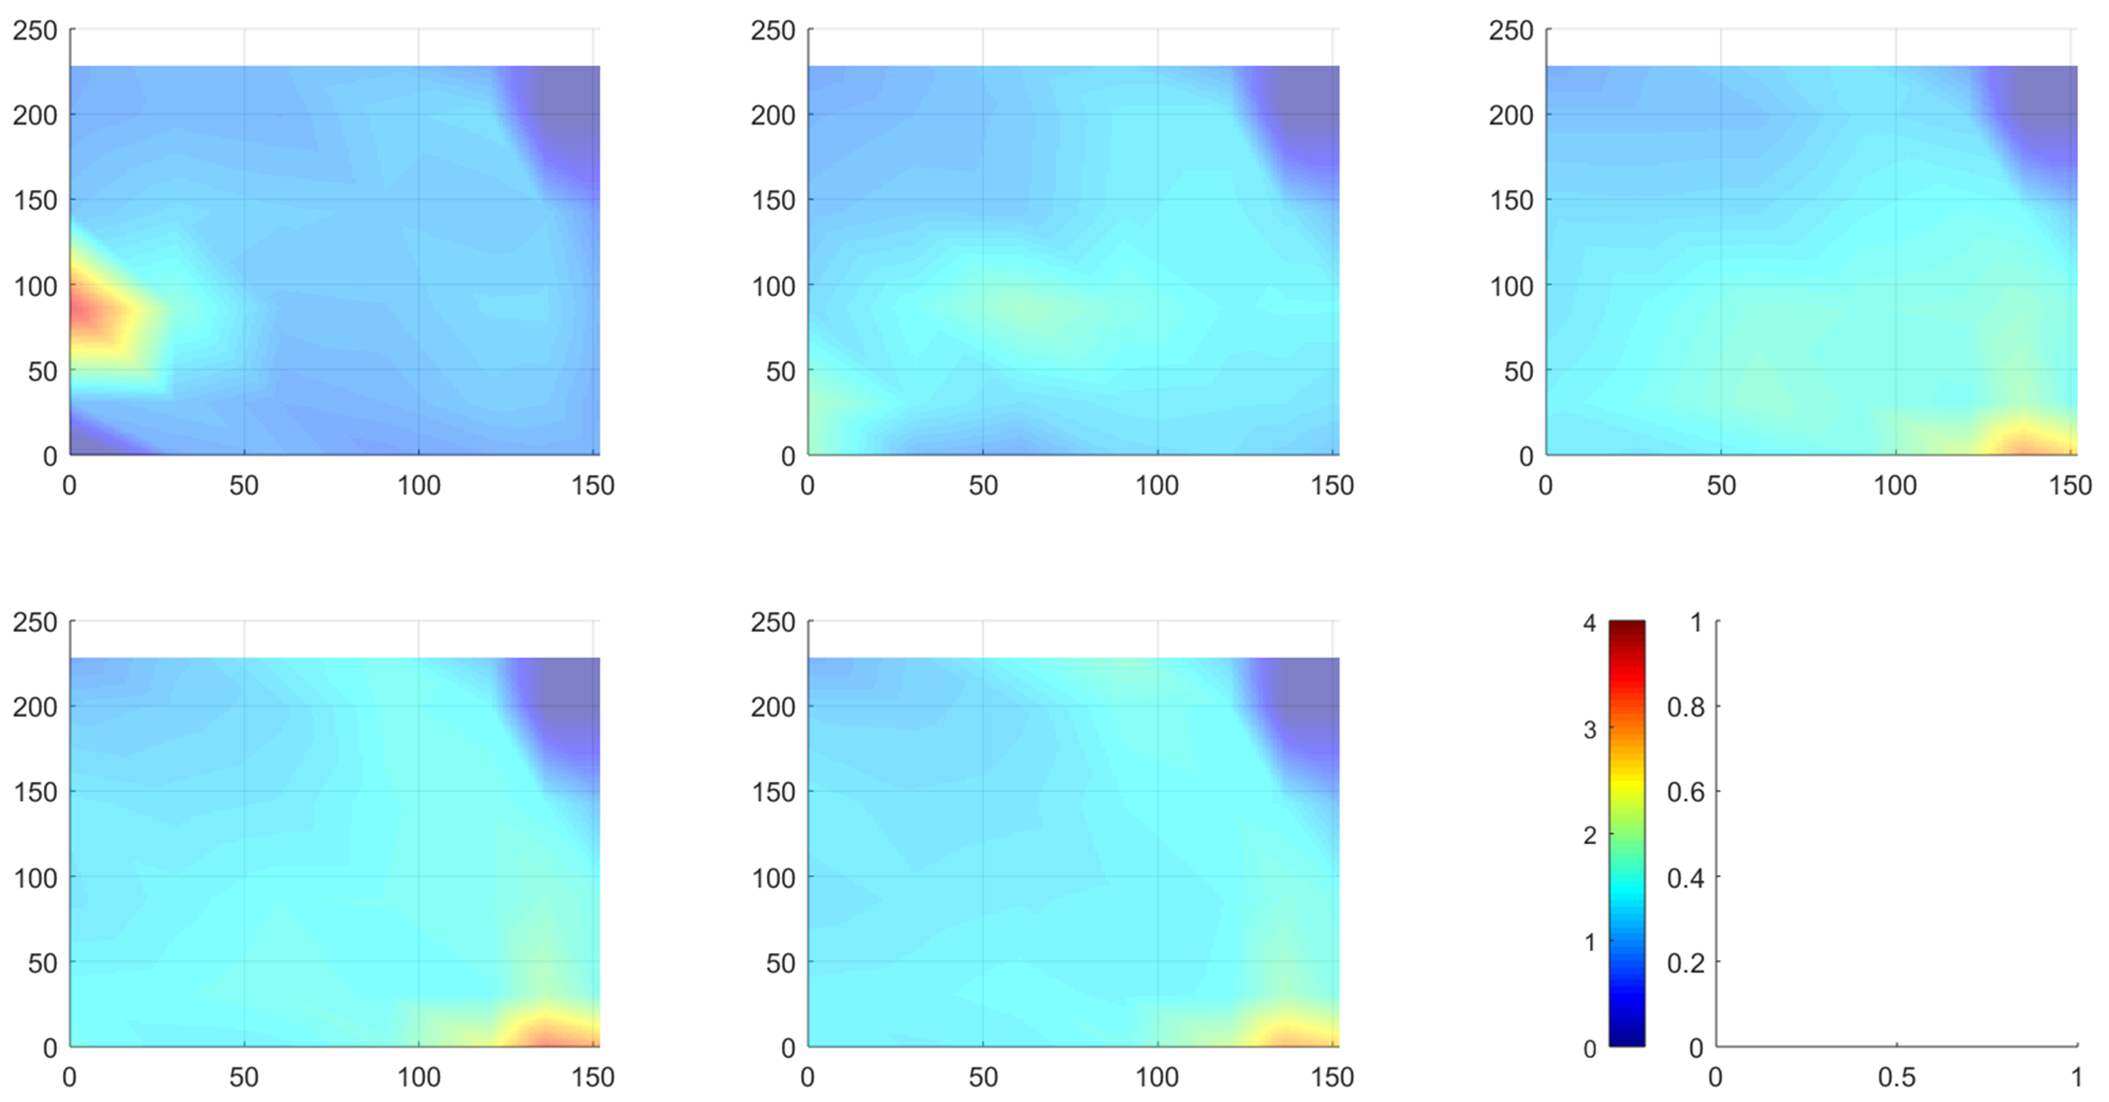
Results
20 bar, 0.8mm, 500rpm

Slide 24
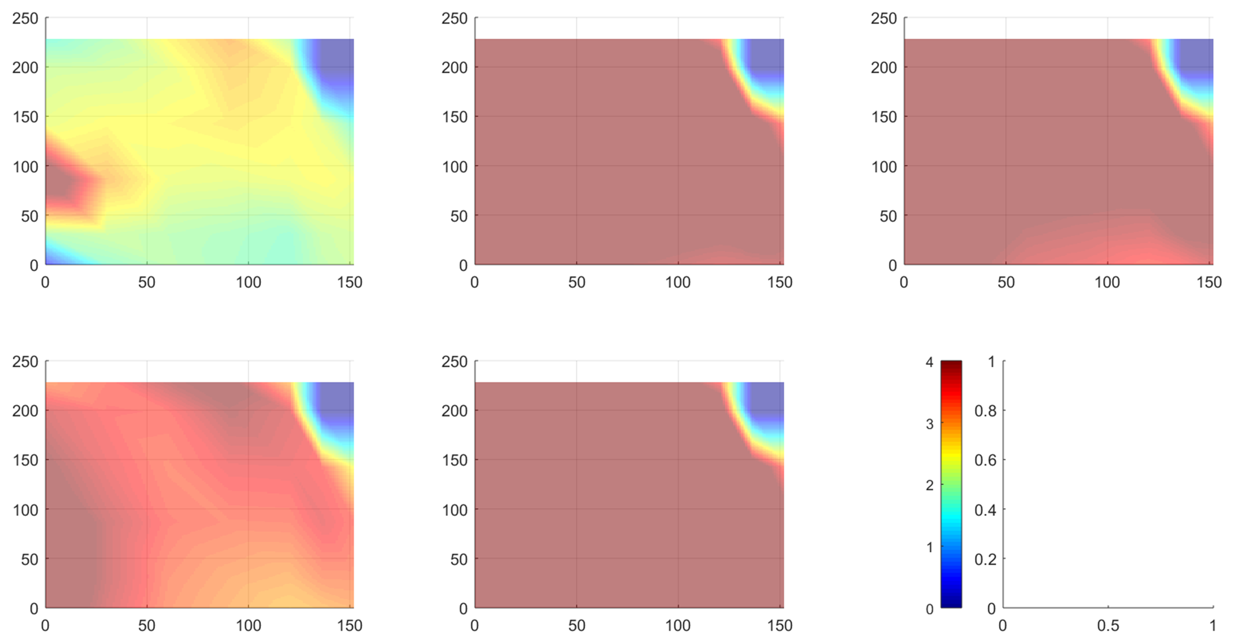
Results
150bar, 0.80mm, RPM=0

Slide 25
Conclusions
Leak tests performed successfully without incident
Hydrogen FC technology has already been identified as a viable solution for powering underground mining equipment
Several demonstrators have been developed and successfully operated.
These demonstrations showed the benefits of FC underground, with both production and cost improvement.
Benefits included health, comfort and cost savings in operating, ventilation and cooling
Hydrogen is perceived unsafe
Risk being a hydrogen leak from on-board storage
No measured information exists on the behaviour of hydrogen in underground mining environments

Slide 26
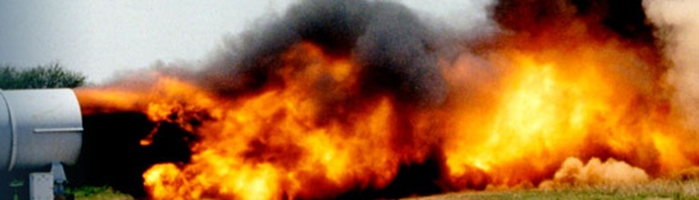
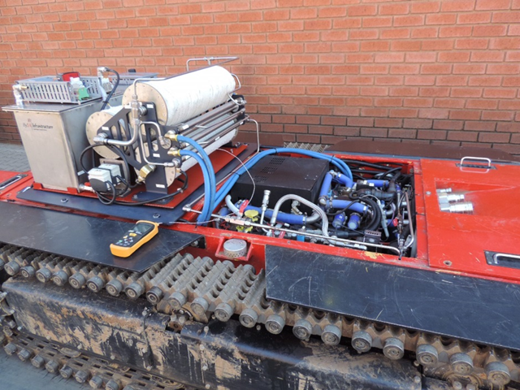
Future work
Move to VTF (95 % complete)
Completely automated: valve timing, flow control, etc.
1000’s of test
  Distances?
  Durations?
  Higher ventilation?
  Higher pressures?
  Bigger volumes?
  Obstacles/pockets
  Effect of safety devices (excess flow valves, etc.)
Thus far all tests have been run until steady state
  What happens for short durations
  What happens with safety devices included
CFD capabilities have been developed

Slide 27
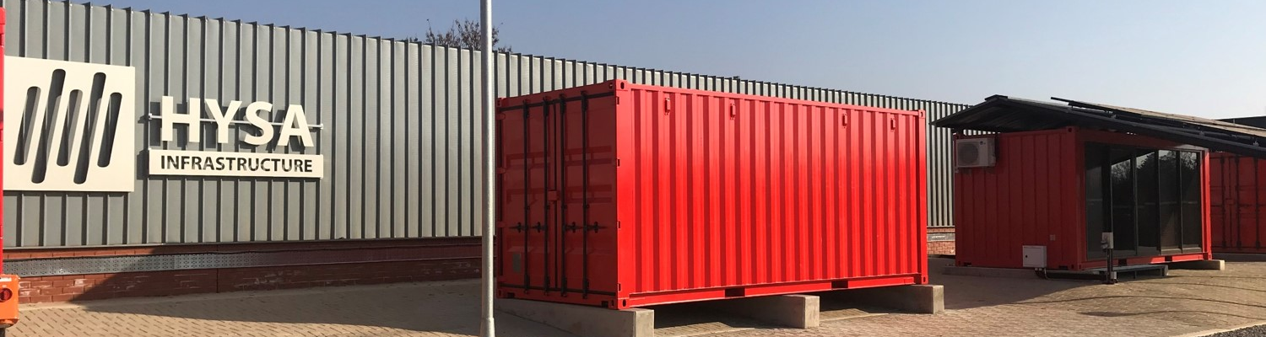
References
P. Griffin, The Carbon Majors Database, CDP Carbon Majors Report, July 2017.
Arnold R. Miller, Fuel-cell mine vehicle-development and testing, Proceedings of the 2000 U.S. DOE Hydrogen Program Review, San Ramon, California, May 9-11, 2000.
Richard S. Schatz, Antonio Nieto, Serguei N. Lvov, Long-term economic sensitivity analysis of light duty underground mining vehicles by power source, International Journal of Mining Science and Technology, Vol. 27, pp. 567-571, 2017.
M.C. Bétournay, P. Laliberté, R. Lacroix, C. Kocsis, S. Hardcastle, G. Desrivières, P. Mousset-Jones, and G. Righettini, Fuel cell versus diesel loader operation: Cost-benefit analysis study, Article in CIM Bulletin, May 2005.
Cédric Philibert, , Renewable Energy for Industry From green energy to green materials and fuels, International Energy Agency (IEA), Insight Series, 2017.
Charles Kocsis, Ventilation Benefit Analysis for Canadian Mines Fuelcell Loader Project, CANMET-MMSL report 602422, Report MMSL 03-040(CR), July 21, 2003.
Andrei V. Tchouvelev, Benjamin Angers, Marc Betournay an Gilles LeBlanc, Hydrogen min introduction initiative – Study of hydrogen behavior in underground mine conditions, 23rd Annual mine diesel emission council (MDEC) conference, Toronto, 2017.
Christopher Jackson and Patrick Molloy, A renewable hydrogen way forward for the mining industry?, Rocky Mountain Institute, Sunshine for mines: https://www.rmi.org/a-renewable-hydrogen-way-forward-for-the-mining-industry/
A.R. Miller, G. van den Berg, D.L. Barnes, R.I. Eisele, D.M. Tanner, J.M. Vallely, and D.A. Lassiter, Fuel cell technology n underground mining, The Southern African Institute for mining and Metallurgy, 533-546, Platinum 2012.

Slide 28
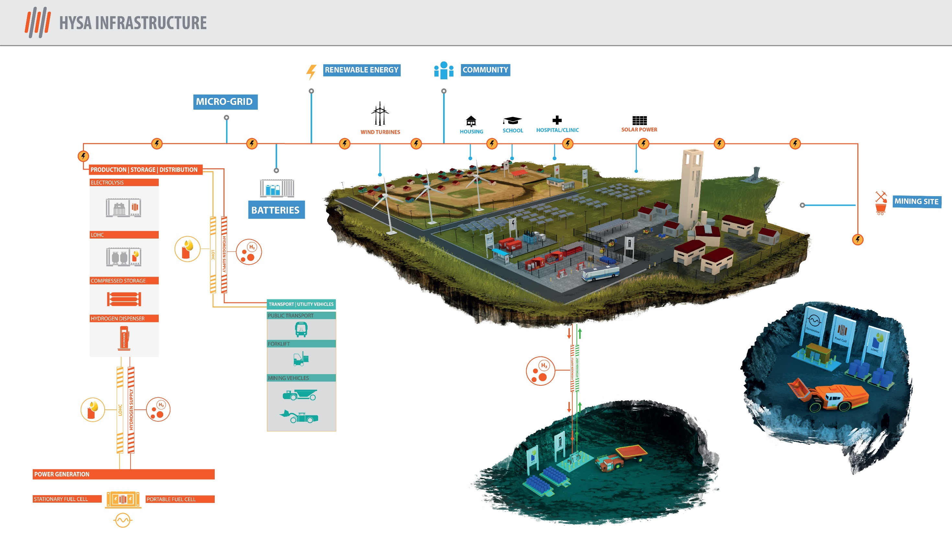
QUESTIONS

