Slide 1


Prediction of Pressure Reduction Rate in 30 m³ Liquid Hydrogen Tank Based on Experimental and Numerical Analysis
25 Sep. 2019 ICHS2019@Adelaide
Paper ID: 172
Kazuma TANI, Takehiro HIMENO, Yasunori SAKUMA, Toshinori WATANABE
The University of Tokyo, Japan
Hiroaki KOBAYASHI
Japan Aerospace Exploration Agency (JAXA), Japan
Terukuni TOGE, Hiroaki KAGAYA, Shoji KAMIYA, Osamu MURAGISHI
Kawasaki Heavy Industries, Ltd., Japan
Notes:
My name is Kazuma I’d like to talk about this presentation with the title of predicting pressure reduction rate in liquid hydrogen tank.

Slide 2
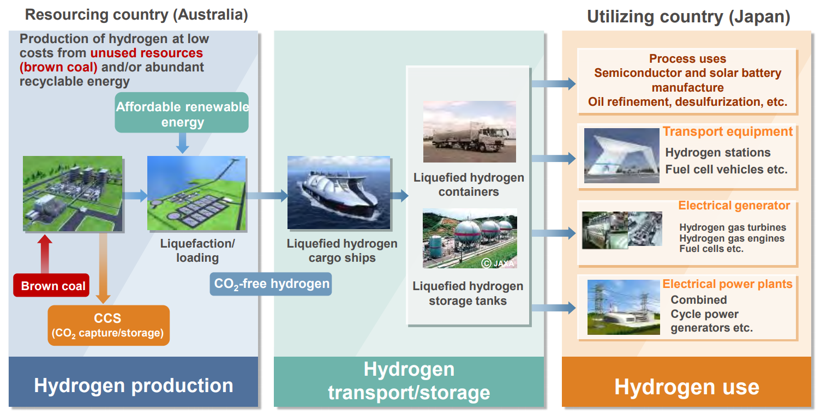
The Hydrogen Energy Supply Chain
LH2 Carrier
Notes:
In this slide, I will explain about Hydrogen Energy Supply Chain project briefly. As you know, liquid hydrogen will be produced from brown coal in Australia, and they will be consumed in Japan so we must carry them with large tanker from Australia to Japan. However, this is the world first project by large liquid hydrogen tanker, so there are some difficulties related to transportation. Our research focuses on this liquid hydrogen carrier.

Slide 3
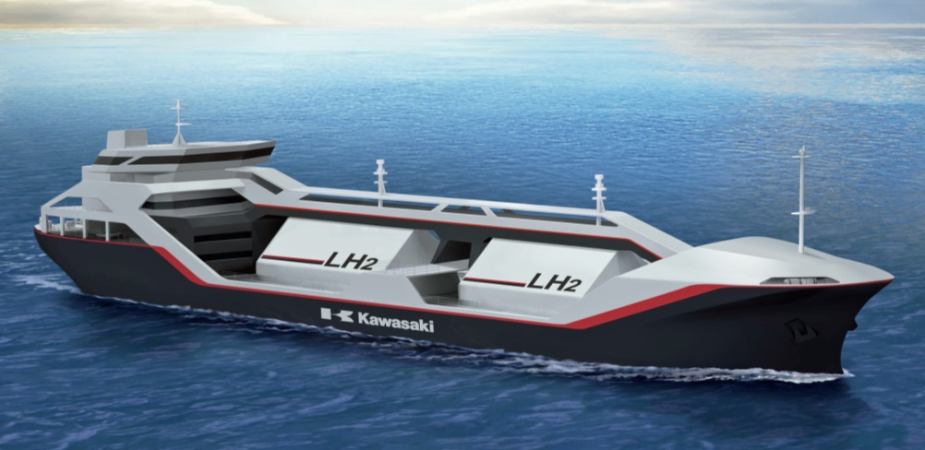
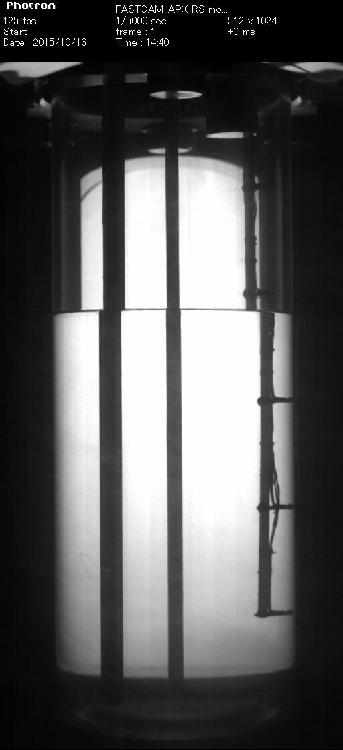
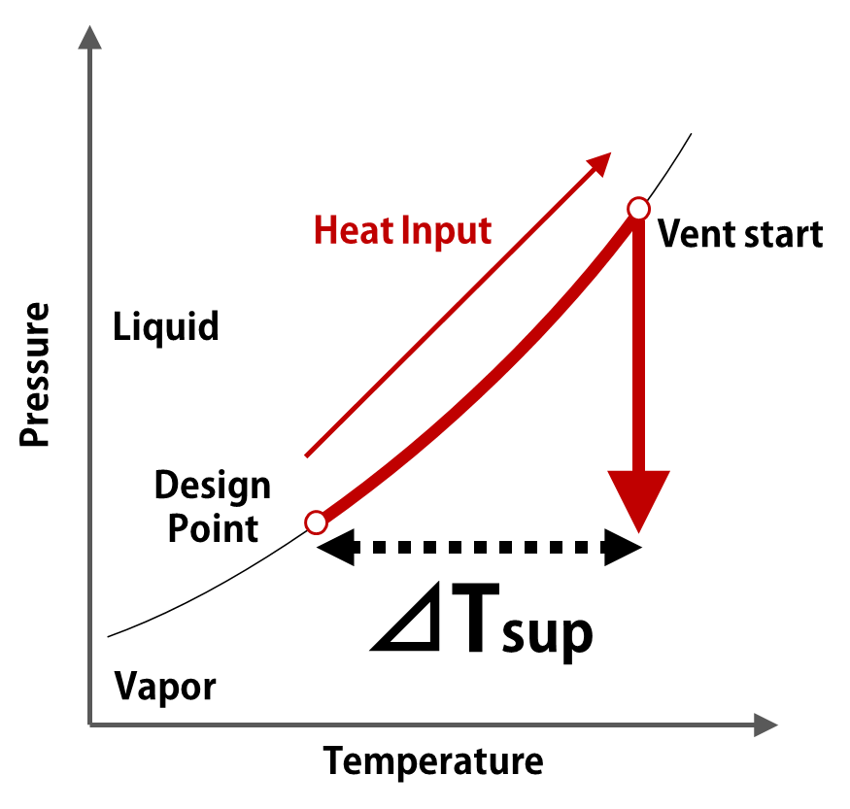
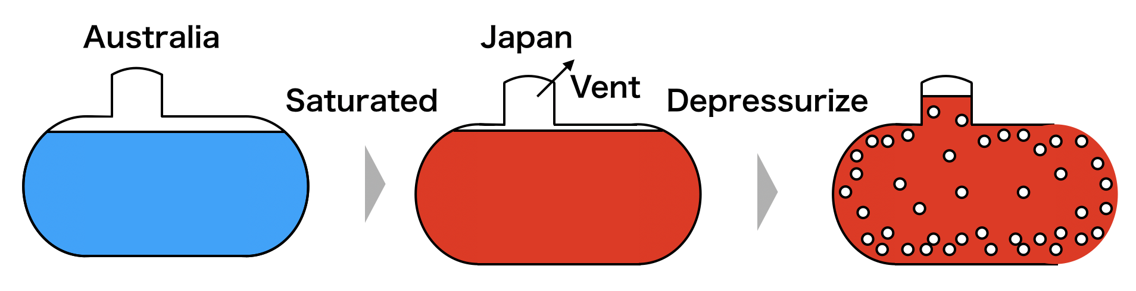
Liquid Hydrogen Carrier
1250m³
Flash Evaporation
: Boiling caused by P drop
Australia
Japan
Heat input from outside LH2 tank
Japan
High P / Saturated liquid inside the tank
Australia
P drop
Study example:
  Small tank (2.94×10⁻³m³)
  LN2 / GN2
Flash evaporation makes it difficult to operate the tank safely
Notes:
I’d like to introduce LH2 tanker. This owns 1250 m3 tanks. After long transportation, whole of the tank will be saturated and high pressure, because of heat input from outside. So we need to depressurize the tank for safety reasons in Japan, but the problem is that flash evaporation occur when saturated liquid undergoes pressure drop. The right movie shows flash evaporation experiment in small scale tank with nitrogen. Here, you can see pressure reduction made the liquid super heated, and it caused boiling. The main point here is this phenomenon makes it difficult to control pressure reduction rate and liquid level. In addition, the data of large tank experiment still lacked though we did small scale tank.
接続詞、副詞節
After long transoportraion, whole of the tank were saturated.
difficulties
This movie shows in small scale tank. 大きいタンクでは実験が不足している。

Slide 4
Research motivation
Problems with controlling LH2 tank safely:
Unknown dP/dt and liquid level
Lack of experimental data with large tank
Research Questions:
How to clarify the dP/dt under flash evaporation condition?
How is liquid behaviour inside large tank during the evaporation process?
Research Objectives:
To predict the relation between dP/dt and vent mass flow rate
  Experiment / Theoretical(Thermodynamic) Analysis
To investigate liquid behaviour during P reduction
  CFD
Notes:
In this slide, I’d like to talk about research objectives. Based on these problems and research questions, research objectives are to predict the predict the relation between pressure reduction rate and vent mass flow rate by experiment with large tank, and thermodynamic analysis. And to investigate liquid behavior by CFD.
------
Based on the research background, I’d like to talk about research motivation. As I said in the previous slide, there are the problems with controlling LH2 tank like this. So I raised these research questions. For answering them, research objectives are to predict the relation between pressure reduction rate and vent mass flow rate by experiment and theoretical analysis, and to investigate liquid behavior during pressure reduction by CFD.
---------
Following this research background, I raised two research questions. First one is how to clarify the pressure reduction rate under flash evaporation condition. Second is how is liquid behavior inside LH2 tank during the evaporation process. For answering these two question, research objective is to predict the relation between pressure reduction rate and vent mass flow . We did experiment and thermodynamic analysis. Second is to investigate liquid behavior during pressure reduction. We did cfd analysis.
Research objectives and queas
difficulties を言って、

Slide 5
Outline
Research background and motivation
  HESC and Liquid Hydrogen Carrier
  Research motivation
Pressure reduction experiments
  Experimental apparatus (30m³ LH2 tank) and test condition
  Results and discussion
Theoretical analysis on the experiments
  Results of 1-D thermodynamic model compared with the experiments
Preliminary study on pressure reduction based on CFD
  Result of one test case
Conclusions and Future Work
Notes:
Here is the outline of my research. I did pressure reduction experiment with large tank, thermodynamic analysis, and CFD. I’ll start by talking about experiments with large tank.

Slide 6
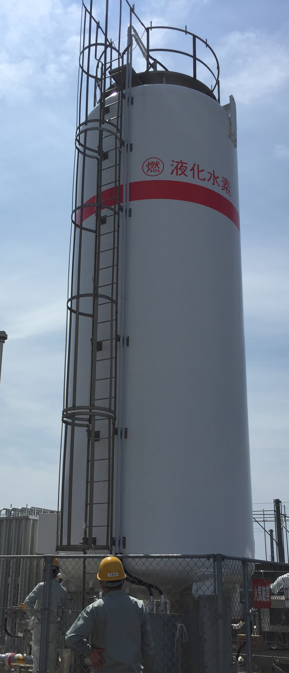
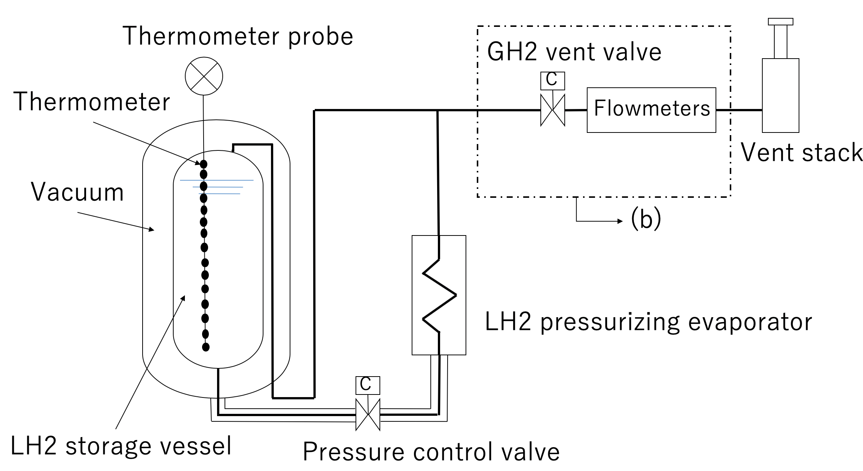
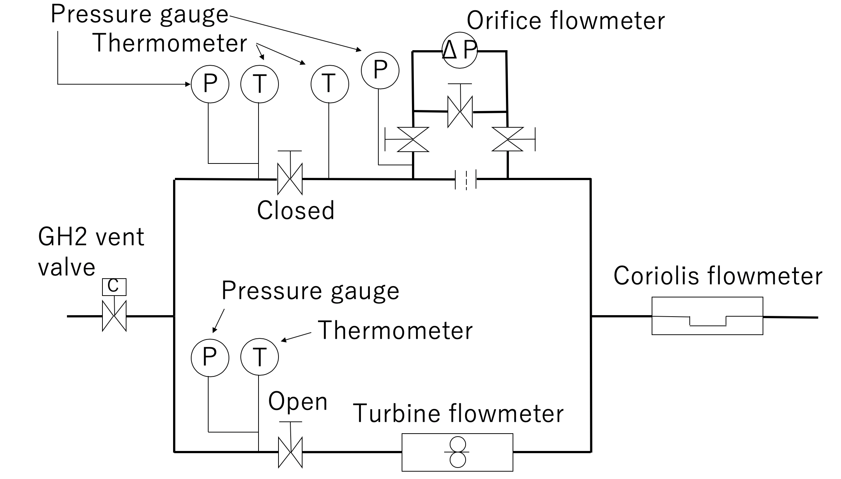
2. Pressure reduction experiments – Overview
Motivation:
To obtain the empirical data for validating the numerical analysis
Strategy:
Pressure drop experiments under various initial T conditions
Pressure gauge
x
Located at JAXA Noshiro Rocket Testing Center
Notes:
The motivation of the experiments is here. We strongly desired experimental data of the large tank, so we have conducted the pressure drop experiments with JAXA by using these experimental apparatus.
-------
This is the schematic of tank, and the vent line. The tank volume is 30m3, and 16 thermometers were additionally equipped inside tank. Tank pressure was obtained at the top of the tank. On the vent line, flow rate is obtained by use of turbine flowmeter, and Coriolis flowmeter.

Slide 7
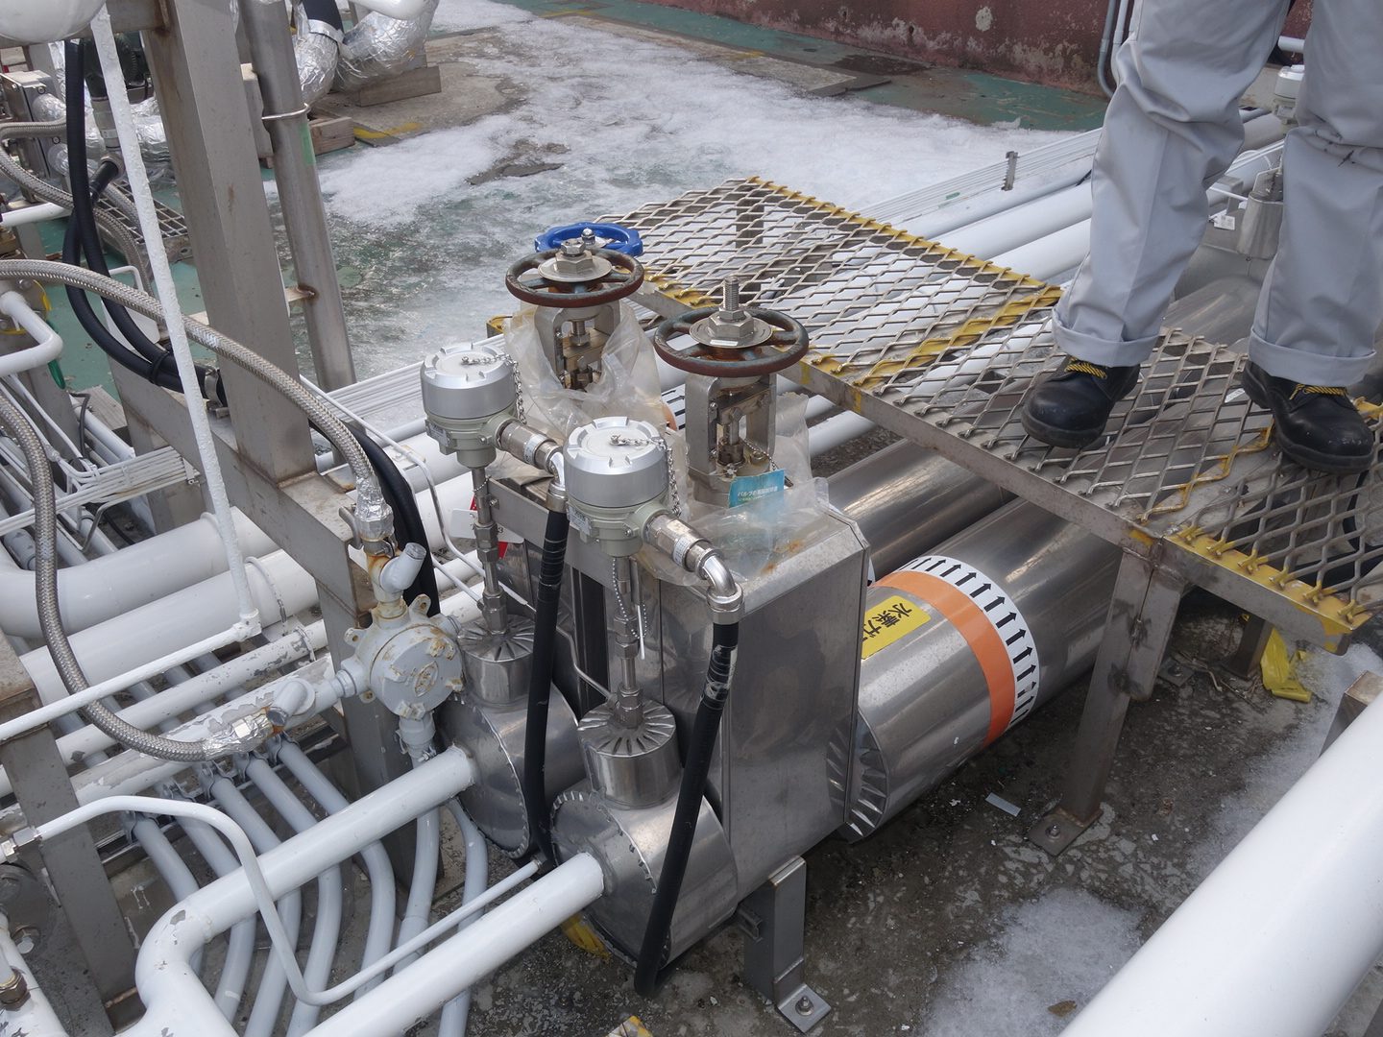
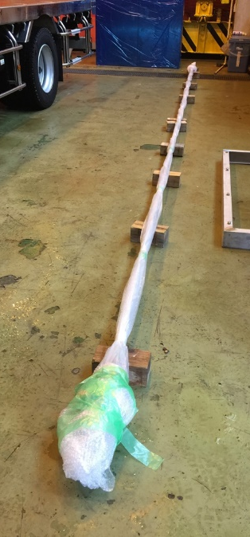
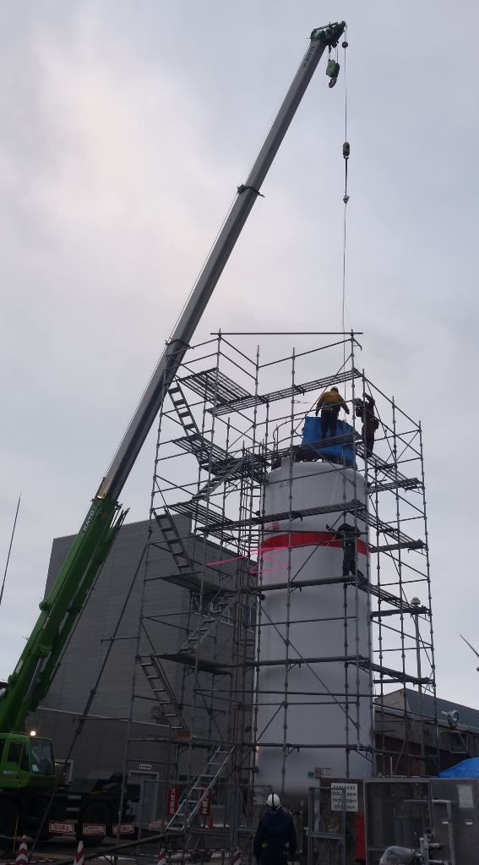
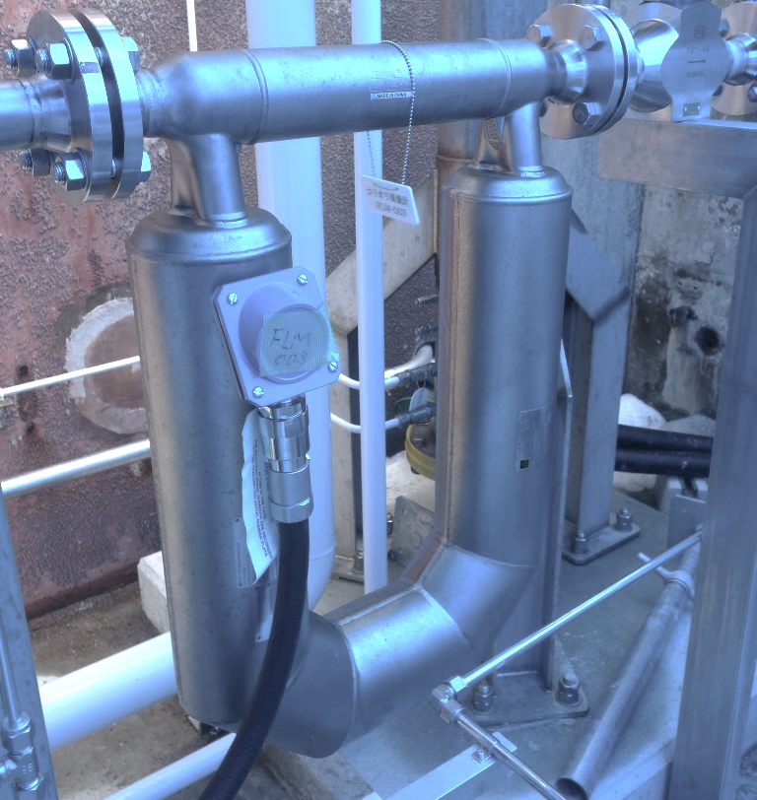
2.1 Pressure reduction experiments – Apparatus
Pressure gauge
x
Turbine and Orifice flowmeter
LH2 tank
V: 30m³
Thermometer probe(16 thermometers) was installed inside LH2 tank
Coriolis flowmeter
The data of P and T(16 points) inside the LH2 tank can be obtained.
P, T, and volume/mass flow rate of vent gas can be measured.
Notes:
This is the schematic of tank, and the vent line. The tank volume is 30m3, and 16 thermometers were additionally equipped inside tank. Tank pressure was obtained at the top of the tank. On the vent line, flow rate is obtained by use of turbine flowmeter, and Coriolis flowmeter.
-------
Though I mentioned in the previous slide, we did the pressure reduction experiments with 30m3 tank. We can obtain pressure, and 16 temperatures inside the tank, and also get pressure, temperature and volume mass flow rate of vent gas.

Slide 8
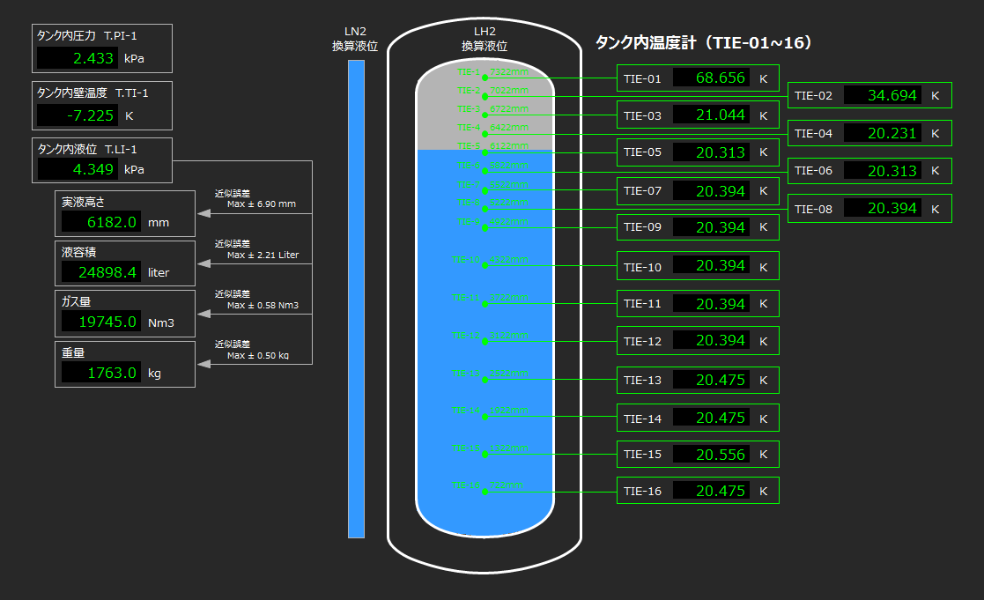
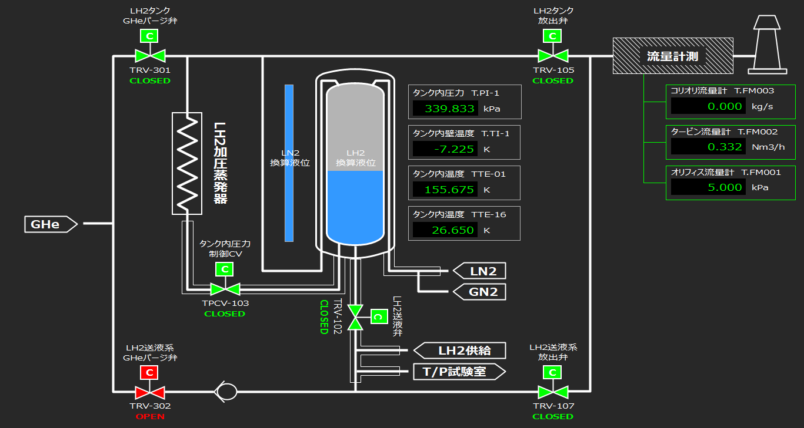
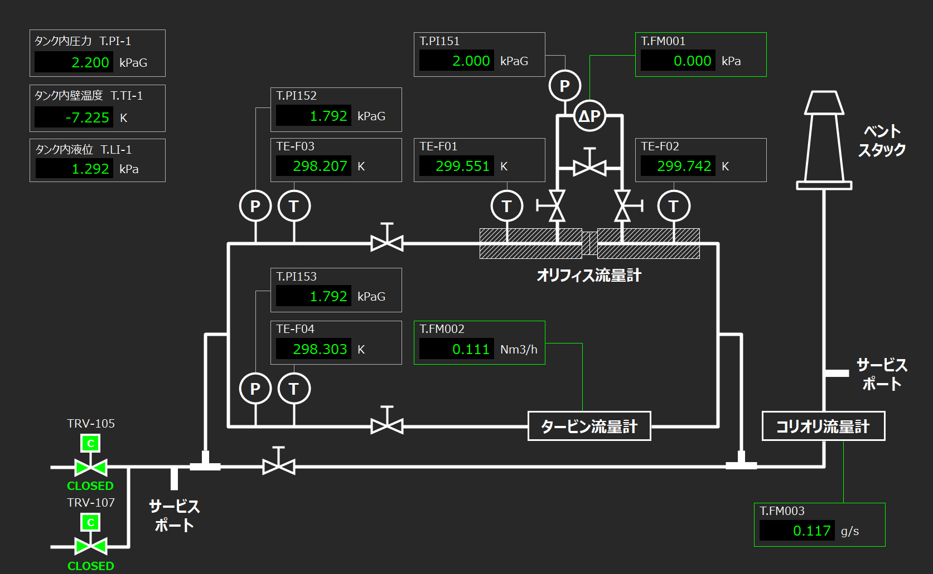
2.1 Pressure reduction experiments
– Apparatus(Remote Monitoring system)
Overview of experimental apparatus
Temperatures inside the LH2 tank
The measured data can be remotely obtained in real time.
Flowmeters
Notes:
We can obtain the experimental data by using this remote monitoring system.
どんなタイプの温度計。圧力計、フローメータ

Slide 9
2.1 Pressure reduction experiments – Method
Experimental procedures
Pressurize the 30m³ tank
Keep the pressure constant and make the liquid hydrogen saturated
Turn on GH2 vent valve and start depressurizing
1
Close
x
Vaporise
Open
Notes:
Next, I'd like to show you the experimental method. At the beginning of the experiment, we pressurize tank by using lh2 pressurizing evaporator.

Slide 10
2.1 Pressure reduction experiments – Method
Experimental procedures
Pressurize the 30m³ tank
Keep the pressure constant and make the liquid hydrogen saturated
Turn on GH2 vent valve and start depressurizing
2
Close
x
Close
Notes:
Then keep the pressure constant and make the lh2 saturated.

Slide 11
2.1 Pressure reduction experiments – Method
Experimental procedures
Pressurize the 30m³ tank
Keep the pressure constant and make the liquid hydrogen saturated
Turn on GH2 vent valve and start depressurizing
2
Close
x
Close
Notes:
By doing this, we can set the initial temperature condition.
1,2 がinitializing

Slide 12
2.1 Pressure reduction experiments – Method
Experimental procedures
Pressurize the 30m³ tank
Keep the pressure constant and make the liquid hydrogen saturated
Turn on GH2 vent valve and start depressurizing
Atmosphere
3
Open
x
Close
Notes:
Finally, open this gh2 vent valve, and depressurize the tank.

Slide 13
2.1 Pressure reduction experiments – Test condition
Experimental condition had been designed to clarify
the relation between gas volume and dP/dt
the influence of the liquid T
Baseline
Test 1
GAS
2
3
4
GAS
GAS
GAS
Initial pressure was determined with consideration of the designed pressure of the experimental facility
LIQ.
LIQ.
LIQ.
LIQ.
Test | Case ID | Liq. Level | Liq. T [K] | Initial P [kPaG]
1 | 1-1, 1-2 | High | 20.4(T_{sat}@0kPaG) | 300.0 | w/o boiling
2 | 2-1, 2-2 | Low | 20.4(T_{sat}@0kPaG) | 356.5(Case 3) / 306.8(Case 4) | w/o boiling(Baseline)
3 | 3 | Low | 24.7(T_{sat}@180kPaG) | 351.0 | with boiling
4 | 4 | Low | 26.1(T_{sat}@300kPaG) | 308.2 | with boiling
Notes:
Let’s move on to experimental conditions. In the experiment, we’d like to find out the sensitivity of gas volume inside tank, and liquid temperature to pressure drop. Therefore, we set 4 test conditions like this. For understanding the effect of gas volume, we did test 1 and 2 where liquid levels were different. And we also conducted test 2, 3, and 4 for clarifying the influence of liquid temperature by changing it. The initial pressure of all tests are around 300 kPaG, so only test4 case was fully saturated. Test 3 was partially saturated.

Slide 14
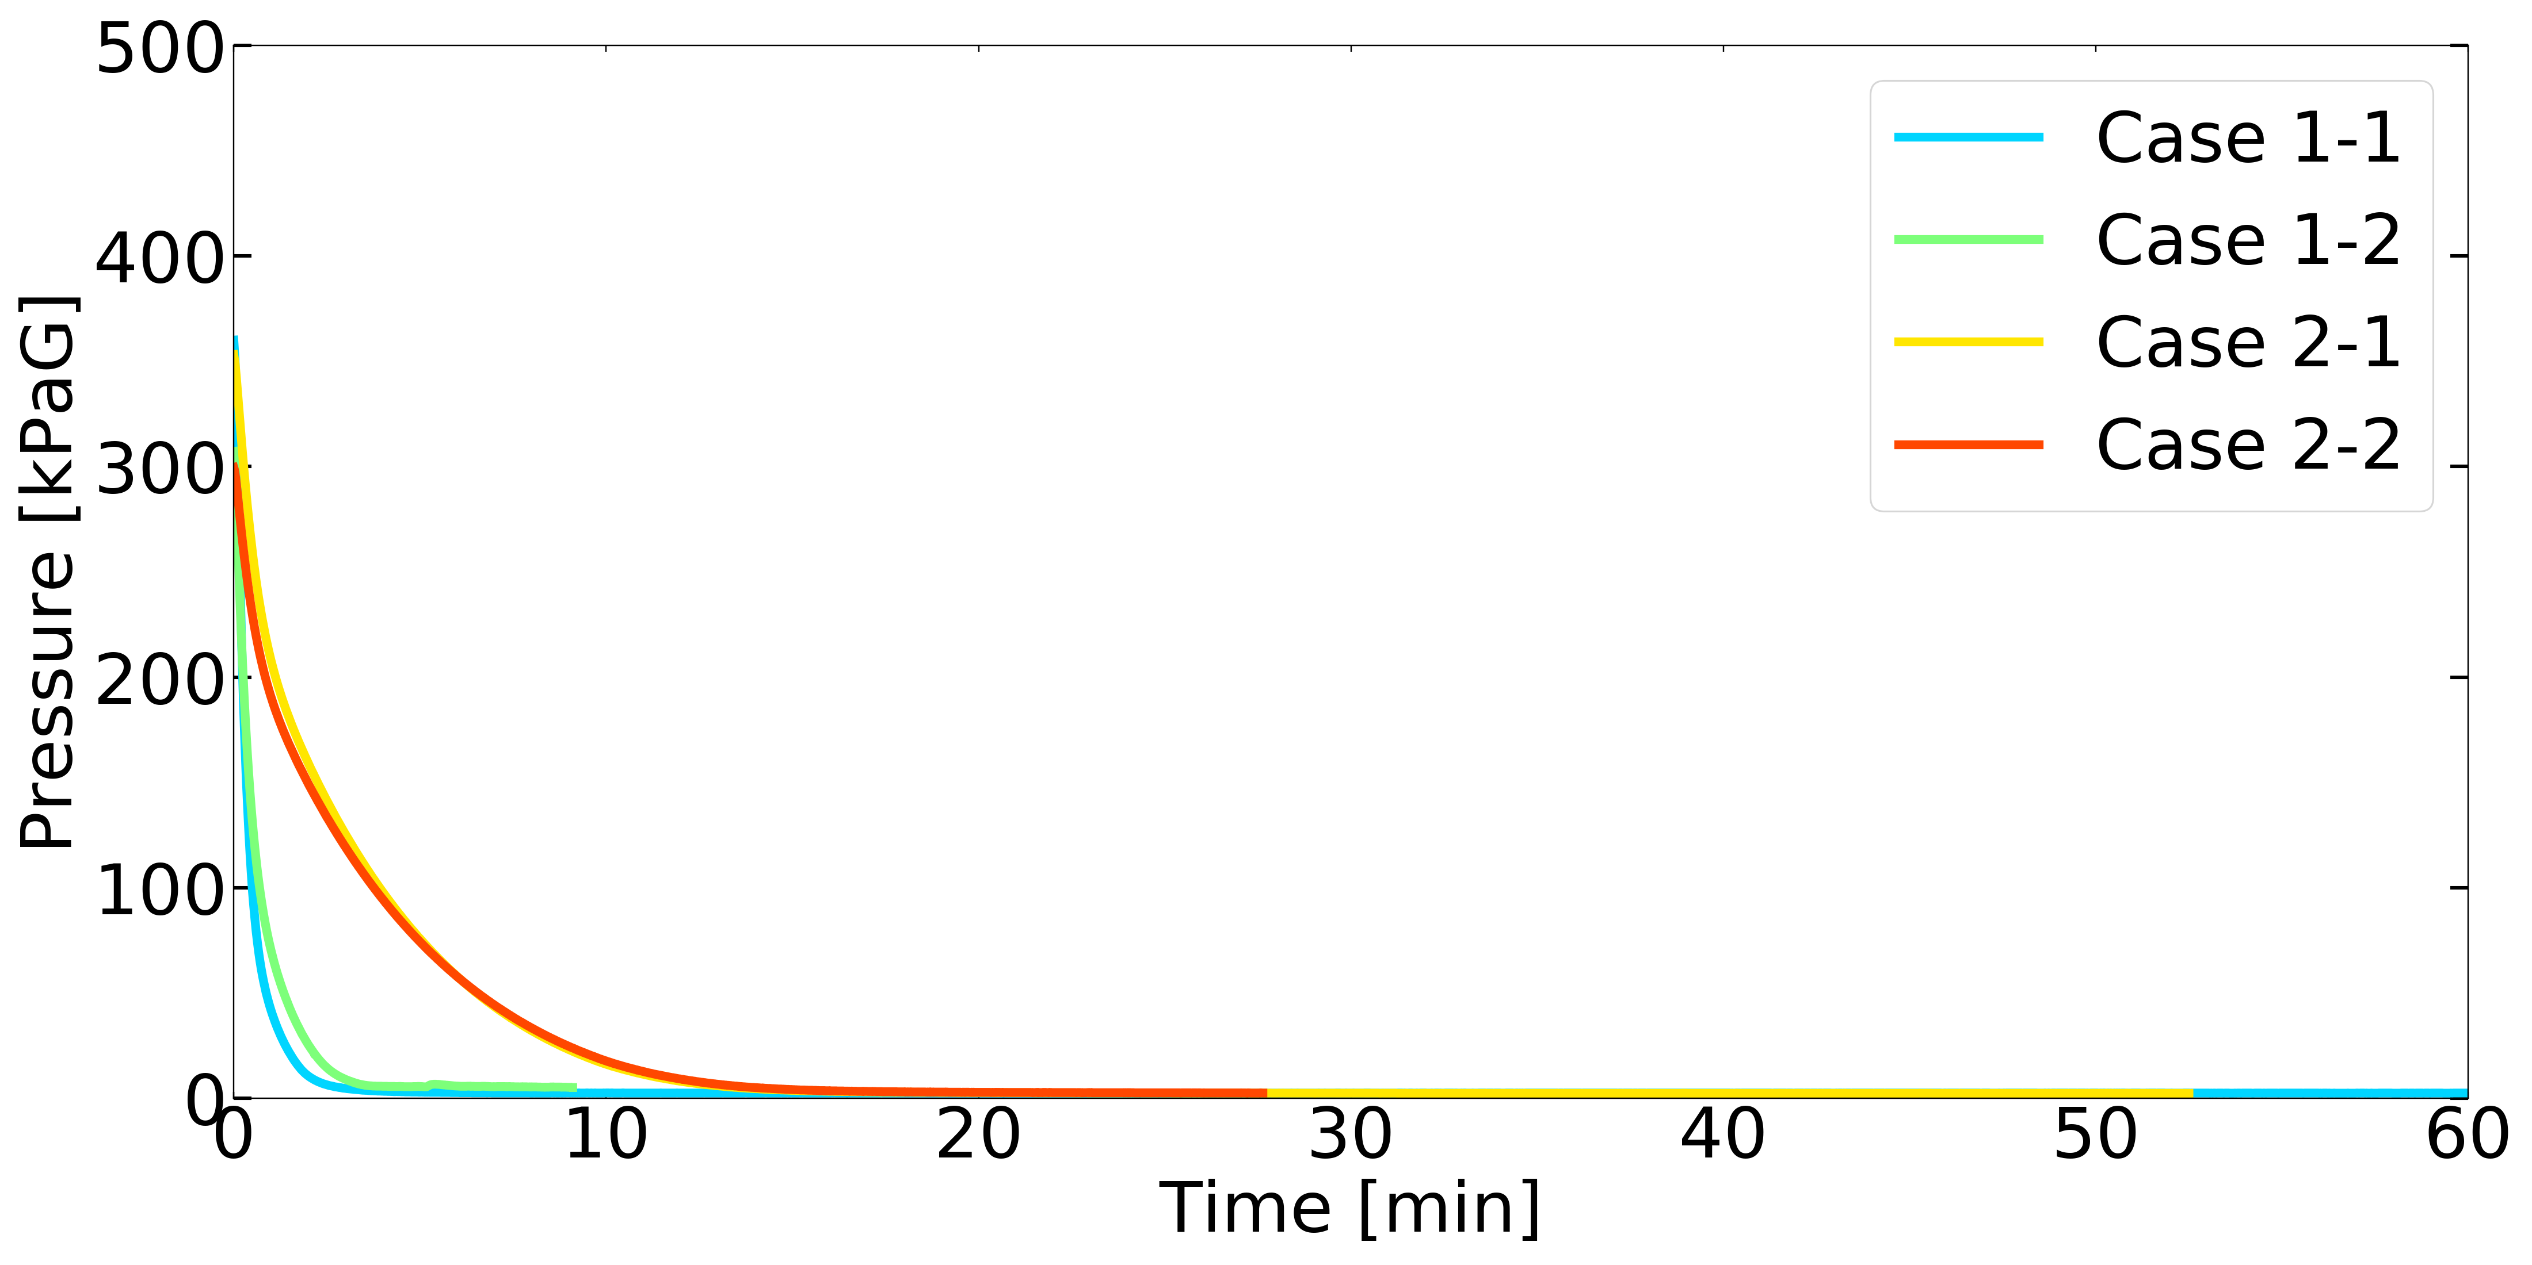
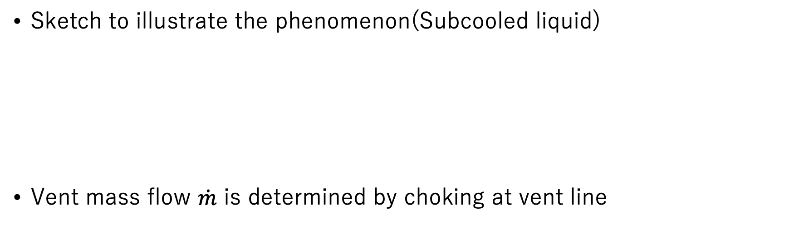
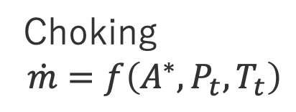
2.2 Pressure reduction experiments – Influence of gas volume
Choking
$$\dot{m}=f\left(A^{∗}, P_{t}, T_{t}\right)$$
Sketch to illustrate the phenomenon(Subcooled liquid)
Vent mass flow $\dot{m}$ is determined by choking at vent line
Open
Adiabatic expansion
Pressure /Temperature
w/o boiling
Gas volume inside liquid tank governed the pressure reduction rate.
Test 2(15 min)
Test 1(5 min)
Notes:
In this slide, I’d like to describe the influence of gas volume comparing the results of test 1 and 2. In these cases, boiling did not occur due to subcooled condition. Therefore, pressure and temperature decreased following adiabatic expansion. On the other hand, vent mass flow is determined by choking at vent line, so larger gas volume led to longer pressure reduction time. We can easily understand that because this is the no boiling condition.

Slide 15
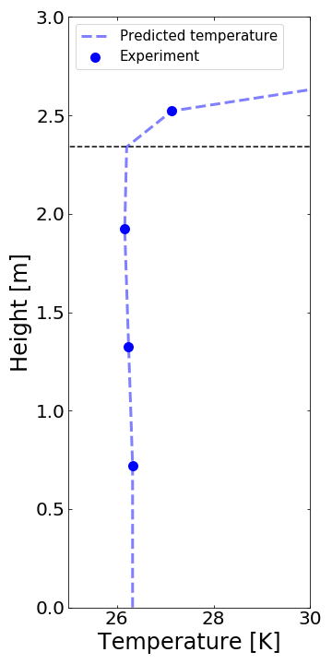
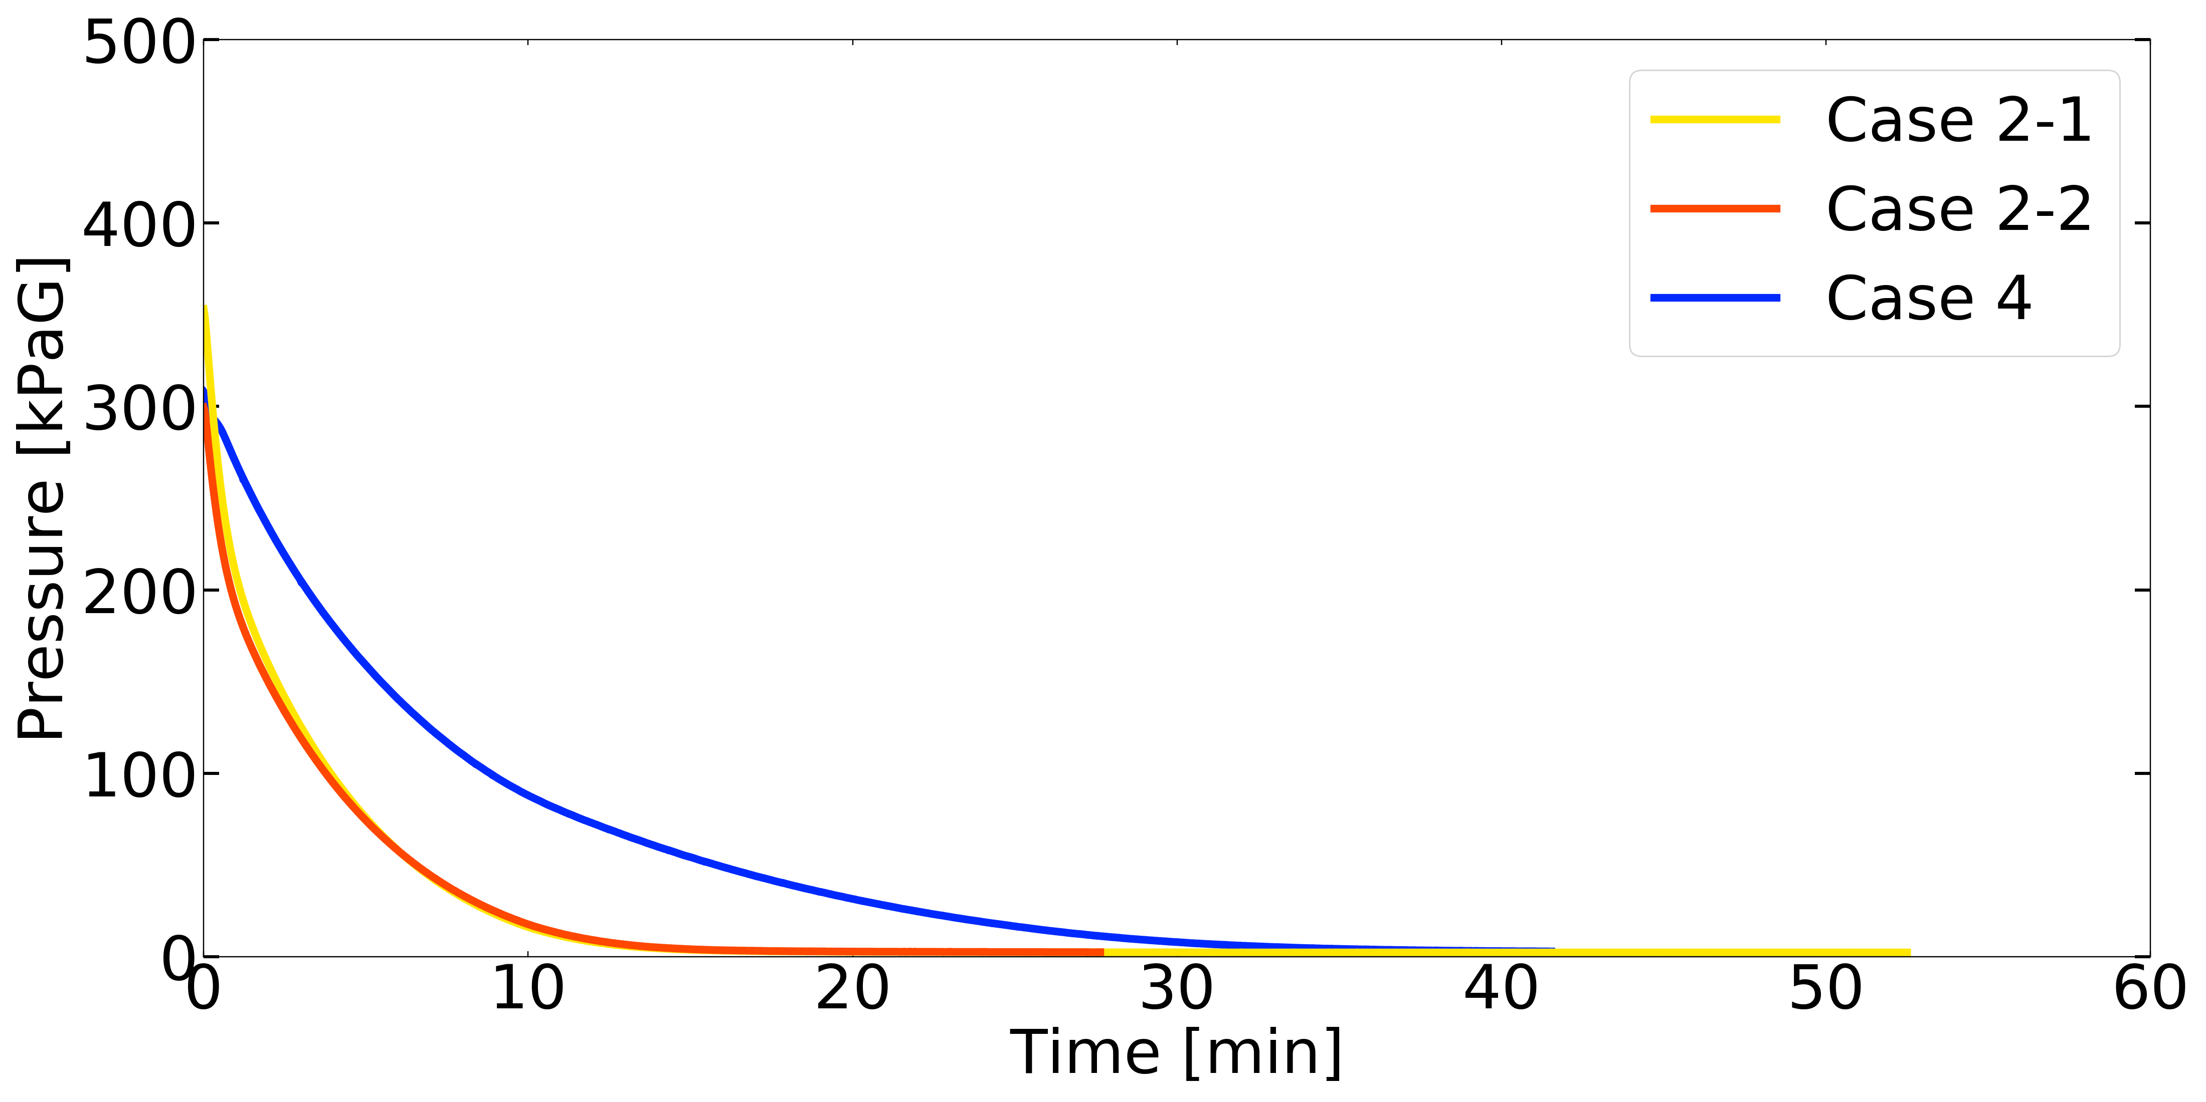
2.2 Pressure reduction experiments – Influence of liquid T
Initial condition
Temperature in liquid phase was homogeneous
Test 4 requires 3 weeks of sealing duration
Results
Test 4 took 30 minutes longer than Test 2 because of flash evaporation
Didn’t measure the liquid level
1
2
Test 2
Test 4
20.4 K
26.1 K
3
Approximate Liquid surface
3 weeks
Initial temperature
20.4 K
26.1 K
30min
4
Boiling
?
Notes:
Here, I’d like to talk about test 4 where liquid was fully saturated. This resembles the condition of the lh2 tanker. First, I’ll explain about the initial condition. The left graph shows the initial temperature distribution, vertical line is height, and horizontal line is temperature. You can see temperature in liquid phase was homogeneous. On the other hand, test 4 requires 3 weeks to make the condition. Second, let me introduce the result. The test including boiling took 30min longer than the test without boiling. Therefore, higher liquid temperature led to longer reduction time. In addition to this, we didn’t know what happened inside the tank. Off course, the bubble was generated, but that amount was not confirmed.
------------------
Test 4 saturation. final phase -> similar condition of tanker.
Even though, we need much more time. venting time is longer. distinguished
Initial condition -> 3weeks similar condition
However, we don't know how much
venting time 1~3でしている。
What happend inside tank, off cource generation
liquid
the amount due to the

Slide 16
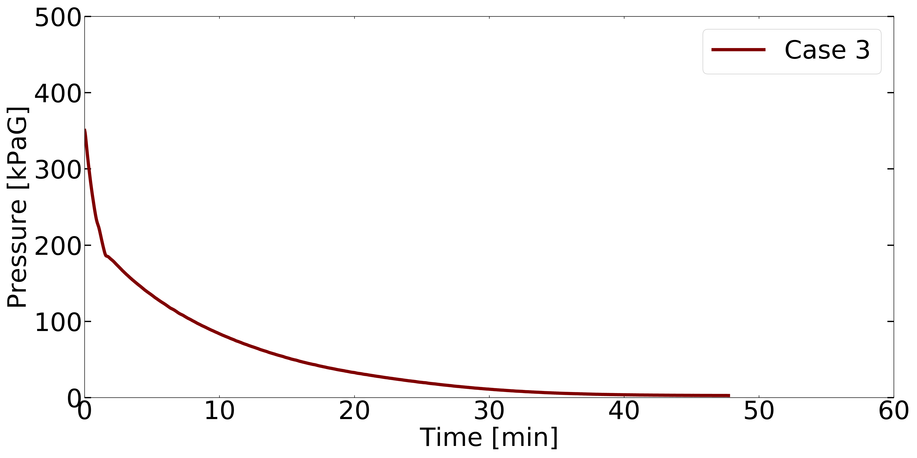
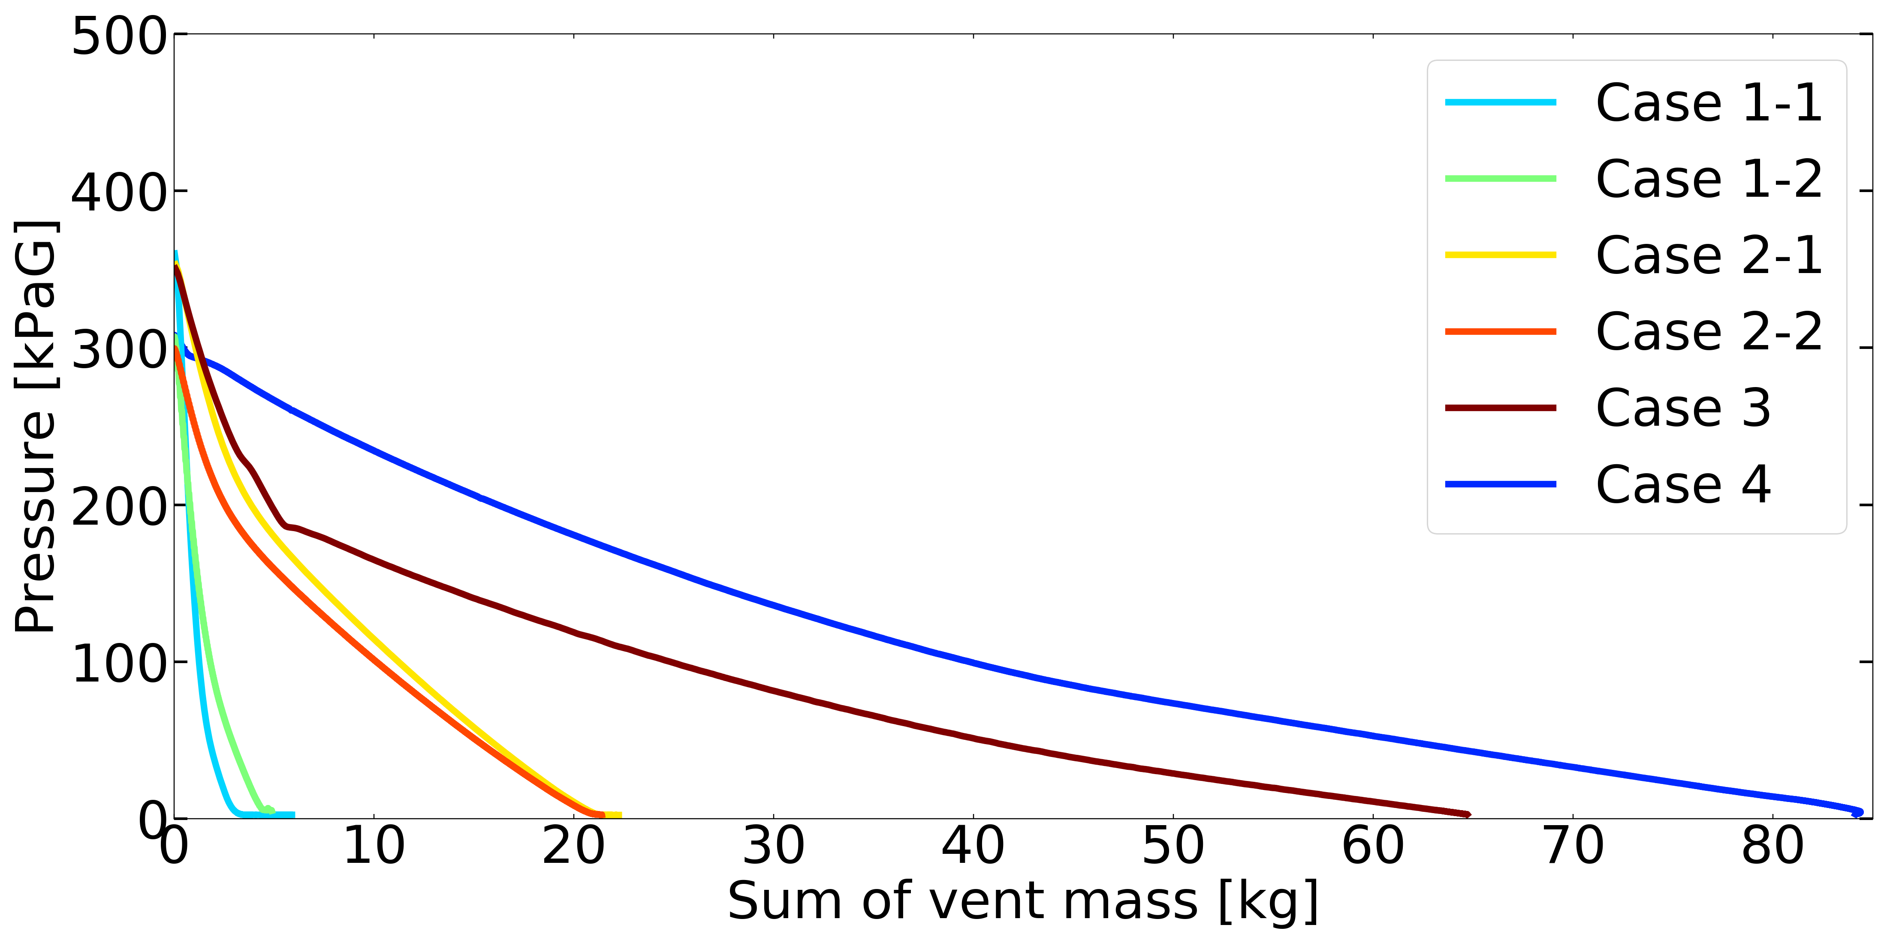
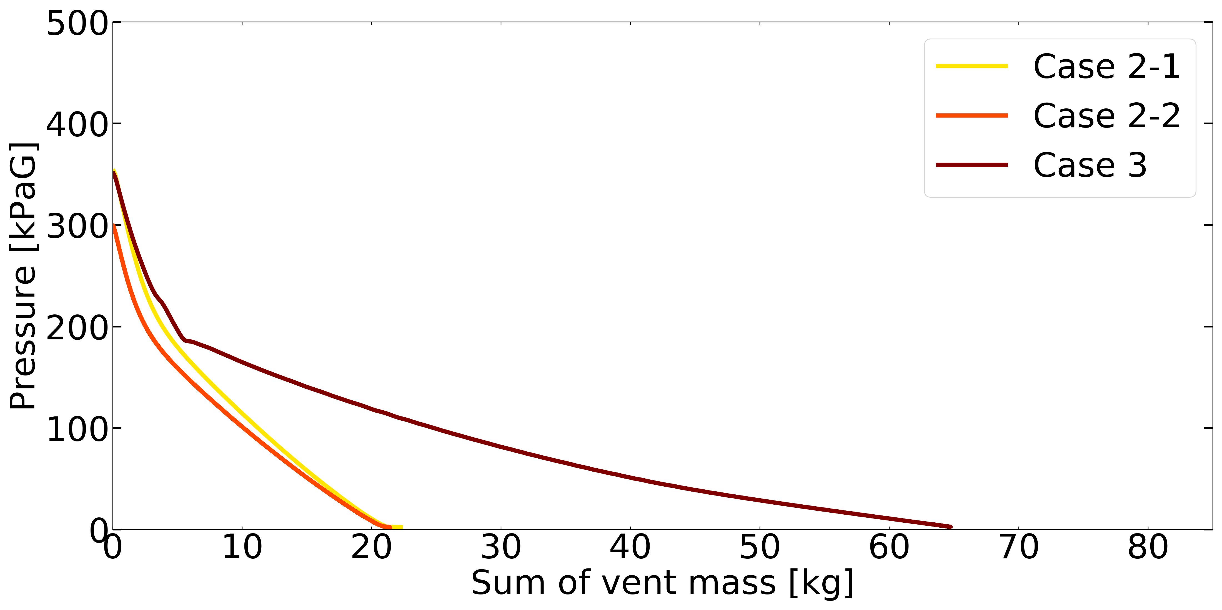
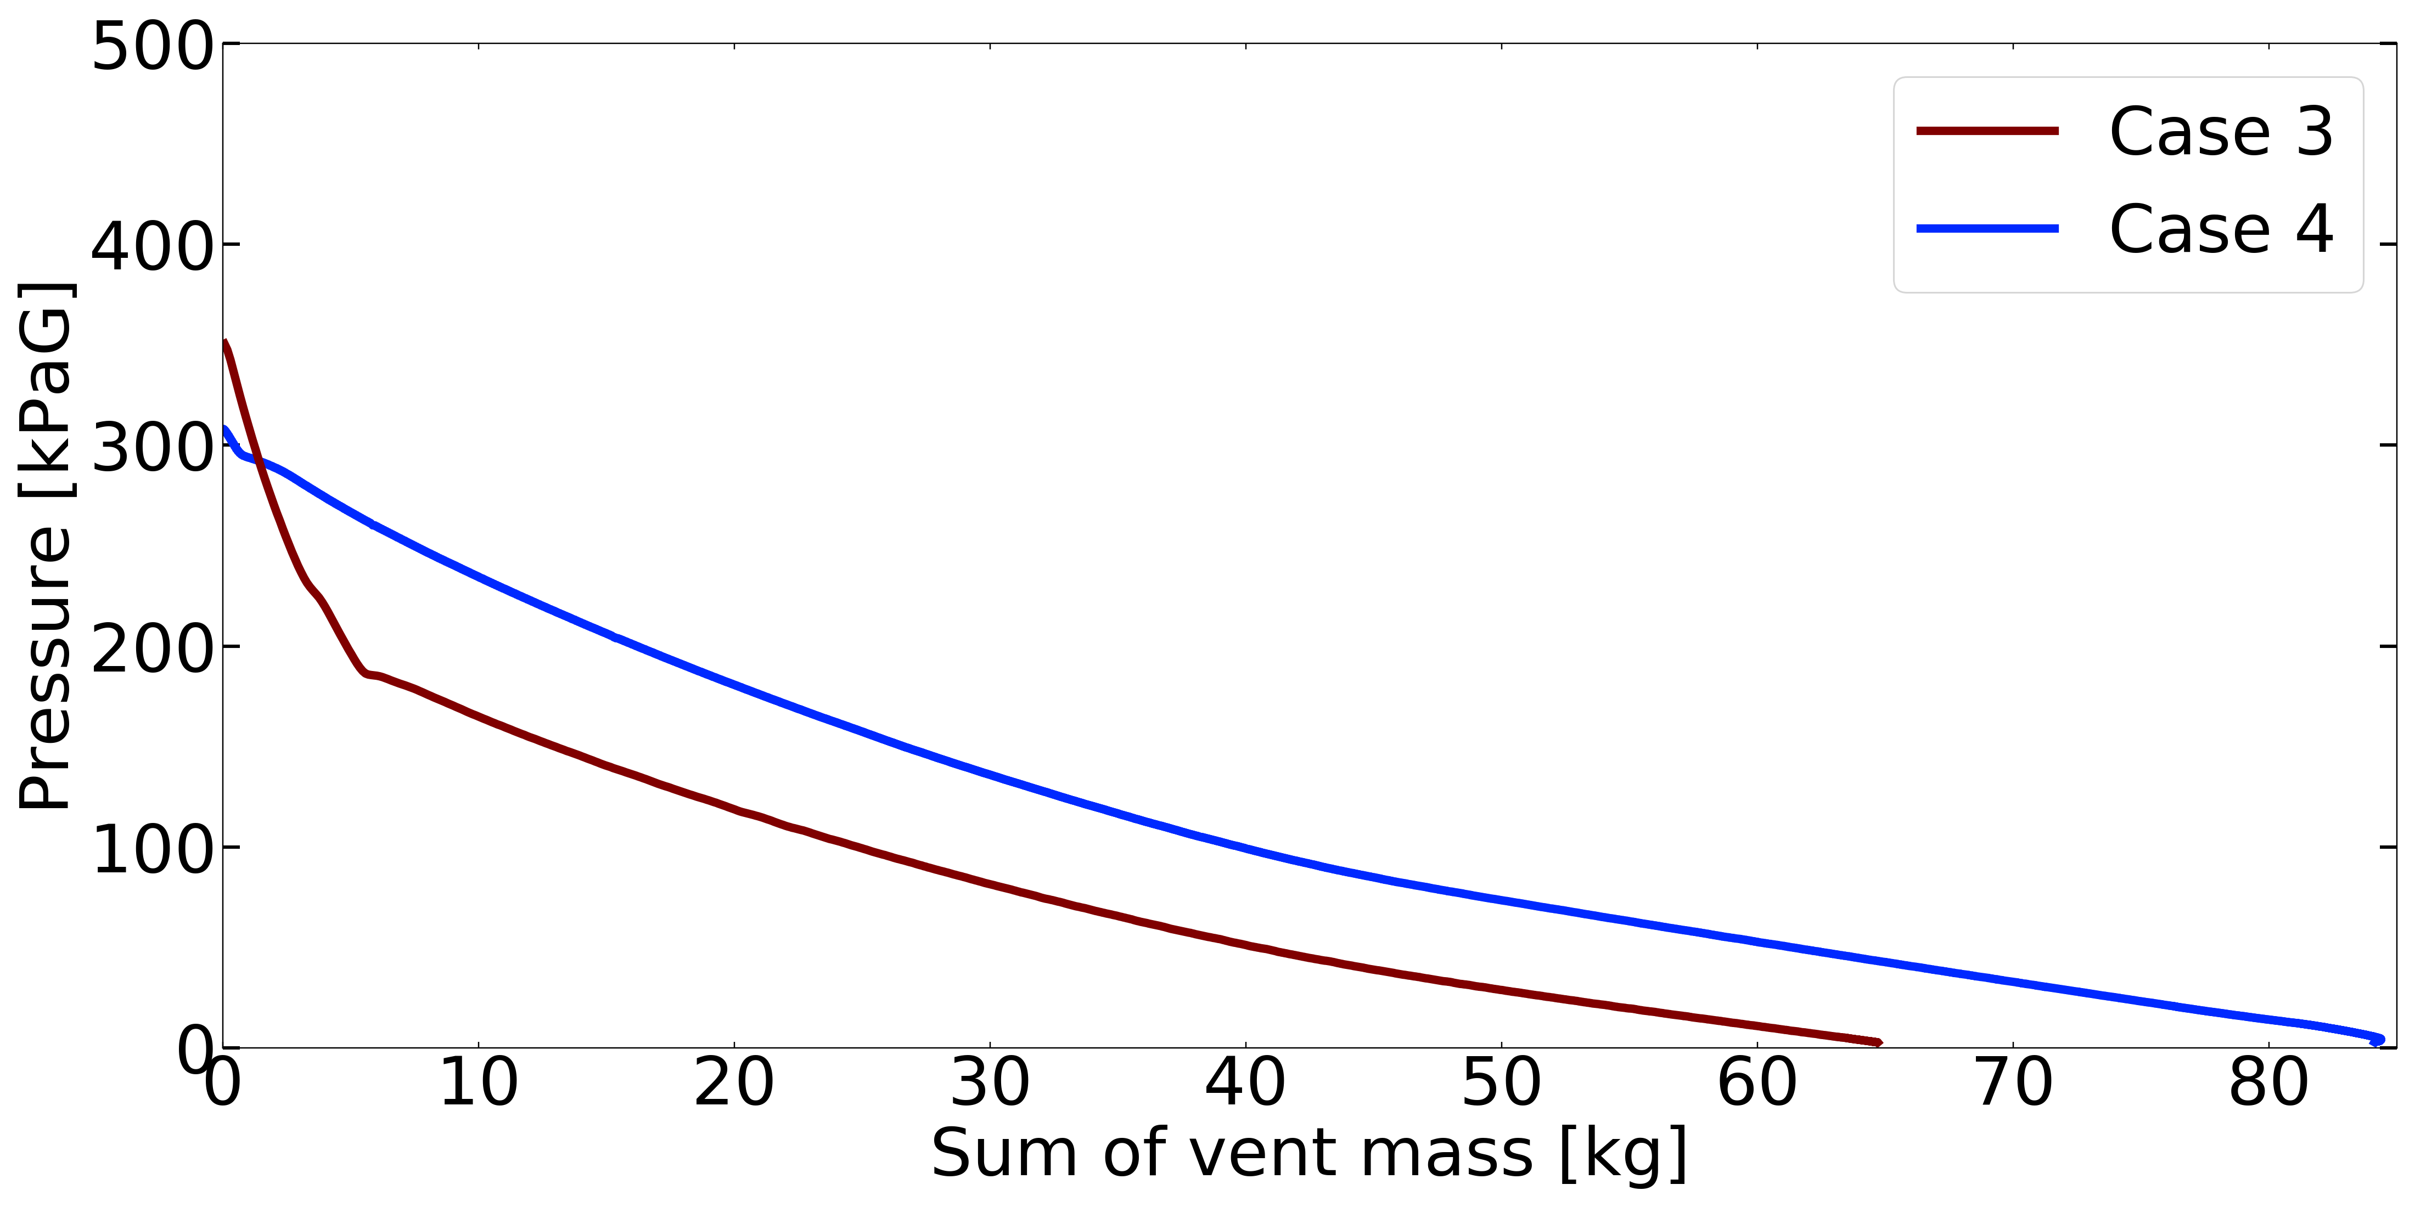
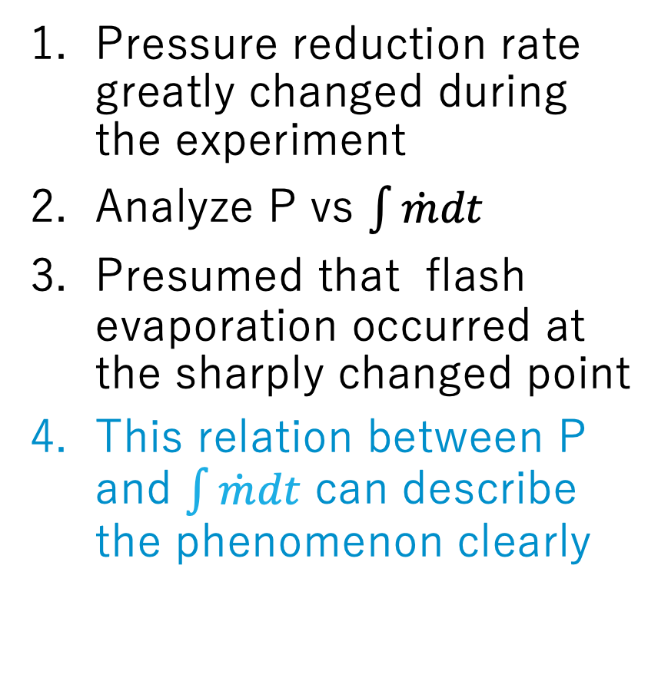
2.2 Pressure reduction experiments – Result(Test 3)
Pressure reduction rate greatly changed during the experiment
Analyze P vs $\int{\dot{m}dt}$
Presumed that flash evaporation occurred at the sharply changed point
This relation between P and $\int{\dot{m}dt}$ can describe the phenomenon clearly
1
Test3
24.7 K
2,3
Flash evaporation occurred
Similar to Test 2
Adiabatic expansion
w/o boiling
Similar to Test 4
with boiling
Notes:
In this slide, I’ll explain about test 3, which was partially saturated. As the graph, the time variation of pressure, shows, the inclination changed dramatically at around 180kPaG. For understanding this, we compared the experiments by the relation between pressure and sum of vent mass. As a result, it was found that first part was similar to no boiling condition, and last part was similar to the boiling condition. This means that flash evaporation occurred at this point, in other words, the tendency without boiling matched adiabatic expansion, and the pressure and temperature obeyed Clausius-Clapeyron equation when boiling occurred. The important point here is the time-independent relation can describe the pressure reduction phenomenon clearly, which means that the phenomenon inside tank was under equilibrium.
------------
w/o adiabatic
assumptions of adiabatic well established. tendency
in the two phase
in the present cases,
later part similar to the boiling condition.
When the boiling occur, pressure and temepratureクラペイロんクラウジウスにobey
partially saturated
parallel - >similar resemble
adiabatic expansion w/o boil.
with boil.

Slide 17
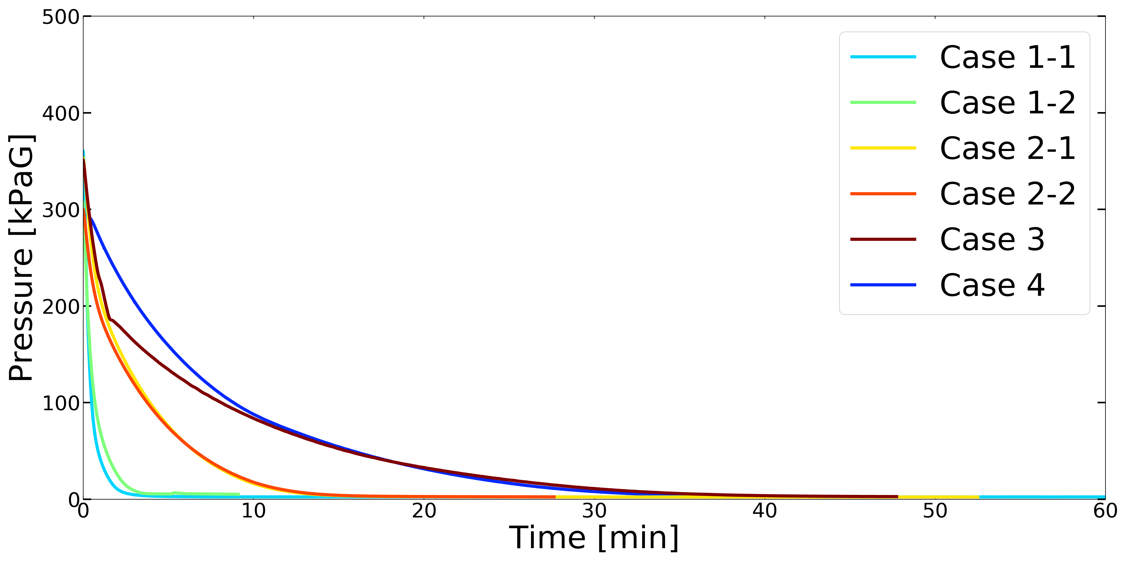
2.2 Pressure reduction experiments – Summary
Larger gas volume → Longer pressure reduction duration(Test1,2)
Higher liquid temperature → Longer pressure reduction duration(Test2,3,4)
Pressure reduction rate greatly changed during Case-3 experiment(Test3)
Pressure reduction duration
Test1
(1)Test1 5 min
(2) Test2 15 min
Test2
Test3
20.4 K
Test4
20.4 K
(3)Test3 45 min
(4)Test4 45min
(1)
(2)
24.7 K
26.1 K
(3)
(4)
Notes:
This is the summary of the experimental results. The gas volume and liquid temperature had a great impact on venting time. In these experiments, the tests without boiling followed adiabatic expansion, and the ones with boiling obeyed Clausius-Clapeyron equation.

Slide 18
3. Theoretical analysis on the experiments – Overview
Motivation:
To clarify the relation between dP/dt and the vent mass flow rate
Strategy:
Based on experimental analysis, the phenomenon occurred under equilibrium state, which can be represented by 1-D thermodynamic model.
Assume equilibrium state inside the LH2 tank
Develop 1-D thermodynamic model, which can calculate dP/dt if the data of vent mass flow rate is given
Notes:
Next, I’ll introduce the overview of the thermodynamic analysis. As I said, the motivation is to clarify the relation between pressure reduction rate and the vent mass flow rate. Based on experiment, it was confirmed that thermal equilibrium was established at local point inside the tank , because we didn’t see extreme boiling like bumping and geyserying, and time history follows adiabatic or Clausius-Clapeyron equation. So I thought that we could assume the approximation of equilibrium inside the tank, and develop 1-d thermodynamic model which could calculate pressure reduction from vent mass flow.
the relation はいらない。
We cannot see geyserying, superheat
in the case well established w/o boil.
two phase well
time history obeys adiabatic and クラウジウスクラペイロんのしきn
apploximation of
Based on experiment, it was confirmed that at local point inside the tank thermal equilibrium was established.

Slide 19
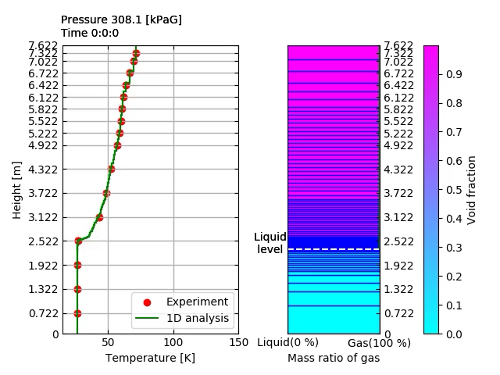
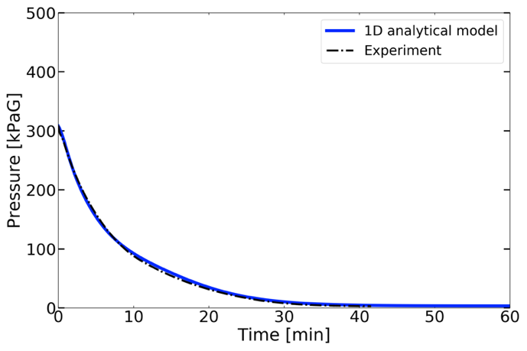
3. Theoretical analysis on the experiments – Results (1)
Test 4 (Saturated liquid)
The time variation of temperature distribution and the liquid level
Time variation of pressure
Notes:
This slide shows the results of test 4, comparing 1-d model calculation and experiment. The right graph shows the temperature distribution and the void fraction inside the tank. The red point illustrates experimental data, and green line corresponds to the 1-d calculation. On the other hand, this blue line shows the boundary of the individual element and white dot line shows the surface of liquid. The color inside each element illustrates the void fraction. light blue color is liquid and red color is gas. Then, we would like to see the results. As you can see, 1-d model can calculate the time variation of temperature correctly. Morover, as the left graph shows, The time variation of pressure also matches well. In the next slide, I’d like to describe the pressure time history in detail.
--------------
これがmethodの
This slide shows
orange experimental results
corresponding to 1-d thermodynamic analysis
This picure shows represents gas phase
blue line shows indivisual element
control volumes
This is the 1-d
many
indicated by the control volume
we would like to see
バックアップスライドとして、partially の動画も入れておく

Slide 20
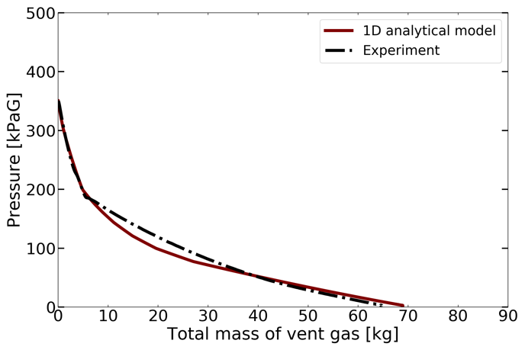
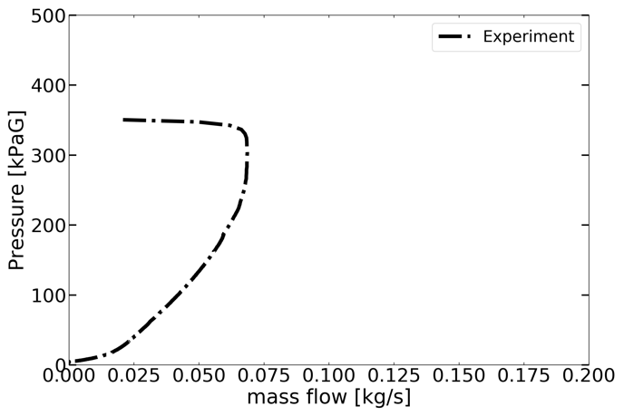
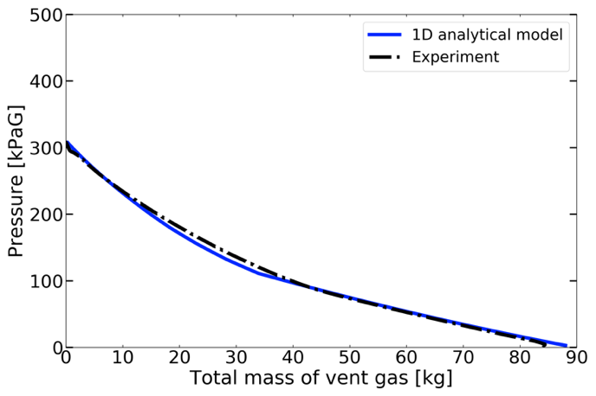
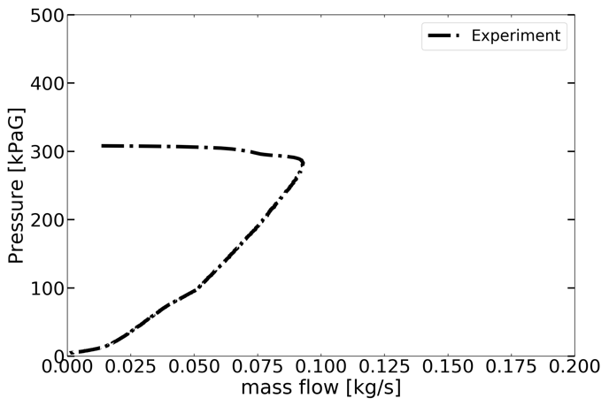
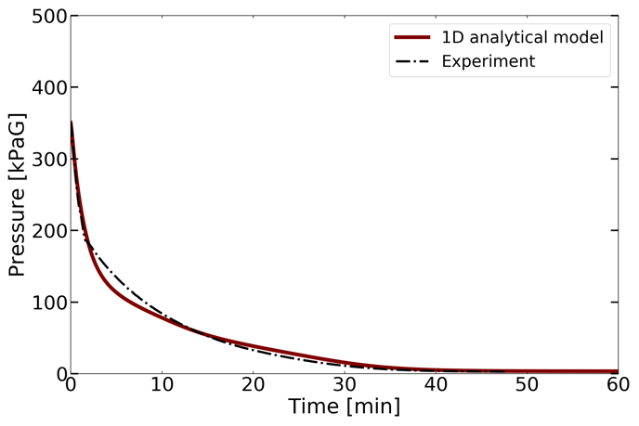


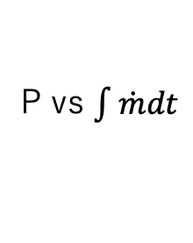
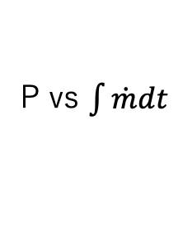
3. Theoretical analysis on the experiments – Results (2)
P vs $\int{\dot{m}dt}$
P vs$\dot{m}$
P vs $\int{\dot{m}dt}$
P vs$\dot{m}$
Test 3
(Case 5)
Test 4
(Case 6)
24.7 K
26.1 K
1-D theoretical model can reproduce the dP/dt from the data of vent mass flow rate correctly.
Notes:
Here, I would like to show you the results of test 3 and 4. From 1-d analysis, Upper left graph which was the relation between pressure and sum of vent gas was obtained. Upper right graph illustrates the pressure corresponding to mass flow rate of experiment. We can lead to the time variation of pressure, the lower graph, from these relations. As you see, 1-D model can reproduce the pressure reduction rate. The assumptions we used can be also established in large lng tank. Therefore, as long as the vent mass flow rate is the same order, we can apply this simulation tool to the expected LH2 tanker.
----------
横軸が何か縦軸が何かを示す。
levelが小さすぎる。font size
この仮定はlngでもやっている。今の排気のスピードであれば、想定実機タンクでも
unloadの時のnominal
LNGとそこまで変わらない。We confirmed that venting time of liquid hydrogen is same as that of LNG
Pressure reduction duration should be the same order of those of LNG.
We continue that simulation tool

Slide 21
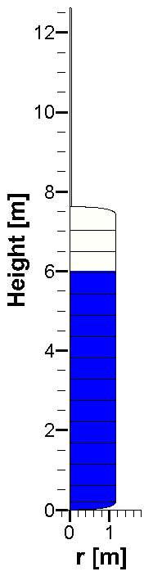
4. Preliminary study on pressure reduction based on CFD
– Overview
Motivation:
To clarify the liquid motion under flash evaporation condition
Strategy:
As a preliminary study, two-phase flow CFD is applied to 2-D test case which represents rapid pressure reduction
Supply the flow details by CFD means
Method:
In-house code: CIP-LSM(CIP based Level Set & MARS)
  Hydrodynamic equations for free surface flow: TCUP(Temperature-based CIP-CUP)
  Tracking liquid surface: HLSM(Hybrid Level Set & MARS method)
  Phase change model and sub-grid bubble inception model have been implemented
    The amount of bubble generation can be controlled
  Hybrid MPI & OpenMP application
Mesh schemes: 272660 cells
Notes:
At last part, I’d like to explain about future works briefly. Even though 1-d simulation tool can analyze the pressure reduction phenomenon, there still remains the problem with flow details, especially in hazardous situation which extremely increases liquid level. Flow rate in our experiments was well controlled, however in the case of dangerous situation, we have to consider rapid pressure reduction cases. As a just trial, we simulated the hazardous situation by use of our cfd tool.

Slide 22
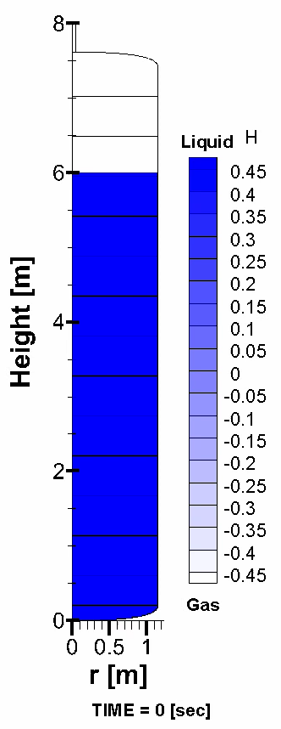
4. Preliminary study on pressure reduction based on CFD
– Result of one test case
The simplified situation of step pressure reduction from 300kPaG to 0kPaG(Just example)
Initial condition:
Pressure: 0 kPaG
Temperature: 26.1 K
  Liquid is 5.7K super heated
Liquid level: 6 m
Open to atmosphere at the edge of the vent line
The amount of generated bubble had never been optimized in this test case.
Further visualized experiments are needed.
Vent
Liquid
occupation ratio
Half tank model
Notes:
This slide shows an example case I tried by using vof based inhouse code. I calculated step pressure reduction from 300kPaG to 0kPaG by using the half tank model. The initial condition were liquid was 5.7 superheated, and liquid level was 6m. This tank was open to atmosphere. I’ll show you the video. This situation cannot be established in real world, but from this trial the inhouse-code can be applied to the 2 phase flow simulation of large tank. In addition, the amount of the bubble had never been optimized, so it was found that further visualized experiments will be needed.
-----------------
Step reduction from 300 kPaG to 0 kPaG
idealistic. extreme case. robust.
abnormal case.
emergency and harzardous なシチュエーションを目標としていることを述べる。
安全弁のCV value of relief valve.
In this case, rapid reduction simplified the step reduction.
Just example.
half tank model
the amount of generated bubble had never been proved は強め。
Upper wall
vent line was connected to
大きな穴を開ける

Slide 23
5. Conclusions and Future work
To predict the relation between pressure reduction rate and vent mass flow
  Experiment:
    Thermodynamic parameters during pressure reduction experiments have been measured.
    The phenomenon w/o boiling obeys adiabatic expansion, and the one with boiling follows Clausius–Clapeyron equation.
  Theoretical Analysis:
    1-D model can clarify the relation between pressure reduction rate and vent mass flow.
    1-D model has been verified by the experimental data.
To investigate liquid behaviour during pressure reduction
  CFD(Future work)
    Further studies such as the visualized pressure reduction experiment are needed for proving the amount of bubble generation.
Notes:
boilがなければadiabatic expansion
boil クラペイロんクラウジウスを
1-D model has been verifiedに変える
川重のプロジェクトに関することは神谷さんに聞いてみる。

Slide 24
End
Thank you for listening
Kazuma Tani
Mail: tani@aero.t.u-tokyo.ac.jp
Notes:
練習が足りない
接続詞がない
前と後ろのスライドの繋がりがない

Slide 25
Backup slides

Slide 26
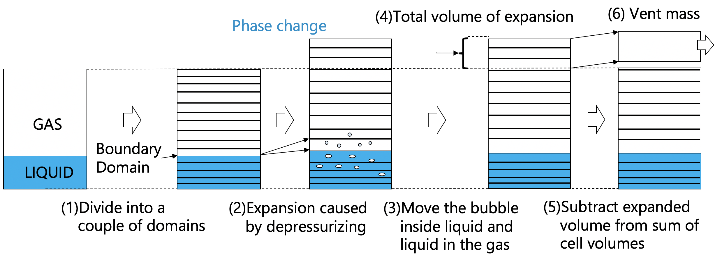
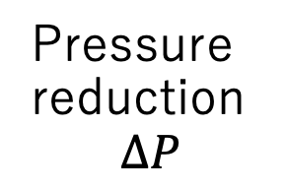
Theoretical analysis on the experiments – Method (1)
1-D model
Each cell has the thermodynamic parameters, and is tracked like Lagrange approach
2
Assumption
Gas: Ideal gas
Liquid: Incompressible
Equilibrium state is established
Adiabatic: each cell
1
3
Algorithm
1. Volume
2. Temperature
3. Void ratio
4. Vent mass
Pressure reduction
$$∆P$$
Notes:
Here, I’d like to talk about brief outline of 1-d theoretical model. First, we divide the tank like this. And each cell owns their thermodynamic parameters and is tracked like Lagrange approach. Then we assume gas is ideal gas, liquid is incompressible, and equilibrium state is established, and each cell doesn’t get heat input from outside. Based on this assumptions, I developed the model which can calculate volume, temperature, void ratio, and vent mass from pressure reduction and initial condition. First, divide the tank into several cells, depressurize each cell. In this phase, phase change such as flash evaporation occurred. Then, calculate the extra volume, and add it to vent mass. In the next slide, I’ll introduce this pressure drop phase.
no heat input -> idiabatic

Slide 27
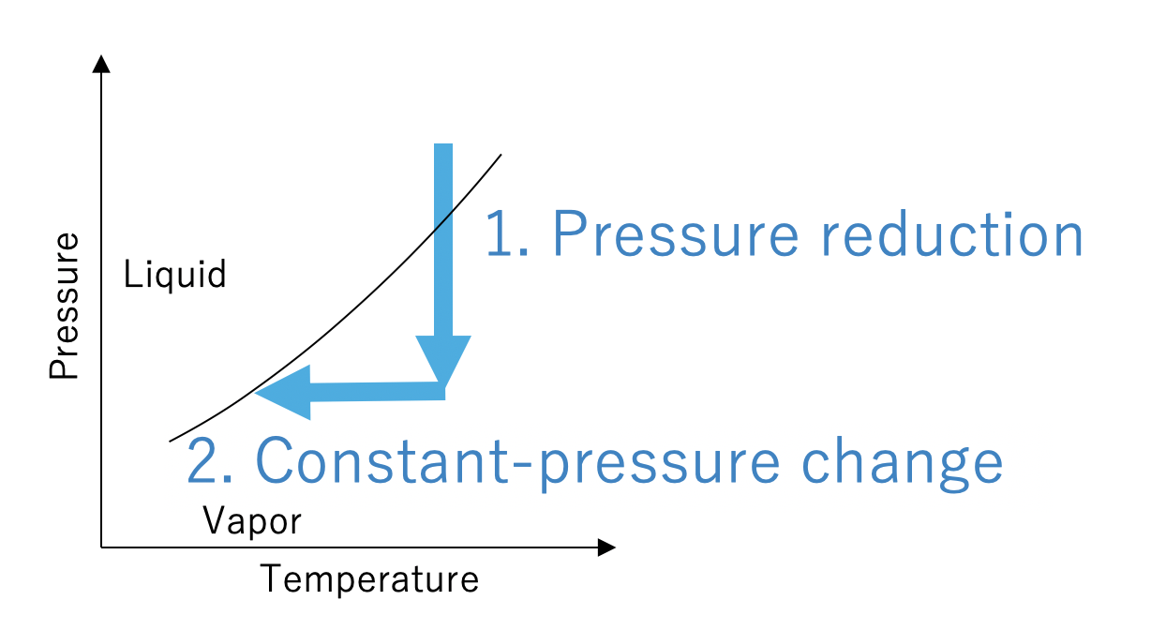
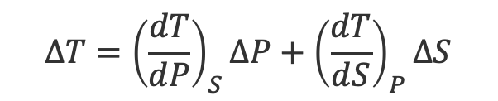
Theoretical analysis on the experiments – Method (2)
Gas phase follows adiabatic process
Only pressure is changed with regard to liquid
If the moved state is non-equilibrium, we assume that the state will be transformed to equilibrium based on isobalic change.
Ex. Liquid
$$∆T={\left(\frac{dT}{dP}\right)}_{S}∆P+{\left(\frac{dT}{dS}\right)}_{P}∆S$$
Notes:
Basically, adiabatic expansion occurs in gas phase, and only pressure is changed in liquid phase.
ΔT = (dT/dP)p ΔP + (dT/ds)s ΔS
with phase change |w/o phase change
Thermodynamic change for small time division divided into adiabatic change at constant-entropy and isobaric phase with phase change at constant-pressure.
スライド・グラフ・縦軸・横軸が何かを述べる。

Slide 28
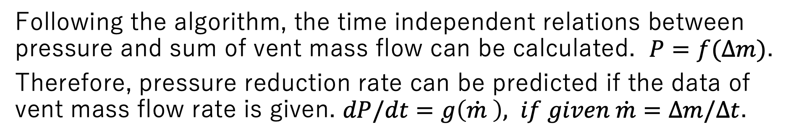
Theoretical analysis on the experiments – Method
Following the algorithm, the time independent relations between pressure and sum of vent mass flow can be calculated. $P=f(∆m)$.
Therefore, pressure reduction rate can be predicted if the data of vent mass flow rate is given. $dP/dt=g\left(\dot{m} \right), if given \dot{m}=∆m/∆t$.
In this research, the experimental data of vent mass flow rate was employed for calculating pressure reduction rate.
x
Time independent
Time dependent

Slide 29
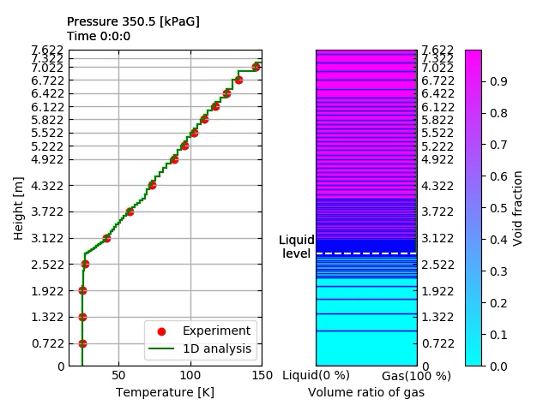
Test 3(Partially saturated)
In this case, I controlled the bubble rise speed, but the time variation of temperature was the same as no controlled version.

Slide 30
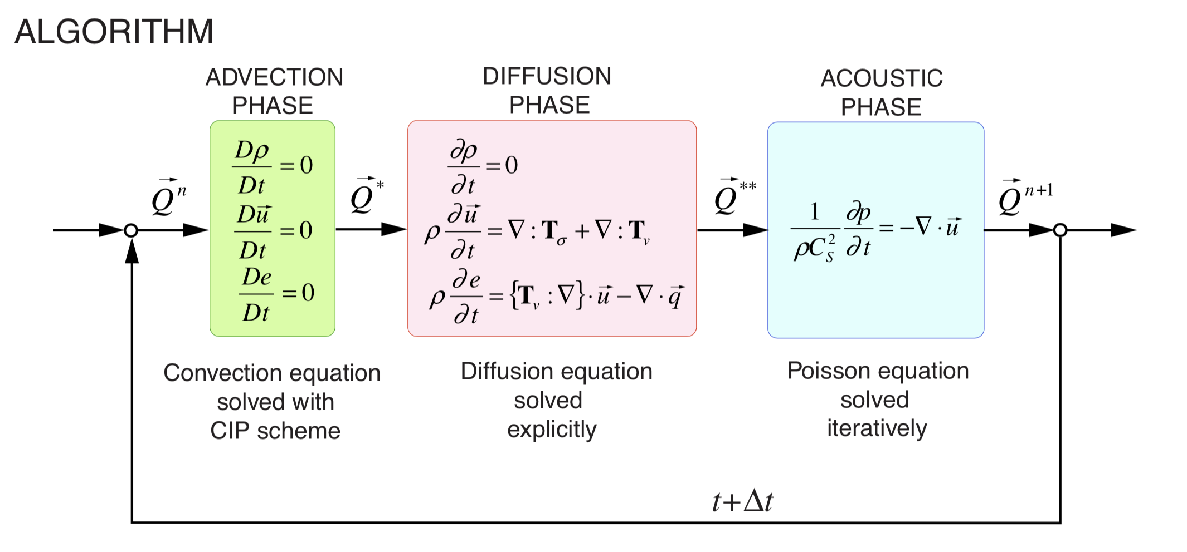
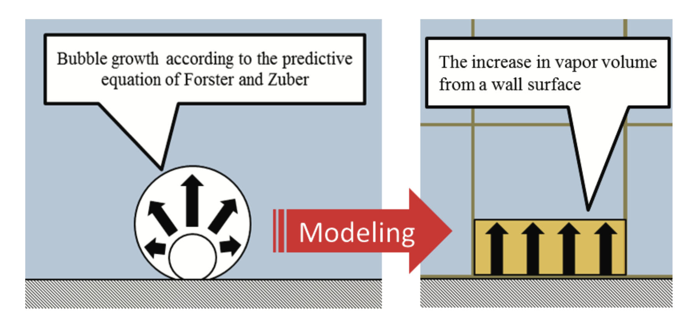
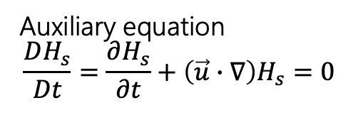
CFD(CIP-LSM / CIP based Level Set & MARS)
1. TCUP
Finite volume method
3. Immersed Boundary method
Liquid
Gas
Latent heat
4. Bubble inception model
2. HLSM
GAS
Auxiliary equation
$$\frac{DH_{s}}{Dt}=\frac{∂H_{s}}{∂t}+\left(\vec{u}∙∇\right)H_{s}=0$$
LIQ.

Slide 31
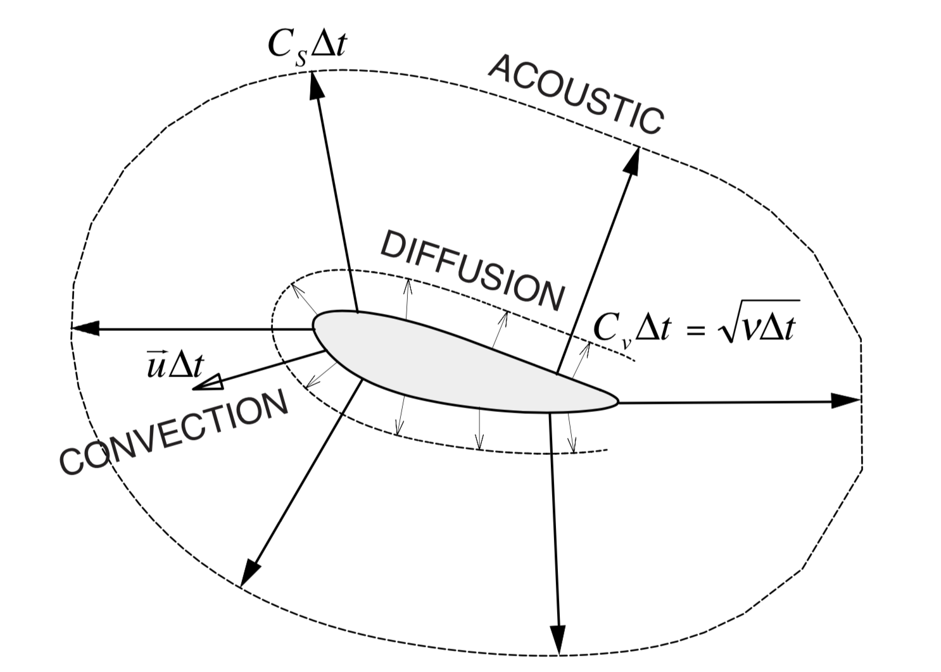
CFD(CIP-LSM / CIP based Level Set & MARS)
TCUP(Thermo-CCUP)
Advection phase: Move substances
Diffusion phase: Uniform randomly (Constant-density change)
Acoustic phase: Propagate the information (Isentropic change)

Slide 32
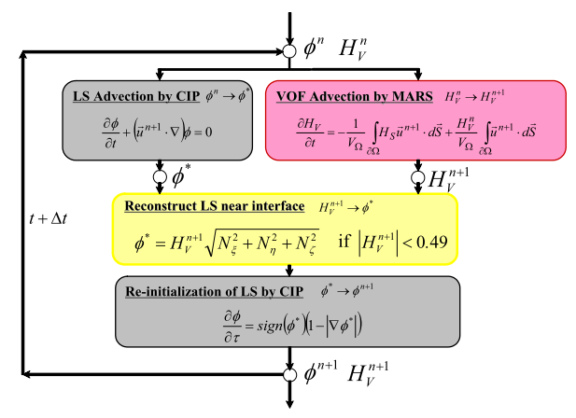
CFD(CIP-LSM / CIP based Level Set & MARS)
HLSM
(Hybrid Level-Set & MARS method)
MARS method:
One of PLIC-VOF method.
Convey VOF function
Level Set method:
Calculate the distance from liquid surface
Suppress the diffusion of liquid surface calculated by MARS
GAS
LIQ.

Slide 33
CFD(CIP-LSM / CIP based Level Set & MARS)
Phase change model
Small
Bubble size
Big
Bubble Inception model
CIP-LSM
Bubble inception model will be applied to the small bubble which cannot be tracked by CFD
If bubble size is bigger than stencil, we can calculate the amount of phase change with CFD

Slide 34
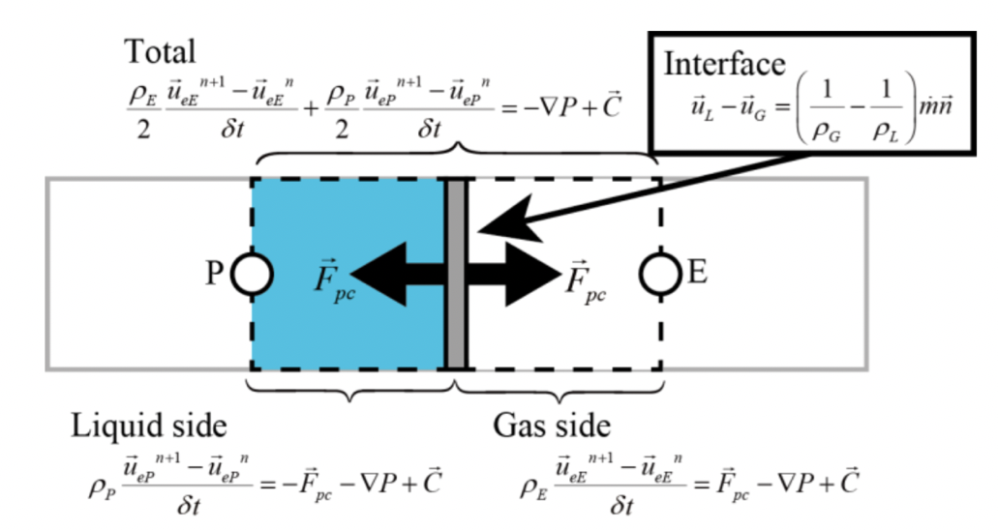
CFD(CIP-LSM / CIP based Level Set & MARS)
Phase change model
Reference: Umemura, Y., Himeno, T., Watanabe, T., Numerical Simulation of Bubble Growth and Departure on Heat Transfer Surface, J. Jpn. Soc. Microgravity Appl. Vol. 29 No. 1 2012.(Japanese)

Slide 35
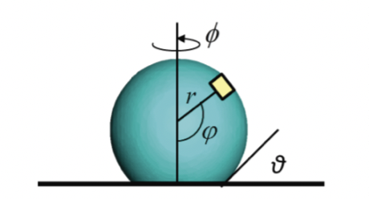



CFD(CIP-LSM / CIP based Level Set & MARS)
Bubble inception model
$$∆T_{SH}=\frac{2σ\left(\frac{1}{ρ_{GAS}}−\frac{1}{ρ_{LIQ}}\right)T_{sat}}{L_{vap}}\frac{1}{r_{cavity}}$$
Super heat is calculated by this equation.
$$\dot{m}\left(φ\right)= \frac{κ_{LIQ}\left(T_{wall}−T_{sat}\right)}{\left.L_{vap}×r(\cos{θ}−\cos{φ}\right)}$$
$$\dot{V}=\frac{1}{ρ_{GAS}}\oint_{Bubble}^{ }{\dot{m}\left(φ\right)dS\left(φ\right)}=\frac{2πκ_{LIQ}\left(T_{wall}−T_{sat}\right)r}{ρ_{GAS}L_{vap}}\log{\frac{\cos{θ}}{\cos{θ}−ε}}$$
Reference: Umemura, Y., Himeno, T., Kinefuchi, K., Tani, N., Negishi, H., Kobayashi, H., Ohira, K., and Fukasawa, O., Numerical Modelling of Boiling Flow in a Cryogenic Propulsion, 51st AIAA/SAE/ASEE Joint Propulsion Conference, Orland, FL, July 27-29, 2015.

