Slide 1


Experimental study on hydrogen/air premixed flame propagation in closed rectangular channels
Xiaobo Shen*, Chao Zhang, Jennifer Wen, Guangli Xiu
East China University of Science and Technology
Notes:
Good afternoon everyone, my name is Xiaobo Shen coming from East China University of Science and Technology. Today I’m honored to introduce my study to you. The title of my study is Experimental Study on The Hydrogen/Air Premixed Flame Propagating in rectangular channels.

Slide 2

Contents
Background
Why did we choose the hydrogen/air gas as the testing gas and why did we do this study.
Previous works
The history of the study on flame propagating in channels. Different ways to analyze the premixed flame in channels.
Experimental setup
A chamber with igniter, pressure sensor, schlieren system, high-speed camera and other auxiliary equipment.
Results and Conclusions
Discuss the property of premixed flame propagating in channels.
Notes:
I will introduce my study in following four sections. The first section is about background telling about why we choose the hydrogen/air gas and why we do this study. The second section is previous works telling about the history of the study on flame propagating in tubes. The third section is about experimental setup. In this section I will tell you about the ways we conduct our experiment. the last section is results and conclusions telling about the works we did in this study.

Slide 3
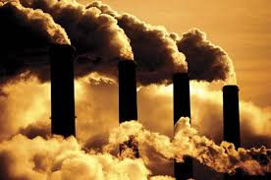

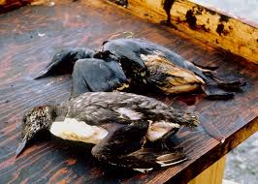


Background
Fossil fuel has long been a major source of energy, but it cause a series of environment issues such as the greenhouse effect.
Hydrogen energy can satisfy people’s demands to replace fossil fuel.
Notes:
Fossil fuel has long been a major source of energy. With the large development of industry and the increasing needs from human beings, the fossil fuel will be exhausted soon in the future. In addition, fossil fuel has caused a series of environmental issues, e.g. greenhouse effect. Thus, it necessitates the demand of environmental- friendly alternative fuel. Hydrogen is widely regarded as one of the most promising clean energy carrier.

Slide 4
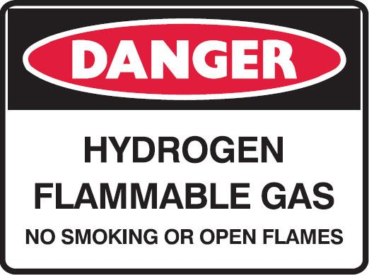
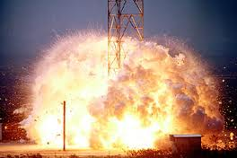
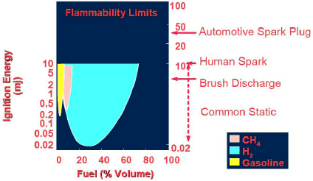
Hazards of Hydrogen
Wide Flammable Range
High diffusivity
Low Ignition Energy
Large burning velocity
Hydrogen embrittlement
Confined spaces
Pipelines
Corridors
Tunnels…
Usually the structures of channels (tubes) were used to simulate the confined spaces in the laboratory.
Notes:
However, hydrogen has wide flammability range, high diffusivity, very low ignition energy and large burning velocity, which makes it a great hazard in industry. Therefore, safety is of great importance in hydrogen production, storage, transportation and utilization. Especially in confined spaces, once hydrogen was exposed to air or other oxidizers, combustible mixtures would be readily formed and then accidentally ignited by energy source. The subsequent flame propagation and transition (from laminar to turbulence, or from deflagration to detonation) are quite complex. In worst cases, the flame is able to produce violent pressure and temperature rise, and even strong shock waves, which could probably lead to serious fatalities and destructions. Therefore, for safe use of hydrogen, it is necessary to gain insight of its combustion and flame propagation processes in confined spaces. Usually the structures of channels (tubes) were used to simulate the confined spaces in the laboratory.

Slide 5
Previous works
Tulip flame is an important phenomenon for premixed flame propagating in tubes. Ellis took the first photography of this phenomenon in 1928. (Ellis, J. Fuel Sci, 1928 )
In 1996, Clanet and Searby distinguished four characteristic stages of tulip flame formation in channels (Clanet, C. et al. 1996), including :
① Spherical flame expansion
② Finger-shaped flame acceleration
③ Flame-side wall contact
④ The tulip inversion
Notes:
Ellis [4] took the first photograph of the inverted flame in the channel in 1928. Salamandra [5] et al. named this featured flame shape as “tulip flame”. Thereafter, Clanet and Searby [6] distinguished four characteristic stages of tulip flame formation in channels, including spherical flame expansion, finger-shaped flame acceleration, flame-side wall contact and the tulip inversion.

Slide 6
Previous works
The formation of the distortion shape coincides the decrease of flame speed and pressure rise.
In 2011, A new stage after the four classic stages was first discovered by Xiao et al. and me and was named as “Distorted tulip flame”. (Xiao, H., et al. 2011)
Tulip inversion
Process of distortion
Notes:
Then time goes to 2011, …
As you can see, the tulip lips distorted again forming two more cusps.

Slide 7
Previous works
Interactions of the flame front with pressure waves
H.Guenoche, et al. 1964
Xiao et al. 2011,2017
R.Starke, et al. 1986
Wall quenching effect
Assumptions
M.Matalon, et al. 1994
J.W.Dold, et al. 1995
Hydrodynamic instabilities
Vortex structures forming in the burned gas
D.A.Rotman, et al. 1964
Xiao et al. 2010
C.Clanet, et al. 1996
Xiao et al. 2018
Rayleigh–Taylor instabilities
Aiming to understand the mechanism, it is quite important to know the flame evolution in different scales
Boundary layer effect? Pressure wave? Flame instability??
Notes:
Underlying mechanisms were proposed by researchers, e.g. ….. But controversies still remain.
Aiming to …….Especially, you need to know what’s going on after classic tulip inversion, is tulip distortion essential?? What is the role of pressure wave or flame instability on flame deformation?

Slide 8
Experimental setup
High voltage igniter
Electrode
Concave mirror
Aperture
Iodine lamp
Pressure relief opening
Gas mixing device
Pressure sensor
Oscilloscope
Knife edge
High-speed camera
Synchronization controller
The dimensions of the two channels are channel (a) 300mm×25mm×25mm and channel (b) 530mm×80mm×80mm, giving aspect ratios “α”, i.e. length over width, of 12 and 6.625.
Notes:
The experiments were conducted in two horizontal rectangular combustion channels with different aspect ratios. The test rig is equipped with a schlieren system, a high-speed camera, a gas mixing system, a high-voltage ignition, a pressure recording system, a synchronization controller and a data acquisition system. The channels have two quartz visible sidewalls for schlieren photography. The top and bottom walls are TP304 stainless steel.

Slide 9
Flame shape changes
At early stage, the premixed flames of hydrogen-air mixture in this study underwent the same classic flame deformations as the four stages divided by Clanet and Searby.
Tulip distortion occurs right after the classic inversion as first defined by Xiao et al. 2011.
Tulip distortion continued until reaching the channel end.
Flame shape changes in channel with smaller aspect ratio.
(channel size: 530mm*80mm*80mm)

Slide 10
Flame shape changes
Classic Four-stage flame shape changes were still observed, which indicates the robustness of classic tulip shape in flame evolution.
More complex flame deformations were found after the formation of tulip flame.
For example, elongated tulip flame; T-shape flame; Second plane flame, Second tulip inversion…
Flame shape changes in channel with larger aspect ratio.
(channel size: 300mm*25mm*25mm)

Slide 11
Flame tip velocity and pressure dynamics
Larger aspect ratio
  The velocity of flame tip underwent a fluctuation process because of the changing area of flame front.
  The pressure also fluctuated and increased gradually.
  The flame velocity fluctuated as well in channel with smaller aspect ratio.
  But the pressure built up in a stabler manner.
Smaller aspect ratio
We have built a new system with more varied aspect ratios.
Much More detailed deep analyses will be coming soon in journals.
We really appreciate your attention in the future!!

Slide 12
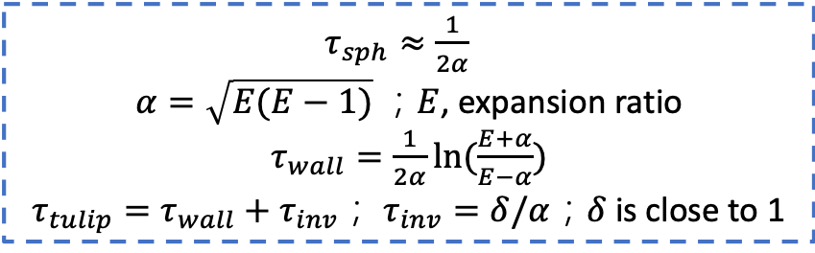
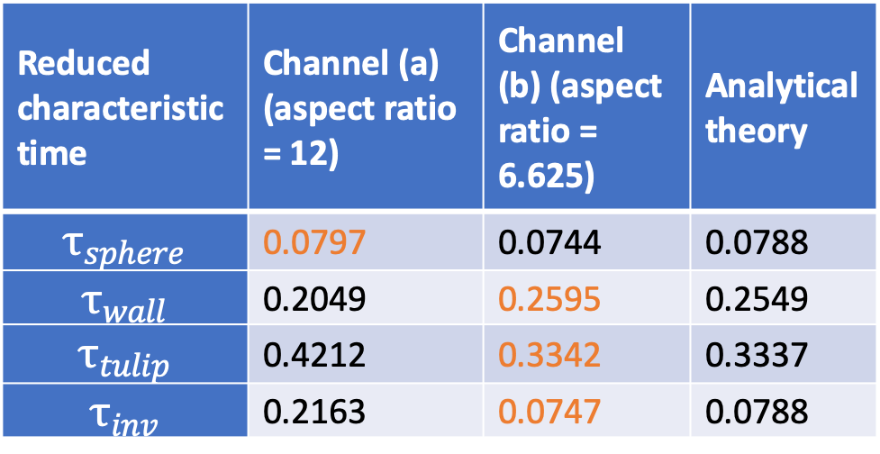
Theoretical prediction
$τ_{sph}≈\frac{1}{2α}$
$α=\sqrt{E(E−1)} ；E$, expansion ratio
$τ_{wall}=\frac{1}{2α}ln(\frac{E+α}{E−α})$
$τ_{tulip}=τ_{wall}+τ_{inv}$； $τ_{inv}=δ/α$；$δ$ is close to 1
Bychkov et al.,
Combustion and Flame, 150, No. 4, 2007, pp. 263-276
Reduced characteristic time | Channel (a) (aspect ratio = 12) | Channel (b) (aspect ratio = 6.625) | Analytical theory
$$τ_{sphere}$$ | 0.0797 | 0.0744 | 0.0788
$$τ_{wall}$$ | 0.2049 | 0.2595 | 0.2549
$$τ_{tulip}$$ | 0.4212 | 0.3342 | 0.3337
$$τ_{inv}$$ | 0.2163 | 0.0747 | 0.0788
The equations cannot predict the acceleration process well in the channel with small width due to the stronger boundary layer effect which is ignored in the theory.
Notes:
In 2007, Bychkov et al. proposed an analytical theory to describe the acceleration process of flame propagating in half-open channels.

Slide 13
The evidence of propagating pressure wave
The time lag between the inflection point of velocity curve and the first peak of pressure growth rate was about 0.7ms.
The distance between the flame tip position upon the first flame-wall contact and the pressure sensor was 0.27 m.
Sound speed in unburned gas was about 408 m/s.
The calculated time that the pressure wave took to propagate to pressure sensor could be calculated as 0.662ms.
Pressure growth rate and flame tip velocity versus time .
(channel size: 300mm*25mm*25mm)
Notes:
In this conference paper, we have done some analyses. First of all, we found another evidence of…
Herein, it is believed to be attributed to the pressure wave. A pressure wave will be generated upon the contact between the flame skirt and the walls due to the great loss of flame area, heat production and flame acceleration. Then it travels downstream and reflects on the end wall, during which it will further compress the unburnt gas around the pressure sensor close to the end wall. As a consequence, the first peak of the pressure variation rate lags behind the flame forefront speed.
To quantify the assumption, we did a calculation. We will see from the flame images that,

Slide 14
Pressure wave and flame interaction
A new flame shape change process was found in this study.
Tulip flame was elongated and then changed to a “T-shaped” flame.
Elongated tulip flame
The pressure wave meeting with flame front at specific time might be responsible for this process.
“T-shaped” flame
Petchenko, Bychkov et al. numerically found the similar “T-shape” but call it “violent folding” and attributed it to the flame –acoustic resonance.
(Phys. Rev. Lett., 97, 164501, 2006)
Notes:
As mentioned before, we found new…
Say, after reflection on the right end wall, the pressure wave moves backwards and eventually runs into the flame stretching the structure

Slide 15
The calculated meeting moment of pressure wave and flame front
At t = 2.333ms, pressure wave met with flame front.
When the pressure wave met with the flame front, the flame inversion has started for a while and a plane flame has already been formed.
Position of flame tip and pressure wave versus time.
(channel size: 300mm*25mm*25mm)
Notes:
we also calculated the meeting moment of …

Slide 16

The calculated meeting moment of pressure wave and flame front
Meeting point
t = 5.092ms
Flame shape changes after tulip inversion
When the pressure wave met with the flame front, the flame front was still in a curving shape, but the velocity was decreasing.
Position of flame tip and pressure wave versus time.
(channel size: 530mm*80mm*80mm)

Slide 17
Conclusions
The “T-shaped flame” structure was observed. It is thought to be resulted from the elongated tulip flame shape and the collapse of two flame lips.
After the flame touches the sidewall, the pressure wave is produced and travels downwards. After reflection on the end wall, the pressure wave compressed the unburnt gas further resulting in the observed phase shift (time lag) between the flame tip velocity and pressure growth rate.
The pressure wave may not be the necessary factor of the formation of the tulip flame. The pressure wave has remarkable effect on flame shape change when it meets with flame front after reflection on the end wall.

Slide 18
Thanks for your attention
Any question?

