Slide 1
Tunnel Scenario Estimation & Discussion
Chris LaFleur, Sandia National Laboratories
Team Members: Brian Ehrhart, Dusty Brooks, Alice Muna
ICHS 2019
SAND2019-7907 PE

Slide 2
Outline
Event Sequence Diagram
Uncertainty
Step Through Event Tree
Results
Discussion

Slide 3

Method to Estimate the Risk of FCEV Incidents in Tunnels
Event Sequence Diagram - represents an undesired event as a sequence of sub-events
  Event tree begins with an initiating event and illustrates the chronological sequence of events involving the successes and/or failures of the system components
  Each bifurcation is assigned a probability of occurrence
  Total for each outcome is the combination of all the probabilities leading to that outcome
Branch line results are calculated via Monte Carlo sampling of all conditional probabilities
Journal paper with all the analysis and results Accepted for Publication in Fire Technology

Slide 4
Uncertainty
Not enough data to estimate probabilities with high confidence
Uncertainty distributions were derived based on the current state-of-knowledge
Each branch line result is a range of possible probabilities for each scenario
Each branch point uncertainty was propagated through the event tree to perform a Monte Carlo analysis
Probability of each scenario is presented as a distributions of these multiple calculations

Slide 5
Event Tree

Slide 6
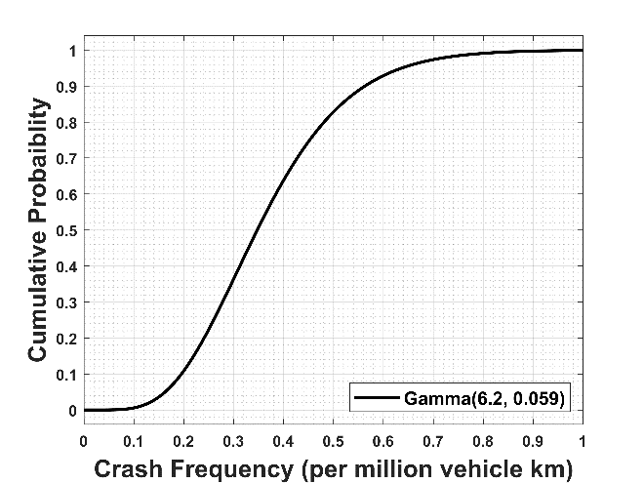
Event Tree
Initiating Event – Hydrogen Vehicle Crash in a Tunnel
  Generic crash rate for tunnels used as a conservative estimate
  Tunnel crash frequency estimates averaged over a three-year period for 10 different countries published
  Expressed as crashes per million vehicle kilometers:
  0.277, 0.337, 0.355, 0.420, 0.315, 0.8, 0.303, 0.253, 0.145, 0.483, and 0.345
Reference: Bassan S (2016) Overview of traffic safety aspects and design in road tunnels. IATSS Research 40 (1):35-46.

Slide 7
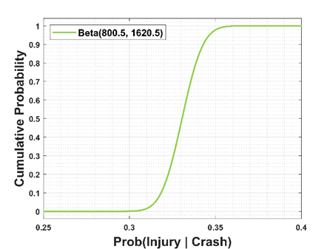
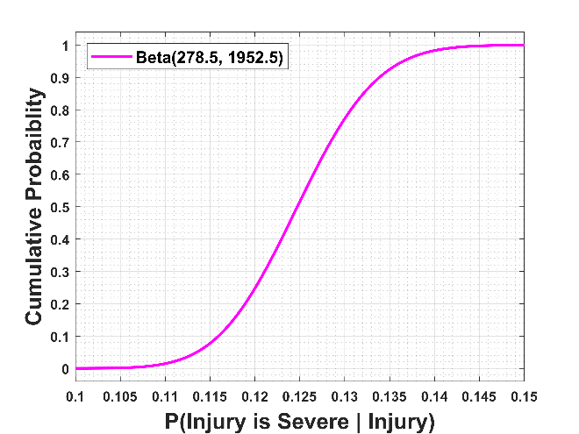
Event Tree
Severity of a Crash - Severe injury is a proxy for crash severity (people are very vulnerable)
  Breaks probability of a severe crash into two components: the probability, given a crash, that an injury occurs and the probability, given an injury, that the injury is severe
  Total of 2420 crashes and 800 injuries for Probability of Injury occurring
  Total of 2230 injuries with 278 of them severe from 4 different studies
References: Bassan S (2016) Overview of traffic safety aspects and design in road tunnels. IATSS Research 40 (1):35-46.
Ciro Caliendo MLDG, Maurizio Guida, (2013) A crash-prediction model for road tunnels, . Accident Analysis & Prevention, 55:107-115.

Slide 8
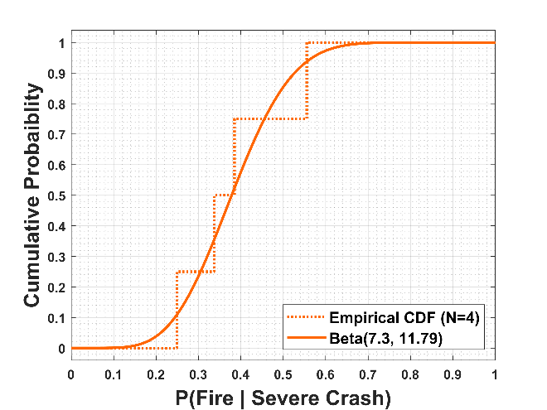
Event Tree
Hydrocarbon Fire - likelihood of a crash causing a fire given that the crash was severe
  Assumes than a crash involves at least one traditionally-fueled vehicle and that any crash resulting in a fire is considered severe
  Used average severe crash rates and average fire crash rates from Italy, Norway, and Switzerland over a four year period
Reference: Bassan S (2016) Overview of traffic safety aspects and design in road tunnels. IATSS Research 40 (1):35-46.

Slide 9
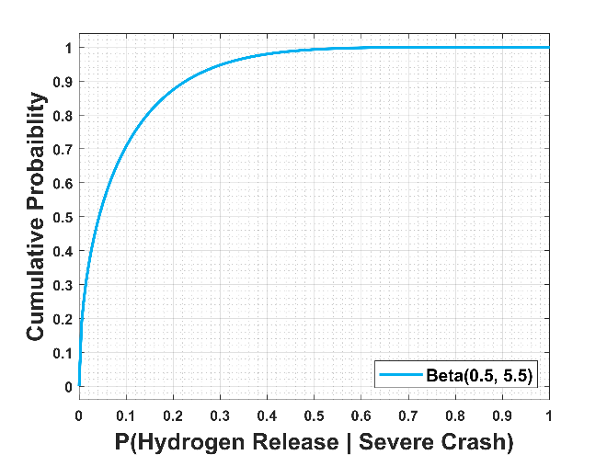
Event Tree
Damage-Induced Hydrogen Release – Probability that hydrogen is released due to crash
  Used published crash test data
  Five tests were available, no releases
  Used Jeffrey’s prior (0.5 event)
References: Pape D, Cox A (2015) Compressed Hydrogen Container Fueling Options for Crash Testing. National Highway Traffic Safety Administration, Washington, DC
Batelle Memorial Institute (2015) Crashworthiness Research of Prototype Hydrogen Fuel Cell Vehicles: Task Order 7 Project Report. National Highway Traffic Safety Administration, Washington, DC

Slide 10
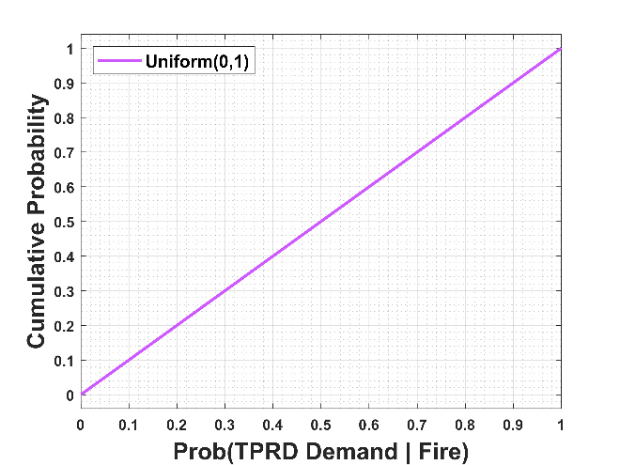
Event Tree
Pressure Release Device Demand– Probability that hydrocarbon fire exposes thermally-activated pressure relief device (TPRD) on the H2 tank
  Actual crash specifics determine the extent of the fire and the proximity of the vehicle and pressure vessel to the fire; neither of these parameters are known
  Uniform distribution between zero and one was assumed due to high uncertainty

Slide 11
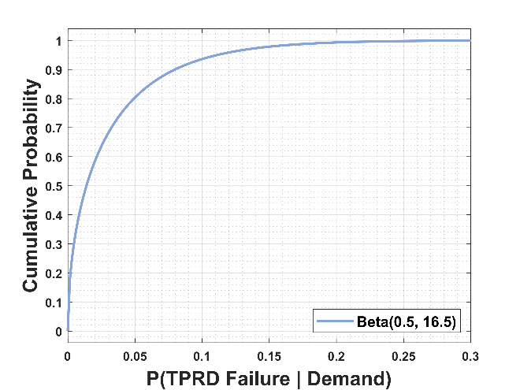
Event Tree
Pressure Relief Device Activation– Possibility that TPRD fails to operate on demand
  literature review was performed on pressurized hydrogen tank fire testing that included TPRDs
  Five sources of data were found
  Used Jeffrey’s prior (0.5 event) because no failures were recorded
References: Koji Yamazaki YT (2017) Study of a post-fire verification method for the activation status of hydrogen cylinder pressure relief devices. IJHE, 42 (11):7716-7720
Suzuki J, Tamura Y, Watanabe S, Takabayashi M, Sato K (2006) Fire Safety Evaluation of a Vehicle Equipped with Hydrogen Fuel Cylinders: Comparison with Gasoline and CNG Vehicles. 2006 SAE World Congress, Detroit, Michigan, 4/3/2006 - 4/6/2006
Jinyang Zheng HB, Ping Xu, Honggang Chen, Pengfei Liu, Xiang Li, Yanlei Liu, (2010) Experimental and numerical studies on the bonfire test of high-pressure hydrogen storage vessels, . IJHE, 35 (15):8191-8198.
Weyandt N (2009) Compressed Hydrogen Cylinder Research and Testing in Accordance with FMVSS 304. Southwest Research Institute,
Seike M, Ejiri Y, Nobuyoshi Kawabata, Hasegawa M, Tanaka H (2014) Fire Experiments of Carrier loaded FCV in Full-Scale Model Tunnel - Estimation of Heat release rate and Smoke Generation Rate. Paper presented at the Third International Conference on Fire in Vehicles, Berlin, Germany, 10/1/2014 - 10/2/2014

Slide 12
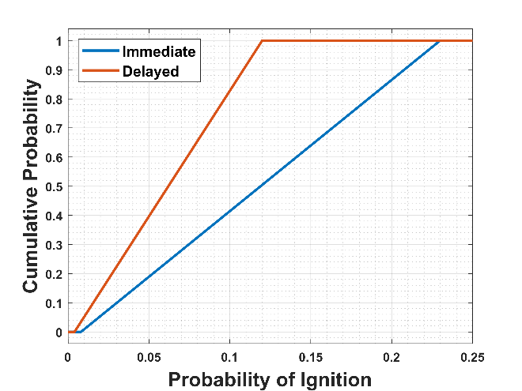
Event Tree
Hydrogen Ignition – Probability that released hydrogen will ignite
  Probabilities derived for the Canadian Hydrogen Safety Program by adapting non-hydrogen ignition values suggested in Cox, Lees, & Ang.
  Historically used for hydrogen quantitative risk assessment and to develop separation distances in NFPA
  Actual hydrogen release rate are incident specific - distributions for immediate and delayed ignition were defined as uniform between the bounding values in the table
References: Tchouvelev A, Hay D, Bénard P (2006) Quantitative risk comparison of hydrogen and CNG refuelling options. Final Technical Report to Natural Resources Canada
Cox, A. W, Lees, Frank P, Ang, M. L, Institution of Chemical Engineers and Inter-Institutional Group on the Classification of Hazardous Locations Classification of hazardous locations. Institution of Chemical Engineers, London, 1990.
Notes:
Based on the pressure vessel testing detailed previously, it is most likely that hydrogen released would be small amounts present in the fuel line. GTR-qualified hydrogen cylinders contain an internal solenoid valve that prevents the tank from releasing all of its contents through the fuel line if a severe crash occurs (triggered by an accelerometer). Using a uniform distribution was conservative and deemed appropriate given the uncertainty involved in quantifying this parameter across scenarios.
. If the fire was large enough to activate the TPRD which releases hydrogen from the pressure vessel, it is assumed to ignite the released hydrogen immediately, forming a jet flame. As the state-of-knowledge about FCEV fires increases, this assumption may change. Thus, it is assumed that for that particular case there is a 100% chance of ignition and 100% chance of immediate ignition. Note that separate branches are not shown for the cases of 0% probability.

Slide 13
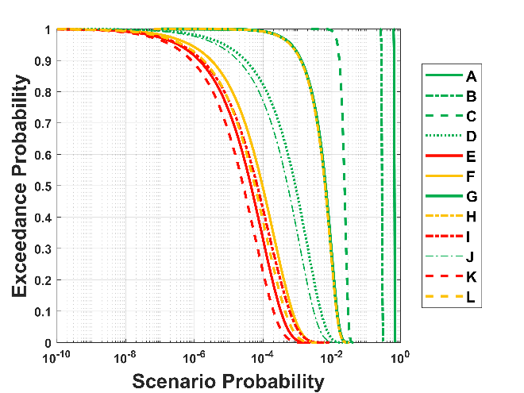
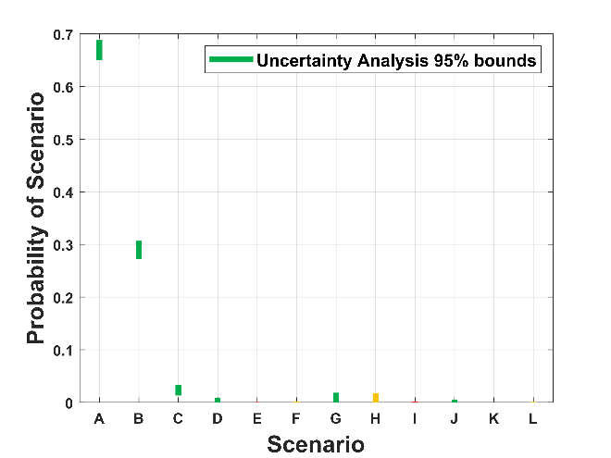
Event Tree Results
Legend for Branch Line Results
  Green: Hydrogen does not contribute to consequence of crash
  Yellow: Hydrogen does contribute to consequence
  Red: Hydrogen contributes to catastrophic consequence
Exceedance probability curves for each branch line show that the scenarios with the highest consequences from hydrogen have probabilities on the order of 1E-05 to 1E-04
Overwhelmingly, the most likely scenarios are those in which hydrogen does not significantly contribute to the consequences.

Slide 14
Discussion
What scenario(s) should be the basis of regulatory requirements?

