Slide 1
Deflagration-to-detonation transition of H₂-CO-Air mixtures in a partially obstructed channel
26. September 2019
International Conference on Hydrogen Safety (ICHS) 2019
Adelaide, SA, Australia
D. Heilbronn, C. Barfuß, T. Sattelmayer
Institute of Thermodynamics, Technical University of Munich
Notes:
Welcome everyone
My name is Daniel Heilbronn and today i´d like to present the results I obtained on
Deflagration to detonation transition of hydrogen carbon monoxide air mixtures in a partially obstructed channel
The experiment were conducted at a small scale test rig at the institute of thermodynamics at TU Munich
The topic is motivated by …

Slide 2
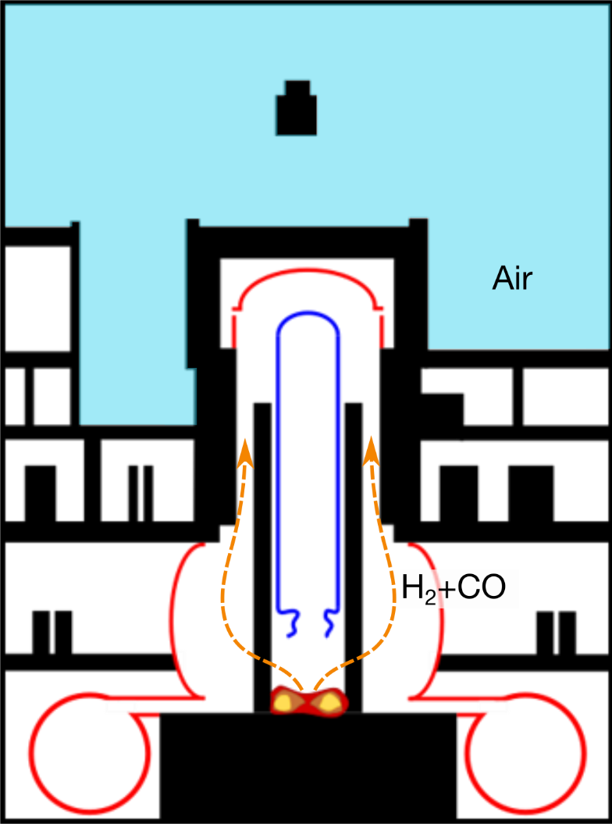
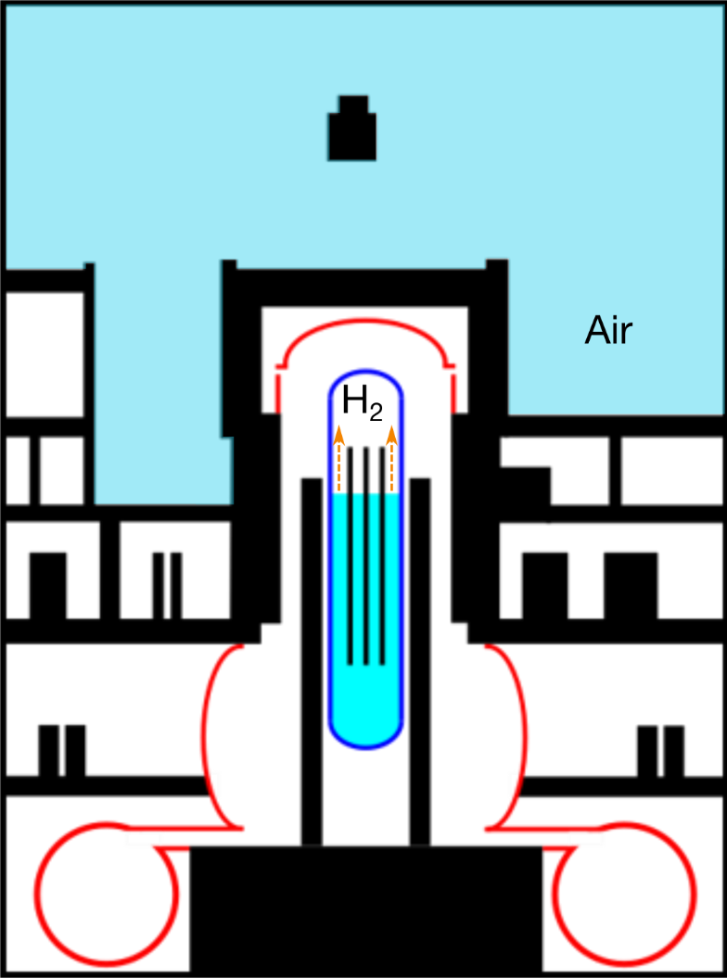
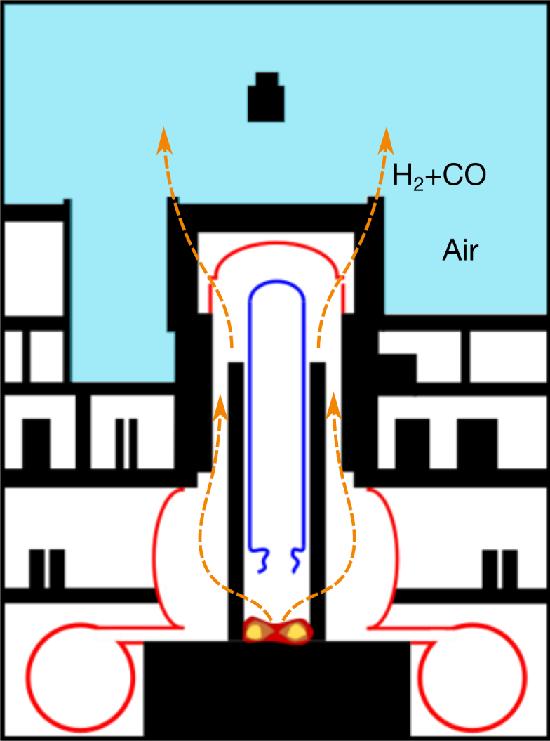
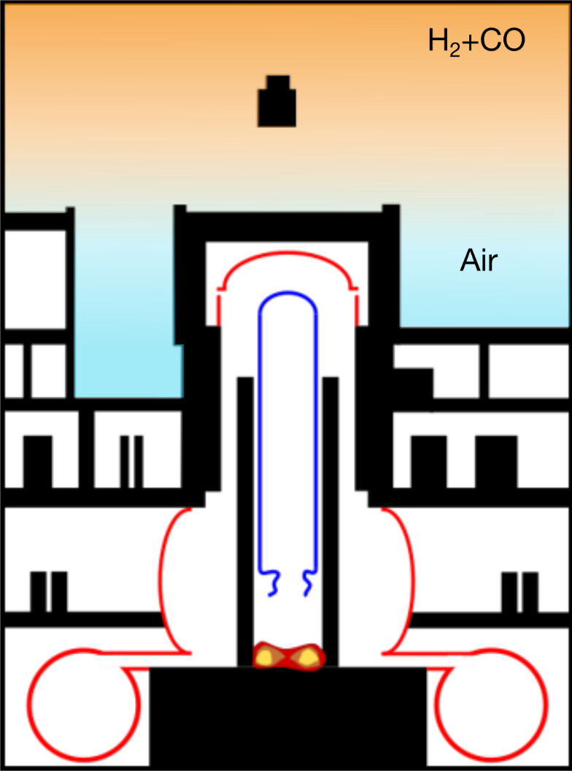
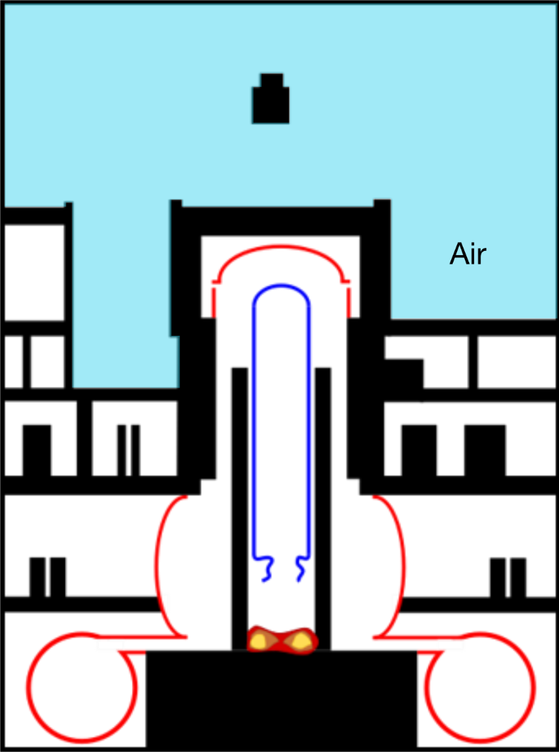
Motivation
Severe accident in nuclear power plant
H₂-Formation
Core meltdown & pressure vessel failure
MCCI - Formation of H₂ and CO
Leakage of Containment
Formation of a stratified combustible mixture in the reactor building
Destruction of final barrier
Notes:
An severe accident scenario in a nuclear power plant
In case of a loss of coolant accident, the water level in the reactor might decrease
The fuel rods are not sufficiently cooled and hence heated up
At a distinct temperature level the zirconium of the fuel rod claddings reacts with the steam
Hydrogen is produced
If cooling of the reactor core is not restored the core might melt down accumulating at the lower end of the reactor pressure vessel
Due to the high pressure and temperature the reactor pressure vessel might fail and the molten core hits the concrete structure beneath the reactor pressure vessel
Interactions of the molten core and the concrete will lead to the formation of more hydrogen and, in case of limestone concrete CO is produced
Both gases accumulate in the containment
High temperatures and pressure might lead to a failure of the containment sealings
Hydrogen and CO will exit the containment, forming a stratified combustible due to buoyancy effects and mixing with the ambient air in the reactor building
Due to the low ignition energy and wide flammability limits an explosion is likely
High dynamic pressure due to flame acceleration and DDT will finally lead to the destruction of the final barrier between the radioactive inventory and the environment

Slide 3
Motivation
Small scale experiment
Fundamental understanding:
Fuel composition
Geometry
Fuel distribution
Venting
Empirical criteria:
σ-criteria for flame acceleration
7λ-criteria for detonation
CFD:
Flame brush velocities
Pressure loads
Structural response
FA and DDT-prediction in stratified
H₂-CO-air mixtures on large scales
Prevention of failure by means of design
Notes:
In terms of an accident scenario small scale experiments can provide knowledge on several levels
First small scale experiment can be used to gain a fundamental understanding of how various parameters influence flame acceleration and ddt
In our case the fuel composition, internal geometry of the explosion channel, the fuel distribution and the influence of venting are investigated in various steps of the research project
By collecting data at various operational parameters, empirical criteria such as the sigma criterion and the 7lambda criterion can be extended to h2-co-air mixtures
Furthermore small scale validation data is used for the validation of an cfd code in order to determine flame brush velocities and pressure loads as well as the structural response on confining structures
The final aim of the project is to provide a set of tools for industrial application in order to predict FA and DDT in stratified H2-CO-air mixtures
By doing so a more precise design of the confining structures not only in nuclear applications but also for the chemical industry is possible

Slide 4
Experimental setup - Geometry
3.95 m
6 m
2.05 m
B-B
Spacing = 300 mm
A-A
300 mm
GraVent test rig:
Segment based design
Flexible positioning for optical measurements
Rectangular cross section
GraVent test rig:
High blockage ratio
Obstacles 12mm in axial direction
Long obstructed section
Obstacles BR60
Explosion channel
24 mm
60 mm
Explosion channel
B-B
A-A
Venting volume
Venting volume
Notes:
For the small scale experiment the GraVent test rig is used
The test rig consists of 7 segments which are merged to channel of an overall length of 6m
An optical segment can be mounted on all positions allowing for optical access in later stages of the project
The explosion channel has a rectangular cross section of 300x60mm and is used for the presented experiments
For the presented measurements obstacles were mounted at the ceiling and the floor of the channel
By doing so 60% of the cross section is blocked
The obstacles are 12mm in axial direction
Obstacles were mounted at a spacing of 300mm for a distance of 3.95m
The last part of the channel is unobstructed
The configuration was chosen in a way to provide sufficient flame acceleration while not suppressing DDT in the obstructed part

Slide 5
Experimental setup - Instrumentation
x
Tracking of flame brush with 36 Photodiodes
Kistler 601A pressure transducers
Sample frequency 250 kHz
Ignition by spark plug
Notes:
Measurements were conducted using conventional instrumentation of the test rig
The trajectory of the flame brush was measured with 36 photodiodes mounted in the ceiling of the channel
The majority of the photodiodes were mounted in the obstructed part as indicated by the red dots
The dynamic pressure was recorded with 8 Kistler 601A pressure transducers with a maximum load of 250 bar
Both systems were operated at a sample frequency of 250 kHz
Ignition of the mixture was achieved by a conventional spark plug mounted on the right end plate of the channel

Slide 6
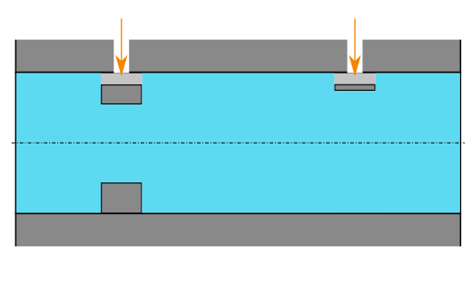
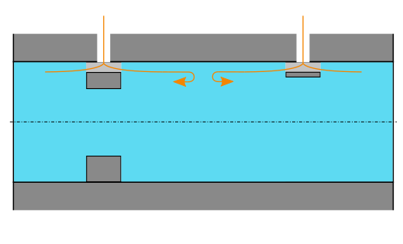
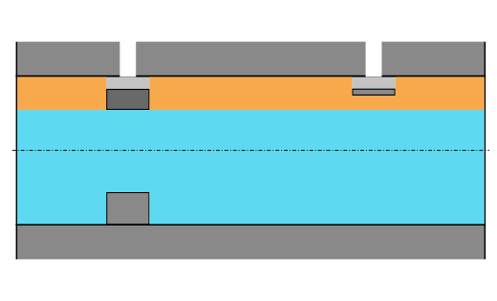
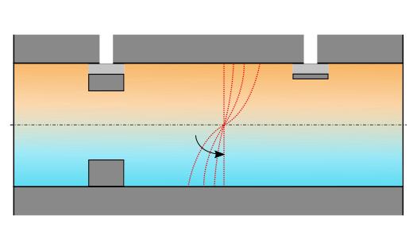
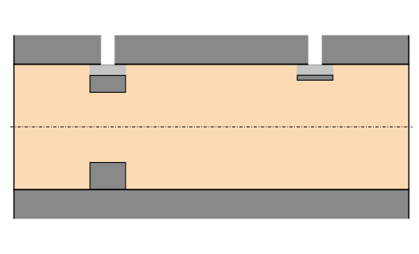
Experimental setup - Procedure
H₂+CO
Fuel is provided by mixing unit
Setting of fuel volume content:
Vacuum at p₁
Injection of fuel for t_{in}
Deflection of the inflowing fuel gas
Establishing of a stratified layer
Diffusion for time t_{d} defines concentration gradient
Homogenous mixtures at t_{d}=60s
Measurement of fuel content by partial pressures
H₂+CO
p₁
p₂
t_{d}
Air
Notes:
The fuel provided for the test rig was mixed by an external mixing unit
Therefore hydrogen and co were provided by gas cylinders and mixed by the methods of partial pressures
For setting a desired fuel volume, the procedure was as follows
First the channel the evacuated to vacuum at pressure p1 prior to fuel injection
The fuel is injected into the channel through holes in the ceiling
The opening time of the valves control the amount of fuel injected
During the inflow, the gas hits deflection plates which are provided by the obstacles or which are mounted additionally at the injection holes
Due to the deflection a stratified layer of H2 and CO is formed under the ceiling of the channel
Due to diffusion processes the fuel diffuses downwards establishing a transverse concentration gradient
The slope of the gradient is defined by the diffusion time td between the end of injection and ignition
For achieving a homogenous fuel distribution over the channel height, the diffusion time was set to 60s
The fuel content is measured using the methods of partial pressures
Therefore the pressure in the channel prior to injection and before ignition was used

Slide 7
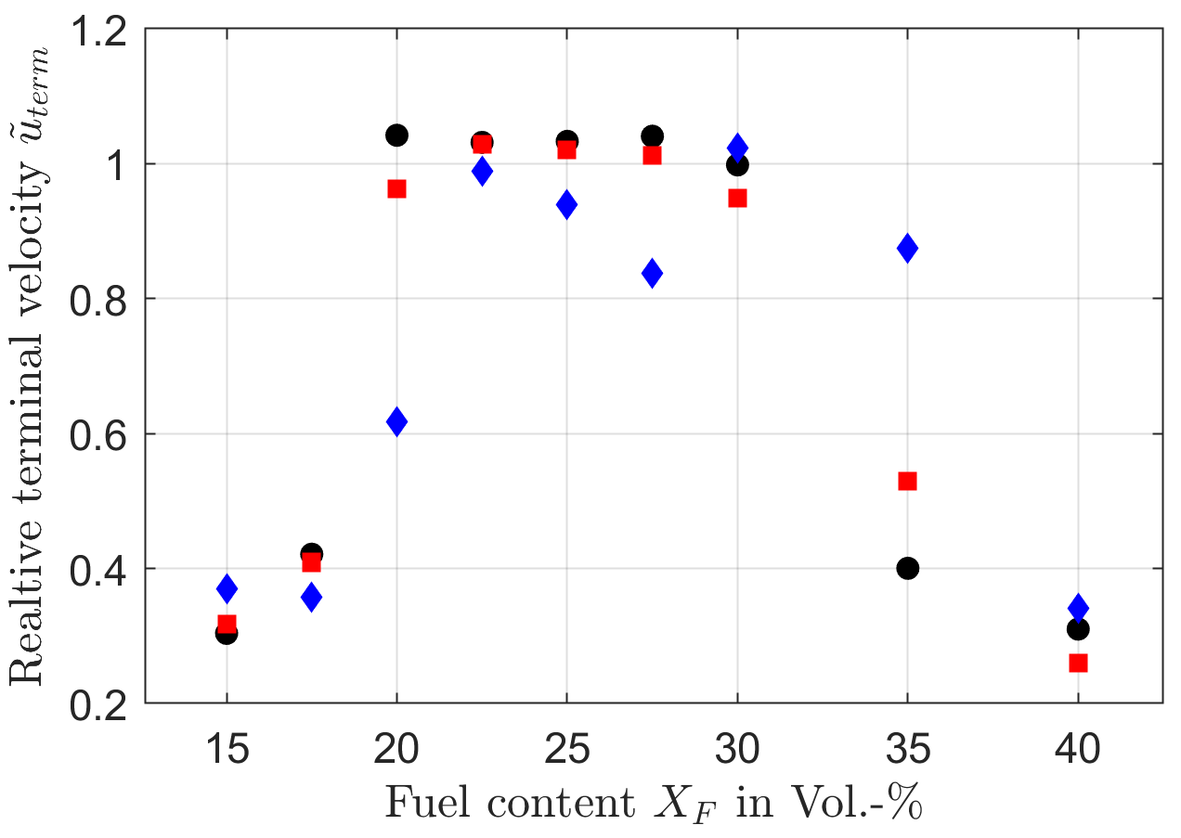
Results – Terminal velocity
Fuels of 100/0 ( ), 75/25 ( ) and 50/50 ( ) H₂/CO
Fuel content from X_{F}=15-40 Vol.-%
Relative terminal velocities:
Measured in unobstructed part
Normalized by D_{CJ}
Mean of three experiments per mixture
Regimes:
2
1)
$${\tilde{u}}_{term}≈0.25−0.4D_{CJ}$$
1
1
2)
$${\tilde{u}}_{term}≈D_{CJ}$$
Shift from 1 to 2 at higher fuel content for higher CO content in fuel
Shift from 2 to 1 at higher fuel content for higher CO content in fuel
Notes:
During the actual campaign fuel content was varied from 15-40 vol.-%
The fuel composition was varied from 100/0, 75/25 to 50/50 H2 to CO
On the left the velocities in the unobstructed part at the end of the channel are plotted against the fuel content in the channel
The velocity was obtained by averaging the measured velocity over the unobstructed part
Finally the velocity was normalized by the chapman-jouguet velocity for a stable detonation for the given mixture
Each data point was obtained by averaging at least three data points around the aimed fuel content
A fuel of 100/0 is indicated by black circles, a fuel 75/25 is indicated by red squares, a fuel of 50/50 H2/CO is marked by blue diamonds
Basically two regimes can be distinguished:
Regime one at very lean and very fuel rich mixtures is found at terminal velocities around 0.25-0.4 DCJ
The second regime is found for fuel contents between 20 and 30 vol.-% and is in order of DCJ
The main outcome is the transition from regime 1 to 2 and backwards
While for pure hydrogen and 75/25 the shift to regime two is obvious between 17.5 and 20 vol.-%, a 50/50 mixture will stay between the two regimes at lower terminal velocities
For the shift from 2 to 1 the opposite is the case
While 100/0 and 75/25 already shift back to regime one, a fuel of 50/50 is found to stay at the detonative regime 1
This behavior is also found for the measured dynamic peak pressures

Slide 8
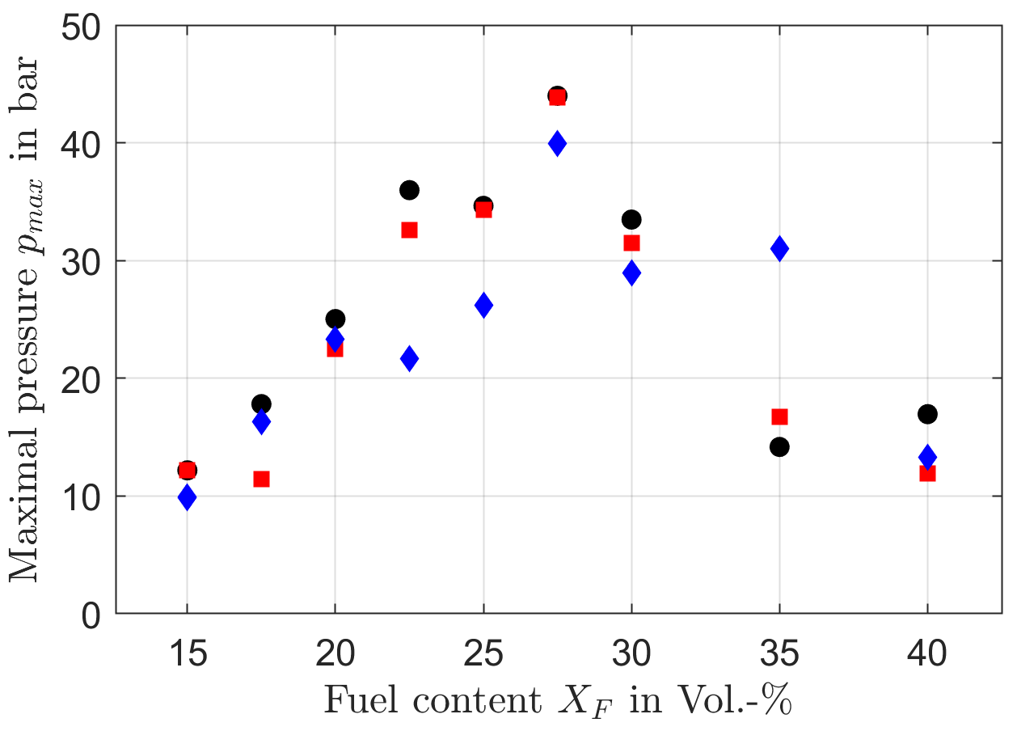
Results - P_{max}
Peak dynamic pressure:
Peak pressure increases towards stoichiometric mixtures
Highest peak pressures for 100/0 H₂/CO ( )
Lower peak pressures for 75/25 ( ) and 50/50 ( ) H₂/CO
Exception: X_{F}=35 Vol.-% (Detonation)
Notes:
Which are plotted against the fuel content in this diagram
Again each data point represents the average of three experiments around an aimed fuel content
It was observed that, coming from 15 vol.-% fuel content the measured peak pressures increase
The maximum is found at 27.5 vol.-% for pure hydrogen
Co content in the fuel leads to lower peak pressures at lean mixtures
The behavior is most prominent for a fuel of 50/50 between 22.5 and 30 vol.-%
One exception is the data point obtained at 35 Vol.-%
The observation matches with the delayed shift from the detonative combustion regime at 35 Vol.-% for 50/50

Slide 9
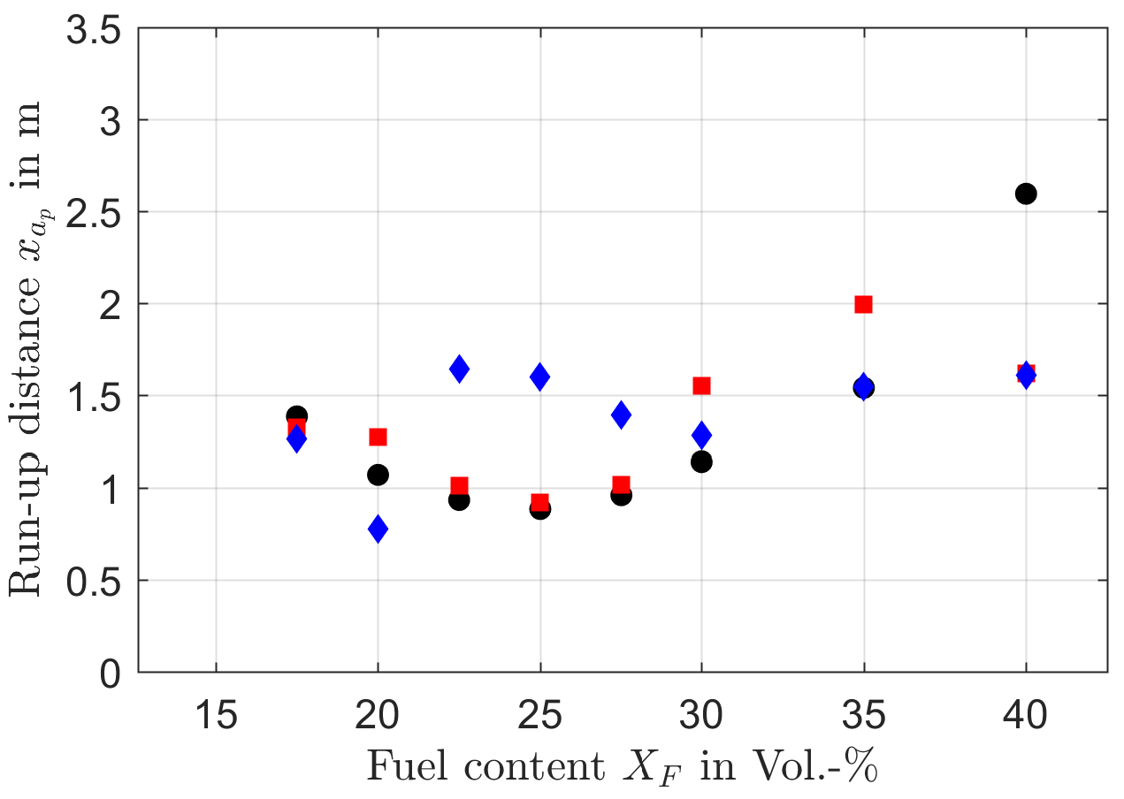
Results – Run up distance
Run-up distance to speed of sound of the products
Critical condition for onset of DDT
For lean mixtures 100/0 H₂/CO ( ) shows mostly shortest Run-up distance
Small difference to 75/25 H₂/CO ( )
Turning point at X_{F}=30 Vol.-%
Higher CO content leads to shorter Run-up distance
Notes:
Finally the run up distance to the speed of sound of the products are plotted against the fuel content
The run up distance is measured as the distance between the location of ignition and the position at which the velocity of the flame brush exceeds the speed of sound of products at an isobaric combustion
This state is assumed to be crucial for DDT
For mixtures below 30 vol.-% mixtures if 100/0 show the shortest run up distance
Co addition in this case leads to slightly longer run up distances, especially for 50/50
For higher fuel contents this trend seemed to be reversed
Run up distances for fuel of 50/50 decreases compared to hydrogen
The overall behavior in fuel rich mixtures might be related to a shift of the maximum of the laminar flame speed towards higher fuel contents

Slide 10
Conclusion and Outlook
Accomplishments:
Investigation of H₂/CO mixtures in partially obstructed channel
High blockage ratio and large spacing at long obstructed part in order to trigger flame acceleration and DDT
Recording of flame trajectory and dynamic pressures
Outcome of the Experiments:
H₂-air mixtures tend to higher pressures and flame speeds in lean and stoichiometric conditions
CO addition in case of fuel rich mixtures tend to higher flame speeds and pressures
Influence in fuel concentration gradients
Outlook:
Influence of geometry (lower spacing, lower BR)
Impact of concentration gradients by means of optical measurements
Notes:
I want to end my presentation with the conclusion and outlook
In the presented study the flame dynamics of h2/co mixtures were investigated in a partially obstructed channel
The blockage ratio was set to 60%, the spacing was 300mm the obstacles ranged over a length of 3.95m
The collected data included the flame trajectory and the dynamic pressure
Three mixtures were investigated at fuel volume contents of 15-40 vol.-%
The results showed, that hydrogen air mixtures tend to higher pressures and flame speed in lean and stochiometric conditions
For fuel rich conditions the results are less unambiguous
Mixtures of 50/50 h2 to co showed higher pressures and stayed in the detonation regime for a higher fuel contents
This might be related to a shift in the maximum laminar flame velocity towards higher fuel contents for higher CO contents in the fuel
Especially when investigating concentration gradients this effect might become more important
Before considering concentration gradients a more detailed look into the influence of the geometry is necessary
Therefore experiments with lower blockage ratio and smaller spacings are conducted in order to judge whether the trend at high fuel contents is preserved
Afterwards the impact of concentration gradients on the flame dynamics by the means of optical measurements will be investigated

Slide 11
Deflagration-to-detonation transition of H₂-CO-Air mixtures in a partially obstructed channel
26. September 2019
International Conference on Hydrogen Safety (ICHS) 2019
Adelaide, SA, Australia
D. Heilbronn, C. Barfuß, T. Sattelmayer
Institute of Thermodynamics, Technical University of Munich
Acknowledgment: The presented work is funded by the German Federal Ministry of Economic Affairs and Energy (BMWi) on the basis of a decision by the German Bundestag (project.no. 1501545A) which is gratefully acknowledged
Notes:
Thank you for your attention
Looking forward to answer your questions

