Slide 1


A GIS-BASED RISK ASSESSMENT OF HYDROGEN TRANSPORT:
A CASE STUDY IN YOKOHAMA, JAPAN
(ID153)
International Conference on Hydrogen Safety
September, 24-26 2019, Adelaide (Australia)
Noguchi, H.¹, Omach, T.², Seya, H³. and Fuse, M.¹
¹Graduate School of Engineering, Hiroshima University
²Port and harbor Bureau, Kobe City Government
³Graduate School of Engineering, Kobe University
This study was funded by the Japan Science and Technology Agency (JST) and the Cross-ministerial Strategic Innovation Promotion Program (SIP)

Slide 2
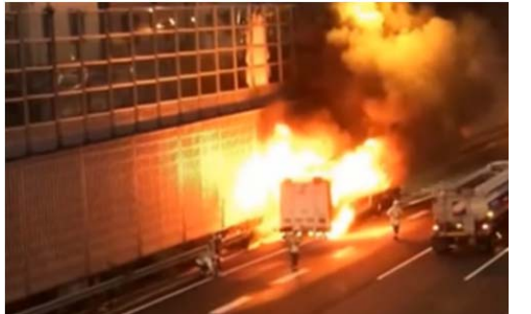
Risk Assessment for Hydrogen Transport
Introduction
Realizing the hydrogen economy in Japan
Japanese government advances introducing hydrogen economy.
The hydrogen economy needs the transport (e.g. for hydrogen station ).
Hydrogen transport in Japan
Because of the topographical restrictions, a truck is used as major means of hydrogen transport.
The truck will pass the urban areas with population concentration.
Hydrogen has dangerous physical properties (e.g. explosion and fire).
Hydrogen transporting trailer Accident in Japan¹⁾
The safety of hydrogen transport must be verified through risk assessment.
Source of phot
1) High Pressure Gas Safety Institute of Japan, Technical report of technical standards for mobile compressed hydrogen station, https://www.meti.go.jp/meti_lib/report/2016fy/000121.pdf
Notes:
As well know で水素は危険性をもつ

Slide 3
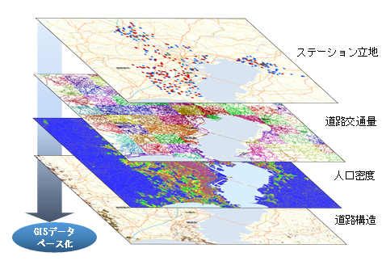
Limitation of Previous Studies & Aim of This Study
Introduction
Overview
Risk assessment for hydrogen transport [1-3] has received lesser attention than the that for hydrogen station [4-22].
Limitation of previous studies [1-3]
Risk assessment of hydrogen transport by truck is critical in considering the spatial features of the transport route.
However, the previous studies considered only virtual spatial features and not actual spatial features.
Aim of this studies
Location of hydrogen station
Assessing the risk of hydrogen transport by road considering the actual spatial features of the transport route, based on a geographic information system (GIS).
Traffic Volume
Population density
GIS
Road structure
Overlapping spatial features by GIS

Slide 4
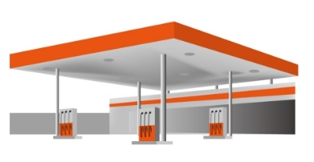



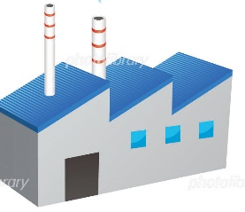




Analytical Framework
Methodology
Risk model for each road segment
Hydrogen station
Segment-1
Segment-2
Segment-3
Storage base
Risk (fatalities / year) is expressed as a product of frequency and consequence.
Assessing the risk for each the segment
Dividing a transportation route to many segments
As spatial features, “the road structure”, “road-traffic”, and “population density” are considered in the each road segment.
$R_{is}=T_{i}∙F_{is}∙C_{is}$
i: road segment
S: hydrogen transport accident scenario
R: risk (fatalities/year) of the hydrogen transport accident scenario
T_{i}: number of hydrogen transport trucks passing through the segment i
F: frequency of hydrogen transport accident scenarios, (accident/year))
C: consequence of the accident scenario(fatalities/accident)

Slide 5
Overview of Frequency Model (accidents/year)
Methodology
Estimating the frequency of hydrogen transport accident scenario at the each segment
Accident cause is divided into traffic accident and others.
Quantifying the degree of contribution of spatial features (the road structure and road-traffic volumes) to the frequency as spatial feature factor f
$F_{ijS}=\left\{a∙b_{j}∙\prod_{k}{f_{ijk}+c_{j}∙\left(1−a\right)}\right\}∙d_{S}∙D∙λ$
Except for
Traffic Accident
Traffic Accident
i: road segment
j: leakage scale
k: spatial-feature type of the transport route
S: hydrogen transport accident scenario
λ: frequency of leakage accidents by hydrogen
transport trucks, leaks/(truck‧km)
f: spatial-feature factor
D: transport distance (km)
a: percentage of traffic accidents to total leak accidents
b: percentage of traffic accidents by leakage scale
c: percentage of other accidents by leakage scale
d: percentage occurrence of hydrogen-transport accident scenarios
Notes:
パラメータa,b,c,dはETから得る．

Slide 6
Estimation of Special Feature Factor f
Methodology
Spatial feature k | leakage scale j |  |  | Summation
 | Large | Medium | Small
Tunnel | 30 | 20 | 10 | 60
Bridge | 45 | 35 | 5 | 85
Summation | 75 | 55 | 15 | 145
Accident data [24]
Spatial feature k | leakage scale j
 | Large | Medium | Small
Tunnel | 0.97 | 0.88 | 1.61
Bridge | 1.02 | 1.09 | 0.57
Spatial feature k | leakage scale j |  |  | Rate r_{k}
 | Large | Medium | Small
Tunnel | 31.03 | 22.76 | 6.21 | 0.41
Bridge | 43.97 | 32.24 | 8.79 | 0.59
Rate r_{j} | 0.52 | 0.38 | 0.10 | 145.00
Spatial feature factor f
Expected value from marginal distribution
k: spatial-feature type
j: leakage scale
f : spatial feature factor,
AC: number of logistics-truck traffic accidents
r_{k} , r_{j}: logistics-truck traffic accident occurrence percentage
Notes:
パラメータa,b,c,dはETから得る．

Slide 7
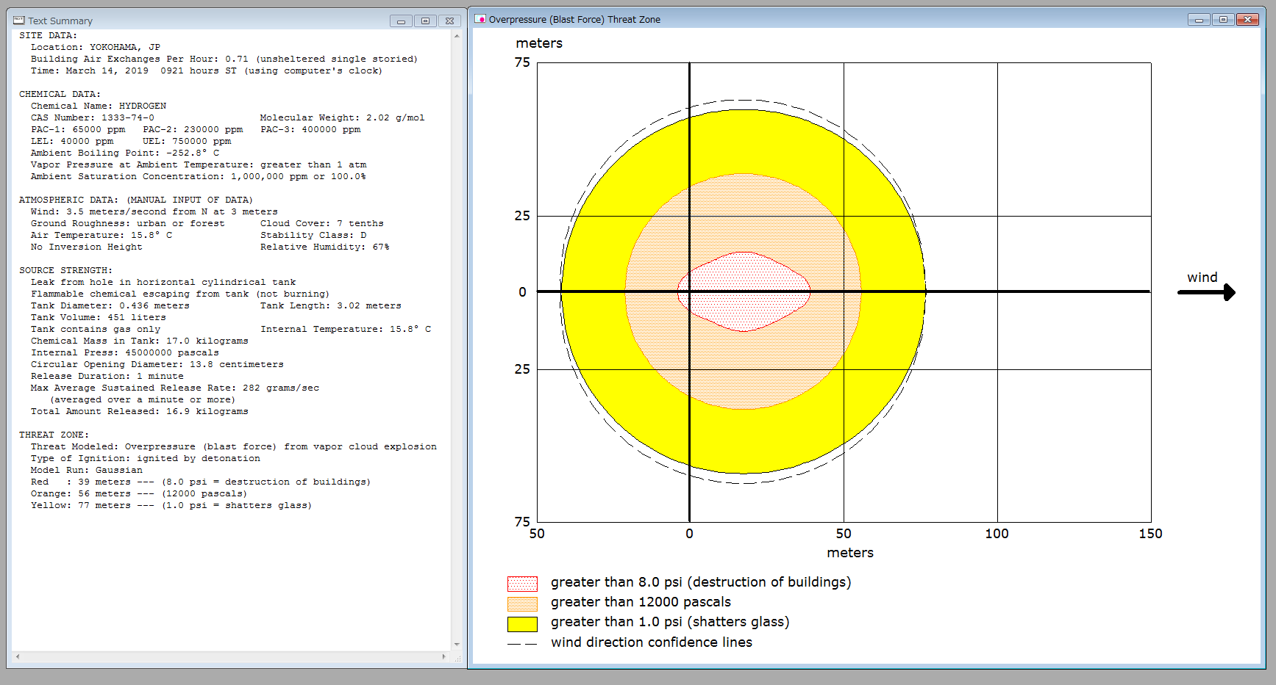

Overview of Consequence Model (fatalities / year)
Methodology
Consequence model estimate the number of fatality people due to accident.
Probability of Fatality c is calculated by probit model.
Affected area under the physical quantity are forecasted by Areal Locations of Hazardous Atmospheres (ALOHA)[25].
$C_{is}=C_{s}×A_{s}×P_{i}$
i: road segment
S: hydrogen transport accident scenario
A: area impacted by the accident scenario
P: population density surrounding the given road segment (number of residents/km2)
C: probability of fatality
Output of ALOHA tool

Slide 8
Estimation of Probability of Fatality c
Methodology
The probability of fatality c is based on the probit values obtained from the probit model of fires and explosions respectively.
 | Probit model [26] | Parameter
Fire |  | S: hydrogen-transport accident scenario (1: fire accident and 2: explosion accident) C: probability of fatality Y: probit value I: thermal radiation intensity P: peak overpressure t: exposure time
Explosion
The conversion model covert probit value Y into probability of fatality c
 | Conversion model [27] | Parameter
Fire/explosion |  | S: accident scenario C: probability fatality Y: probit value
Notes:
パラメータa,b,c,dはETから得る．

Slide 9
Conditions of Case Study
Case study
Major Conditions of Transport
Conditions of Transport | Detail
Year and Area | The first half of the 2020s, YOKOHAMA City
Hydrogen career | Compressed hydrogen
Transportation Route | Shortest route, From JX ISOGO Hydrogen Shipment Base to four Hydrogen Stations in YOKOHAMA city
Transportation Frequency | 60 (/year)
Number of road segments | 1119
Major conditions of Accident Scenario
Scenario | Condition | Value
Explosion | Leakage quantity [1] | 17 kg
 | Affected Area estimated by ALOHA | 4356m²
 | Physical quantity [29] | 12 (kPa)
Fire | Leakage quantity [28] | 17 kg
 | Affected area estimated by ALOHA | 314m²
 | Physical quantity [1] | 12.5 (kW/m²)

Slide 10
Result of Spatial Feature Factor
Case study
Spatial-feature type |  |  | Large-scale leakage | Medium-scale leakage | Small-scale leakage
Road structure | Road type | National highway | 1.26 | 1.14 | 0.97
 |  | Major local road | 0.80 | 0.91 | 1.02
 |  | Ordinary prefectural road | 0.78 | 0.95 | 1.02
 |  | Ordinary municipal road | 0.53 | 0.78 | 1.05
 |  | Expressway | 2.82 | 1.63 | 0.84
 | Road configuration | Intersection | 0.66 | 0.98 | 1.02
 |  | Straight road (tunnel) | 2.76 | 1.75 | 0.82
 |  | Straight road (bridge) | 1.73 | 1.35 | 0.92
 |  | Level crossing | 11.14 | 1.15 | 0.62
 | Topography surrounding road | Urban (densely populated) | 0.51 | 0.67 | 1.07
 |  | Urban (other) | 0.71 | 0.88 | 1.03
 |  | Non-urban | 1.68 | 1.41 | 0.91
Traffic volume | Travel velocity | Stopped | 0.25 | 0.49 | 1.11
 |  | Under 10 km/h | 0.12 | 0.26 | 1.15
 |  | Under 20 km/h | 0.24 | 0.50 | 1.10
 |  | Under 30 km/h | 0.41 | 0.80 | 1.05
 |  | Under 40 km/h | 0.91 | 1.25 | 0.96
 |  | Under 50 km/h | 1.64 | 1.61 | 0.88
 |  | Under 60 km/h | 2.46 | 1.87 | 0.81
 |  | Under 70 km/h | 3.25 | 2.10 | 0.75
 |  | Under 80 km/h | 4.04 | 2.09 | 0.72
 |  | Under 90 km/h | 3.92 | 1.98 | 0.75
 |  | Under 100 km/h | 4.87 | 2.30 | 0.66
 |  | Under 120 km/h | 5.86 | 2.55 | 0.59
24 spatial feature types are reflected to the risk
Notes:
パラメータa,b,c,dはETから得る．

Slide 11
Result of Frequency of Accidents
Case study
Frequency of explosion
(accidents /year)
Frequency of fire
(accidents /year)

Slide 12
Result of Consequence of Accidents
Case study
Consequence of explosion
(Fatalities /year)
Consequence of fire
(Fatalities /year)
Notes:
確率と違ってばらつく

Slide 13
Result of Risk Assessment for The Explosion Accident
Case study
All assessed risk less than the risk criteria (10⁻⁶ (fatalities/year)) indicated by ISO[29]
The highest risk was 10⁻⁷＜R≦10⁻⁶, which was calculated for 139 road segments (12.4% of the routes)
Explosion risk is higher than fire risk
Risk Assessment for explosion accident
(Fatalities /year)

Slide 14
Result of Risk Assessment for The Fire Accident
Case study
All assessed risk less than the risk criteria (10⁻⁶ (fatalities/year)) indicated by ISO[29]
The highest risk was 10⁻¹⁰＜R≦10⁻⁹ , which was calculated for 655 road segments (64.3% of the route)
Risk Assessment for fire accident
(Fatalities /year)

Slide 15
Discussion and Conclusion
This study evaluated the risk of hydrogen transport by road considering the actual spatial features of the transport route using GIS
Case study indicate that the risk of the hydrogen transport by road in YOKOHAMA at the first half of the 2020s is acceptable level
The risk values differ at the order level between road segments
Population density is detected as a key factor in the risk assessment
For full-introduction of hydrogen transport, the road segment that is used by many routs should be cared because the risk of the segment may over the criteria under the full instruction.

Slide 16
Reference
Gerboni, R. and Salvador, E., Hydrogen Transportation Systems: Elements of Risk Analysis, Energy 34, No. 12, 2009, pp. 2223-2229.
Moonis, M., Wilday, A.J. and Wardman, M.J., Semi-Quantitative Risk Assessment of Commercial Scale Supply Chain of Hydrogen Fuel and Implications for Industry and Society, Process Safety and Environmental Protection, 88, No. 2, 2010, pp. 97-108.
Lasn, K. and Echtermeyer, A.T., Safety Approach for Composite Pressure Vessels for Road Transport of Hydrogen. Part 1: Acceptable Probability of Failure and Hydrogen Mass, International Journal of Hydrogen Energy, 39, No. 26, 2014, pp. 14132-14141.
Kikukawa, S., Yamaga, F. and Mitsuhashi, H., Risk Assessment of Hydrogen Fueling Stations for 70 MPA FCVs, International Journal of Hydrogen Energy, 33, No. 23, 2008, pp. 7129-7136.
Kikukawa, S., Mitsuhashi, H. and Miyake, A., Risk Assessment for Liquid Hydrogen Fueling Sations, International Journal of Hydrogen Energy, 34, No. 2, 2009, pp. 1135-1141.
Casamirra, M., Castiglia, F., Giardina, M. and Lombardo, C., Safety Studies of a Hydrogen Refuelling Station: Determination of the Occurrence Frequency of the Accidental Scenarios, International Journal of Hydrogen Energy, 34, No. 14, 2009, pp. 5846-5854.
LaChance, J., Risk-Informed Separation Distances for Hydrogen Refueling Stations, International Journal of Hydrogen Energy, 34, No. 14, 2009, pp. 5838-5845.
Zhiyong, L., Xiangmin, P. and Jianxin, M., Harm Effect Distances Evaluation of Severe Accidents for Gaseous Hydrogen Refueling Station, International Journal of Hydrogen Energy, 35, No. 3, 2010, pp. 1515-1521.
Zhiyong, L., Xiangmin, P. and Jianxin, M., Quantitative Risk Assessment on a Gaseous Hydrogen Refueling Station in Shanghai, International Journal of Hydrogen Energy, 35, No. 13, 2010, pp. 6822-6829.
Haugom, G. P. and Friis-Hansen, P., Risk Modelling of a Hydrogen Refuelling Station Using Bayesian Network, International Journal of Hydrogen Energy, 36, No. 3, 2011, pp. 2389-2397.
Kim, E., Lee, K., Kim, J., Lee, Y., Park, J. and Moon, I., Development of Korean Hydrogen Fueling Station Codes Through Risk Analysis, International Journal of Hydrogen Energy, 36, No. 20, 2011, pp. 13122-13131.
Kim, J., Lee, Y. and Moon, I., An Index-Based Risk Assessment Model for Hydrogen Infrastructure, International Journal of Hydrogen Energy, 36, No. 11, 2011, pp. 6387-6398.
Zhiyong, L., Xiangmin, P. and Jianxin, M., Quantitative Risk Assessment on 2010 Expo Hydrogen Station, International Journal Of Hydrogen Energy, 36, No. 6, 2011, pp. 4079-4086.
Nakayama, J., Sakamoto, J., Kasai, N., Shibutani, T. and Miyake, A., Preliminary Hazard Identification for Qualitative Risk Assessment on a Hybrid Gasoline-Hydrogen Fueling Station with an On-Site Hydrogen Production System Using Organic Chemical Hydride, International Journal of Hydrogen Energy, 41, No. 18, 2016, pp. 7518-7525.
Tsunemi, K., Yoshida, K., Yoshida, M., Kato, E., Kawamoto, K., Kihara, T. and Saburi, T., Estimation of Consequence and Damage Caused by an Organic Hydride Hydrogen Refueling Station, International Journal of Hydrogen Energy, 42, No. 41, 2017, pp. 26175-26182.
Huang, Y. and Ma, G., A Grid-Based Risk Screening Method for Fire and Explosion Events of Hydrogen Refuelling Stations, International Journal of Hydrogen Energy, 43, No. 1, 2018, pp. 442-454.
Dadashzadeh, M., Kashkarov, S., Makarov, D. and Molkov, V., Risk Assessment Methodology for Onboard Hydrogen Storage, International Journal of Hydrogen Energy, 43, No. 12, 2018, pp. 6462-6475.
Hirayama, M., Shinozaki, H., Kasai, N. and Otaki, T., Comparative Risk Study of Hydrogen and Gasoline Dispensers for Vehicles, International Journal of Hydrogen Energy, 43, No. 27, 2018, pp. 12584-12594.
Honselaar, M., Pasaoglu, G. and Martens, A., Hydrogen Refuelling Stations in the Netherlands: An Intercomparison of Quantitative Risk Assessments Used for Permitting, International Journal of Hydrogen Energy, 43, No. 27, 2018, pp. 12278-12294.
Sakamoto, J., Misono, H., Nakayama, J., Kasai, N., Shibtani, T. and Miyake, A., Evaluation of Safety Measures of a Hydrogen Fueling Station Using Physical Modeling, Sustainability, 10, No.11, 2018, pp. 3846.
Tsunemi, K., Yoshida, K., Kihara, T., Saburi, T. and Ono, K., Screening-Level Risk Assessment of a Hydrogen Refueling Station that Uses Organic Hydride, Sustainability, 10, 2018, pp. 4477.
Gye, H., Seo, S., Bach, Q., Ha, D. and Lee, C., Quantitative Risk Assessment of an Urban Hydrogen Refueling Station, International Journal of Hydrogen Energy, 44, No. 2, 2019, pp. 1288-1298.
Institute for Traffic Accident Research and Data Analysis, Traffic Accident Count Tool, http://www.itarda.or.jp/shukei/, (in Japanese).
Institute for Traffic Accident Research and Data Analysis, Traffic Accident Count Tool, http://www.itarda.or.jp/shukei/, (in Japanese).
United States Environmental Protection Agency (EPA), ALOHA Software, https://www.epa.gov/cameo/aloha-software.
Eisenberg A.N., Lynch, J.C. and Breeding, J.R., Vulnerability Model: A Simulation System for Assessing Damage Resulting From Marine Spills, DTIC Document, 1975.
CCPS (Center for chemical Process Safety of the American Institute of Chemical Engineering), Guideline for Chemical Process Quantitative Risk Analysis Second Edition, Safety, Security, and Risk Management, CCPS, New York, 2010.
LaChance, J., Houf, W., Middleton, B. and Fluer, L., Analyses to Support Development of Risk-Informed Separation Distances for Hydrogen Codes and Standards, Sandia Report Sand, 2009-0847, 2009.
ISO (2018) Draft international standard ISO 19880-1, Gaseous hydrogen – Fueling stations –, International Standard Organization

Slide 17
Thank you very much for your attention
d195644@hiroshima-u.ac.jp

