Slide 1



Interaction of Hydrogen Jets with Hot Surfaces
A. Kessler, S. Knapp, A. Koleczko, N. Eisenreich speaker: L. Schindhelm
Fraunhofer Institute Chemical Technology ICT, Pfinztal, Germany

Slide 2
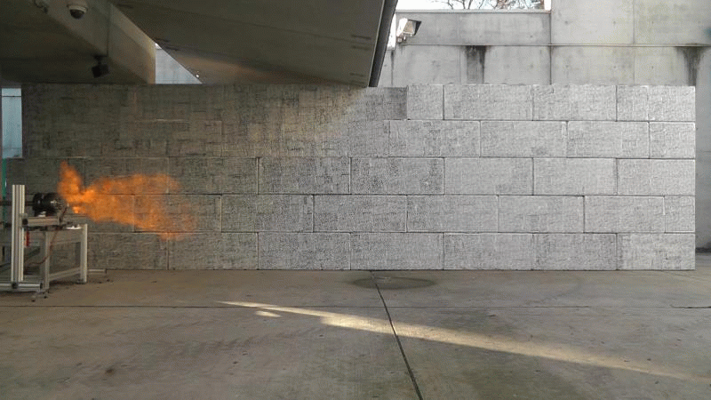
Interaction of Hydrogen Jets with Hot Surfaces
Problem
High pressure hydrogen storage and refueling
  Safety valve / rupture disk activation, accidents,…
Resulting hydrogen jets may ignite spontaneously – or not!
Notes:
Auf 2 Folien + Bild

Slide 3

Interaction of Hydrogen Jets with Hot Surfaces
Problem
Moving scheme (explosion / cold jet) depends on various parameters
  Most important: pressure & nozzle configuration
  „Late ignition“ at hot sufaces: important issue
    Strongly enhanced flame velocities by turbulence
    Upstream flames (especially dangerous with continous feed of hydrogen)
Mechanisms not fully understood
Notes:
Auf 2 Folien + Bild

Slide 4
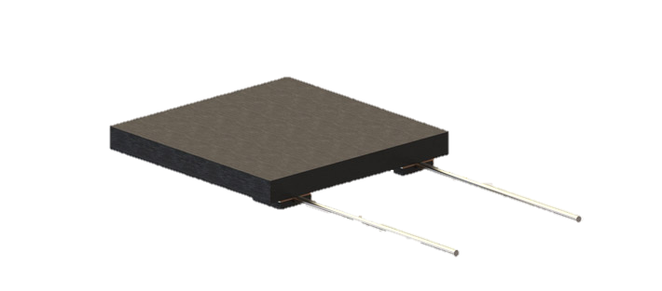
Interaction of Hydrogen Jets with Hot Surfaces
Approach
Highly dynamic hydrogen jets
Spontaneous release by rupture disk out of pipe Ø 10mm
10 / 20 / 40 MPa nominal release pressure
Ignition source: glow platelet
  3m / 5m distance to nozzle
  temperature of platelet: 1223 K
In total 7 experiments in this series of experiments

Slide 5
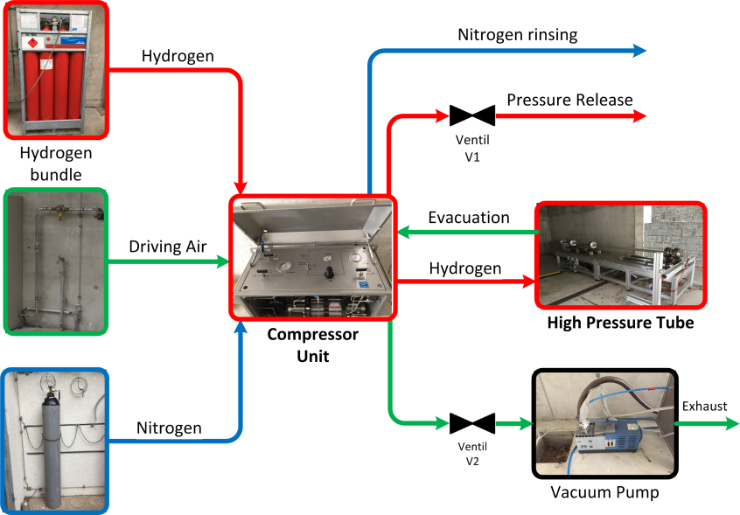
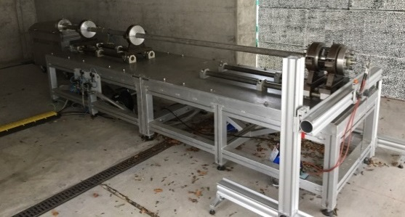
Interaction of Hydrogen Jets with Hot Surfaces
Experimental Setup
Fraunhofer ICT high pressure release facility
  ~5l Volume
  Fully remote controlled

Slide 6
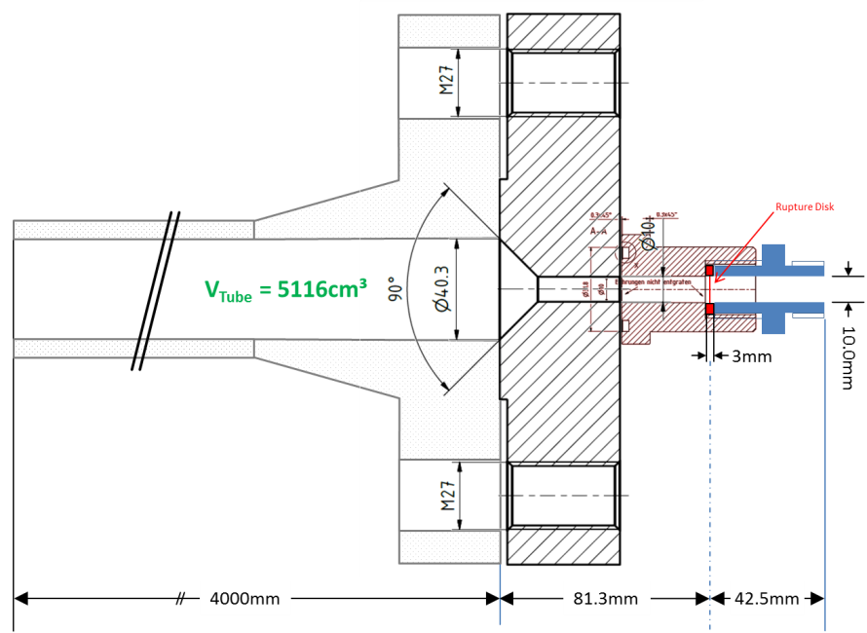
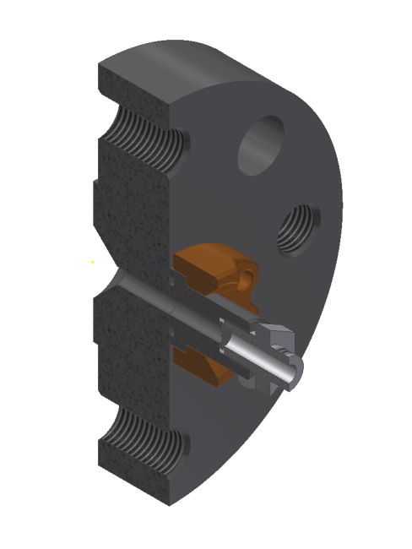
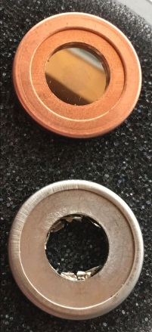
Interaction of Hydrogen Jets with Hot Surfaces
Release configuration

Slide 7
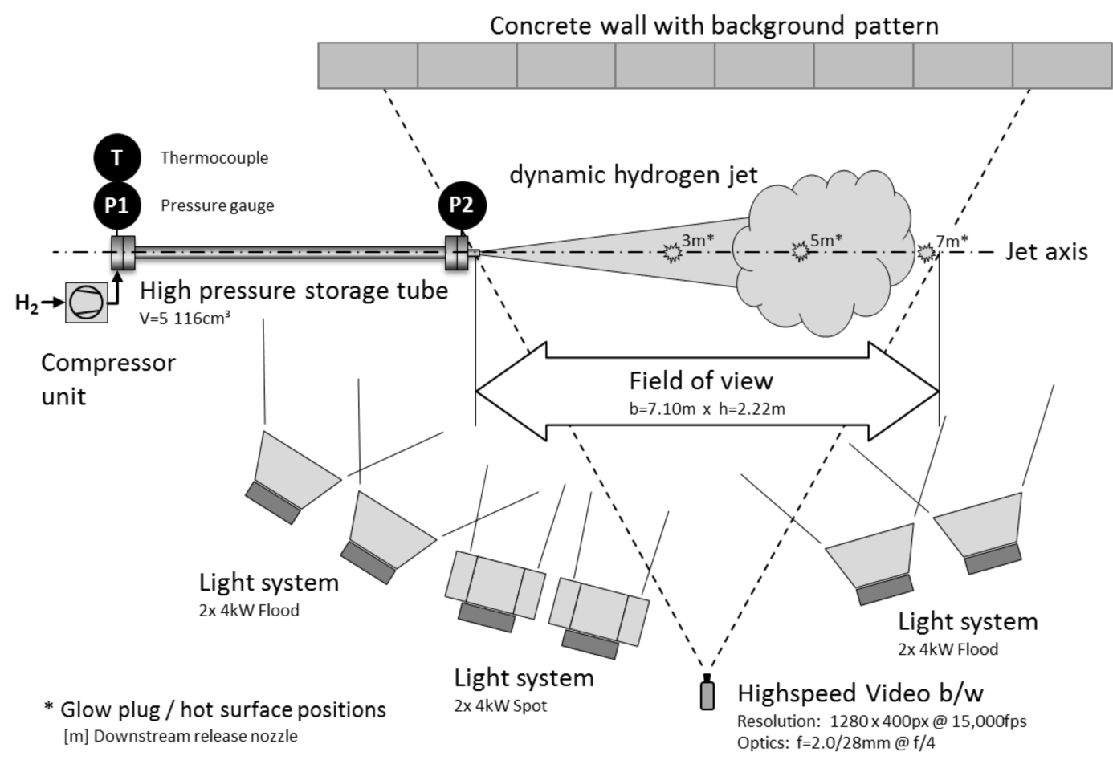
Interaction of Hydrogen Jets with Hot Surfaces
Experimental Setup

Slide 8
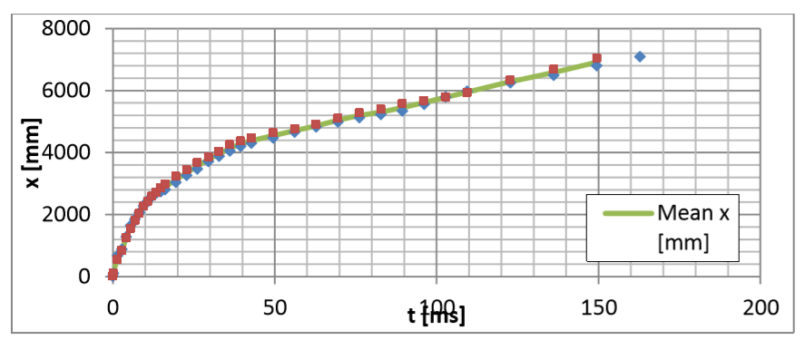
Interaction of Hydrogen Jets with Hot Surfaces
Reproducibility
Data evaluation
  Video analysis methods (including Background Oriented Schlieren method; BOS)
Exemplaric results:
  Jet head propagation
Notes:
Hier evtl. andere Grafik

Slide 9

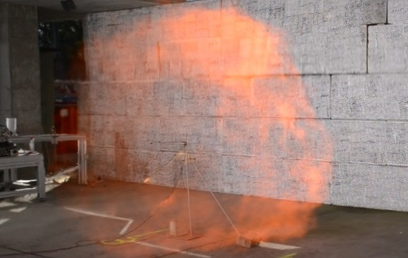
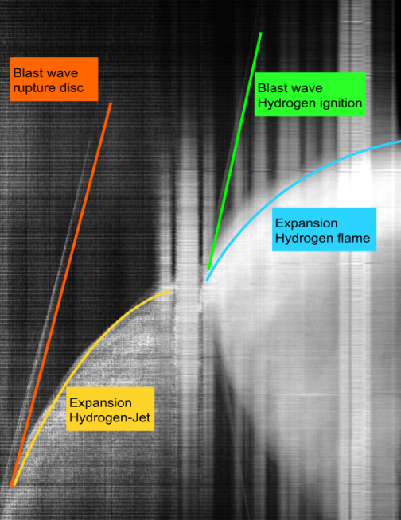
Interaction of Hydrogen Jets with Hot Surfaces
Types of reaction
Normal
Strong

Slide 10
Interaction of Hydrogen Jets with Hot Surfaces
Velocities and localisation of ignition
→ conclusion
Number | Pressure [MPa] | Distance [m] | # Platelets | v _{upstream} [m/s] | v _{downstream} [m/s] | Ignition at
EP1 | 10 | 3 | 1 | 73.3 | 20.8 | wake
EP2 | 40 | 3 | 1 | 241 | 111 | wake
EP3 | 40 | 3 | 3 | 118.1 | 76.2 | front stagnation, wake, irregular flame structure
EP4 | 40 | 5 | 1 | 1: 43.5 2: 64.4 | 1: 51.1 2: 43.4 | front stagnation,flame separation

Slide 11
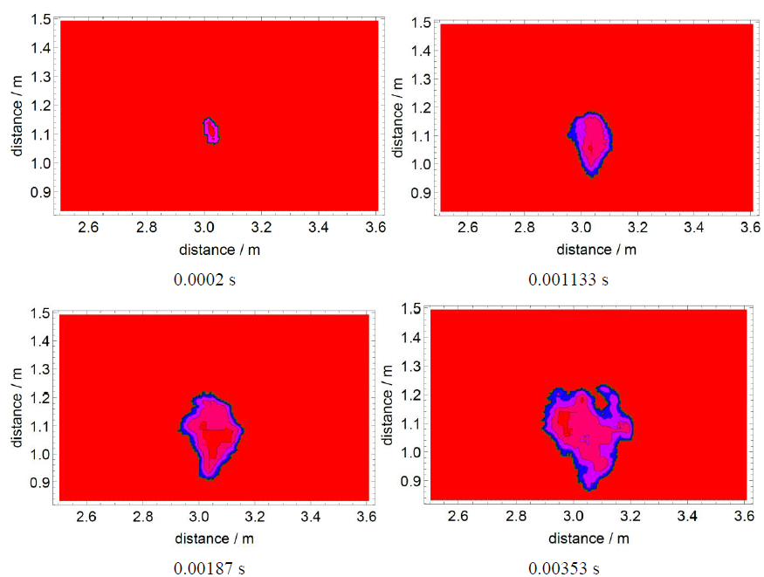
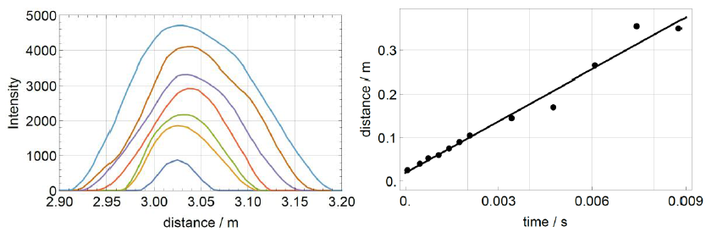
Interaction of Hydrogen Jets with Hot Surfaces
Experiment EP1 with 10 bar, 3 m, 1 platelet
→o
→c
Jet arrives at platelet after 0.04 s
Ignition 2-3 cm behind platelet (wake)
Oval shape up to 2 ms after ignition
t = 200 µs → t = 3530 µs
v = 39.6 m/s
t = 333 µs → t = 2000 µs

Slide 12
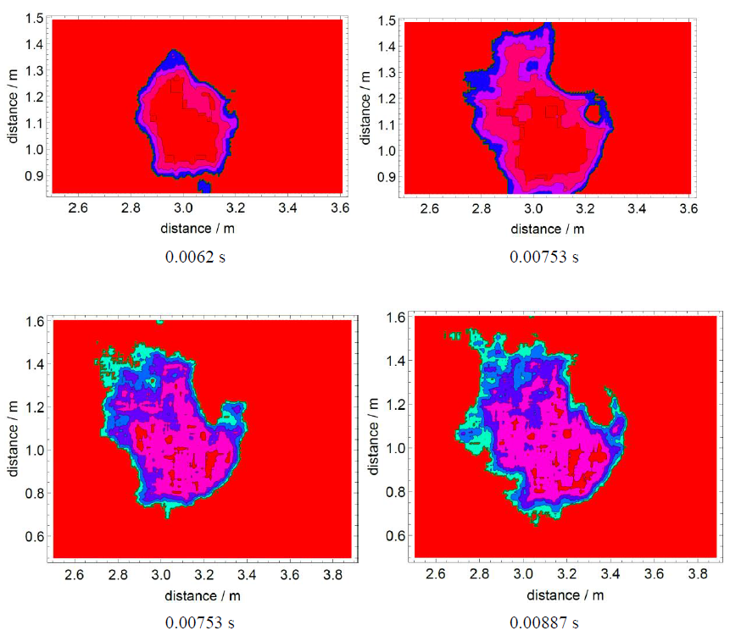
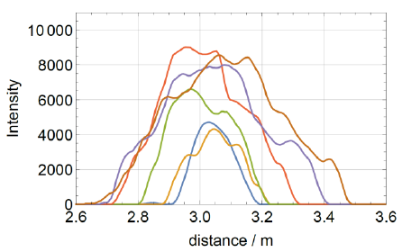
Interaction of Hydrogen Jets with Hot Surfaces
Experiment EP1 with 10 bar, 3 m, 1 platelet
→o
→c
Jet arrives at platelet after 0.04 s
Ignition 2-3 cm behind platelet (wake)
Oval shape up to 2 ms after ignition
From 2 ms to 9 ms intensive flame around platelet → low disturbance by platelet
t = 6.2 ms → t = 8.87 ms
t = 2.0 ms → t = 9.0 ms

Slide 13
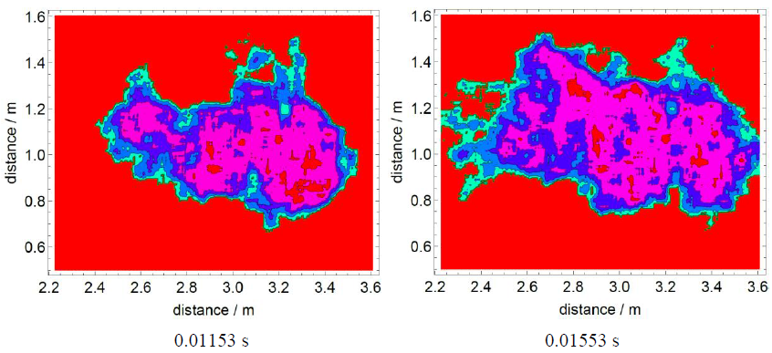
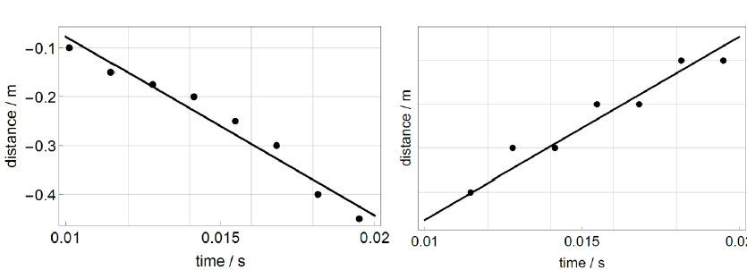
Interaction of Hydrogen Jets with Hot Surfaces
Experiment EP1 with 10 bar, 3 m, 1 platelet
→o
→c
Jet arrives at platelet after 0.04 s
Ignition 2-3 cm behind platelet (wake)
Oval shape up to 2 ms after ignition
From 2 ms to 9 ms intensive flame around platelet → low disturbance by platelet
High upstream speed after 10 ms
but no flame separation
Flame detectable until 50 ms
t = 11.5 ms → t = 15.5 ms
v = 77.3 m/s
v = 20.8 m/s

Slide 14
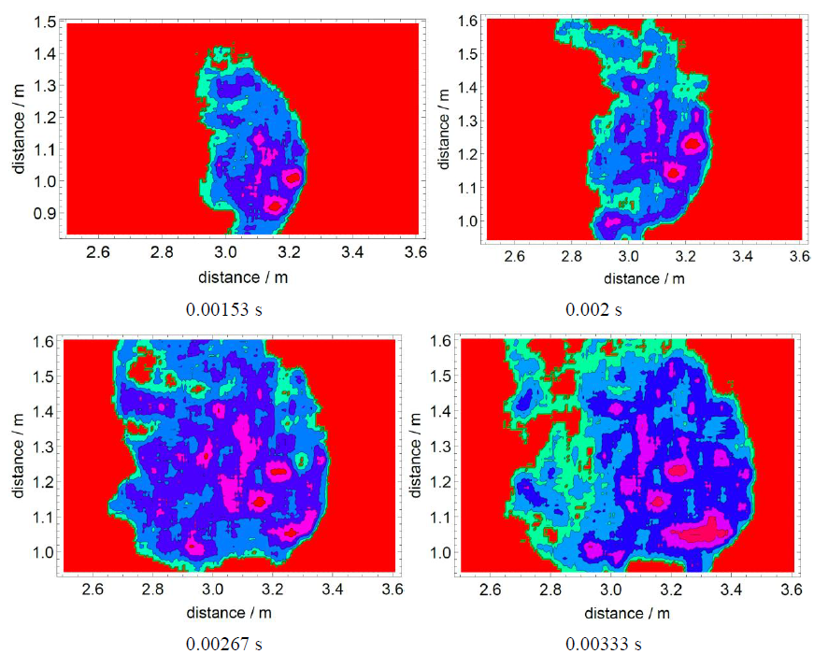
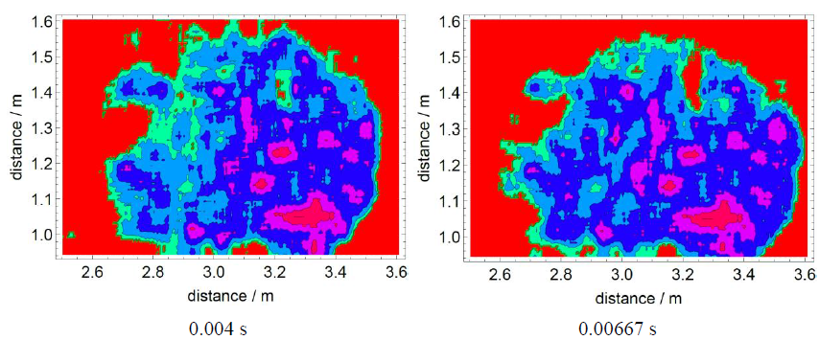
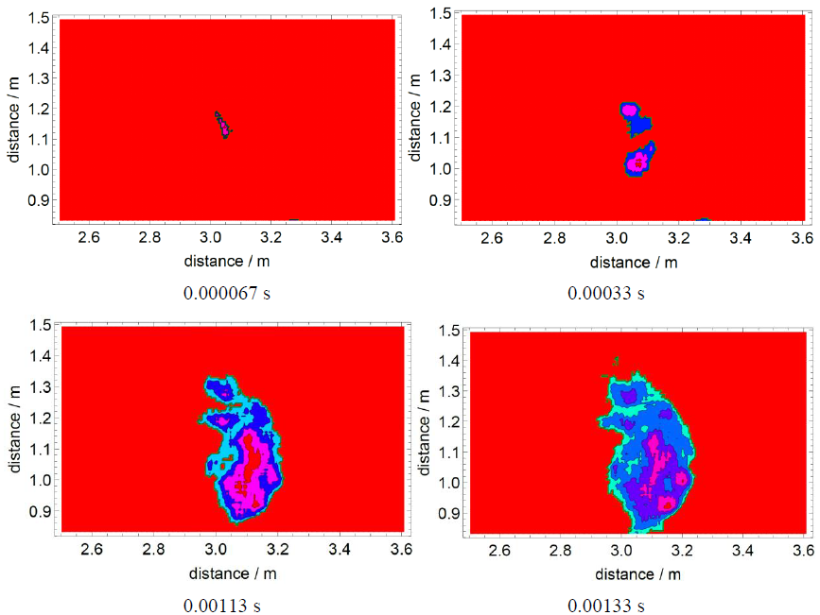
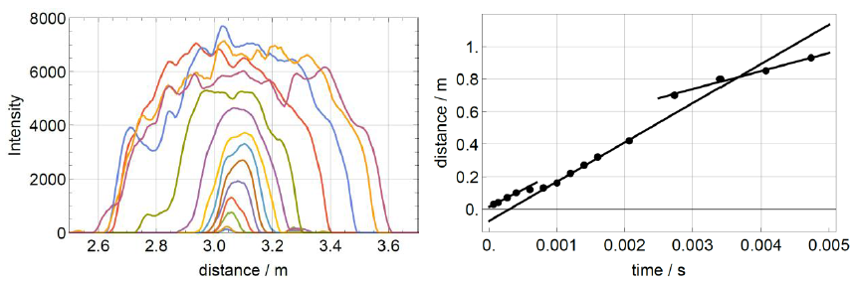
Interaction of Hydrogen Jets with Hot Surfaces
Experiment EP3 with 40 MPa, 3 m, 1 platelet
→o
→c
t = 1.53 ms
t = 1.33 ms
Jet ignited in the wake of platelet
Hemispheric shape expanding to deformed spherical explosion
Flame velocities:
  213 m/s (until 400 µs)
  241 m/s (expansion of flame to stagnation point (t= 1 ms → 2 ms)
  111 m/s downstream expansion
  (t= 2 ms → 5 ms)
t = 67 µs
t = 1.13 ms
t = 67 µs
t = 330 µs
t = 2.67 ms
t = 4.0 ms
t = 6.67 ms
t = 3.33 ms
t = 2.0 ms
t = 67 µs → t = 6.6 ms
v = 111 m/s

Slide 15
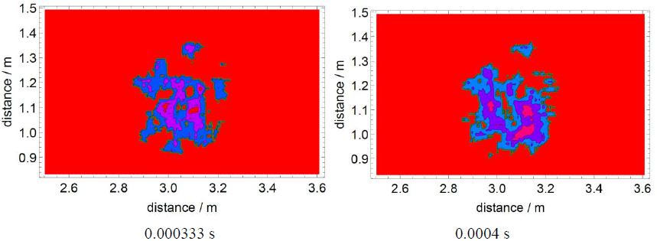
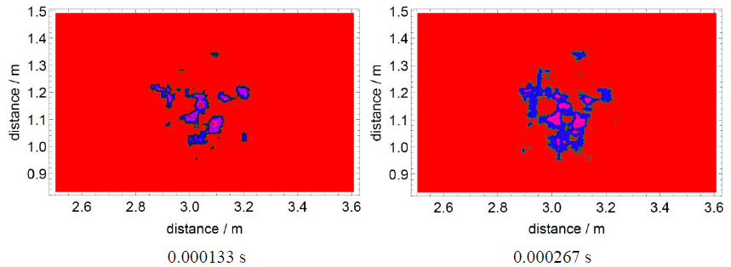
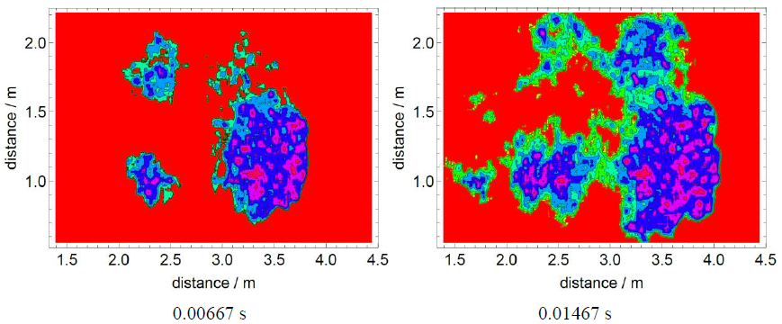
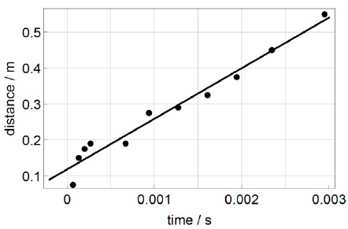
Interaction of Hydrogen Jets with Hot Surfaces
Experiment EP3 with 40 MPa, 3 m, 3 platelets
→o
→c
t = 333 µs
t = 400 µs
t = 133 µs
t = 267 µs
Jet ignition after 0.02 s after rupture disc break with 0.2 ms ignition delay
Central flame velocity 200-300 m/s for 0.4 ms, flame propagation with 141 m/s
Irregular flame structure forms itself around the platelets (first 400 µs after ignition)
double headed flame propagation following spherical geometry with gap due to the platelets
t = 133 µs
t = 14.7 ms
t = 6.7 ms
t = 14.7 ms
t = 133 µs → t = 14.7 ms
v = 141 m/s

Slide 16
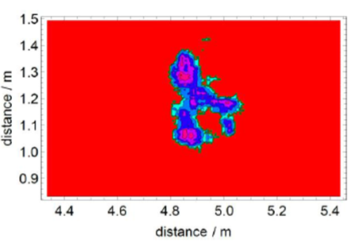
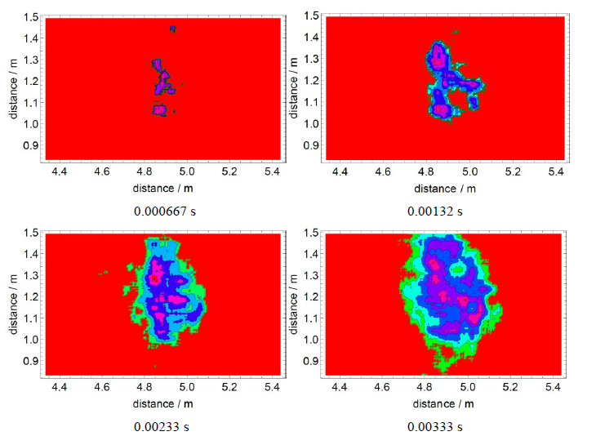
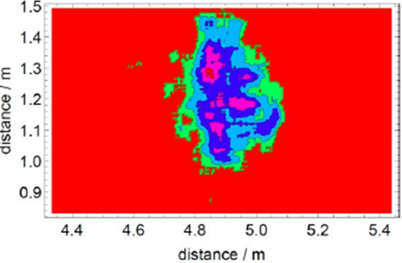
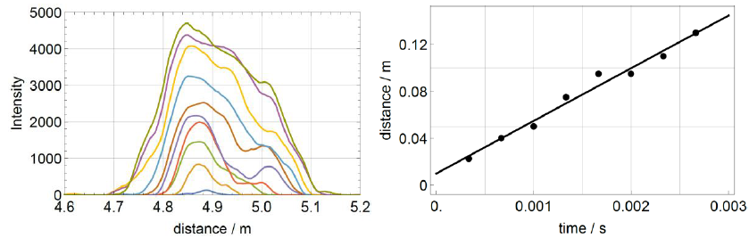
Interaction of Hydrogen Jets with Hot Surfaces
Experiment EP5 with 40 MPa, 5 m, 1 platelet
→o
→c
Ignition at front stagnation point of the single platelet (79 ms after jet arrival)
Nearly spherical explosion around stagnation point for 0.3 ms
Explosion in wake is ignited afterwards
Unification to single explosion
after 167 ms
t = 667 µs → t = 3330 µs
v = 44.9 m/s

Slide 17
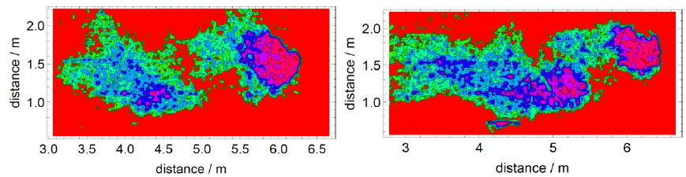
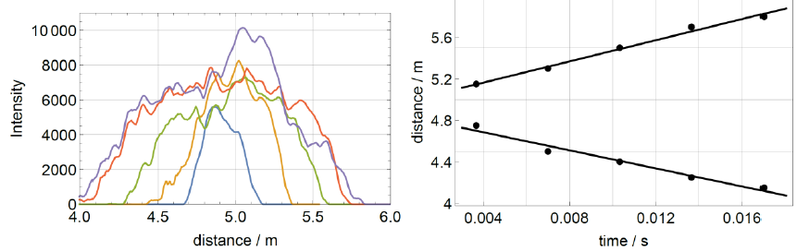
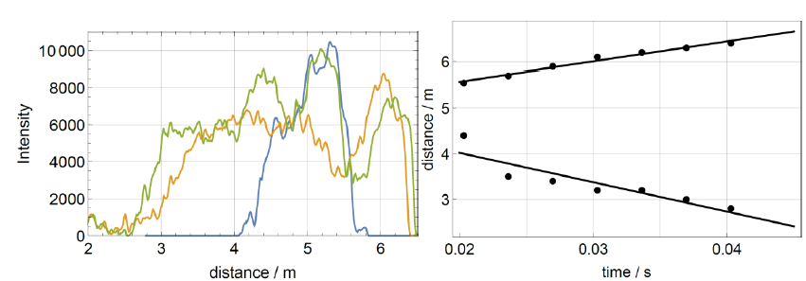
Interaction of Hydrogen Jets with Hot Surfaces
Experiment EP5 with 40 MPa, 5 m, 1 platelet
→o
→c
Separation of upstream and downstream flame
Upstream flame accelerated to source
t = 3.33 ms → t = 4 ms
v = 51.1 m/s
v = 43.4 m/s
v = 43.5 m/s
v = 64.4 m/s

Slide 18
Interaction of Hydrogen Jets with Hot Surfaces
Conclusion
Interaction of H₂ jets investigated using high speed video analysis & BOS method
Jets ignite under all conditions (10-40 bar, platelet temperature 1223 K)
Flame front propagation depends on all three varied parameters
  Initial H₂ reservoir pressure
  Number of platelets
  Distance between nozzle and hot surface
Notes:
Tabelle + Punkte

Slide 19
Interaction of Hydrogen Jets with Hot Surfaces
Conclusion (1)
All of the experiments with distances of 3 and 5 m led to strong reaction.
Two ignition points : 10 - 30 cm in front and 10 - 30 cm after the platelets, nearly simultaneous or successively. → overlapping reactions
Similar effects of 1 or 3 platelet, acting as a flame holder → initiated flame stabilizes around platelet for more than 0.5 s after ignition

Slide 20
Interaction of Hydrogen Jets with Hot Surfaces
Conclusion (2)
Flames stabilize at the front stagnation point as well as wake, expand with varying its maximum temperature position slightly.
Upstream and downstream flame propagation starts after some milliseconds at the stabilized flames. The flames are broadened or may form a double head
Further separated explosions occur in the upstream area of the jets in some cases.

Slide 21
Interaction of Hydrogen Jets with Hot Surfaces
Thank you for your attention!
Conclusion
→ overview
Tube pressure [MPa] | Distance [m] | Number of platelets | Jet arrival at hot platelets [s] | v of initial explosion [m/s]* | v upstream | v downstream [m/s]** | Ignition at
10 | 3 | 1 | 0.041 | 39.6 | 73.3 | 20.8 | wake
10 | 3 | 3 | 0.040 | 76.5 | 46.1 | 32.4 | front stagnation and wake
20 | 3 | 1 | 0.037 | 83.2 | 54.8 | 40.4 | wake
20 | 3 | 3 | 0.036 | 84.8 | 164.2 | 35.2 | front stagnation and wake
40 | 3 | 1 | 0.02 | 213 | 241 | 111 | wake
40 | 5 | 1 | 0.07 | 44.9 | 43.5 | 51.1 64.4 | 43.4*** | front stagnation
40 | 3 | 3 | 0.02 | 200-300 initially, 140.9 | 118.1 | 76.2 | front stagnation and wake, irregular flame structure

