Slide 1
Hot surface ignition in flowing streams of hydrogen-air mixtures
C. Proust

Slide 2

Introduction (i)
Practical ignition sources :
  Electrical devices (ATEX group)
  Electrostatics
  Hot surfaces
  Ultrasounds
  Light sources (UV ?)
  High pressure releases
Relevant ignition parameters :
  MIEs
  Critical Hot surface Temperature (and power)
  Diffuse ignition
  Auto Ignition Temperature

Slide 3
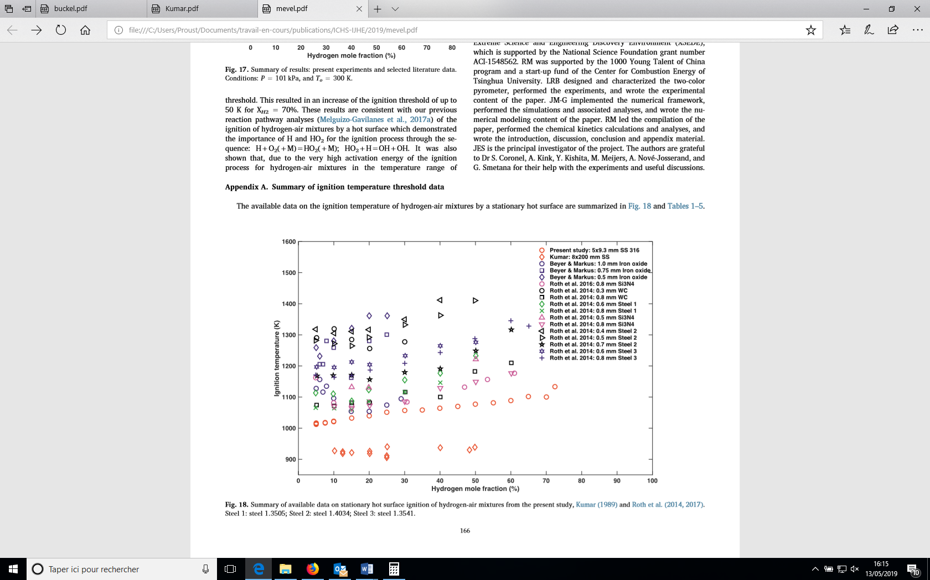
Introduction (ii)
Literature
What is the critical hot surface ignition temperature (Tp_ign) for H₂-air mixture ?
Is it a fundamental parameter (influence of T, %H₂, Velocity…) ?

Slide 4
Available knowledge
Phenomenological models :
  Static classical autoignition model (Semenov) applied to the thermal boundary layer on the hot surface (Laurendeau, Weinberg). Tp_ign depends on the activation energy, heat release and thickness of the layer (hence of the convection) but not on the surface area.
  Flame propagation model (Proust). The flame is able to escape the boundary layer when the flame thickness calculated at Tp is smaller than the boundary layer. Tp_ign depends on the boundary layer thickness (hence on the convection) and on the burning velocity. Independant on the surface area.
Numerical simulations :
  Finite difference fluid mechanics simulation (Kumar 1989) incorporating multispecies reactions. 1 D sheared flow sweeping along the surface. Tp_ign does not depend on the surface area nor on the convection.
  CFD simulation (OPENFoam) with multispecies reactions performed in axysymmetric 2D. Tp-ign may depend on the details of the heating mode (gradients of temperature along the heated object) and on the geometry. Ignition is easier in wakes suggesting convection is influencial.

Slide 5
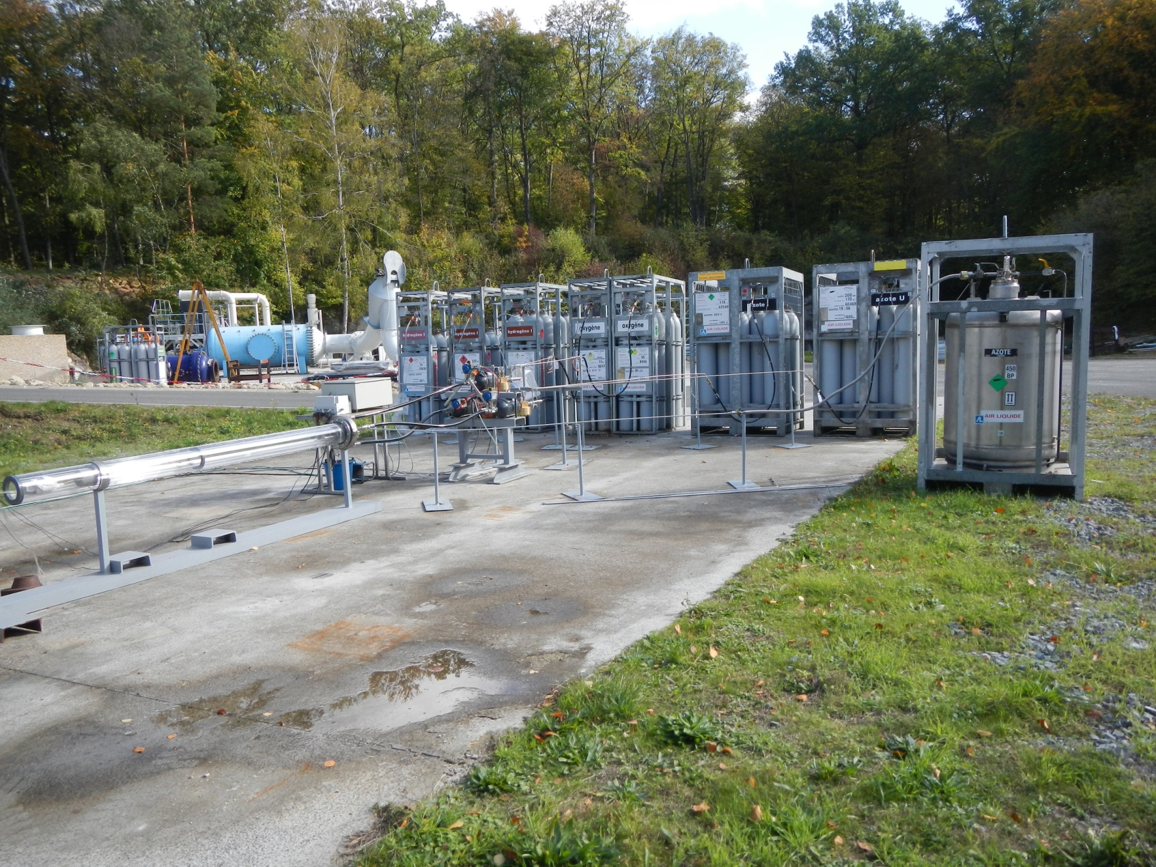
Experimental details (i)
GH2
GO2
GN2
LN2
Pressure regulators
Mixing tube

Slide 6
Experimental details (ii)

Slide 7

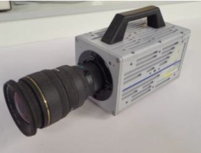
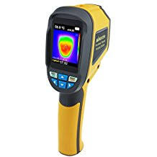
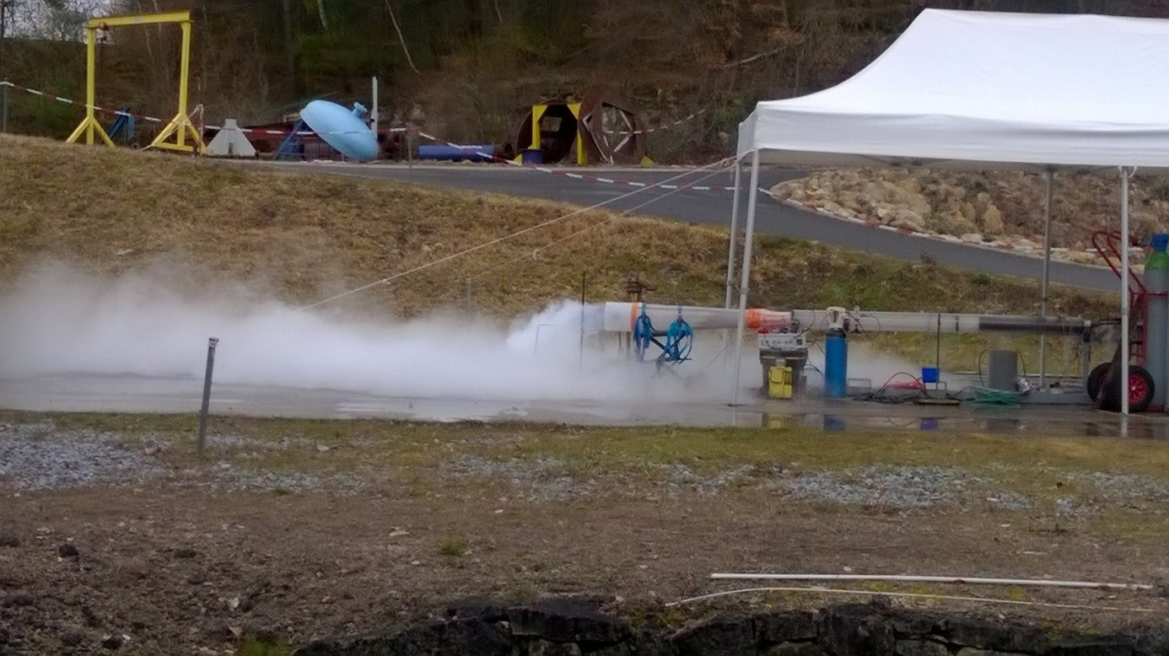
Experimental details (iii)
(300 i/s)
T/C type K 250 μm
Jet
O2
Stable current supply
Performances :
  4 to 80% H2
  Ambient to -150°C
  Ambient pressure
  Velocity from nearly 0 to 30 m/s
IR

Slide 8
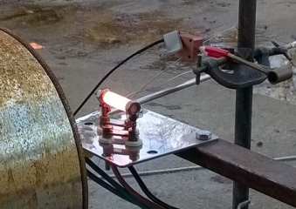
Measurements

Slide 9
Results (i)
Ambient <1 m/s

Slide 10
Results (ii)
10 %H2 and <1 m/s

Slide 11
Results (iii)
10 %H2 and ambient

Slide 12
Conclusions
Tp-ign does not vary to vary significantly with the experimental conditions investigated : % H₂, T, U.
This is not fully coherent with available knowledge, in particular the negligible influence of T and U.
Tp-ign is very close to AIT and perhaps in the specific case of the device used, AIT mechanism is promoted in some « shielded » zone.
Further experimental work and simulations are welcome.

