Slide 1

Paper-ID: 229
EXPERIMENTS ON THE COMBUSTION BEHAVIOUR OF HYDROGEN-CARBON MONOXIDE-AIR MIXTURES
A. Friedrich, G. Necker, G. Stern, A. Veser, J. Grune (Pro-Science)
M. Kuznetsov, T. Jordan (KIT)
Supported by:

Slide 2
Outline
Introduction
Safety Considerations & Experimental Set-up
Test Procedure
Experiments in the Explosion Bomb
Summary

Slide 3
Introduction
General Aim & Project Partners
In severe nuclear reactor accidents with core meltdown high pressure and temperature loads to the safety containment can occur, which might lead to local leakages of hydrogen and carbon monoxide formed due to the reaction of molten core and water or concrete. In such cases flammable H₂-CO-air mixtures are generated in adjacent air-filled compartments.
For the evaluation of the damage potential that is associated with such scenarios and
as a basis for the development of mitigation measures the combustion behavior of such stratified H₂-CO-air layers in semi-confined geometries has to be investigated.
In this two-phase joint research project of PS/KIT with the Chair of Thermodynamics
at the Technical University of Munich (TUM) the combustion properties of H₂-CO-air mixtures are investigated with the aim to create a new scientific basis for the analysis of H₂-CO-combustions in compartments outside the containment of a nuclear power plant.
In the first part of the current project Pro-Science performed small scale experiments in
an explosion bomb to determine experimentally fundamental burning characteristics of
H₂-CO-air-mixtures.

Slide 4
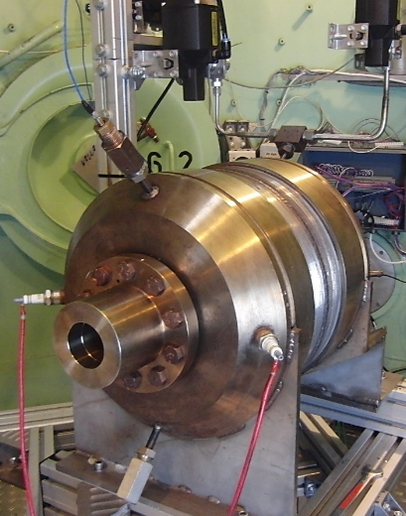
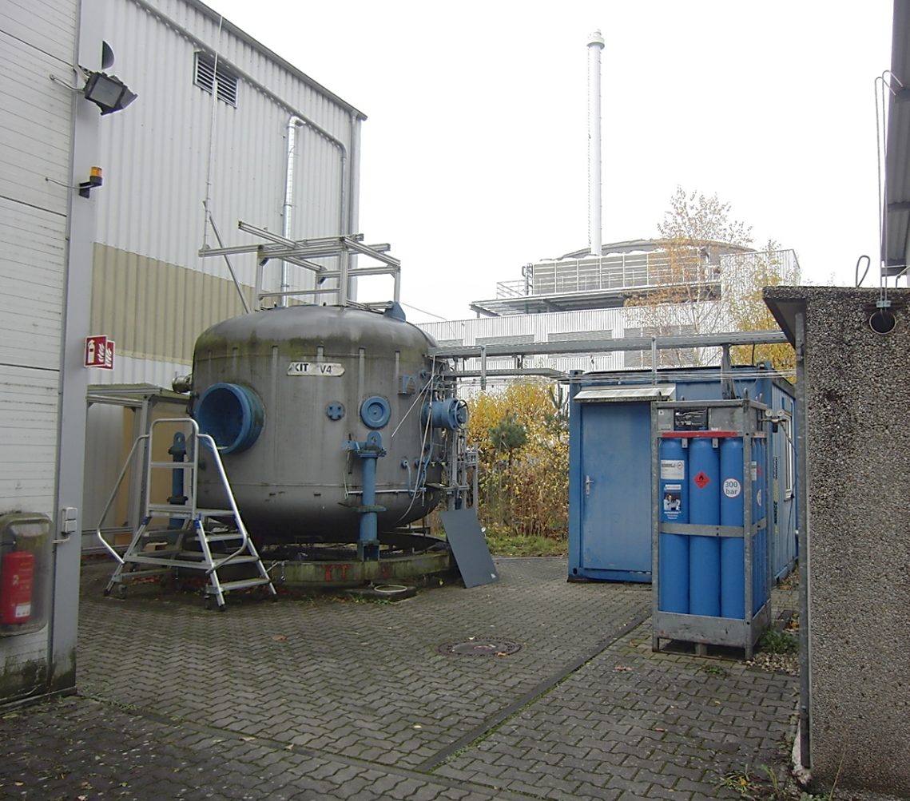
Safety Considerations & Experimental Set-up
Safety considerations and preparation of the bomb facility
Explosion bomb installed to safety vessel V4 at hydrogen test site HYKA
at KIT (Dim. V4 [m]: d_{i} x H: 3.3 x 3.1 ➔ V = 21.5 m³, p_{stat}: 40 bar)
Due to the acute toxicity of CO extended
safety concept necessary:
All components bearing CO (except gas cylinder)
housed in safety vessel,
During operation continuous ventilation through
exhaust (580 m³/h (≈ 0.5 air-changes/min)) in a
height of 6 m,
CO-sensor in safety vessel,
Access to vessel only with personalized CO-sensor,
CO-cylinder in outdoor cabinet with CO-sensor.
Chimney
Vessel
exhaust
Explosion bomb
Vessel
V4
Control
room
H₂-
Bundle
Gas-cylinder cabinet (CO)

Slide 5
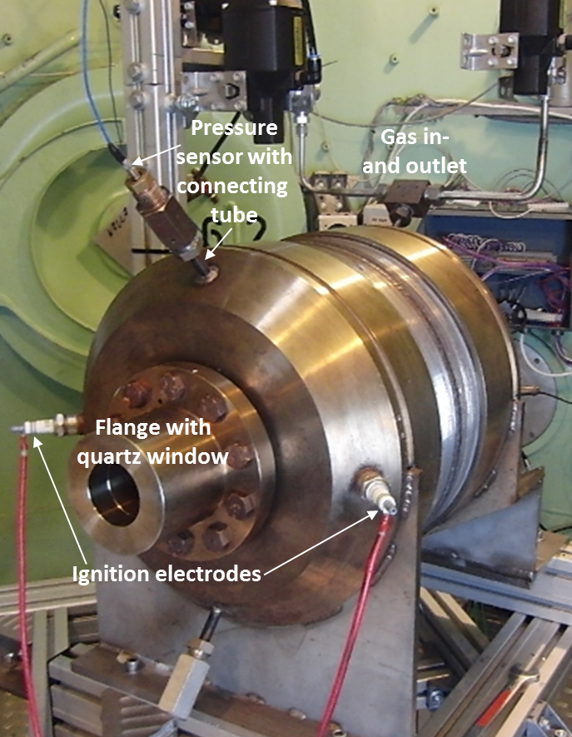
Safety Considerations & Experimental Set-up
Experimental Set-Up
Bomb equipped with 2 dynamic pressure sensors (fine & coarse) and 2 thermocouples,
Chimney
V13
H₂
CO
P
p_{static}
Vacuum-pump for evacuation of bomb and lines,
V05
V04
V03
V06
V07
Gas-analysis
Gas cylinders for H₂ and CO, air from compressed air grid at KIT,
V09
V02
Vacuum
pump
V08
V01
p_{dynamic}
P
T
Filling via 3 massflow-controllers for H₂, CO and Air (Bronkhorst, Series F), and mixing chamber,
Mixing-
chamber
P
T
Explosion-
bomb
Static pressure sensor for vacuum and pressure control (Leybold, DI 2001, 0 – 2000 mbar),
V10
V11
V12
Ignition
electrodes
Gas-analysis: Sensors for H₂ and CO (Messkonzept, FTC 300, 0 – 100 Vol% H₂,
Sensors Europe, S-AGM Plus, 0 – 35 Vol% CO),
Massflow
Massflow
Massflow
Spherical bomb:
d_{i} = 25 cm (V = 8.2 dm³),
p_{statMax} = 800 bar,
T_{max} = 300 °C
H₂
Air
Ignition electrodes.
Air
CO

Slide 6
Safety Considerations & Experimental Set-up
Test procedure
Evacuation of bomb, mixing-chamber and pipe system,
Chimney
V13
H₂
CO
P
p_{static}
V05
V04
V03
V06
V07
Gas-analysis
V09
V02
Vacuum
pump
V08
V01
p_{dynamic}
P
T
Mixing-
chamber
P
T
Explosion-
bomb
V10
V11
V12
Massflow
Massflow
Massflow
H₂
Air
Air
CO

Slide 7
Safety Considerations & Experimental Set-up
Test procedure
Evacuation of bomb, mixing-chamber and pipe system,
Adjustment of desired mixture during bypass-
flow via mixing-chamber and chimney,
Chimney
V13
H₂
CO
P
p_{static}
V05
V04
V03
V06
V07
Gas-analysis
V09
V02
Vacuum
pump
V08
V01
p_{dynamic}
P
T
Mixing-
chamber
P
T
Explosion-
bomb
V10
V11
V12
Massflow
Massflow
Massflow
H₂
Air
Air
CO

Slide 8
Safety Considerations & Experimental Set-up
Test procedure
Evacuation of bomb, mixing-chamber and pipe system,
Adjustment of desired mixture during bypass-
flow via mixing-chamber and chimney,
Filling of bomb with mixture up to slight overpressure (approx. 1200 mbar),
Chimney
V13
H₂
CO
P
p_{static}
V05
V04
V03
V06
V07
Gas-analysis
V09
V02
Vacuum
pump
V08
V01
p_{dynamic}
P
T
Mixing-
chamber
P
T
Explosion-
bomb
V10
V11
V12
Massflow
Massflow
Massflow
H₂
Air
Air
CO

Slide 9
Safety Considerations & Experimental Set-up
Test procedure
Evacuation of bomb, mixing-chamber and pipe system,
Adjustment of desired mixture during bypass-
flow via mixing-chamber and chimney,
Filling of bomb with mixture up to slight overpressure (approx. 1200 mbar),
Mixing-chamber and bypass are purged with air, simultaneously analysis of bomb content during depressurization to 1000 ±10 mbar,
Chimney
V13
H₂
CO
P
p_{static}
V05
V04
V03
V06
V07
Gas-analysis
V09
V02
Vacuum
pump
V08
V01
p_{dynamic}
P
T
Mixing-
chamber
P
T
Explosion-
bomb
V10
V11
V12
Massflow
Massflow
Massflow
H₂
Air
Air
CO

Slide 10
Safety Considerations & Experimental Set-up
Test procedure
Evacuation of bomb, mixing-chamber and pipe system,
Adjustment of desired mixture during bypass-
flow via mixing-chamber and chimney,
Filling of bomb with mixture up to slight overpressure (approx. 1200 mbar),
Mixing-chamber and bypass are purged with air, simultaneously analysis of bomb content during depressurization to 1000 ±10 mbar,
Ignition,
Chimney
V13
H₂
CO
P
p_{static}
V05
V04
V03
V06
V07
Gas-analysis
V09
V02
Vacuum
pump
V08
V01
p_{dynamic}
P
T
Mixing-
chamber
P
T
Explosion-
bomb
V10
V11
V12
Ignition
electrodes
Massflow
Massflow
Massflow
H₂
Air
Air
CO

Slide 11
Safety Considerations & Experimental Set-up
Test procedure
Evacuation of bomb, mixing-chamber and pipe system,
Adjustment of desired mixture during bypass-
flow via mixing-chamber and chimney,
Filling of bomb with mixture up to slight overpressure (approx. 1200 mbar),
Mixing-chamber and bypass are purged with air, simultaneously analysis of bomb content during depressurization to 1000 ±10 mbar,
Ignition,
Evacuation of bomb, mixing-chamber and pipe system.
Chimney
V13
H₂
CO
P
p_{static}
V05
V04
V03
V06
V07
Gas-analysis
V09
V02
Vacuum
pump
V08
V01
p_{dynamic}
P
T
Mixing-
chamber
P
T
Explosion-
bomb
V10
V11
V12
Massflow
Massflow
Massflow
H₂
Air
Air
CO

Slide 12
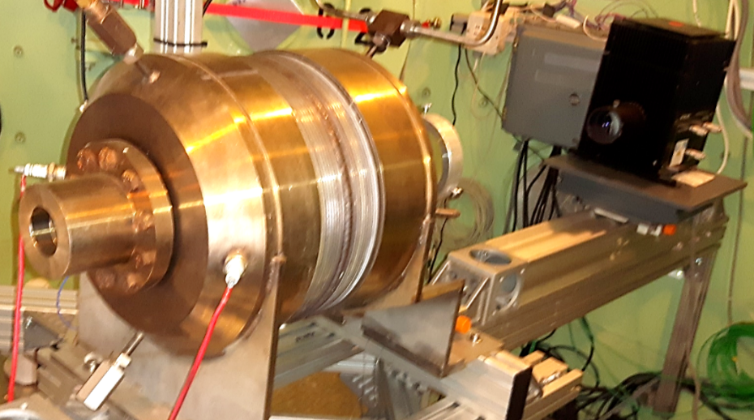
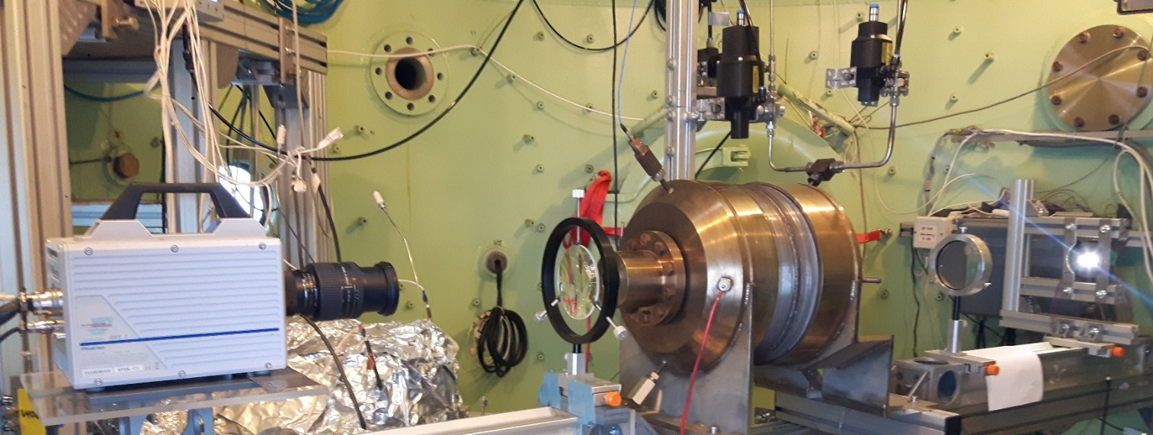
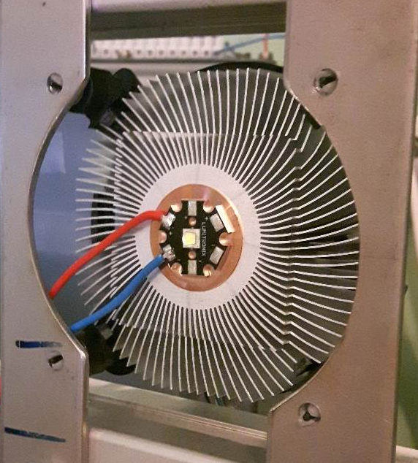
Safety Considerations & Experimental Set-up
High-speed videography
In roughly half of the experiments a high-speed camera and a shadowgraphy system was used,
Photron FASTCAM-SA1.1,
max. res.: 1024 x 1024 Pixel (1,05 Megapixel) @ max. 5,4 kHz, max. frame rate: 675 kHz @ 64 x 16 Pixel
During the campaign the special lamp failed (irreparable), so a new lamp on LED-basis was developed,
With this lamp the
experiments,
especially on weak
mixtures, were
completed.

Slide 13
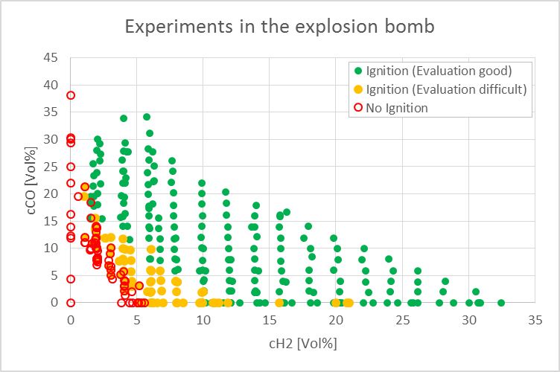
Experiments in the Explosion Bomb
Test-Matrix
Approximately 400 Ignition attempts were performed, but in more than 120 of these attempts no ignition was observed.
➔ Lower Flammability Limit

Slide 14
Experiments in the Explosion Bomb
Lower Flammability Limit
Flammability limits of the binary mixtures: H₂-air: 4,0 Vol% CO-air: 12,2 Vol%
The reaction of a dry CO-O₂ mixture is very slow even at high temperatures, but the overall reactivity is greatly accelerated in the presence of trace amounts of moisture or H₂,
But in the bomb experiments dry air was used to generate the mixture and thus no ignition of CO-air mixtures without H₂ was possible,
In first tests an experiment was stopped when no ignition was observed in the first attempt,
In later experiments (with HS-camera) up to 4 (rarely 5) ignition attempts with increasing ignition duration (0.1 s up to > 2 s) were performed,
Mixture was labelled “unignitable” when all 4 attempts did not show any sign of ignition (neither in pressure nor in HS-video-record),

Slide 15
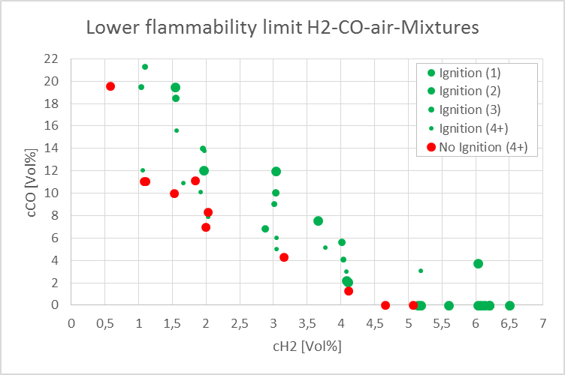
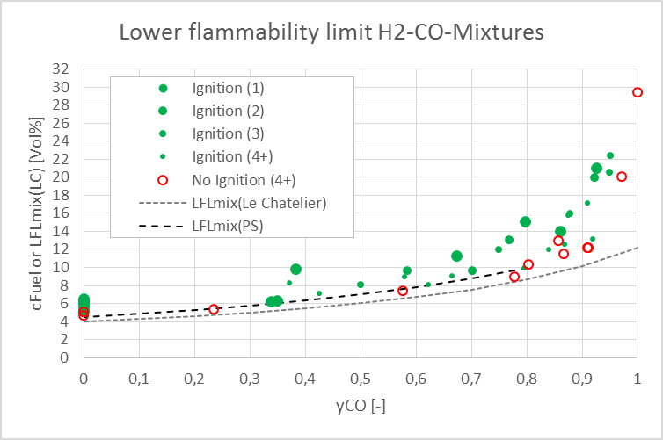
Experiments in the Explosion Bomb
Lower Flammability Limit
Size of green dots (and number in brackets) indicates number of attempts needed to ignite the mixture,
H₂-air mixtures could not be ignited below 5.2 Vol%,
Pure CO-air mixtures (without H₂) could not be ignited at all,
Comparison with values calculated using
Le Chatelier’s Mixing Law
for Flammability Limits
shows larger differences for y_{CO} > 0.8.

Slide 16
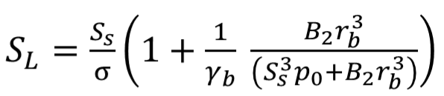
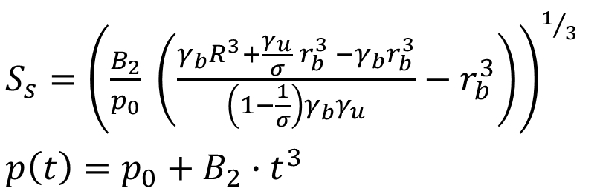
Experiments in the Explosion Bomb
Laminar Burning Velocities (Pressure Method)
(no correction of stretch and instabilities possible)
S_{S}: visible flame velocity S_{L}: laminar flame velocity
B₂: coefficient p₀: initial pressure
γ_{b}/γ_{u}: c_{p}/c_{v} burned, unburned σ: expansion ratio (ρ_{u}/ρ_{b}),
r_{b}: radius of burned gas R: radius of bomb
Kuznetsov et al. Laminar burning velocities of hydrogen-oxygen-steam mixtures at elevated temperatures and pressures, Proc. Comb. Inst. 33(2011) 895-903

Slide 17
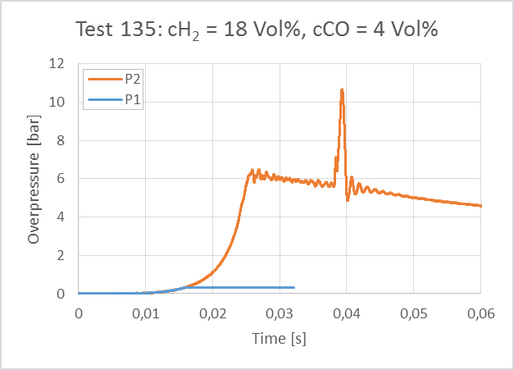
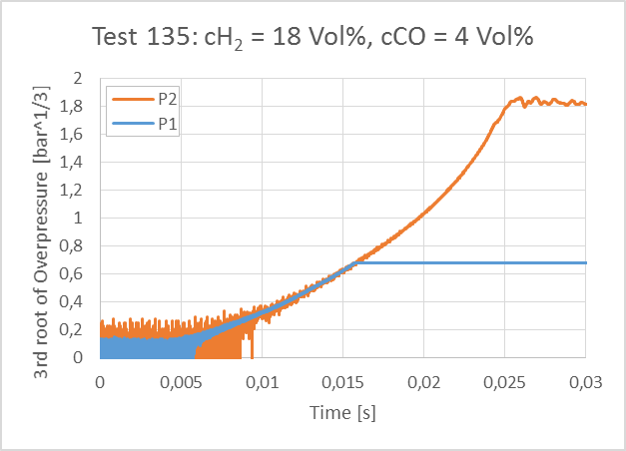
Experiments in the Explosion Bomb
Laminar Burning Velocities (Pressure Method)
Pressure increase in initial phase is due to (almost) spherical propagation of flame front,
So ∆p α t³ and thus representation of p^{1/3} over t should yield a straight line.

Slide 18
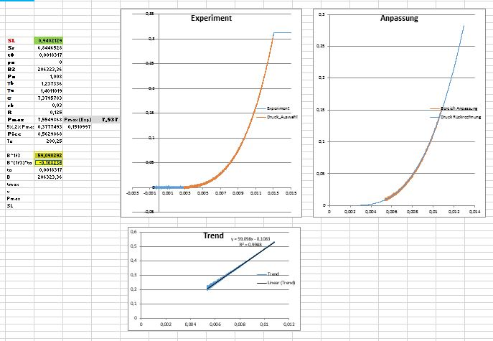
Experiments in the Explosion Bomb
Laminar Burning Velocities (Pressure Method)
Set p(t=0) = 0 and plot p(t)^{1/3} over t, pressure record used up to p = 0,02 * p_{max},
Linear regression, where slope yields B₂, and intercept yields t₀,
Problem: Result is dependent on range of regression!
Experiment
Fit
Regression

Slide 19
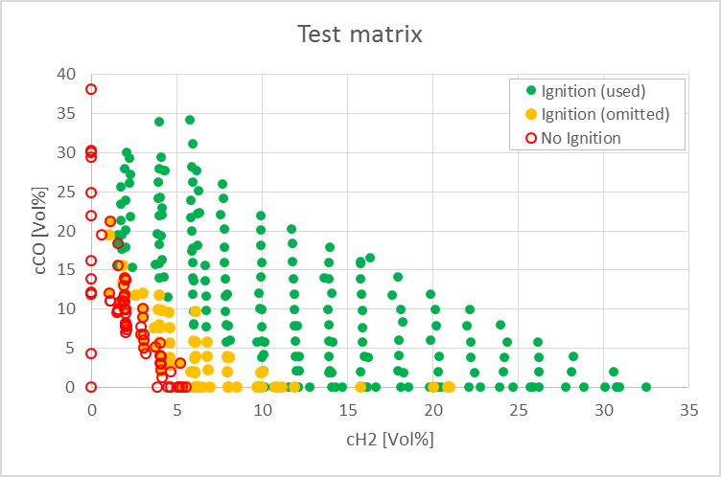
Experiments in the Explosion Bomb
Laminar Burning Velocities (Pressure Method)
It was not possible to determine the laminar burning velocity for all tests with ignition,
Difficulties during evaluation especially for lean mixtures.
Reasons:
  late ignition
  (recording time for P1 already over)
  quenching (➔ only experiments with
  p_{max(Exp)} ≥ 80% p_{AICC} were used)
  irregular combustion
  ➔ poor quality of regression
  (only evaluations with a goodness of
  fit R² > 0.99 were used)

Slide 20
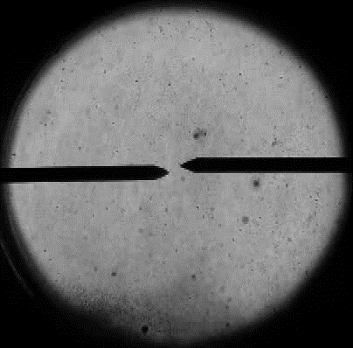
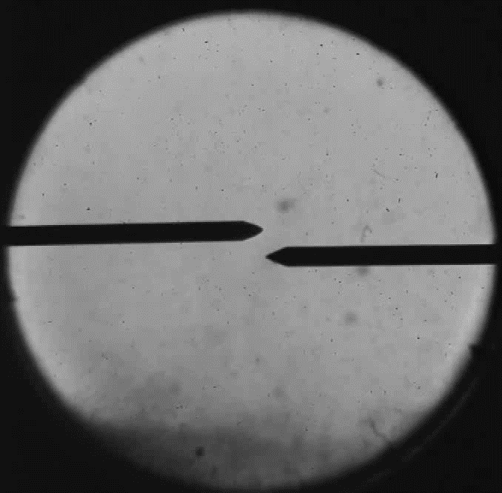
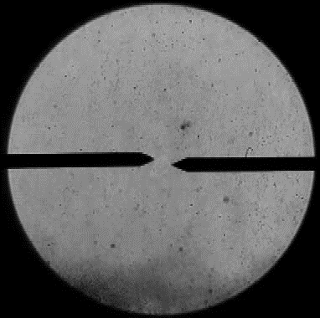
Experiments in the Explosion Bomb
Evaluation of shadowgraphy HS-movies
Determination of the burning velocity by tracking the circular flame front in the HS-videos
3 Examples (framing rate: 10.000 frames/s)
HSCO-013
12 Vol% H₂ in air
HSCO-188
6 Vol% H₂ + 6 Vol% CO in air
HSCO-059
2 Vol% H₂ + 10 Vol% CO in air

Slide 21
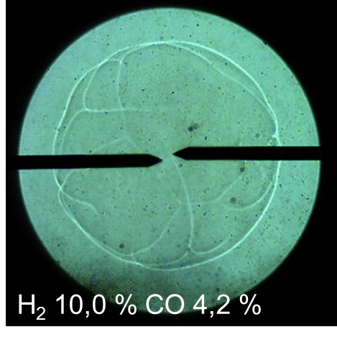
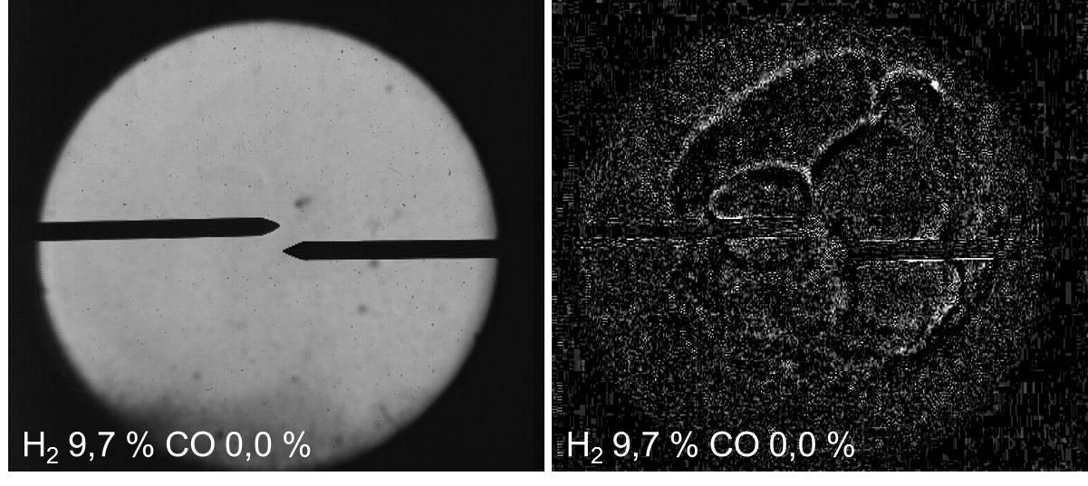
Experiments in the Explosion Bomb
Evaluation of shadowgraphy HS-movies
Principle
Circle was drawn on the borderline of the bubble, increase in radius over time yields velocity,
depending on necessity contrast is normalized or enhanced in image series (using Imagej),
in case method is applicable similar velocities as for pressure method were determined.
Problems
image noise
flame front sometimes hardly visible
flame shows no regular shape in diffuse borderline,
quenching of flame.
Original image
Background subtracted and
normalized

Slide 22
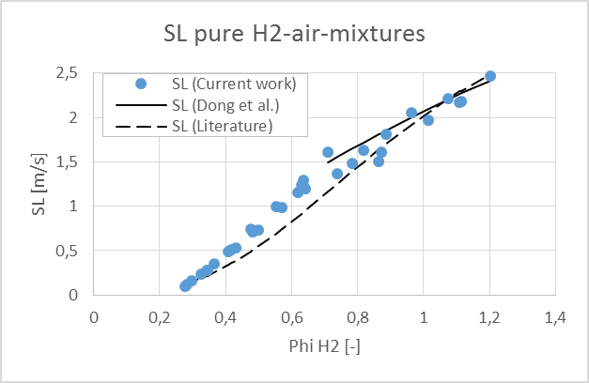
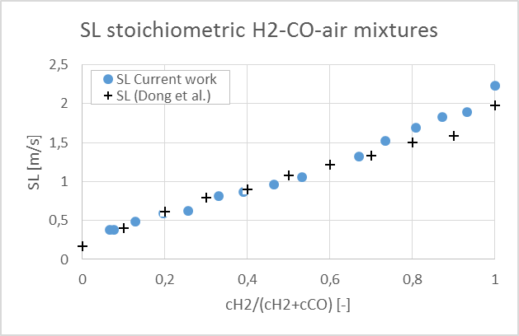
Experiments in the Explosion Bomb
Laminar burning velocities
Results of series with pure H₂-air mixtures could be compared with data from literature and formula published
by Dong et al. (2009) for fuel rich mixtures,
Only few data for H₂-CO-air mixtures available for evaluation of the method used, most useful:
  Dong et al. (2009):
  stoichiometric H₂-CO-air mixtures with various H₂/CO-ratios
Good agreement observed for both comparisons.
Dong C.et al.; Experimental study on the laminar flame speed of hydrogen/carbon monoxide/air mixtures, Fuel 88 (2009) 1858–1863

Slide 23
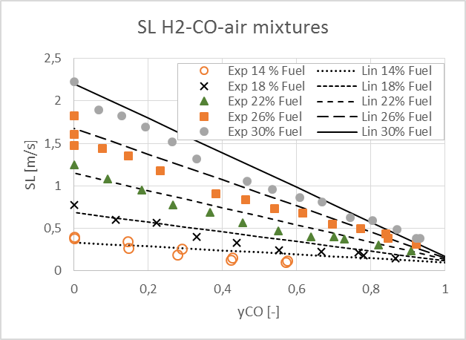
Experiments in the Explosion Bomb
Laminar Burning Velocities (pressure method)
Laminar flame velocities of the mixtures decrease with increasing CO-fraction in the fuel,
Decrease from values for pure H₂-air-mixtures (y_{CO} = 0) to values for pure CO-air-mixtures,
decrease can be linearly approached
Only few SL-values for CO available, so equation
by Dong et al. (2009) was used,
Equation was derived for high CO-concentrations (>22 Vol%), utilization of equation down to 12 Vol% led to increasing deviations of approximation in CO rich mixtures especially for c_{Fuel} < 16 Vol%,
More accurate values for laminar burning velocity of pure CO-air mixtures would help to increase the accuracy of the proposed approximation.

Slide 24
Summary
The experimental investigation on the combustion behavior of H₂-CO-air-mixtures up to the stoichiometric composition (approx. 30 Vol% fuel in air) was performed using a bomb facility with pressure measurements and a high-speed shadowgraphy system at KIT,
Analysis of experimental data showed that Le Chatelier's mixing rule for lower flammable limits of mixtures can be used as conservative measure to determine the LFL of H₂-CO-air mixtures,
For a wide range of fuel concentrations with various H₂/CO ratios laminar burning velocities were determined and compared successfully with literature data, if available,
An easy-to-use correlation was proposed for estimation of laminar burning velocities for different mixture compositions using the laminar burning velocities of the two fuel components of the mixture,
The current work shows that CO-fractions in H₂-air mixtures can neither be neglected nor treated as H₂, since both, addition of CO and replacement of H₂ by CO in H₂-air mixtures have an influence on the combustion behavior of the mixture.
Thank you for your attention!
The authors are very grateful to the German Federal Ministry for Economic Affairs and Energy (BMWi) for funding (Project No. 1501545B), and also to the partners from the Chair of Thermodynamics at the Technical University of Munich (TUM) for fruitful discussions and support in the current work.

