Slide 1
Effect of expansion ratio on flame acceleration during hydrogen fueled gas explosions
Department of Chemical System Engineering
The University of Tokyo
Jun Yaguchi, Wookyung Kim,
Toshio Mogi and Ritsu Dobashi
2019/09/26

Slide 2
Introduction
Due to prevalence of hydrogen use, the appropriate assessment of hydrogen fueled gas explosion is needed.
Flame surface is wrinkled spontaneously.
Flame surface area is increased.
Flame speed is accelerated.
Cellular flame (propane/air)^{[1]}
The intensity of blast wave is increased.^{[2]}
A precise understanding of the flame turbulence is indispensable to perform an appropriate risk assessment of hydrogen fueled gas explosion.
[1] Kim, W., Mogi, T., Kuwana, K., Dobashi, R., Self-similar propagation of expanding spherical flames in large scale gas explosions, Proceedings of the Combustion Institute 35, 2051-2058 (2015)
[2] A. Thomas, et al, Flame noise: Sound emission from spark-iginited bubbles of combustible gas, Pro. Roy. Soc. A294, 449- 466 (1966).

Slide 3
Introduction - Flame front instabilities^{[3, 4]}
Two instabilities induce flame turbulence spontaneously.
From small scale
From large scale
Diffusional-thermal instability
Darrieus-Landau instability
caused by the preferential diffusion for non-equidiffusive mixtures
caused by the thermal volumetric expansion of burned gas
The effect on the self-acceleration is remarkable.
There are few data of large-scale experiments.
The research topic of the present study
[3] F. A. Williams, Combustion Theory : Second Edition, Westview Press (1985).
[4] D. Bradley, et al., Flame acceleration due to flame-induced instabilities in large-scale explosions, Combustion and Flame 124, 2001, pp. 551-559

Slide 4

Reserch contents
Objective
Investigation of the effect of the volumetric expansion ratio ε on DL instability
The density of unburned gas
ε =
The density of burned gas
Experimental conditios
H₂ /O₂-N₂-Ar mixed gas
O₂ : (N₂+Ar) = 21 : 79
8.0
φ = 1.0
7.5
ε was changed by changing N₂/Ar ratio
The volumetric expansion ratio
ε [-]
7.0
N₂
Small ε
H₂
and
O₂
↔
6.5
0
0.2
0.4
0.6
0.8
1
Ar
Large ε
Ar concentration / (Ar+N₂concentration) [-]

Slide 5
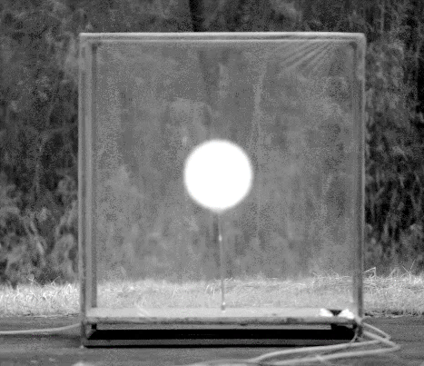
Reserch contents
Experimantal methods
Laboratory – scale experiments
Soap bubble
Large – scale experiments
Plastic tent
Soap bubble
Plastic tent
Flame
5 cm
0.5 m
The effect of scale was investigated.

Slide 6
Experimental apparatus of laboratory-scale
Imaging and recording with shlieren photography
Soap bubble
Pulse
generator
Schlieren mirror
Computer
High speed camera
Knife edge
t = 7.4 ms
t = 0.8 ms
t = 2.4 ms
5 cm
t =9.8 ms
Soap bubble
Mercury
lamp
10 cm
Microphone
Electrodes
1 m
Pressure
gauge
Nozle
Amplifier
Oscilloscope
Valve
Mixing
chamber
Igniter
H₂
O₂
Vacuum pump
Schlieren mirror
N₂
Ar

Slide 7

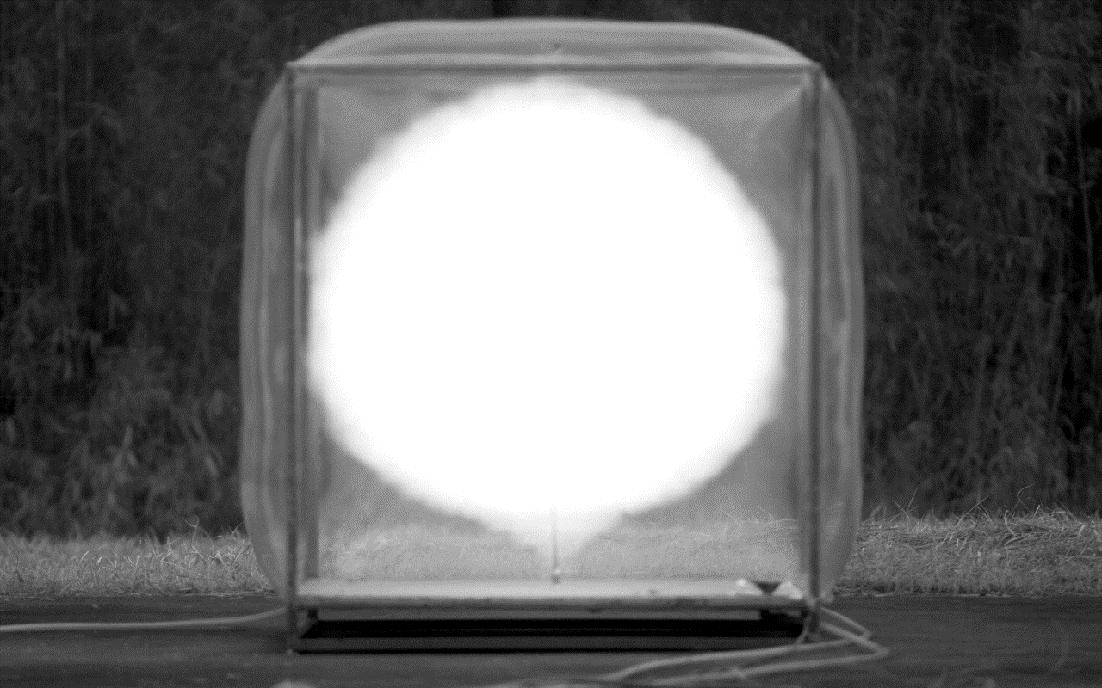
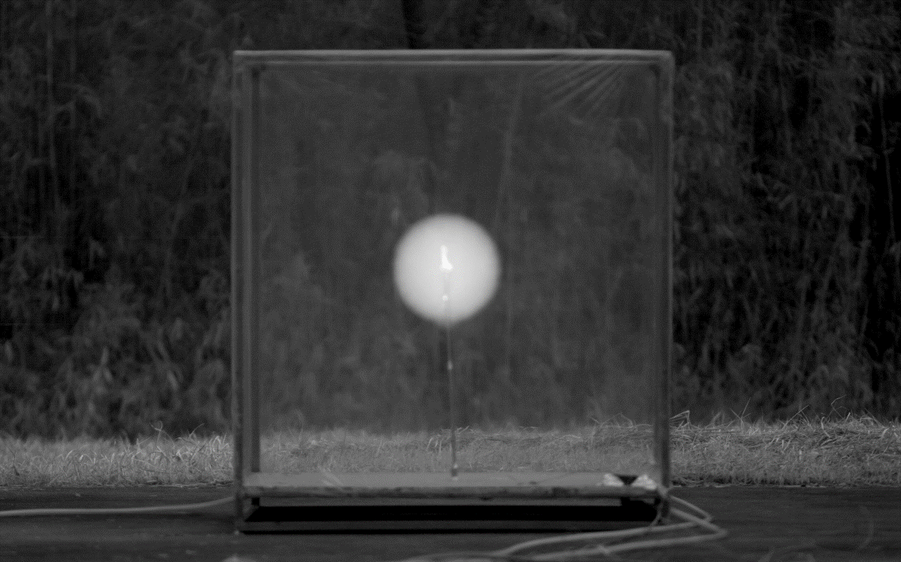
Experimental apparatus of large-scale
0 ms
2 ms
14 ms
Plastic tent
5 ms
9 ms
recording
0.5 m
Plastic tent
Monochrome
high speed camera
Gas concentration
measuring instrument
1 m
Electrodes
1 m
Circulaton
pump
Computer
1 m
3 m
H₂
O₂
Ar
Igniter
Pulse
Generator
Oscilloscope
Piezoelectoric
pressure sensor

Slide 8
Results and discussions（Laboratory-scale）
Dimensionless burning velocity VS Dimensionless flame radius
1.8
1.6
φ = 1.0
1.4
ε = 7.88, Ar
1.2
v_{b}/S_{L} [-]
1.0
Dimensionless burning velocity
Flame acceleration
0.8
0.6
Flame propagation
is not accelerated.
ε = 6.99, N₂
0.4
0.2
0
0
50
100
150
Dimensionless flame radius,
r/δ [-]
S_{L} , δ, ε: calculated with CHEMKIN
ε : volumetric expansion ratio [-]
δ : Laminar flame thickness [mm]
r : Flame radius [mm]
v_{b} : Burning velocity（measured value） [m/s]
S_{L} : Unstreched burning velocity [m/s]
✔
Both diffusional-thermal and DL instability were not observed.

Slide 9
Results and discussions（Large-scale）
Dimensionless burning velocity VS Dimensionless flame radius
4
φ = 1.0
3
ε = 7.13, N₂
v_{b}/S_{L} [-]
2
Dimensionless burning velocity
Flame acceleration
1
ε = 8.06, Ar
Flame propagation
is not accelerated.
0
0
400
800
1200
1600
Dimensionless flame radius,
r/δ [-]
S_{L} , δ, ε: calculated with CHEMKIN
ε : volumetric expansion ratio [-]
δ : Laminar flame thickness [mm]
r : Flame radius [mm]
v_{b} : Burning velocity（measured value） [m/s]
S_{L} : Unstreched burning velocity [m/s]
✔
The flame acceleration by DL instability was observed.
The flame acceleration at both of volumetric expansion ratios was almost the same.
✔

Slide 10
Results and discussions（Large-scale）
The effect of ε on r_{c}
Experiment
Laminar flame propagation (r = εS_{L}t)
Cellular regime
Cellular regime
0.5
0.5
0.4
0.4
r_{c}
N₂
0.3
r_{c}
Ar
0.3
φ = 1.0
Ar 44 vol%
Flame radius, r [m]
φ = 1.0
Ar 0 vol%
Flame radius, r [m]
0.2
0.2
0.1
0.1
0
0
0
5
10
15
20
25
30
0
5
10
15
20
25
30
Time, t [ms]
Time, t [ms]
9.0
φ = 1.0
r_{c} : critical flame radius [cm]
8.0
ε = 7.13, N₂
7.0
The transition point to cellular regime of DL instability
6.0
ε = 8.06, Ar
Critical flame radius, r_{c} [cm]
✔ ε ↑ … r_{c}↓
5.0
4.0
3.0
2.0
An increase in ε promoted the onset of DL instability.
1.0
0

Slide 11
Introduction - Flame front instabilities^{[3, 4][}
Two instabilities induce flame turbulence spontaneously.
From small scale
From large scale
Diffusional-thermal instability
Darrieus-Landau instability
caused by the preferential diffusion for non-equidiffusive mixtures
caused by the thermal volumetric expansion of burned gas
When the deficient reactant diffuses faster, instability occurs.
On the other hand, thermal conduction stabilizes flame front.
Le =
α
Le < 1…The distabilizing effect due to non-equidiffusivity
D
Le > 1…The stabilizing effect due to themal conduction
α : The thermal diffusivity [m²/s]
D : The mass diffusivity of
deficient reactant [m²/s]
Ex. H₂/Air : Instability is intensified at φ < 1.0.
[3] F. A. Williams, Combustion Theory : Second Edition, Westview Press (1985).
[4] D. Bradley, et al., Flame acceleration due to flame-induced instabilities in large-scale explosions, Combustion and Flame 124, 2001, pp. 551-559

Slide 12
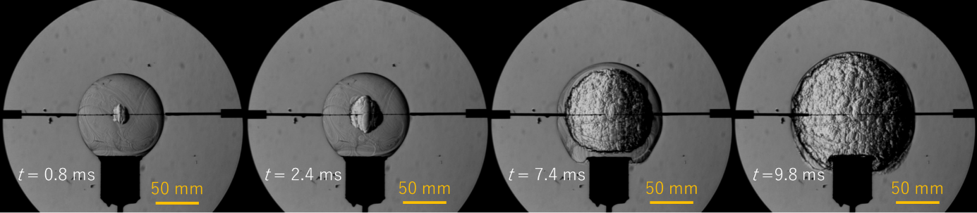
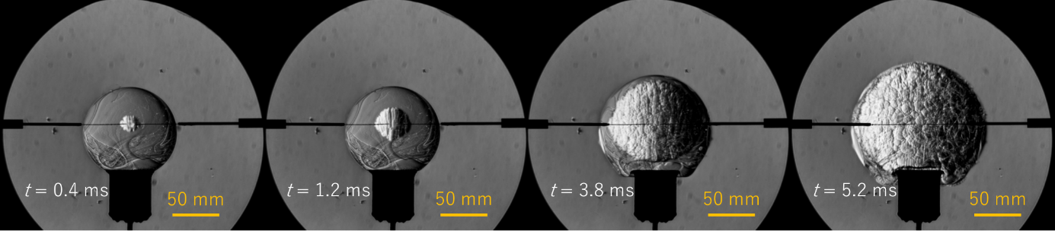
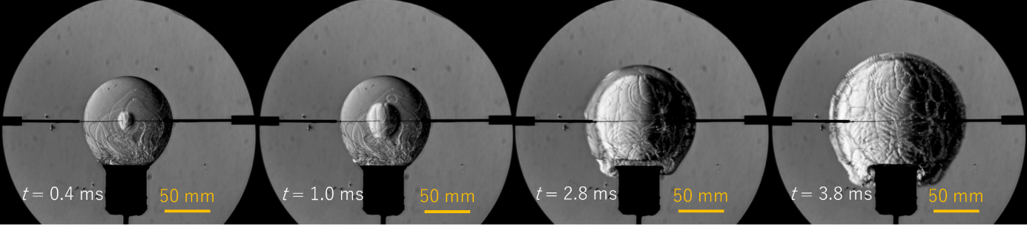
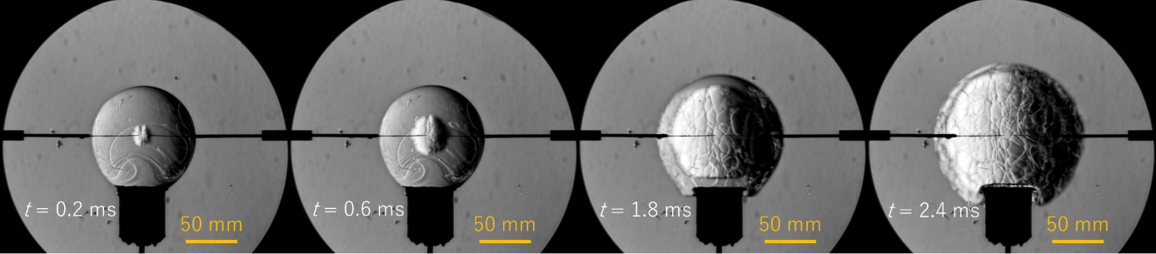
Schlieren photography of laboratory-scale tests
φ = 0.6
N₂
Ar
φ = 1.8
N₂
The flame of φ = 0.6 is remarkably unstable than that of φ = 1.8, notwithstanding different inert gas.
Ar

Slide 13
Results and discussions（Laboratory-scale）
Dimensionless burning velocity VS Dimensionless flame radius
1.8
1.6
φ = 0.6, ε = 5.62, N₂
1.4
φ = 0.6, ε = 6.85, Ar
1.2
1.0
v_{b}/S_{L} [-]
Dimensionless burning velocity
Flame acceleration
0.8
φ = 1.0, ε = 7.88, Ar
φ = 1.8, ε = 7.27, Ar
0.6
φ = 1.0, ε = 6.99, N₂
φ = 1.8, ε = 6.38, N₂
0.4
Flame propagation
is not accelerated.
0.2
0
0
50
100
150
Dimensionless flame radius,
r/δ [-]
S_{L} , δ, ε: calculated with CHEMKIN
ε : volumetric expansion ratio [-]
δ : Laminar flame thickness [mm]
r : Flame radius [mm]
v_{b} : Burning velocity（measured value） [m/s]
S_{L} : Unstreched burning velocity [m/s]
✔ φ =0.6
Flame acceleration by instability was observed.
✔ φ =1.0, 1.8
Flame acceleration by instability was not observed.

Slide 14
Results and discussions（Large-scale）
Dimensionless burning velocity VS Dimensionless flame radius
4
φ = 0.71, ε = 6.31, N₂
φ = 0.66, ε = 6.99, Ar
3
φ = 1.03, ε = 7.13, N₂
v_{b}/S_{L} [-]
φ = 1.02, ε = 8.06, Ar
2
Dimensionless burning velocity
Flame acceleration
1
φ = 1.77, ε = 6.62, N₂
φ = 1.50, ε = 7.84, Ar
Flame propagation is not accelerated.
0
0
400
800
1200
1600
Dimensionless flame radius,
r/δ [-]
S_{L} , δ, ε: calculated with CHEMKIN
ε : volumetric expansion ratio [-]
δ : Laminar flame thickness [mm]
r : Flame radius [mm]
v_{b} : Burning velocity（measured value） [m/s]
S_{L} : Unstreched burning velocity [m/s]
✔
The lower φ was, the more the flame acceleration was intensified due to diffusional-thermal instability. The effect of φ on the flame acceleration was more remarkable than the effect of ε.

Slide 15
Results and discussions（Large-scale）
The effect of ε on r_{c}
r_{c} : critical flame radius [cm]
ε : volumetric expansion ratio[-]
φ : equivalence ratio [-]
9.0
Ar
8.0
7.0
N₂
6.0
5.0
Critical flame radius, r_{c} [cm]
4.0
3.0
2.0
1.0
0
φ = 0.71
φ = 0.66
φ = 1.03
φ = 1.02
φ = 1.77
φ = 1.50
ε = 6.31
ε = 6.99
ε = 7.13
ε = 8.06
ε = 6.62
ε = 7.84
✔ φ ↓ … r_{c}↓
Diffusional-thermal instability promoted the onset of flame acceleration.
Or the effect of thermal conduction inhibited flame acceleration.
✔ ε ↑ … r_{c}↓
An increase in ε promoted the onset of flame acceleration.

Slide 16
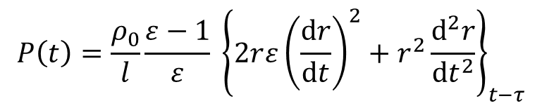
Results and discussions（Large-scale）
Blast wave
8
[2]
φ = 1.50, Ar 31 vol%
6
φ = 1.02, Ar 44 vol%
$$P\left(t\right)=\frac{ρ_{0}}{l}\frac{ε−1}{ε} {\left\{2r{ε\left(\frac{dr}{dt}\right)}^{2}+r^{2}\frac{d^{2}r}{dt^{2}}\right\}}_{t−τ}$$
φ = 0.66, Ar 43 vol%
4
φ = 1.77, Ar 0 vol%
φ = 1.03, Ar 0 vol%
2
φ = 0.71, Ar 0 vol%
Overpressure, P [kPa]
l : the distance from the ignition point
ε : the expansion ratio
ρ₀ : the density of the medium
r : the flame radius
τ : the traveling time of blast wave
to the observed point
0
-2
-4
l = 3 m
-6
0
20
40
60
80
Time, t [ms]
✔ At any equivalence ratio, the blast wave was greatly raised with an increase in Ar content ratio, because
the intensity of the blast wave depends on the square of the flame speed and the flame acceleration.
[2] A. Thomas, et al, Flame noise: Sound emission from spark-iginited bubbles of combustible gas, Pro. Roy. Soc. A294, 449- 466 (1966).

Slide 17
Conclusions
✔
Studies on gas explosions of H₂-O₂-N₂-Ar mixtures were conducted in laboratory-scale and large-scale experiments.
✔
When expansion ratio was larger, the critical radius r_{c} became smaller. This indicates that large expansion ratio promotes the onset of DL instability.
✔
it was not easy to examine the effect of expansion ration on the dimensionless burning velocity in the experimental conditions performed in this study.
It was found that the flame speed was more accelerated even if the flame scale was large at fuel lean condition, in which diffusional-thermal instability is effective.
✔
The measured intensity of blast wave became much stronger when the flame was accelerated.
✔

Slide 18
Thank you for your attention.

Slide 19
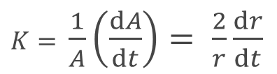
Results and discussions（Large-scale）
Definition of r_{c}^{[5]}
The onset of flame acceleration
0.5
0.4
0.3
r_{c}
35
Flame radius, r [m]
φ = 1.03
Ar 0 vol%
0.2
30
Defined critical flame radius
associated with onset of
self-accelerarion
0.1
0
25
0
5
10
15
20
25
30
Time, t [ms]
20
15
Measured flame speed, dr/dt [m/s]
φ = 1.03
Ar 0 vol%
10
5
Unstretched laminar flame speed
0
0
500
1000
1500
2000
2500
Flame strech rate, K = (2/r)(dr/dt) [1/s]
K : Flame strech rate [1/s]
A : The flame surface area [m²]
$K=$ $\frac{1}{A}\left(\frac{dA}{dt}\right)= \frac{2}{r}\frac{dr}{dt}$
[5]Kim, W., Mogi, T., Kuwana, K., Dobashi, R., Self-similar propagation of expanding spherical flames in large scale gas explosions,
Proceedings of the Combustion Institute 35, 2015, pp. 2051-2018

Slide 20
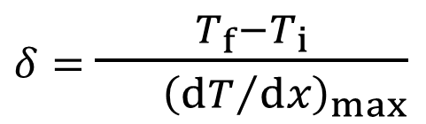
The definition of flame thickness
$δ=$ $\frac{T_{f}−T_{i}}{ {\left({dT}/{dx}\right)}_{max}}$
[6]
T_{f} : the flame temperature
T_{i} : unburned gas temperature
(dT/dx)_{max} : maximum temperature gradient
[6] Law, C. and Sung, C., Structure, aerodynamics, and geometry of premixed flamelets, Progress in Energy and Combustion Science 26, 2000, pp. 2459-2505

Slide 21
Experimental conditions of large-scale tests
 | Concentration [vol%] |  |  |  | φ | ε | S_{L} | δ | r_{c}
 | H₂ | O₂ | N₂ | Ar | [-] | [-] | [m/s] | [cm] | [cm]
A-1 | 23 | 16 | 61 | 0 | 0.71 | 6.31 | 1.11 | 0.0342 | 3.0
A-2 | 22 | 17 | 18 | 43 | 0.66 | 6.99 | 1.45 | 0.0341 | <1.0
B-1 | 30 | 15 | 55 | 0 | 1.03 | 7.13 | 2.16 | 0.0329 | 6.5
B-2 | 31 | 15 | 10 | 44 | 1.02 | 8.06 | 2.71 | 0.0348 | 4.5
C-1 | 43 | 12 | 45 | 0 | 1.77 | 6.62 | 2.70 | 0.0304 | 8.3
C-2 | 42 | 14 | 13 | 31 | 1.50 | 7.84 | 3.70 | 0.0328 | 6.0

