Slide 1


Characterization of Hydrogen Transport Accident in Japan
Based on Network Theory
(ID152)
International Conference on Hydrogen Safety
September, 24-26 2019, Adelaide (Australia)
Noguchi, H.¹, Lam, C.Y.¹ and Fuse, M.¹
¹Graduate School of Engineering, Hiroshima University
This study was funded by the Japan Science and Technology Agency (JST) and the Cross-ministerial Strategic Innovation Promotion Program (SIP)

Slide 2
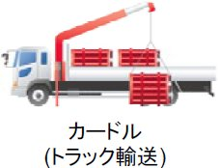
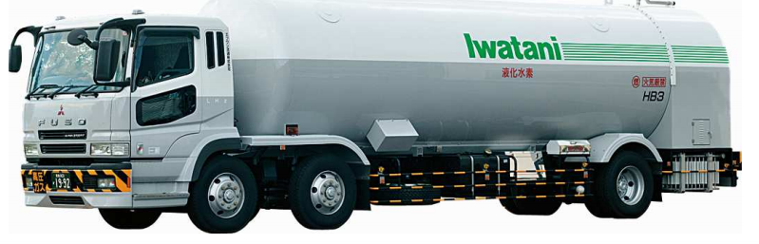
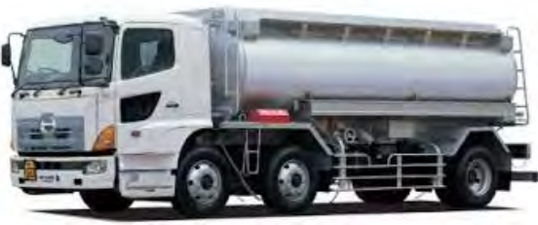
Japan Targets a Hydrogen Society
Introduction
Hydrogen economy needs hydrogen transport
Because of the topographical restrictions, truck is used as major means of hydrogen transport in Japan.
Different types of truck are used for each hydrogen energy carrier.
Compressed hydrogen | Liquid hydrogen | Liquid organic hydride
Cylinder truck | Tank lorry; ultra cold¹⁾ | Tank lorry; normal temperature²⁾
Dangerousness of Hydrogen transport
Harmful properties of hydrogen (e.g. explosion and fire) is well known to have serious consequence.
Risk of hydrogen transport should be assessed.
Source of phot
© Iwatani Corporation, http://www.f-suiso.jp/wp-content/uploads/2014/12/a21bf3de4dfff39fd354b69187045505.pdf
Ministry of Economy, Trade and Industry, https://www.meti.go.jp/committee/kenkyukai/energy/suiso_nenryodenchi/suiso_nenryodenchi_wg/pdf/005_02_00.pdf

Slide 3
Risk assessment needs accident scenarios
Introduction
Limitations of previous studies
Accident scenario needs characterizing the accident process from causes and result.
Limitations of previous studies[1-3];
  Statistical limitation[1,2]; the number of accident cases are very limited
  Methodological limitation[3]; existing method does not follow accident process
Caused Events
Medium Events
Result Events
Accident process
Aim of this study
Characterizing the accident process of hydrogen transport in Japan with overcoming two limitations by using network theory.

Slide 4

Overview of Analytical Frame
Methodology
Collecting accident case of hydrogen transport
B
Overcoming statistical limitation
A
Supplementation of accident case
C
E
D
F
Construction of Accident network
B
A
C
Overcoming methodological limitation
E
Network analysis of Accident network
D
F

Slide 5
Overview of Analytical Frame
Methodology
Collecting accident case of hydrogen transport
B
Overcoming statistical limitation
A
Supplementation of accident case
C
E
D
F
Construction Accident network
B
A
C
Overcoming methodological limitation
E
Network analysis of Accident network
D
F

Slide 6
Accident Case in This Study
Methodology
Category | Variable | Hydrogen energy carriers
 |  | Compressed hydrogen | Liquid hydrogen | Liquid organic hydride
Accidents | Truck type | Cylinder truck | Tank lorry | Tank lorry
 | Physical properties | Flammable compressed gas | Flammable liquid gas | Combustible liquid
 | Accidents | 2[5] | 1[5,7] | 1[6]
Similar accidents | Transported Products | LPG | LPG, LNG | Automobile fuel (gasoline, light oil and heating oil)
 | Truck type | Cylinder truck | Tank lorry | Tank lorry
 | Physical properties | Flammable liquid gas | Flammable liquid gas | Flammable liquids
 | Accidents | 144[5] | 19[5] | 54[6]
Total Accident cases |  | 146 | 20 | 55
Because the number of accident cases of hydrogen transport are very limited, the similar accident cases ware utilized.
As the similarities, truck types and physical properties are selected:
    Truck type will affect the whole accident process on the road
    Physical property will affect result event of the accident process

Slide 7
Overview of Analytical Frame
Methodology
Collecting accident case of hydrogen transport
B
Overcoming statistical limitation
A
Supplementation of accident case
C
E
D
F
Construction of Accident network
B
A
C
Overcoming methodological limitation
E
Network analysis of Accident network
D
F

Slide 8
Construction of Accident Network
Methodology
Accident case 1
Accident case 2
Accident case 3
Accident network
AE1
AE4
AE1
AE1
AE4
AE2
AE2
AE2
AE2
AE3
AE3
AE3
AE3
Adjacency Matrix of accident case
Adjacency Matrix of accident case
Adjacency Matrix of accident case
Adjacency Matrix
of accident network
Accident network[4]consists accident events and its relationships.
Accident Events (AE1～AE4) and its relationship are obtained from the accident cases[5-7].
Accident networks are constructed for each hydrogen energy carrier.

Slide 9
Overview of Analytical Frame
Methodology
Collecting accident case of hydrogen transport
B
Overcoming statistical limitation
A
Supplementation of accident case
C
E
D
F
Construction of Accident network
B
A
C
Overcoming methodological limitation
E
Network analysis of Accident network
D
F

Slide 10
Network Analysis of Accident Network
Methodology
Detecting major accident process
AE1
AE4
AE1
AE4
0.3
0.2
AE2
AE2
0.5
Adjacency matrix of accident network
AE3
AE3
Finding key accident event from network perspective
Measuring the connection to the other accident events
Key accident event has the high connection to the other nodes.
AE1
AE4
Connection to the other nodes
0.33
0.17
0.6 0.4 0.2 0
For other accident events
AE2
From other accident events
0.5
AE3
0 0.2 0.4 0.6
Connection from the other nodes

Slide 11
Result of Detected Accident Events
Methodology
Type | Accident Event | No.
Cause | Traffic accident (internal factors) | C1
 | Traffic accident (external factors) | C2
 | Not following the regulated loading | C3
 | Poor installation/poor inspection of vehicle, cylinders, or tanks | C4
Medium | Mutual vehicle collision | M1
 | Collision with a structure near the road | M2
 | Overturning | M3
 | Falling | M4
 | Vehicle fire (no leak of loaded contents) | M5
 | Cylinder scattering | M6
Result | Explosion/fire | R1
 | Leak (break in the body of the cylinder or tank) | R2
 | Leak (safety valve, valve, tubing, lid) | R3
 | Leak (Unknown) | R4
 | No leak | R5
15 Accident Events ware detected from the related accident.
Accident events are classified three types; cause, medium, and result.

Slide 12
Result of Accident Network of Compressed Hydrogen
Result
Major accident process; “C3 (Not following the regulated loading)” → “M6 (Cylinder scattering)” → “R3 (Leak (safety valve, valve, tubing, lid))”

Slide 13
Result of Accident Network of Liquid Hydrogen
Result
Major accident process;“C2 (Traffic accident due to external factors)” → “M1 (Mutual vehicle collision)” → “R3 (Leak (safety valve, valve, tubing, lid))”

Slide 14
Result of Accident Network of Liquid Organic Hydride
Result
Major accident process;“C1 (Traffic accident (internal factors))” → “M3 (Overturning)” → “R2 (Leak (break in the body of the cylinder or tank))”

Slide 15
Result of Key Accident Event of Compressed Hydrogen
Result
Connection to the other nodes
Poor installation/poor inspection of vehicle, cylinders, or tanks
For other accident events
From other accident events
Leak (break in the body of the cylinder or tank)
Connection to the other nodes

Slide 16
Result of Key Accident Event: Liquid Hydrogen
Result
Connection to the other nodes
Poor installation/poor inspection of vehicle, cylinders, or tanks
For other accident events
From other accident events
Leak (break in the body of the cylinder or tank)
Connection to the other nodes

Slide 17
Result of Key Accident Event of Organic Liquid Hydride
Result
Connection to the other nodes
Poor installation/poor inspection of vehicle, cylinders, or tanks
For other accident events
From other accident events
Leak (break in the body of the cylinder or tank)
Connection to the other nodes

Slide 18
Discussion & Conclusion
This study characterize accident process of hydrogen transport in Japan by using accident network based on network theory.
The accident network revealed major accident process and key accident events.
Limitation of this study is that reliability of result of liquid hydrogen because only 20 accident cases ware used for the analysis.
To overcome this limitation, HAZID study that is a hazard specification method based on brainstorming without accident cases will be apply to analysis for liquid hydrogen.

Slide 19
Reference
Ordin, P.M., Review of hydrogen accidents and incidents in NASA Operations, NASA technical memorandum, 1974, TM X-71565
Galassi, M.C., Papanikolaou, E., Baraldi,D., Funnemark, E., Håland, E., Engebø, A., Haugom, G.P., Jordan, T. and Tchouvelev, A.V., HIAD – hydrogen incident and accident database, International Journal of Hydrogen Energy, 37, No. 22, 2012, pp. 17351-17357.
Lowesmith, B.J., Hankinson, G. and Chynoweth, S., Safety issues of the liquefaction, storage and transportation of liquid hydrogen: An analysis of incidents and HAZIDS, International Journal of Hydrogen Energy, 39, No. 35, 2014, pp. 20516-20521.
High Pressure Gas Safety Institute of Japan, High Pressure Gas Safety Act Database, www.h2incidents.org, https://www.khk.or.jp/public_information/information/incident_investigation/hpg_incident/incident_db.html
High Pressure Gas Safety Institute of Japan, High Pressure Gas Safety Act Database, www.h2incidents.org, https://www.khk.or.jp/public_information/information/incident_investigation/hpg_incident/incident_db.html
Fire and Disaster Management Agency, Fire and Disaster Management Agency, database http://www.khk-syoubou.or.jp/hazardinfo/guide.html
The Online Data & Information Network of the European Commission Joint Research Centre (JRC), Hydrogen Incident and Accident Database (HIAD2.0)-free access to the renewed hydrogen incident and accident database, https://odin.jrc.ec.europa.eu/giada/

Slide 20
Thank you very much for your attention
d195644@hiroshima-u.ac.jp

Slide 21
Example of accident case
Traffic accident due to the external force
A tractor-semitrailer with horizontally mounted tubes filled with compressed hydrogen was struck by a northbound pickup truck that veered into the semitrailer's right rear axle. The tractor-semitrailer then went out of control and left the roadway, coming to rest. As a result of rotational torque and impact, the end of one tube was sheared off at the bulkhead and left the tube bundle. During the process, some of the tubes, valves, piping, and fittings at the rear of the semitrailer were damaged and released hydrogen. The hydrogen ignited and burned the rear of these mitrailer. In the meantime, the pickup truck had also run off the road and its fuel line ruptured, resulting in the truck being destroyed by fire.
Failing
Leak
(safety valve, valve, tubing, lid)
Explosion / fire
Accident event
Summarization by using accident events and its relationship
Accident case [1]
[1]Hydrogen tool, Lessons Learned, https://h2tools.org/lessons?search_api_fulltext=&page=12

