Slide 1
Towards fire test protocol for hydrogen storage tanks
International Conference on Hydrogen Safety 2019, Adelaide, Australia 24-26th September
V. Molkov, S. Kashkarov
Hydrogen Safety Engineering and Research Centre, University of Ulster

Slide 2
Definitions
Heat release rate (HRR) | - | Heat release rate in a fire [MW] (can easily be measured by propane flow rate to a burner).
Specific heat release rate (HRR/A) | - | Heat release rate in a fire, HRR, divided by the area of fire source, A, [MW/m²]
Fire resistance rating (FRR, required by first responders – EU HyResponse project) | - | Time from burner ignition until container rupture in a fire (without TPRD or failed TPRD or localised fire far from TPRD)

Slide 3
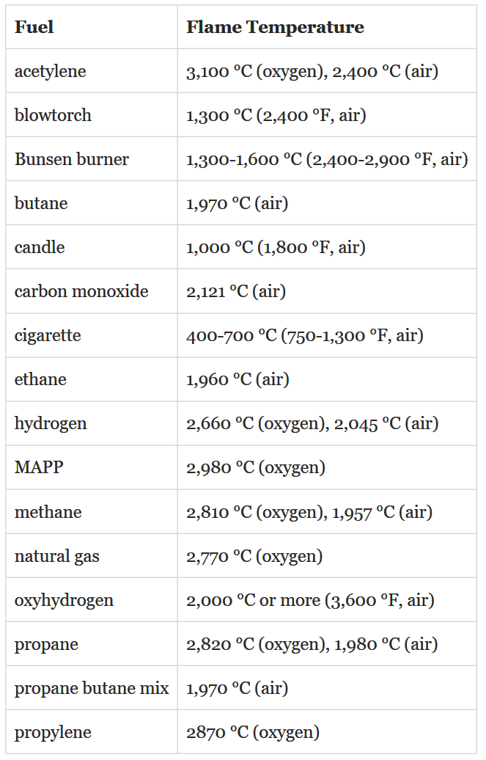
Maximum temperature limit in GTR#13
Localised part: 900ºC. Engulfing part: 1100ºC
Reported temperatures are higher than GTR#13 requirements for maximum temperature (see Table).
Why do we need to reduce temperature in qualification fire test? No reasoning from safety point of view.
Suggestion: remove the requirement for maximum temperature from GTR#13 “fire test”, i.e. with localised and engulfing portions (as in “engulfing fire test”).

Slide 4
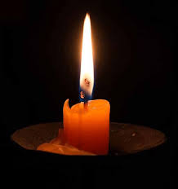
Only temperature control insufficient
Anecdotal way to pass GTR#13 fire test
Tank
Thermocouples
Three candles
This “test” will result in infinite FRR of any tank

Slide 5
Realistic HRR/A in automobile fires
Published data
The automobile fire research over almost half a century (1976-2017) demonstrates that HRR/A in gasoline fire is published by professionals as 1-2 MW/m²:
  On road: HRR/A=2 MW/m² (A. Heselden, Proceedings of the 2nd International Symposium on Aerodynamics and Ventilation of Vehicle Tunnels, Cambridge, UK, 23-25 March 1976, pp. J1-1–J1-18).
  On road: HRR/A=2 MW/m² (S. Liew, D. Deaves, Proceedings of the
  First International Conference on Safety in Road and Rail Tunnels,
  Basel, Switzerland, 23rd–25th November 1992, pp. 227–237).
  Pool fire equation by Babrauskas for gasoline spill: HRR/A=2.2 MW/m² (V. Babrauskas, Heat release rates, The SFPE Handbook of Fire Protection Engineering, National Fire Protection Association, Quincy, MA, USA, 2002, 3-1–3-37).
  On concrete: HRR/A=0.8-1.0 MW/m² (H. Ingason, Y.Z. Li, Fire Safety Journal, 91, 2017, 399–406).
GTR#20: Korean LPG burner with HRR/A=0.8 MW/m².
Conclusion: GTR#13 fire test must be at HRR/A>1 MW/m²

Slide 6
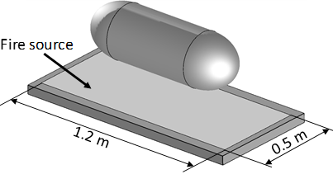
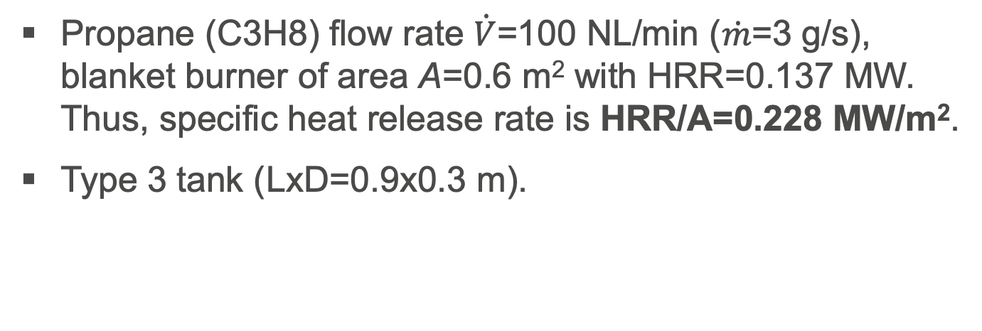
Consequences of lowered HRR/A test
Example: JARI test
Propane (C3H8) flow rate $\dot{V}$=100 NL/min ($\dot{m}$=3 g/s), blanket burner of area A=0.6 m² with HRR=0.137 MW. Thus, specific heat release rate is HRR/A=0.228 MW/m².
Type 3 tank (LxD=0.9x0.3 m).

Slide 7
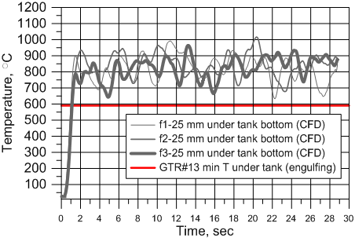
Consequences of lowered HRR/A test
Example: JARI test
“Trap”: GTR#13 temperature requirements are satisfied, but… (see next slide)

Slide 8
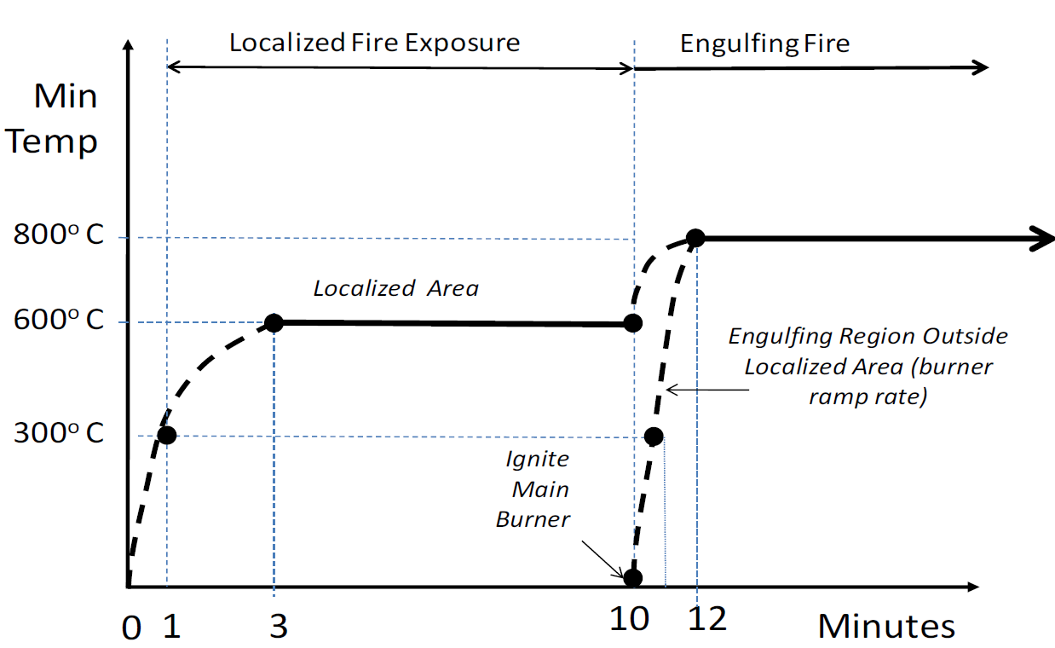
FRR is a function of HRR/A
Real fires against fire test in GTR#13: why?
GTR#13 fire test
Realistic fires

Slide 9
Where is the “game”?
“Use a low HRR/A”
FRR=5.5~6.0 min

Slide 10
Where is the “game”?
“Use a low HRR/A”
FRR=24 min
0.2 MW/m²

Slide 11
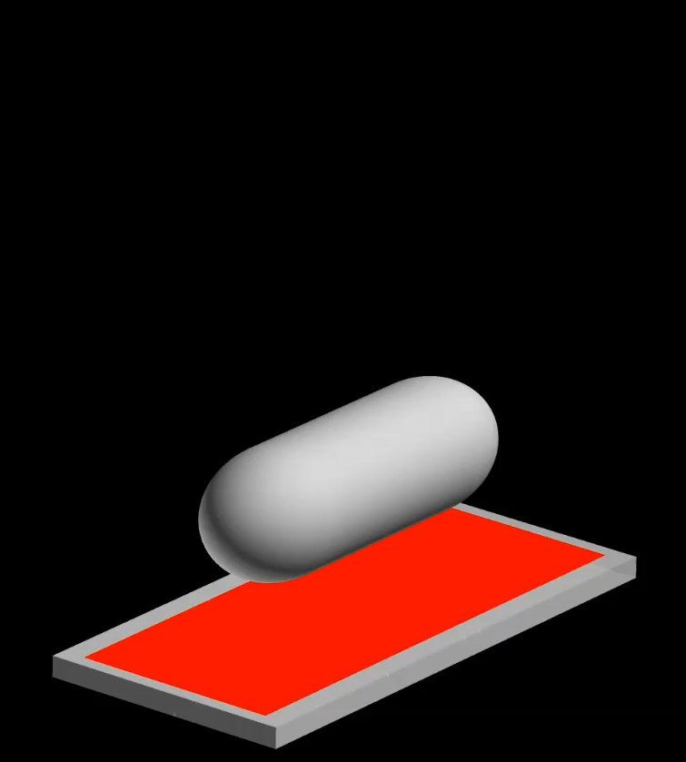
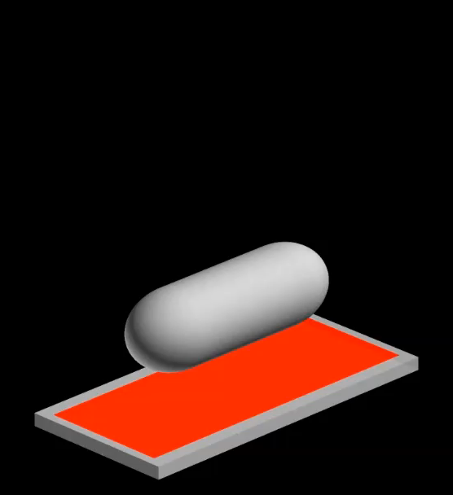
Low vs real HRR/A: stand-alone tank
HRR/A=0.228 MW/m²
HRR/A=1 MW/m²
590°C (GTR#13 min required)
1030°C
1230 °C

Slide 12
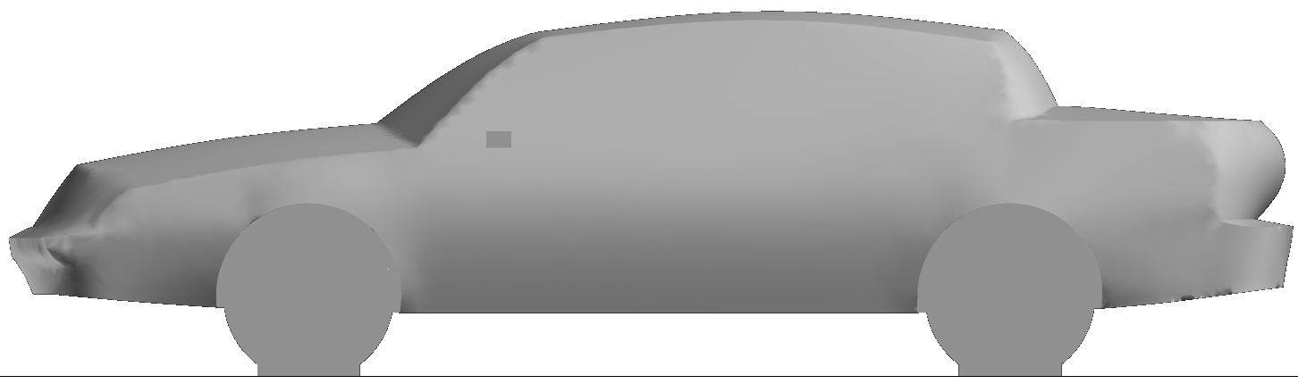
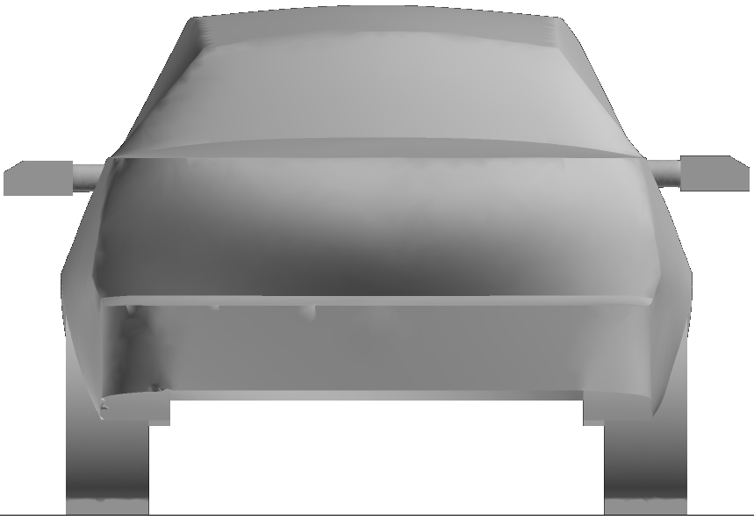
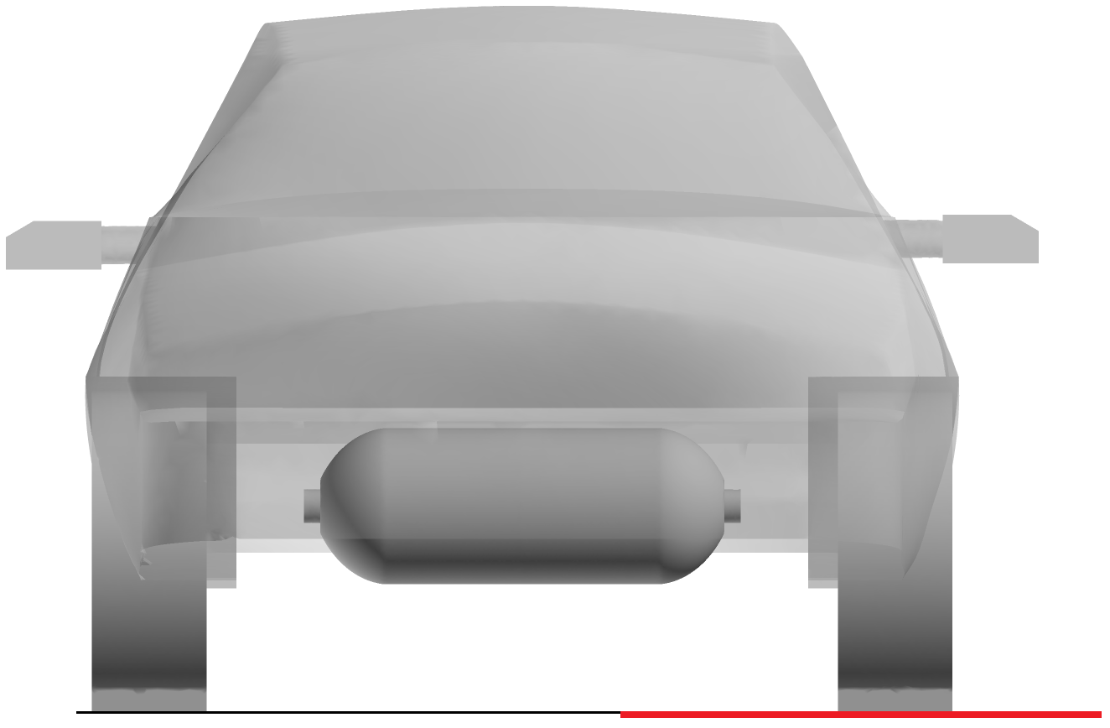
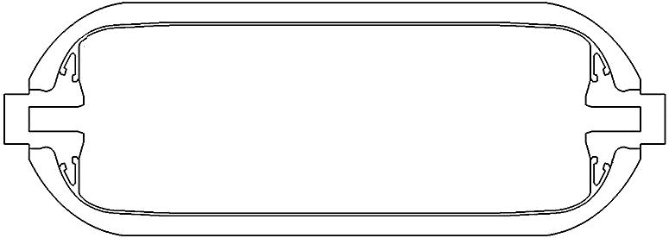
In-situ localised fire
Car and tank geometry, TCs and fire location
5.2 m
1.82 m
1.47 m
Localised fire area
250 mm
25 mm
0.25 m
TC1
TC2
TC3
TC4
TC5
TC6
Conjugate heat transfer from fire to
700 bar Type 4 tank (LxD=0.91x0.325 m).
Fire source (No.1, No.2) covers
localised area of tank 0.25 m

Slide 13
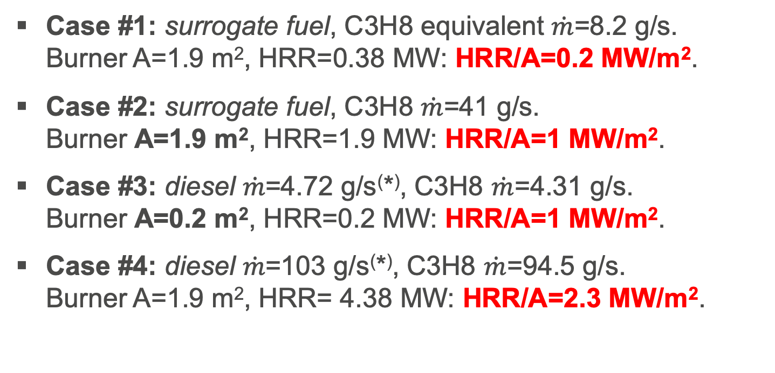
In-situ localised fire
Range: A=0.2-1.9 m², HRR/A=0.2-2.3 MW/m²
Case #1: surrogate fuel, C3H8 equivalent $\dot{m}$=8.2 g/s.
Burner A=1.9 m², HRR=0.38 MW: HRR/A=0.2 MW/m².
Case #2: surrogate fuel, C3H8 $\dot{m}$=41 g/s.
Burner A=1.9 m², HRR=1.9 MW: HRR/A=1 MW/m².
Case #3: diesel $\dot{m}$=4.72 g/s⁽*⁾, C3H8 $\dot{m}$=4.31 g/s.
Burner A=0.2 m², HRR=0.2 MW: HRR/A=1 MW/m².
Case #4: diesel $\dot{m}$=103 g/s⁽*⁾, C3H8 $\dot{m}$=94.5 g/s.
Burner A=1.9 m², HRR= 4.38 MW: HRR/A=2.3 MW/m².
⁽*⁾ Obtained using D. Drysdale, An introduction to fire dynamics, 3rd ed., 2011.

Slide 14
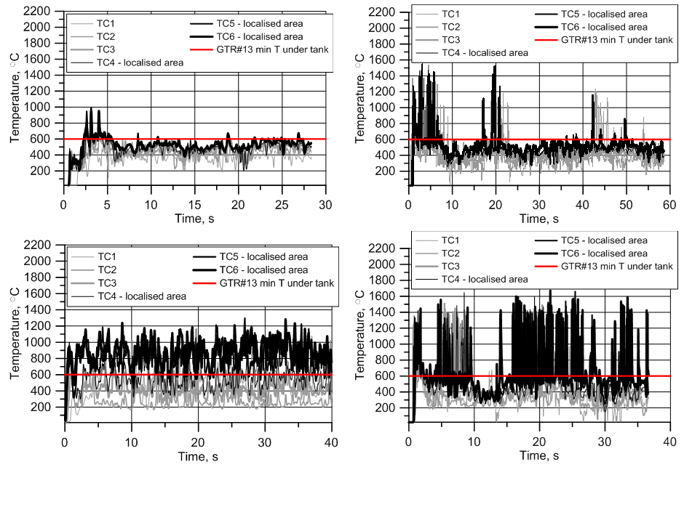
In-situ localised fire (reality)
Even min T requirements not always satisfied!
Case 1
Case 2
Case 4
Case 3
Stand-alone tank test doesn’t reflect reality (it is conservative in sense of T)

Slide 15
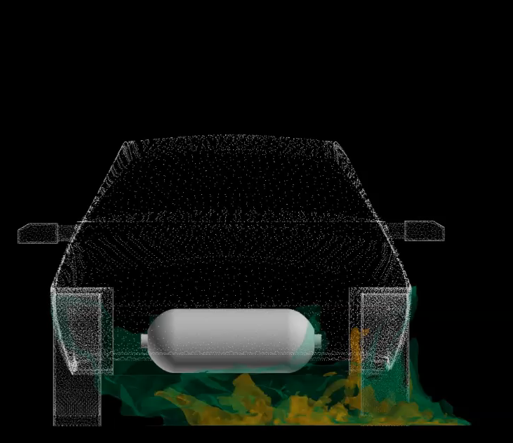
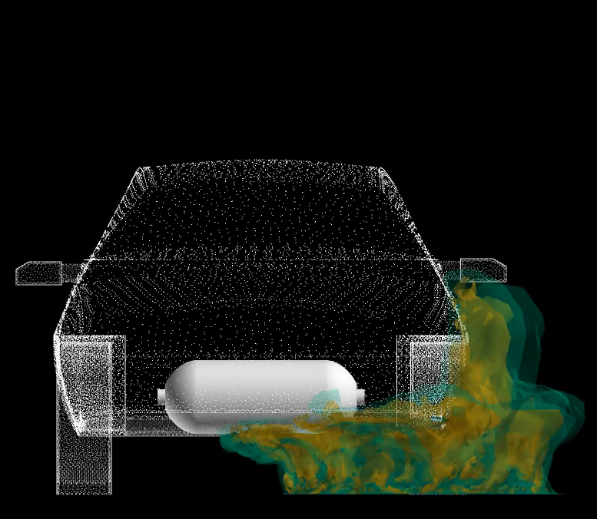
In-situ localised fire (reality only #2 !)
Do we need localised portion in “fire test”?
#1 (not real): HRR/A=0.2 MW/m²
#2: HRR/A=1 MW/m²
600°C (GTR#13 min required)
1030°C

Slide 16
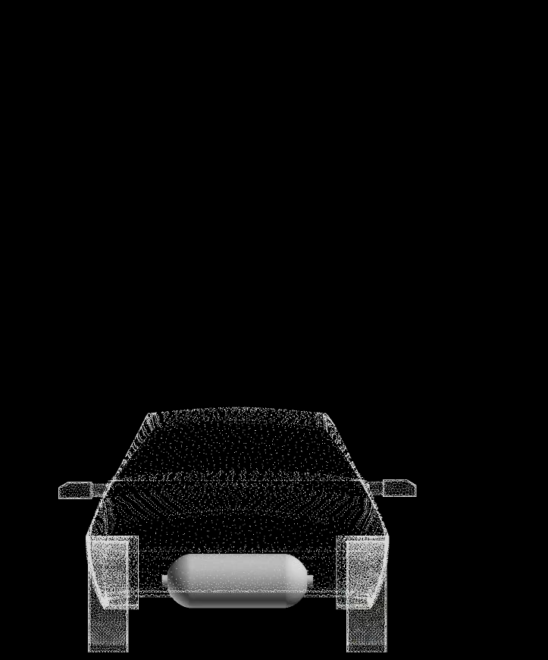
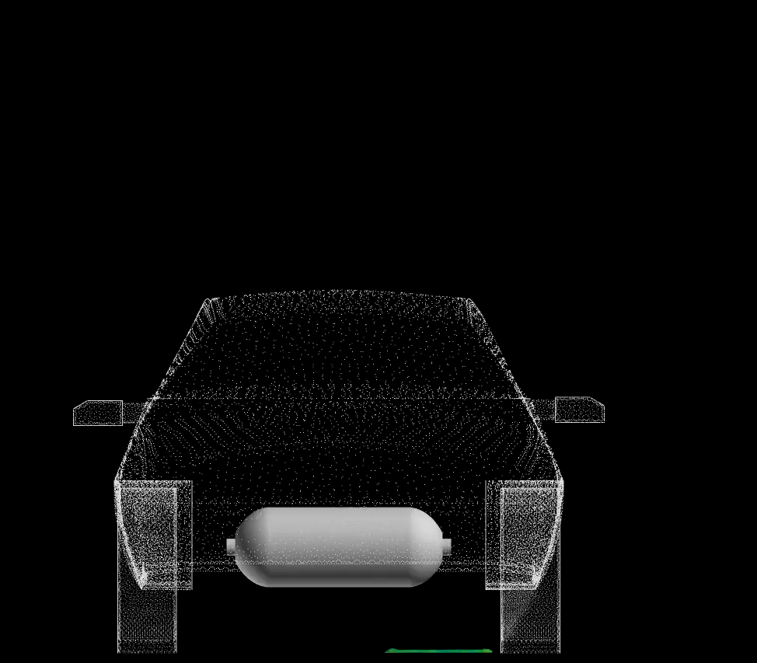
In-situ localised fire (reality)
Cases 3 and 4: temperature iso-surfaces
#3: HRR/A=1 MW/m²
#4: HRR/A=2.3 MW/m²
600°C (GTR#13 min required)
1030°C

Slide 17
Concluding remarks (1/2)
GTR#13 fire test protocol must include requirement to burner to provide specific heat release rate HRR/A≥1 MW/m².
  This will exclude rupture of tanks in a fire that passed GTR#13 fire test.
  This is necessary to provide fire test reproducibility in different laboratories.
Maximum temperature requirements in GTR#13 should be relaxed as it doesn’t correspond published data and can be prohibitive to use realistic fire source with HRR/A≥1 MW/m².

Slide 18
Concluding remarks (2/2)
The use of burners with HRR/A below 1 MW/m² should be prohibited to exclude rupture of tanks that passed GTR#13 fire test in real automobile fires.
In-situ fire test (realistic) is different from standardised GTR#13 fire test. Because realistic automobile fires with HRR/A ≥1 MW/m² provide engulfing conditions from the beginning, it is worth to consider cancelling localised portion in current “fire test”.
FRR measurement (test without TPRD) must be included into GTR#13 by request of first responders (HyResponse project).

Slide 19
Acknowledgements
This research has received funding from the Fuel Cells and Hydrogen 2 Joint Undertaking under grant agreement No 826193 (HyTunnel-CS). This Joint Undertaking receives support from the European Union’s Horizon 2020 research and innovation programme, Hydrogen Europe and Hydrogen Europe research.
Dr Yohsuke Tamura from JARI for experimental data used for model validation.

