Slide 2
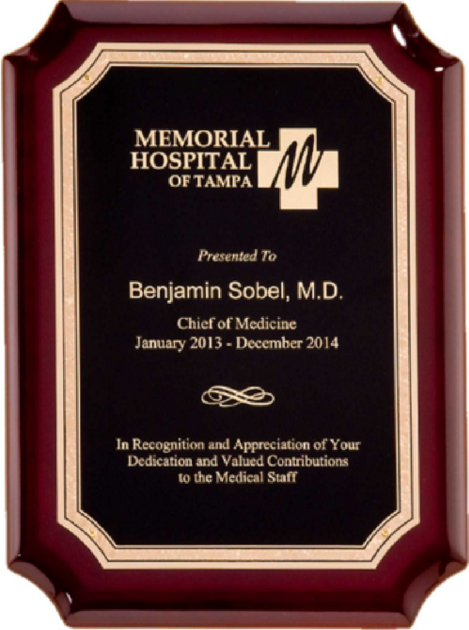
Robert Schefer Memorial
Best Paper Award
September 23-26, 2017

Slide 3
Paper ID 279
Robert Schefer Memorial
Best Paper Award
Quantifying the Potential
Consequences of a
Detonation in a Hydrogen Jet Release
C. Regis Bauwens,
Sergey Dorofeev
September 23-26, 2019

Slide 7
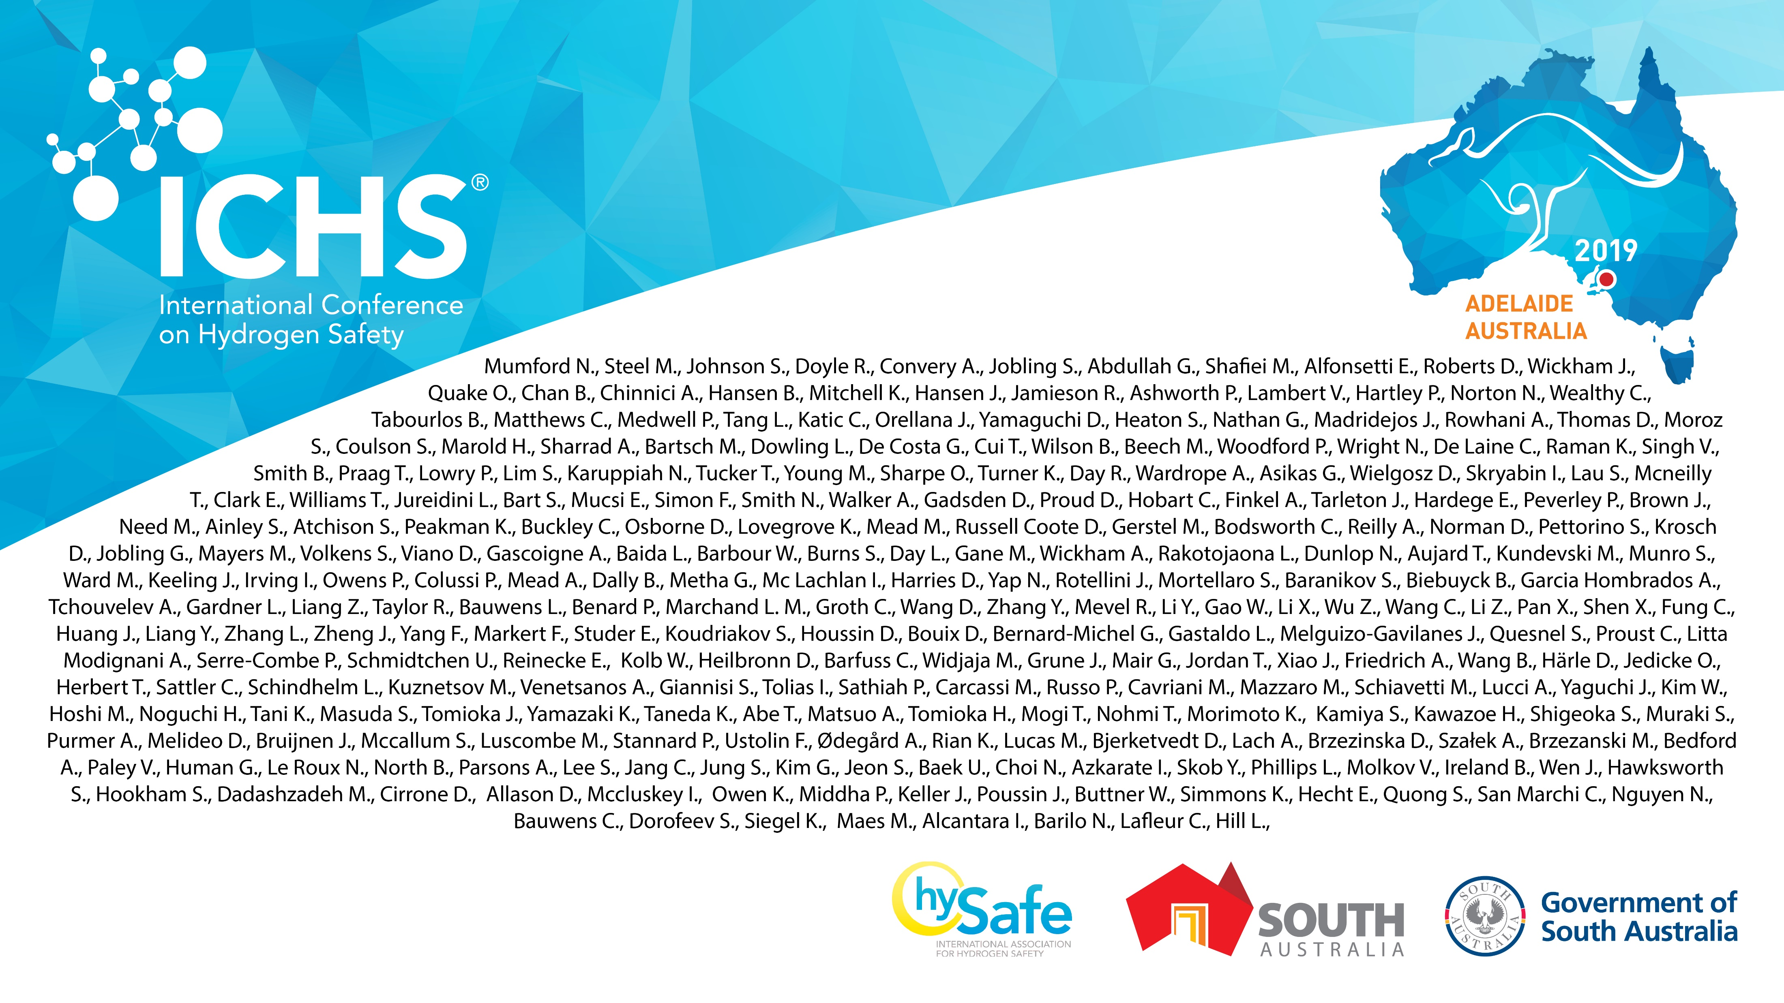

Slide 8
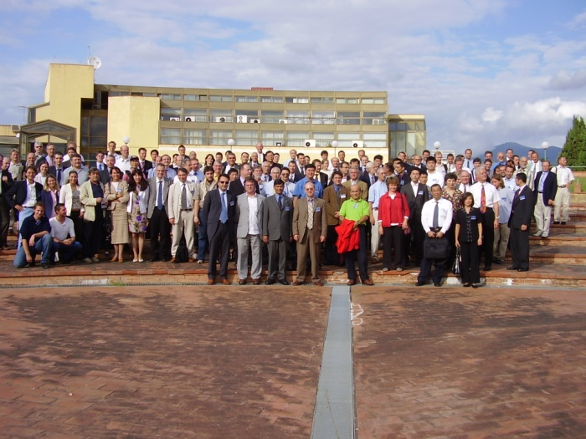
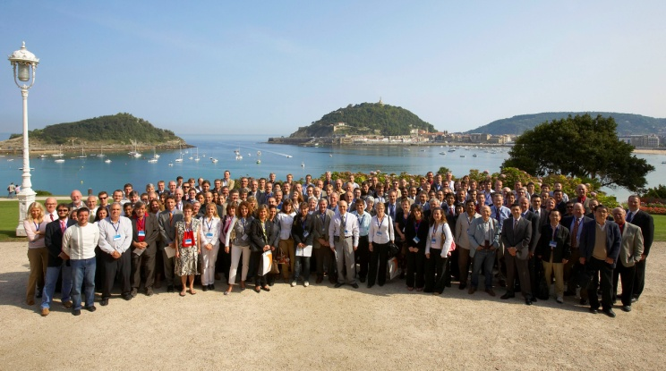
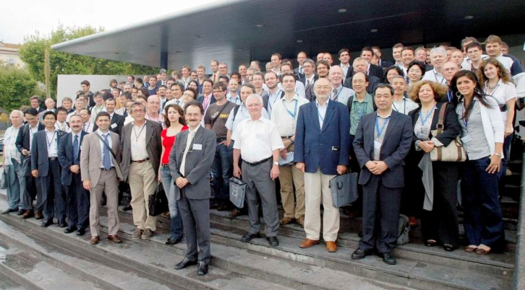
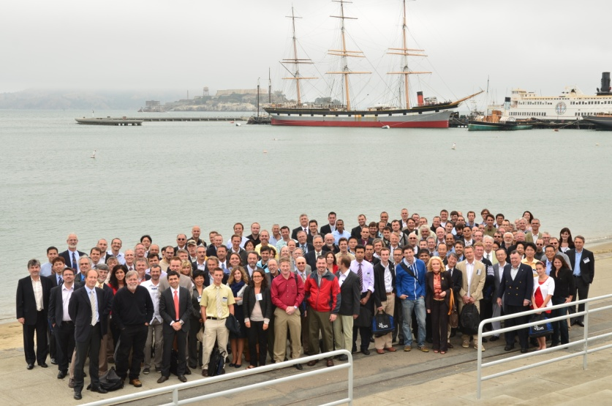
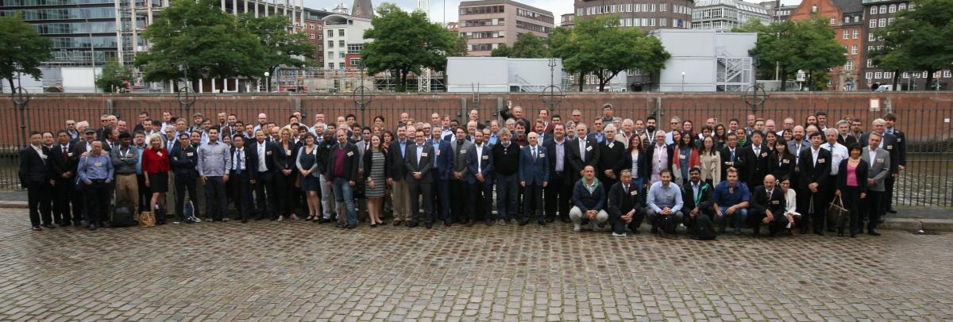
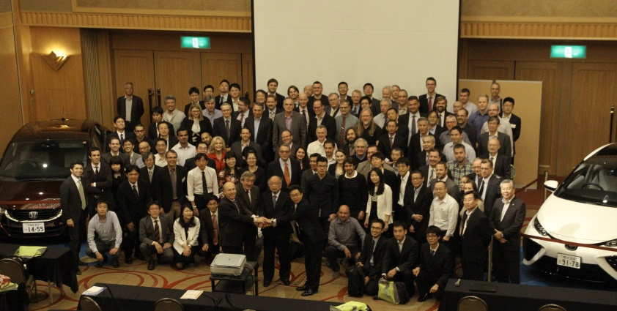
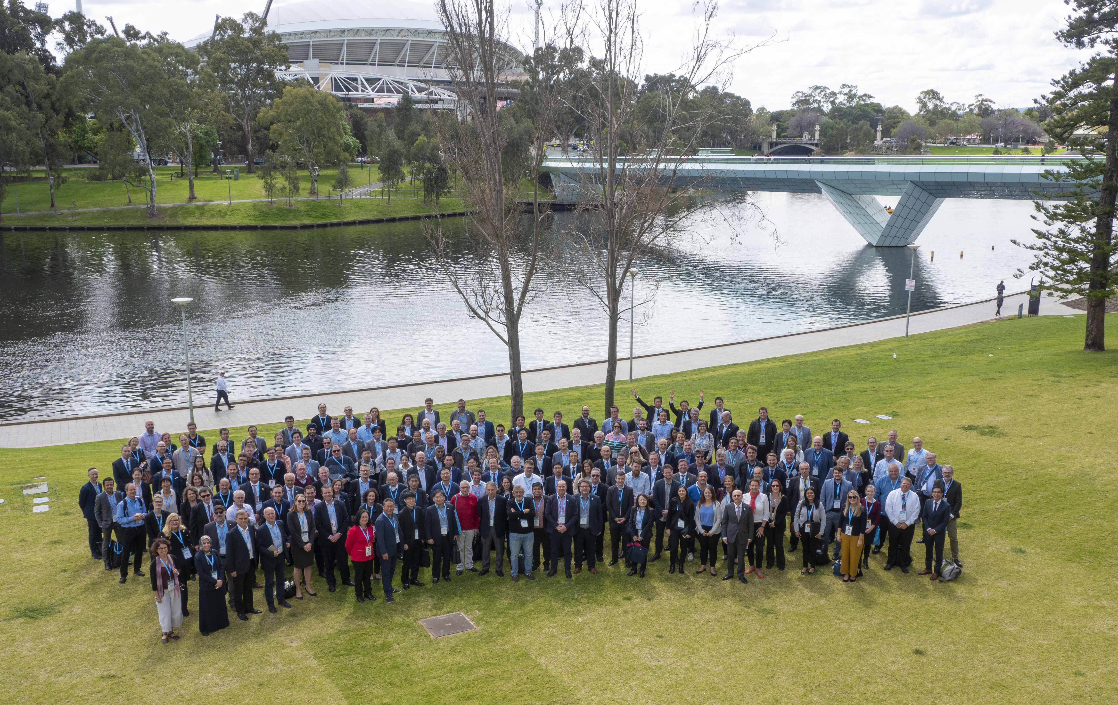
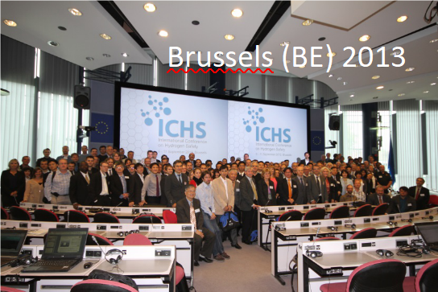
San Sebastian (ES) 2007
Pisa (IT) 2005
Ajaccio(FR) 2009
Yokohama (JP) 2015
San Francisco (USA) 2011
Hamburg (DE) 2017
Adelaide (AU) 2019

