Slide 1
International Conference on Hydrogen Safety 2021
CFD Model Based ANN Prediction of Flammable Vapor Cloud Formed by Liquid Hydrogen Spill
September 21-24 2021

Slide 2
OUTLINE
Introduction
Numerical Method
Model Calculation and Verification
Prediction Using Artificial Neural Network
Conclusions

Slide 3
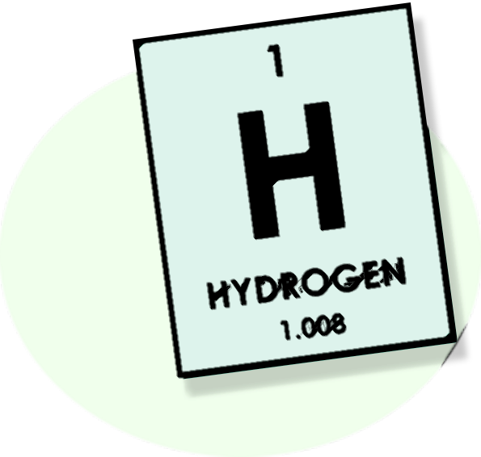
Introduction
High efficiency of storage and transportation
Long distance transportation is economical
Hazards of Liquid Hydrogen Leakage
Liquid Hydrogen
Physical explosion
Chemical explosion
Low temperature injury
Biological asphyxia
Lower construction cost of hydrogenation station
Good compatibility

Slide 4
Numerical Method
Basic governing equations
The continuity, momentum and energy equations
(1)
(2)
(3)
The wind field, corresponding turbulent kinetic energy and turbulent diffusivity
(4)
(5)
(6)

Slide 5
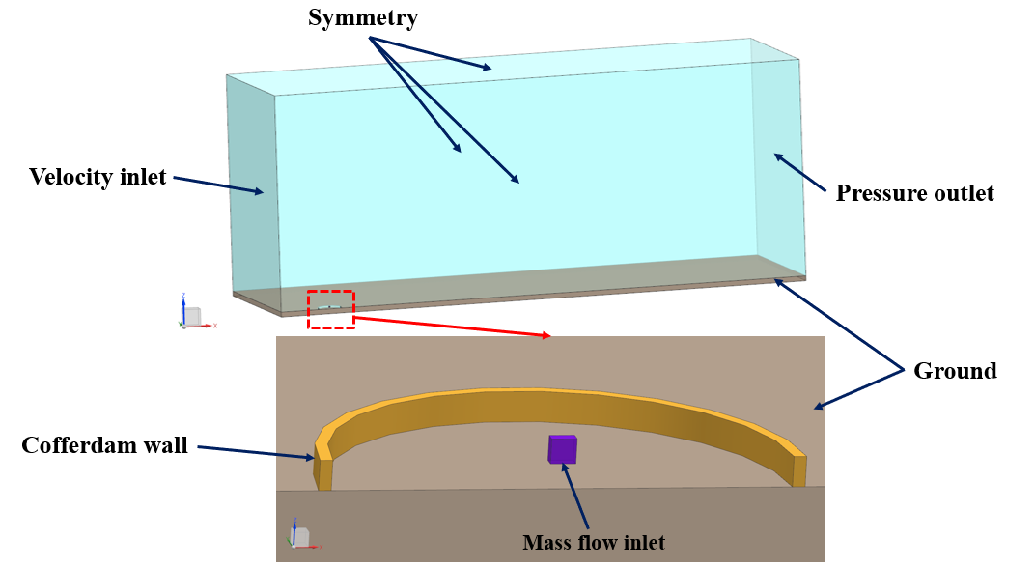
Numerical Method
Geometric model
Fig - Schematic diagram of calculation domain
and boundary conditions

Slide 6
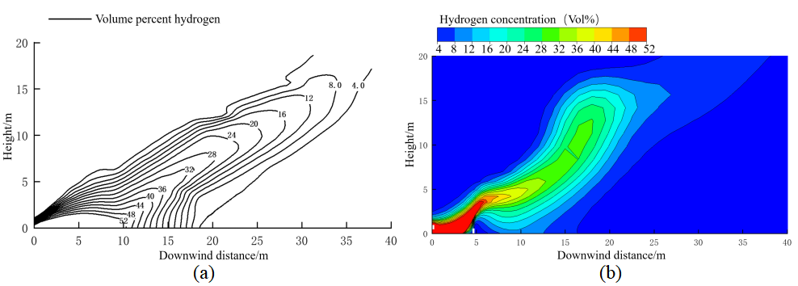
Model calculation and verification
Fig - Hydrogen concentration contour on the symmetric plane at 20.94 s. (a) Experimental result. (b) Simulation result.
Table -The relative deviation of simulation and experiment

Slide 7
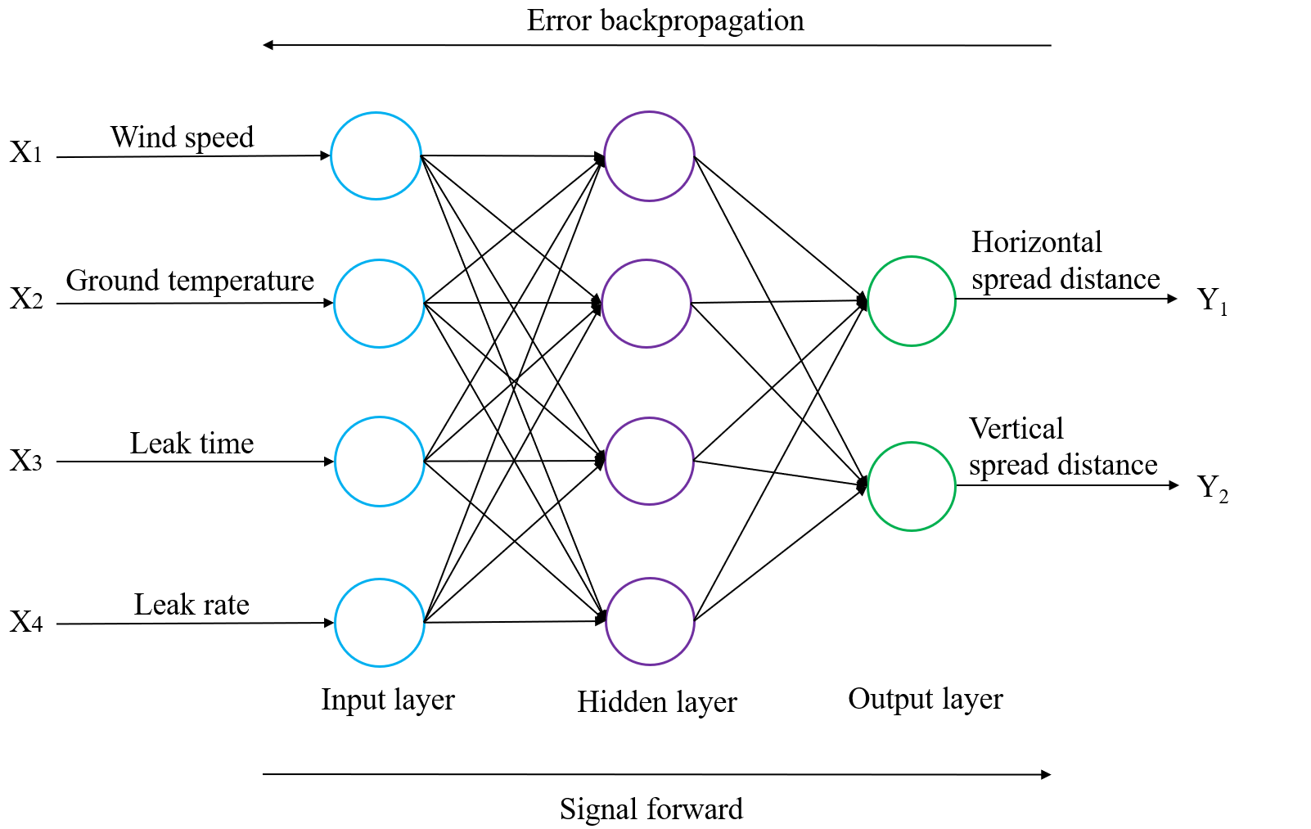
Prediction Using Artificial Neural Network
Fig-Structure diagram of three-layer neural network model.

Slide 8
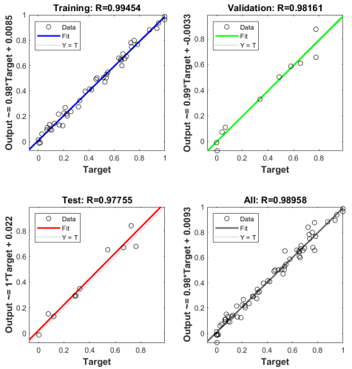
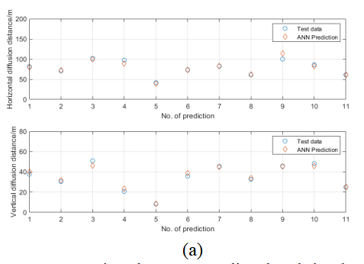
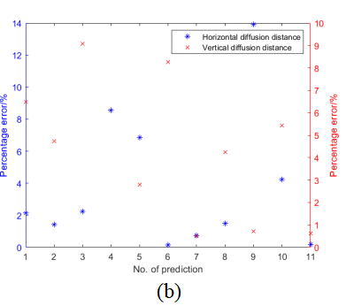
Prediction Using Artificial Neural Network
Fig - Comparison between predicted and simulated values. (a) The result of ANN prediction. (b) The percentage errors of horizontal and vertical diffusion distance.
Fig-Regression correlation coefficient between predicted output and simulation results.

Slide 9
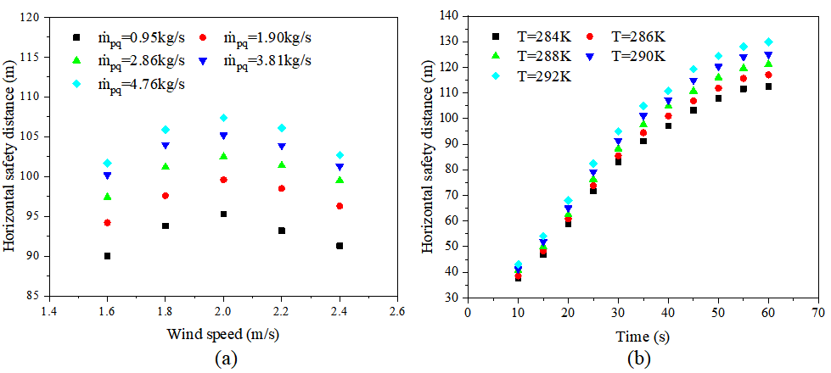
Prediction Using Artificial Neural Network
Fig- Variations of horizontal safety distance. (a) Different wind speeds and leakage rates(t=40s, T=288K). (b) Different leakage time and ground temperature($m_{pq}$=4.76kg/s, $u_{0}$2.2m/s).

Slide 10
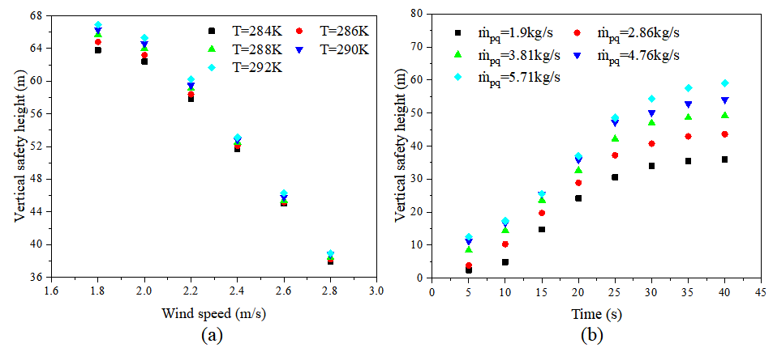
Prediction Using Artificial Neural Network
Fig - Variations of vertical safety height. (a) Different wind speeds and temperature (t=40s, $m_{pq}$=4.76kg/s). (b) Different leakage time and leakage rates (T=288K, $u_{0}$=2.2m/s).

Slide 11
Conclusions
Compared with the prediction results of fitting formula, ANN model has a better prediction in the horizontal and vertical diffusion distance of flammable vapor cloud, and the prediction speed is improved dozens of times in comparison with the speed of numerical simulation. The application of the ANN model will contribute to the rapid determination of dangerous regions and the guidance of emergency in the case of liquid hydrogen leakage.
The wind speed has a great influence on the diffusion distance of the flammable vapor cloud. The horizontal diffusion distance begins to decrease when the reference wind speed more than 2.0m/s while the vertical diffusion distance decreased continuously with the increasing wind speed. It is an effective measure to increase the ambient wind speed to promote the movement of hydrogen cloud and narrow the safety scope.
Both horizontal and vertical diffusion distance increase and then go to be flat with the increase of leakage time, and they are positively correlated with the leakage rate and the ground temperature. However, the variations in ground temperature obtain a limited impact on the diffusion distance of combustible vapor clouds because of the extreme difference in temperature between liquid hydrogen and the ground.

Slide 12
Thanks for your attentions!
This work was supported by the financial supports from the National Natural Science Foundation of China (Project No. 51476120).
He, P¹, Li, X², Bénard, P³, Chahine, R³and Xiao, J^{1, 2, 3}
¹Hubei Research Center for New Energy & Intelligent Connected Vehicle, Hubei Key Laboratory of Advanced Technology for Automotive Components, Wuhan University of Technology, Hubei 430070, China
²Institute of Thermal Science and Technology, Shandong University, Shandong 250061, China
³Hydrogen Research Institute, Université du Québec à Trois-Rivières, Canada

