Slide 1
The background fill can also be changed to an image. (Right click on the slide and select “Format Background…”)
A brief history of Process Safety Management
International Conference of Hydrogen Safety 2021
Paper 146
Martha Boss, Bob Hudson, Graeme Cook

Slide 2
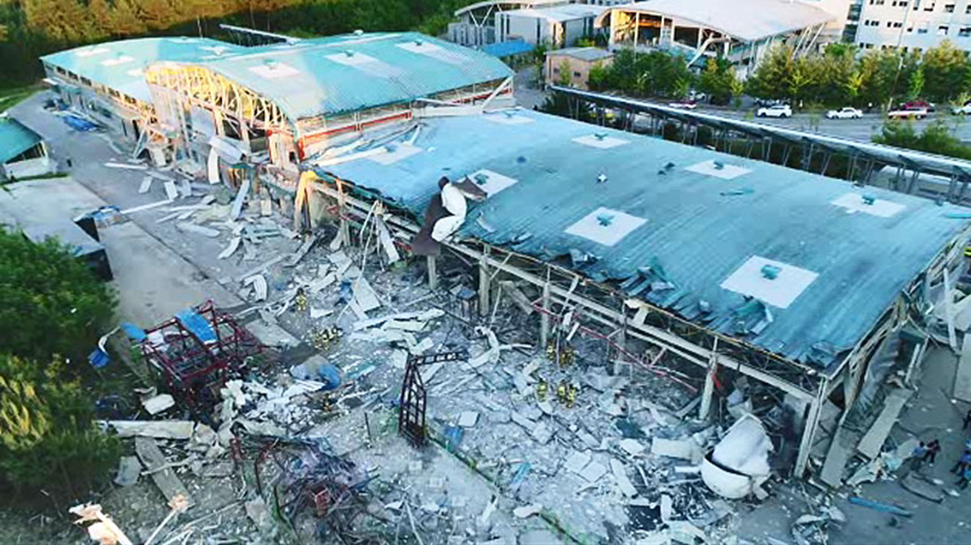
Health & Safety Moment:
In May 2019 a hydrogen storage tank at a research centre exploded, destroying a complex about half the size of a football field, killing two and injuring six.
In June 2019 there was an explosion at a hydrogen refuelling station when a hydrogen leak subsequently ignited, causing significant damage to the station and surrounding buildings.
In September 2019 a hydrogen gas leak and subsequent fire at a chemical plant caused three workers suffering burns.
The emergent hydrogen markets have suffered incidents resulting in damage to property and fatalities. These incidents reminds us of the hazards of hydrogen.
Detailed design and safety reviews are required to learn from such incidents.
Stakeholder engagement and communication in the safety planning process will help build and maintain public confidence.
“Those who don’t know history are destined to repeat it” Edmund Burke

Slide 3
A LOOK BACK AT PROCESS SAFETY MANAGEMENT
Why concern ourselves with Process Safety Management’s history ?
Origins of PSM Practice
Formalizing PSM Practices
Formative Incidents
Causes, Changing Risk Factors, and Improved Prevention

Slide 4
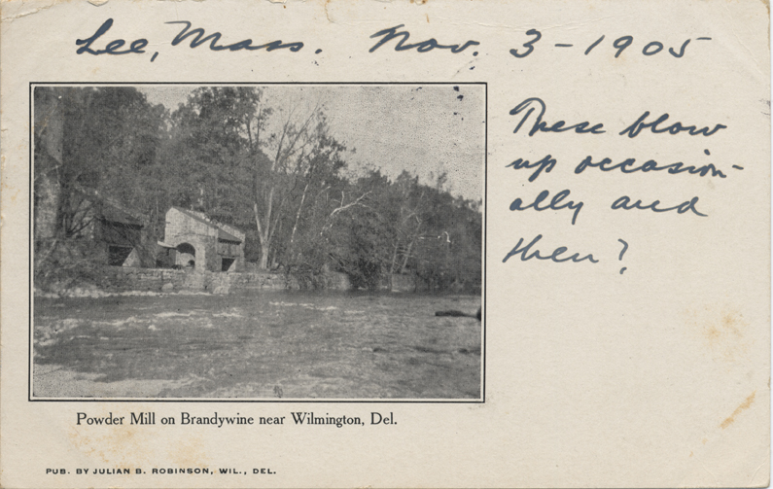
Origins of Process Safety Management
1802
US; DuPont Brandywine (Gun) Powder Works
Fourth walls were open, facing away from plant
Plant Manager had to personally start up new processes
Clothing without pockets or cuffs and boots without hobnails
Safe siting practices kept buildings isolated from each other
Written safety rules developed in 1811
1860s
US; Transcontinental Railroad
Manufacturing of explosive moved to be close to work sites
after incidents during storage and transportation
Instability of nitroglycerin eventually led Alfred Nobel to invent dynamite

Slide 5
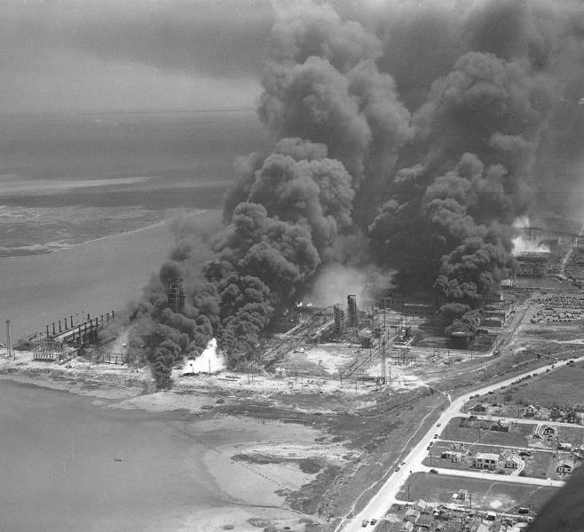
Formalising PSM Practices
1940s and 1950s
US; Ammonia and Air Separation Plants
Incidents involving ammonia and air separation plants
American Institute of Chemical Engineers (AIChE) convenes a conference on process safety
Led to the founding of the Center for Chemical Process Safety

Slide 6
Formative Process Safety Incidents
1976
Italy; Seveso - release of dioxin
Led to Seveso Directive; and UK’s COMAH regulation covering industrial manufacture or use of hazardous substances
1984
India; Bhopal - release of methyl isocyanate
Led to the United States establishing the OSHA PSM and EPA RMP regulations
2010
US; Gulf of Mexico - explosion, fire and oil release
Led to establishment of the Bureau of Safety and Environmental Enforcement and Well Control Rule and Safety and Environmental Management Systems (SEMS) regulations
The Seveso Directives are the main EU legislation dealing specifically with the control of on-shore major accident hazards involving dangerous substances. The Seveso III Directive came into force on 1 June 2015, implemented by the Control of Major Accident Hazards Regulations (COMAH) Regulations 2015 (as amended) have replaced by the COMAH Regulations 2015.

Slide 7
Causes, Changing Risk Factors, and Improved Prevention
PSM elements most likely to fail and lead to catastrophic incidents
MI
Mechanical Integrity
MoC
Management of Change
Training
Site Specific Training

Slide 8
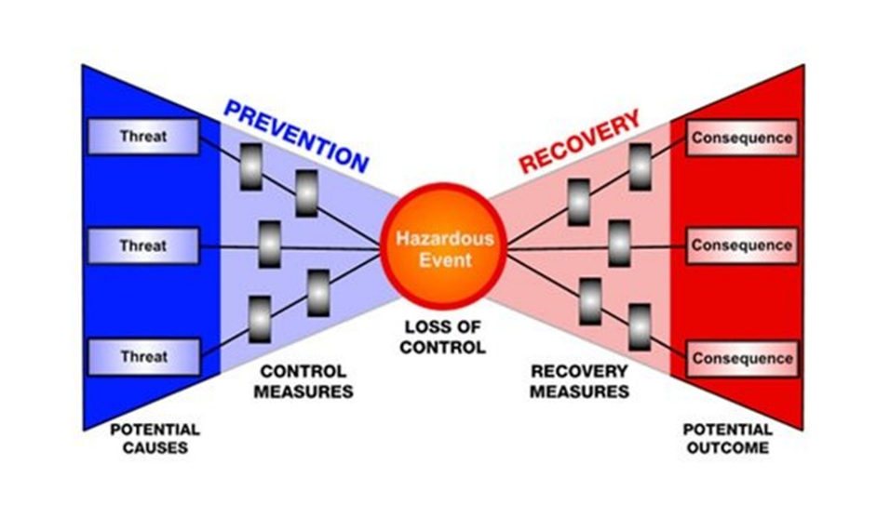
“Bow-Tie” Risk Assessment
Control measures that are lacking
Cause incidents; and
Lead to poor recovery measures that make the event worse

Slide 9
Future PSM Challenges and Opportunities
Shuttering and repurposing of plants
Operating processes well below design capacity
Better redesign of retained plants
Less inefficient use of fossil fuels; and substitutions for fossil fuels
Better means to produce energy
More efficient methods to deliver energy
More reliance on batteries for transportation and electric utilities
More automation and reliance on sensors and remote operation
Smaller workforces, multi-tasking of operators, supervisors, and managers
Opportunities for workforces to reposition to less hazardous work tasks

Slide 10
LESSONS FOR HYDROGEN PSM - PRODUCTION, DISTRIBUTION AND USE
Recent Incidents Involving “New” Hydrogen Uses
European Hydrogen Safety Panel (EHSP)
Applying Lessons Learned and Charting a Safe Course

Slide 11
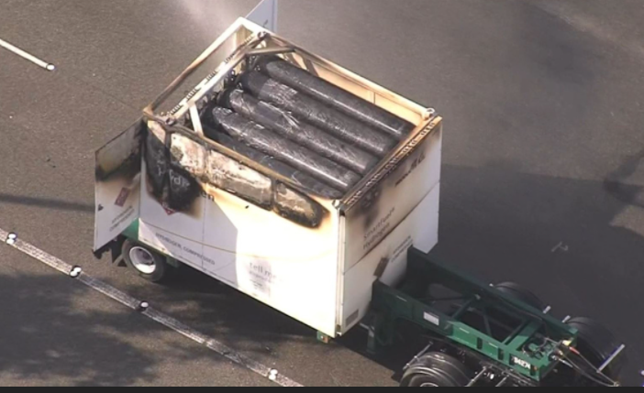
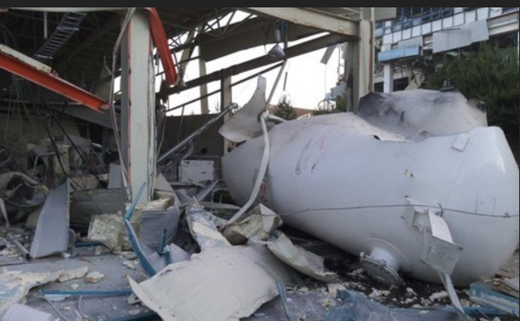
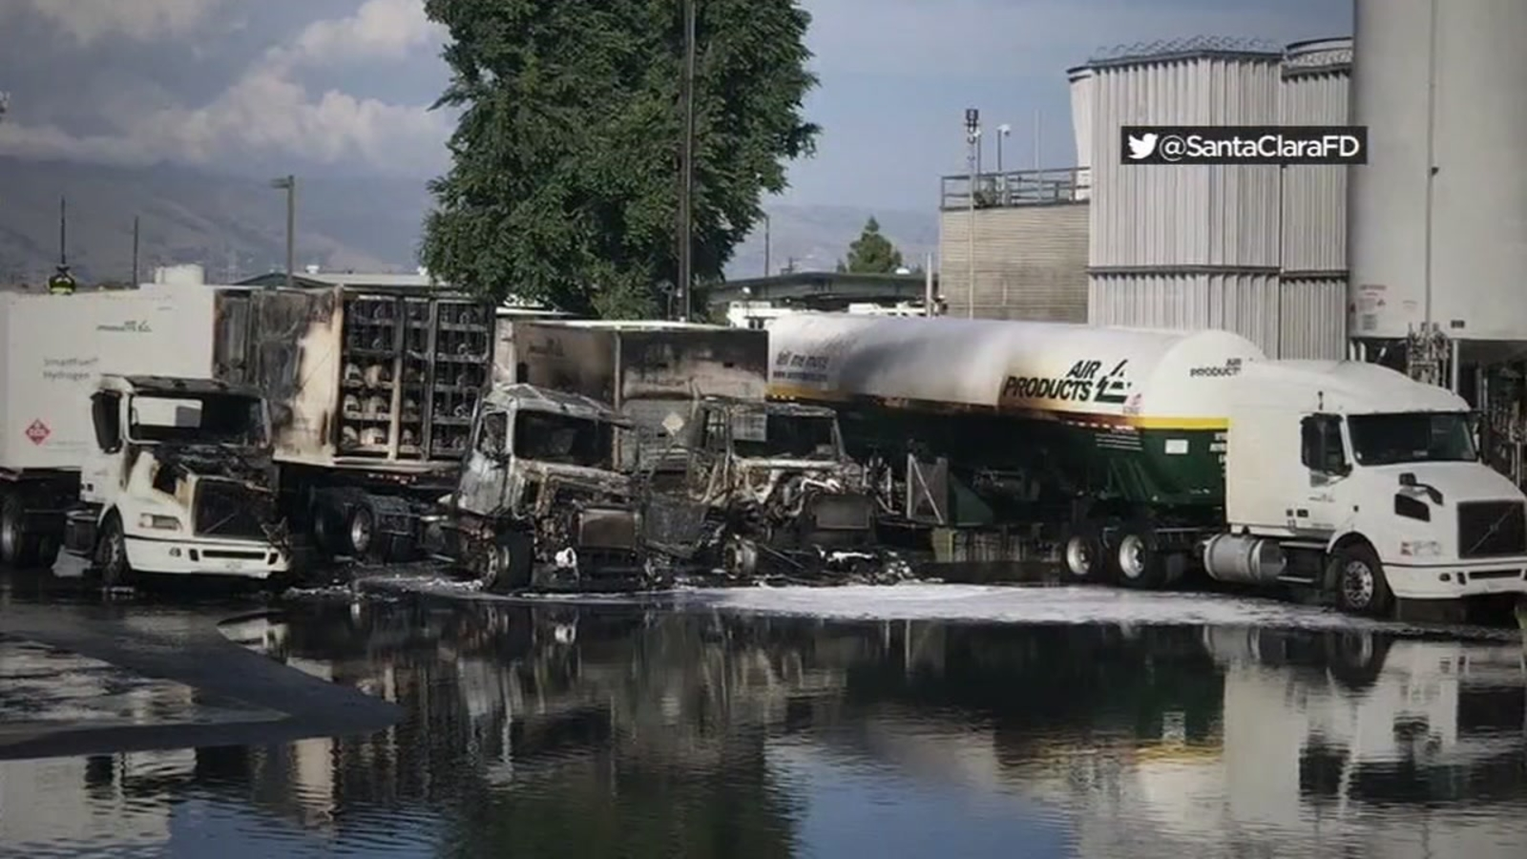
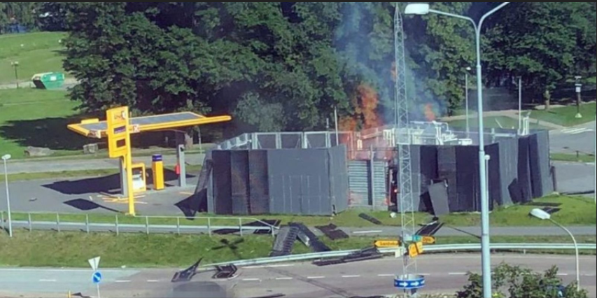
Recent Incidents Involving “New” Hydrogen Uses
2018
US; Diamond Bar, California - Hydrogen delivery truck fire
2019
South Korea; Gangneung – Hydrogen storage tank explosion
2019
US; Santa Clara, California - Hydrogen leaking from a storage tank hose-to-truck connection ignited
2019
Norway - Hydrogen explosion at fueling station

Slide 12
European Hydrogen Safety Panel (EHSP)
The Hydrogen Incidents and Accidents Database (HIAD) maintained by the Joint Research Centre of the European Commission (EC-JRC)
  through on-going analysis and input into HIAD, the Centre has identified three event categories:
    Non-hydrogen system initiating event
    Hydrogen system initiating event: event triggered directly by a system containing hydrogen and includes as sub-categories: jet fire and explosions, no hydrogen release and unignited hydrogen release. Note: The majority of the events subsequently analysed occurred due to hydrogen system failures.
    False positive: emergency alarm or procedure triggered in the absence of any actual problem

Slide 13
Joint Research Centre of the European Commission (EC-JRC)
In their 2019 report, the EC-JRC summarized these recommendations
Inspection and Maintenance. Increased frequency of inspections, regular verification of structural integrity, determination of corrosion that required maintenance or change out, leakage tests, pipe tests
Personnel. Use of enhanced security, working permits, supervision (especially during soldering), regular and refresher training
Process/plant modifications. Use of mitigation barriers (forced ventilation, concentration detectors, automatic closing valves, system purging with verification, elimination of ignition sources, use of ATEX equipment), design to limit hydrogen inventory, segregation and separation of reactive chemicals, gasket tightening, reviews of pressure control systems (vents, alarms), fast isolation means, electrical power load protection, electromagnetism protection, passive barriers, and increased use of sensors
Miscellaneous. Provisions for effective mechanical integrity evaluations (critical component evaluations, corrosion testing, avoidance of flange connections, redundant systems), enforced fire barriers, electrolytic cell controls.

Slide 14
Applying Lessons Learned and Charting a Safe Course
The following actions should be considered in assisting with the societal adoption of hydrogen as a safe fuel source:
Thoroughly investigate recent incidents to determine their root causes and implement mitigative measures across the industry. Be prepared to address concerns arising out of these incidents.
Survey the public to determine what concerns they have about the use of hydrogen as a fuel for motor vehicles, as a space heating fuel, or as a replacement for natural gas or propane in domestic uses such as cooking and provision of hot water. Implement a common approach, to the extent feasible, to effectively address these concerns.
Anticipate and proactively address the potentially negative aspects of taking what has historically been the industrial and commercial use of hydrogen as a fuel gas, to placement in residential settings.

Slide 15
Thank you.

