Slide 1



EXPERIMENTAL STUDY OF THE MITIGATION OF HYDROGEN-AIR EXPLOSIONS by aqueous foam
Jérôme Daubech, Emmanuel Leprette, Thomas Trautsolt, Namane Mechitoua, Lynda Porcheron, Gilles Roure
20/09/2023

Slide 2
Context

Slide 3
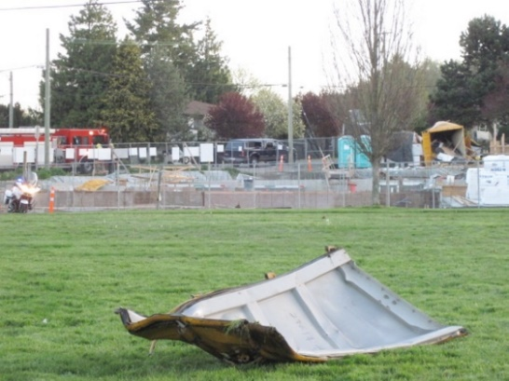
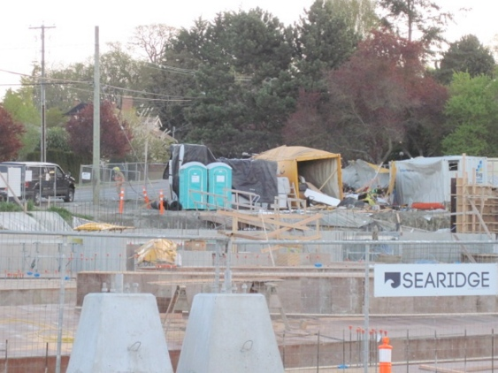
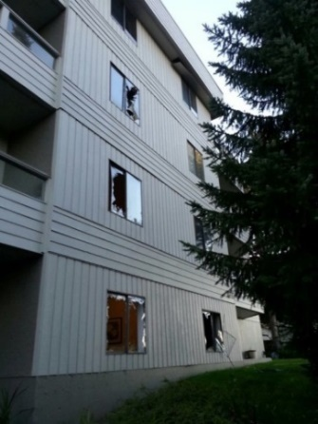
Development of hydrogen production technologies and use:
A good opportunity to accelerate the ecological transition and to create an industrial sector
But important risks associated with the use of hydrogen
The mitigation of a hydrogen explosion in an enclosure:
Detection and ventilation,
Explosion venting.
In highly constrained urban environments, explosion venting could lead to significant overpressure effects outside the enclosure, which is unacceptable.
Alternative mitigation techniques can be a solution :
not to extinguish the hydrogen flame,
but to decrease severity.
Example of gas explosion in a shipping container : April 13th, 2013 in Saanich in British Columbia (Canada)

Slide 4
To study these alternative mitigation techniques, a scientific collaboration is created between :
Ineris
EDF
AI group
Two mitigation techniques are investigated:
Injection of aqueous foam,
Injection of inhibiting powder.
Objective → Present :
The experimental configurations,
The experimental results.

Slide 5
Experimental configurations and results

Slide 6
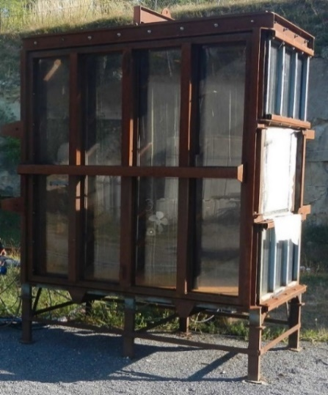
Experimental set-up
Explosion chamber:
4 m³ (2 m x 2 m x 1 m)
Vent surface covered by a plastic film: 0.6 x 0.6 m²
Opening overpressure: 50 mbar
Transparent wall
Ignition:
Backwall
Pyrotechnical match (60 J)
In a metallic cylinder filled with a 17 % H2/air mixture to protect the ignition device

Slide 7
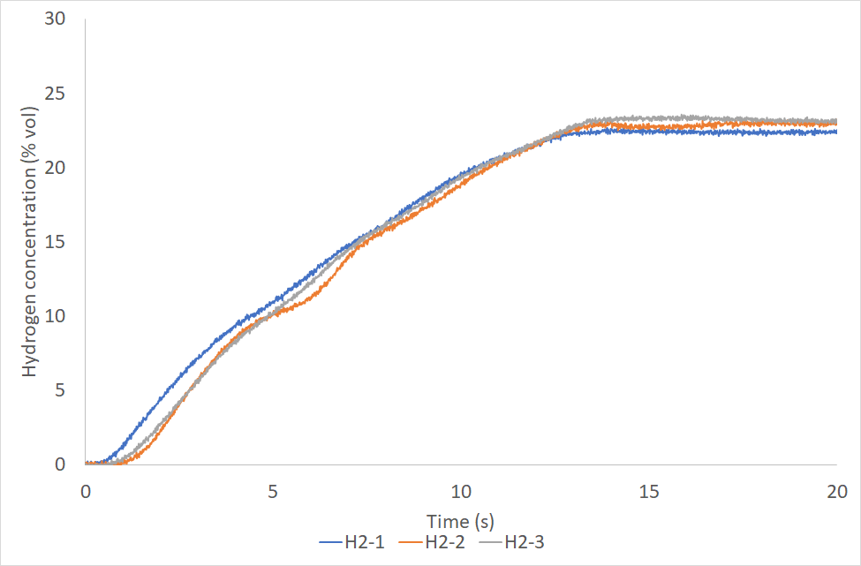
Experimental set-up
The instrumentation is composed by:
3 oxygen analyzers,
a piezoresistive pressure sensor Pint (Kistler 0-2 bar),
a piezoresistive pressure sensor Pint 2 (Kistler 0-2 bar),
a piezoresistive pressure sensor Plent1 (Kistler 0-2 bar),
a normal camera to film the foam injection,
Hydrogen injection is realized from a 50 l pressurized tank (initial pressure = 40 bar) to a 3 mm diameter hole in the center of the floor.
A specific work is done to calibrate the injection time, and to check homogeneity of the flammable mixture.
Experimental sequence :
Hydrogen injection in the explosion chamber
Foam generation until the explosion chamber is completely filled
Hydrogen injection in the ignition cylinder,
Ignition
Pint
Pint2
2 m
Ignition
H2
Plent2
Hydrogen injection

Slide 8
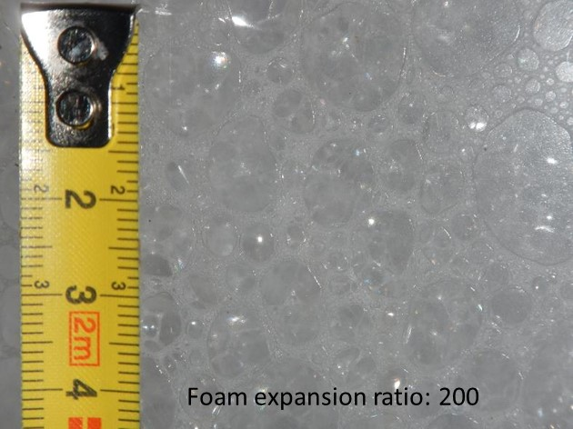
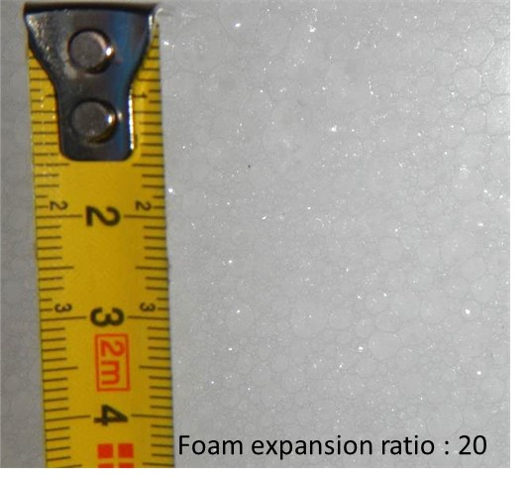
Experimental set-up
Foam generation:
200 liters tank filled with water + emulsifying agent (3% by volume)
Foam generation device (colander)
The flammable mixture was formed before the foam injection
Two foam expansion ratios: 20 and 200

Slide 9
Experimental configurations
n° of configuration | Concentration of flammable mixture | Foam expansion ratio
Ref 1 | Quiescent 16 % H2/air | No Foam
Ref 2 | Quiescent 21 % H2/air | No Foam
1 | Quiescent 16 % H2/air | 200
2 | Quiescent 16 % H2/air | 20
3 | Quiescent 21 % H2/air | 20

Slide 10
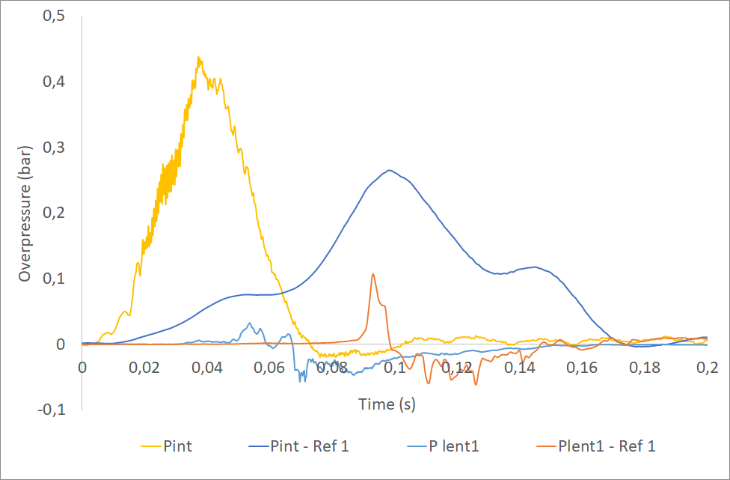
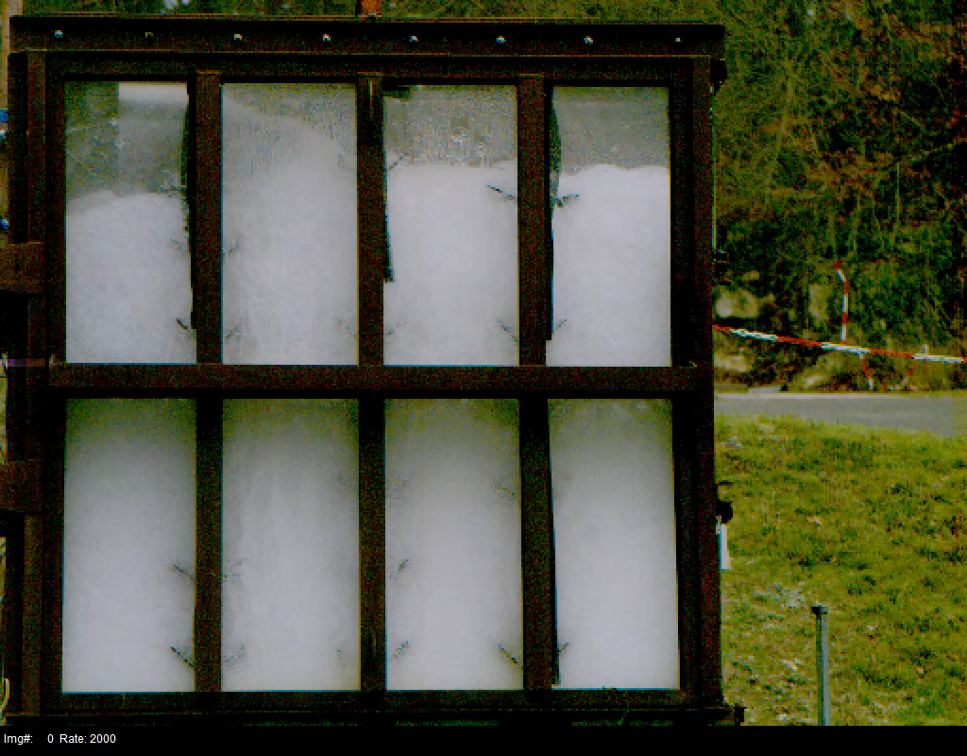
Experimental results
Configuration 1 :
Quiescent 16% H2/air mixture
Foam expansion ratio = 200
Compared reference test with foam (Ref 1)
Internal overpressures :
with foam = 460 mbar
without foam = 275 mbar
Substantial increase of pressure rise-up with foam
Aggravation of internal overpressure effects
External overpressures :
with foam = 40 mbar
without foam = 125 mbar
→ Significant decrease in external overpressure effects

Slide 11
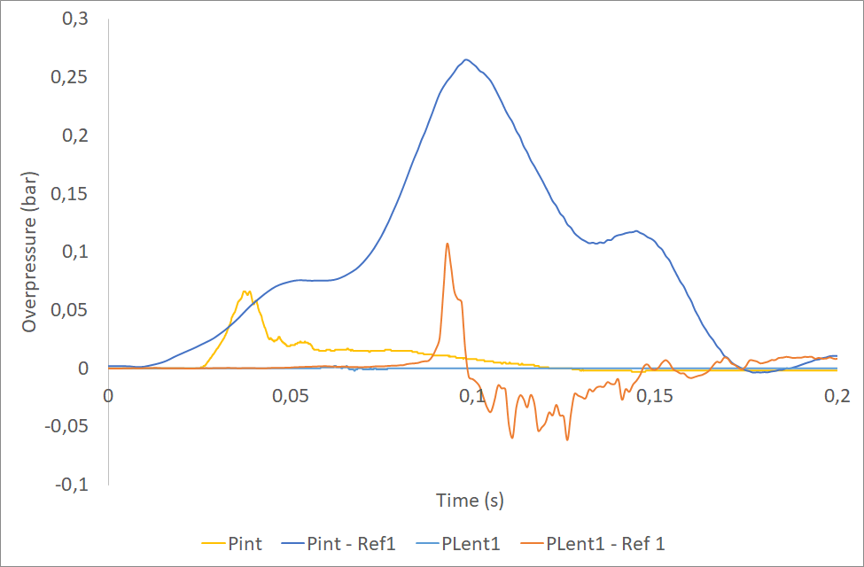
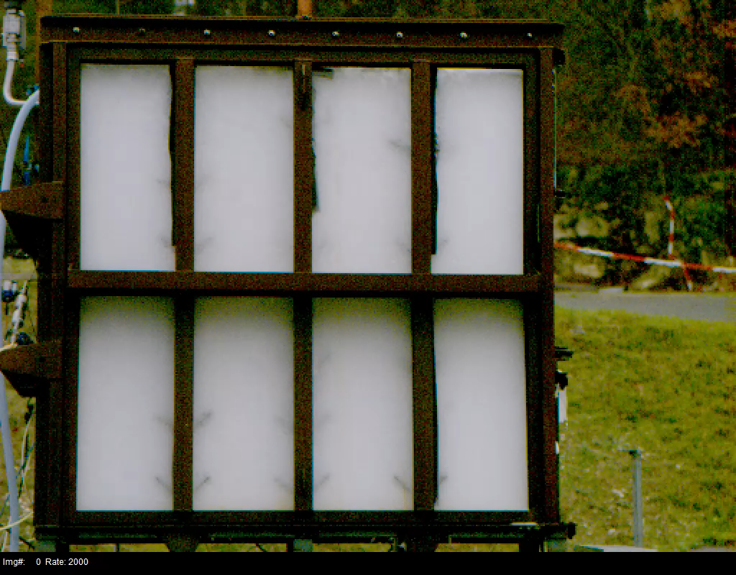
Experimental results
Configuration 2 :
Quiescent 16% H2/air mixture
Foam expansion ratio = 20
Compared reference test with foam (Ref 1)
Internal overpressures :
with foam = 60 mbar
without foam = 275 mbar
Important decrease in internal overpressure effects
No external effect with the foam

Slide 12
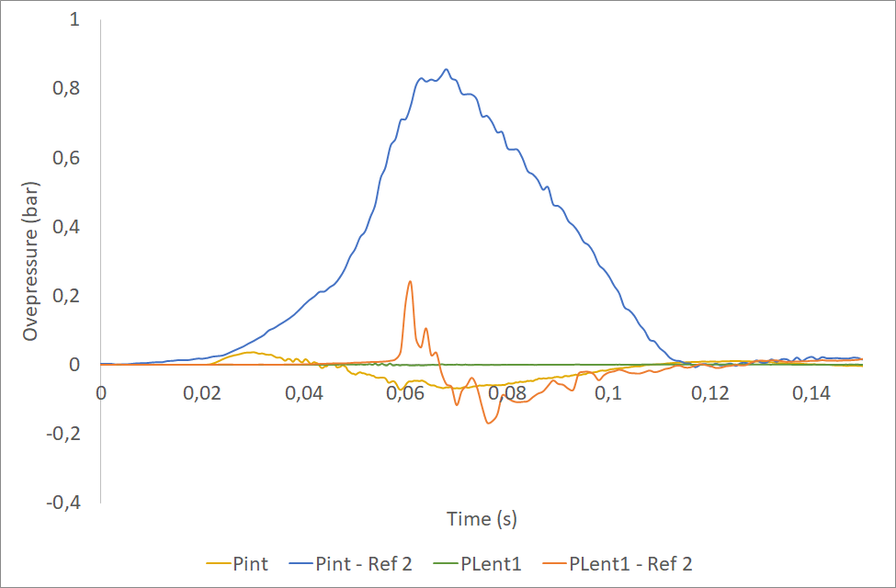

Experimental results
Configuration 3 :
Quiescent 21% H2/air mixture
Foam expansion ratio = 20
Compared reference test with foam (Ref 2)
Internal overpressures :
with foam = 50 mbar
without foam = 850 mbar
Important decrease in internal overpressure effects
No external effect with the foam

Slide 13
Conclusions and perspectives

Slide 14
High expansion foam :
Increase of internal explosion overpressure,
Increase of pressure rise-up,
But, a significant decrease in external overpressure.
Low expansion foam :
Important decrease of internal explosion overpressure,
No external effect.
The low-expansion foam has shown its potential to mitigate a hydrogen explosion in a confined space by significantly reducing the overpressure levels in the foam-filled enclosure and limiting the secondary explosion phenomenon.
To go further :
Find a foam expansion ratio between 20 and 200 that would allow a good compromise between interesting mitigation and limited quantities of water,
Characterise the distribution of hydrogen when the foam is injected during the hydrogen leak,
Test the influence of a partial filling with foam when the flammable atmosphere is already present,
Test real-life situations where foam injection is carried out simultaneously with the formation of the flammable atmosphere.

