Slide 1



EXPERIMENTAL STUDY OF THE MITIGATION OF HYDROGEN-AIR EXPLOSIONS by inhibiting powder
Jérôme Daubech, Emmanuel Leprette, Thomas Trautsolt, Namane Mechitoua, Lynda Porcheron, Gilles Roure
20/09/2023

Slide 2
Context

Slide 3
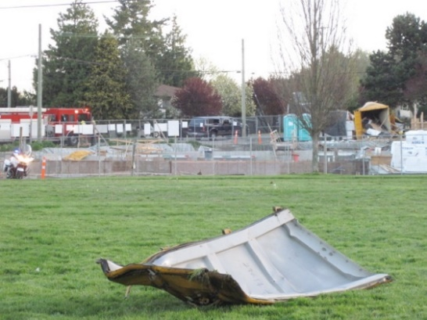
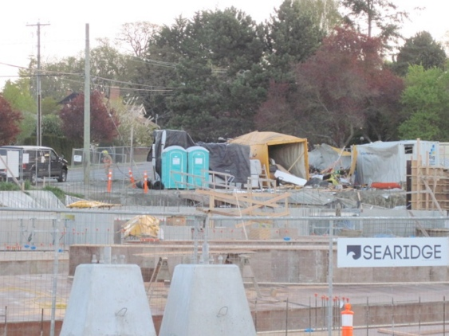
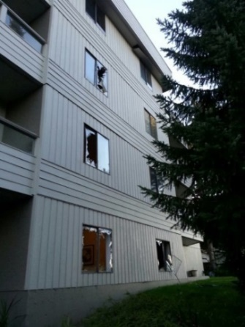
Development of hydrogen production technologies and use:
A good opportunity to accelerate the ecological transition and to create an industrial sector
But important risks associated with the use of hydrogen
The mitigation of a hydrogen explosion in an enclosure:
Detection and ventilation,
Explosion venting.
In highly constrained urban environments, explosion venting could lead to significant overpressure effects outside the enclosure, which is unacceptable.
Alternative mitigation techniques can be a solution :
not to extinguish the hydrogen flame,
but to decrease severity.
Example of gas explosion in a shipping container : April 13th, 2013 in Saanich in British Columbia (Canada)

Slide 4
To study these alternative mitigation techniques, a scientific collaboration is created between :
Ineris
EDF
AI group
Two mitigation techniques are investigated:
Injection of aqueous foam,
Injection of inhibiting powder.
Objective → Present :
The experimental configurations,
The experimental results.

Slide 5
First experimental campaign

Slide 6
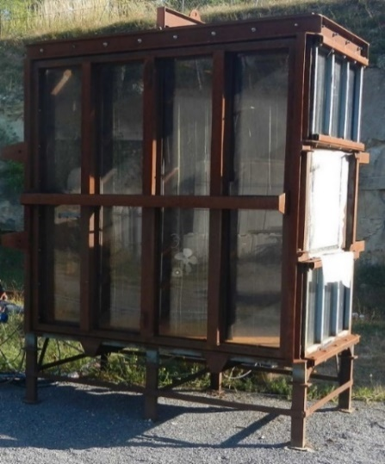
Experimental set-up
Explosion chamber:
4 m³ (2 m x 2 m x 1 m)
Vent surface covered by a plastic sheet or PMMA plate: 0.6 x 0.6 m²
Opening overpressure:
  Plastic sheet: 50 mbar
  PMMA plate: 900 mbar
Transparent wall
Ignition:
Backwall
Pyrotechnical match (60 J)
In a metallic cylinder filled with a 17 % H2/air mixture to protect the ignition device

Slide 7
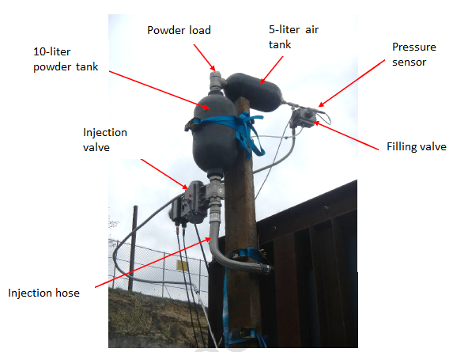
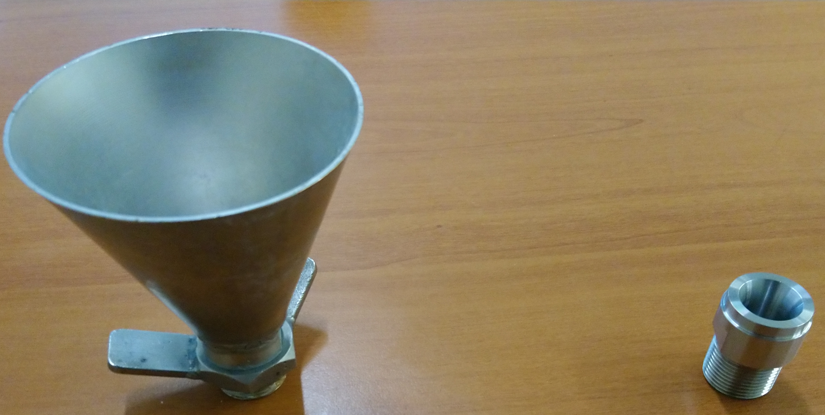
Experimental set-up
Powder injection:
10-liters powder tank
5-liters air tank
Pneumatic valve
Pressure sensor
The injection is realized through a 6 mm diameter orifice topped by a diffuser with an initial pressure of 15 bar.

Slide 8
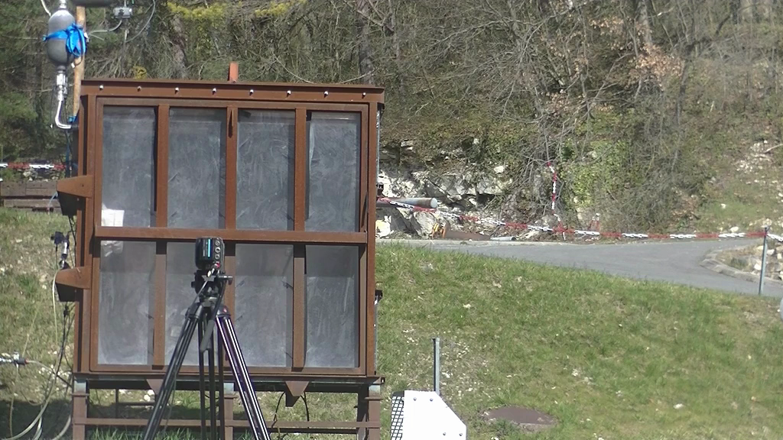
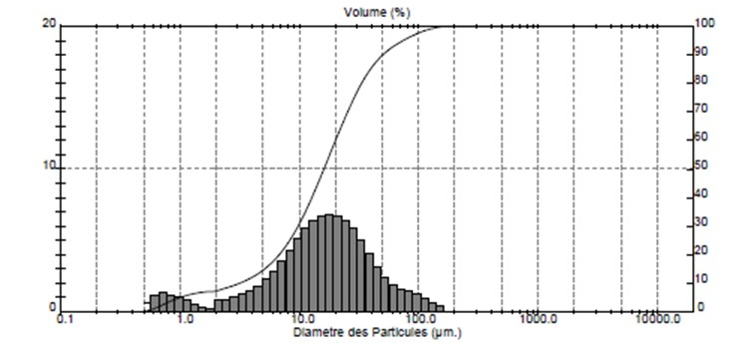
Experimental set-up
Powder characteristics:
Sodium bicarbonate NaHCO₃ → “Granito”, provided by AI Group
Mean diameter of the volume-weighted distribution D43= 25 µm
Sauter diameter D32= 6 µm
Injection of powder: 8 kg – D43 = 25µm

Slide 9
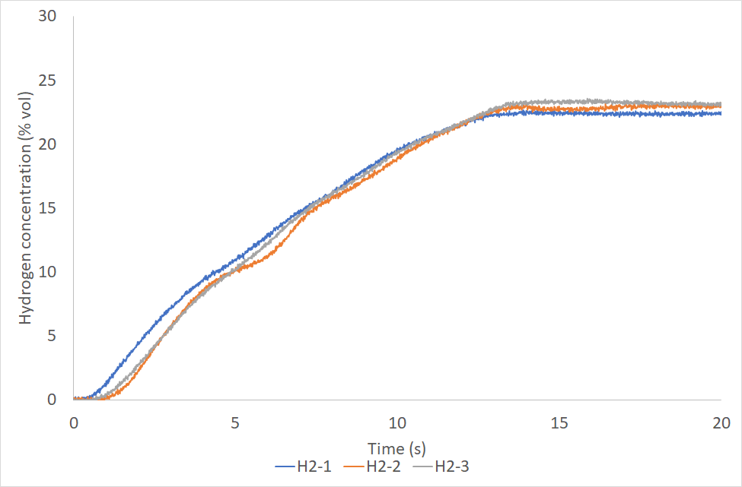
Experimental set-up
The instrumentation is composed by:
3 oxygen analyzers,
a piezoresistive pressure sensor Pint (Kistler 0-2 bar),
a piezoresistive pressure sensor Pint 2 (Kistler 0-2 bar),
a piezoresistive pressure sensor Plent1 (Kistler 0-2 bar),
a normal camera to film the powder injection,
Hydrogen injection is realized from a 50-liter pressurized tank (initial pressure = 40 bar) through a 3 mm diameter hole in the center of the floor.
A specific work is done to calibrate the injection time and to check homogeneity of the flammable mixture.
Experimental sequence :
Hydrogen injection in the explosion chamber
Hydrogen injection in the ignition cylinder,
Powder injection
Ignition 150 ms after the end of powder injection
Pint
Pint2
2 m
Ignition
H2
Plent2
Hydrogen injection

Slide 10
Experimental configurations
Config | Powder median diameter D₄₃ | Powder Mass | Powder expected concentration (kg/m³) | Concentration | Vent panel
1 | 25 µm | 2 kg | 0.5 | 16 % H2/air | Plastic sheet
2 | 25 µm | 4 kg | 1 | 16 % H2/air | Plastic sheet
3 | 25 µm | 4 kg | 1 | 16 % H2/air | 3 mm PMMA plate
4 | 25 µm | 8 kg | 2 | 16 % H2/air | 3 mm PMMA plate

Slide 11
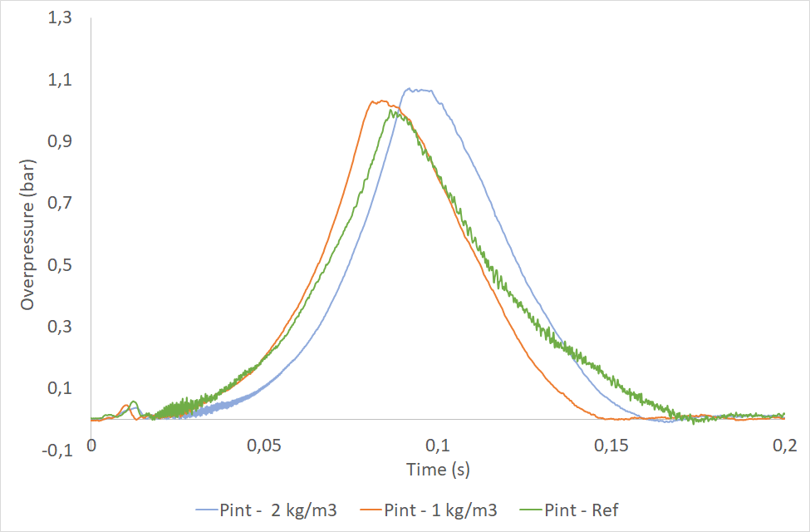
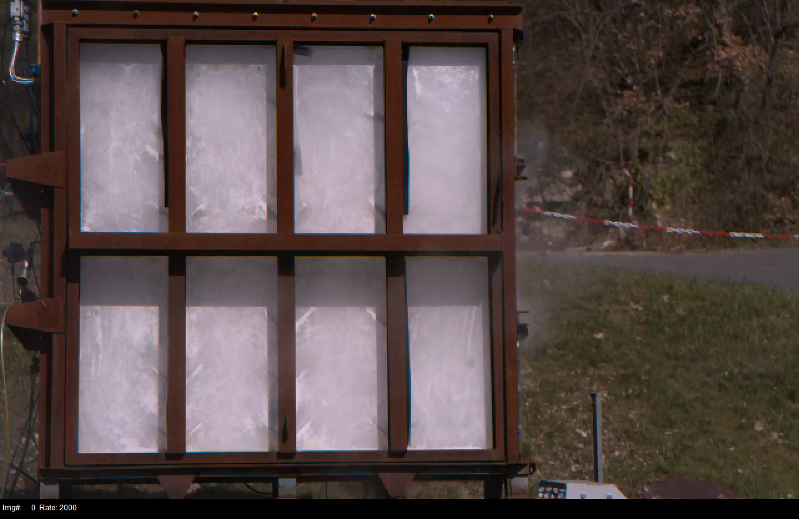
Experimental results
Comparison:
16% H2/air mixture
Dispersed powder: 4 and 8 kg
Vent: PMMA plate
Reference test: Turbulent test (discharging the air tanks at 15 bar not charged with powder)
No significant influence of the powder:
Similar overpressure level
Similar pressure rise-up
16 % H2/air – Powder: 8 kg
Notes:
The reference test is not a quiescent test but a turbulent test. In fact, it was carried out by discharging the cylinders with air not charged with powder. The aim is to evaluate the efficiency of the powder without the effect of the injection system.

Slide 12
Conclusion of the first experimental campaign
The theoretical analysis based on the flame heat losses (presented in the paper) shows that :
The injected inhibitor mass is too low to extinguish the flame,
But a mitigating effect should have been observed.
An explanation could be found during the powder injection:
The horizontal powder jet impacts the vent wall, creating
  a very concentrated cloud near the vent,
  a poor region near the ignition source
The ignition is located on the opposite wall,
During the flame propagation, the major part of the powder is pushed out.
A second experimental campaign was settled, last summer:
to improve powder injection and dispersion,
to evaluate the mitigating efficiency of the powder in more calibrated conditions.

Slide 13
Second experimental campaign

Slide 14
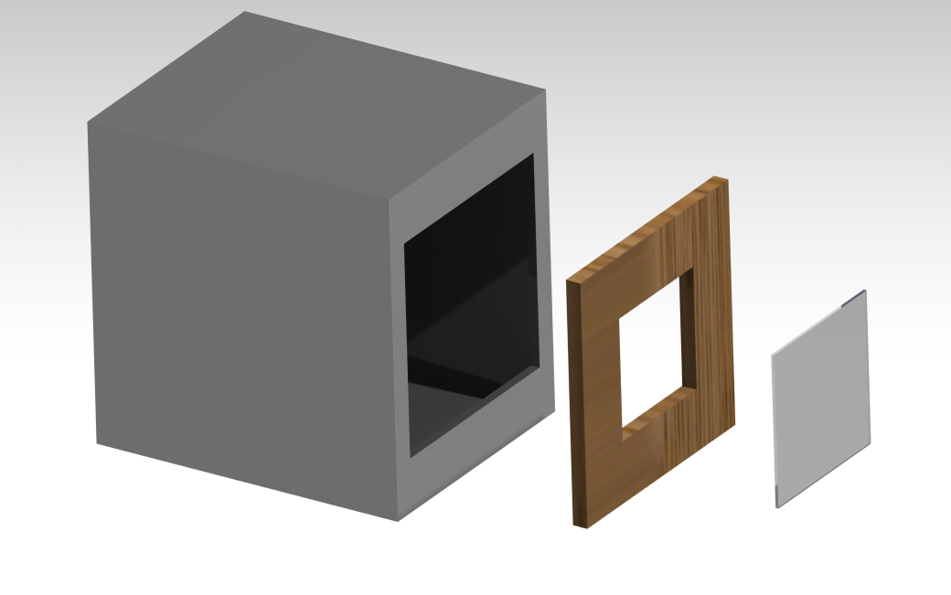
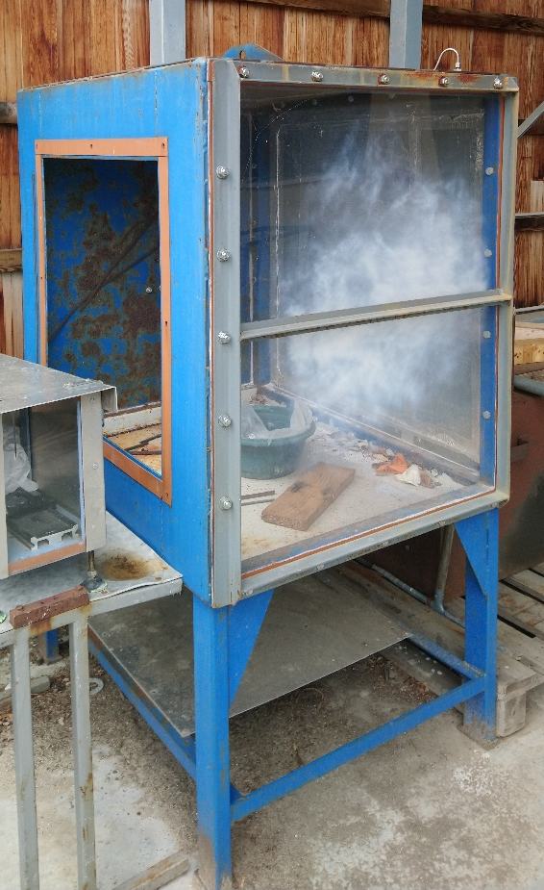
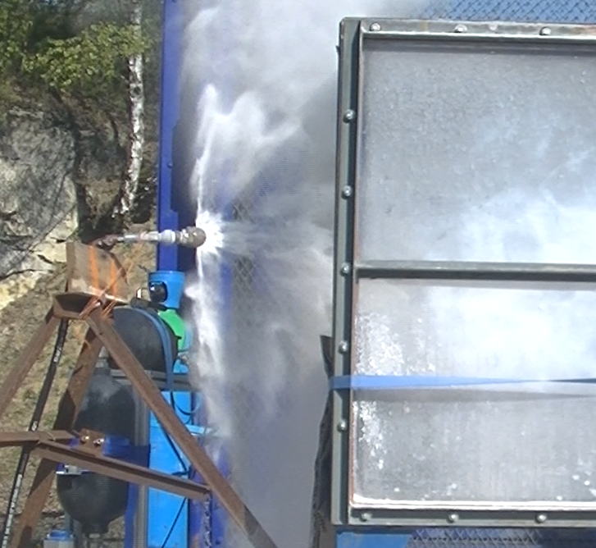
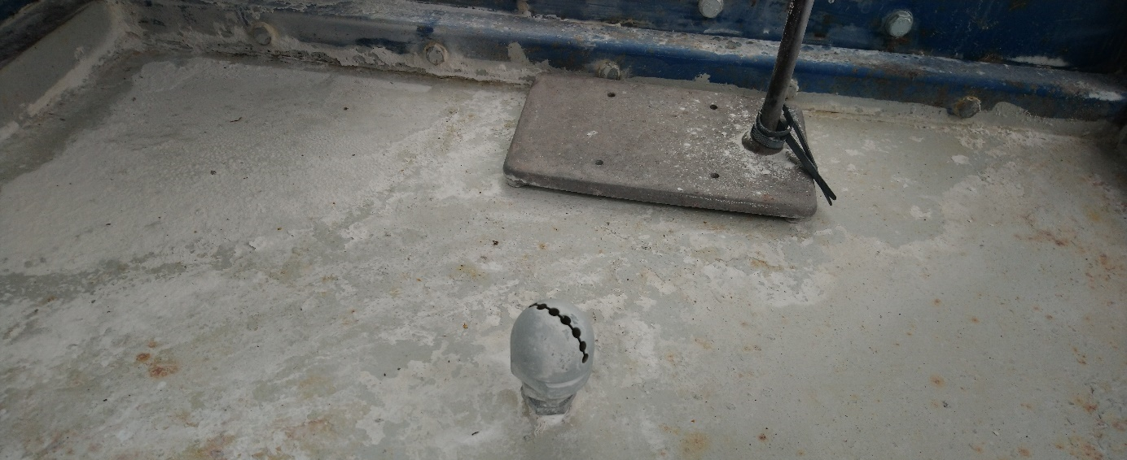
Experimental set-up
Explosion chamber:
1 m³ (1.1 m x 0.9 m x 0.9 m)
Vent surface covered by a plastic sheet: 0.4 x 0.4 m²
Opening overpressure: 30 mbar
Transparent wall
Powder injection
Injection device same as for the previous campaign,
Different injection nozzles located in the center of the chamber floor.
The powder cloud at the moment of injection takes the shape of a fan, favoring the mixing of the powder with the flammable atmosphere.
Gas injection device same as for the previous campaign
Instrumentation :
Opacimeter
Piezoresistive pressure sensor (Kistler 0-2 bar)

Slide 15
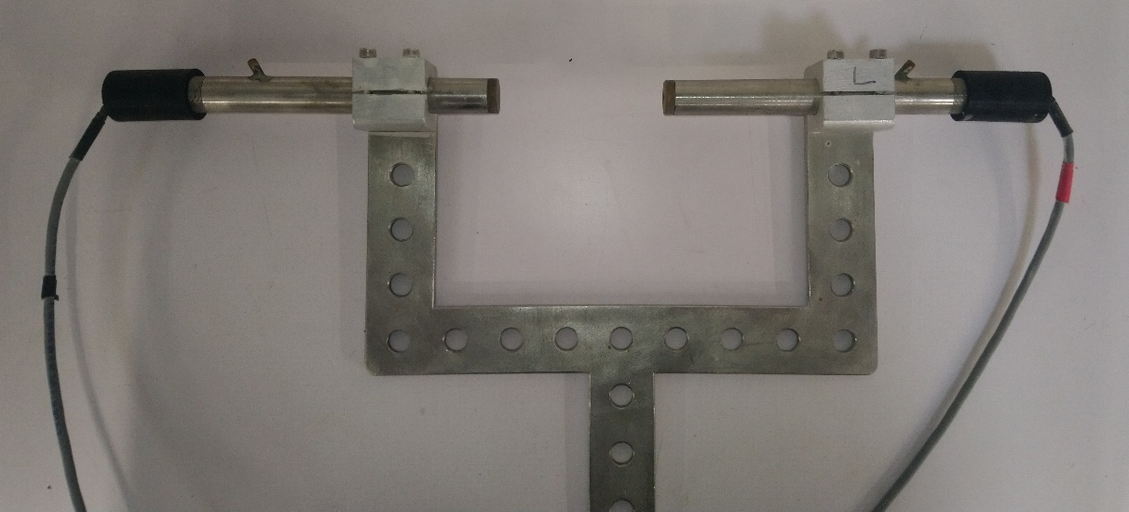
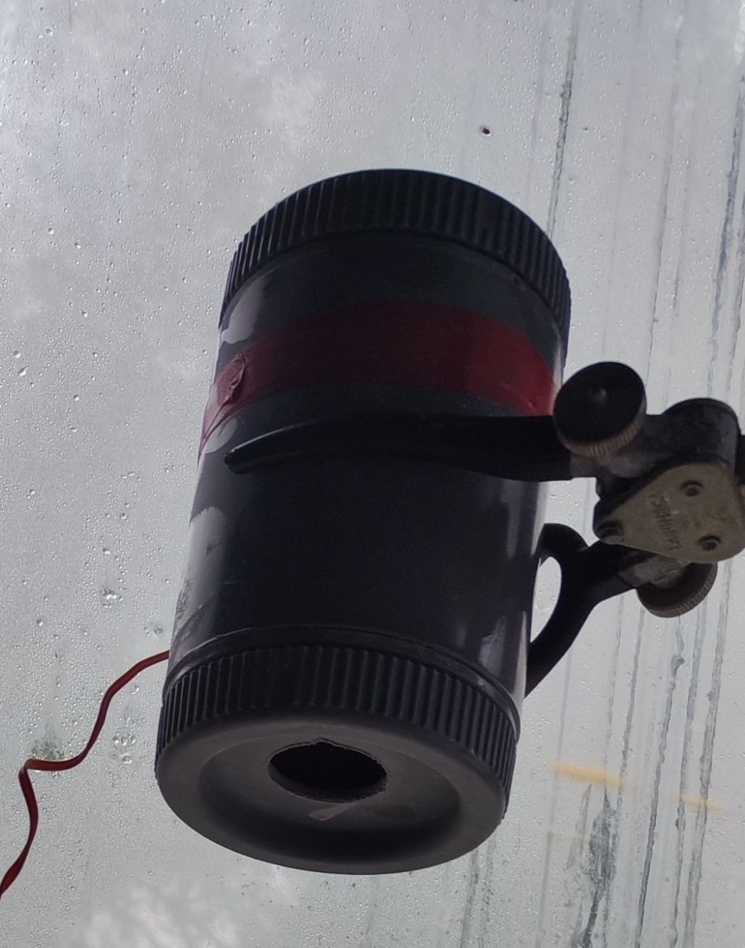
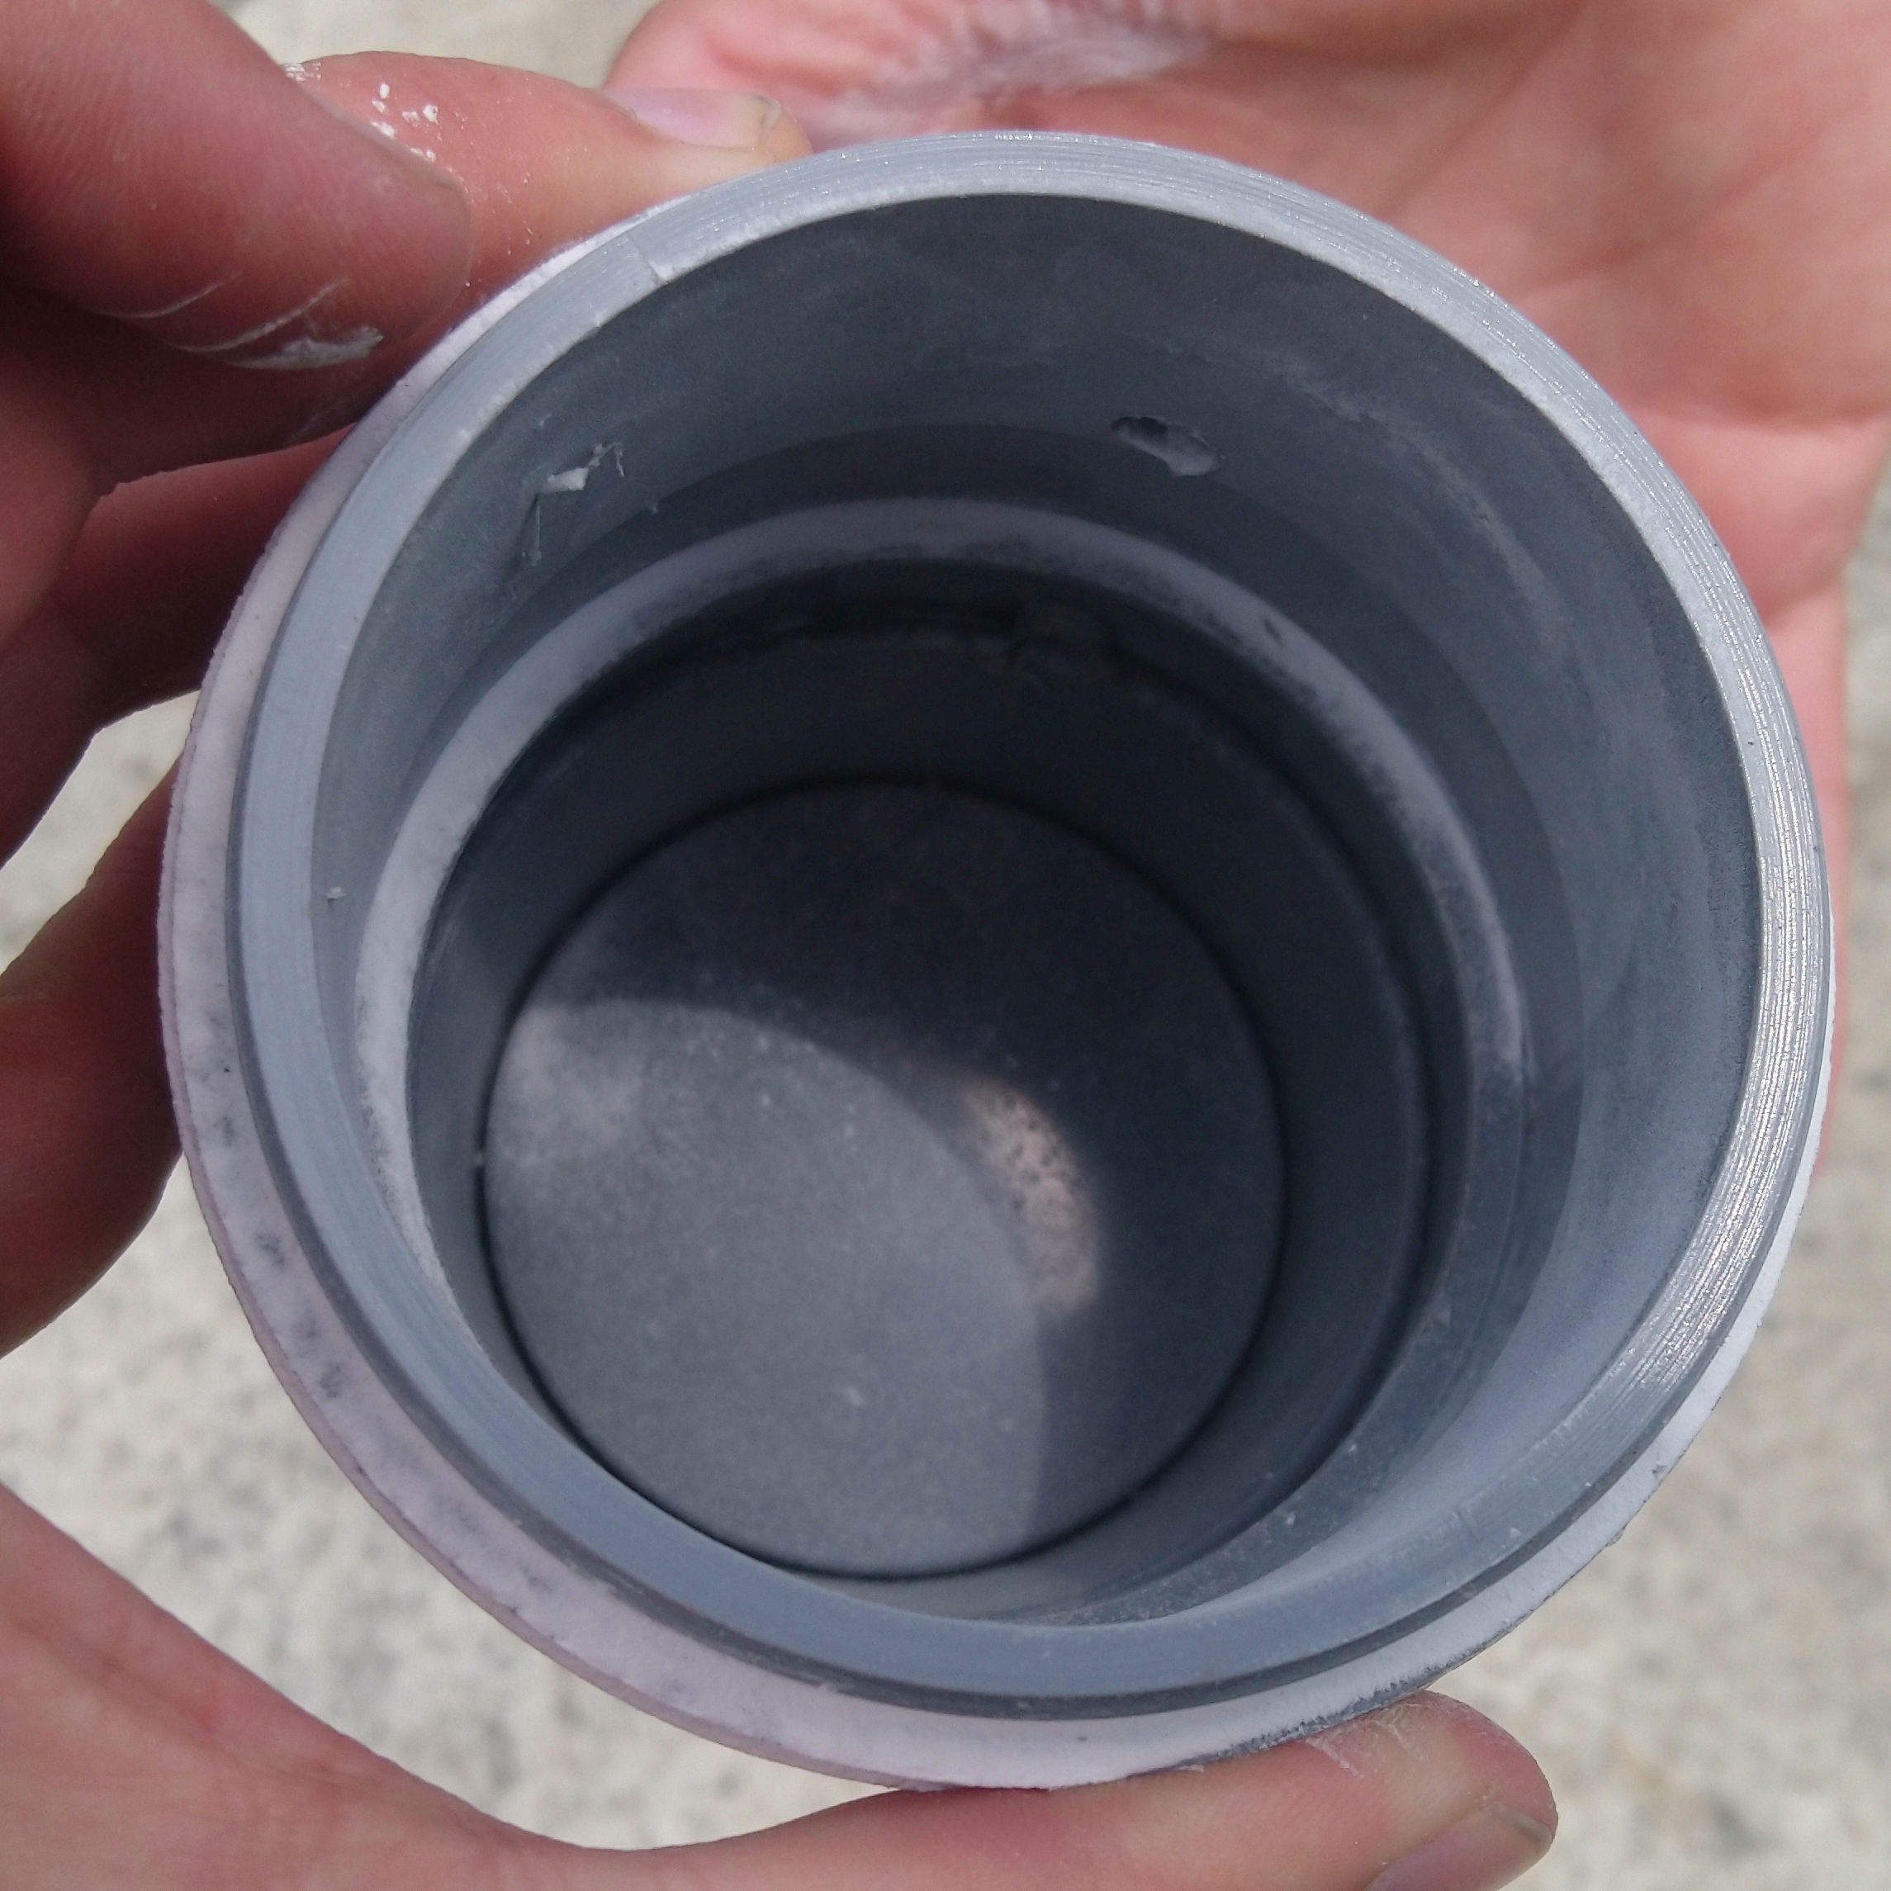
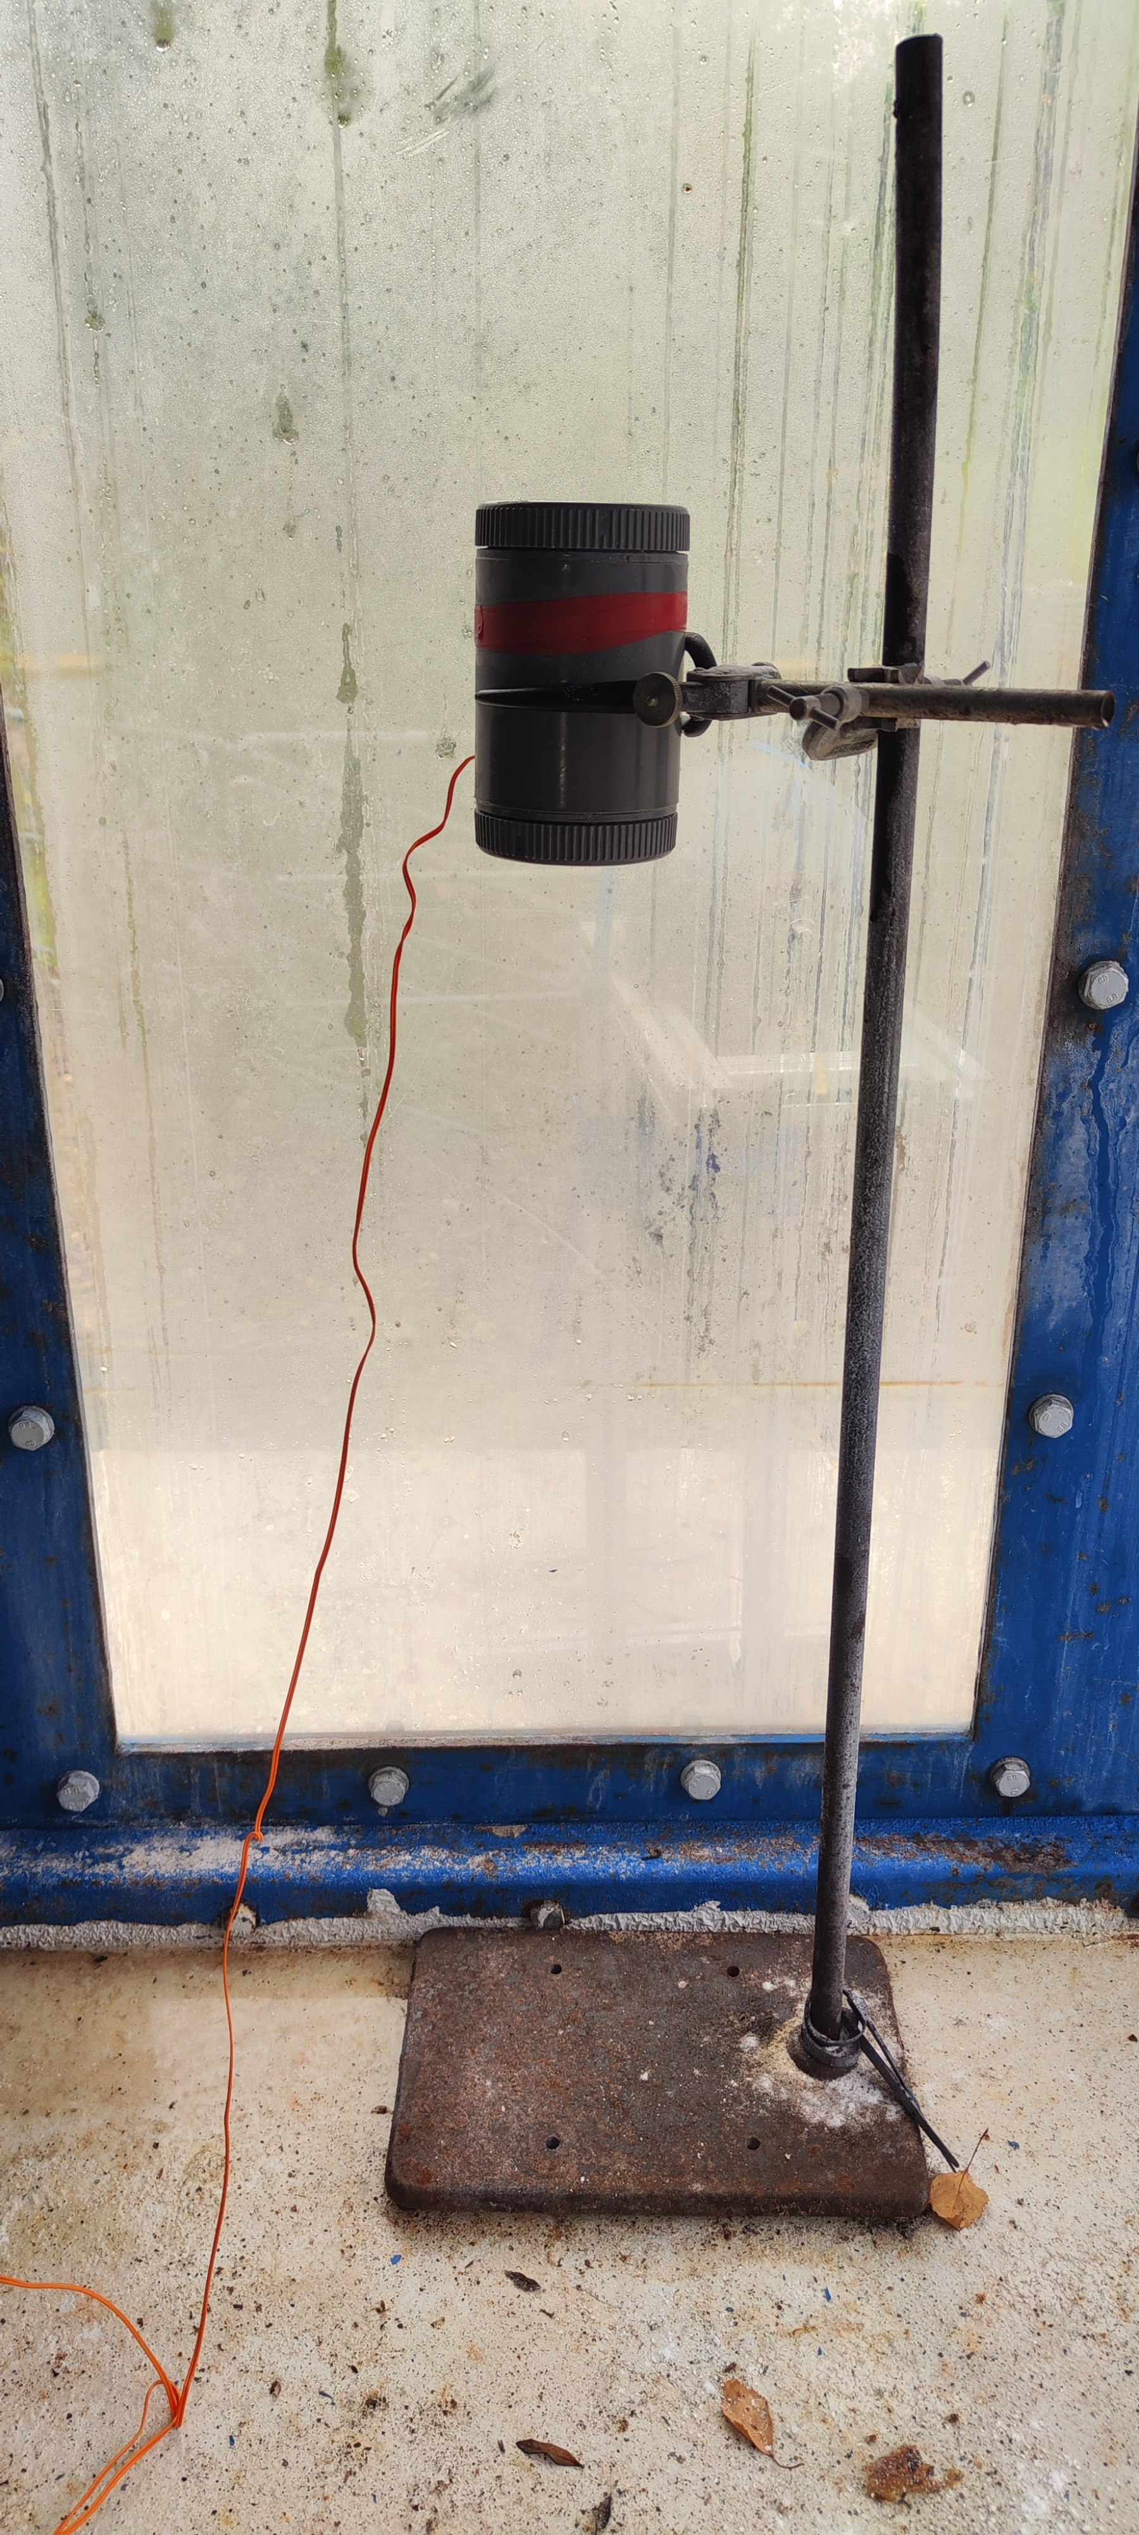
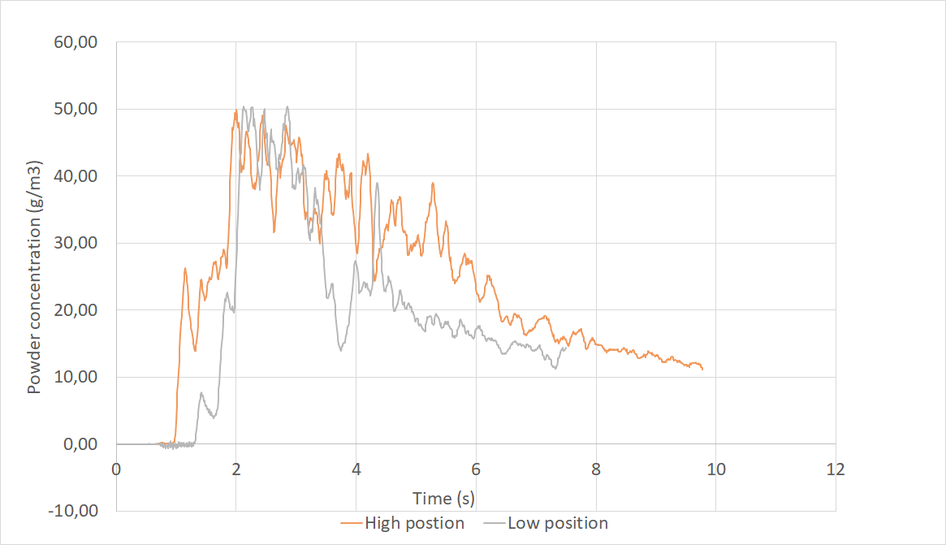

Experimental set-up
A control of cloud powder homogeneity is done with an home-made opacimeter
Ignition:
Pyrotechnical match (60 J) protected in a small cylinder :
  The cylinder, partially open at the bottom, fills with a flammable mixture during injection,
  The match ignites the mixture in the cylinder.
  A dust level check in the cylinder was carried out during powder injection.
Chemical igniter (5000 J) directly located in the dust flammable cloud
Ignition activated 500 ms after the end of powder injection
Home-made opacimeter
Dust level after 8 kg powder injection
Evolution of powder concentration for high and low opacimeter position

Slide 16
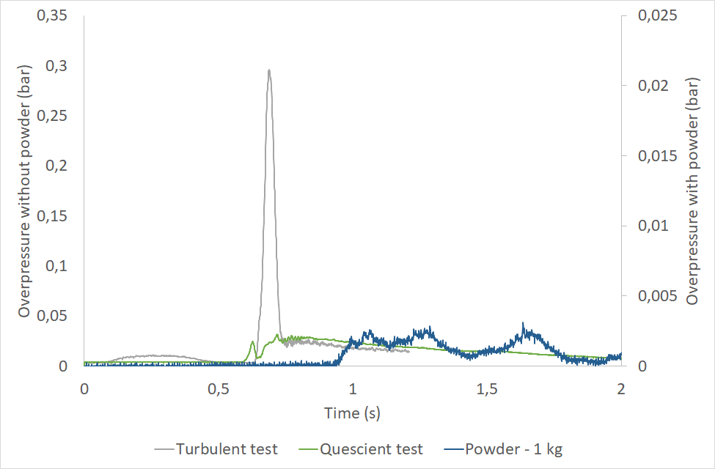
Experimental results
Explosion tests with stoichiometric methane/air mixture
Configuartion | Overpressure | Observation
Quiescent stoichiometric CH4/air | 50 mbar
Turbulent stoichiometric CH4/air | 300 mbar | Air-induced turbulence condition simulating powder injection
Turbulent stoichiometric CH4/air with powder (1 kg) | < 5 mbar
Possible extinction of methane flame by the 1 kg of powder.

Slide 17
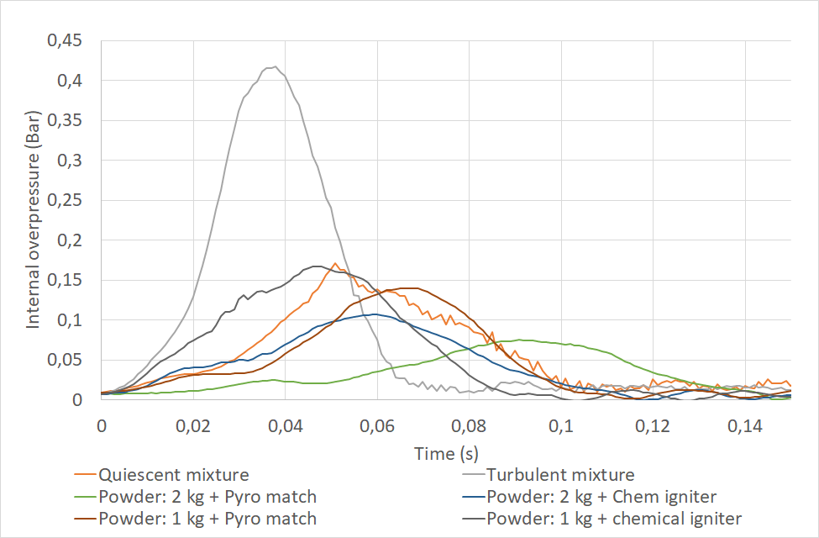
Experimental results
Explosion tests with 16 % hydrogen/air mixture
Configuration | Overpressure (mbar)
Quiescent mixture | 170
Turbulent mixture | 420
Powder: 2kg + Pyrotechnical match | 75
Powder: 2kg + Chemical igniter | 110
Powder: 1kg + Pyrotechnical match | 140
Powder: 1kg + Chemical igniter | 170
Same order of magnitude between the pyrotechnical match and the chemical igniter
At 1 kg of powder, the inhibiting effect exists, but it is offset by the effect of the turbulence induced by the powder injection.
With 2 kg of powder, the inhibiting effect is dominant, and the pressure level is divided by 2 compared with the quiescent test.
But it's less effecient than the methane tests.
Notes:
A expliquer oralement :
- at 1 kg of powder, the inhibiting effect exists, but it is offset by the effect of the turbulence induced by the powder injection, so that overall there is no attenuation effect compared with the test at rest. The result is therefore the same as in the first campaign in a 4 m3 chamber
- with 2 kg of powder, the inhibiting effect is dominant, and the pressure level is divided by 2 compared with the test at rest.
But it ‘s less efficient tha

Slide 18
Conclusions and perspectives

Slide 19
First experimental campaign:
No significant effects of powder,
Strong inhomogeneity of the powder cloud,
Rapid blowing out of powder during initial flame development.
Second experimental campaign:
Tests carried out last summer still under analysis,
Improvement of powder injection and dispersion – Better homogeneity,
The first analysis shows interesting mitigating effects of NaHCO₃ powder provided that the inhibitor concentration is at least 2 kg/m³.
To go further :
Continue to analyze new tests and configurations carried out at higher concentrations,
Analyze the dynamics of pressure rise,
Investigate the role of powder :
  Flame heat losses?
  Chemical effects?

