Slide 1
Numerical simulation of pressure recovery phenomenon (PRP) in liquid ammonia tank
International Conference on Hydrogen Safety
19-21 September 2023, Quebec, Canada
Srinivas Sivaraman, Dmitriy Makarov, Vladimir Molkov
Hydrogen Safety Engineering and Research Centre (HySAFER)

Slide 2
Liquid ammonia tank venting
Problem overview
Liquified ammonia is often stored and transported at high pressures, with a risk of vessel failure and containment loss due to over-pressurization.
Emergency depressurization is crucial to prevent damage to the pressure vessel during severe boil-off situations. The process can involve complex phase changes due to pressure reduction.
CFD multiphase modelling may serve as an advanced design tool to have insight into physics of such complex phenomena.
Image source: Tani, K., Himeno, T., Sakuma, Y., Watanabe, T., Kobayashi, H., Toge, T., Unno, S., Kamiya, S., Muragishi, O. and Kanbe, K., 2021. Pressure recovery during pressure reduction experiment with large-scale liquid hydrogen tank. International Journal of Hydrogen Energy, 46(57), pp.29583-29596.

Slide 3
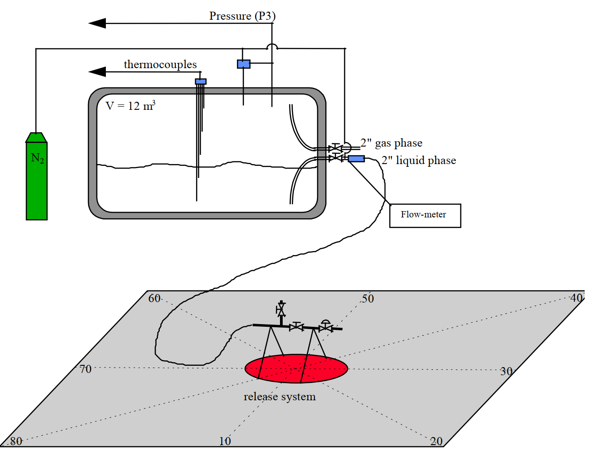
Validation experiment
Validation experiment
INERIS (Bouet R et al., 2005)
INERIS experiment program: 1 gas phase release, 14 liquid phase releases
Gaseous release (Test No. 1) was used in this study
NH3 tank: volume 12 m3, ext. length 4.81m, int. length 3.7m, int. ∅ 1.874 m
Release system: 2 valves, hose length 10.4 m, int. ∅ 50 mm
Release pipe: ∅ 50 mm, length 0.19 m, 1 m above ground.
NH3 venting:
460 seconds duration
Initial pressure and temperature not reported
Final pressure - approx. 0.18 MPa(abs)
Mass of released ammonia 300 kg (continuous flowrate not measured)

Slide 4
CFD model
Equations 1/2
3D conservation equations: mass, momentum, energy
Multiphase model: VOF (Volume-of-Fluid)
VOF : HEM (homogenous equilibrium) based model
Two phases share a single velocity and temperature field.
SST 𝑘−ω model, ideal gas EoS.
Numerical details:
Pressure-velocity coupling: SIMPLE-C algorithm.
Liquid density modelled as function of temperature.
First-order upwind numerical scheme for convective terms.

Slide 5
CFD model
Equations 2/2 – phase interaction

Slide 6
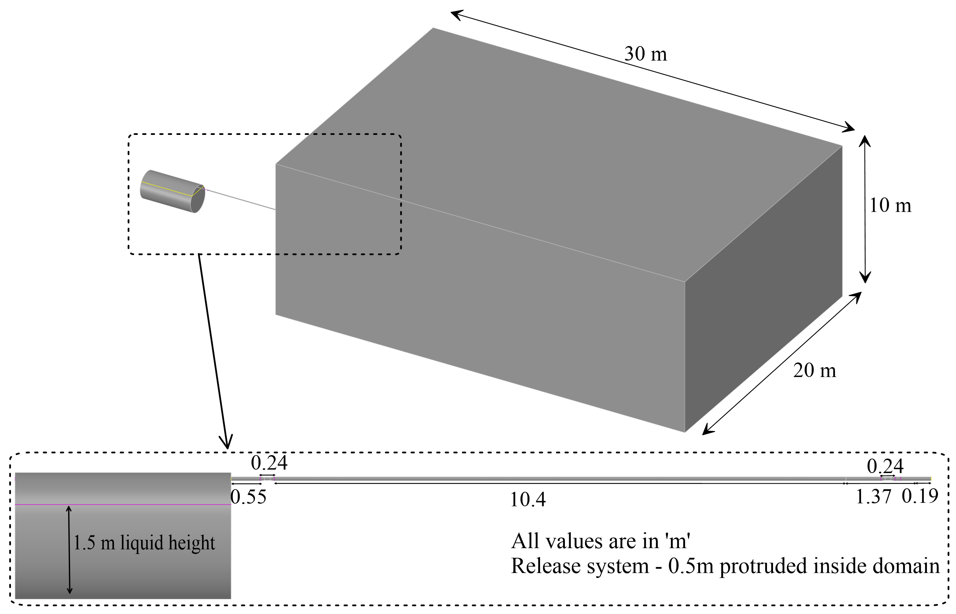
CFD model
Calculation domain
NH3 tank: horizontal cylinder with length 3.7m, ∅ 1.874 m
Flexible pipe is modelled as a straight pipe.
Atmosphere area : L*W*H=30*20*10 m (to ensure correct pipe exit conditions).
Liquid level: 1.5 m from tank bottom which corresponds to 85% fill level

Slide 7
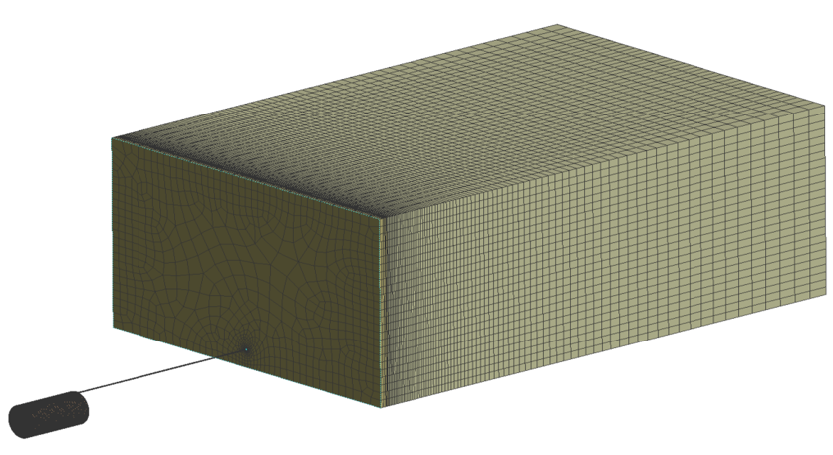
CFD model
Mesh
Hexahedral mesh: 419,953 CVs.
CV growth rate: 1.1 near pipe exit and 1.2 far field from the nozzle.
Mesh quality: 0.58 (min orthogonal quality) and 0.95 average quality.

Slide 8
CFD model
Initial conditions and Boundary conditions
Initial temperature and pressure
NH3 tank and vent pipe: T=9.5 ℃ , p=604 kPa (abs)
Ambient atmosphere: T=14 ℃, p=101.3 kPa (abs)
Initial volume fraction
Vent pipe before 2nd valve: αg=1, yNH3=1.0
Tank walls, pipe walls, ground surface:
non-slip, non-permeable boundaries
Ambient atmosphere:
Non-reflecting pressure boundary, p=101.3 kPa (abs)

Slide 9
Simulations
Grid sensitivity analysis
Effect of grid resolution in vent pipe on depressurisation dynamics
Effect of grid resolution in tank on depressurisation dynamics

Slide 10
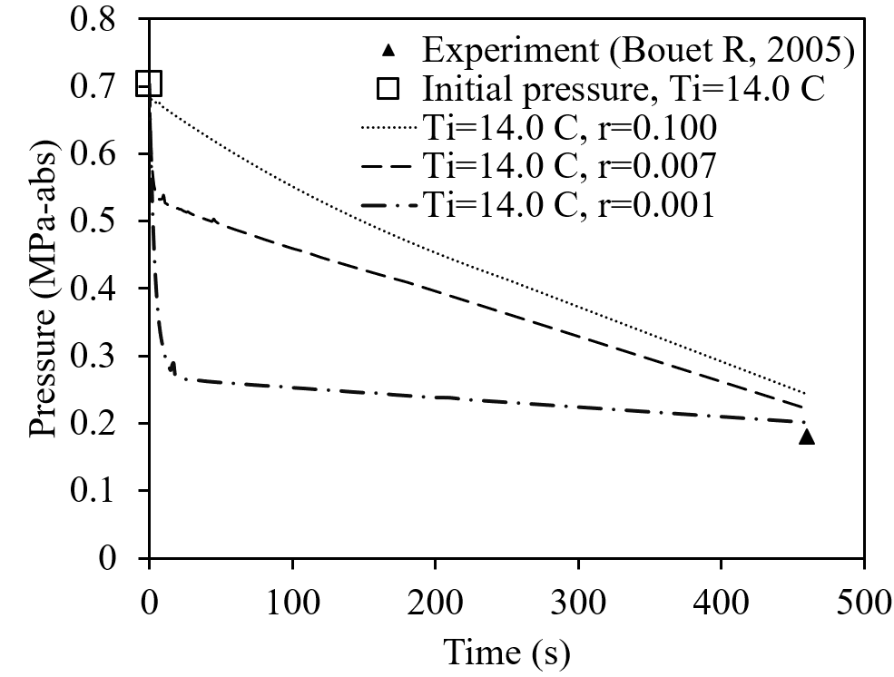
Simulations
Depressurisation dynamics 1/2
Initial liquid ammonia temp < ambient (14°C) due to diurnal variations, heavy tank insulation, and large ammonia mass.
Findings from CFD model calibration studies supports hypothesis regarding initial liquid ammonia temperature.

Slide 11
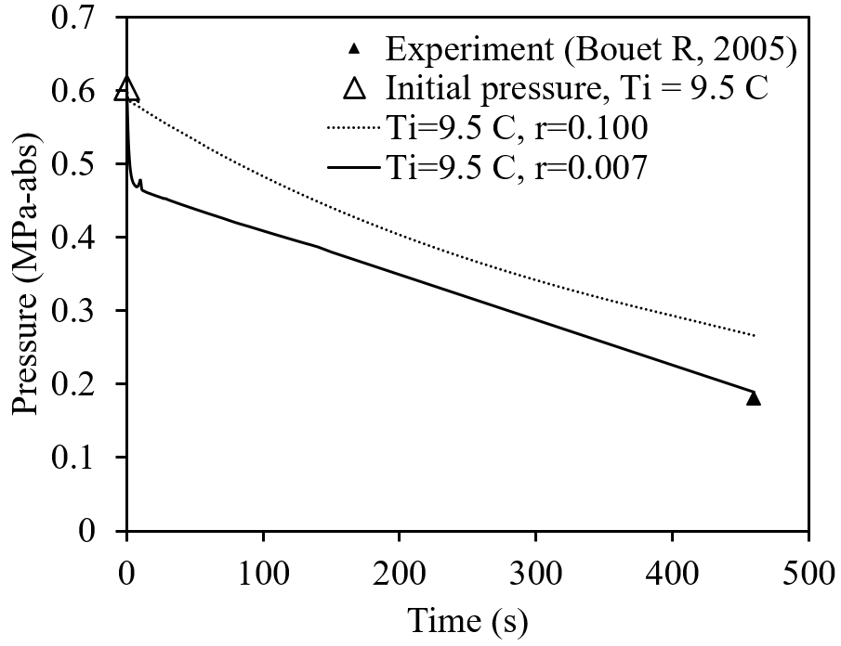
Simulations
Depressurisation dynamics 2/2
Evaporation rate in Lee's model depends on time relaxation and temperature difference from saturation.
CFD model trials confirm the need for higher time relaxation values at lower initial temperatures to achieve equal evaporated mass.
Based on model calibration, values of liquid temperature-dependent Lee’s time relaxation parameter are defined as r = 0.007 s-1 to r = 0.1 s-1.

Slide 12
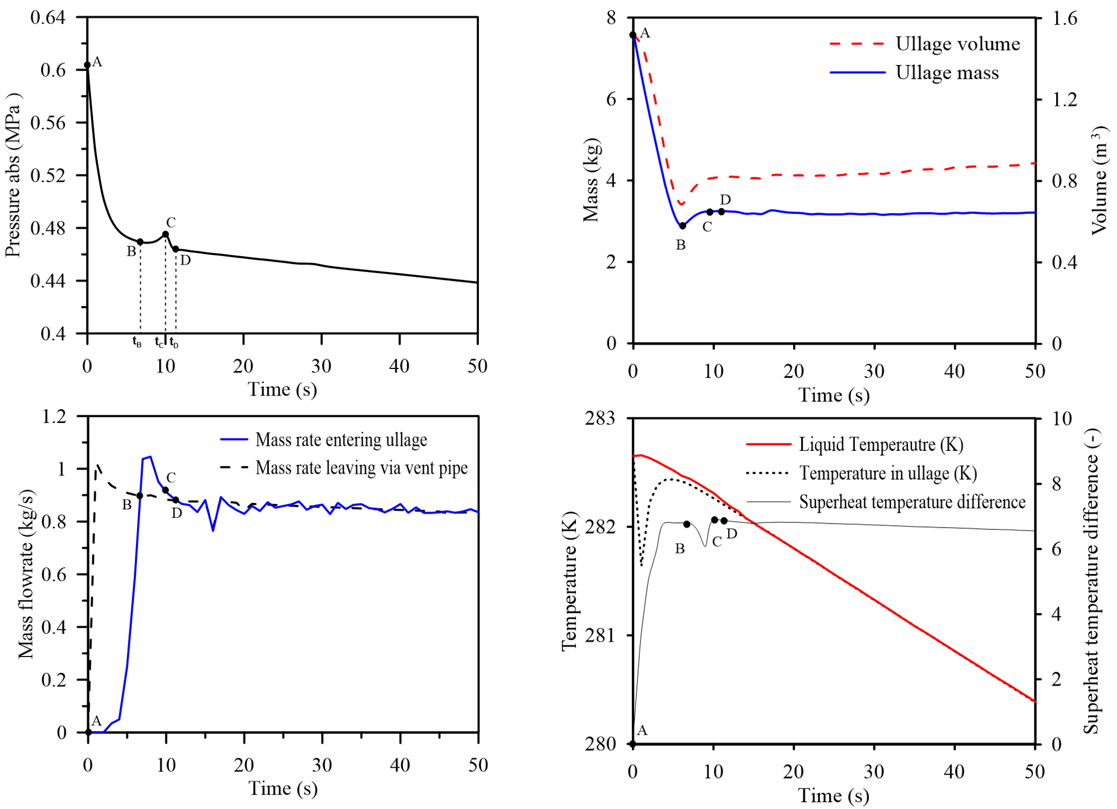
Simulations
Pressure recovery phenomenon (PRP) 1/2

Slide 13
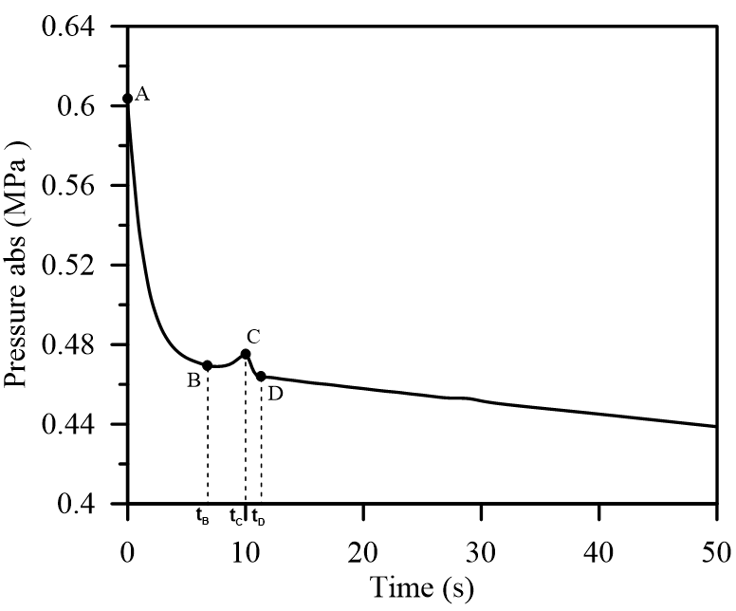
Simulations
Pressure recovery phenomenon (PRP) 2/2
Pressure recovery phenomenon is explained by ammonia vapour mass changes in ullage.
Delay in vapour release to ullage from bubbles defines the pressure recovery timing.
Analytical verification for delay in vapour release
Analytically calculated ∆𝑡bubble :7s and simulated ∆𝑡bubble: 6.5s after which pressure starts to recover.

Slide 14
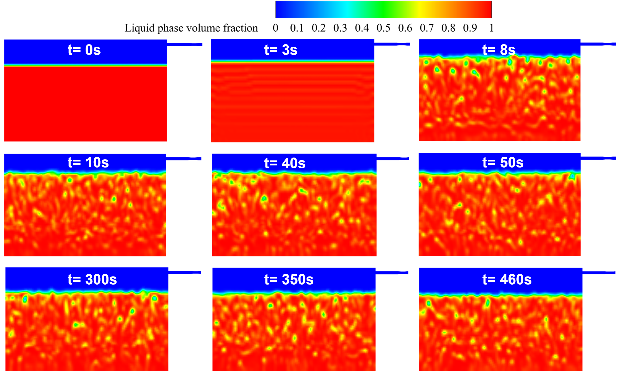
Simulations
Flash boiling time history

Slide 15
Conclusions
Liquid NH₃ tank venting operation
For the first time, numerical investigation of pressure recovery phenomenon (PRP) and the flash boiling behaviour of liquid ammonia during tank venting operation was performed.
CFD model is applied to simulate pressure recovery, flash boiling, as well as temperature and pressure dynamics in ammonia storage during.
Extensive model calibration was done to establish a time relaxation parameter “band value” applicable for ammonia tank depressurization based on initial temperature assumptions.
Numerical model simulated the characteristic bubble rise time which explains the pressure recovery time and the time delay was found to closely match analytical calculations.

Slide 16
Acknowledgements:
The research was supported through the following grants:
EPSRC Centre for Doctoral Training in Sustainable Hydrogen “SusHy” (EP/S023909/1)
EPSRC Northern Ireland HPC Kelvin-2 facility (EP/T022175/1)
EPSRC (01.09.23-31.03.27, 43 months). UK-MaRes Hub: UK National Clean Maritime Research Hub. Grant number: EP/Y024605/1. Total £9.3M (FEC), UU - £630k.
ulster.ac.uk/principles-hydrogen-safety
ulster.ac.uk/hydrogen-safety-technologies
Thank you!

