Slide 1


ICHS 2023- 20/09/2023
EXPERIMENTAL INVESTIGATION OF FLUID-STRUCTURE INTERACTION IN THE CASE OF HYDROGEN/AIR DETONATION IMPACTING A THIN PLATE
Co-authors :
Dr Sergey KUDRIAKOV
Dr Etienne STUDER
Dr Christian TENAUD
Alexis DANCELME

Slide 2
Plan
Context and Experimental setup
Experimental results
Current and future work
ICHS 2023- 20/09/2023 - Alexis Dancelme

Slide 3
Plan
Context and Experimental setup
Experimental results
Current and future work
ICHS 2023- 20/09/2023 - Alexis Dancelme

Slide 4
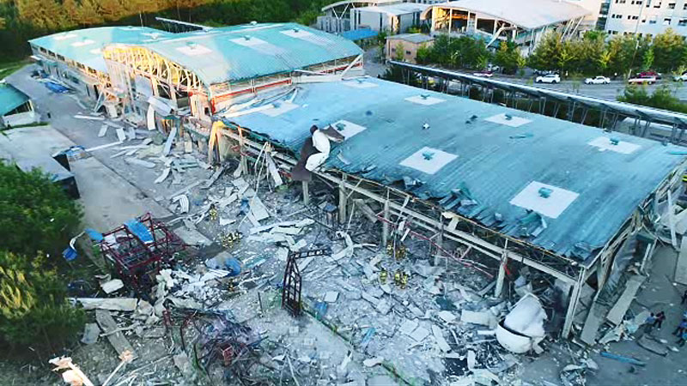

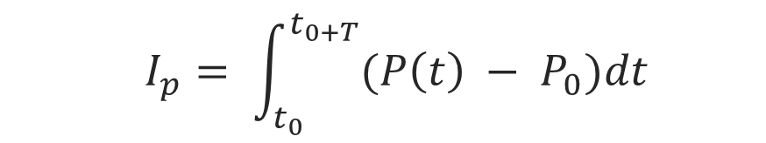


CONTEXTE
CONTEXT
→ Risk linked to the presence of Hydrogen in a confined space
Shock formation
Deflagration to detonation transition
Detonation
Slow Deflagration
Fast Deflagration
$$\sim 10−300 m.s^{−1}$$
$$<1000 m.s^{−1}$$
$$\sim 2000 m.s^{−1}$$
      Real structure are very difficult for analysis
      A lot to learn for simple structure such as plate
      Study of the fluid-structure interaction in the case of detonation
      The pressure and impulse have a significant imapct on structure deformation
    $$I_{p}= \int_{t_{0}}^{t_{0+T}}{(P\left(t\right) − P_{0})dt}$$
H2 station accident
(South Korea, 2019)
ICHS 2023- 20/09/2023 - Alexis Dancelme

Slide 5



CONTEXTE
CONTEXT
→ Risk linked to the presence of Hydrogen in a confined space
Shock formation
Deflagration to detonation transition
Detonation
Slow Deflagration
Fast Deflagration
$$\sim 10−300 m.s^{−1}$$
$$<1000 m.s^{−1}$$
$$\sim 2000 m.s^{−1}$$
      What is the influence of the plate deformation on the reflected shock (pressure and impulse)?
      Are the current models and correlation derived for solid explosive valid?
    $$I_{p}= \int_{t_{0}}^{t_{0+T}}{(P\left(t\right) − P_{0})dt}$$
H2 station accident
(South Korea, 2019)
ICHS 2023- 20/09/2023 - Alexis Dancelme

Slide 6
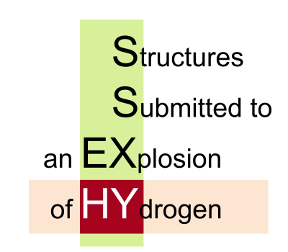

SSEXHY EXPERIMENTAL FACILITY
  Simple geometry : plate
  Control of initial Hydrogen concentration
    Study focused on mixture close to stoechiometry ($X_{H_{2}}≈29.5\%$)
P3
P1
P3
P1
3 sections of 1310 mm long
Large spectrum of admissible pressure
Fluid Structure Interaction module
Instrumentations | Sensors
Photomultipliers | 14
Pressure sensors | 8
Configuration with plate
ICHS 2023- 20/09/2023 - Alexis Dancelme

Slide 7
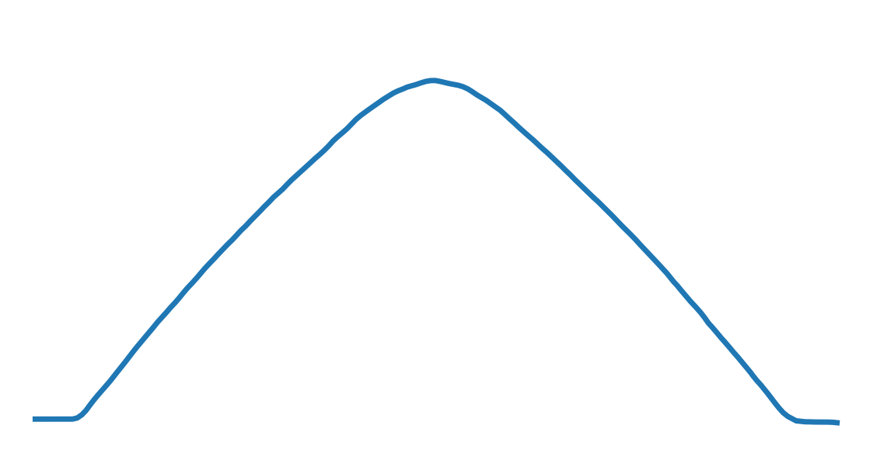
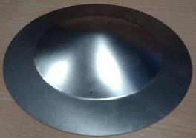
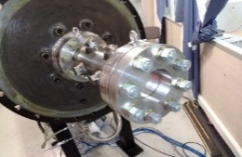

SSEXHY EXPERIMENTAL FACILITY
  Simple geometry : plate
  Control of initial Hydrogen concentration
    Study focused on mixture close to stoechiometry ($X_{H_{2}}≈29.5\%$)
P3
P1
$$δ$$
Scheme of a deformed plate
Plate after deformation and laser measurment
ICHS 2023- 20/09/2023 - Alexis Dancelme

Slide 8


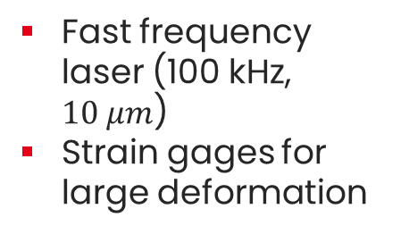
SSEXHY EXPERIMENTAL FACILITY
  Simple geometry : plate
  Control of initial Hydrogen concentration
    Study focused on mixture close to stoechiometry ($X_{H_{2}}≈29.5\%$)
P3
P1
Fast frequency laser (100 kHz, $10 μm$)
Strain gages for large deformation
$$\frac{R}{2}$$
$$120°$$
Measurment on the plate, strain gages and laser
Plate after deformation and laser measurment
ICHS 2023- 20/09/2023 - Alexis Dancelme

Slide 9
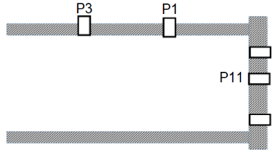
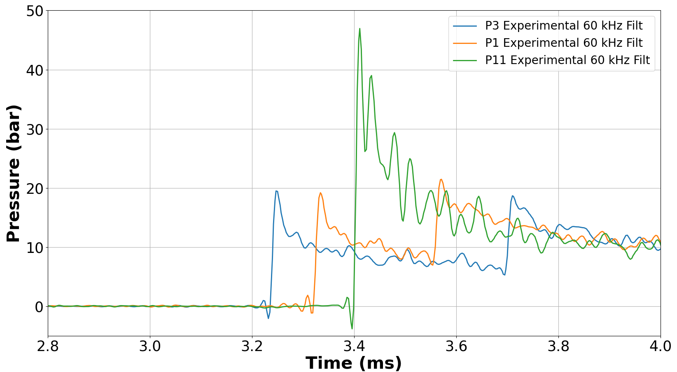

METHODOLOGY
16.6 cm
16.6 cm
$X_{H2}=28.9 \%$
Characterize pressure field at reflection
Reference signal for a non deformable material to study fluid-structure coupling
Pressure signals close to reflection
ICHS 2023- 20/09/2023 - Alexis Dancelme

Slide 10
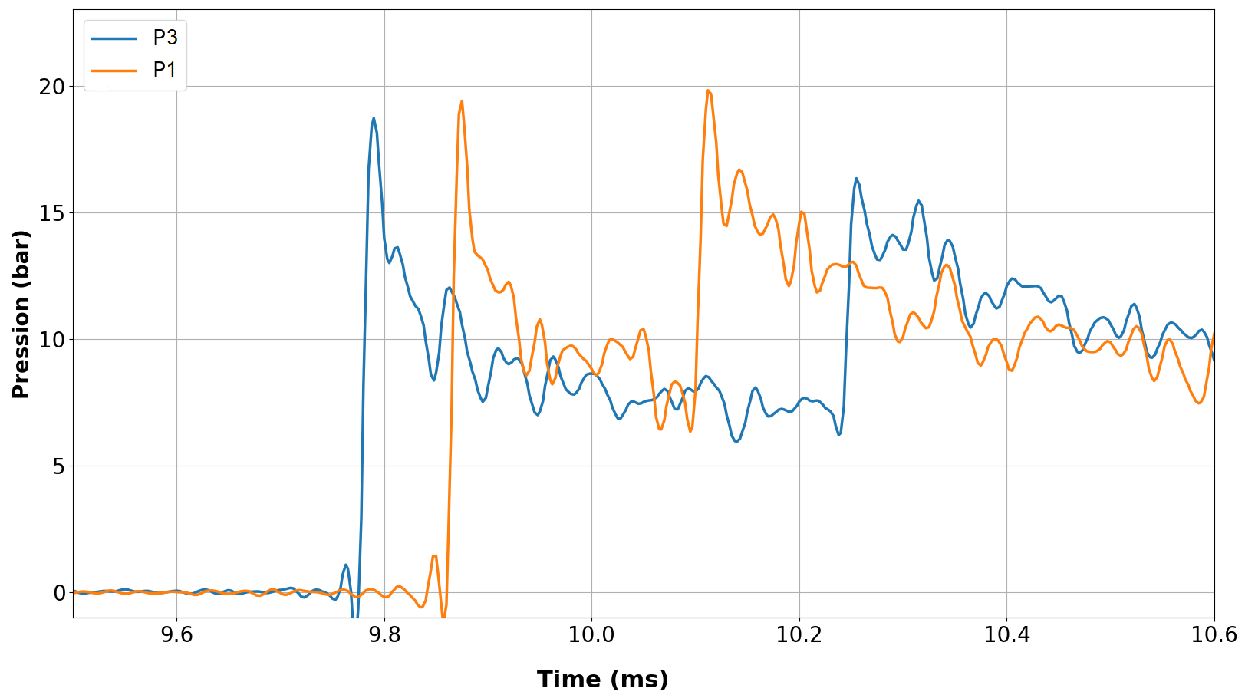
METHODOLOGY
P3
16.6 cm
16.6 cm
P1
Only P1 and P3 available
Uses of the reflected signal for comparison with non-deformable flange
Pressure signals close to reflection
ICHS 2023- 20/09/2023 - Alexis Dancelme

Slide 11
Plan
Context and Experimental setup
Experimental results
Current and future work
ICHS 2023- 20/09/2023 - Alexis Dancelme

Slide 12
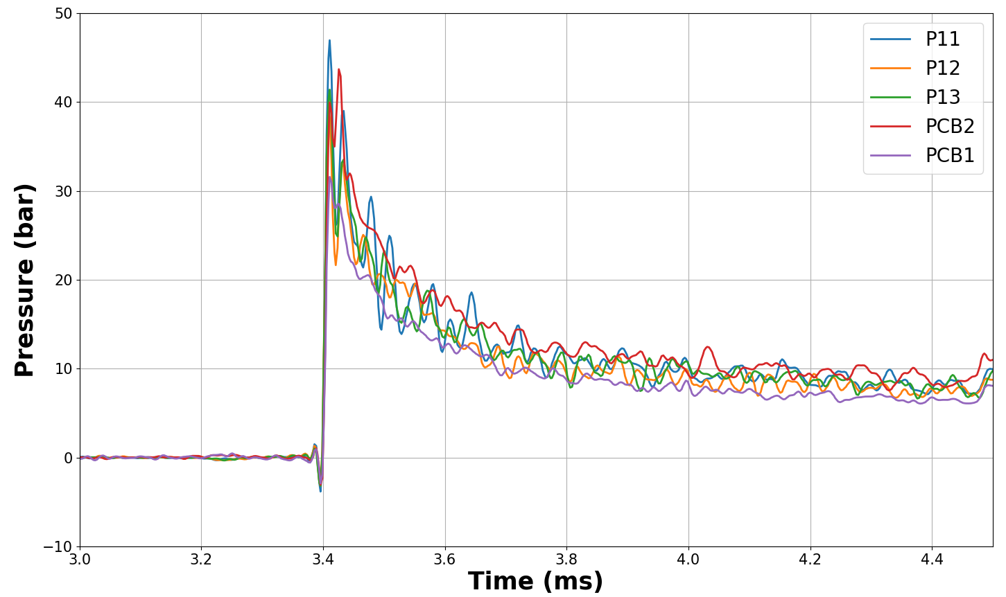



METHODOLOGY
16.6 cm
16.6 cm
$X_{H2}=28.9 \%$
All sensor on the full flange
Homogeneity of the load on the flange
ICHS 2023- 20/09/2023 - Alexis Dancelme

Slide 13
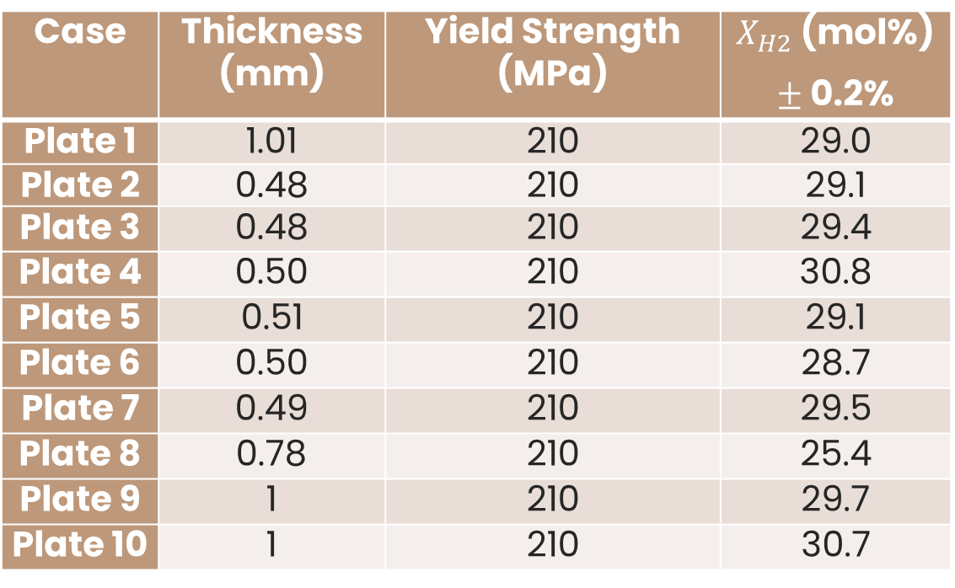

EXPERIMENTAL RESULTS
  Test matrix for thin plate at $X_{H_{2}}≈29.5\%$
Case | Thickness (mm) | Yield Strength (MPa) | $X_{H2}$ (mol%) $±$ 0.2%
Plate 1 | 1.01 | 210 | 29.0
Plate 2 | 0.48 | 210 | 29.1
Plate 3 | 0.48 | 210 | 29.4
Plate 4 | 0.50 | 210 | 30.8
Plate 5 | 0.51 | 210 | 29.1
Plate 6 | 0.50 | 210 | 28.7
Plate 7 | 0.49 | 210 | 29.5
Plate 8 | 0.78 | 210 | 25.4
Plate 9 | 1 | 210 | 29.7
Plate 10 | 1 | 210 | 30.7
Experimental campaign for thin plate
ICHS 2023- 20/09/2023 - Alexis Dancelme

Slide 14
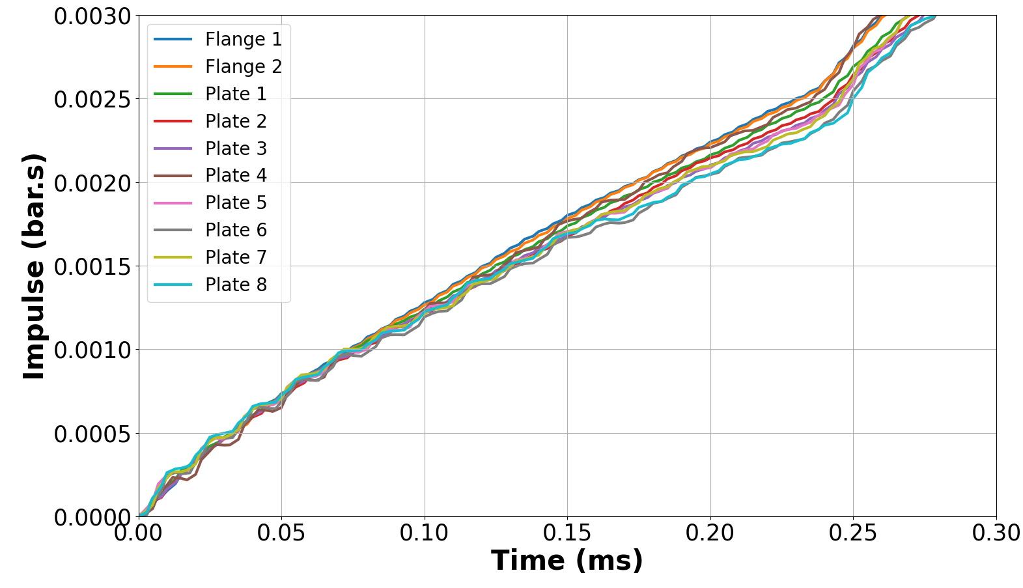
EXPERIMENTAL RESULTS
P3
16.6 cm
16.6 cm
P1
Good repeatability before reflection
Impulse comparison for P1 sensor
ICHS 2023- 20/09/2023 - Alexis Dancelme

Slide 15
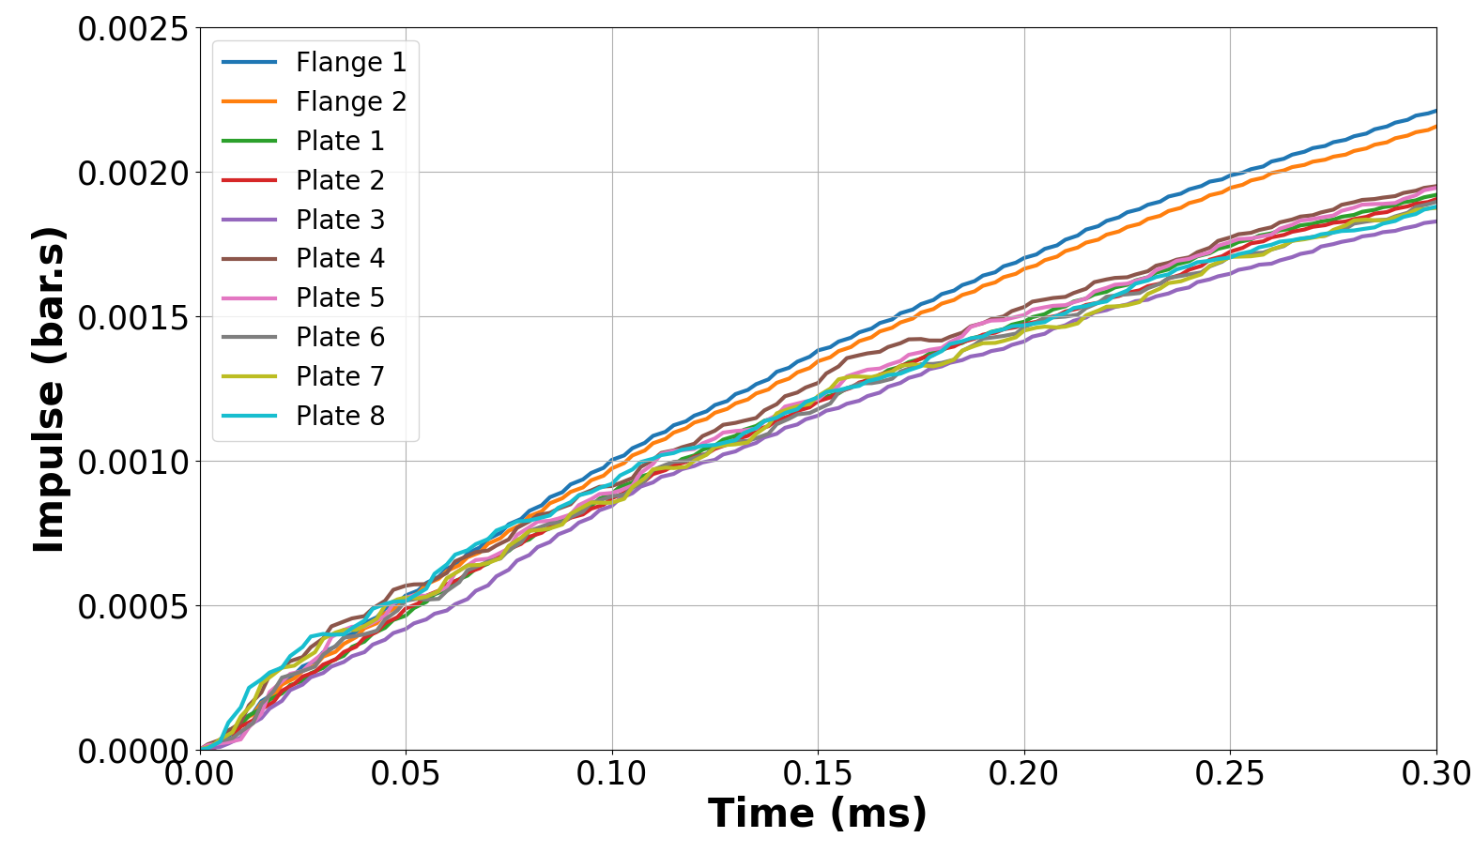
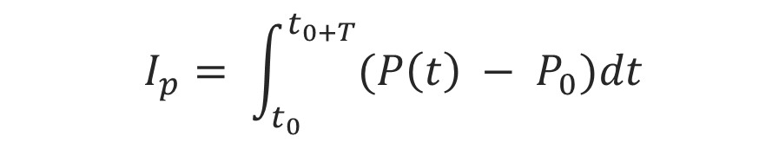
EXPERIMENTAL RESULTS
P3
16.6 cm
16.6 cm
P1
Systematic decay in impulse
Reference pressure define as pressure just before the reflected shock arrival
    $$I_{p}= \int_{t_{0}}^{t_{0+T}}{(P\left(t\right) − P_{0})dt}$$
Impulse comparison for P1 sensor
ICHS 2023- 20/09/2023 - Alexis Dancelme

Slide 16
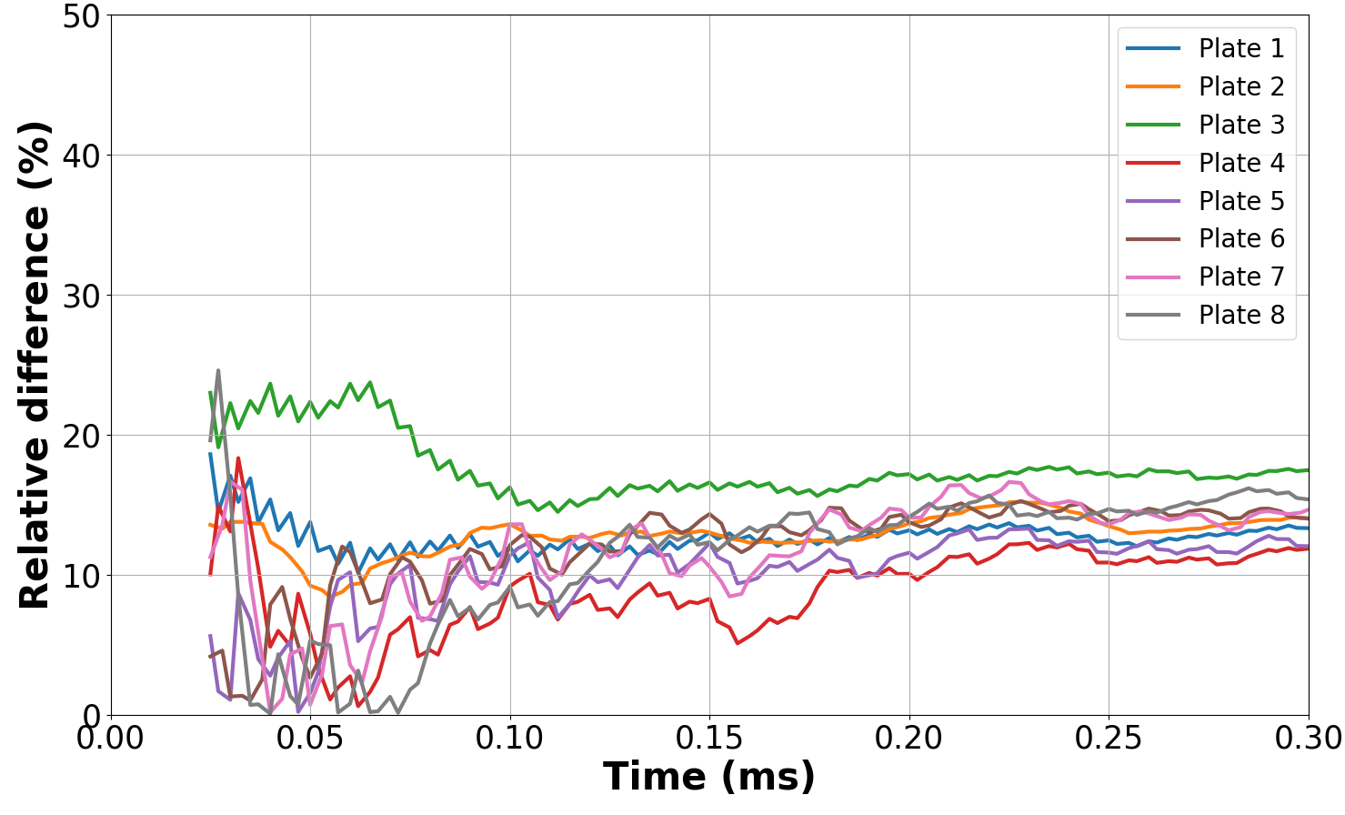
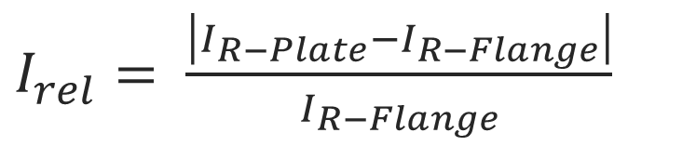
EXPERIMENTAL RESULTS
P3
16.6 cm
16.6 cm
P1
$I_{rel}= \frac{\left|I_{R−Plate}−I_{R−Flange}\right|}{I_{R−Flange}}$
Relative impulse for P1
Systematic reduction of impulse of the order of 15%
ICHS 2023- 20/09/2023 - Alexis Dancelme

Slide 17
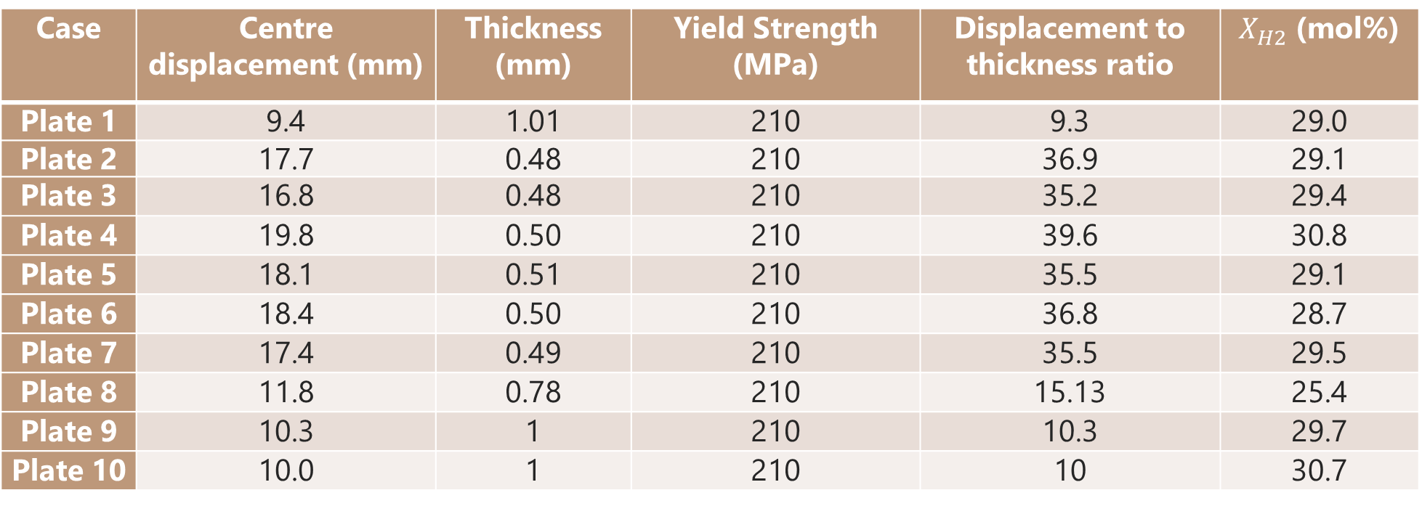

EXPERIMENTAL RESULTS
  Experimental campaign for thin plate at $X_{H_{2}}≈29.5\%$
Case | Centre displacement (mm) | Thickness (mm) | Yield Strength (MPa) | Displacement to thickness ratio | $X_{H2}$ (mol%)
Plate 1 | 9.4 | 1.01 | 210 | 9.3 | 29.0
Plate 2 | 17.7 | 0.48 | 210 | 36.9 | 29.1
Plate 3 | 16.8 | 0.48 | 210 | 35.2 | 29.4
Plate 4 | 19.8 | 0.50 | 210 | 39.6 | 30.8
Plate 5 | 18.1 | 0.51 | 210 | 35.5 | 29.1
Plate 6 | 18.4 | 0.50 | 210 | 36.8 | 28.7
Plate 7 | 17.4 | 0.49 | 210 | 35.5 | 29.5
Plate 8 | 11.8 | 0.78 | 210 | 15.13 | 25.4
Plate 9 | 10.3 | 1 | 210 | 10.3 | 29.7
Plate 10 | 10.0 | 1 | 210 | 10 | 30.7
Experimental campaign for thin plate
ICHS 2023- 20/09/2023 - Alexis Dancelme

Slide 18

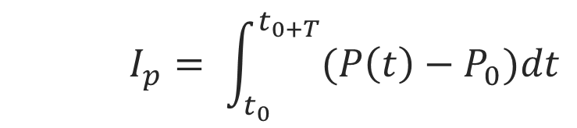

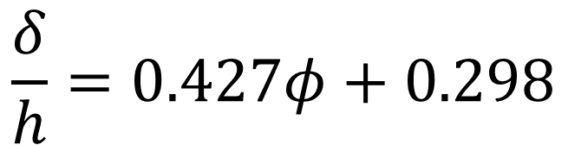

EXPERIMENTAL RESULTS
    Plate deformation
      Solid explosive¹
Plate
h
$$\frac{δ}{h}=0.427φ+0.298$$
Explosive
Scheme of a plate with an explosive sheet
$$φ=\frac{I_{p}∙R}{h^{2}\sqrt{ρσ_{0}}}$$
    $$I_{p}= \int_{t_{0}}^{t_{0+T}}{(P\left(t\right)−P_{0})dt}$$
$$δ$$
¹ G.N. Nurick, Deformation of Thin Plates subjected to impulsive loading – Part I, II, III (1989, 1989, 2016)
ICHS 2023- 20/09/2023 - Alexis Dancelme

Slide 19
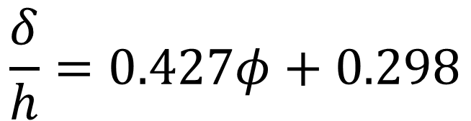


EXPERIMENTAL RESULTS
$$\frac{δ}{h}=0.427φ+0.298$$
$$φ=\frac{I_{p}∙R}{h^{2}\sqrt{ρσ_{0}}}$$
$$\frac{δ}{h}∝\frac{1}{h^{2}}$$
Case | Centre displacement (mm) | Thickness (mm) | Yield Strength (MPa) | Displacement to thickness ratio | Impulsion corresponding to Nurick’s correlation (bar.s)
Plate 1 | 9.4 | 1.01 | 210 | 9.3 | 0.0046
Plate 2 | 17.7 | 0.48 | 210 | 36.9 | 0.0042
Plate 3 | 16.8 | 0.48 | 210 | 35.2 | 0.0040
÷2
x4
Comparison of the experimental results with the Nurick’s correlation
ICHS 2023- 20/09/2023 - Alexis Dancelme

Slide 20
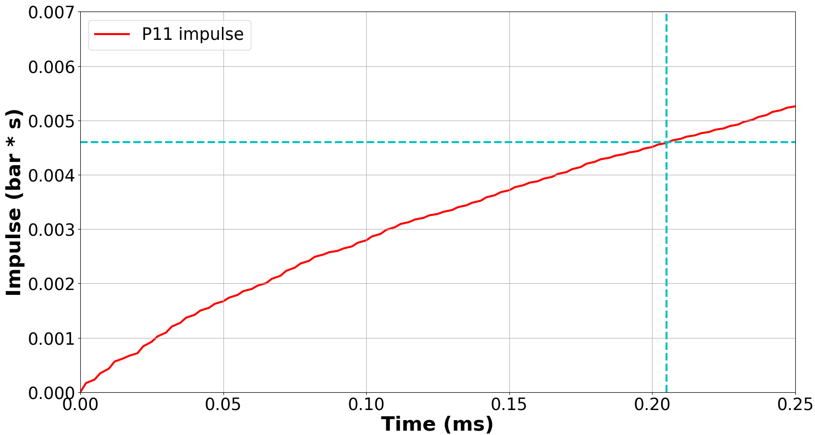
EXPERIMENTAL RESULTS
$$\frac{δ}{h}=0.427φ+0.298$$
$$φ=\frac{I_{p}∙R}{h^{2}\sqrt{ρσ_{0}}}$$
Impulse reached after ~ 0.2 ms
Impulsion mesurée à la bride
ICHS 2023- 20/09/2023 - Alexis Dancelme

Slide 21
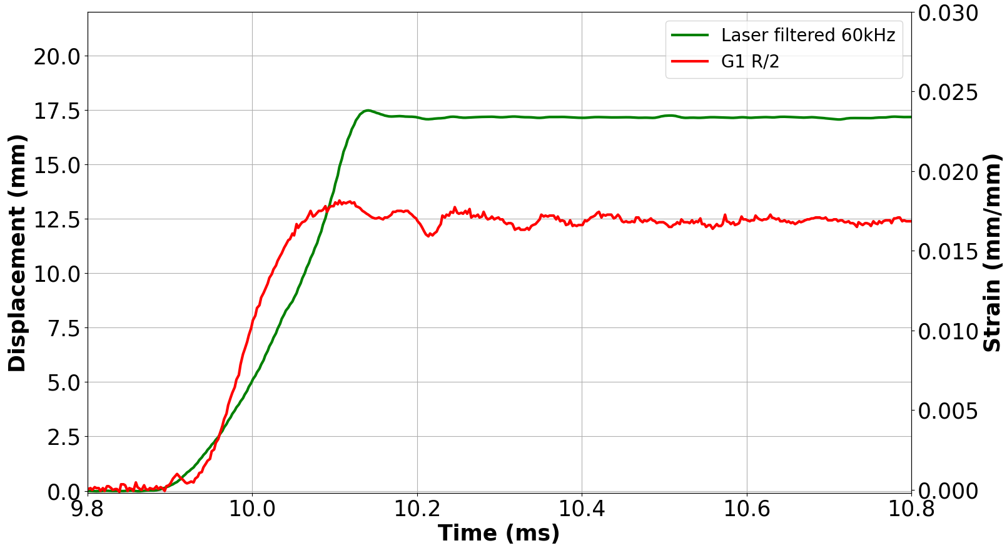

EXPERIMENTAL RESULTS
P3
16.6 cm
16.6 cm
P1
$X_{H2}=29.1 \%$
Strain gage and laser signal
$$\frac{R}{2}$$
$$120°$$
Measured deformation time ~0.2-0.25 ms
ICHS 2023- 20/09/2023 - Alexis Dancelme

Slide 22
Plan
Context and Experimental setup
Experimental results
Current and future work
ICHS 2023- 20/09/2023 - Alexis Dancelme

Slide 23

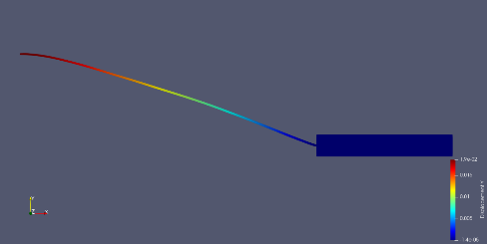
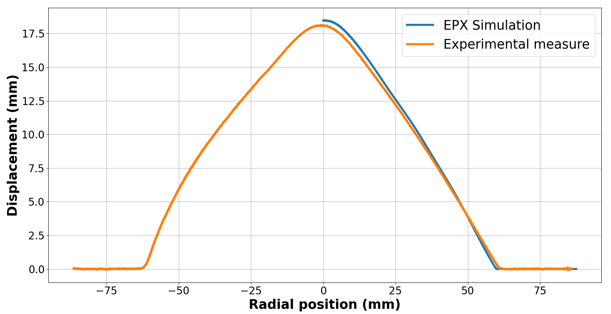
CURRENT AND FUTURE WORK

Slide 24
CONCLUSION
  Homogemous load at reflection in the case of detonation
  Characterize the fluid-structure coupling with a systematic decay of 15% in impulse after reflection
  Applicability of Nurick’s correlation based on solid explosive to find impulse at reflection and deformation time
  Numerical simulation catches the important characterisics for displacement
  Perspectives
    Experimental : Statistical analysis of the deformed shape
    Experimental : Extension to fast flame (higher deformation for lean mixture)
    Converging to a coupled approach for the simulation

Slide 25
Thanks for your attention!
Any questions?
25

