Slide 1
Hydrogen Research Priority Workshop Hydrogen & Fuel Cell Vehicles Global Technical Regulation
Nha Nguyen
U.S. Department of Transportation
National Highway Traffic Safety Administration

Slide 2
Background
In 2009, The U.S., Japan and Germany co-sponsored a working group to develop a Global Technical Regulation (GTR) Under the United Nations 1998 Agreement.
The working group consisted of governments participants from China, European Union, Korea, Canada and India; and industry participants from standard organizations, automobile and component manufacturers
In June 2013, Phase 1 was completed, establishing GTR No. 13: Contracting Parties under the 1998 Agreement are obligated to start an adoption process of GTR No.13 into their national regulations
http://www.unece.org/trans/main/wp29/wp29wgs/wp29gen/wp29glob_registry.html

Slide 3
Compresses Hydrogen Fuel Cell Vehicle
High pressure fuel container system
Fuel system at vehicle level: in-use and post-crash hydrogen leakage limits
Electrical integrity of high voltage system: in-use and post-crash

Slide 4
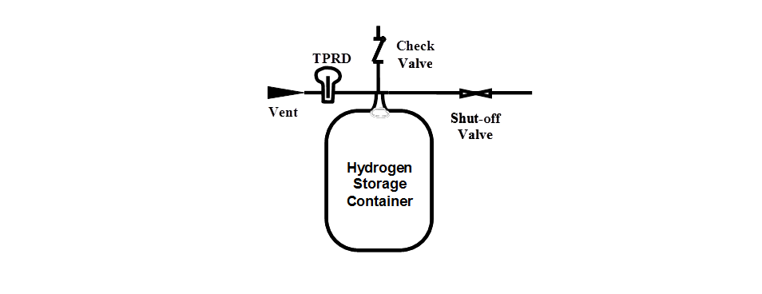
Verification test for Baseline Metrics
Baseline Initial Burst Pressure Test
Burst pressure within ±10% of BP0
Burst pressure ≥ BPmin of 225% NWP
Baseline Initial Pressure Cycling Test
Pressure cycle for 22,000 cycles without rupture

Slide 5
Verification Test for Performance Durability (Sequential hydraulic cycling tests)
Number of cycles is specified by individual contracting party (5,500, 7,500 and 11,000)
Proof pressure test
Drop (impact) test
Surface damage
Chemical exposure
ambient temperature pressure cycling tests
High temperature static pressure test
Extreme temperature pressure cycling
Residual proof pressure test (180% NWP for 4 mins)
Residual strength burst test (within 20% of BPo)
180% NWP
(4 min)

Slide 6
Verification Test for On-Road Performance (Sequential pneumatic/hydraulic cycling tests)
Number of cycles: 500
Proof pressure test
Ambient and extreme temperature gas pressure cycling test (pneumatic)
Extreme temperature static gas pressure leak/permeation test (pneumatic)
Residual proof test (180% NWP for 4 mins)
Residual strength burst test (hydraulic) – Within 20% of BPo
180% NWP
(4 min)

Slide 7
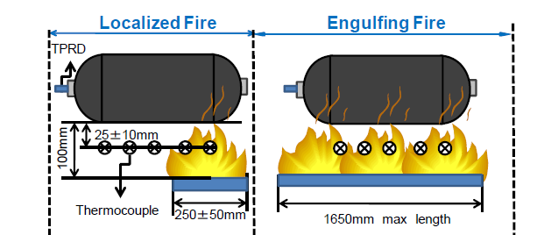
Combining Localized and Engulfing Fire
A hydrogen storage system is pressurized to NWP and exposed to fire. A temperature-activated pressure relief device shall release the contained gases in a controlled manner without rupture.

Slide 8
Fire Test Profile
Localized Fire Exposure
Engulfing Fire
Min
Temp
800º C
Localized Area
600º C
Engulfing Region Outside Localized Area (burner ramp rate)
300º C
Ignite
Main
Burner
0
1
3
11
13
Minutes

Slide 9
Fuel System Requirements
Fuel System Integrity:
Fuel Receptacle and Label requirements
PRD requirements
Exhaust requirements
In-use fuel leakage:
Warning tell-tale at 2±1% of Hydrogen concentration in enclosed spaces
Post-crash leakage:
Less than 3±1% of Hydrogen concentration in enclosed spaces

Slide 10
Electrical Safety
In-Use requirements:
Protection from high voltage shock
Absence of high voltage
Isolation resistance
Barrier
label
Isolation resistance monitoring system
Functional safety
Post-crash requirements:
Protection from high voltage shock
Battery leakage and retention

Slide 11
Status of GTR Adoption
Adopted:
EU transposed GTR into UN-ECE
Japan
Korea
The U.S. is currently preparing a notice of proposed rulemaking (NPRM):
Completed a series of fuel tank tests to validate the test procedures
NPRM is expected in 2017

Slide 12
GTR Phase 2
Phase 2 GTR is expected to start early 2017
Material compatibility
Stress rupture
Electric safety
Improve current test procedures
Potential scope revision to include other vehicle classes

Slide 13
http://www.nhtsa.gov/
nha.nguyen@dot.gov
Questions

Slide 14
HFCV GTR No. 13 Hydrogen Research priority workshop

